Slide 1

CEPC partial double ring FFS design
Dou Wang, Jie Gao, Feng Su, Yuan Zhang, Yiwei Wang, Bai Sha, Huiping Geng, Tianjian Bian, Na Wang, Xiaohao Cui, Yuanyuan Wei
CEPC AP meeting, 2016.06.17

Slide 2
CEPC vs. LEP2
parameter | CEPC |  |  | LEP2
Physics working point | H |  | Z
energy/beam [GeV] | 120 |  | 45.5 | 105 | 45.6
Circumference [km] | 54 |  | 54 | 27
Single ring/double ring | Partial double |  |  | Single
Pretzel scheme | No |  |  | Yes
bunches/beam | 67 | 44 | 1100 | 4 | 12
bunch population [10¹¹] | 2.85 | 2.67 | 0.46 | 4.2 | 1.96
beam current [mA] | 16.9 | 10.5 | 45.4 | 3 | 4.2
luminosity/IP x 10³⁴cm⁻²s⁻¹ | 2.9 | 2.0 | 3.1 | 0.0012 | 0.0034
energy loss/turn [GeV] | 2.96 |  | 0.062 | 3.34 | 0.12
synchrotron power [MW] | 50 | 31 | 2.8 | 22 | 1.1
RF voltage [GV] | 3.6 | 3.5 | 0.12 | 3.5
f_{RF} [MHz] | 650 |  |  | 352 | 352

Slide 3
CEPC vs. ILC
parameter | CEPC |  | ILC
Physics working point | H | Z
energy/beam [GeV] | 120 | 45.5 | 125 | 250
Linear/circular | circular |  | linear
bunches/beam | 67/44 | 1100 | 1312 | 1312
bunch population [10¹¹] | 2.85/2.67 | 0.46 | 0.2 | 0.2
Normalized vertical emittance [nm] | 1738/1456 | 249 | 35 | 35
IP vertical betay [mm] | 1.36/1.24 | 1.0 | 0.41 | 0.48
IP RMS veritcal beam size [nm] | 100/88 | 53 | 7.7 | 5.9
beam current [mA] | 16.9/10.5 | 45.4 | 5.8 | 5.8
luminosity/IP x 10³⁴cm⁻²s⁻¹ | 2.9/2.0 | 3.1 | 0.97 | 2.05
energy loss/turn [GeV] | 2.96 | 0.062 | No
f_{RF} [MHz] | 650 | 650 | 1300 | 1300
Average number of photons / particle n_{γ} | 0.47 | 0.24 | 1.16 | 1.72

Slide 4
CDR验收目标
充分考虑物理目标需求、机器亮度目标、加速器物理、探测器及重要硬件的可实现性、机器运行稳定性和可调节性，给出CEPC的合理优化加速器物理设计
考核指标：
  亮度：Higgs达到 2×10³⁴cm⁻²s⁻¹, Z达到 1×10³⁴cm⁻²s⁻¹
  动力学孔径：含error和beam-beam，on-momentum达到20σ_{x} × 40σ_{y，}±2%达到5σ_{x} × 10σ_{y}

Slide 5
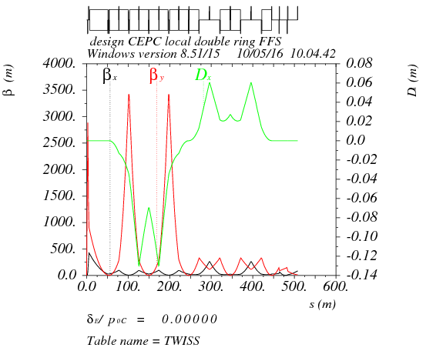
Betax*= 0.25m,Betay*=1.36mm
Crab sex
Critical energy= 190kev
dmux = -14.464497
dmuy = -200.084478
K2HS := 11.96m⁻³
K2VS := 32.74 m⁻³

Slide 6
DA of the whole ring
(arc+PDR+bypass+FFS)
Arc sextupole: 2 groups
Crab sextupoles - off
DA (on-momentum): 27σ_{x} × 57σ_{y}
DA (±0.5%): 2σ_{x} × 2σ_{y}

Slide 7
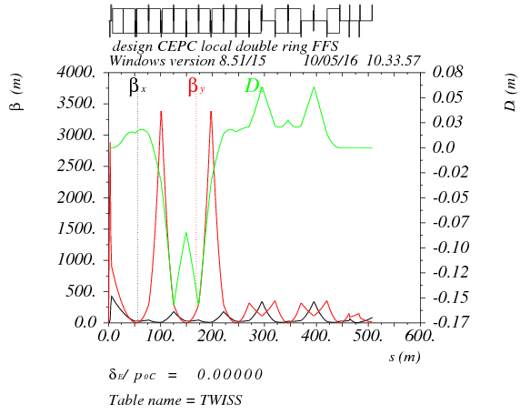
Bandwith optimization

Slide 8
parameter for CEPC partial double ring
（wangdou20160325）
 | Pre-CDR | H-high lumi. | H-low power | W | Z
Number of IPs | 2 | 2 | 2 | 2 | 2
Energy (GeV) | 120 | 120 | 120 | 80 | 45.5
Circumference (km) | 54 | 54 | 54 | 54 | 54
SR loss/turn (GeV) | 3.1 | 2.96 | 2.96 | 0.59 | 0.062
Half crossing angle (mrad) | 0 | 15 | 15 | 15 | 15
Piwinski angle | 0 | 2.5 | 2.6 | 5 | 7.6
N_{e}/bunch (10¹¹) | 3.79 | 2.85 | 2.67 | 0.74 | 0.46
Bunch number | 50 | 67 | 44 | 400 | 1100
Beam current (mA) | 16.6 | 16.9 | 10.5 | 26.2 | 45.4
SR power /beam (MW) | 51.7 | 50 | 31.2 | 15.6 | 2.8
Bending radius (km) | 6.1 | 6.2 | 6.2 | 6.1 | 6.1
Momentum compaction (10⁻⁵) | 3.4 | 2.5 | 2.2 | 2.4 | 3.5
β_{IP} x/y (m) | 0.8/0.0012 | 0.25/0.00136 | 0.268 /0.00124 | 0.1/0.001 | 0.1/0.001
Emittance x/y (nm) | 6.12/0.018 | 2.45/0.0074 | 2.06 /0.0062 | 1.02/0.003 | 0.62/0.0028
Transverse σ_{IP} (um) | 69.97/0.15 | 24.8/0.1 | 23.5/0.088 | 10.1/0.056 | 7.9/0.053
ξ_{x}/IP | 0.118 | 0.03 | 0.032 | 0.008 | 0.006
ξ_{y}/IP | 0.083 | 0.11 | 0.11 | 0.074 | 0.073
V_{RF} (GV) | 6.87 | 3.62 | 3.53 | 0.81 | 0.12
f _{RF} (MHz) | 650 | 650 | 650 | 650 | 650
Nature σ_{z} (mm) | 2.14 | 3.1 | 3.0 | 3.25 | 3.9
Total σ_{z} (mm) | 2.65 | 4.1 | 4.0 | 3.35 | 4.0
HOM power/cavity (kw) | 3.6 | 2.2 | 1.3 | 0.99 | 0.99
Energy spread (%) | 0.13 | 0.13 | 0.13 | 0.09 | 0.05
Energy acceptance (%) | 2 | 2 | 2
Energy acceptance by RF (%) | 6 | 2.2 | 2.1 | 1.7 | 1.1
n_{γ} | 0.23 | 0.47 | 0.47 | 0.3 | 0.24
Life time due to beamstrahlung_cal (minute) | 47 | 36 | 32
F (hour glass) | 0.68 | 0.82 | 0.81 | 0.92 | 0.95
L_{max}/IP (10³⁴cm⁻²s⁻¹) | 2.04 | 2.96 | 2.01 | 3.09 | 3.09

Slide 9
parameter for CEPC partial double ring
（wangdou20160525）
 | Pre-CDR | H-high lumi. | H-low power
Number of IPs | 2 | 2 | 2
Energy (GeV) | 120 | 120 | 120
Circumference (km) | 54 | 60 | 60
SR loss/turn (GeV) | 3.1 | 2.96 | 2.96
Half crossing angle (mrad) | 0 | 15 | 15
Piwinski angle | 0 | 4.0 | 4.0
N_{e}/bunch (10¹¹) | 3.79 | 1.56 | 1.56
Bunch number | 50 | 135 | 81
Beam current (mA) | 16.6 | 16.9 | 10.1
SR power /beam (MW) | 51.7 | 50 | 30
Bending radius (km) | 6.1 | 6.2 | 6.2
Momentum compaction (10⁻⁵) | 3.4 | 2.2 | 2.2
β_{IP} x/y (m) | 0.8/0.0012 | 0.104/0.003 | 0.104/0.003
Emittance x/y (nm) | 6.12/0.018 | 2.03/0.0061 | 2.03/0.0061
Transverse σ_{IP} (um) | 69.97/0.15 | 14.5/0.14 | 14.5/0.14
ξ_{x}/IP | 0.118 | 0.0086 | 0.0086
ξ_{y}/IP | 0.083 | 0.11 | 0.11
V_{RF} (GV) | 6.87 | 3.72 | 3.72
f _{RF} (MHz) | 650 | 650 | 650
Nature σ_{z} (mm) | 2.14 | 3.0 | 3.0
Total σ_{z} (mm) | 2.65 | 3.9 | 3.9
HOM power/cavity (kw) | 3.6 | 1.3 | 0.76
Energy spread (%) | 0.13 | 0.13 | 0.13
Energy acceptance (%) | 2 | 2 | 2
Energy acceptance by RF (%) | 6 | 2.5 | 2.5
n_{γ} | 0.23 | 0.44 | 0.44
Life time due to beamstrahlung_cal (minute) | 47 | 43 | 43
F (hour glass) | 0.68 | 0.97 | 0.97
L_{max}/IP (10³⁴cm⁻²s⁻¹) | 2.04 | 1.60 | 0.96

Slide 10
Change the circumference of booster?

Slide 11
Thanks！

