Slide 1
CEPC APDR SRF considerations(4) -LEP Cavity Voltage &BBU
Zhenchao LIU
2016.6.17

Slide 2
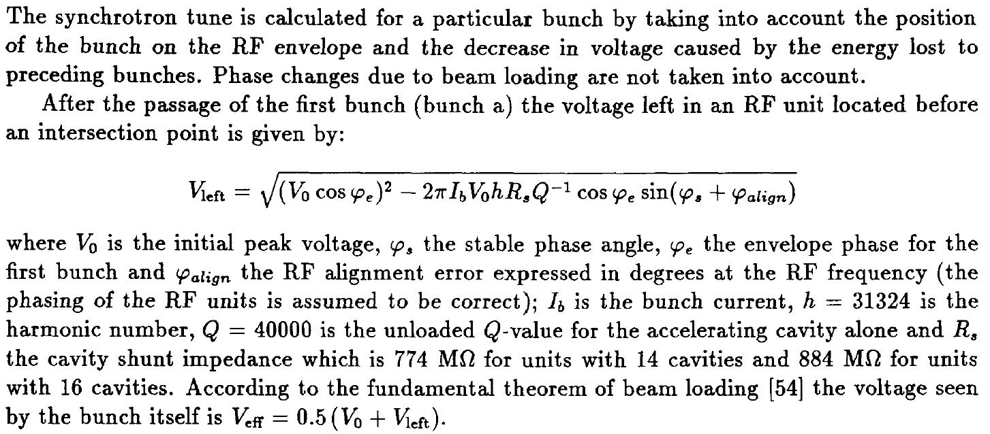
LEP
LEP bunch train 2014 report, p49

Slide 3
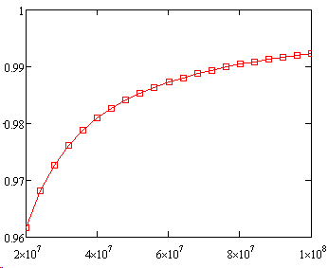
Assume:
φ_{e}= 1deg., φ_{s}=116deg., φ_{align}=3deg., I_{b}=0.45mA, h=31324, Q=40000, R_{s}=774MΩ（14 cavities）
V₀ (initial peak voltage)from 20MV-100MV
2.3MV/cavity(acc. voltage)
Voltage decrease:
V_{left}/V₀
1 bunch ~1%
4 bunches ~4%
APDR:
8 DR: 2.5%(HL)5.3/2.5%(Z)
6 DR: 3.3%(HL)
V₀(V)

Slide 4
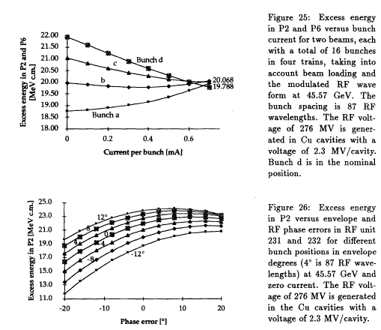

Slide 5
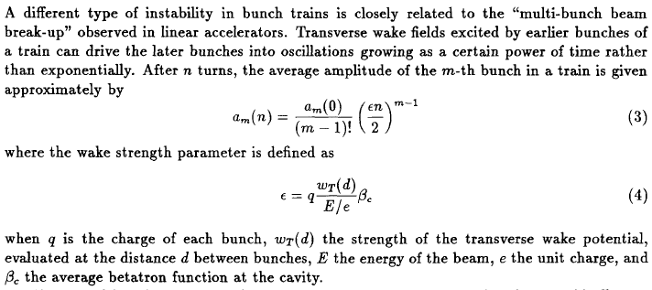
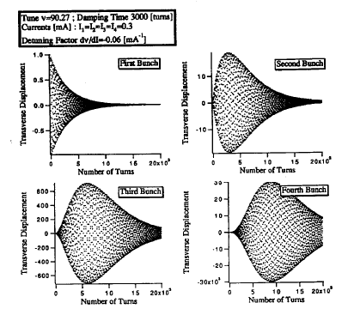
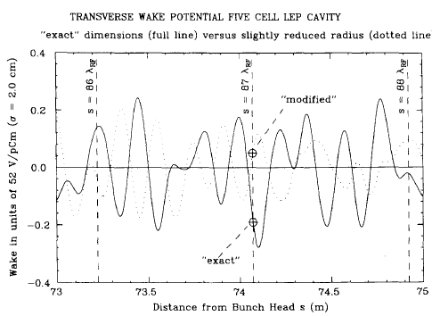
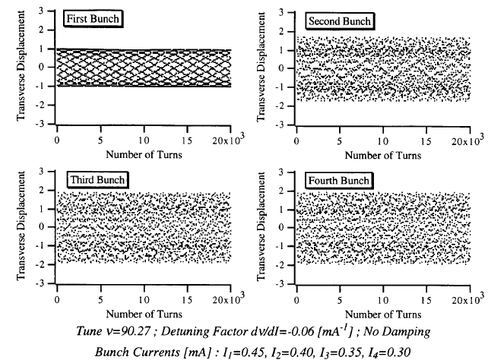
BBU
1）LEP bunch train 2014 report; 2）CERN-sL-94-75

Slide 6
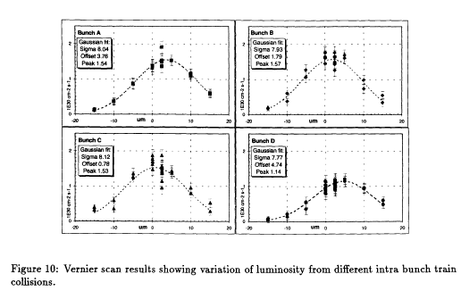

Slide 7
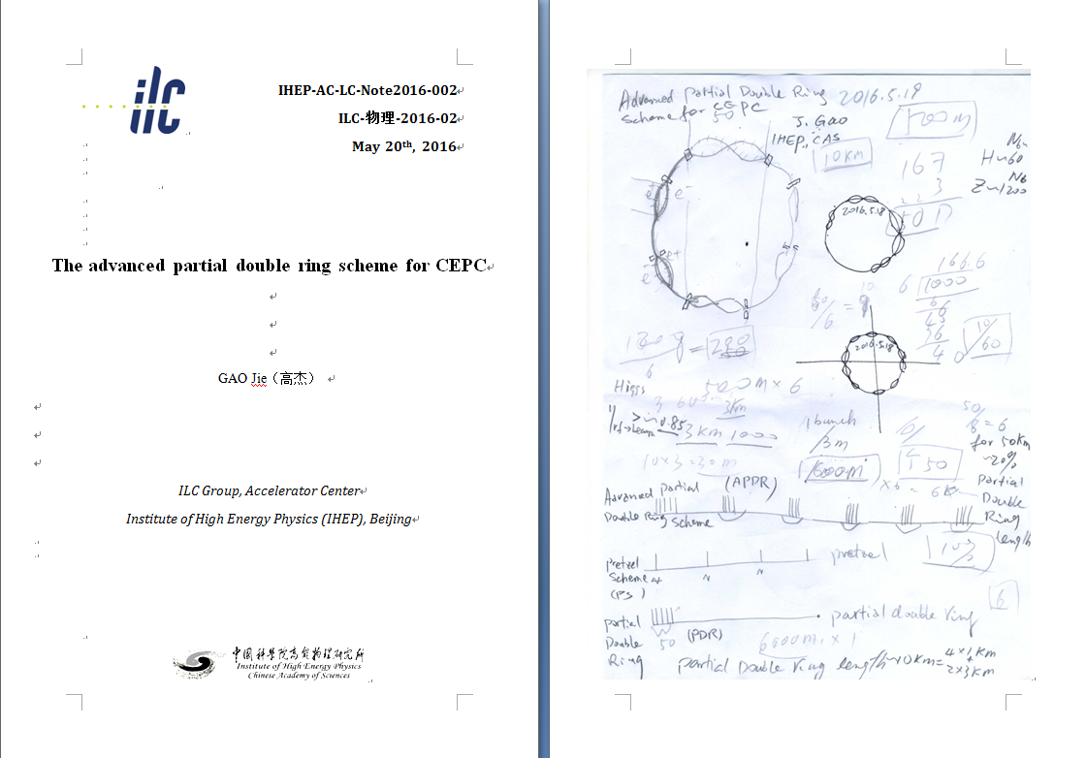
New idea：APDR

Slide 8
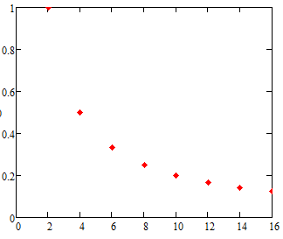
What is the best number of PDR?
There are 2n PDR in the circumference（n=1,2…).
Assume the voltage decrease in the 2 PDR design is a.
The voltage decrease in the 2n PDR design is a/n.
Voltage decrease(a=1)
Number of PDR

Slide 9
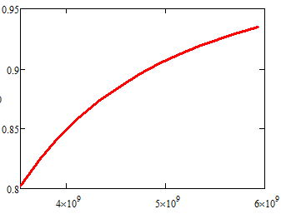
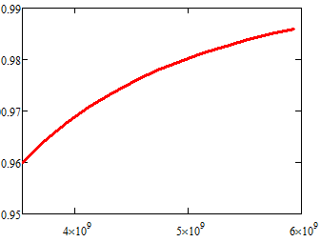
What is the best voltage?
R/Q=Vc^2/ωU, assume P_{pulse}>>P_{cw}
d, cavity effective length, q bunch charge, N_{b} bunches per train, N_{cav} cavity number.
H-low power case:
q=42.8nC,Vsr=2.96GV, N_{cav} =384
Assume matching
V_{c}’/V_{c}
N_{b}=50
V_{c}’/V_{c}
N_{b}=11
V_{RF} (GV)
V_{RF} (V)

Slide 10
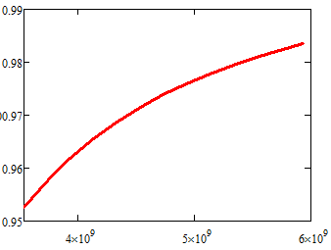
What is the best voltage?
R/Q=Vc^2/ωU, assume P_{pulse}>>P_{cw}
d, cavity effective length, q bunch charge, N_{b} bunches per train, N_{cav} cavity number.
H-low power case:
Nb=11,q=42.8nC,Vsr=2.96GV,
Assume matching
N_{cav} =498
N_{cav} =384
V_{c}’/V_{c}
V_{c}’/V_{c}
Working V_{RF}
Working V_{RF}
V_{RF} (V)
V_{RF} (V)

Slide 11
Phase
The bunches in a bunch train will be accelerated at different Vc_{i}
The bunches in a bunch train will be accelerated at different synchrotron phase to keep constant energy gain.
Va_{i}=Vc_{i}*cosϕs_{i}=C

Slide 12
New SRF layout
IP1
RF station
Double Ring
(1km/3km)
C≈60km
RF&DR center 30°equispaced
IP3

Slide 13
bunch
3.3us
t
26.7us

Slide 14
Wangdou20160219
 | Pre-CDR | H-high lumi. |  | H-low power |  | Z
Number of IPs | 2 | 2 |  | 2 |  | 2
Energy (GeV) | 120 | 120 |  | 120 |  | 45.5
Circumference (km) | 54 | 54 |  | 54 |  | 54
SR loss/turn (GeV) | 3.1 | 2.96 |  | 2.96 |  | 0.062
Half crossing angle (mrad) | 0 | 14.5 | 15 | 11.5 | 15 | 15
Piwinski angle | 0 | 2 | 2.5 | 2 | 2.6 | 8.5
N_{e}/bunch (10¹¹) | 3.79 | 3.79 | 2.85 | 2.81 | 2.67 | 0.46
Bunch number | 50 | 50 | 67 | 40 | 44 | 1100
Beam current (mA) | 16.6 | 16.9 | 16.9 | 10.1 | 10.5 | 45.4
SR power /beam (MW) | 51.7 | 50 | 50 | 30 | 31.2 | 2.8
Bending radius (km) | 6.1 | 6.2 | 6.2 | 6.2 | 6.2 | 6.1
Momentum compaction (10⁻⁵) | 3.4 | 3.0 | 2.5 | 2.6 | 2.2 | 3.5
β_{IP} x/y (m) | 0.8/0.0012 | 0.306/0.0012 | 0.25/0.00136 | 0.22/0.001 | 0.268 /0.00124 | 0.08/0.001
Emittance x/y (nm) | 6.12/0.018 | 3.34/0.01 | 2.45/0.0074 | 2.67/0.008 | 2.06 /0.0062 | 0.62/0.002
Transverse σ_{IP} (um) | 69.97/0.15 | 32/0.11 | 24.8/0.1 | 24.3/0.09 | 23.5/0.088 | 7/0.046
ξ_{x}/IP | 0.118 | 0.04 | 0.03 | 0.04 | 0.032 | 0.005
ξ_{y}/IP | 0.083 | 0.11 | 0.11 | 0.11 | 0.11 | 0.084
V_{RF} (GV) | 6.87 | 3.7 | 3.62 | 3.6 | 3.53 | 0.12
f _{RF} (MHz) | 650 | 650 | 650 | 650 | 650 | 650
Nature σ_{z} (mm) | 2.14 | 3.3 | 3.1 | 3.2 | 3.0 | 3.9
Total σ_{z} (mm) | 2.65 | 4.4 | 4.1 | 4.2 | 4.0 | 4.0
HOM power/cavity (kw) | 3.6 | 3.3 | 2.2 | 1.5 | 1.3 | 0.99
Energy spread (%) | 0.13 | 0.13 | 0.13 | 0.13 | 0.13 | 0.05
Energy acceptance (%) | 2 | 2 | 2 | 2 | 2
Energy acceptance by RF (%) | 6 | 2.2 | 2.2 | 2.2 | 2.1 | 1.1
n_{γ} | 0.23 | 0.49 | 0.47 | 0.47 | 0.47 | 0.27
Life time due to beamstrahlung_cal (minute) | 47 | 53 | 36 | 41 | 32
F (hour glass) | 0.68 | 0.73 | 0.82 | 0.69 | 0.81 | 0.95
L_{max}/IP (10³⁴cm⁻²s⁻¹) | 2.04 | 2.97 | 2.96 | 2.03 | 2.01 | 3.61

Slide 15
6 double ring | Pre-CDR Zhaijiyuan20160327 | PDR(HL) Zhaijiyuan20160327&0408 | APDR(HL V_{RF}=3.62) | APDR (H-low power) | APDR (Z)
Number of IPs | 2 | 2 | 2 | 2 | 2
Energy (GeV) | 120 | 120 | 120 | 120 | 45.5
Circumference (km) | 54 | 54 | 54 | 54 | 54
SR loss/turn (GeV) | 3.1 | 2.96 | 2.96 | 2.96 | 0.062
Half crossing angle (mrad) | 0 | 15 | 15 | 15 | 15
Piwinski angle | 0 | 2.5 | 2.5 | 2.6 | 8.5
N_{e}/bunch (10¹¹) | 3.79 | 2.85 | 2.85 | 2.67 | 0.46
Bunch number | 1 | 1 | 22x3 | 15x3 | 367x3
Beam current (mA) | 16.6 | 16.96 | 17 | 10.5 | 45.4
SR power /beam (MW) | 53.2 | 51 | 50 | 31.2 | 2.8
Bending radius (km) | 6.1 | 6.2 | 6.2 | 6.2 | 6.1
V_{RF} (GV) | 6.87 | 3.65 | 3.62 | 5.16 | 0.357
f _{RF} (MHz) | 650 | 650 | 650 | 650 | 650
Cavity No. | 384 | 384 | 384 | 498 | 48
Cavity gradient | 15.8 | 20.6 | 20.6 | 22.6 | 16.2
Accelerating phase | 63.1 | 35.2 | 35.2-32.3 | 55.5-55 | 80.2-79.8
CW power/cavity （kW） | 275 | 263.4 | 260 | 126 | 117
Peak power/train (kW) | / | 2220 | 2345 | 1148 | 1237
Total Power （MW) | 105.6 | 382.5 | 100.4 | 62.7 | 5.6
Cell/cavity | 5 | 2 | 2 | 2 | 2
Cavity/module | 4 | 6 | 8 | 4(3) | 4
Module/station | 6 | 10 | 8 | 21 | 2
Total module | 96 | 64 | 48 | 126 | 12
R/Q (Ω) | 514 | 206 | 206 | 206 | 206
G | 268 | 268 | 268 | 268 | 268
HOM loss factor/cavity (V/pC) | 1.8 | 0.54 | 0.54 | 0.54 | 0.54
HOM power/cavity (kW) | 3.6 | 0.8 | 0.838 | 0.485 | 0.361
Working Temperature（K） | 2 | 2 | 2 | 2 | 2
Q0 | 4E10 | 2E10 | 2E10 | 2E10 | 2E10
τ（ms） | 1.156 | 0.097 | 0.811 | 2.045 | 2.243
QL | 2.36e6 | 1.97e5 | 1.656e6 | 4.18e6 | 4.58e6
Bandwidth(kHz) | 0.28 | 3.3 | 0.196 | 0.077 | 0.071
Detuning F (kHz) | -0.27 | -1.16 | -0.138 | -0.111 | -0.234
Stored energy/cavity(J) | 158.7 | 107.4 | 107.4 | 126.9 | 65.3
Frev(kHz) | 5.484 | 5.484 | 5.484 | 5.484 | 5.484
Gap length (us) | / | 0.3-160 | 26.7 | 26.7 | 26.7
η(RF to beam efficiency)(%) | 100 | 27% | ~100 | ~100 | ~100
Vc decrease(%) | / | / | 3.3 | 1.3 | 2.5
TB/τ | / | 1.7 | 0.0158 | 0.013 | 0.012

Slide 16
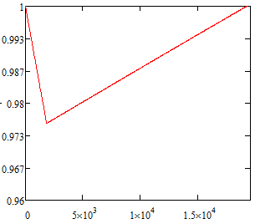
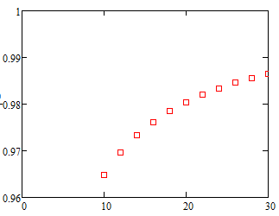
Accelerator gradient decrease in one RF cavity (Z)
Bunch train passing
Bunch train space
Assume matching
Final Eacc/Initial Eacc
Final Eacc/Initial Eacc
Initial Eacc(MV/m)
RF cycles
Field evolution in cavity
Field decrease vs. various initial field gradient of the cavity

Slide 17
New SRF layout
IP1
RF station
Double Ring
(1km/3km)
C≈62km
RF&DR center 22.5°equispaced
IP3

Slide 18
bunch
3.3us
t
20us

Slide 19
8 double ring | Pre-CDR Zhaijiyuan20160327 | PDR(HL) Zhaijiyuan20160327&0408 | APDR(HL) | APDR(HL V_{RF}=3.62) | APDR (H-low power V_{RF}=3.53) | APDR (H-low power) | APDR (Z)
Number of IPs | 2 | 2 | 2 | 2 | 2 | 2 | 2
Energy (GeV) | 120 | 120 | 120 | 120 | 120 | 120 | 45.5
Circumference (km) | 54 | 54 | 54 | 54 | 54 | 54 | 54
SR loss/turn (GeV) | 3.1 | 2.96 | 2.96 | 2.96 | 2.96 | 2.96 | 0.062
Half crossing angle (mrad) | 0 | 15 | 15 | 15 | 15 | 15 | 15
Piwinski angle | 0 | 2.5 | 2.5 | 2.5 | 2.6 | 2.6 | 8.5
N_{e}/bunch (10¹¹) | 3.79 | 2.85 | 2.85 | 2.85 | 2.67 | 2.67 | 0.46
Bunch number | 1 | 1 | 17x4 | 17x4 | 11x4 | 11x4 | 275x4
Beam current (mA) | 16.6 | 16.96 | 17 | 17 | 10.5 | 10.5 | 45.4
SR power /beam (MW) | 53.2 | 51 | 50 | 50 | 31.2 | 31.2 | 2.8
Bending radius (km) | 6.1 | 6.2 | 6.2 | 6.2 | 6.2 | 6.2 | 6.1
V_{RF} (GV) | 6.87 | 3.65 | 5.16 | 3.62 | 3.53 | 5.16 | 0.357/0.12/0.12
f _{RF} (MHz) | 650 | 650 | 650 | 650 | 650 | 650 | 650
Cavity No. | 384 | 384 | 498 | 384 | 384/768/192 | 498 | 48/16/16
Cavity gradient | 15.8 | 20.6 | 22.6 | 20.6 | 20/20/20 | 22.6 | 16.2/16.3/32.6
Accelerating phase | 63.1 | 35.2 | 55.3-55 | 35.2-33 | 33-31.6/33-31.6/33-31.6 | 55.3-55 | 80.1-79.9/58.9-56.9/58.9-58
CW power/cavity （kW） | 275 | 263.4 | 201 | 260 | 163.3/81.6/326.6 | 126 | 117/350/350
Peak power/train (kW) | / | 2220 | 1389 | 1389 | 843 | 843 | 884
Total Power （MW） | 105.6 | 382.5 | 100.4 | 100.4 | 62.7 | 62.7 | 5.6
Cell/cavity | 5 | 2 | 2 | 2 | 2/1/4 | 2 | 2/2/1
Cavity/module | 4 | 6 | 6(3,2) | 6 | 6/12/3 | 6(3,2) | 6/2/2
Module/station | 6 | 10 | 10(11） | 8 | 8/8/8 | 10(11） | 1/1/1
Total module | 96 | 64 | 126 | 64 | 64/64/64 | 126 | 8/8/8
R/Q (Ω) | 514 | 206 | 206 | 206 | 206/103/412 | 206 | 206/206/103
G | 268 | 268 | 268 | 268 | 268 | 268 | 268
HOM loss factor/cavity (V/pC) | 1.8 | 0.54 | 0.54 | 0.54 | 0.54/0.27/1.08 | 0.54 | 0.54/0.54/0.27
HOM power/cavity (kW) | 3.6 | 0.8 | 0.838 | 0.838 | 0.485/0.24/0.97 | 0.485 | 0.36/0.36/0.18
Working Temperature（K） | 2 | 2 | 2 | 2 | 2 | 2 | 2
Q0 | 4E10 | 2E10 | 2E10 | 2E10 | 2E10 | 2E10 | 2E10
τ（ms） | 1.156 | 0.097 | 1.263 | 0.811 | 1.242 | 2.045 | 2.243/0.76/0.76
QL | 2.36e6 | 1.97e5 | 2.579e6 | 1.656e6 | 2.53e6 | 4.18e6 | 4.58e6/1.55e6/1.55e6
Bandwidth(kHz) | 0.28 | 3.3 | 0.126 | 0.196 | 0.128 | 0.077 | 0.071/0.209/0.209
Detuning F (kHz) | -0.27 | -1.16 | -0.180 | -0.138 | -0.083 | -0.111 | -0.234/-0.347/-0.347
Stored energy/cavity(J) | 158.7 | 107.4 | 126.9 | 107.4 | 100 | 126.9 | 65.3/65.3/133
Frev(kHz) | 5.484 | 5.484 | 5.484 | 5.484 | 5.484 | 5.484 | 5.484
Gap length TB (us) | / | 0.3-160 | 20 | 20 | 20 | 20 | 20
η(RF to beam efficiency)(%) | 100 | 27% | ~100 | ~100 | ~100 | ~100 | ~100
Vc decrease(%) | / | / | 1.6 | 2.5 | 1.6 | 1 | 1.7/5.3/2.5
TB/τ | / | 1.7 | 0.0158 | 0.025 | 0.0098 | 0.0098 | 0.0089/0.0263/0.0263

Slide 20
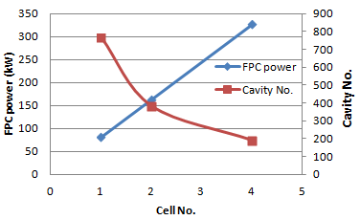
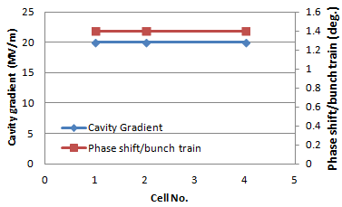
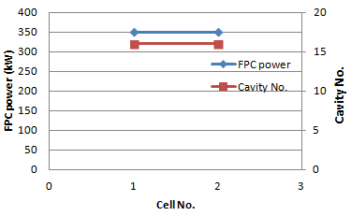
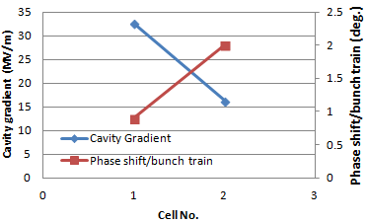
8 DR H-Low power mode
8 DR H-Low power mode
8 DR Z mode
8 DR Z mode

Slide 21
CEPC APDR SRF Design
APDR SRF Challenge | Difficulty | Methods | CDR
Phase stability | ☆☆☆ | Feedback control, injection control, phase stability, SR damping,… | ±0.1%
Voltage control | ☆☆☆ | Feedback control, | ±1%
BBU | ☆☆ | Variation on bunch current, Low wake field excitation at bunch train length, High damping SC cavity, Radiation damping(wiggler), bunch spacing, feedback,… | >500mA (Z>1A)
HOM damping | ☆☆ | Single cell beam pipe/slotted cavity(multi-cell) | 1-3kW
Longitudinal instability | ☆☆
Transverse instability | ☆☆
Impact bunch position control | ☆☆☆
Input coupler | ☆☆ |  | 130kW(1cell),260kW(2cell); Z:350kW(2cell),175kW(1cell)
Q₀ | ☆☆ | EP is very important | 2E10
Cavity gradient | ☆☆☆ | 20.6MV/m&Q₀=2E10@2K (☆☆) 32.6MV/m&Q₀=2E10@2K (☆☆☆, lower the Q₀) | H mode:2E10 Z mode:> 5E9

Slide 22
Working plan
Time(month)
6-7 | BBU, cavity requirements, cavity design
8 | HOM optimization, input coupler
9-10 | Phase stability, longitudinal instability
11-12 | System check

Slide 23
Conclusion
The 8-double ring and 6-double ring seem available when using the same parameter as PDR(V_{RF}=3.62GV) for HL. The 8-double ring has a lower phase variation than the 6-double ring .
The phase region is from 35.2-33 degree for bunches in a bunch train for the 8-double ring HL mode. The phase region is from 35.2-32.3 degree for the 6-double ring HL mode.
The bunch energy gain in each cavity is constant.
The RF to beam efficiency is ~100%.

Slide 24
Thanks!

