Slide 1

CEPC Partial Double Ring
Lattice Design and DA Study
SU Feng GAO Jie WANG Dou WANG Yiwei
Li Yongjun BIAN Tianjinan BAI Sha DUAN Zhe GENG Huiping ZHANG Yuan XU Gang XIAO Ming
Key Laboratory of Particle Acceleration Physics and Technology
Institute of High Energy Physics
Chinese Academy of Sciences
2016.6.17

Slide 2
Out line
CEPC PDR Lattice Redesign and Consideration
CEPC APDR (Advanced Partial Double Ring) Consideration
CEPC PDR DA Study
SPPC Key Physics Problem and My Study Plan

Slide 3
CEPC PDR Lattice Redesign and Consideration
Feng Su, Yiwei Wang, Jie Gao
2016.6.16

Slide 4
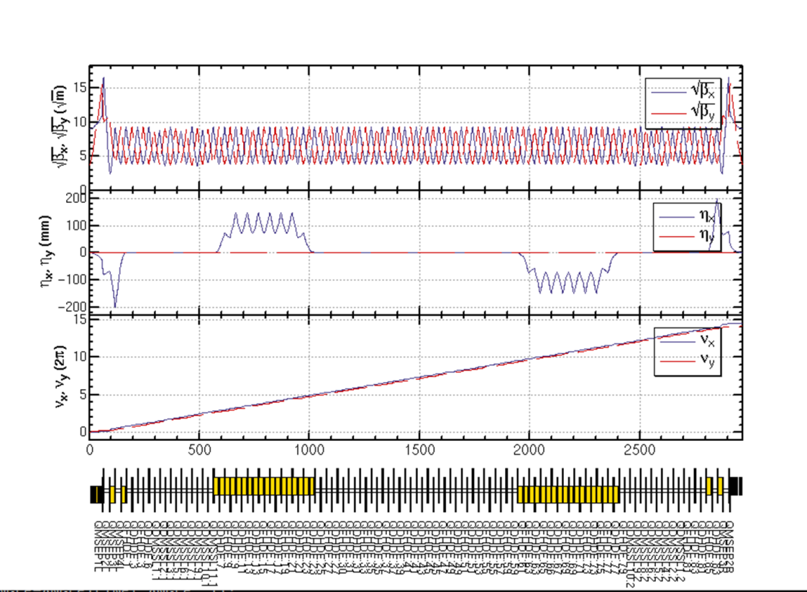
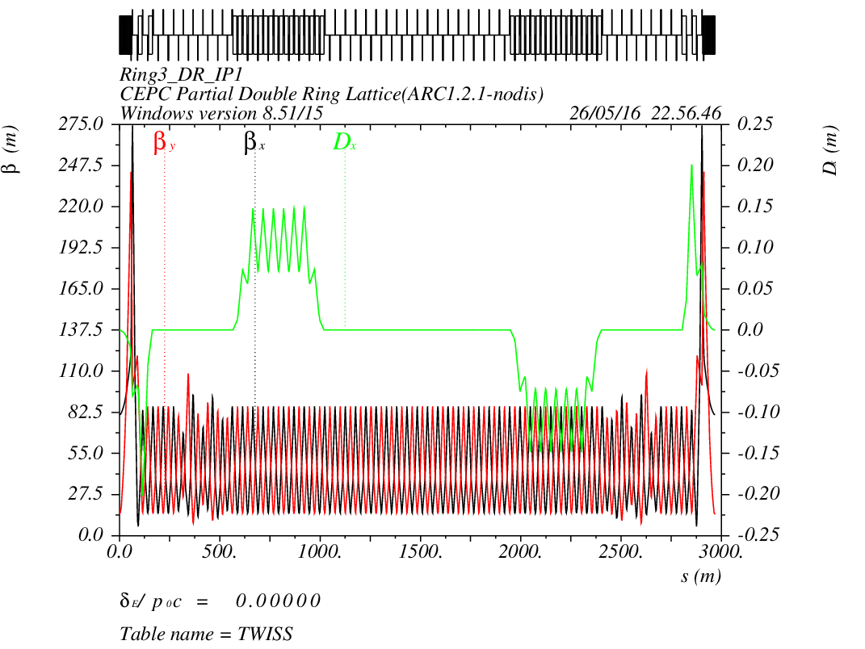
CEPC PDR1.0.2 noFFS

Slide 5

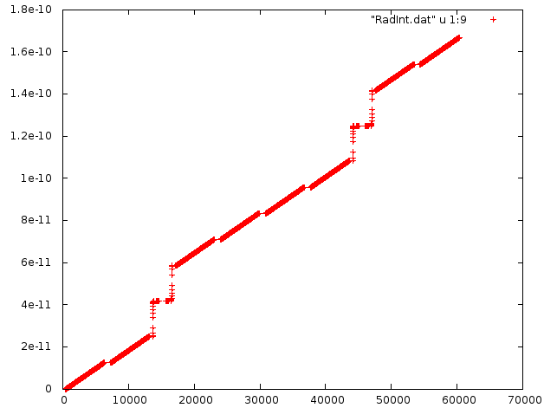






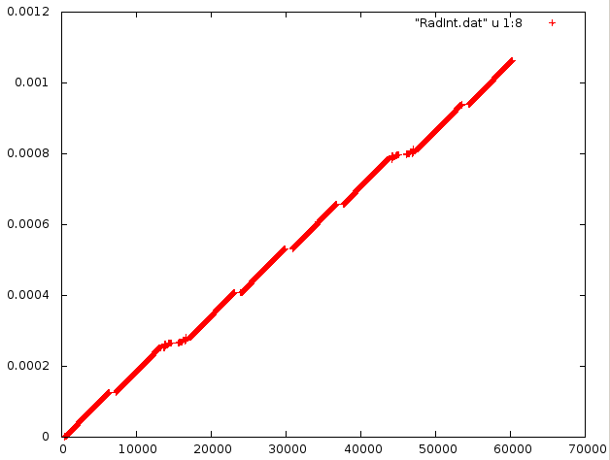
Emittance growth source
I5x
S
Cq*(120/0.511E-3)^2/1*I5x[[-1]]/I2[[-1]]
Out[15]:= 3.3103495751811973e-09
I2
2.06nm->3.31nm
S
Yiwei Wang, 3th Jun 2016, CEPC AP meeting

Slide 6
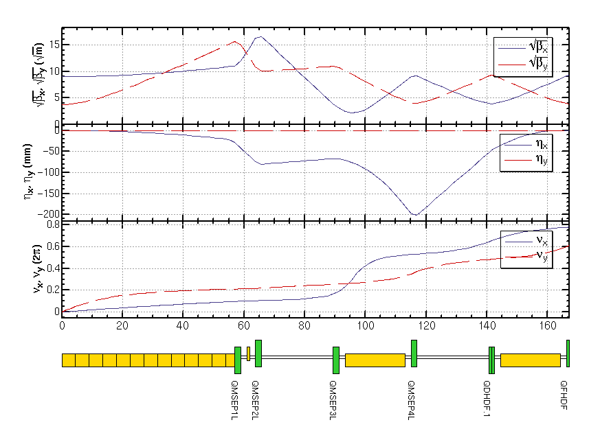
CEPC PDR1.0.2 noFFS

Slide 7
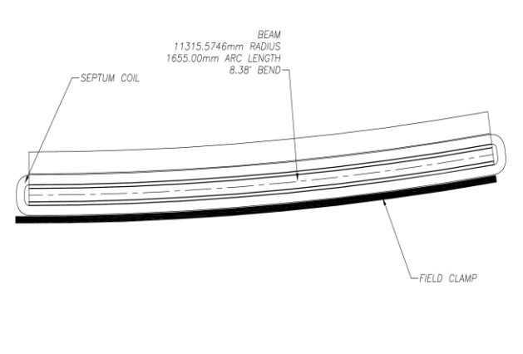
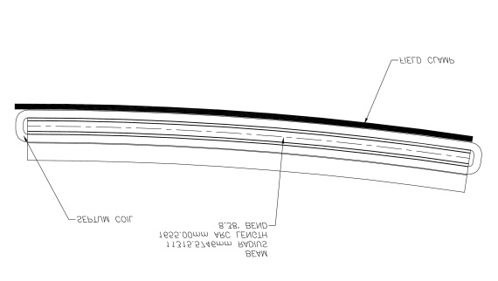
Separator with Thin Septum Magnet
Sigmax=697.8um 20sigma=14mm
20mm
Beam
dump
Septum Magnet：L=3m
（4.25mrad）thicknes=3-5mm
rho=705.822m B=0.56T
Separator： 62.5 urad
12 个
0.75 mrad
Notes:
Beam size is 700 micrometer。 just in case 以防万一

Slide 8
Dipole Strength Version 1.0.2
 | Angle(mrad) | L(m) | Rho(m) | Brho(E0/c)(T/m) | B(T) | Ek(KeV) | KeV/m
B0 | 3.232 | 19.6 | 6064.36 | 400 | 0.06596 | 631.625 | 32.226
BSepL | -0.0625 | 4.5 | -72000 | 400 | -0.00556 | 53.2 | 11.822
BSeptumL | -4.25 | 3 | -705.822 | 400 | -0.56667 | 5426.4 | 1808.8
BMatch1L | -0.469 | 4.9 | -10447.8 | 400 | -0.03829 | 366.624 | 74.821
BMatch2L | -3.171 | 19.6 | -6181.02 | 400 | -0.06471 | 619.704 | 31.618
BMatch3L | -4.36 | 19.6 | -4495.41 | 400 | -0.08898 | 852.069 | 43.473
B2 | 2.167 | 19.6 | 9044.76 | 400 | 0.04422 | 423.494 | 21.607
B3 | 2.167 | 19.6 | 9044.76 | 400 | 0.04422 | 423.494 | 21.607
B4 | -2.167 | 19.6 | -9044.76 | 400 | -0.04422 | 423.494 | 21.607
B5 | -2.167 | 19.6 | -9044.76 | 400 | -0.04422 | 423.494 | 21.607
BMatch3R | 4.36 | 19.6 | 4495.41 | 400 | 0.08898 | 852.069 | 43.473
BMatch2R | 3.171 | 19.6 | 6181.02 | 400 | 0.06471 | 619.704 | 31.618
BMatch1R | 0.469 | 4.9 | 10447.8 | 400 | 0.03829 | 366.624 | 74.821
BSeptumR | 4.25 | 3 | 705.822 | 400 | 0.56667 | 5426.4 | 1808.8
BSepR | 0.0625 | 4.5 | 72000 | 400 | 0.00556 | 53.2 | 11.822

Slide 9
Upload Methods
Week Septum：can we make the septem much weaker and longer
No Septum: Straight section to acquire a big distance. Need dual-aperture quadrupole.
Use defocusing quadrupole.

Slide 10
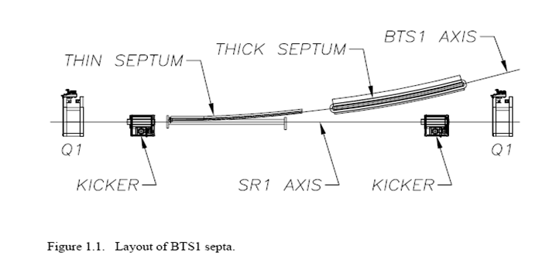
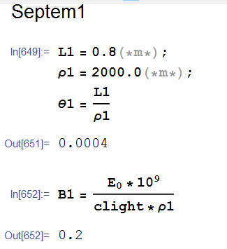
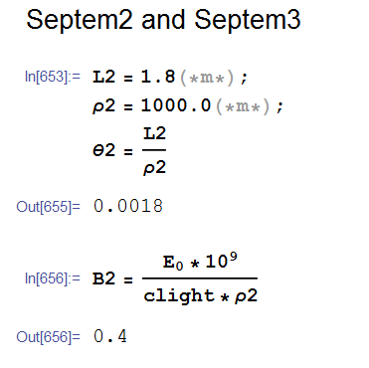
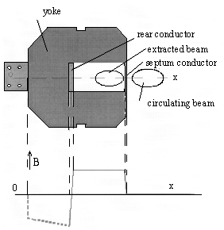
Septum
Thin Septum:
d=20mm, B<0.6T, L=0.6-0.8m
Thick Septum:
d=100mm, B<1T, L=1.2-1.8m
---From Kang Wen

Slide 11
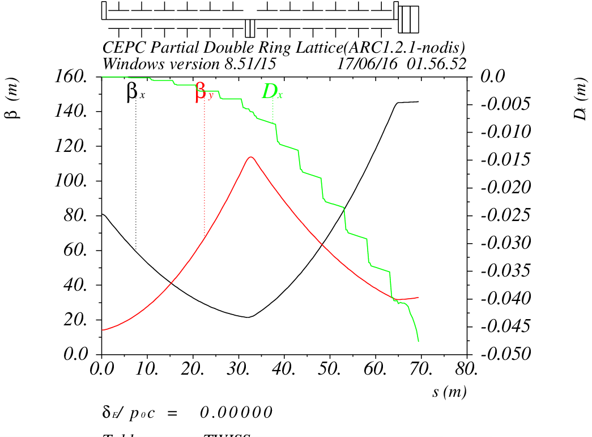
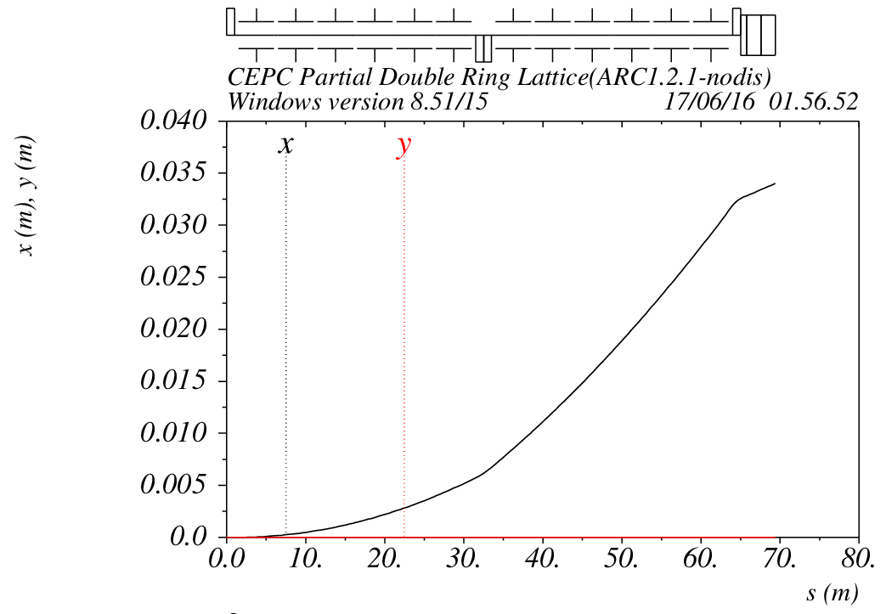
Septum

Slide 12
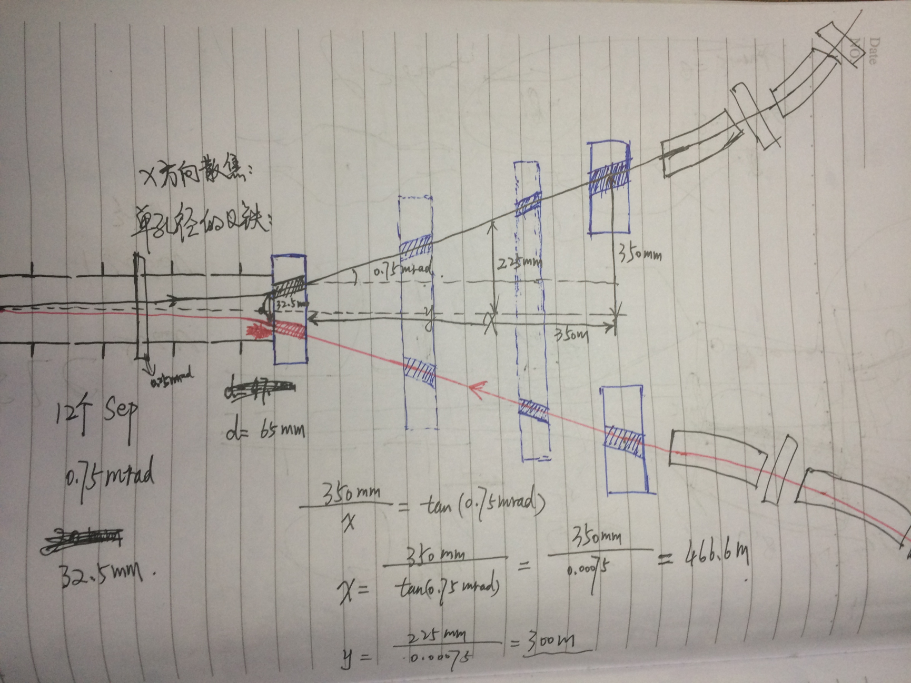
Dual Aperture Q

Slide 13
CEPC Pre-CDR 磁铁参数
B铁
磁铁数量 | 1984
最大磁场强度（T） | 0.07
磁铁气隙（mm） | 80
偏转角度（mrad） | 3.17
磁长度（m） | 18
偏转半径（m） | 6094
好场区范围（mm) | 100
铁心截面尺寸W*H（mm） | 450*400
CEPC MQ
数量 | 2304
孔径（mm） | 100
磁场梯度（T/m） | 10
有效长度（m） | 2.0
铁芯宽度和高度（mm） | 700*700
铁芯长度（mm） | 1960
CEPC MS | SD | SF
数量 | 992 | 992
孔径（mm） | 120 | 120
好场区（mm） | 100 | 100
磁场梯度（T/m^2） | 180 | 180
磁长度（m） | 700 | 400
铁芯宽度和高度（mm） | 520 | 520
铁芯长度（mm） | 670 | 370
CEPC 对撞区 超导Q | QF | QD
磁场梯度（T/m） | 304 | 309
有效长度（m） | 1.25 | 0.72
线圈最大磁场（T） | 7.2 | 7.1
线圈内直径（mm） | 40 | 40
线圈外直径（mm） | 74 | 74
恒温器外直径（mm） | 400 | 400
线圈纵向长度（mm） | 1500 | 950

Slide 14
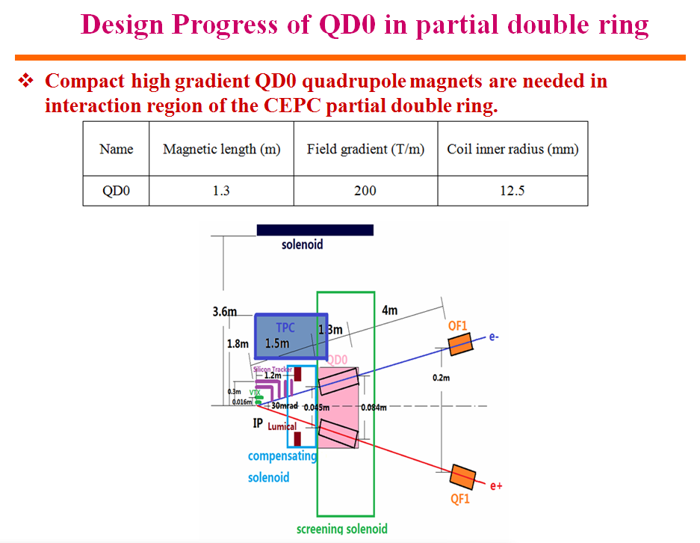
drift
Yingshun Zhu, May 4, CEPC AT meeting

Slide 15
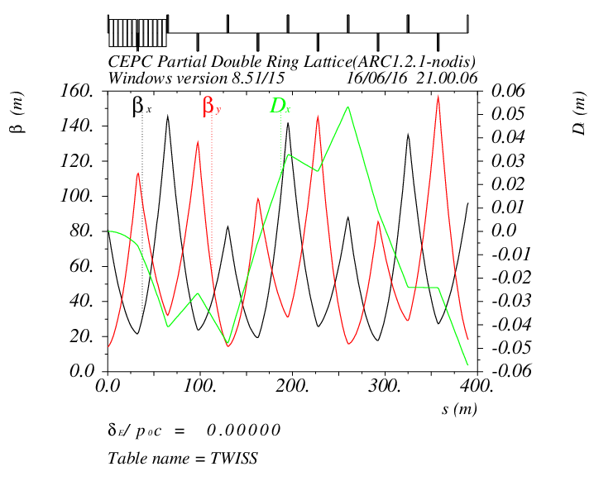
Separator + Straight Section

Slide 16
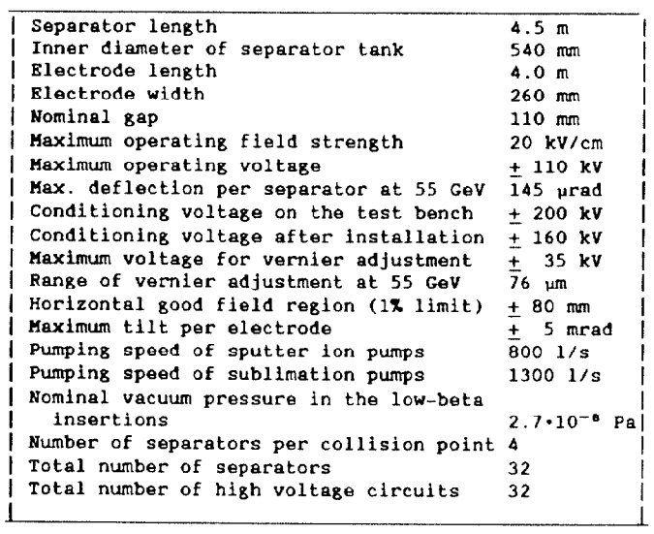
Electrostatic Separator in LEP
L=4.5m
Lelectrode=4.0m
Efield=2MV/m
E=55GeV
Angle=145urad
E=120GeV
Angle=66urad

Slide 17
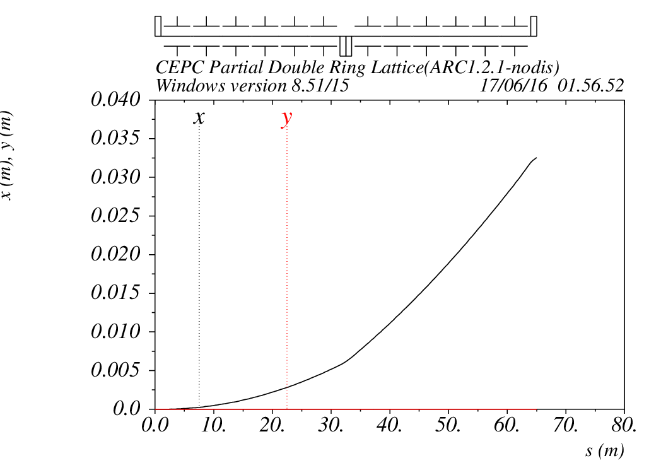
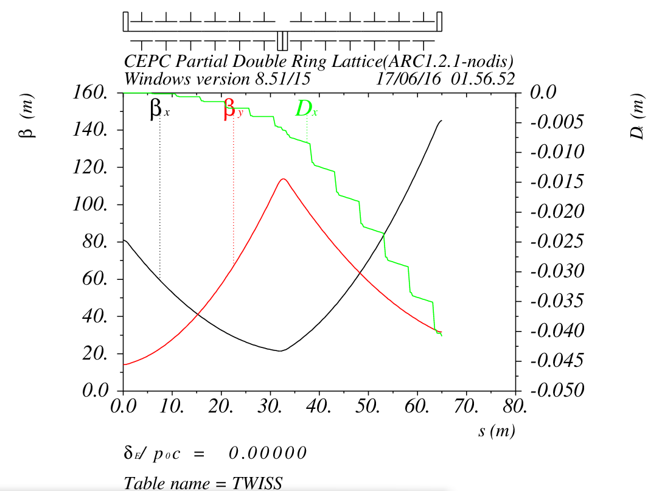
Defocusing Quadrupole

Slide 18
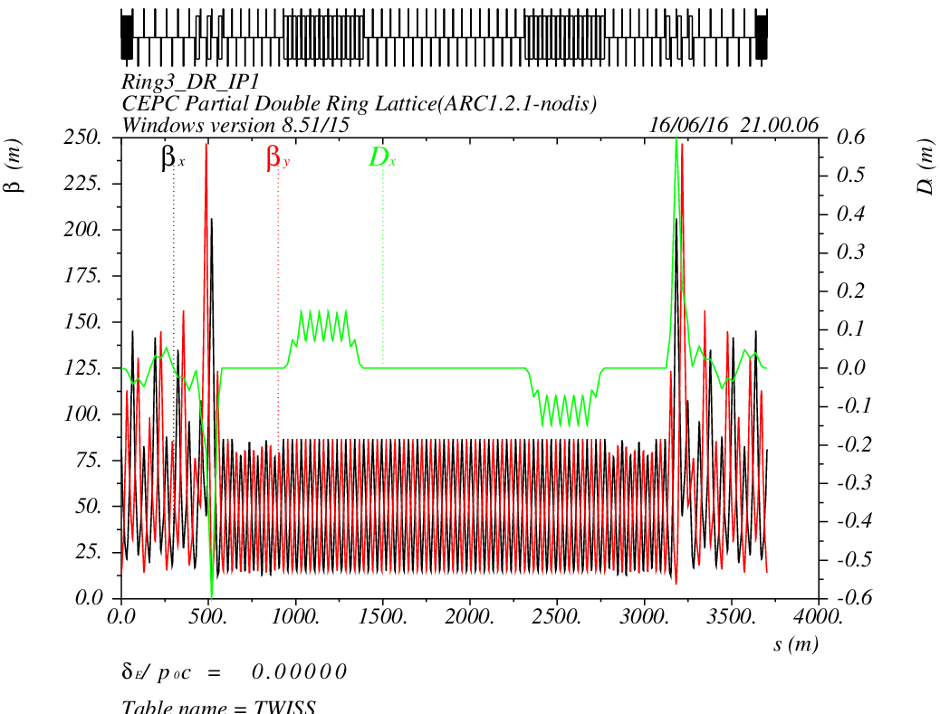
CEPC PDR1.0.3 noFFS

Slide 19
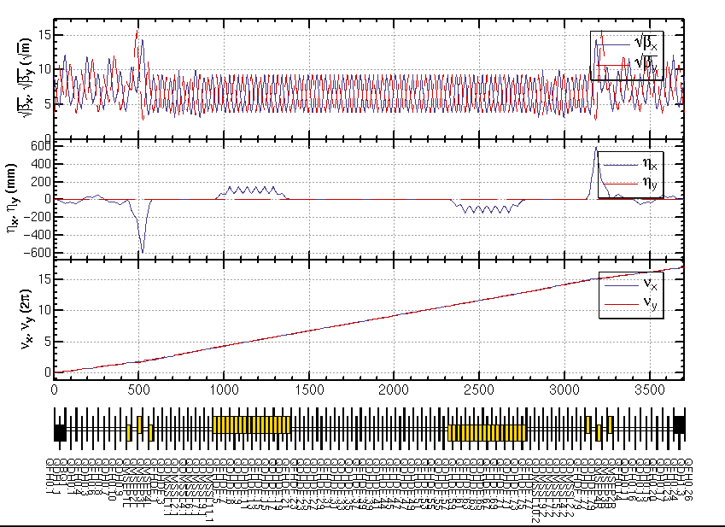
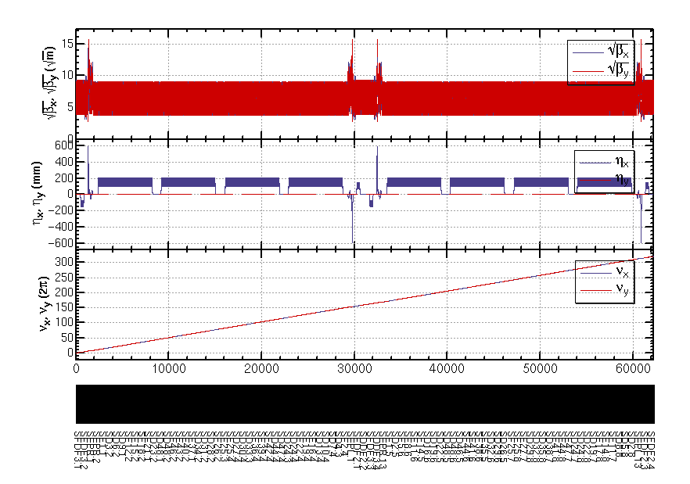
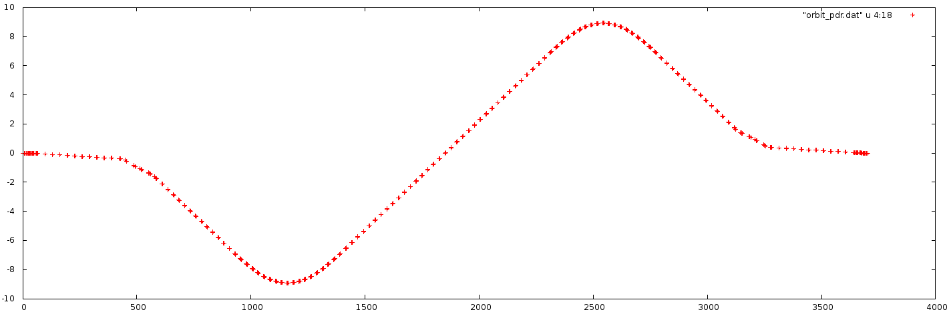
CEPC PDR1.0.3 noFFS by SAD

Slide 20
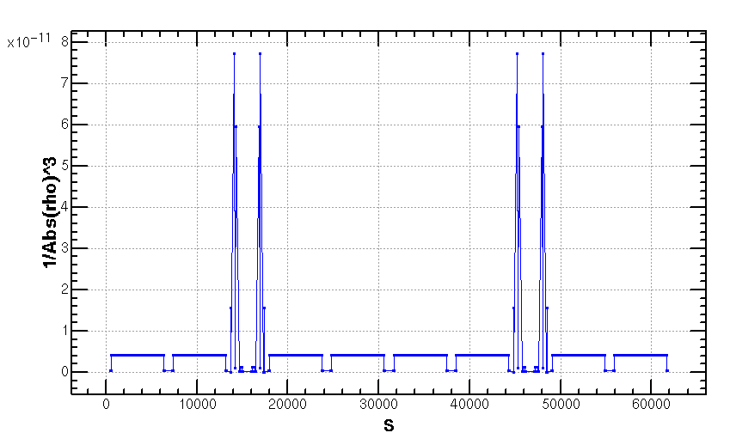
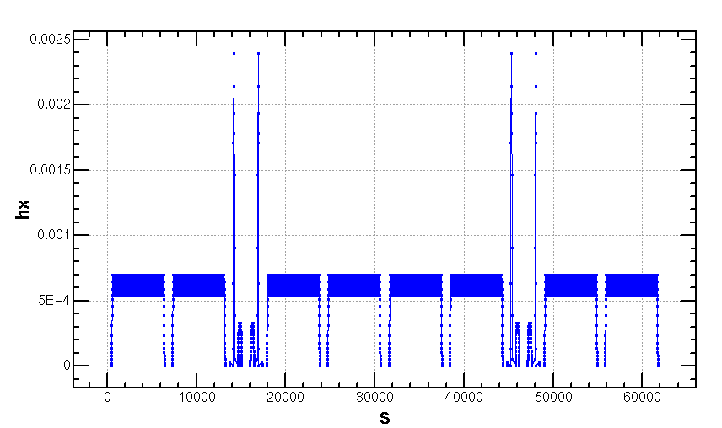
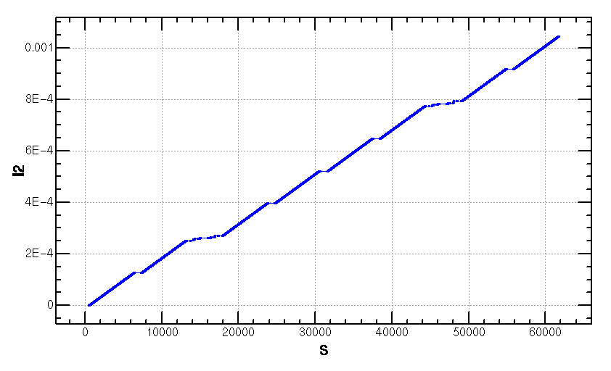
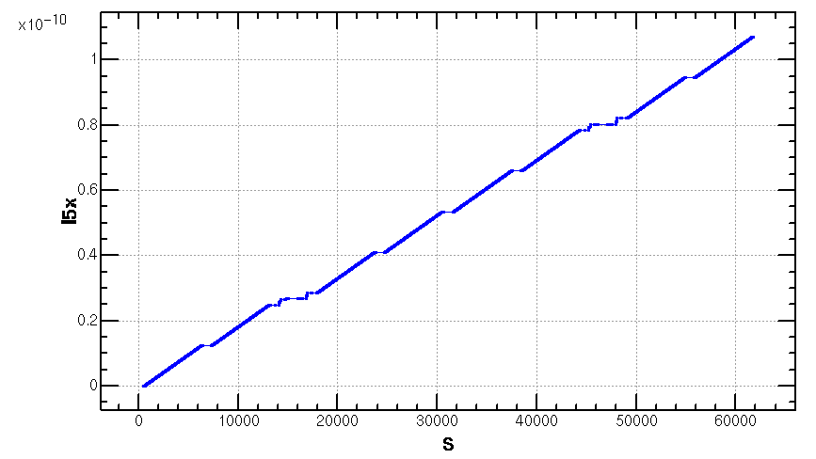
Emittance Increase (2.06nm->2.1668nm)

Slide 21
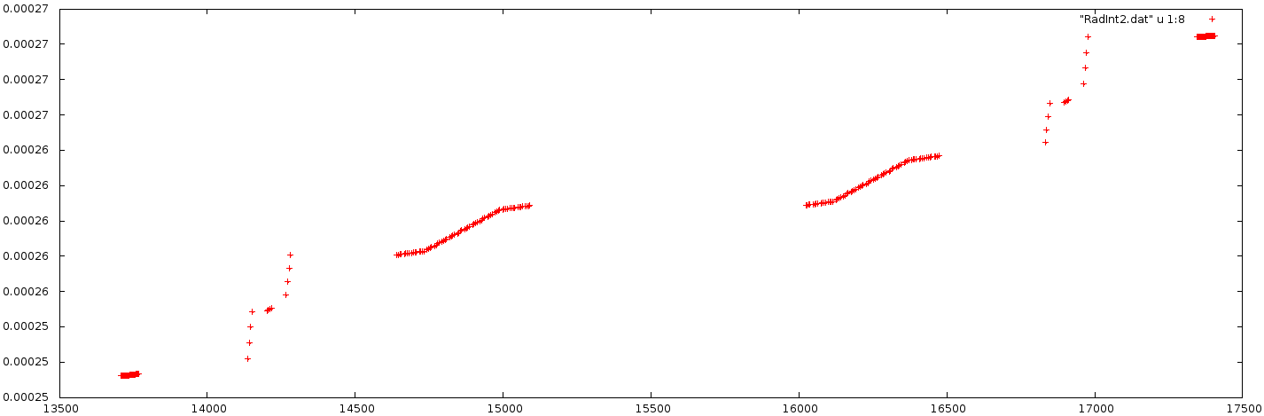
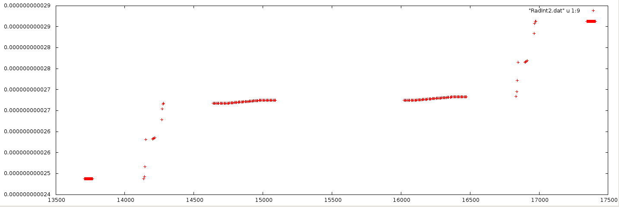
PDR Part
I2/S
I5x/s

Slide 22
CEPC APDR Consideration
Feng Su, Jie Gao, Yiwei Wang
2016.6.16

Slide 23
CEPC Advanced Partial Double Ring Layout II
1/2RF
1/2RF
1/2RF
ARC
1/2RF
IP1_ee
1/2RF
APDR
APDR
1/2RF
3Km
1/2RF
1/2RF
APDR
APDR
1/2RF
1/2RF
C=65640.2m
IP1_ee/IP3_ee, 2.968Km
IP2_pp/IP4_pp, 1132.8m
APDR, 1052.87m
4 Short Straights, 94.4m
12 Long Straights, 566.4m
4 Long ARC, 124*FODO, 5852.8m
4 Medium ARC, 104*FODO, 4908.8m
4 Short ARC, 14*FODO, 660.8m
1/2RF
1/2RF
APDR
APDR
1/2RF
IP3_ee
1/2RF
1/2RF
1/2RF
SU Feng
2016.6.2

Slide 24
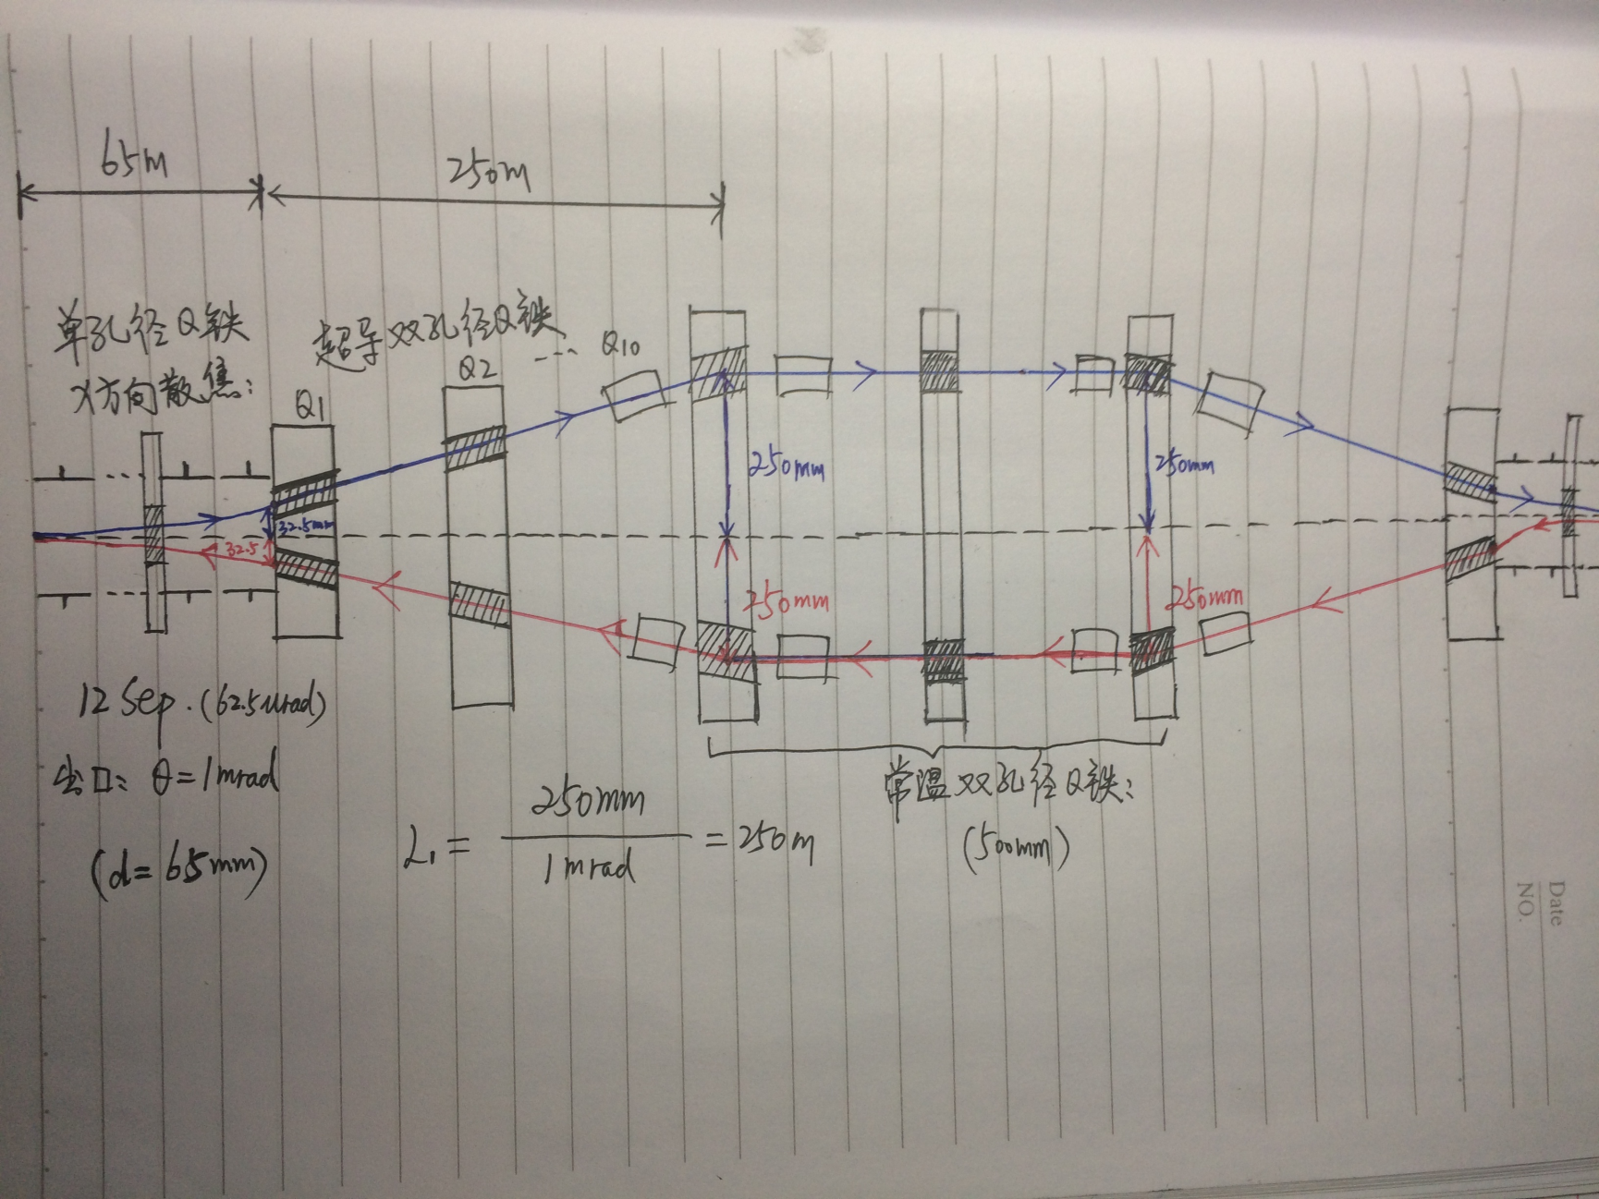

Slide 25
CEPC PDR DA Study
Feng Su, Yongjun Li, Yiwei Wang, Dou Wang, Jie Gao,
Tianjian Bian, Sha Bai
2016.6.16

Slide 26
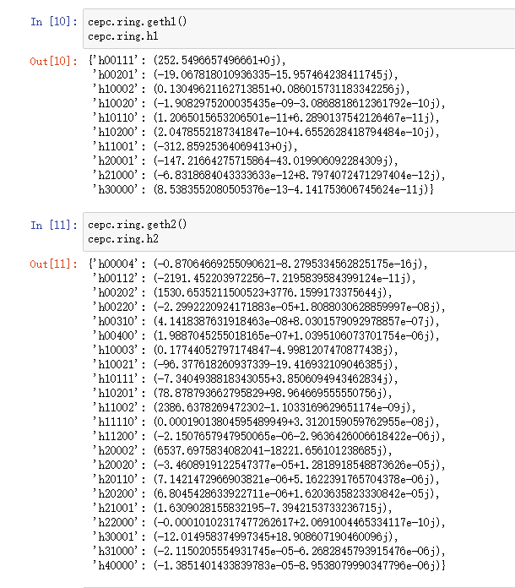
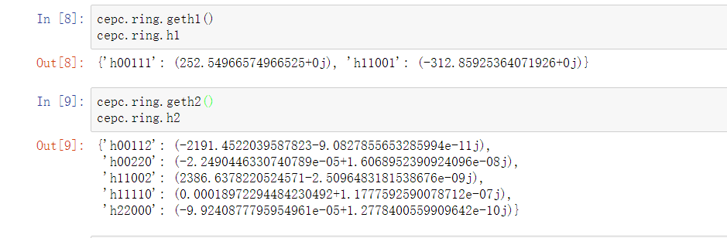
Nonlinear Driving Term
h_{abcde} , a+b+c+d+e=3 ,
1st order nonlinear driving term
a+b+c+d+e=4 ,
2nd order nonlinear driving term
1st order chromaticity: h11001, h00111
2nd order chromaticity: h11002, h00112
Tune with amplitude: h11110, h22000, h00220

Slide 27
Nonlinear Driving Term
Betx：80.992367
bety：14.172123
2nm
Sizmax：402.47um
Sigmay：9.22um

Slide 28
SPPC Key Physics Problem and My Study Plan
Feng Su, Jingyu Tang, Jie Gao
2016.6.17

Slide 29
SPPC Key Physics Problem
1. Parameter Optimized: high luminosity: 1.2×10³⁵ cm⁻²s⁻¹ ~1.0×10³⁶ cm⁻²s⁻¹
  Supported by powerful injector chain and strong focusing at IPs
  Integrated luminosity enhancement by exploring emittance damping
2. Challenges in lattice design
  Insertion lattice (IP, collimation, extraction, injection)
  Compatible with the CEPC rings
  3. Machine protection :
  Very high synchrotron radiation power: 56 W/m @dipole.
  High circulation current: 1 A
  Machine protection by sophisticated collimation system /abort system (6.6 GJ per beam; inefficiency: 10⁻⁶)
4.Instability issues:
  Electron cloud, resistive wall (beam screen, collimators) etc.
5. Beam-beam effects
  Different effects: incoherent tune shift, PACMAN effect, coherent effect, Nominal B-B tune shift set to conservative 0.012, but may increased according to simulations and machine studies. May be increased during the burn-up process of beam by controlling emittance heat-up. Remedy by electron lens

Slide 30
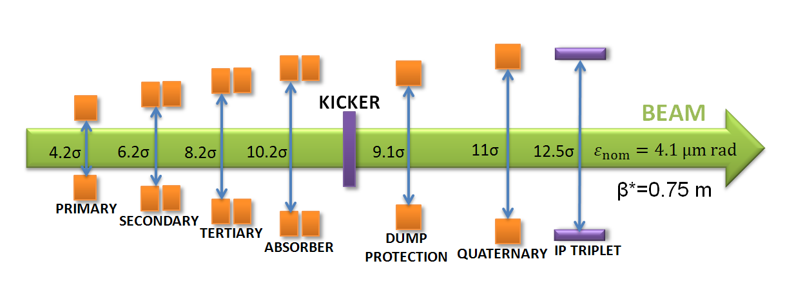
Collimation method
  Collimation: must beam very efficient, e.g. inefficiency 10⁻⁶ (vs 10⁻⁵ at LHC/14-TeV), to prevent significant beam loss at arcs, and reduce loss rate at detectors
  Collimation efficiency decreases with increasing energy, more sophisticated design is needed
  A four-stage collimation method (similar at LHC, or one more stage ) is considered for both transverse and longitudinal collimation
Jingyu Tang,FCC Week, April 11-15, 2016, Rome, Italy

Slide 31

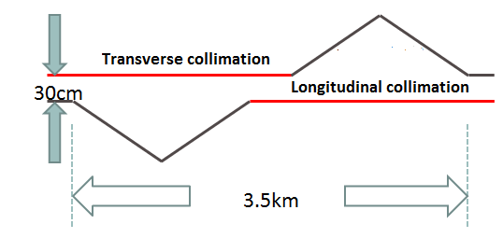
  LHC collimation problem: large beam loss at the DS section, due “Single-diffractive (SD) effect“ downstream of IR7 (trans. Coll.),
  SD effect becomes even more important at higher energy
  Solution: Trans. and long. collimation in a same LSS
  Consider use of SC quads (lower field, large apertures with shielding) to increase phase advance
  Material also be an important issue: contribution to impedance, needing new type materials
  Novel collimation methods under consideration: bent crystal, electron lens, nonlinear magnets etc.
Jingyu Tang,FCC Week, April 11-15, 2016, Rome, Italy

Slide 32
My Plan
1.Parameter Optimized: Optimize the first version SPPC parameter (including longitudinal dynamics)(2016.7-8)
2. SPPC Lattice Design:
(IR Design LSS_rf LSS_inj/extr ARC)(2016.7.8.9)
3. Beam Dynamics Study:
DA(Sixtrack)(2016.7-11)

Slide 33
Thank You !

