Slide 1
Lattice design for CEPC PDR
Yiwei Wang, Feng Su, Jie Gao
17th Jun 2016, CEPC AP meeting

Slide 2
CEPC primary parameter （wangdou20160325）
 | Pre-CDR | H-high lumi. | H-low power | W | Z
Number of IPs | 2 | 2 | 2 | 2 | 2
Energy (GeV) | 120 | 120 | 120 | 80 | 45.5
Circumference (km) | 54 | 54 | 54 | 54 | 54
SR loss/turn (GeV) | 3.1 | 2.96 | 2.96 | 0.59 | 0.062
Half crossing angle (mrad) | 0 | 15 | 15 | 15 | 15
Piwinski angle | 0 | 2.5 | 2.6 | 5 | 7.6
N_{e}/bunch (10¹¹) | 3.79 | 2.85 | 2.67 | 0.74 | 0.46
Bunch number | 50 | 67 | 44 | 400 | 1100
Beam current (mA) | 16.6 | 16.9 | 10.5 | 26.2 | 45.4
SR power /beam (MW) | 51.7 | 50 | 31.2 | 15.6 | 2.8
Bending radius (km) | 6.1 | 6.2 | 6.2 | 6.1 | 6.1
Momentum compaction (10⁻⁵) | 3.4 | 2.5 | 2.2 | 2.4 | 3.5
β_{IP} x/y (m) | 0.8/0.0012 | 0.25/0.00136 | 0.268 /0.00124 | 0.1/0.001 | 0.1/0.001
Emittance x/y (nm) | 6.12/0.018 | 2.45/0.0074 | 2.06 /0.0062 | 1.02/0.003 | 0.62/0.0028
Transverse σ_{IP} (um) | 69.97/0.15 | 24.8/0.1 | 23.5/0.088 | 10.1/0.056 | 7.9/0.053
ξ_{x}/IP | 0.118 | 0.03 | 0.032 | 0.008 | 0.006
ξ_{y}/IP | 0.083 | 0.11 | 0.11 | 0.074 | 0.073
V_{RF} (GV) | 6.87 | 3.62 | 3.53 | 0.81 | 0.12
f _{RF} (MHz) | 650 | 650 | 650 | 650 | 650
Nature σ_{z} (mm) | 2.14 | 3.1 | 3.0 | 3.25 | 3.9
Total σ_{z} (mm) | 2.65 | 4.1 | 4.0 | 3.35 | 4.0
HOM power/cavity (kw) | 3.6 | 2.2 | 1.3 | 0.99 | 0.99
Energy spread (%) | 0.13 | 0.13 | 0.13 | 0.09 | 0.05
Energy acceptance (%) | 2 | 2 | 2
Energy acceptance by RF (%) | 6 | 2.2 | 2.1 | 1.7 | 1.1
n_{γ} | 0.23 | 0.47 | 0.47 | 0.3 | 0.24
Life time due to beamstrahlung_cal (minute) | 47 | 36 | 32
F (hour glass) | 0.68 | 0.82 | 0.81 | 0.92 | 0.95
L_{max}/IP (10³⁴cm⁻²s⁻¹) | 2.04 | 2.96 | 2.01 | 3.09 | 3.09

Slide 3
Considerations on ARC lattice design
FODO cell, 90 ° /90 °
non-interleaved sextupole scheme
n=5
All 3rd and 4th RDT due to sextupoles cancelled
Amplitude-dependent tune shift is very small
Ncell= 120
LB= 19.96
Lcell= 47.92
theta= .0032188449319567555
Lring= 54820.479999999996
Nstr1= 18
Nstr2= 20
Vrfc= 220625000
frf= 6.5e+08

Slide 4
this lattice
H-low power wangdou20160325
NIP=2
Eng=120
Lring=54820.48
U0=2.933
thetaC=-
thetaP=-
Ne=2.67
Nb=44
Ib=.0105
Pbeam=30.800
rhoB=6200
alfap=-
bxstar=-
bystar=-
ex=2.094e-09
ey=0
sigxIP=-
sigyIP=-
ksix=-
ksiy=-
Vrf=3.53e+09
frf=6.5e+08
sigmaz=.00264
sigmazt=-
Phom=-
sigmae=.00130
eapt=-
eaptrf=-
ngamma=-
tbs=-
Fhg=-
Lmax=-
NIP=2 ! Number of IPs [1]
Eng=120 ! Energy [GeV]
Lring=54*1E3 ! Circumference [m]
U0=2.96 ! SR loss/turn [GeV]
thetaC=15 ! Half crossing angle [mrad] thetaP=2.6 ! Piwinski angle [1]
Ne=2.67 ! Ne/bunch [10^11] Nb=44 ! bunch number [1]
Ib=10.5*1e-3 ! Beam current[A]
Pbeam=31.2 ! SR power/beam [MW] rhoB=6.2*1e3 ! Bending radius [m]
alfap=2.2e-5 ! Momentum compaction [1] bxstar=0.268 ! beta x at IP [m]
bystar=0.00124 ! beta y at IP [m]
ex=2.06*1e-9 ! emittance x [m*rad]
ey=0.0062*1e-9 ! emittance y [m*rad]
sigxIP=23.5*1e-6 ! beam size x at IP [m]
sigyIP=0.088*1e-6 ! beam size y at IP [m] ksix=0.032 ! ksix/IP [1]
ksiy=0.11 ! ksiy/IP [1]
Vrf=3.53*1e9 ! Vrf [V]
frf=650*1e6 ! frf [Hz]
sigmaz=3.0 ! Nature sigmaz [mm]
sigmazt=4.0 ! Total sigmaz [mm]
Phom=1.3 ! HOM power/cavity [kw] sigmae=0.13/100 ! Energy spread [1] eapt=2/100 ! energy acceptance [1] eaptrf=2.1/100 ! energy acceptance by RF [1] ngamma=0.47 ! number of gamma
tbs=32 ! life time due to beamstrahlung [min] Fhg=0.81 ! Factor of hour glass
Lmax=2.01 ! Lmax/IP [10^34/cm^2/s]
Damping time 15ms, i.e. 82 turns; filling factor 72.2%

Slide 5
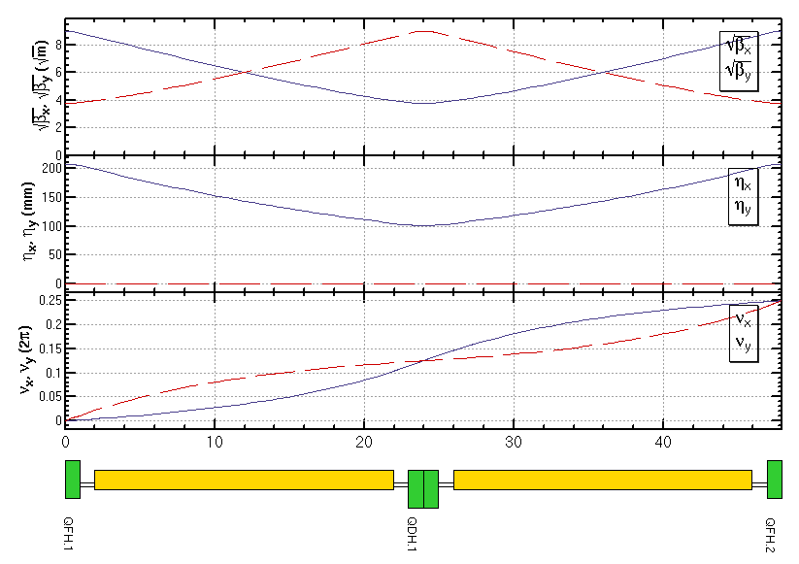
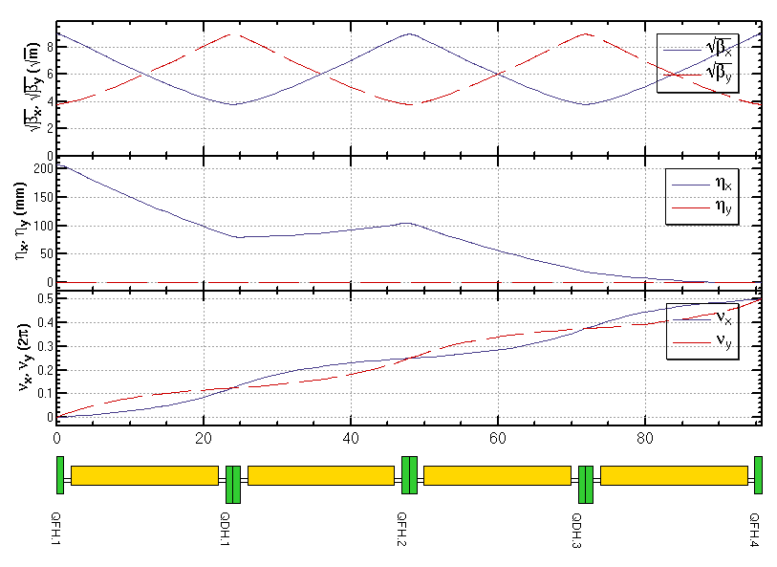
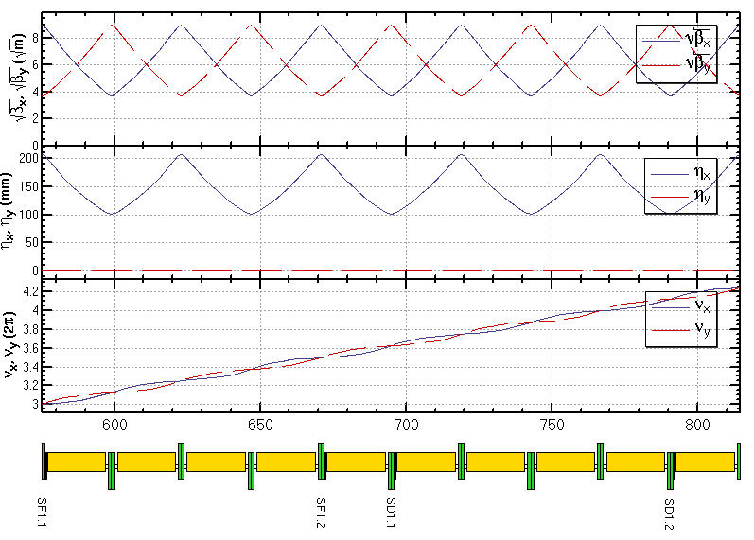
ARC lattice
FODO cell
Dispersion Suppressor
Sextupole configuration

Slide 6
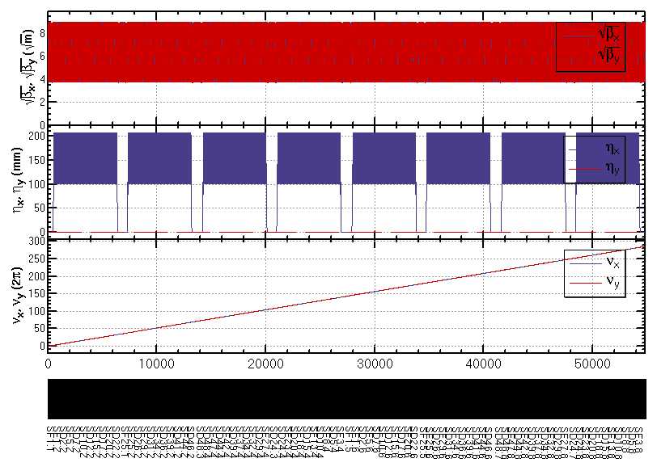
ARC lattice (cont.)
Whole ARC (w/o FFS,PDR)

Slide 7
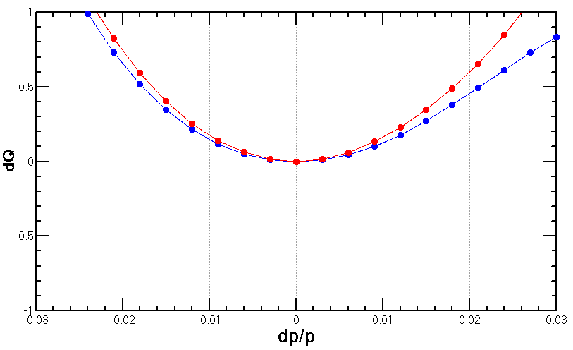
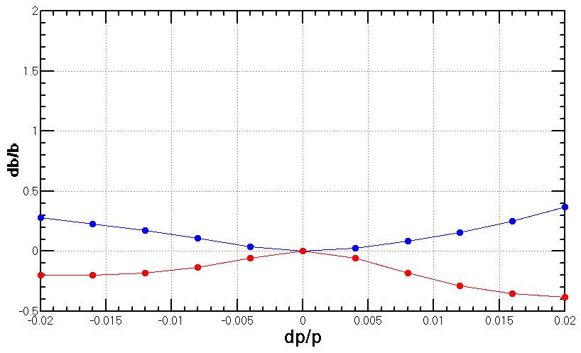
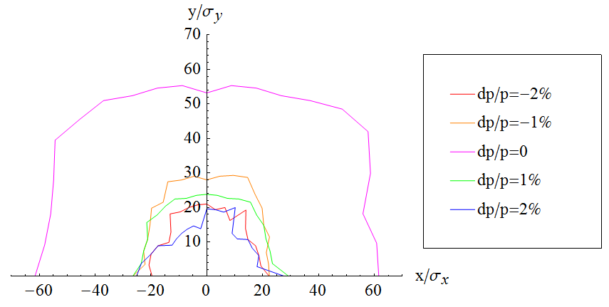
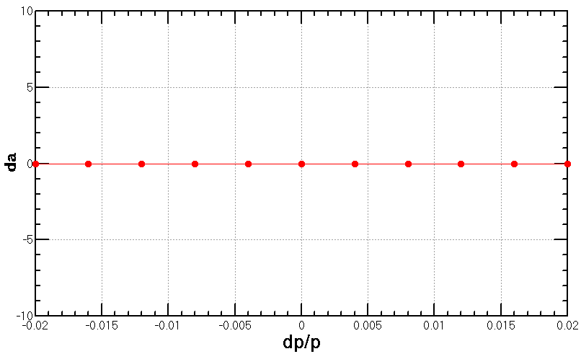
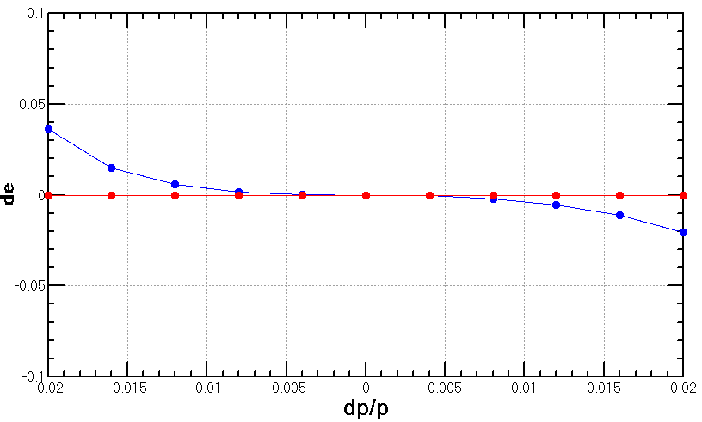
Chromaticity and DA
w/o sync. motion
ARC_4
90/90 non-interleaved
SF1 =(L =.39999999999999997 K2 =.9680546863397813 )
SD1 =(L =.39999999999999997 K2 =-1.8843252788338383 )

Slide 8
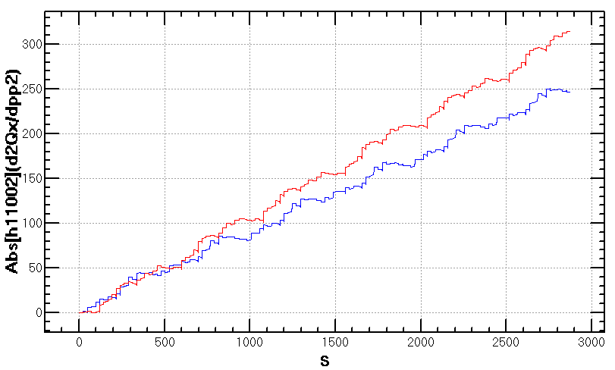
Second order chromaticity
Source of the second order chromaticity
Period=4× 5 cells
However Correction within 4× 5 cells may distroy the –I for off-momentum particles, but it’s worthy to be tried.
Further check the source: coupling of QQ, QS, SS, …?
dQ vs. dp/p for Whole ARC
Mainly second order chromaticity
12× 5 cells

Slide 9
Challenge of key issues in main ring physics design
Momentum acceptance must be as large as 2% including the beam-beam effect and errors.
Stable prezel orbit for the single ring scheme
Uneven load for the partial double ring scheme
Machine detector interface
Compensation of high solenoid field

Slide 10
Goal of physics design toward CDR
Stable prezel orbit for the single ring scheme
Orbit distortion?
Errors
Orbit distortion?
Dynamic aperture reduction ?% after correction
Beam beam
Luminosity reduction including effects other than beam-beam should be small?
Injection
Acceptable size of beam-stay region in final doublet
Momentum acceptance must be as large as 2% including the beam-beam effect and errors.
at least 5*sigma for dp/p=2% and 20*sigma for on momentum particles for including everything
Injection?

