Slide 1
Update on pretzel scheme design
Geng Huiping
CEPC Accelerator Group Meeting
2016.06.17

Slide 2
Contents
First try with downhill simplex method
Goal of Pretzel CDR (error, beam-beam, injection)
Pretzel CDR timeline

Slide 3
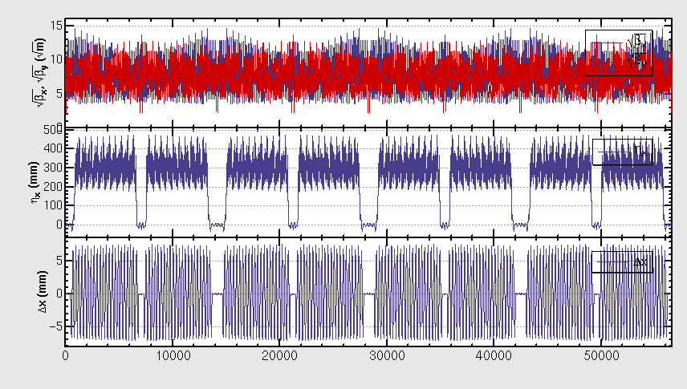
Pretzel design used for DA optimization

Slide 4
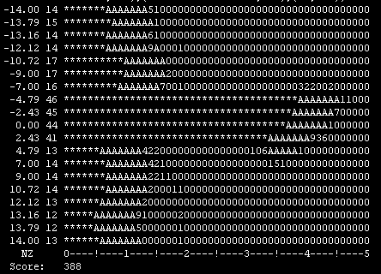
DA result with downhill simplex method (first try)
Only changes sextupoles strengths
Result selected from many outputs
Corresponding sextupole setup not recorded
Trying to use quadrupole and sextupole at the same time
Modify code(thousands of lines), needs time
Coupling : 0.003

Slide 5
Goal of Pretzel design in CDR
Realize beam separation of 50 bunches
Complete the correction of orbit effect
Reasonable DA w/o FFS
Reasonable DA w/o FFS with sawtooth effect
Try DA w/ FFS, error
Beam beam and injection needs to talk to other people

Slide 6
Timeline of Pretzel design in CDR
Realize beam separation of 50 bunches (done)
Complete the correction of orbit effect (done)
Reasonable DA w/o FFS (next one-three month ?)
Reasonable DA (w/o) FFS with sawtooth effect (~2day )
Try DA w/ FFS (will try when code is ready, maybe parrallel with 3), error(depending on time)
Beam beam and injection needs to talk to other people

Slide 7
Challenges in pretzel design
Off center orbit effect will break the periodicity of betatron and dispersion, thus the ideal cancellation of driving terms disapprear
Coupling between quadrupoles and sextupoles makes the adjustment of tune and chromaticity coupled together
Off center orbit in quadrupoles and sextupoles also generate extra bending fields, which makes the orbit and dispersion also couples with tune and chromaticity
No existing DA optimization code deals with such complicated issues (to my knowledge), code developing needed
Multiple objective code development needed
Lack of experience

Slide 8
Summary
DA seems promising with Downhill simplex method
Efforts mainly focus on DA optimization
Will also try Zhang Yuan’s multi-objective code
More time and man power needed

