Slide 1
Overview of MDI design II
Sha Bai
CEPC AP meeting
2016-06-17

Slide 2
MDI outline
IR Layout
Solenoid compensation
Superconducting magnet
Background
Collimator
Shielding
Luminosity calorimeter
Vertex detector
Mechanics……

Slide 3
Machines
Double ring with crossing angle: BEPCII, SuperKEKB, FCC-ee, CEPC……
Single ring with pretzel: LEP, CESR, CEPC……
Linear collider: ILC, CLIC, TESLA……

Slide 4
Comparison of MDI design parameters
 | BEPCII | SuperKEKB | FCC-ee | CEPC | LHC | SppC | LEP | CESR
Energy | 1.89GeV | 4.0/7.0GeV | 175GeV | 120GeV | 7TeV | 35TeV | 91GeV | 1.5-5.6GeV
Crossing-angle | 22mrad | 83mrad | 30mrad | 30mrad | 285urad | 146urad | 0mrad | 3.5mrad
L* | 1m | 0.7m | 2.2m | 1.5m | 22.965m | 34m | 1m | 0.437m
Solenoid central field | 1.0T | 1.5T | 2T | 3.5T | 4T@CMS 2T@ATLAS |  | 1.658T | 1.5T @Ebeam<4GeV 1T @Ebeam<2GeV
Solenoid effective length | 3.68m | 2.4m | 12m | 7.6m | 13m |  | 6.56m | 3.51m

Slide 5
Compensation principle – skew quads
Solenoid longitudinal field introduces x-y coupling, add skew quadrupoles to cancel the coupling.
The coupling coefficients is given:
In thin lens approximation for skew quads:
Denoting the coupling coefficients arising from skew quads and solenoids by

Slide 6
LEP solenoid compensation
Putting two skew quadrupoes SQ13 and SQ14 on the left hand side, with opposed polarities, doubles the imaginary contribution as expected for the solenoid compensation and extinguishes the real components, so that no coupling propagates in the lattice.

Slide 7
LEP solenoid compensation
For the “high” luminosity insertion, an ideal position for a compensator would be where
In order to have no real components and opposed imaginary vectors for the two resonances.
In the “low” luminosity insertion, there is no position as figure1 where the above one satisfied, thus, find two positions on one side such that:

Slide 8
CESR Interaction region and solenoid compensation

Slide 9
CESR anti-solenoid magnets
compensating solenoid (length ~95cm and B-field ~1.85T), placed in the straight reserved
for the round beam quad, (3.75 to 4.7m from the IP)

Slide 10
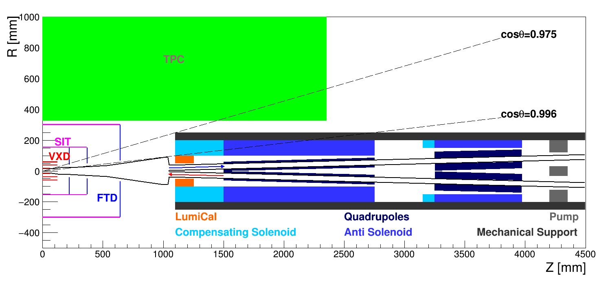
CEPC anti-solenoid design I

Slide 11
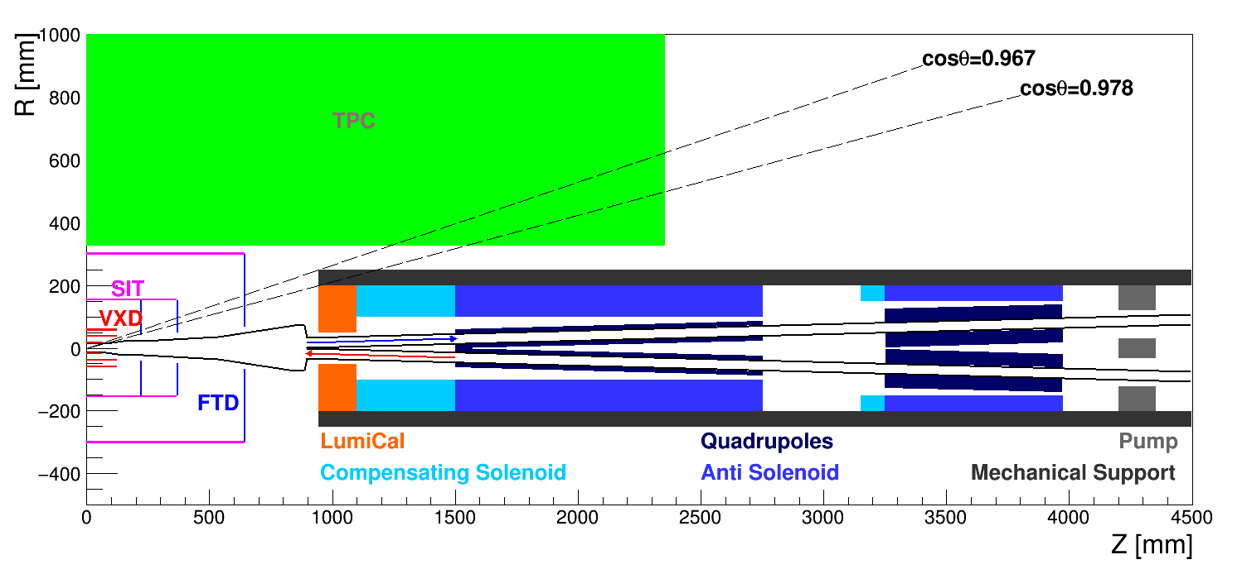
CEPC anti-solenoid design II

Slide 12
References
LEP Design report.
G. Guignard, et al., “Linear coupling compensation in the long straight sections of LEP”, LEP-70/55, 3.4.1978.
G. Guignard, et al., “Measurement and compensation of the solenoid effects in LEP”, Proceedings of EPAC1990_1432.
G. Guignard, et al., “Revised schemes of skew quadrupoles for solenoid compensation in LEP”, LEP Report -70/75, 1978.
S. Peggs, et al. “The projection approach to solenoid compensation”,Particle Accelerators 1982 Vol.12 pp. 219-229.
Y. Nosochkov, et al., “Detector solenoid compensation in the PEP-II B-Factory”, SLAC-PUB-95-6890, LBL-37227.
Y. Nosochkov and A. Seryi, “Compensation of detector solenoid effects on the beam size in a linear collider”, PRSTAB 8, 021001(2005).

