Slide 1
CEPC injector beam dynamics
Guoxi Pei , Xiaoping Li, Shilun PEI, Jingru Zhang, Cai MENG, Xiangjian Wang
Institute of High Energy Physics, CAS, Beijing

Slide 2
Main parameters of Injector
Parameter | Symbol | Unit | Value
e⁻ /e⁺ beam energy | E_{e-}/E_{e+} | GeV | 6
Repetition rate | f_{rep} | Hz | 50
e⁻ /e⁺ bunch population @ 6 GeV | Ne-/Ne₊ |  | 2×10¹⁰
Energy spread (e⁻ /e⁺ ) | σ_{E} |  | <1×10⁻³
Emitance (e⁻ /e⁺ ) |  |  | 0.3 mm⋅ mrad
e⁻ beam energy on Target |  | GeV | 4
e⁻ bunch charge on Target |  | nC | 10

Slide 3
Layout of Injector
Injection time
Accelerating gradient@ different section: different accelerating tube
SLED (200 MeV-1.1GeV without SLED, Gradient?)
1.1 GeV damping ring

Slide 4
Capture RF system of positron
SuperKEKB
CEPC
80 MW
可以用到多高的梯度？
按照scale，可以用到20 MV/m
40 MW

Slide 5
Positron capture
r=15 mm
18 MV/m

Slide 6
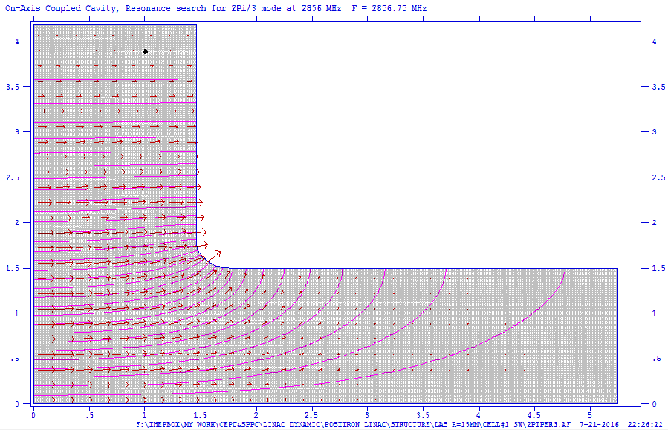
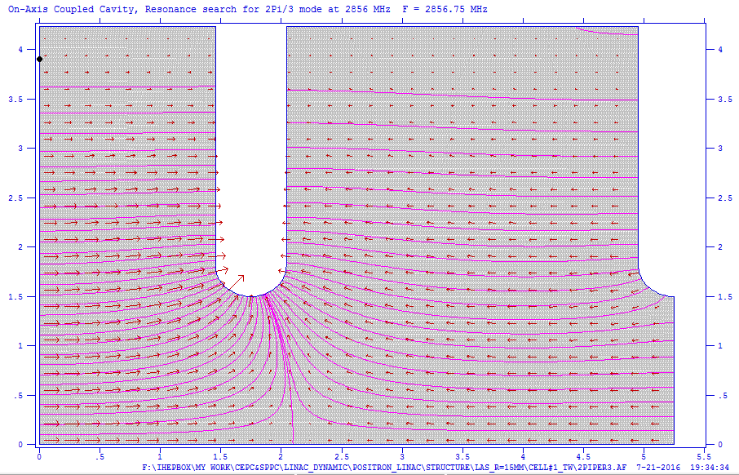
Large aperture accelerating tube

Slide 7
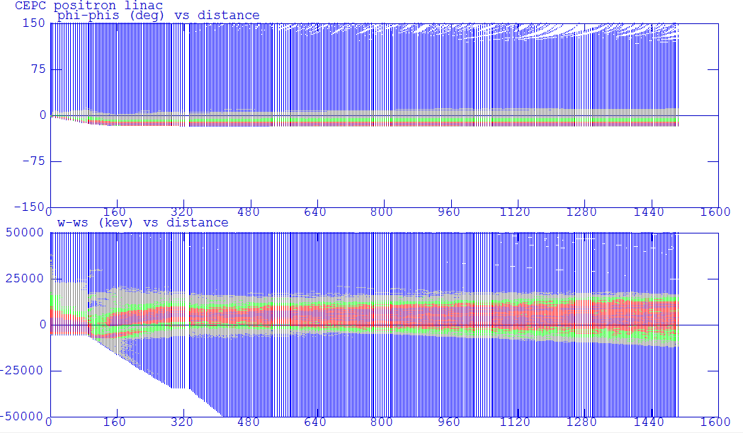
Beam envelope

Slide 8
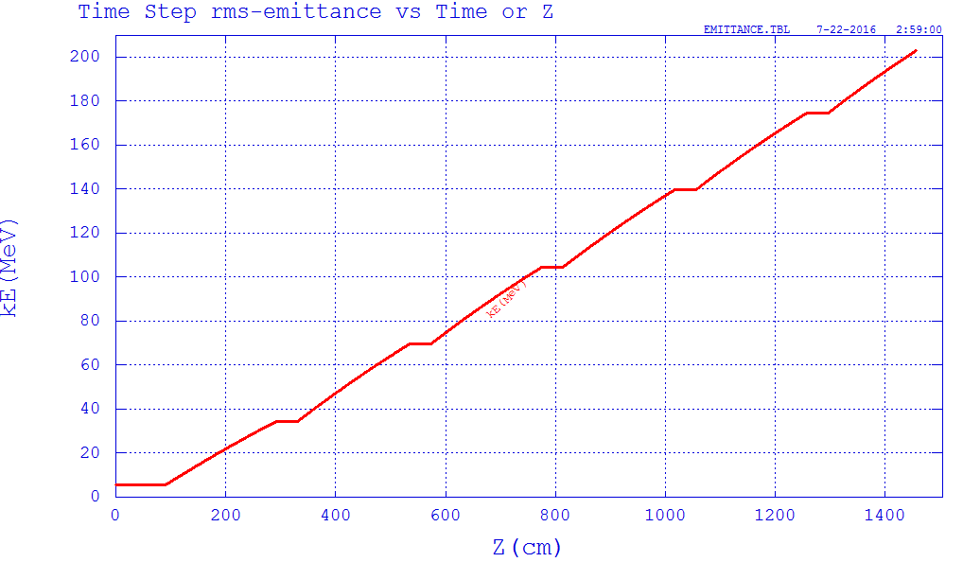
Emittance & Energy

Slide 9
Beam loss

