Slide 1
APDR SRF analysis
Zhenchao LIU
2016-7-22

Slide 2
Outline
APDR SRF scheme
Cavity requirement
Phase and voltage analysis
CEPC SRF of 2PDR&DR

Slide 3
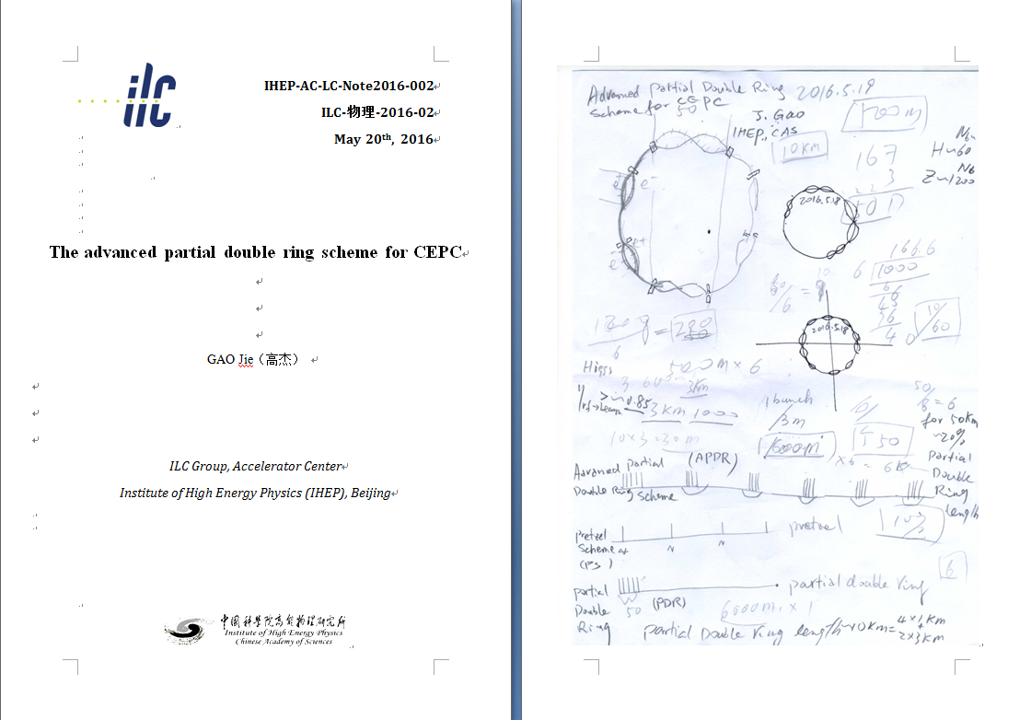
New idea：APDR

Slide 4
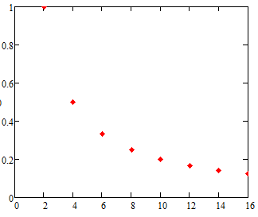
What is the best number of PDR?
There are 2n PDR in the circumference（n=1,2…).
Assume the voltage decrease in the 2 PDR design is a.
The voltage decrease in the 2n PDR design is a/n.
Voltage decrease(a=1)
Number of PDR

Slide 5
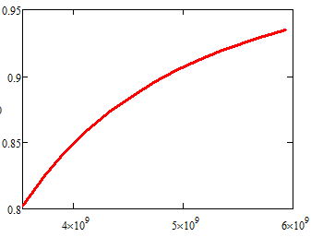
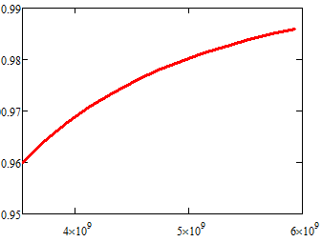
What is the best voltage?
R/Q=Vc^2/ωU, assume P_{pulse}>>P_{cw}
d, cavity effective length, q bunch charge, N_{b} bunches per train, N_{cav} cavity number.
H-low power case:
q=42.8nC,Vsr=2.96GV, N_{cav} =384
Assume matching
V_{c}’/V_{c}
N_{b}=50
V_{c}’/V_{c}
N_{b}=11
V_{RF} (GV)
V_{RF} (V)

Slide 6
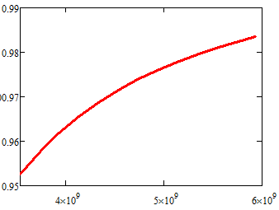
What is the best voltage?
R/Q=Vc^2/ωU, assume P_{pulse}>>P_{cw}
d, cavity effective length, q bunch charge, N_{b} bunches per train, N_{cav} cavity number.
H-low power case:
Nb=11,q=42.8nC,Vsr=2.96GV,
Assume matching
N_{cav} =498
N_{cav} =384
V_{c}’/V_{c}
V_{c}’/V_{c}
Working V_{RF}
Working V_{RF}
V_{RF} (V)
V_{RF} (V)

Slide 7
Phase
The bunches in a bunch train will be accelerated at different Vc_{i}
The bunches in a bunch train will be accelerated at different synchrotron phase to keep constant energy gain.
Va_{i}=Vc_{i}*cosϕs_{i}=C

Slide 8
New SRF layout
IP1
RF station
Double Ring
(1km/3km)
C≈60km
RF&DR center 30°equispaced
IP3

Slide 9
bunch
3.3us
t
26.7us

Slide 10
Wangdou20160219
 | Pre-CDR | H-high lumi. |  | H-low power |  | Z
Number of IPs | 2 | 2 |  | 2 |  | 2
Energy (GeV) | 120 | 120 |  | 120 |  | 45.5
Circumference (km) | 54 | 54 |  | 54 |  | 54
SR loss/turn (GeV) | 3.1 | 2.96 |  | 2.96 |  | 0.062
Half crossing angle (mrad) | 0 | 14.5 | 15 | 11.5 | 15 | 15
Piwinski angle | 0 | 2 | 2.5 | 2 | 2.6 | 8.5
N_{e}/bunch (10¹¹) | 3.79 | 3.79 | 2.85 | 2.81 | 2.67 | 0.46
Bunch number | 50 | 50 | 67 | 40 | 44 | 1100
Beam current (mA) | 16.6 | 16.9 | 16.9 | 10.1 | 10.5 | 45.4
SR power /beam (MW) | 51.7 | 50 | 50 | 30 | 31.2 | 2.8
Bending radius (km) | 6.1 | 6.2 | 6.2 | 6.2 | 6.2 | 6.1
Momentum compaction (10⁻⁵) | 3.4 | 3.0 | 2.5 | 2.6 | 2.2 | 3.5
β_{IP} x/y (m) | 0.8/0.0012 | 0.306/0.0012 | 0.25/0.00136 | 0.22/0.001 | 0.268 /0.00124 | 0.08/0.001
Emittance x/y (nm) | 6.12/0.018 | 3.34/0.01 | 2.45/0.0074 | 2.67/0.008 | 2.06 /0.0062 | 0.62/0.002
Transverse σ_{IP} (um) | 69.97/0.15 | 32/0.11 | 24.8/0.1 | 24.3/0.09 | 23.5/0.088 | 7/0.046
ξ_{x}/IP | 0.118 | 0.04 | 0.03 | 0.04 | 0.032 | 0.005
ξ_{y}/IP | 0.083 | 0.11 | 0.11 | 0.11 | 0.11 | 0.084
V_{RF} (GV) | 6.87 | 3.7 | 3.62 | 3.6 | 3.53 | 0.12
f _{RF} (MHz) | 650 | 650 | 650 | 650 | 650 | 650
Nature σ_{z} (mm) | 2.14 | 3.3 | 3.1 | 3.2 | 3.0 | 3.9
Total σ_{z} (mm) | 2.65 | 4.4 | 4.1 | 4.2 | 4.0 | 4.0
HOM power/cavity (kw) | 3.6 | 3.3 | 2.2 | 1.5 | 1.3 | 0.99
Energy spread (%) | 0.13 | 0.13 | 0.13 | 0.13 | 0.13 | 0.05
Energy acceptance (%) | 2 | 2 | 2 | 2 | 2
Energy acceptance by RF (%) | 6 | 2.2 | 2.2 | 2.2 | 2.1 | 1.1
n_{γ} | 0.23 | 0.49 | 0.47 | 0.47 | 0.47 | 0.27
Life time due to beamstrahlung_cal (minute) | 47 | 53 | 36 | 41 | 32
F (hour glass) | 0.68 | 0.73 | 0.82 | 0.69 | 0.81 | 0.95
L_{max}/IP (10³⁴cm⁻²s⁻¹) | 2.04 | 2.97 | 2.96 | 2.03 | 2.01 | 3.61

Slide 11
6 double ring | Pre-CDR Zhaijiyuan20160327 | PDR(HL) Zhaijiyuan20160327&0408 | APDR(HL V_{RF}=3.62) | APDR (H-low power) | APDR (Z)
Number of IPs | 2 | 2 | 2 | 2 | 2
Energy (GeV) | 120 | 120 | 120 | 120 | 45.5
Circumference (km) | 54 | 54 | 54 | 54 | 54
SR loss/turn (GeV) | 3.1 | 2.96 | 2.96 | 2.96 | 0.062
Half crossing angle (mrad) | 0 | 15 | 15 | 15 | 15
Piwinski angle | 0 | 2.5 | 2.5 | 2.6 | 8.5
N_{e}/bunch (10¹¹) | 3.79 | 2.85 | 2.85 | 2.67 | 0.46
Bunch number | 1 | 1 | 22x3 | 15x3 | 367x3
Beam current (mA) | 16.6 | 16.96 | 17 | 10.5 | 45.4
SR power /beam (MW) | 53.2 | 51 | 50 | 31.2 | 2.8
Bending radius (km) | 6.1 | 6.2 | 6.2 | 6.2 | 6.1
V_{RF} (GV) | 6.87 | 3.65 | 3.62 | 5.16 | 0.357
f _{RF} (MHz) | 650 | 650 | 650 | 650 | 650
Cavity No. | 384 | 384 | 384 | 498 | 48
Cavity gradient | 15.8 | 20.6 | 20.6 | 22.6 | 16.2
Accelerating phase | 63.1 | 35.2 | 35.2-32.3 | 55.5-55 | 80.2-79.8
CW power/cavity （kW） | 275 | 263.4 | 260 | 126 | 117
Peak power/train (kW) | / | 2220 | 2345 | 1148 | 1237
Total Power （MW) | 105.6 | 382.5 | 100.4 | 62.7 | 5.6
Cell/cavity | 5 | 2 | 2 | 2 | 2
Cavity/module | 4 | 6 | 8 | 4(3) | 4
Module/station | 6 | 10 | 8 | 21 | 2
Total module | 96 | 64 | 48 | 126 | 12
R/Q (Ω) | 514 | 206 | 206 | 206 | 206
G | 268 | 268 | 268 | 268 | 268
HOM loss factor/cavity (V/pC) | 1.8 | 0.54 | 0.54 | 0.54 | 0.54
HOM power/cavity (kW) | 3.6 | 0.8 | 0.838 | 0.485 | 0.361
Working Temperature（K） | 2 | 2 | 2 | 2 | 2
Q0 | 4E10 | 2E10 | 2E10 | 2E10 | 2E10
τ（ms） | 1.156 | 0.097 | 0.811 | 2.045 | 2.243
QL | 2.36e6 | 1.97e5 | 1.656e6 | 4.18e6 | 4.58e6
Bandwidth(kHz) | 0.28 | 3.3 | 0.196 | 0.077 | 0.071
Detuning F (kHz) | -0.27 | -1.16 | -0.138 | -0.111 | -0.234
Stored energy/cavity(J) | 158.7 | 107.4 | 107.4 | 126.9 | 65.3
Frev(kHz) | 5.484 | 5.484 | 5.484 | 5.484 | 5.484
Gap length (us) | / | 0.3-160 | 26.7 | 26.7 | 26.7
η(RF to beam efficiency)(%) | 100 | 27% | ~100 | ~100 | ~100
Vc decrease(%) | / | / | 3.3 | 1.3 | 2.5
TB/τ | / | 1.7 | 0.0158 | 0.013 | 0.012

Slide 12
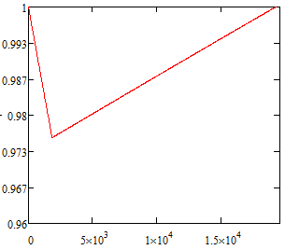
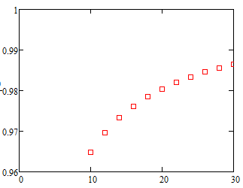
Accelerator gradient decrease in one RF cavity (Z)
Bunch train passing
Bunch train space
Assume matching
Final Eacc/Initial Eacc
Final Eacc/Initial Eacc
Initial Eacc(MV/m)
RF cycles
Field evolution in cavity
Field decrease vs. various initial field gradient of the cavity

Slide 13
New SRF layout
IP1
RF station
Double Ring
(1km/3km)
C≈62km
RF&DR center 22.5°equispaced
IP3

Slide 14
bunch
3.3us
t
20us

Slide 15
8 double ring | Pre-CDR Zhaijiyuan20160327 | PDR(HL) Zhaijiyuan20160327&0408 | APDR(HL) | APDR(HL V_{RF}=3.62) | APDR (H-low power V_{RF}=3.53) | APDR (H-low power) | APDR (Z)
Number of IPs | 2 | 2 | 2 | 2 | 2 | 2 | 2
Energy (GeV) | 120 | 120 | 120 | 120 | 120 | 120 | 45.5
Circumference (km) | 54 | 54 | 54 | 54 | 54 | 54 | 54
SR loss/turn (GeV) | 3.1 | 2.96 | 2.96 | 2.96 | 2.96 | 2.96 | 0.062
Half crossing angle (mrad) | 0 | 15 | 15 | 15 | 15 | 15 | 15
Piwinski angle | 0 | 2.5 | 2.5 | 2.5 | 2.6 | 2.6 | 8.5
N_{e}/bunch (10¹¹) | 3.79 | 2.85 | 2.85 | 2.85 | 2.67 | 2.67 | 0.46
Bunch number | 1 | 1 | 17x4 | 17x4 | 11x4 | 11x4 | 275x4
Beam current (mA) | 16.6 | 16.96 | 17 | 17 | 10.5 | 10.5 | 45.4
SR power /beam (MW) | 53.2 | 51 | 50 | 50 | 31.2 | 31.2 | 2.8
Bending radius (km) | 6.1 | 6.2 | 6.2 | 6.2 | 6.2 | 6.2 | 6.1
V_{RF} (GV) | 6.87 | 3.65 | 5.16 | 3.62 | 3.53 | 5.16 | 0.357/0.12/0.12
f _{RF} (MHz) | 650 | 650 | 650 | 650 | 650 | 650 | 650
Cavity No. | 384 | 384 | 498 | 384 | 384/768/192 | 498 | 48/16/16
Cavity gradient | 15.8 | 20.6 | 22.6 | 20.6 | 20/20/20 | 22.6 | 16.2/16.3/32.6
Accelerating phase | 63.1 | 35.2 | 55.3-55 | 35.2-33 | 33-31.6/33-31.6/33-31.6 | 55.3-55 | 80.1-79.9/58.9-56.9/58.9-58
CW power/cavity （kW） | 275 | 263.4 | 201 | 260 | 163.3/81.6/326.6 | 126 | 117/350/350
Peak power/train (kW) | / | 2220 | 1389 | 1389 | 843 | 843 | 884
Total Power （MW） | 105.6 | 382.5 | 100.4 | 100.4 | 62.7 | 62.7 | 5.6
Cell/cavity | 5 | 2 | 2 | 2 | 2/1/4 | 2 | 2/2/1
Cavity/module | 4 | 6 | 6(3,2) | 6 | 6/12/3 | 6(3,2) | 6/2/2
Module/station | 6 | 10 | 10(11） | 8 | 8/8/8 | 10(11） | 1/1/1
Total module | 96 | 64 | 126 | 64 | 64/64/64 | 126 | 8/8/8
R/Q (Ω) | 514 | 206 | 206 | 206 | 206/103/412 | 206 | 206/206/103
G | 268 | 268 | 268 | 268 | 268 | 268 | 268
HOM loss factor/cavity (V/pC) | 1.8 | 0.54 | 0.54 | 0.54 | 0.54/0.27/1.08 | 0.54 | 0.54/0.54/0.27
HOM power/cavity (kW) | 3.6 | 0.8 | 0.838 | 0.838 | 0.485/0.24/0.97 | 0.485 | 0.36/0.36/0.18
Working Temperature（K） | 2 | 2 | 2 | 2 | 2 | 2 | 2
Q0 | 4E10 | 2E10 | 2E10 | 2E10 | 2E10 | 2E10 | 2E10
τ（ms） | 1.156 | 0.097 | 1.263 | 0.811 | 1.242 | 2.045 | 2.243/0.76/0.76
QL | 2.36e6 | 1.97e5 | 2.579e6 | 1.656e6 | 2.53e6 | 4.18e6 | 4.58e6/1.55e6/1.55e6
Bandwidth(kHz) | 0.28 | 3.3 | 0.126 | 0.196 | 0.128 | 0.077 | 0.071/0.209/0.209
Detuning F (kHz) | -0.27 | -1.16 | -0.180 | -0.138 | -0.083 | -0.111 | -0.234/-0.347/-0.347
Stored energy/cavity(J) | 158.7 | 107.4 | 126.9 | 107.4 | 100 | 126.9 | 65.3/65.3/133
Frev(kHz) | 5.484 | 5.484 | 5.484 | 5.484 | 5.484 | 5.484 | 5.484
Gap length TB (us) | / | 0.3-160 | 20 | 20 | 20 | 20 | 20
η(RF to beam efficiency)(%) | 100 | 27% | ~100 | ~100 | ~100 | ~100 | ~100
Vc decrease(%) | / | / | 1.6 | 2.5 | 1.6 | 1 | 1.7/5.3/2.5
TB/τ | / | 1.7 | 0.0158 | 0.025 | 0.0098 | 0.0098 | 0.0089/0.0263/0.0263

Slide 16
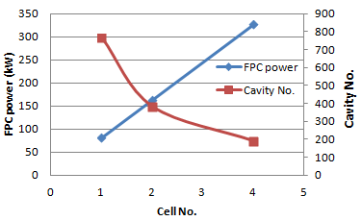
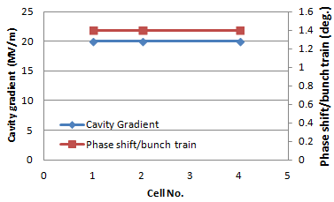
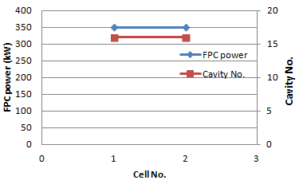
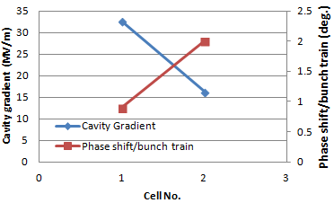
8 DR H-Low power mode
8 DR H-Low power mode
8 DR Z mode
8 DR Z mode

Slide 17
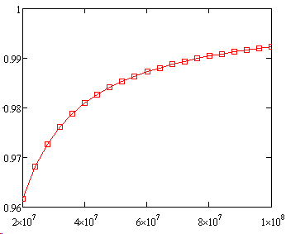
LEP
Assume:
φ_{e}= 1deg., φ_{s}=116deg., φ_{align}=3deg., I_{b}=0.45mA, h=31324, Q=40000, R_{s}=774MΩ（14 cavities）
V₀ (initial peak voltage)from 20MV-100MV
2.3MV/cavity(acc. voltage)
Voltage decrease:
V_{left}/V₀
1 bunch ~1%
4 bunches ~4%
APDR:
8 DR: 2.5%(HL)5.3/2.5%(Z)
6 DR: 3.3%(HL)
V₀(V)
Voltage drop seems acceptable!

Slide 18
CEPC APDR SRF Design
APDR SRF Challenge | Difficulty | Methods | CDR
Phase stability | ☆☆☆ | Feedback control, injection control, phase stability, SR damping,… | ±0.1%
Voltage control | ☆☆☆ | Feedback control, | ±1%
BBU | ☆☆ | Variation on bunch current, Low wake field excitation at bunch train length, High damping SC cavity, Radiation damping(wiggler), bunch spacing, feedback,… | >500mA (Z>1A)
HOM damping | ☆☆ | Single cell beam pipe/slotted cavity(multi-cell) | 1-3kW
Longitudinal instability | ☆☆
Transverse instability | ☆☆
Impact bunch position control | ☆☆☆
Input coupler | ☆☆ |  | 130kW(1cell),260kW(2cell); Z:350kW(2cell),175kW(1cell)
Q₀ | ☆☆ | EP is very important | 2E10
Cavity gradient | ☆☆☆ | 20.6MV/m&Q₀=2E10@2K (☆☆) 32.6MV/m&Q₀=2E10@2K (☆☆☆, lower the Q₀) | H mode:2E10 Z mode:> 5E9

Slide 19
Brief summary
The 8-double ring and 6-double ring seem available when using the same parameter as PDR(V_{RF}=3.62GV) for HL. The 8-double ring has a lower phase variation than the 6-double ring .
The phase region is from 35.2-33 degree for bunches in a bunch train for the 8-double ring HL mode. The phase region is from 35.2-32.3 degree for the 6-double ring HL mode.
The bunch energy gain in each cavity is constant.
The RF to beam efficiency is ~100%.

Slide 20
Cavity requirement

Slide 21
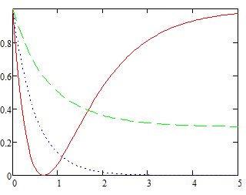
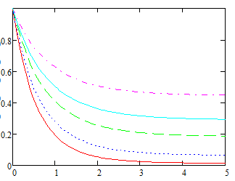
What is the best β？
β=4366
β=
β=0.3
P-/P+
P-/P+
0.2
0.3
0.4
β=1
0.6
0.8
t/τ
t/τ
P-, reflection power; P+, forward power.

Slide 22
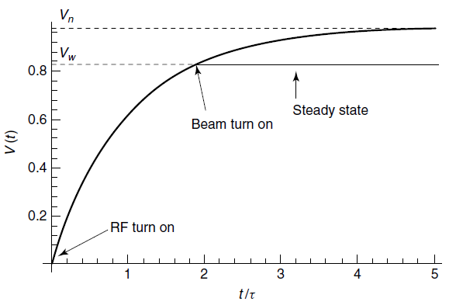

Slide 23
What is the best cavity for APDR?
R/Q=Vc²/ωU
A lower R/Q can give a high U at the same cavity voltage (or gradient)
The gradient is more stable at higher U when the input power is not enough at the pulse period.
It is an opposite design scheme comparing with low-loss cavity or others
Reduced R/Q can also decrease the detuning frequency
R/Q Riris loss factor
Cavity can work at a lower gradient with the same U

Slide 24
Phase and voltage analysis

Slide 25
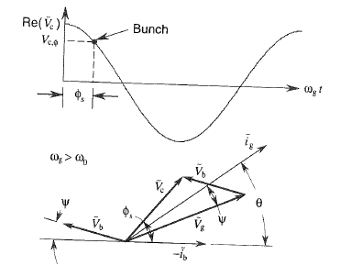
Power coupling
Phasor diagram
φ_{s}≠0 &ω_{g>}ω₀

Slide 26
Optimum coupling
With optimum coupling condition
ig
Vb
Vc
ψ
ϕs
ib
Vg
Ψ=-ϕs

Slide 27
Equispaced bunches
For equispaced bunches:
Consider H-Low power case, I₀=0.021mA,R_{a}=206x2x10¹⁰, beta=7.9x10³, ψ=-33deg.=-0.576
The amplitude of V_{b} is 9.2MV
V_{c}=20MV/m*0.46m=9.2MV, ϕ_{s}=0.576
V_{b}=0.021x206x2x10¹⁰xcos(-0.576)e^{-0.576i}/(1+7.9x10³)=-7.7x10⁶+5x10⁶i
Abs(V_{b})=9.2MV
Angle(V_{b})=-0.576
So, V_{b}=V_{c} & ψ=-ϕ_{s}

Slide 28
APDR bunches
Bunch train case, Tb is the bunch time interval in bunch train; TB is the time interval between bunch trains.
T_{b}≠T_{B}.
Tb<<TB&TB/td<<1
Tb/td=2.428e-4, TB/td=0.016, ϕs=33deg., f=650MHz
Tb
TB

Slide 29
What is beam loading？
It is not a beam in the cavity!!!
It is the beam induced voltage in the cavity!!!
When TB/Td<<1, the multi-bunches induced a constant V_{b}

Slide 30
Optimum coupling
With optimum coupling condition (H low power 8ring)
ig
Vb=9.2MV
Vc=9.2MV
ψ
ϕs
V_{b11}
ib
Vg=15.43MV
1.37°
V_{b1}
Ψ=-ϕs

Slide 31
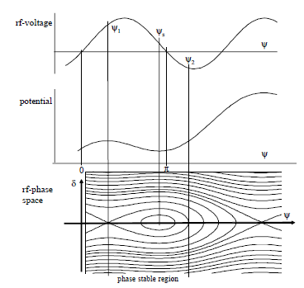
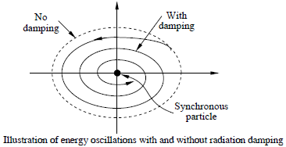
Bunch position
The e+ and e- bunch trains should be symmetry to the two IPs.
The phase shift of the synchrotron phase between each bunch in a bunch train is 0.14 degree for the H low power mode. The total phase shift is 1.4 degree.
After enough synchrotron damping, the bunches will be at its synchrotron phase separately.
If the transport matrix from cavity to IP is the same for e+ and e- bunch trains, there will be no shift for the position of colliding.
RADIATION DAMPING, R.P. Walker

Slide 32
Non-equispaced bunches
Consider H-Low power case, it is equal to 11x4bunches, I₀=0.021mA/11=1.91x10⁻³mA, R_{a}=206x2x10¹⁰, beta=7.9x10³, ψ=-33deg.=-0.576, f=650MHz, t’_{b}=196x77/f=2.322x10⁻⁵s, Q₀=2x10¹⁰
Phase shift is 1.4deg. with 11 bunches, the phase shift between two bunches is 0.14deg. m_{b}=196. So t_{b}=195.999611/f=3.015x10⁻⁷s.
Also we need to assume there is no phase shift between the first bunch of each bunch train.
0.14deg.
.
.
Bunch 1
Bunch 2
….
….
196x2π

Slide 33
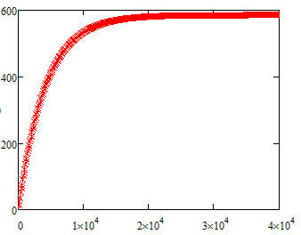
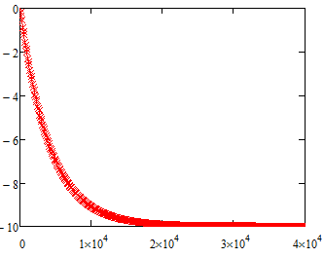
V_{br}=V_{ih}*A
65 circles
~0.012s
Im(A)
Re(A)
T (t_{b})
T (t_{b})
One circle=308t_{b}

Slide 34
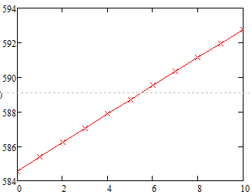
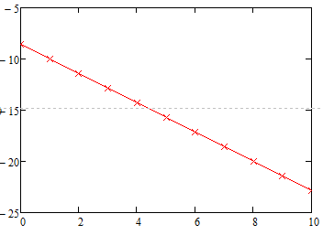
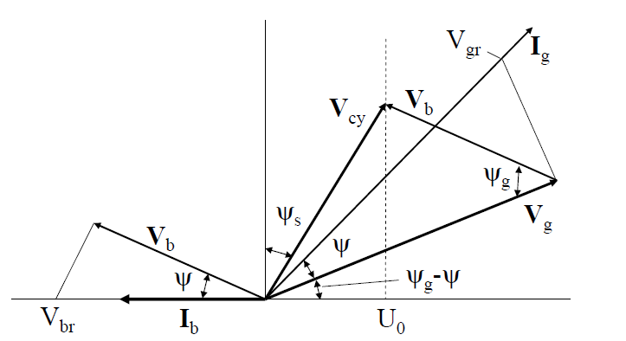
V_{br}=V_{ih}*A, A for bunches in a bunch train after 400000 circles.
Total phase shift of V_{b} is 1.37degree for 11 bunches.
Im(A)
Re(A)
Bunch
Bunch
V_{br} ≈ 1.865x10⁴Vx584.5=1.09x10⁷V
With optimum matching of minimum P_{g}, ψ=-ϕ_{s}
V_{b}=V_{br}cos(-33°)=9.14MV
As V_{c}=9.2MV, so V_{b}≈V_{c}

Slide 35
Vg
8-ring： Bunch No. | Re Vb | Im Vb | Re Vc | Im Vc | Re Vg | Im Vg | ABS Vg | Vg (%) | Vg Angle (deg.) | Vg Angle shift (deg.)
1 | -7.67E+06 | 4.98E+06 | 7.72E+06 | 5.01E+06 | 1.54E+07 | 3.05E+04 | 1.539E+07 | 1.0000 | 0.00 | 0
2 | -7.66E+06 | 5.00E+06 | 7.72E+06 | 4.99E+06 | 1.54E+07 | -6.31E+03 | 1.537E+07 | 0.9991 | -0.13 | 0
3 | -7.64E+06 | 5.02E+06 | 7.72E+06 | 4.97E+06 | 1.54E+07 | -4.31E+04 | 1.536E+07 | 0.9983 | -0.27 | 0
4 | -7.63E+06 | 5.03E+06 | 7.72E+06 | 4.95E+06 | 1.53E+07 | -7.98E+04 | 1.535E+07 | 0.9974 | -0.41 | 0
5 | -7.62E+06 | 5.05E+06 | 7.72E+06 | 4.94E+06 | 1.53E+07 | -1.16E+05 | 1.533E+07 | 0.9966 | -0.54 | 0
6 | -7.60E+06 | 5.07E+06 | 7.72E+06 | 4.92E+06 | 1.53E+07 | -1.53E+05 | 1.532E+07 | 0.9958 | -0.68 | 0
7 | -7.59E+06 | 5.09E+06 | 7.72E+06 | 4.90E+06 | 1.53E+07 | -1.89E+05 | 1.531E+07 | 0.9949 | -0.82 | 0
8 | -7.58E+06 | 5.10E+06 | 7.72E+06 | 4.88E+06 | 1.53E+07 | -2.26E+05 | 1.530E+07 | 0.9941 | -0.96 | 0
9 | -7.56E+06 | 5.12E+06 | 7.72E+06 | 4.86E+06 | 1.53E+07 | -2.62E+05 | 1.528E+07 | 0.9933 | -1.09 | 0
10 | -7.55E+06 | 5.14E+06 | 7.72E+06 | 4.84E+06 | 1.53E+07 | -2.98E+05 | 1.527E+07 | 0.9924 | -1.23 | 0
11 | -7.54E+06 | 5.16E+06 | 7.72E+06 | 4.82E+06 | 1.53E+07 | -3.34E+05 | 1.526E+07 | 0.9916 | -1.37 | 0

Slide 36
Phase evolution
With optimum coupling condition (H low power 8ring)
ig
Vb11
Vb1
Vc=9.2MV
Vc1
Vb=9.2MV
Vc11
ψ
ϕs
Vg1
Vg=15.43MV
ib
1.37degree
Vg11
Ψ=-ϕs

Slide 37
Bunch No. | Pre CDR (CW, P_{g}=P_{avg}) |  | PDR (CW, P_{g}=P_{pulse}, very low RF efficiency) |  | APDR 6 ring (H-low power, CW, P_{g}=P_{avg}) |  | APDR 8 ring (H-low power, CW, P_{g}=P_{avg}) |  | APDR 8 ring (Z, P_{g}=P_{avg})
 | Vrf | Phase shift | Vrf | Phase shift | Vrf | Phase shift | Vrf | Phase shift | Vrf | Phase shift
1 | 1 | 0 | 1 | 0 | 1 | 0.00 | 1 | 0.00 | 1 | 0
2 | 1 | 0 | 1 | 0 | 0.9984 | -0.16 | 0.9984 | -0.14 | 0.9998 | -0.0073
3 | 1 | 0 | 1 | 0 | 0.9968 | -0.31 | 0.9968 | -0.28 | 0.9996 | -0.0145
4 | 1 | 0 | 1 | 0 | 0.9952 | -0.47 | 0.9952 | -0.42 | 0.9994 | -0.0218
5 | 1 | 0 | 1 | 0 | 0.9936 | -0.63 | 0.9936 | -0.56 | 0.9992 | -0.0291
6 | 1 | 0 | 1 | 0 | 0.992 | -0.79 | 0.992 | -0.70 | 0.9990 | -0.0364
7 | 1 | 0 | 1 | 0 | 0.9904 | -0.94 | 0.9904 | -0.84 | 0.9988 | -0.0436
8 | 1 | 0 | 1 | 0 | 0.9888 | -1.10 | 0.9888 | -0.98 | 0.9987 | -0.0509
9 | 1 | 0 | 1 | 0 | 0.9872 | -1.26 | 0.9872 | -1.12 | 0.9985 | -0.0582
10 | 1 | 0 | 1 | 0 | 0.9856 | -1.41 | 0.9856 | -1.26 | 0.9983 | -0.0655
11 | 1 | 0 | 1 | 0 | 0.984 | -1.57 | 0.984 | -1.40 | 0.9981 | -0.0727
15 | 1 | 0 | 1 | 0 | 0.9776 | -2.20 |  |  | 0.9973 | -0.1018
50 | 1 | 0 | 1 | 0 |  |  |  |  | 0.9906 | -0.3564
67 |  |  | 1 | 0 |  |  |  |  | 0.9873 | -0.4800
275 |  |  |  |  |  |  |  |  | 0.0947 | -2.0
Assume V_{rf} is constant at the first bunch of bunch trains and the change of V_{b} is negligible.

Slide 38
Brief summary
V_{b} is 9.14MV with a 1.37deg. phase shift in a bunch train of the APDR H low power of 8 ring case.
The V_{b} of APDR is about the same as equispaced bunches (for simplicity).
V_{b} reaches constant value after about 65 circles (I_{b}=C, ~0.012s).
Beam can be stored by increasing bunch charges stably (with reflection in low current).
V_{c} should keep constant phase and value for each bunch separately.

Slide 39
CEPC SRF of 2PDR&DR

Slide 40
SRF layout of 2PDR
IP1
RF station
C≈54km
RF center 180°equispaced
IP3

Slide 41
Bunch
Bunches passed in the cavity:
44
44
…
…
t
2us
2us
2us→610m

Slide 42
2 double ring | APDR (H-low power V_{RF}=3.53)
Number of IPs | 2
Energy (GeV) | 120
Circumference (km) | 54
SR loss/turn (GeV) | 2.96
Half crossing angle (mrad) | 15
Piwinski angle | 2.6
N_{e}/bunch (10¹¹) | 2.67
Bunch number | 44
Beam current (mA) | 10.5
SR power /beam (MW) | 31.2
Bending radius (km) | 6.2
V_{RF} (GV) | 3.53
f _{RF} (MHz) | 650
Cavity No. | 384/768/192
Cavity gradient | 20/20/20
Accelerating phase | 33/33/33
CW power/cavity （kW） | 163.3/81.6/326.6
Total Power （MW） | 62.7
Cell/cavity | 2/1/4
Cavity/module | 6/12/3
Module/station | 32/32/32
Total module | 64/64/64
R/Q (Ω) | 206/103/412
G | 268
HOM loss factor/cavity (V/pC) | 0.54/0.27/1.08
HOM power/cavity (kW) | 0.485/0.24/0.97
Working Temperature（K） | 2
Q0 | 2E10
τ（ms） | 1.242
QL | 2.53e6
Bandwidth(kHz) | 0.128
Detuning F (kHz) | -0.083
Stored energy/cavity(J) | 100
Frev(kHz) | 5.484
Tb (us) | 2
η(RF to beam efficiency)(%) | ~100
Vc decrease(%) | 0
Tb/τ | 0.00098

Slide 43
SRF layout of DR
IP1
RF station
C≈54km
RF center 180°equispaced
e+ and e- pass the same RF cavity
IP3
Two rings use the same RF station
4 half RF stations of full double ring

Slide 44
bunch
Bunches passed in the cavity:
88
…
…
t
2us
2us
2us→610m

Slide 45
Full double ring | DR (H-low power V_{RF}=3.53)
Number of IPs | 2
Energy (GeV) | 120
Circumference (km) | 54
SR loss/turn (GeV) | 2.96
Half crossing angle (mrad) | 15
Piwinski angle | 2.6
N_{e}/bunch (10¹¹) | 2.67
Bunch number | 44
Beam current (mA) | 10.5
SR power /beam (MW) | 31.2
Bending radius (km) | 6.2
V_{RF} (GV) | 3.53
f _{RF} (MHz) | 650
Cavity No. | 384/768/192
Cavity gradient | 20/20/20
Accelerating phase | 33/33/33
CW power/cavity （kW） | 163.3/81.6/326.6
Total Power （MW） | 62.7
Cell/cavity | 2/1/4
Cavity/module | 6/12/3
Module/station | 32/32/32
Total module | 64/64/64
R/Q (Ω) | 206/103/412
G | 268
HOM loss factor/cavity (V/pC) | 0.54/0.27/1.08
HOM power/cavity (kW) | 0.485/0.24/0.97
Working Temperature（K） | 2
Q0 | 2E10
τ（ms） | 1.242
QL | 2.53e6
Bandwidth(kHz) | 0.128
Detuning F (kHz) | -0.083
Stored energy/cavity(J) | 100
Frev(kHz) | 5.484
Tb (us) | 2
η(RF to beam efficiency)(%) | ~100
Vc decrease(%) | 0
Tb/τ | 0.00098
The parameters can be the same as 2 PDR case

Slide 46
Brief summary
The RF power needed of the 2PDR expanding to half ring is the same as double ring.
Both cases working at CW mode, so the RF parameters are the same.
Bunches are equispaced in the PDR or whole ring.
Multi-RF stations will have the RF parameters as 2 RF stations(4 half RF stations)
In the double ring, the e+ and e- use the same RF station to accelerate. If use different ones, the cavity number will be double and cavity parameters change accordingly.

Slide 47
Thanks!

