Slide 1
Lattice design for CEPC PDR
Yiwei Wang, Feng Su, Jie Gao
22th July 2016, CEPC AP meeting

Slide 2
CEPC primary parameter （wangdou20160325）
 | Pre-CDR | H-high lumi. | H-low power | W | Z
Number of IPs | 2 | 2 | 2 | 2 | 2
Energy (GeV) | 120 | 120 | 120 | 80 | 45.5
Circumference (km) | 54 | 54 | 54 | 54 | 54
SR loss/turn (GeV) | 3.1 | 2.96 | 2.96 | 0.59 | 0.062
Half crossing angle (mrad) | 0 | 15 | 15 | 15 | 15
Piwinski angle | 0 | 2.5 | 2.6 | 5 | 7.6
N_{e}/bunch (10¹¹) | 3.79 | 2.85 | 2.67 | 0.74 | 0.46
Bunch number | 50 | 67 | 44 | 400 | 1100
Beam current (mA) | 16.6 | 16.9 | 10.5 | 26.2 | 45.4
SR power /beam (MW) | 51.7 | 50 | 31.2 | 15.6 | 2.8
Bending radius (km) | 6.1 | 6.2 | 6.2 | 6.1 | 6.1
Momentum compaction (10⁻⁵) | 3.4 | 2.5 | 2.2 | 2.4 | 3.5
β_{IP} x/y (m) | 0.8/0.0012 | 0.25/0.00136 | 0.268 /0.00124 | 0.1/0.001 | 0.1/0.001
Emittance x/y (nm) | 6.12/0.018 | 2.45/0.0074 | 2.06 /0.0062 | 1.02/0.003 | 0.62/0.0028
Transverse σ_{IP} (um) | 69.97/0.15 | 24.8/0.1 | 23.5/0.088 | 10.1/0.056 | 7.9/0.053
ξ_{x}/IP | 0.118 | 0.03 | 0.032 | 0.008 | 0.006
ξ_{y}/IP | 0.083 | 0.11 | 0.11 | 0.074 | 0.073
V_{RF} (GV) | 6.87 | 3.62 | 3.53 | 0.81 | 0.12
f _{RF} (MHz) | 650 | 650 | 650 | 650 | 650
Nature σ_{z} (mm) | 2.14 | 3.1 | 3.0 | 3.25 | 3.9
Total σ_{z} (mm) | 2.65 | 4.1 | 4.0 | 3.35 | 4.0
HOM power/cavity (kw) | 3.6 | 2.2 | 1.3 | 0.99 | 0.99
Energy spread (%) | 0.13 | 0.13 | 0.13 | 0.09 | 0.05
Energy acceptance (%) | 2 | 2 | 2
Energy acceptance by RF (%) | 6 | 2.2 | 2.1 | 1.7 | 1.1
n_{γ} | 0.23 | 0.47 | 0.47 | 0.3 | 0.24
Life time due to beamstrahlung_cal (minute) | 47 | 36 | 32
F (hour glass) | 0.68 | 0.82 | 0.81 | 0.92 | 0.95
L_{max}/IP (10³⁴cm⁻²s⁻¹) | 2.04 | 2.96 | 2.01 | 3.09 | 3.09

Slide 3
Considerations on ARC lattice design
FODO cell, 90 ° /90 °
non-interleaved sextupole scheme
n=5
All 3rd and 4th RDT due to sextupoles cancelled
Amplitude-dependent tune shift is very small
Ncell= 120
LB= 19.96
Lcell= 47.92
theta= .0032188449319567555
Lring= 54820.479999999996
Nstr1= 18
Nstr2= 20
Vrfc= 220625000
frf= 6.5e+08

Slide 4
this lattice
H-low power wangdou20160325
NIP=2
Eng=120
Lring=54820.48
U0=2.933
thetaC=-
thetaP=-
Ne=2.67
Nb=44
Ib=.0105
Pbeam=30.800
rhoB=6200
alfap=-
bxstar=-
bystar=-
ex=2.094e-09
ey=0
sigxIP=-
sigyIP=-
ksix=-
ksiy=-
Vrf=3.53e+09
frf=6.5e+08
sigmaz=.00264
sigmazt=-
Phom=-
sigmae=.00130
eapt=-
eaptrf=-
ngamma=-
tbs=-
Fhg=-
Lmax=-
NIP=2 ! Number of IPs [1]
Eng=120 ! Energy [GeV]
Lring=54*1E3 ! Circumference [m]
U0=2.96 ! SR loss/turn [GeV]
thetaC=15 ! Half crossing angle [mrad] thetaP=2.6 ! Piwinski angle [1]
Ne=2.67 ! Ne/bunch [10^11] Nb=44 ! bunch number [1]
Ib=10.5*1e-3 ! Beam current[A]
Pbeam=31.2 ! SR power/beam [MW] rhoB=6.2*1e3 ! Bending radius [m]
alfap=2.2e-5 ! Momentum compaction [1] bxstar=0.268 ! beta x at IP [m]
bystar=0.00124 ! beta y at IP [m]
ex=2.06*1e-9 ! emittance x [m*rad]
ey=0.0062*1e-9 ! emittance y [m*rad]
sigxIP=23.5*1e-6 ! beam size x at IP [m]
sigyIP=0.088*1e-6 ! beam size y at IP [m] ksix=0.032 ! ksix/IP [1]
ksiy=0.11 ! ksiy/IP [1]
Vrf=3.53*1e9 ! Vrf [V]
frf=650*1e6 ! frf [Hz]
sigmaz=3.0 ! Nature sigmaz [mm]
sigmazt=4.0 ! Total sigmaz [mm]
Phom=1.3 ! HOM power/cavity [kw] sigmae=0.13/100 ! Energy spread [1] eapt=2/100 ! energy acceptance [1] eaptrf=2.1/100 ! energy acceptance by RF [1] ngamma=0.47 ! number of gamma
tbs=32 ! life time due to beamstrahlung [min] Fhg=0.81 ! Factor of hour glass
Lmax=2.01 ! Lmax/IP [10^34/cm^2/s]
Damping time 15ms, i.e. 82 turns; filling factor 72.2%

Slide 5
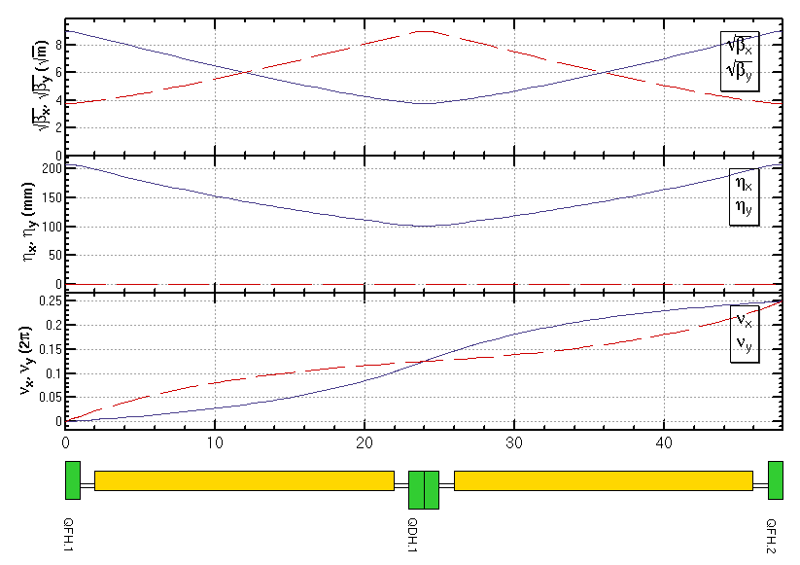
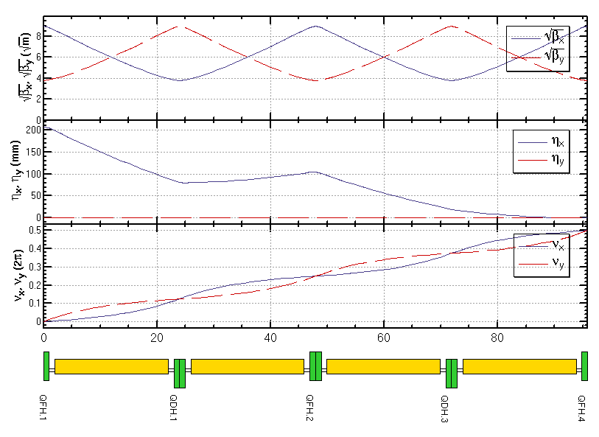
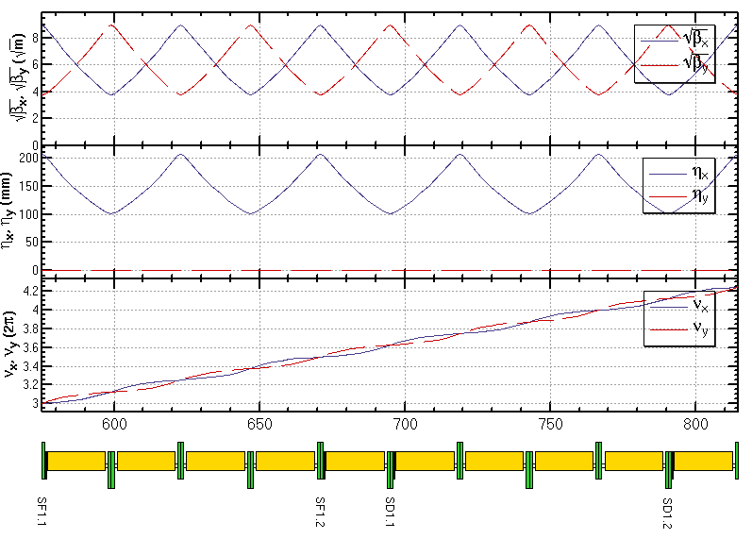
ARC lattice
FODO cell
Dispersion Suppressor
Sextupole configuration

Slide 6
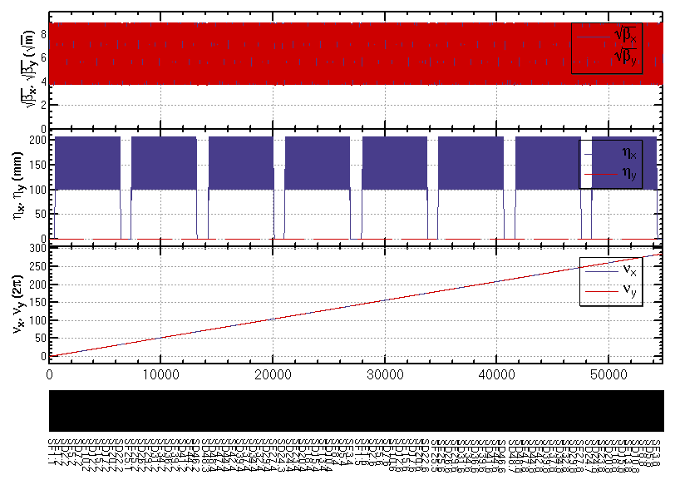
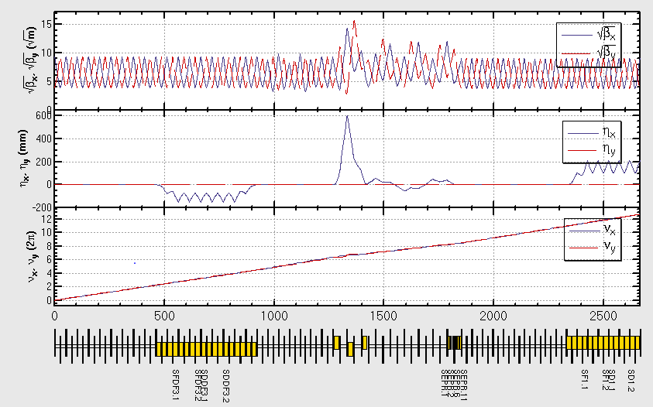
ARC and PDR lattice

Slide 7
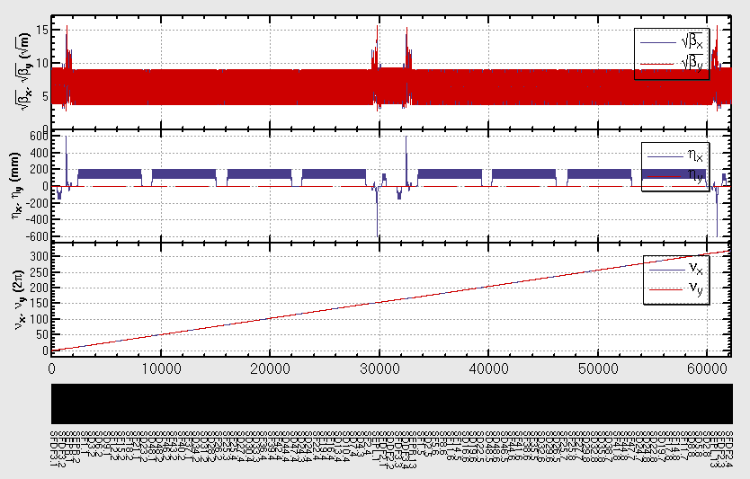
ARC+PDR

Slide 8
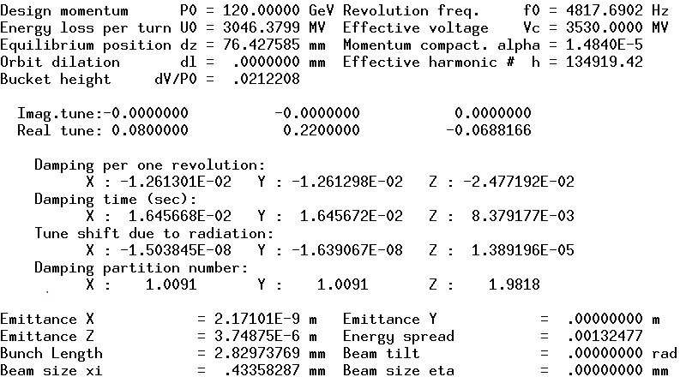
Para of ARC+PDR

Slide 9
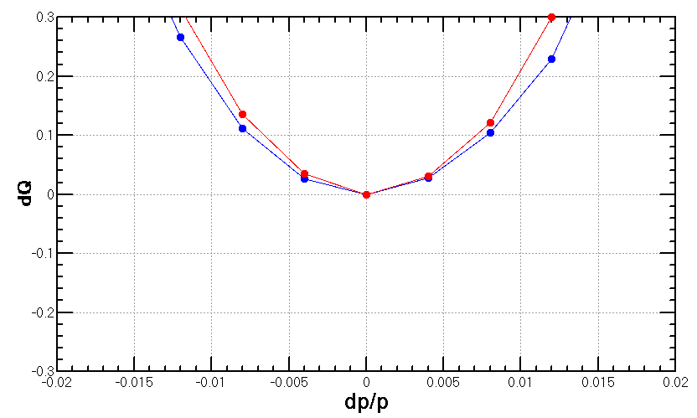
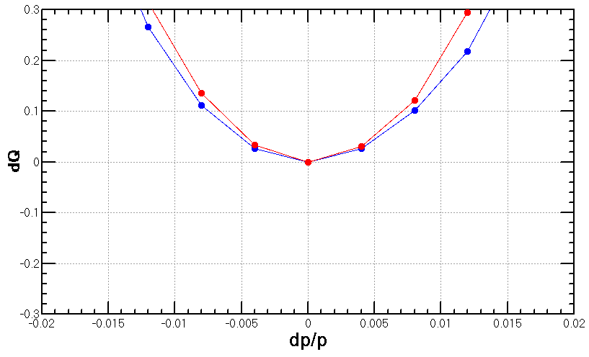
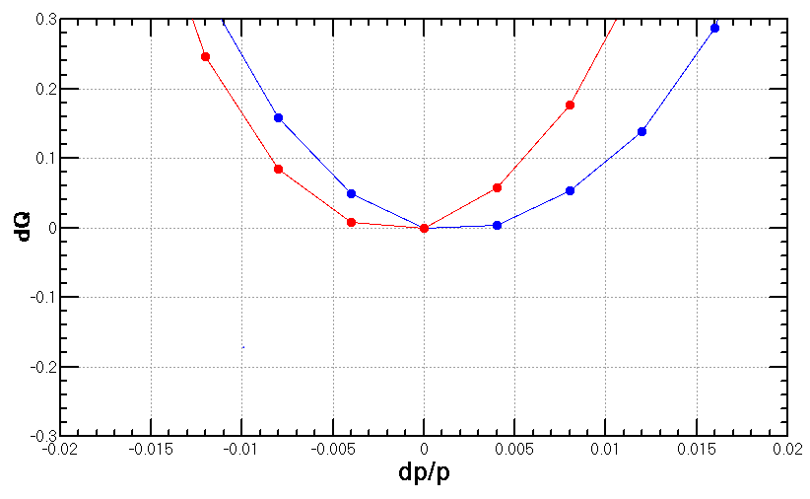
Finite bandwidth chromaticity correction
SF1 =(L =.39999999999999997 K2 =1.0872338850000658 )
SD1 =(L =.39999999999999997 K2 =-2.1201424354323266 )
Dp=0.0001
SFDF3 =(L =.4 K2 =-.8493594692528305 )
SDDF3 =(L =.4 K2 =.46031797364269955 )
SF1 =(L =.39999999999999997 K2 =1.0743425337555785 )
SD1 =(L =.39999999999999997 K2 =-2.113250423331716 )
Dp=0.01
SFDF3 =(L =.4 K2 =-1.0832247134826412 )
SDDF3 =(L =.4 K2 =1.9944186434969469 )
SF1 =(L =.39999999999999997 K2 =1.061241648709442 )
SD1 =(L =.39999999999999997 K2 =-2.1135607367295 )
Dp=0.02

Slide 10
The sextupoles in present PDR lattice don’t help much to the 1st order chromaticity correction, i.e. can’t make local correction
Keep lattice; correct 1st and high order chromaticity with only ARC sextupoles ; correct high order chromaticity with help from PDR sextupoles.
More sextupoles in PDR
Re-design PDR lattice

Slide 11
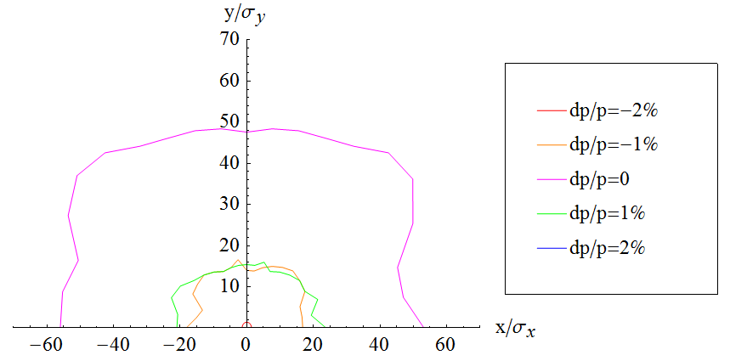
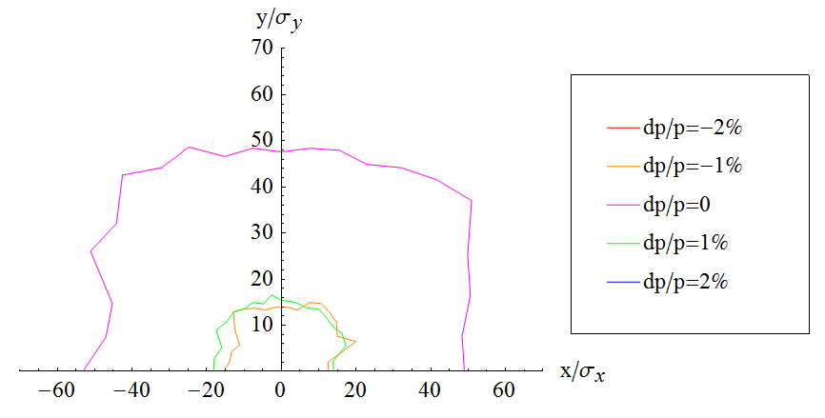
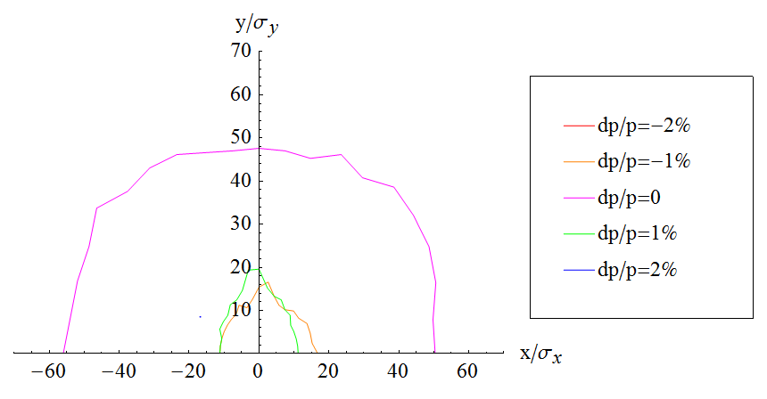
SF1 =(L =.39999999999999997 K2 =1.0872338850000658 )
SD1 =(L =.39999999999999997 K2 =-2.1201424354323266 )
SFDF3 =(L =.4 K2 =-.8493594692528305 )
SDDF3 =(L =.4 K2 =.46031797364269955 )
SF1 =(L =.39999999999999997 K2 =1.0743425337555785 )
SD1 =(L =.39999999999999997 K2 =-2.113250423331716 )
SFDF3 =(L =.4 K2 =-1.0832247134826412 )
SDDF3 =(L =.4 K2 =1.9944186434969469 )
SF1 =(L =.39999999999999997 K2 =1.061241648709442 )
SD1 =(L =.39999999999999997 K2 =-2.1135607367295 )

Slide 12
Reserved

Slide 13
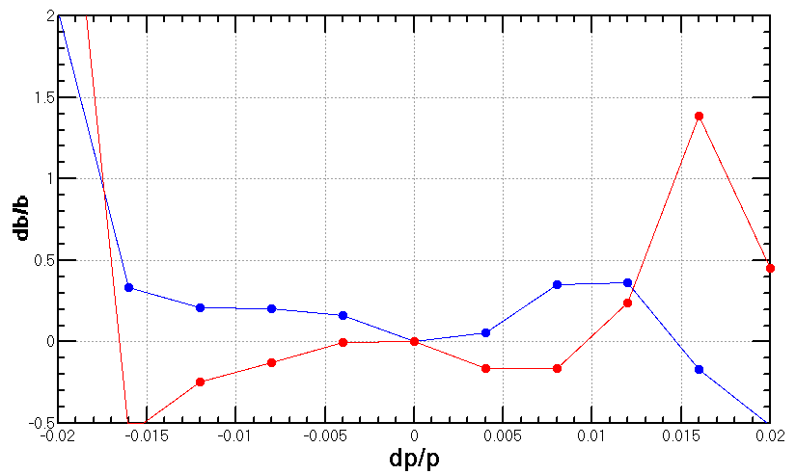
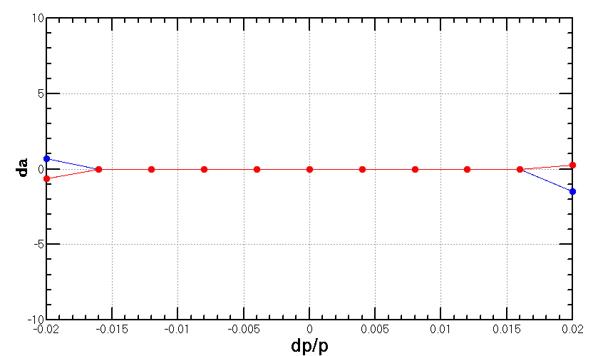
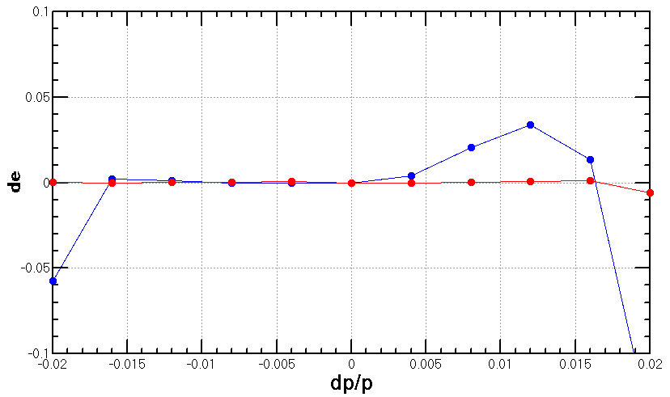
with 2 families

Slide 14
With 2 families
SF1 =(L =.39999999999999997 K2 =1.0872338850000658 ) SD1 =(L =.39999999999999997 K2 =-2.1201424354323266 )

Slide 15
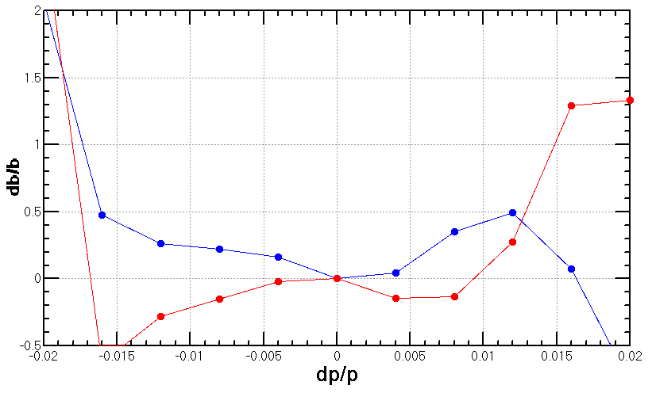
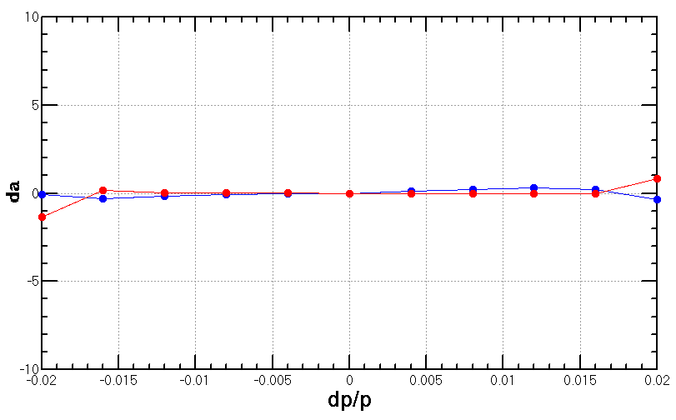
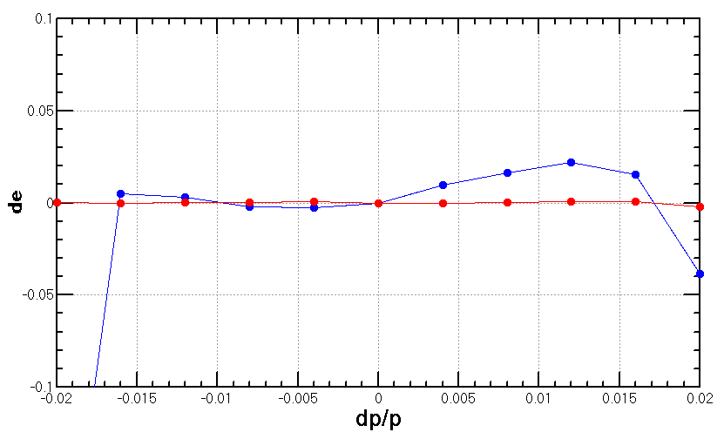
With 4 families (1)

Slide 16
With 4 families (1)
SFDF3 =(L =.4 K2 =-.8493594692528305 )
SDDF3 =(L =.4 K2 =.46031797364269955 )
SF1 =(L =.39999999999999997 K2 =1.0743425337555785 )
SD1 =(L =.39999999999999997 K2 =-2.113250423331716 )

Slide 17
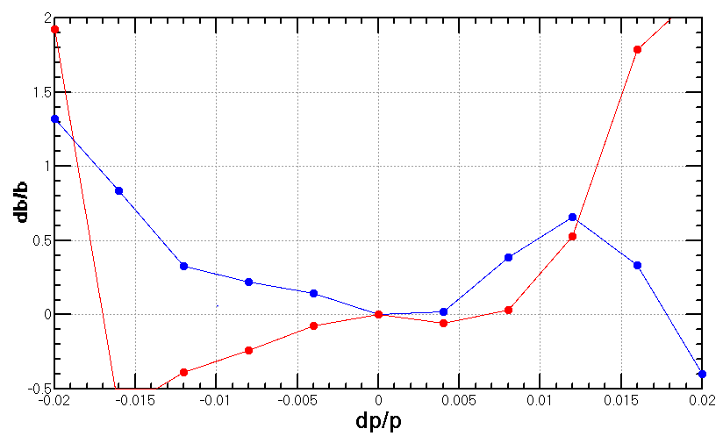
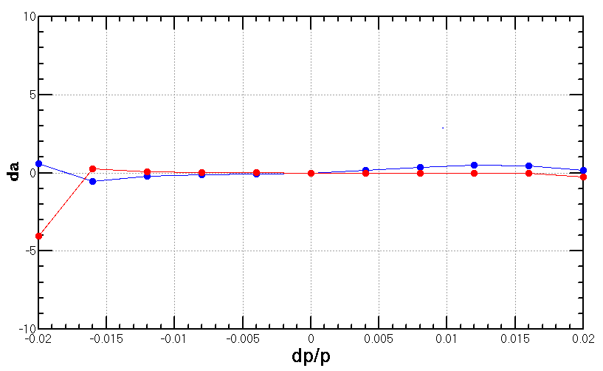
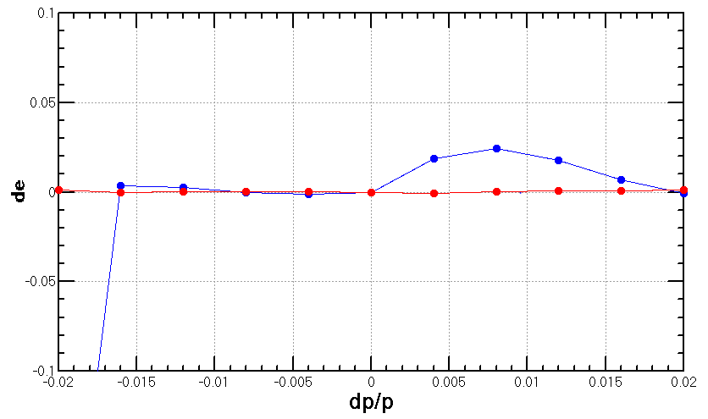
With 4 families (2)

Slide 18
With 4 families (2)
SFDF3 =(L =.4 K2 =-1.0832247134826412 )
SDDF3 =(L =.4 K2 =1.9944186434969469 )
SF1 =(L =.39999999999999997 K2 =1.061241648709442 )
SD1 =(L =.39999999999999997 K2 =-2.1135607367295 )
The sextupoles in present PDR lattice don’t help much to the 1st order chromaticity correction.
Keep lattice; correct 1st order chromaticity with only ARC sextupoles ; correct high order chromaticity with help from PDR sextupoles.
Re-design lattice

