Slide 1
Dynamic aperture optimization of CEPC booster using MOGA
Y. Y. Wei

Slide 2
Introduction
Multiobjective genetic algorithms (MOGA) were developed since 1970s.
Evolved further in the 1990s with the addition of genetic algorithms.
The first application to accelerator physics was about 2005.
Allow to find globally optimal solutions when a large number of fit parameters is used.

Slide 3
Algorithm
Optimize certain objectives while fulfilling certain constraints.
Min/Max $\left\{f_{1}\left(x\right),f_{2}\left(x\right),{…,f}_{m}\left(x\right)\right\}$subject to x$∈g_{i}$,$h_{k}$
1: Initialize population (first generation, random)
2: repeat
3:select parents to generate children (crossover)
4: mutation (children)
5: evaluate (children)
6: merge (parents, children)
7: non-dominated sort (rank)
8: select half of (parents, children)
9: until reach a generation with the desired convergence to the PO set

Slide 4
Application to CEPC booster
Linear lattice parameters are not varied.
L_{cell}=70.8 m , ν_{x}=128.2, ν_{y}=128.3, (60,60) Fodo cell, For bypass lines
8 Families of sextupole strengths are selected as variables (4 families of SF, 4 families of SD, Non-interleaved) .
2 objectives f(1)= -DA_nom_area_p*MA
f(2)= -DA_nom_area_n*MA
800 populations
π

Slide 5
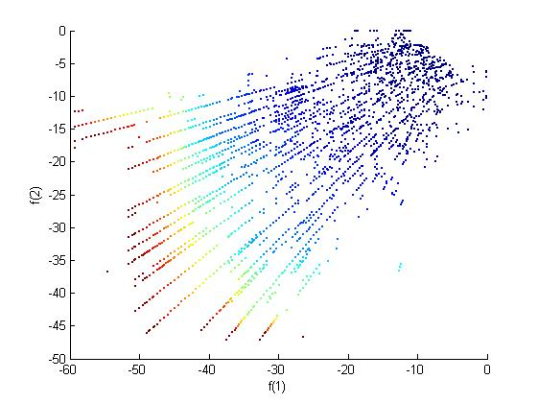
The evolution of 36 generations

Slide 6
Result of 22th generation
1 family of SF, and 1family of SD
1% Δp/p: DA ̴ 49.8mm*23.1mm
-1% Δp/p: DA ̴ 49.8mm*43.3mm
5 family of SF, and 5 family of SD (optimized using MOGA)
1% Δp/p: DA ̴ 62.6mm*36.6mm
-1% Δp/p: DA ̴ 56.2mm*43.3mm

Slide 7
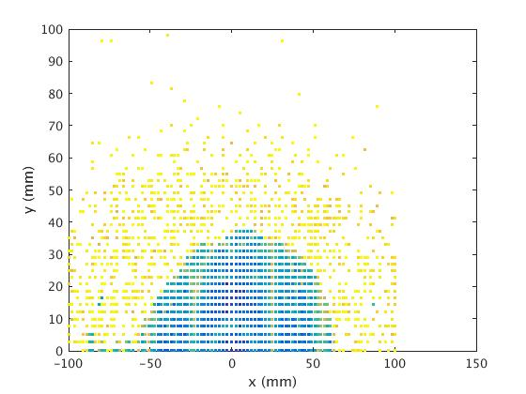
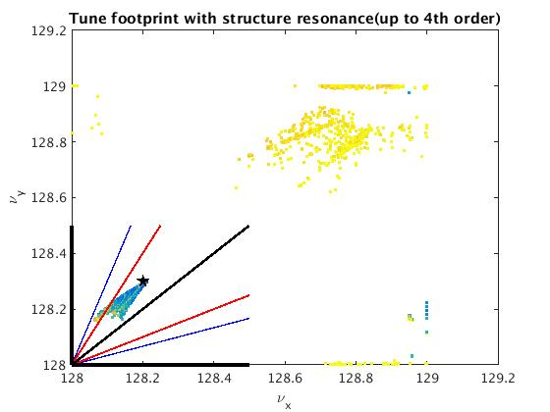
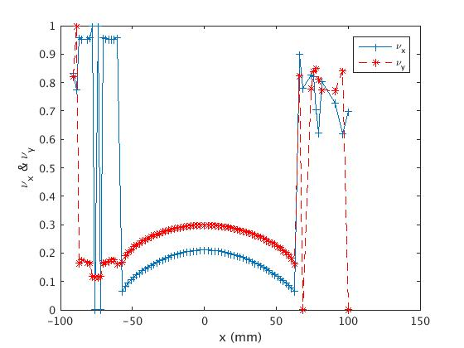
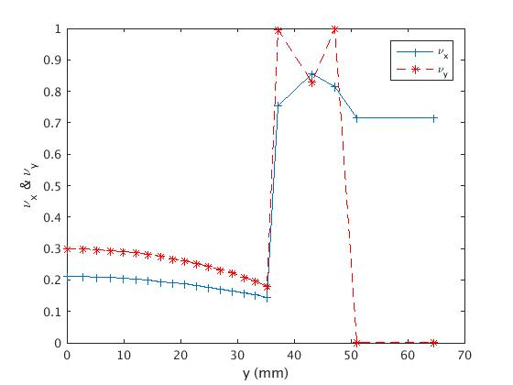
FMA @1% Δp/p

Slide 8
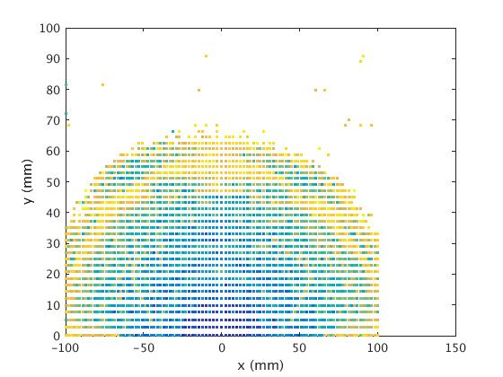
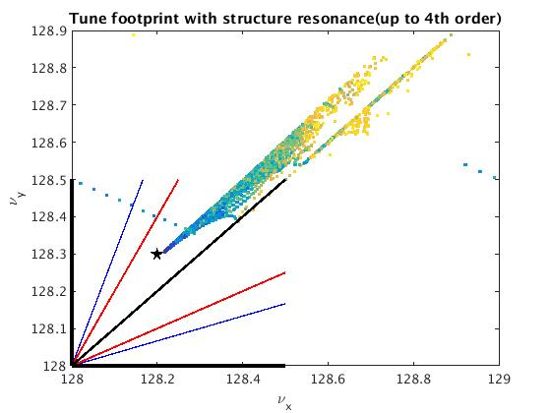
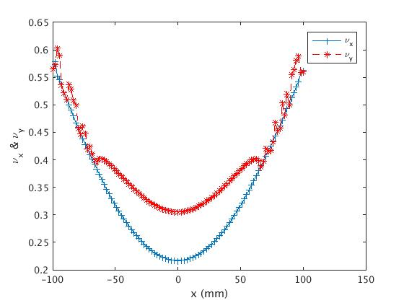
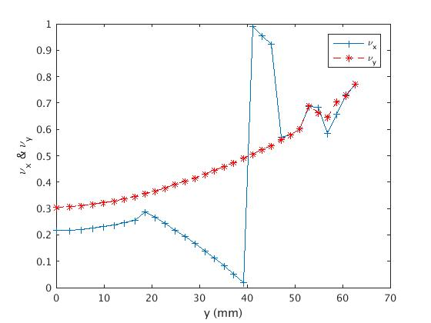
FMA @-1% Δp/p

Slide 9
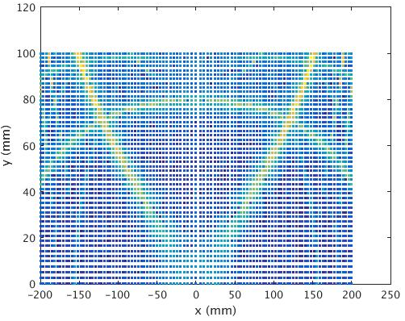
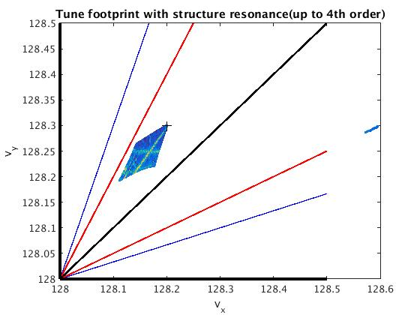
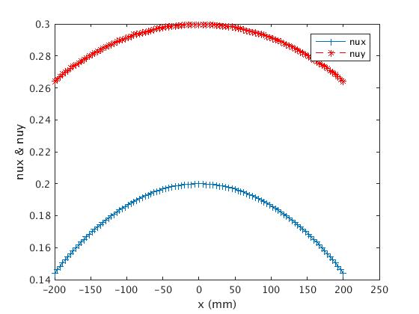
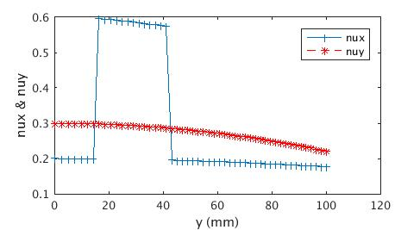

Slide 10
MA after using MOGA
MA before using MOGA

Slide 11
MA after using MOGA
MA before using MOGA

Slide 12
Summary
MOGA now seems working for the dynamic aperture optimization of CEPC booster.
More generations need to be generated to obtain more optimal results.

