Slide 1
Re-organize CEPC Software
Manqi & Gang
2016.08.31

Slide 2
Outline
Status of CS
Software installation
Plan

Slide 3
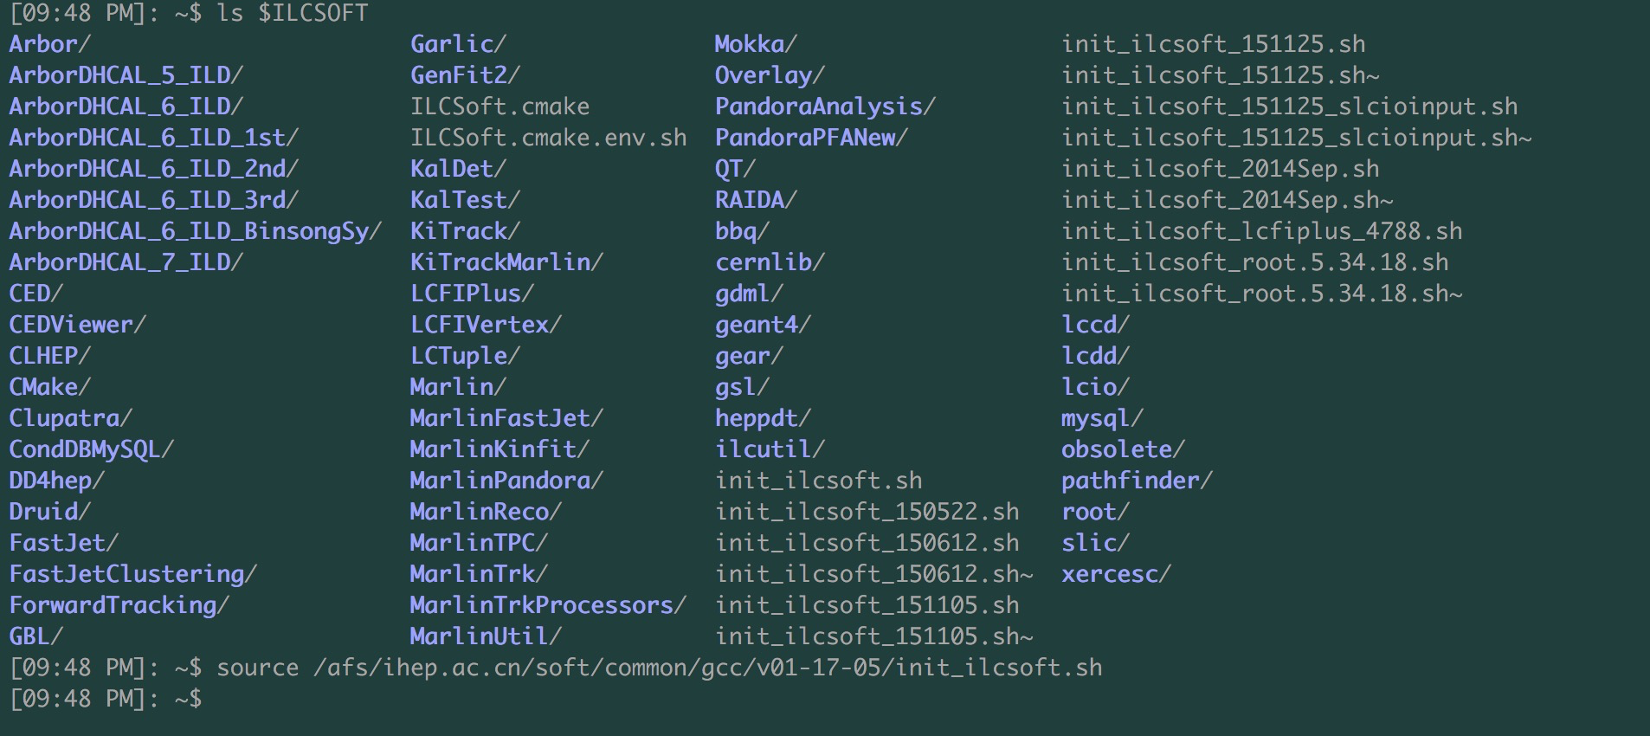
What we are using and how to setup
HFCmake = “cmake -C $ILCSOFT/ILCSoft.cmake”
When using your own env.sh
$: unset MARLIN_DLL
order of *.so files

Slide 4
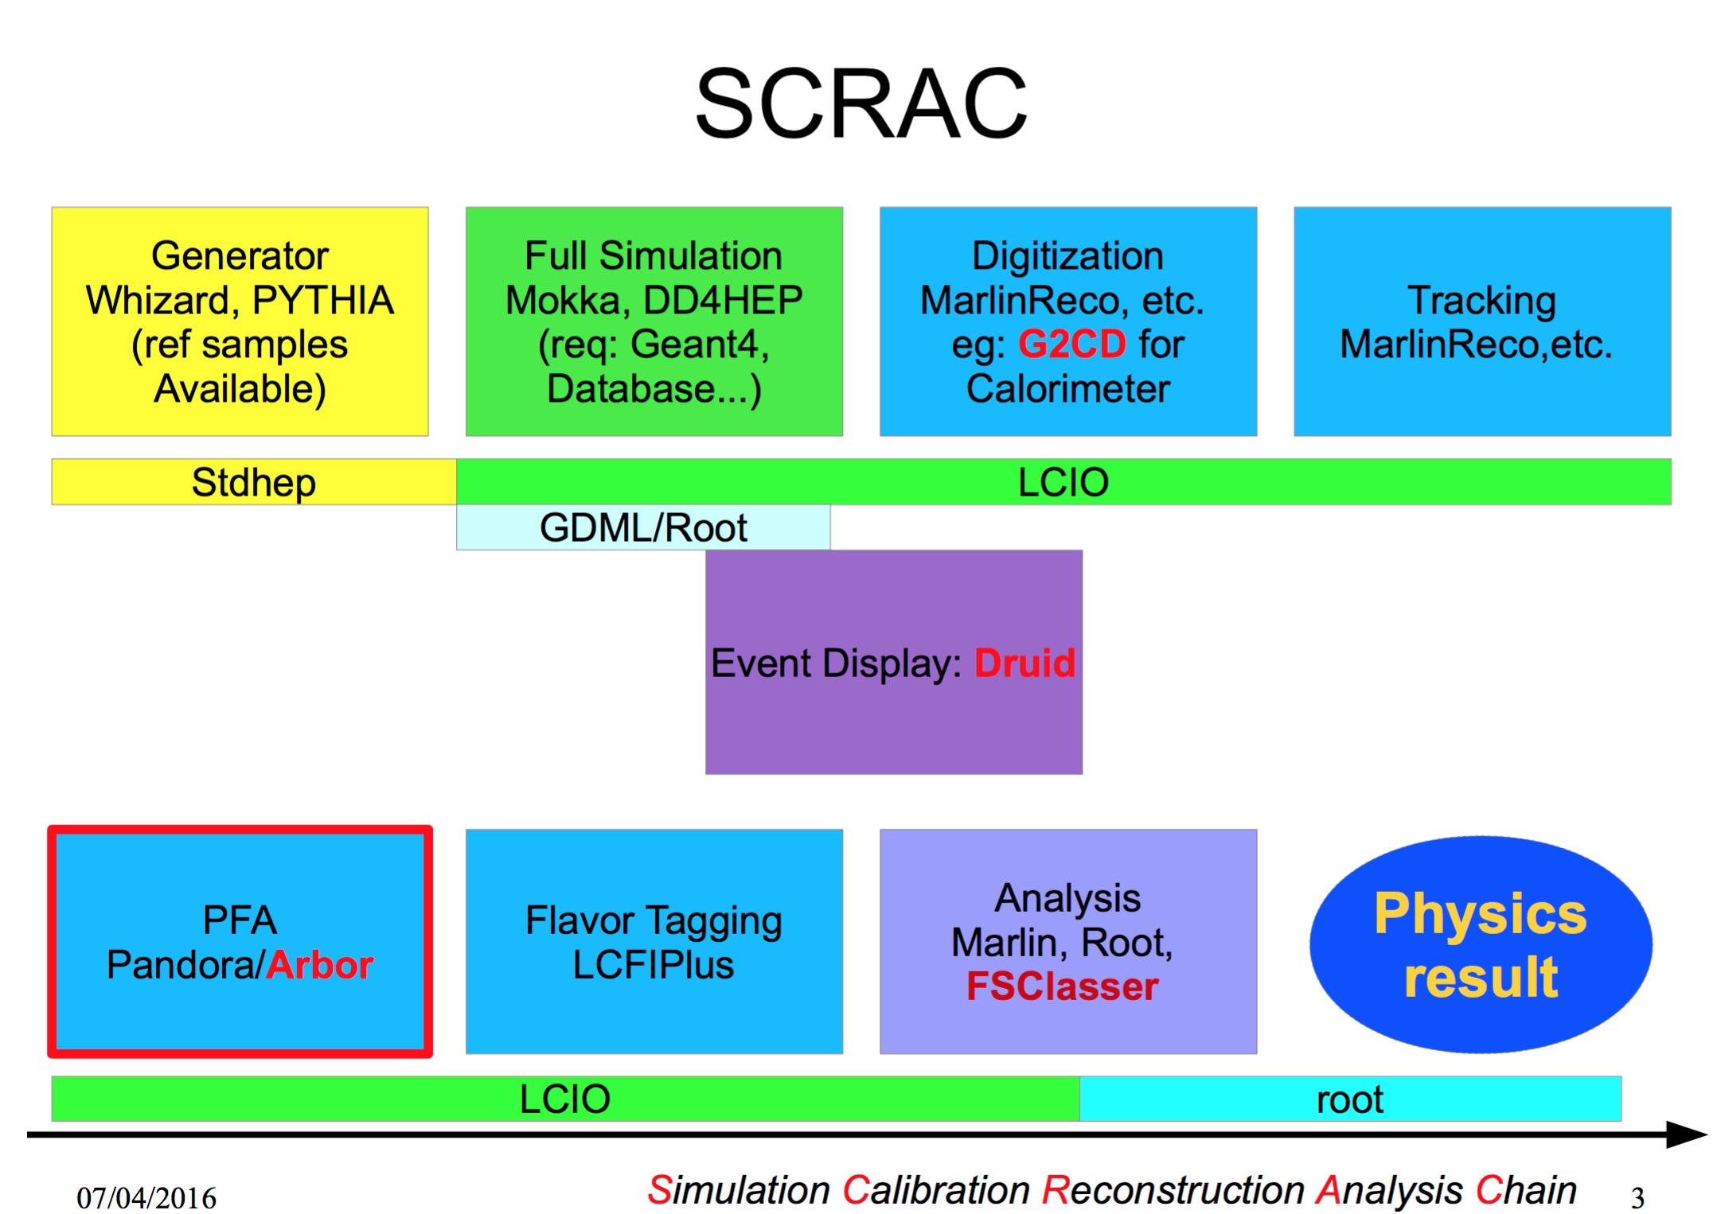

Slide 5
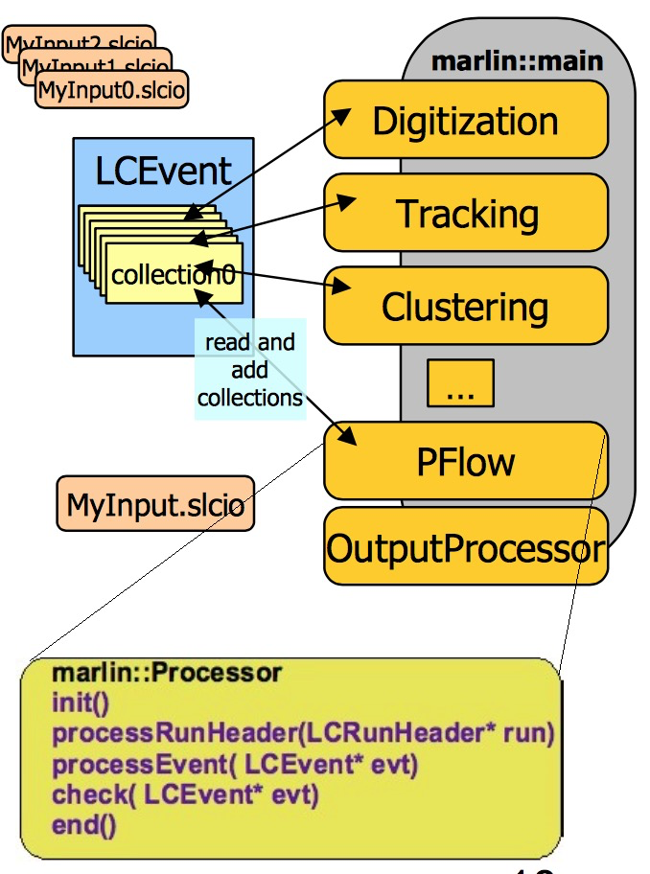
Marlin – application framework
ModularAnalysis Reconstruction for LINear collider
modular C++ application framework for the analysis and reconstruction of ILC data
LCIO as transient data model xml steering files:
fully configure application order of modules/processors parameters global + processor
self documenting
parameters registered in user code consistency check of input/output collection types
Plug & Play of modules

Slide 6
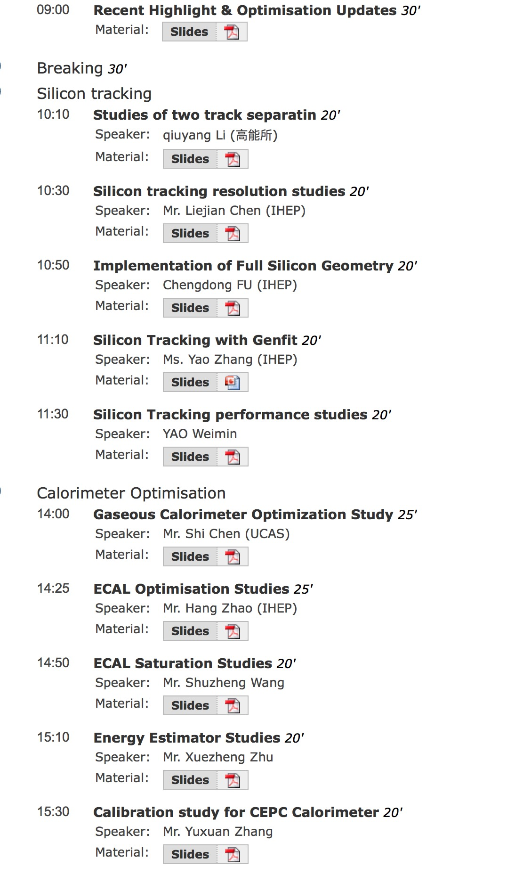
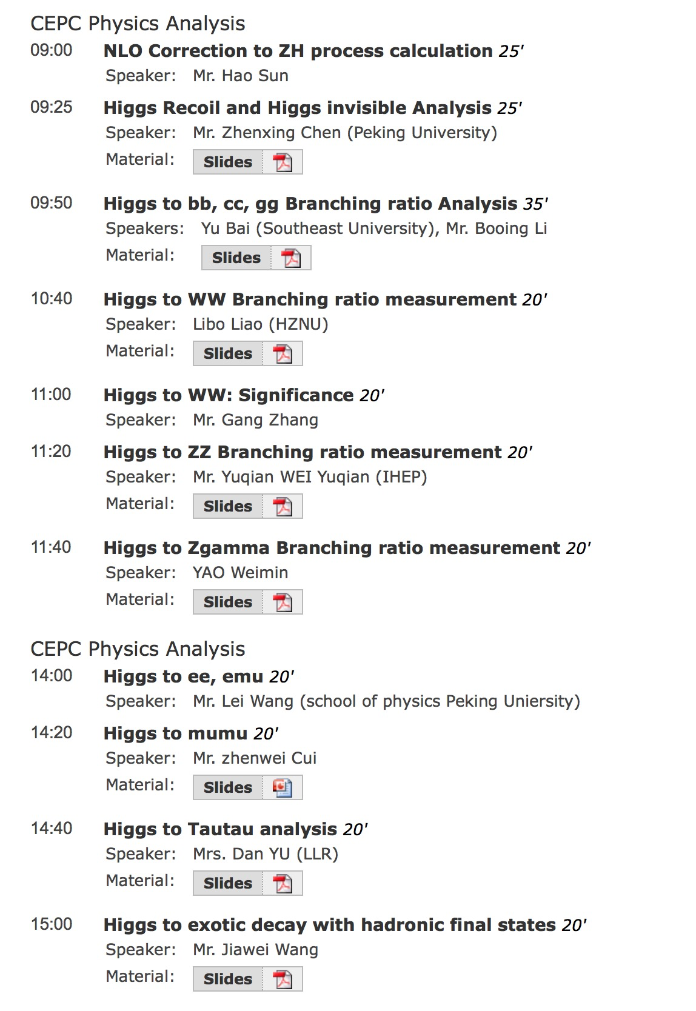
A lots done & achieved
but we go farther

Slide 7
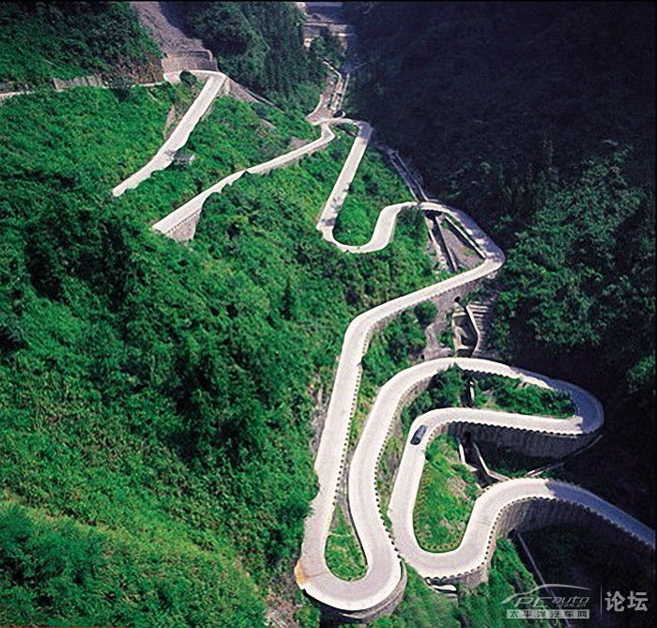
We are here!

Slide 8
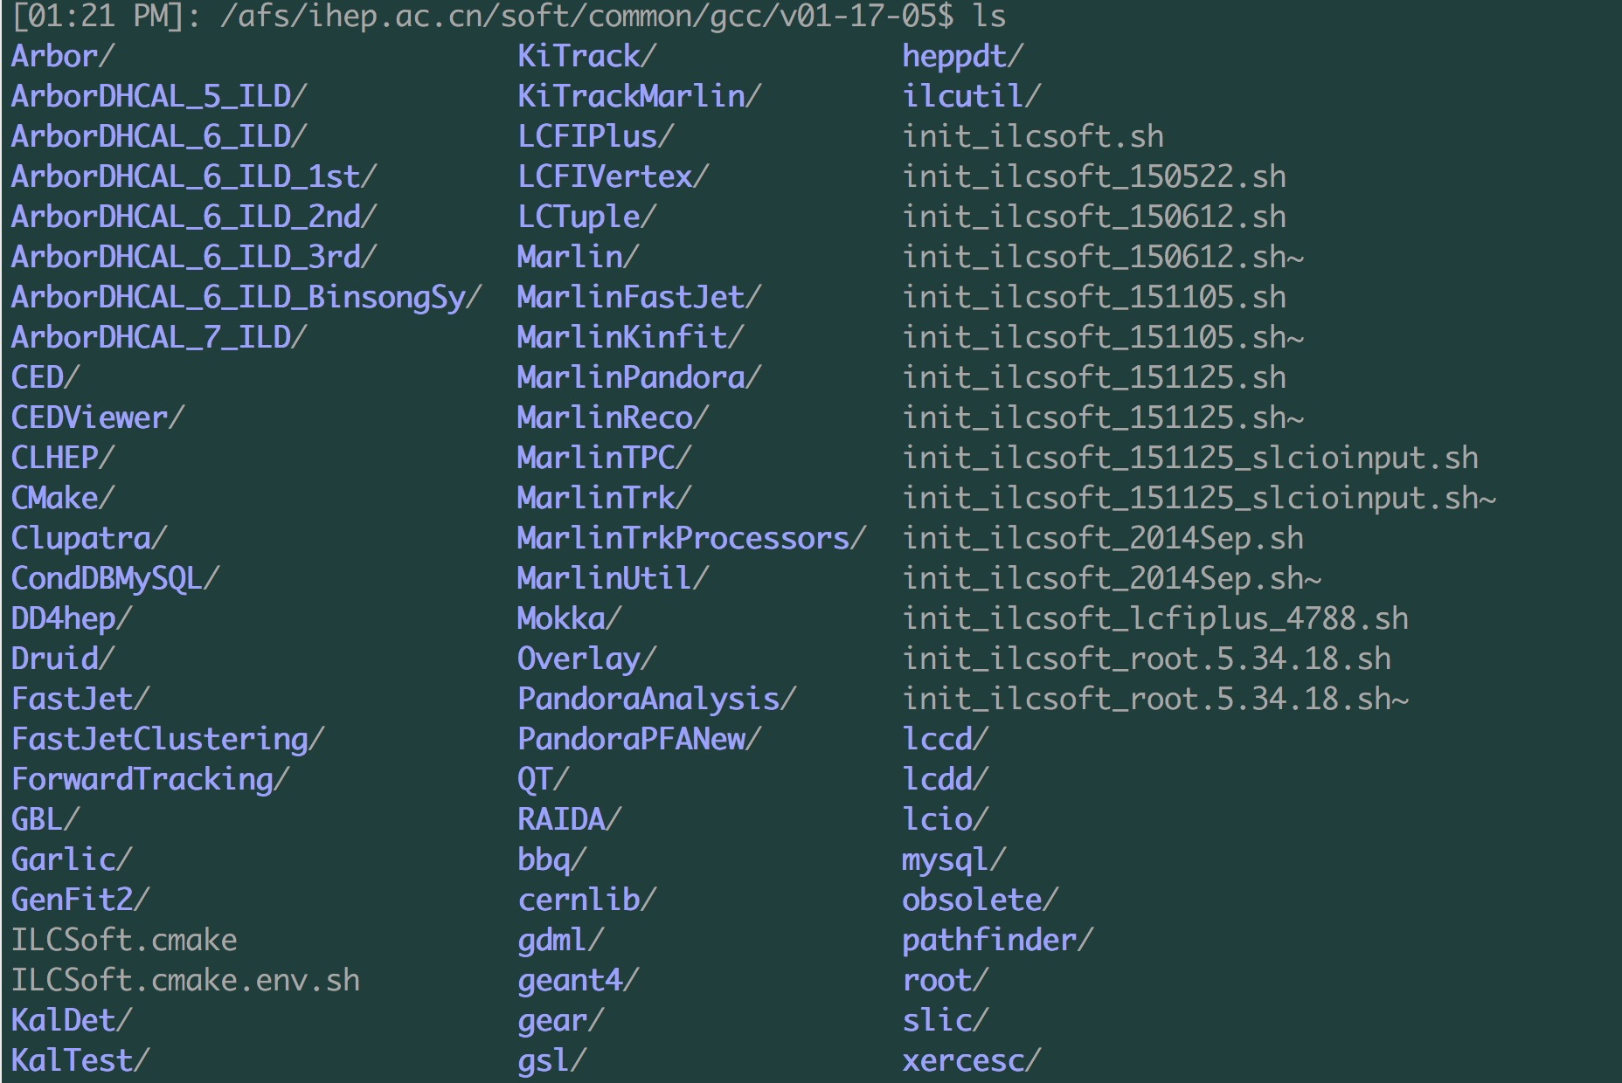
New structure, new compiler, new tools
A set of python scripts is for the installation
/besfs/groups/psip/psipgroup/user/lig/v01-17-05-tools

Slide 9
KD tree feature needs modern compiler: gcc4.9.0
Some old package removed: cernlib …
Need validation

Slide 10
Detector design vs. Precisions
Goal

Slide 11
Step by Step
Install software: more experts
Develop your algorithm / processor: dive deeper into …
Collaborating via GitHub: easy life, easy start, easy focus
Integrate the package one by one → new software, CS

Slide 12
Standard tools
C++
Python
Bash
cmake
Documents

Slide 13
More professional
Documentation & Wiki
GitHub
Standard plot style

Slide 14
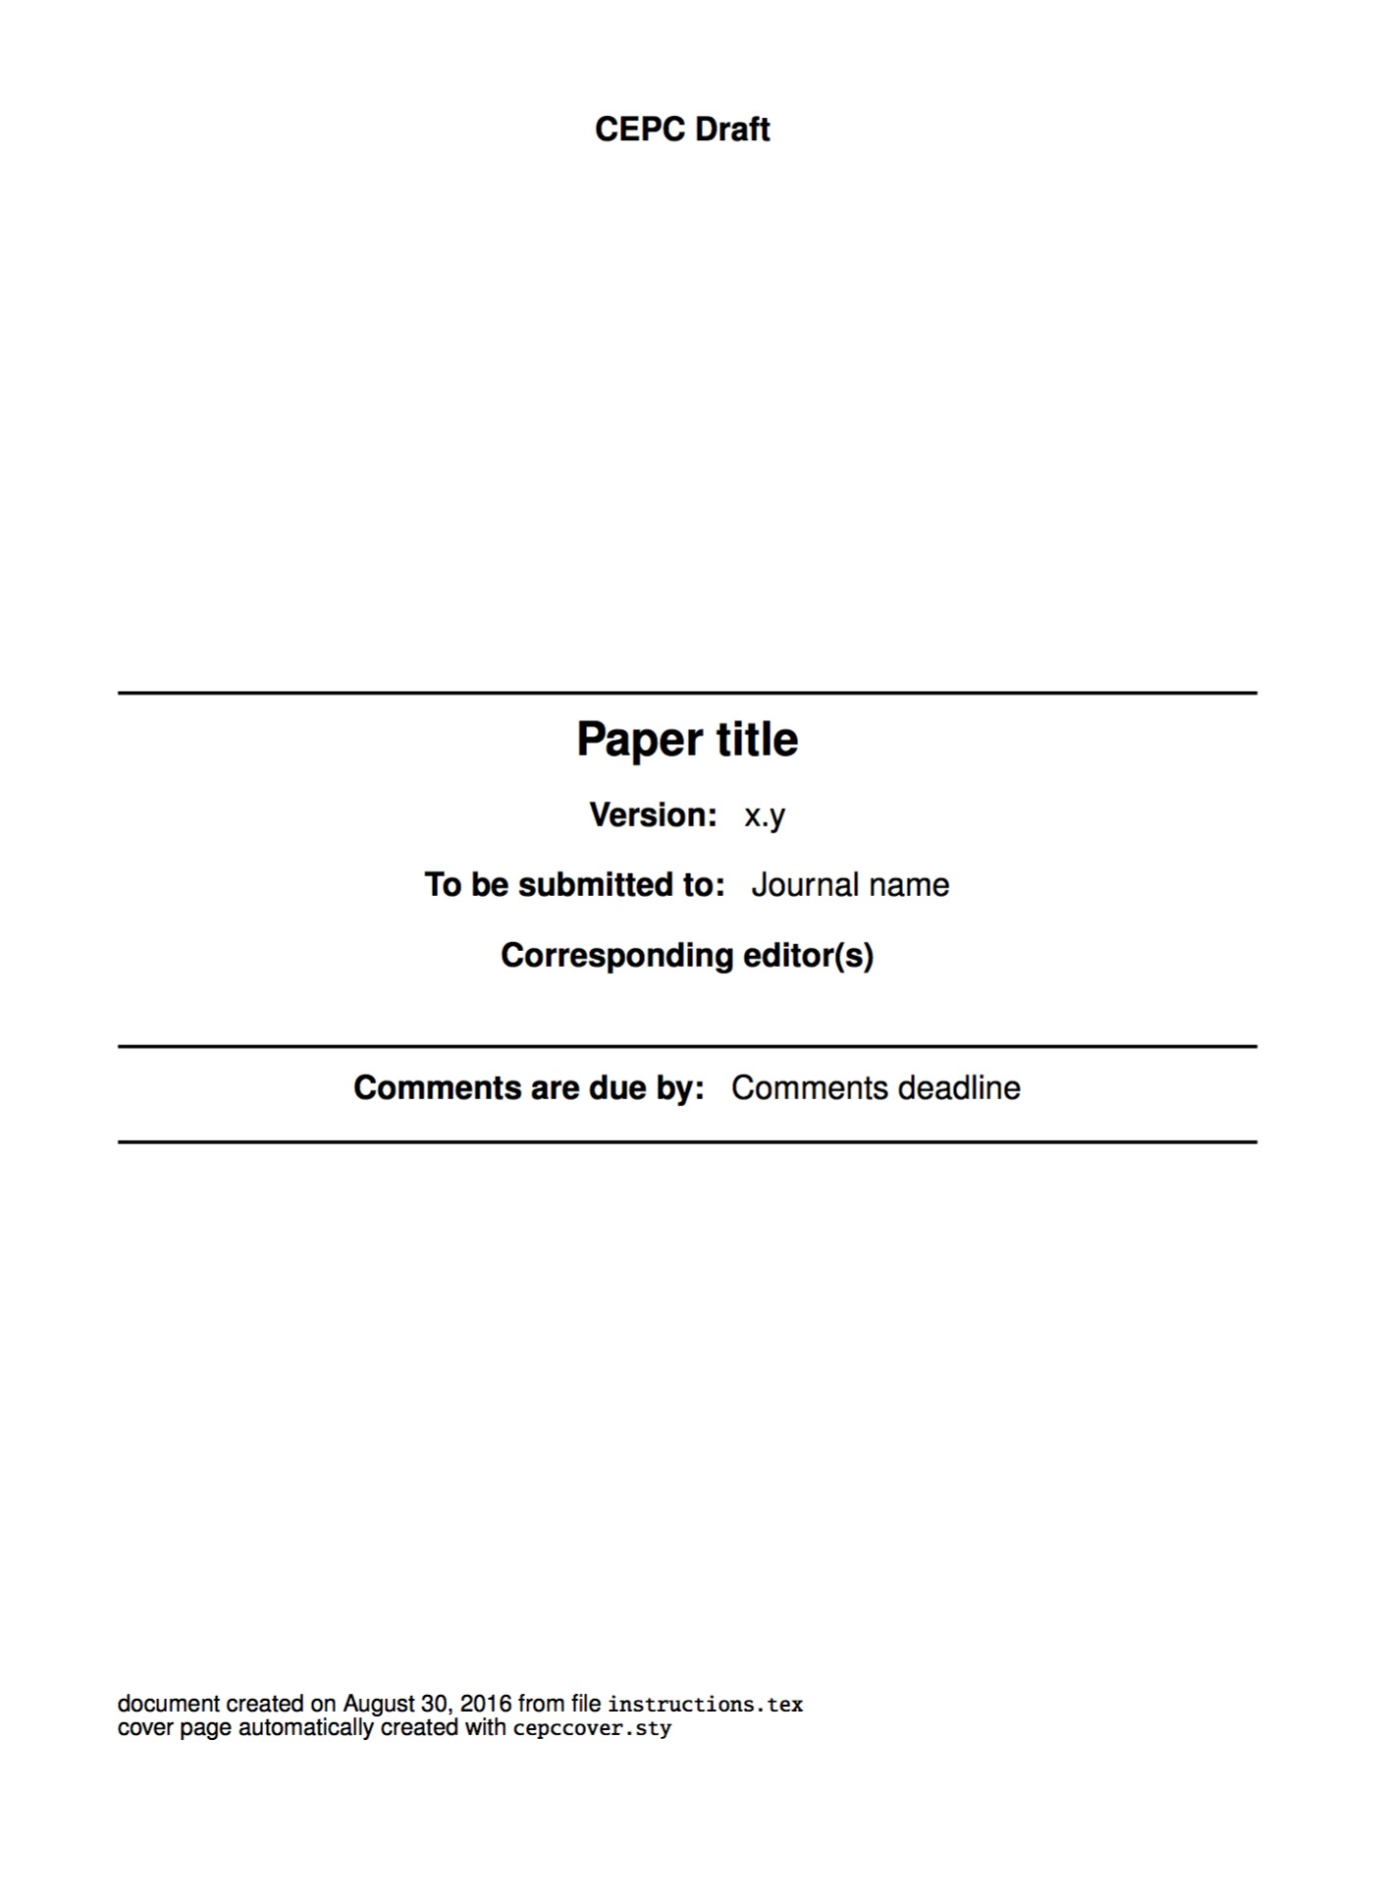
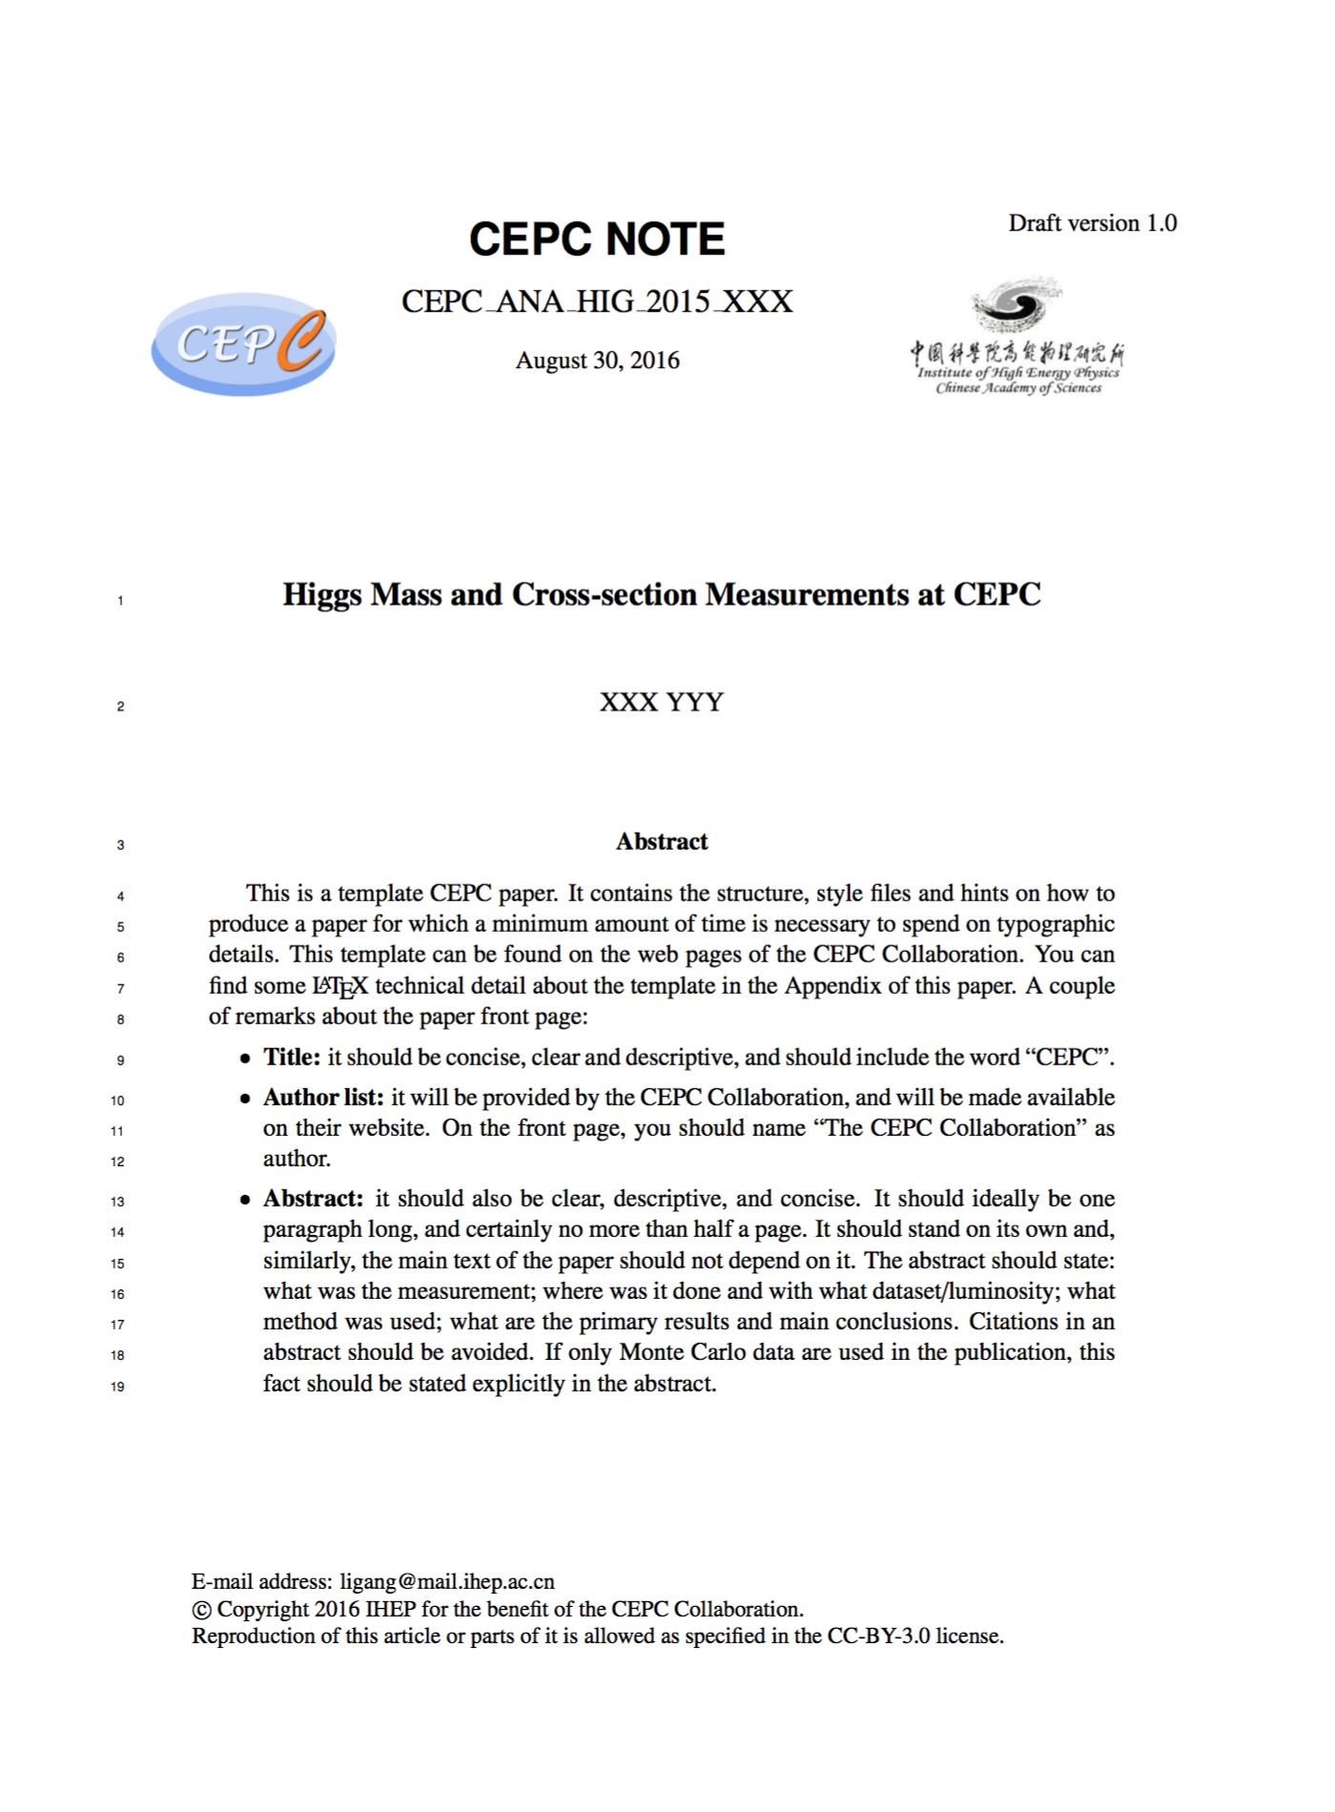
Latex template: read the instructions

Slide 15
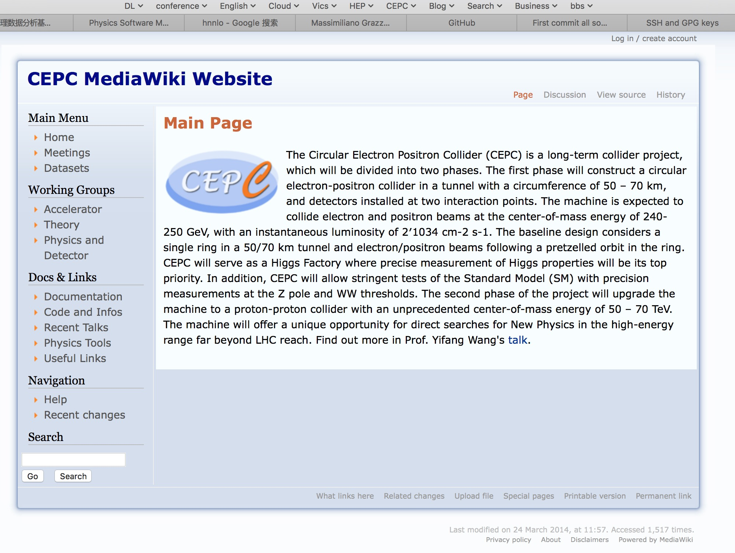
Wiki: create your account and contribute http://cepc.ihep.ac.cn/~cepc/cepc_twiki/index.php/Main_Page

Slide 16
Summary and hope
Lots of achieved
Focus more on detectors next
Reconstruction/simulation software
More professional
More Productive
Become experts
Document well

Slide 17
An tutorial example Higgsrecoil@GitHub

Slide 18
Cross section measurement
For Sun Hao

Slide 19
CS
Simulation
Mokka
Digitization
Services
Analysis
Tools
Reconstruction
Tracking
PFA
HighLevelObjects
Generic Framework
Geant4
GSL
CLHEP
ROOT
Framework
DD4HEP
Isolated Lepton
Isolated Photon
Jets
Event Display
Arbor
Pandora
Marlin
lcio
VTX
SIT
FTD
SET
TPC
ECAL
HCAL
MySQL

