Slide 1

CEPC APDR and PDR scheme
Dou Wang, Jie Gao, Zhenchao Liu, Yiwei Wang, Feng Su, Yuan Zhang, Bai Sha, Huiping Geng, Tianjian Bian, Na Wang, Xiaohao Cui
CEPC AP meeting, 2016.07.29

Slide 2
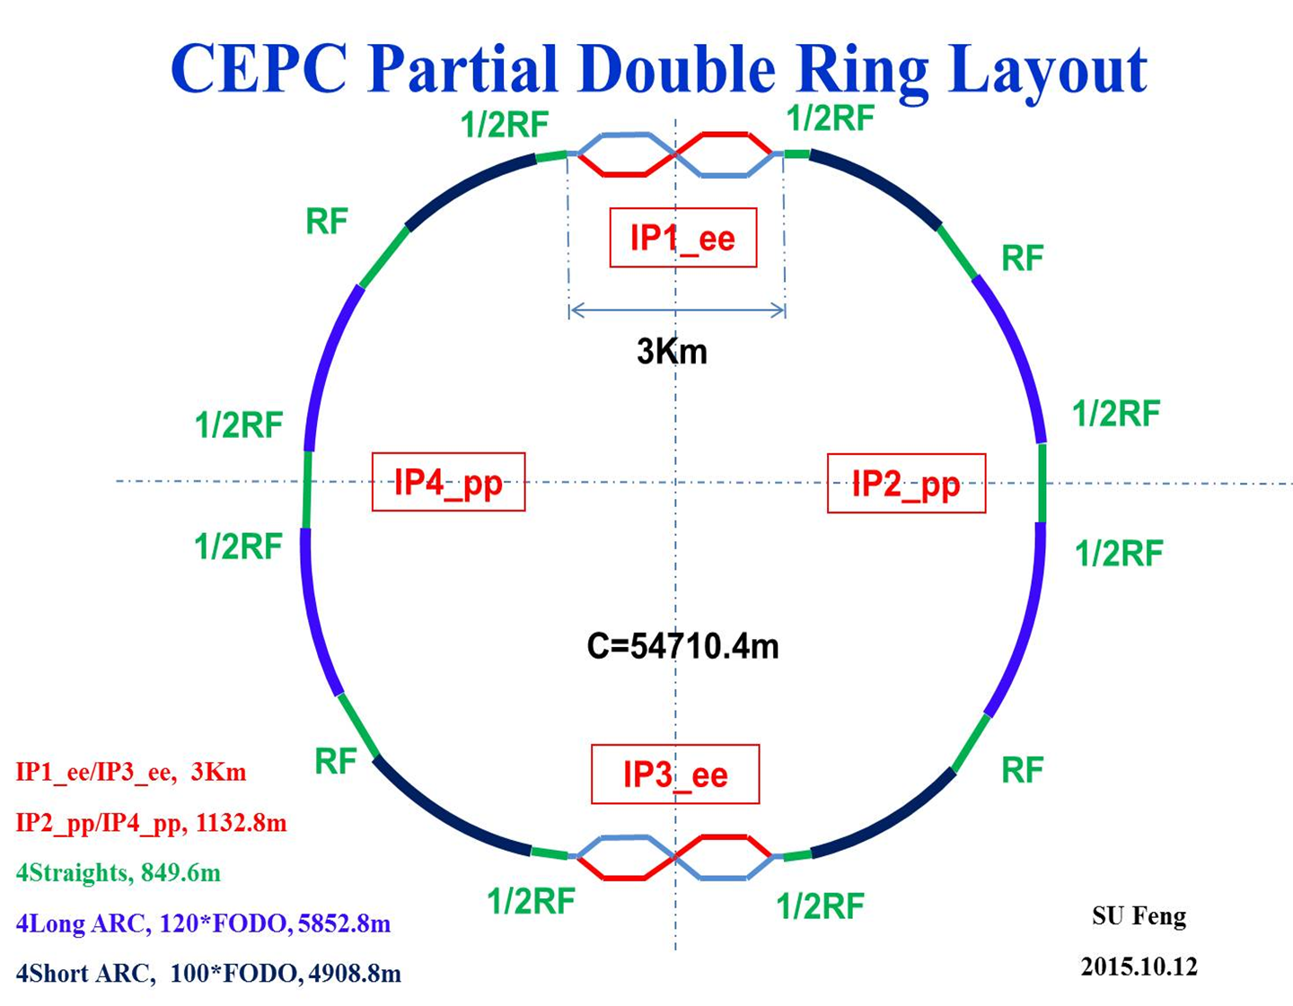

Slide 3
CEPC Advanced Partial Double Ring Layout I
1/2RF
1/2RF
ARC1
IP1_ee
RF
RF
ARC2
APDR
3Km
APDR
ARC3
1/2RF
1/2RF
Bypass
about 42m
IP4_pp
IP2_pp
ARC4
1/2RF
1/2RF
IP1_ee/IP3_ee, 2.968Km
IP2_pp/IP4_pp, 1132.8m
APDR, 1052.87m
4 Short Straights, 141.6m
4 Medium Straights, 566.4m
4 Long Straights, 1132.8m
4 ARC1, 124*FODO, 5852.8m
4 ARC2, 24*FODO, 1132.8m
4 ARC3, 79*FODO, 3728.8m
2 ARC4, 24*FODO, 1132.8m
ARC3
APDR
C=62967.86m
APDR
RF
RF
ARC2
IP3_ee
ARC1
1/2RF
1/2RF
SU Feng
2016.5.23

Slide 4
CEPC Advanced Partial Double Ring Layout II
1/2RF
1/2RF
1/2RF
ARC
1/2RF
IP1_ee
1/2RF
APDR
APDR
1/2RF
3Km
1/2RF
1/2RF
APDR
APDR
1/2RF
1/2RF
C=65640.2m
IP1_ee/IP3_ee, 2.968Km
IP2_pp/IP4_pp, 1132.8m
APDR, 1052.87m
4 Short Straights, 94.4m
12 Long Straights, 566.4m
4 Long ARC, 124*FODO, 5852.8m
4 Medium ARC, 104*FODO, 4908.8m
4 Short ARC, 14*FODO, 660.8m
1/2RF
1/2RF
APDR
APDR
1/2RF
IP3_ee
1/2RF
1/2RF
1/2RF
SU Feng
2016.6.2

Slide 5
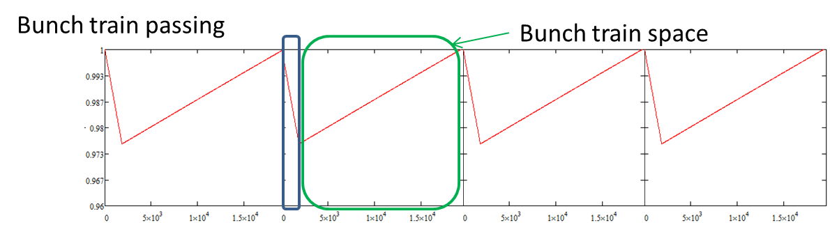
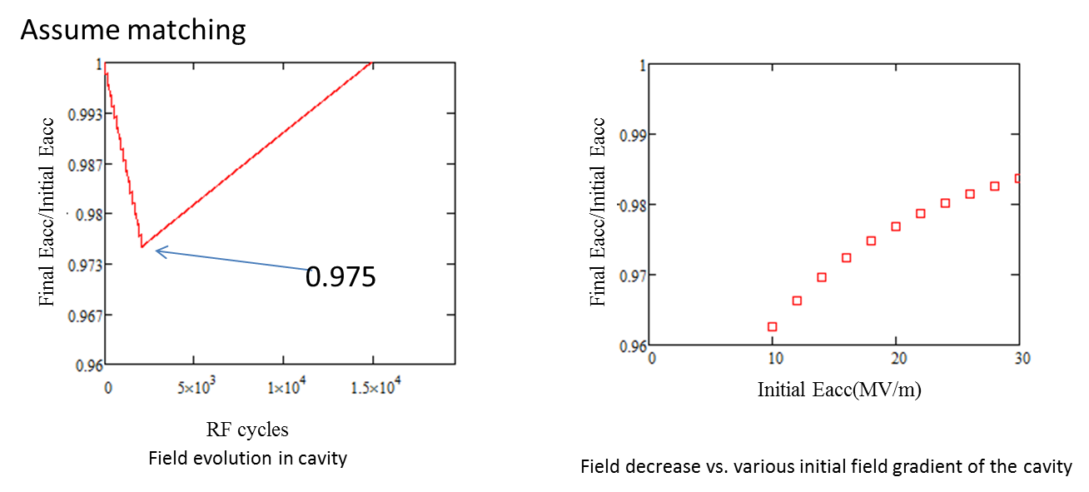
CEPC APDR SRF considerations
The 8-double ring and 6-double ring seem available when using the same parameter as PDR(V_{RF}=3.62GV) for HL. The 8-double ring has a lower phase variation than the 6-double ring .
The phase region is from 35.2-33 degree for bunches in a bunch train for the 8-double ring HL mode. The phase region is from 35.2-32.3 degree for the 6-double ring HL mode.
The bunch energy gain in each cavity is constant.
The RF to beam efficiency is ~100%.

Slide 6
By Zhenchao Liu
Bunch No. | Pre CDR (CW, P_{g}=P_{avg}) |  | PDR (CW, P_{g}=P_{pulse}, very low RF efficiency) |  | APDR 6 ring (H-low power, CW, P_{g}=P_{avg}) |  | APDR 8 ring (HL, CW, P_{g}=P_{avg}) |  | APDR 8 ring (H-low power, CW, P_{g}=P_{avg}) |  | APDR 8 ring (Z, P_{g}=P_{avg})
 | Vrf | Phase shift | Vrf | Phase shift | Vrf | Phase shift | Vrf | Phase shift | Vrf | Phase shift | Vrf | Phase shift
1 | 1 | 0 | 1 | 0 | 1 | 2.20 | 1 | 2.00 | 1 | 1.40 | 1 | 2.0000
2 | 1 | 0 | 1 | 0 | 0.9984 | 2.04 | 0.9984 | 1.88 | 0.9984 | 1.26 | 0.9998 | 1.9927
3 | 1 | 0 | 1 | 0 | 0.9968 | 1.89 | 0.9969 | 1.75 | 0.9968 | 1.12 | 0.9996 | 1.9855
4 | 1 | 0 | 1 | 0 | 0.9952 | 1.73 | 0.9953 | 1.63 | 0.9952 | 0.98 | 0.9994 | 1.9782
5 | 1 | 0 | 1 | 0 | 0.9936 | 1.57 | 0.9938 | 1.50 | 0.9936 | 0.84 | 0.9992 | 1.9709
6 | 1 | 0 | 1 | 0 | 0.992 | 1.41 | 0.9922 | 1.38 | 0.992 | 0.70 | 0.9990 | 1.9636
7 | 1 | 0 | 1 | 0 | 0.9904 | 1.26 | 0.9906 | 1.25 | 0.9904 | 0.56 | 0.9988 | 1.9564
8 | 1 | 0 | 1 | 0 | 0.9888 | 1.10 | 0.9891 | 1.13 | 0.9888 | 0.42 | 0.9987 | 1.9491
9 | 1 | 0 | 1 | 0 | 0.9872 | 0.94 | 0.9875 | 1.00 | 0.9872 | 0.28 | 0.9985 | 1.9418
10 | 1 | 0 | 1 | 0 | 0.9856 | 0.79 | 0.9859 | 0.88 | 0.9856 | 0.14 | 0.9983 | 1.9345
11 | 1 | 0 | 1 | 0 | 0.984 | 0.63 | 0.9844 | 0.75 | 0.984 | 0 | 0.9981 | 1.9273
15 | 1 | 0 | 1 | 0 | 0.9776 | 0 | 0.9781 | 0.25 |  |  | 0.9973 | 1.8982
17 | 1 | 0 | 1 | 0 |  |  | 0.9750 | 0 |  |  | 0.9969 | 1.8836
50 | 1 | 0 | 1 | 0 |  |  |  |  |  |  | 0.9906 | 1.6436
67 |  |  | 1 | 0 |  |  |  |  |  |  | 0.9873 | 1.5200
275 |  |  |  |  |  |  |  |  |  |  | 0.0947 | 0
Assume V_{rf} is constant at the first bunch of bunch trains and the change of V_{b} is negligible.

Slide 7
parameter for CEPC partial double ring
（wangdou20160325）
 | Pre-CDR | H-high lumi. | H-low power | W | Z
Number of IPs | 2 | 2 | 2 | 2 | 2
Energy (GeV) | 120 | 120 | 120 | 80 | 45.5
Circumference (km) | 54 | 54 | 54 | 54 | 54
SR loss/turn (GeV) | 3.1 | 2.96 | 2.96 | 0.59 | 0.062
Half crossing angle (mrad) | 0 | 15 | 15 | 15 | 15
Piwinski angle | 0 | 2.5 | 2.6 | 5 | 7.6
N_{e}/bunch (10¹¹) | 3.79 | 2.85 | 2.67 | 0.74 | 0.46
Bunch number | 50 | 67 | 44 | 400 | 1100
Beam current (mA) | 16.6 | 16.9 | 10.5 | 26.2 | 45.4
SR power /beam (MW) | 51.7 | 50 | 31.2 | 15.6 | 2.8
Bending radius (km) | 6.1 | 6.2 | 6.2 | 6.1 | 6.1
Momentum compaction (10⁻⁵) | 3.4 | 2.5 | 2.2 | 2.4 | 3.5
β_{IP} x/y (m) | 0.8/0.0012 | 0.25/0.00136 | 0.268 /0.00124 | 0.1/0.001 | 0.1/0.001
Emittance x/y (nm) | 6.12/0.018 | 2.45/0.0074 | 2.06 /0.0062 | 1.02/0.003 | 0.62/0.0028
Transverse σ_{IP} (um) | 69.97/0.15 | 24.8/0.1 | 23.5/0.088 | 10.1/0.056 | 7.9/0.053
ξ_{x}/IP | 0.118 | 0.03 | 0.032 | 0.008 | 0.006
ξ_{y}/IP | 0.083 | 0.11 | 0.11 | 0.074 | 0.073
V_{RF} (GV) | 6.87 | 3.62 | 3.53 | 0.81 | 0.12
f _{RF} (MHz) | 650 | 650 | 650 | 650 | 650
Nature σ_{z} (mm) | 2.14 | 3.1 | 3.0 | 3.25 | 3.9
Total σ_{z} (mm) | 2.65 | 4.1 | 4.0 | 3.35 | 4.0
HOM power/cavity (kw) | 3.6 | 2.2 | 1.3 | 0.99 | 0.99
Energy spread (%) | 0.13 | 0.13 | 0.13 | 0.09 | 0.05
Energy acceptance (%) | 2 | 2 | 2
Energy acceptance by RF (%) | 6 | 2.2 | 2.1 | 1.7 | 1.1
n_{γ} | 0.23 | 0.47 | 0.47 | 0.3 | 0.24
Life time due to beamstrahlung_cal (minute) | 47 | 36 | 32
F (hour glass) | 0.68 | 0.82 | 0.81 | 0.92 | 0.95
L_{max}/IP (10³⁴cm⁻²s⁻¹) | 2.04 | 2.96 | 2.01 | 3.09 | 3.09

Slide 8
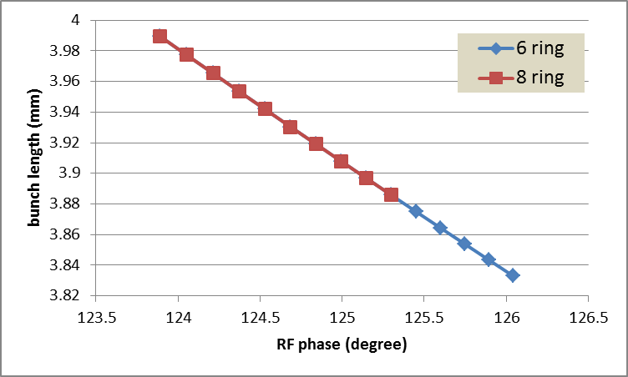
Bunch length error with RF phase adjustment
Error of bunch length: ~-4% (6 ring), ~-3% (8 ring)

Slide 9
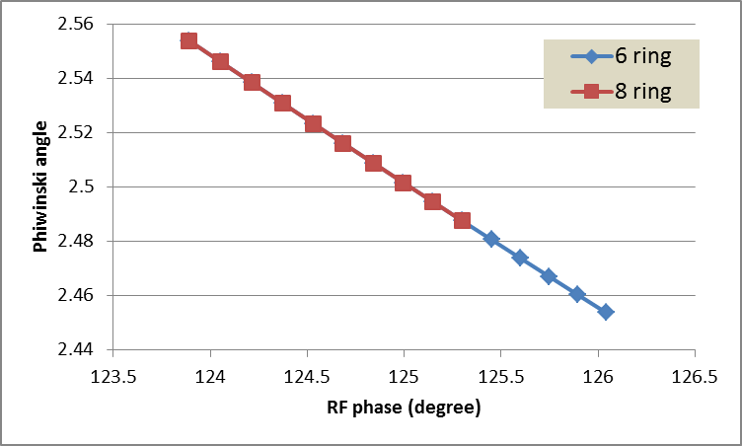
Piwinski error with RF phase adjustment
Error of Piwinski angle: ~-4% (6 ring), ~-3% (8 ring)

Slide 10
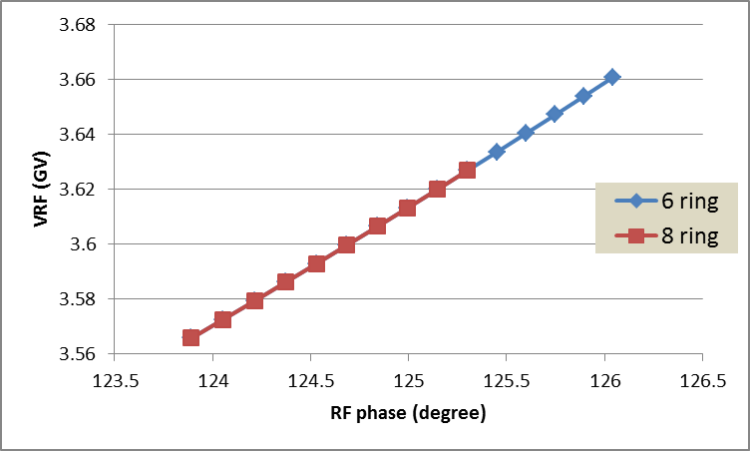
RF voltage error with RF phase adjustment
Error of V_{RF}: ~ 2.6% (6 ring), ~ 1.7% (8 ring)
RF efficiency will be a little lower than 100%.

Slide 11
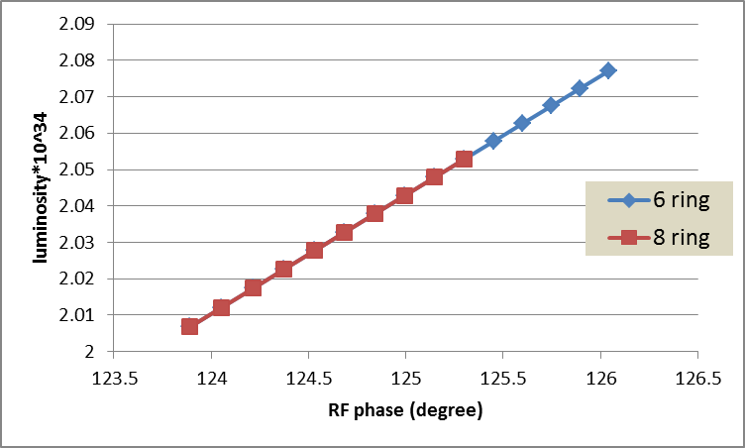
Luminosity error with RF phase adjustment
Error of luminosity: ~ 3.5% (6 ring), ~2.4% (8 ring)

Slide 12
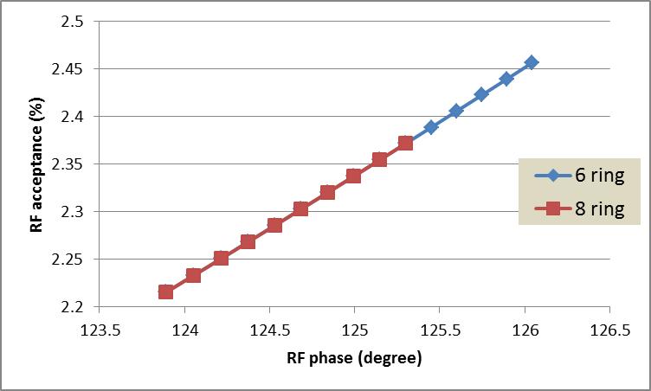
RF acceptance error with RF phase adjustment
Error of RF acceptance: ~ 10% (6 ring), ~ 7% (8 ring)

Slide 13
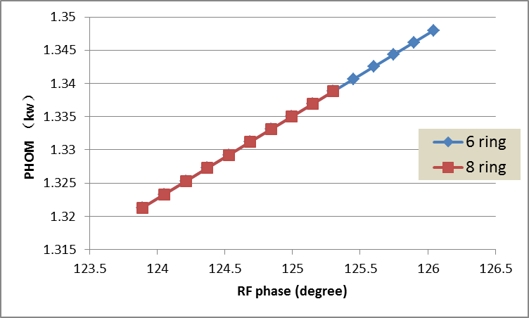
HOM power with RF phase adjustment
Error of HOM power: ~ 2% (6 ring), ~ 1% (8 ring)

Slide 14
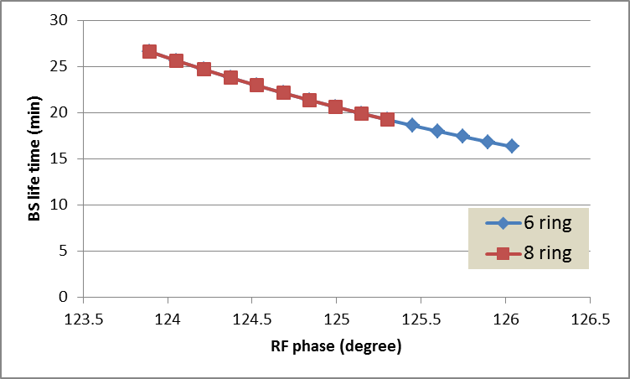
BS life time with RF phase adjustment
Error of BS life time: ~-37% (6 ring), ~-30% (8 ring)
BS life time will be lower than the requirement!!

Slide 15
parameter for CEPC partial double ring
（wangdou20160325）
 | Pre-CDR | H-high lumi. | H-low power | W | Z
Number of IPs | 2 | 2 | 2 | 2 | 2
Energy (GeV) | 120 | 120 | 120 | 80 | 45.5
Circumference (km) | 54 | 54 | 54 | 54 | 54
SR loss/turn (GeV) | 3.1 | 2.96 | 2.96 | 0.59 | 0.062
Half crossing angle (mrad) | 0 | 15 | 15 | 15 | 15
Piwinski angle | 0 | 2.5 | 2.6 | 5 | 7.6
N_{e}/bunch (10¹¹) | 3.79 | 2.85 | 2.67 | 0.74 | 0.46
Bunch number | 50 | 67 | 44 | 400 | 1100
Beam current (mA) | 16.6 | 16.9 | 10.5 | 26.2 | 45.4
SR power /beam (MW) | 51.7 | 50 | 31.2 | 15.6 | 2.8
Bending radius (km) | 6.1 | 6.2 | 6.2 | 6.1 | 6.1
Momentum compaction (10⁻⁵) | 3.4 | 2.5 | 2.2 | 2.4 | 3.5
β_{IP} x/y (m) | 0.8/0.0012 | 0.25/0.00136 | 0.268 /0.00124 | 0.1/0.001 | 0.1/0.001
Emittance x/y (nm) | 6.12/0.018 | 2.45/0.0074 | 2.06 /0.0062 | 1.02/0.003 | 0.62/0.0028
Transverse σ_{IP} (um) | 69.97/0.15 | 24.8/0.1 | 23.5/0.088 | 10.1/0.056 | 7.9/0.053
ξ_{x}/IP | 0.118 | 0.03 | 0.032 | 0.008 | 0.006
ξ_{y}/IP | 0.083 | 0.11 | 0.11 | 0.074 | 0.073
V_{RF} (GV) | 6.87 | 3.62 | 3.53 | 0.81 | 0.12
f _{RF} (MHz) | 650 | 650 | 650 | 650 | 650
Nature σ_{z} (mm) | 2.14 | 3.1 | 3.0 | 3.25 | 3.9
Total σ_{z} (mm) | 2.65 | 4.1 | 4.0 | 3.35 | 4.0
HOM power/cavity (kw) | 3.6 | 2.2 | 1.3 | 0.99 | 0.99
Energy spread (%) | 0.13 | 0.13 | 0.13 | 0.09 | 0.05
Energy acceptance (%) | 2 | 2 | 2
Energy acceptance by RF (%) | 6 | 2.2 | 2.1 | 1.7 | 1.1
n_{γ} | 0.23 | 0.47 | 0.47 | 0.3 | 0.24
Life time due to beamstrahlung_cal (minute) | 47 | 36 | 32
F (hour glass) | 0.68 | 0.82 | 0.81 | 0.92 | 0.95
L_{max}/IP (10³⁴cm⁻²s⁻¹) | 2.04 | 2.96 | 2.01 | 3.09 | 3.09

Slide 16
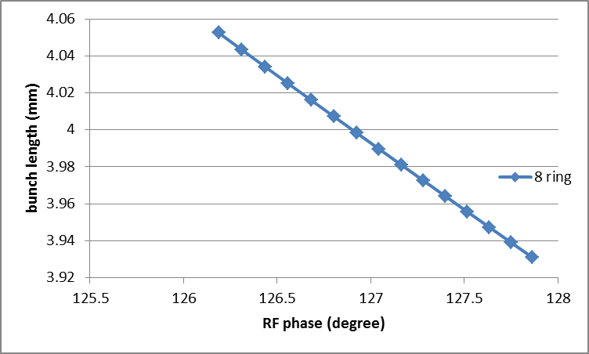
Bunch length error with RF phase adjustment
Error of bunch length: ~-3% (8 ring)

Slide 17
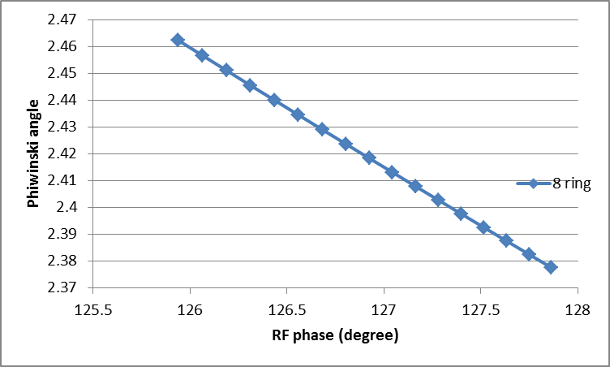
Piwinski error with RF phase adjustment
Error of Piwinski angle: ~-3% (8 ring)

Slide 18
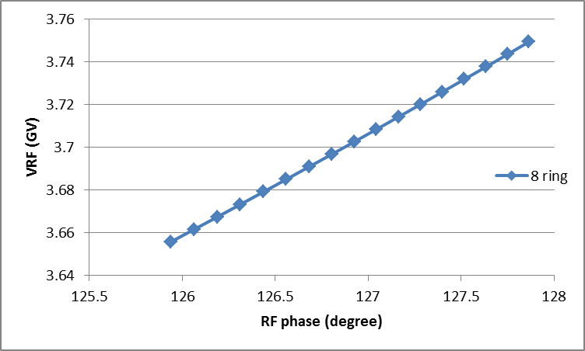
RF voltage error with RF phase adjustment
Error of V_{RF}: ~ 2.6% (8 ring)
RF efficiency will be a little lower than 100%.

Slide 19
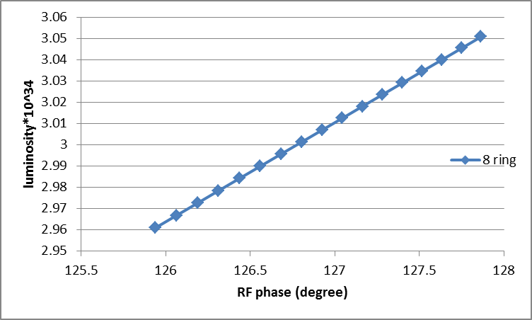
Luminosity error with RF phase adjustment
Error of luminosity: ~3% (8 ring)

Slide 20
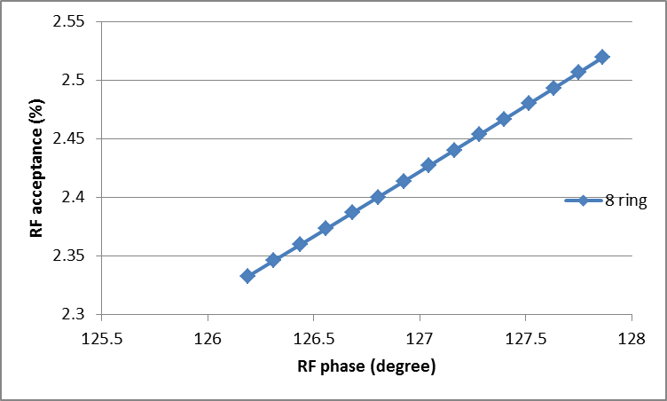
RF acceptance error with RF phase adjustment
Error of RF acceptance: ~ 8% (8 ring)

Slide 21
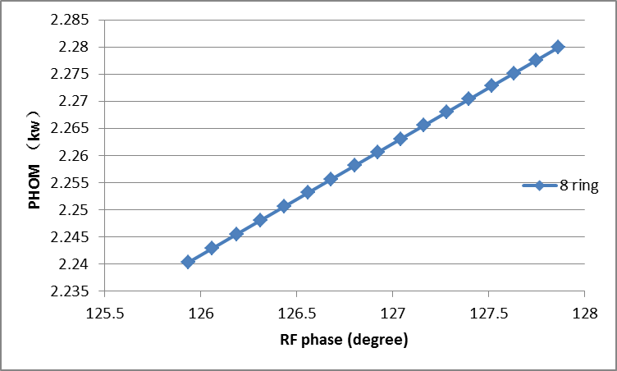
HOM power with RF phase adjustment
Error of HOM power: ~ 1.8% (8 ring)

Slide 22
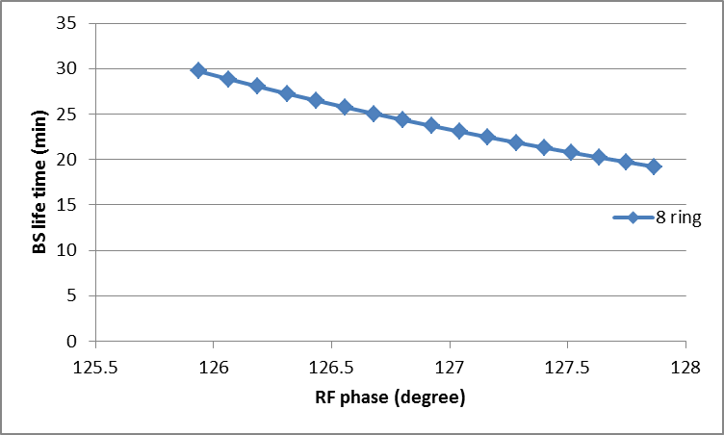
BS life time with RF phase adjustment
Error of BS life time: ~-36% (8 ring)
BS life time will be lower than the requirement!!

Slide 23
parameter for CEPC partial double ring
（wangdou20160325）
 | Pre-CDR | H-high lumi. | H-low power | W | Z
Number of IPs | 2 | 2 | 2 | 2 | 2
Energy (GeV) | 120 | 120 | 120 | 80 | 45.5
Circumference (km) | 54 | 54 | 54 | 54 | 54
SR loss/turn (GeV) | 3.1 | 2.96 | 2.96 | 0.59 | 0.062
Half crossing angle (mrad) | 0 | 15 | 15 | 15 | 15
Piwinski angle | 0 | 2.5 | 2.6 | 5 | 7.6
N_{e}/bunch (10¹¹) | 3.79 | 2.85 | 2.67 | 0.74 | 0.46
Bunch number | 50 | 67 | 44 | 400 | 1100
Beam current (mA) | 16.6 | 16.9 | 10.5 | 26.2 | 45.4
SR power /beam (MW) | 51.7 | 50 | 31.2 | 15.6 | 2.8
Bending radius (km) | 6.1 | 6.2 | 6.2 | 6.1 | 6.1
Momentum compaction (10⁻⁵) | 3.4 | 2.5 | 2.2 | 2.4 | 3.5
β_{IP} x/y (m) | 0.8/0.0012 | 0.25/0.00136 | 0.268 /0.00124 | 0.1/0.001 | 0.1/0.001
Emittance x/y (nm) | 6.12/0.018 | 2.45/0.0074 | 2.06 /0.0062 | 1.02/0.003 | 0.62/0.0028
Transverse σ_{IP} (um) | 69.97/0.15 | 24.8/0.1 | 23.5/0.088 | 10.1/0.056 | 7.9/0.053
ξ_{x}/IP | 0.118 | 0.03 | 0.032 | 0.008 | 0.006
ξ_{y}/IP | 0.083 | 0.11 | 0.11 | 0.074 | 0.073
V_{RF} (GV) | 6.87 | 3.62 | 3.53 | 0.81 | 0.12
f _{RF} (MHz) | 650 | 650 | 650 | 650 | 650
Nature σ_{z} (mm) | 2.14 | 3.1 | 3.0 | 3.25 | 3.9
Total σ_{z} (mm) | 2.65 | 4.1 | 4.0 | 3.35 | 4.0
HOM power/cavity (kw) | 3.6 | 2.2 | 1.3 | 0.99 | 0.99
Energy spread (%) | 0.13 | 0.13 | 0.13 | 0.09 | 0.05
Energy acceptance (%) | 2 | 2 | 2
Energy acceptance by RF (%) | 6 | 2.2 | 2.1 | 1.7 | 1.1
n_{γ} | 0.23 | 0.47 | 0.47 | 0.3 | 0.24
Life time due to beamstrahlung_cal (minute) | 47 | 36 | 32
F (hour glass) | 0.68 | 0.82 | 0.81 | 0.92 | 0.95
L_{max}/IP (10³⁴cm⁻²s⁻¹) | 2.04 | 2.96 | 2.01 | 3.09 | 3.09

Slide 24
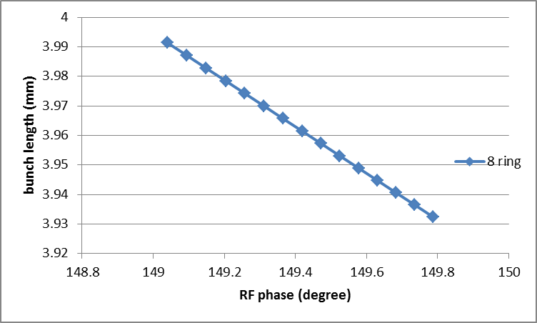
Bunch length error with RF phase adjustment
Error of bunch length: ~-1.5% (8 ring)

Slide 25
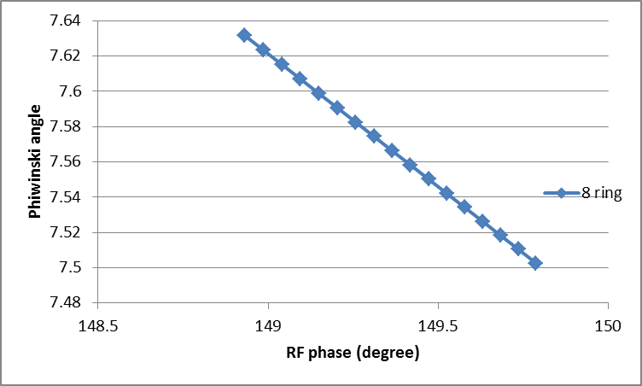
Piwinski error with RF phase adjustment
Error of Piwinski angle: ~-1.7% (8 ring)

Slide 26
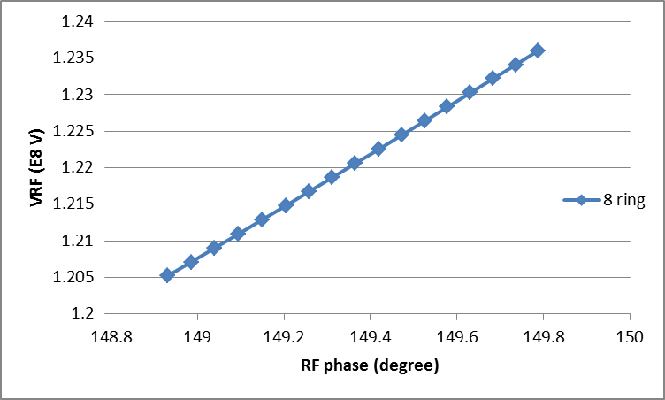
RF voltage error with RF phase adjustment
Error of V_{RF}: ~ 2.6% (8 ring)
RF efficiency will be a little lower than 100%.

Slide 27
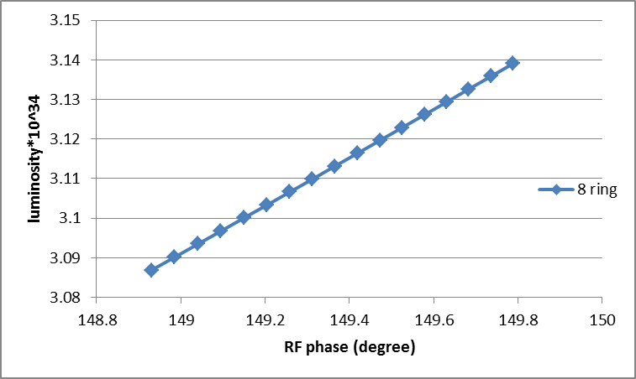
Luminosity error with RF phase adjustment
Error of luminosity: ~1.7% (8 ring)

Slide 28
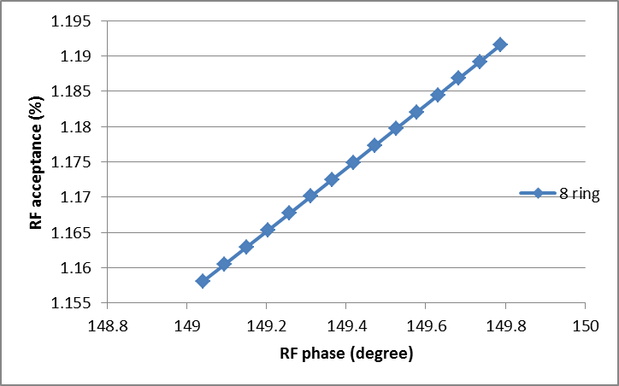
RF acceptance error with RF phase adjustment
Error of RF acceptance: ~ 3% (8 ring)

Slide 29
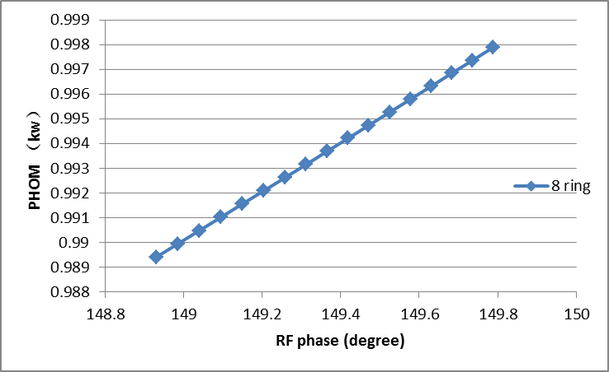
HOM power with RF phase adjustment
Error of HOM power: ~ 0.9% (8 ring)

Slide 30
Thanks！

