Slide 1
MODE Development & Some Try Based on It
ZHANG Yuan, LIU Weibin, WANG Dou, WANG Yiwei, GENG Huiping
July 29th , 2016

Slide 2
MODE: Scalable Enough at 1000-nodes farm?
Yongjun Li, “Multi-objective Dynamic Aperture Optimization for NSLS-II Ring”, IAS program on HEP Conference 2016, Hong Kong

Slide 3
New Parallel Paradigm
High Parallel + High Scalability
Even the time taken by different task is different
Even some node is very busy

Slide 4
Final Telescope optimization
Ref: Yunhai Cai, “An Accelerator Design of Circular Higgs Factory”, Jan, 2016, IAS Program on High Energy Physics, HKUST

Slide 5
Variables
L* = 2m fixed
All other drift may be varied, > 0.5m
Q1-4 strength may be varied,
L of Q1-4 may be varied, in (0.5, 2.5)
Totally 12 variables

Slide 6
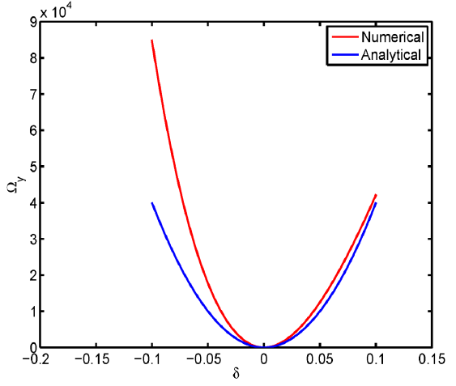
Chromatic Mismatch Parameters
Design Objective:
Minimize the Mismatch Parameter $Ω_{y}$?

Slide 7
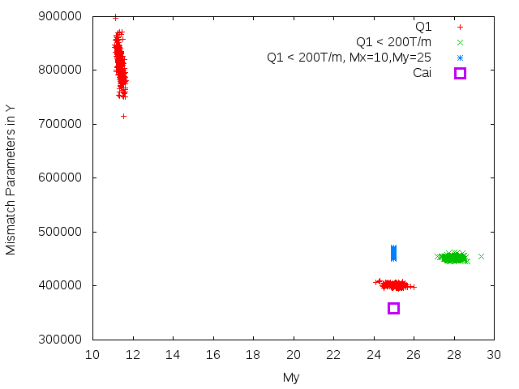
MismatchY = Sum of $Ω\left(δ\right)$,
for $δ$ = -0.11:0.02:0.11
Case Q1: No Extra Constraints
Case Q1<200T/m
Case Q1<200T/m, Mx=10, My=25
Case Cai (thin lens model)

Slide 8
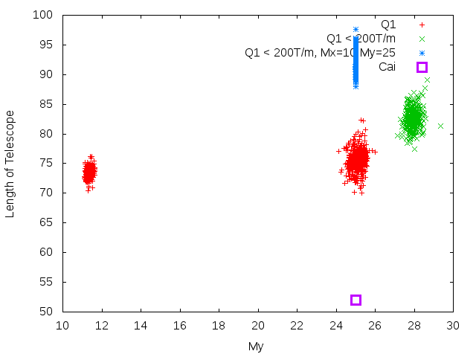
My – Length of Telescope

Slide 9
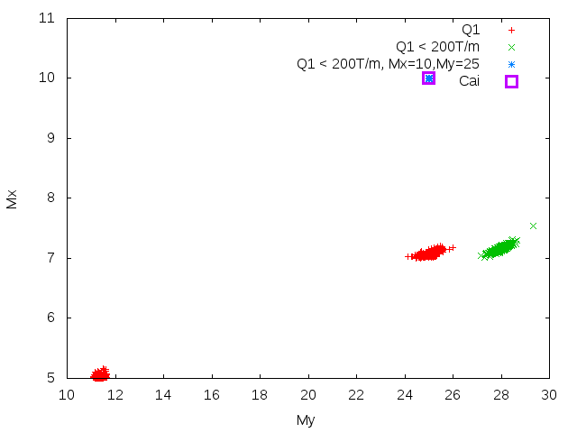
My-Mx

Slide 10
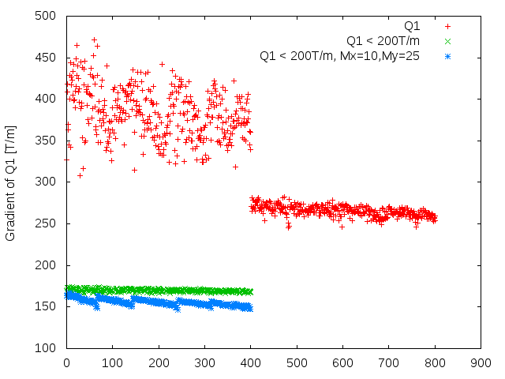
Gradient of Q1

Slide 11
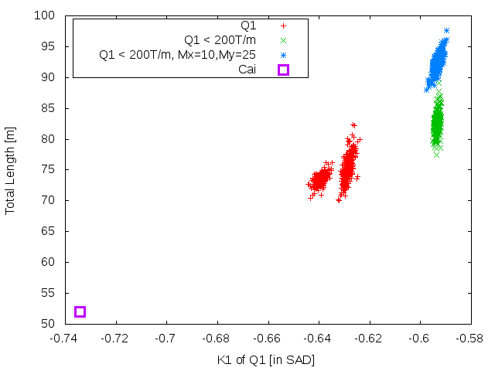
K1 of Q1 – Length of Telescope

Slide 12
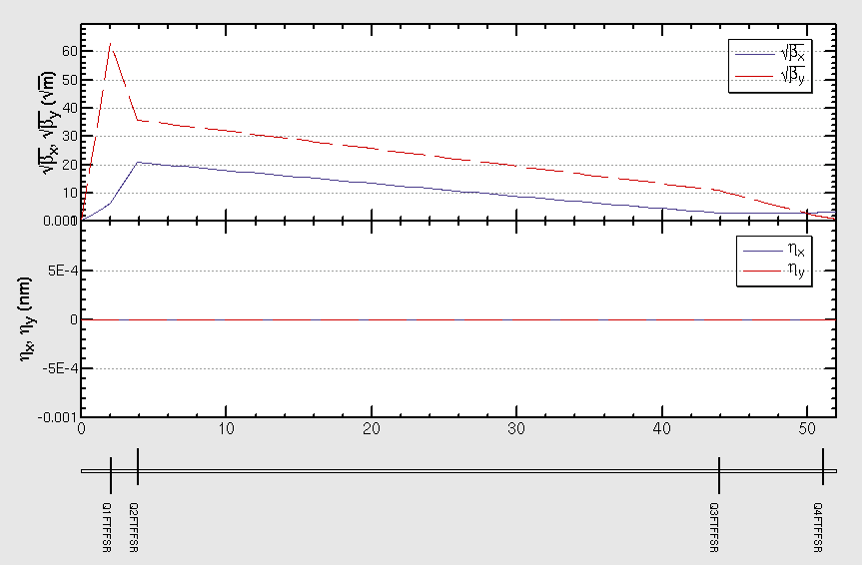
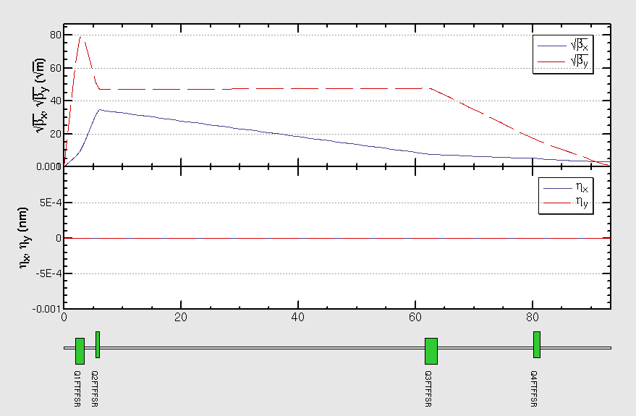
Optics

Slide 13
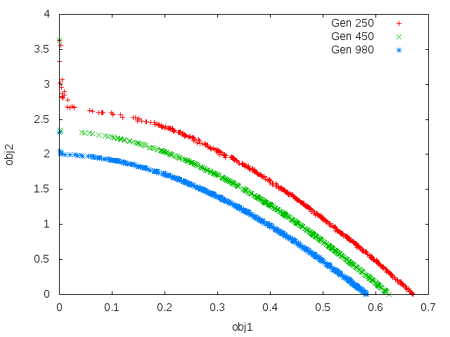
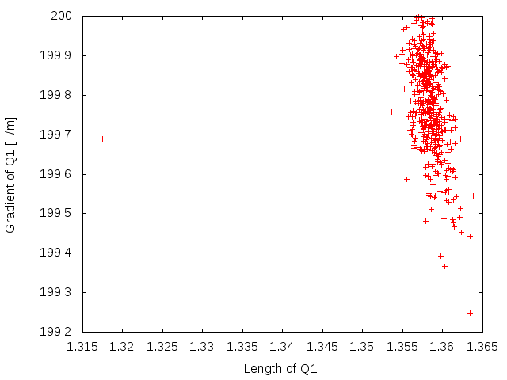
Constraint L < 60m, Mx/My=10/25, Q1 < 200T/m
Seems not convergent, no solution
It seems limited by Q1 gradient

Slide 14
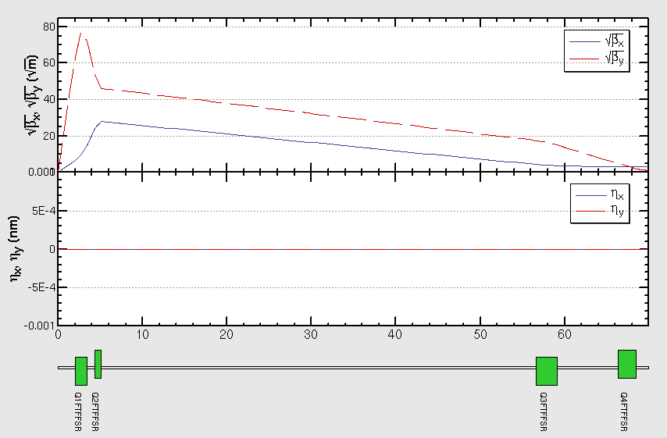
Constraint L < 70m, Mx/My=10/25, Q1 < 200T/m

Slide 15
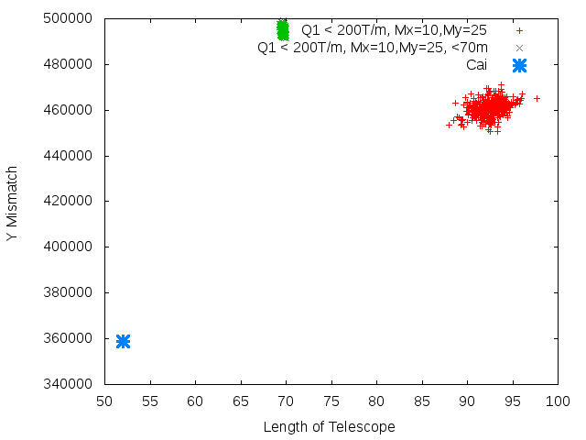
Mismatch - Length

Slide 16
CCY
Uc [keV] = 0.665 E^2 [GeV] * B[T]
Uc < 100keV, => B < 0.01 T
Cai: B = 0.084 T?! Uc = 800keV

Slide 17
Summary
High parallel MODE is implemented
We begin to use MODE to do some matching, parameter scan or optimization.

