Slide 1
Mainring prograss
6 fold emit：2.3nm
Analytical results are agree with numeric results.
8 sextupole families and two tune shift variables, and we got the result showed in the plot.
This is the best solution in that condition(8 sextupole families and two tune shift variables).
2rd chrom:270 3th chrom: 199. Pro.Cai say it is not bad, but expect more knobs to have better result.
If we want better result, more sextupole families and more tune shift variables are expected.(but he formulae are so long that Mathematica in my labtop will breakdown, maybe the code need optimization)

Slide 2
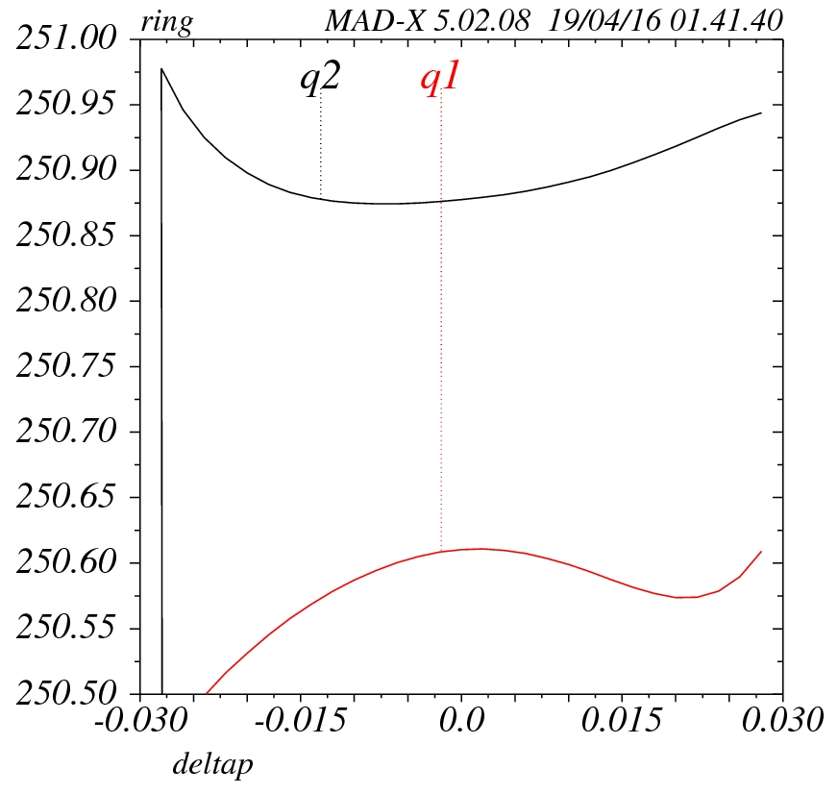
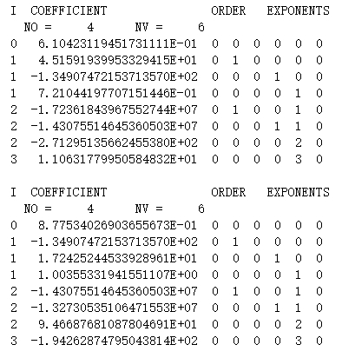

Slide 3
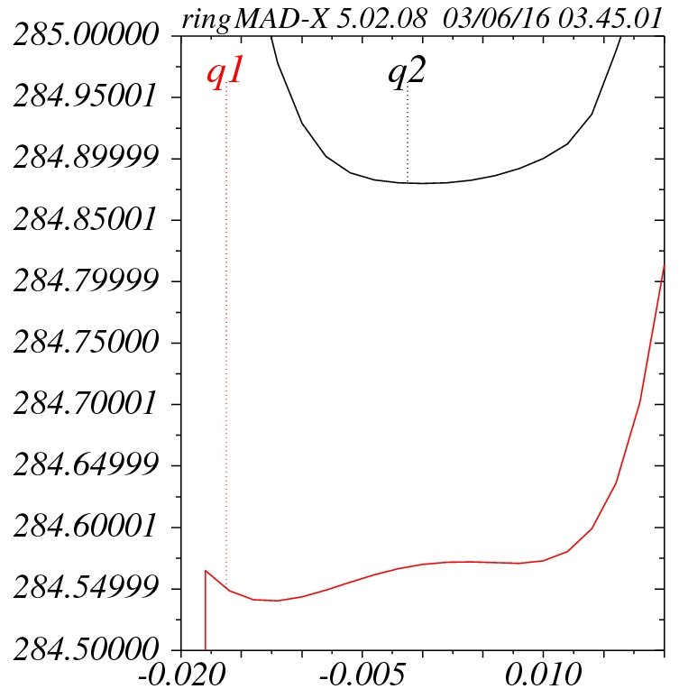

Slide 4
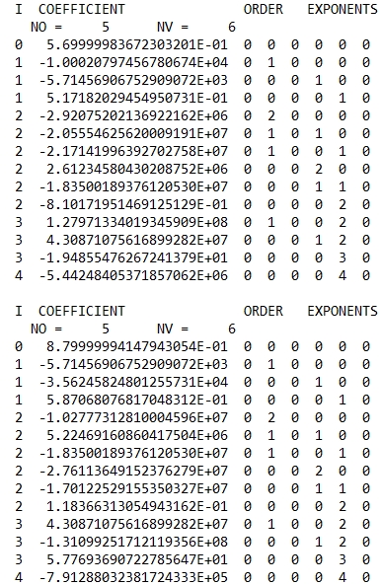
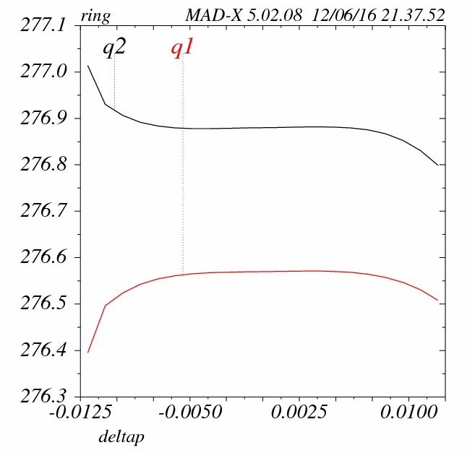

Slide 5
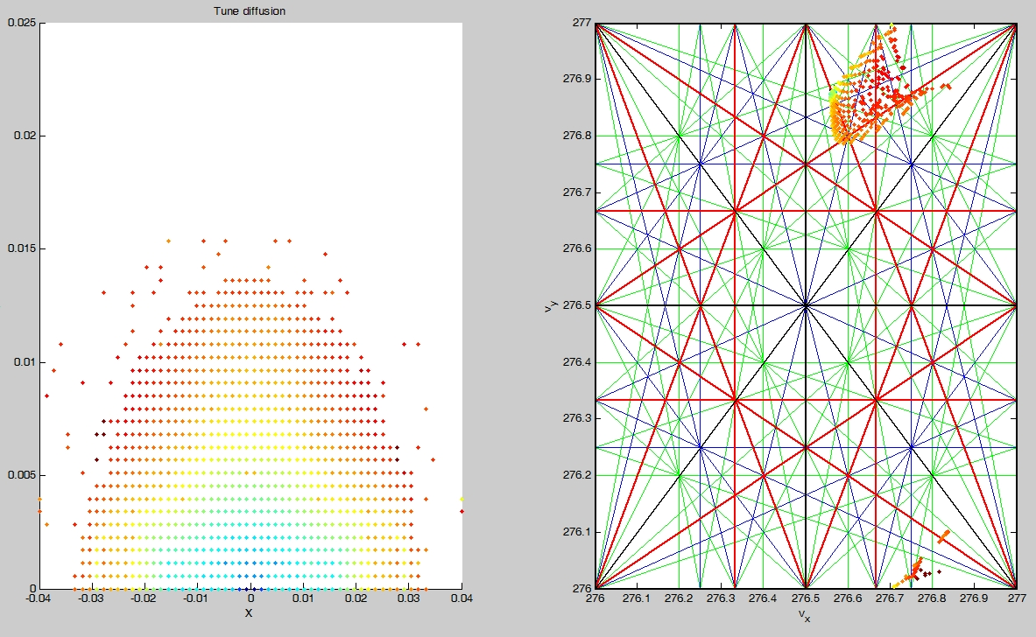
X=72.8sigma Y=1237.2sigma@0%

Slide 6
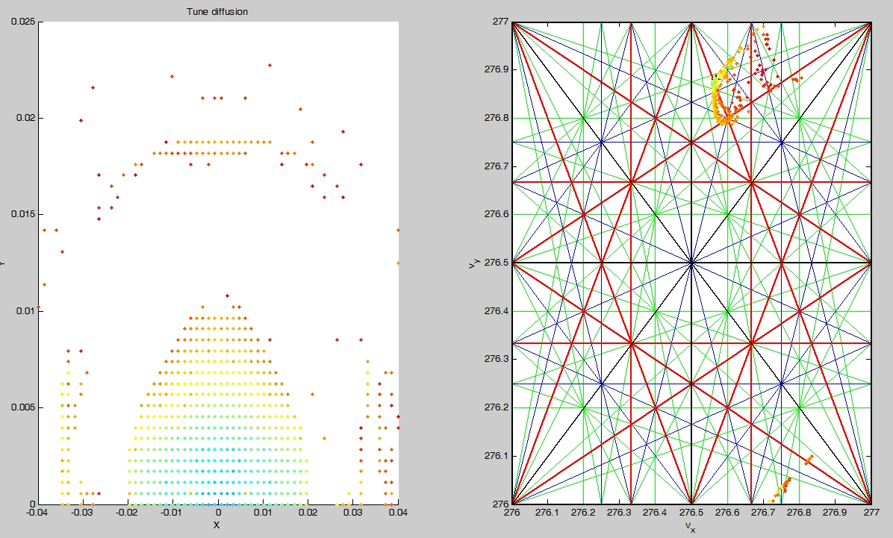
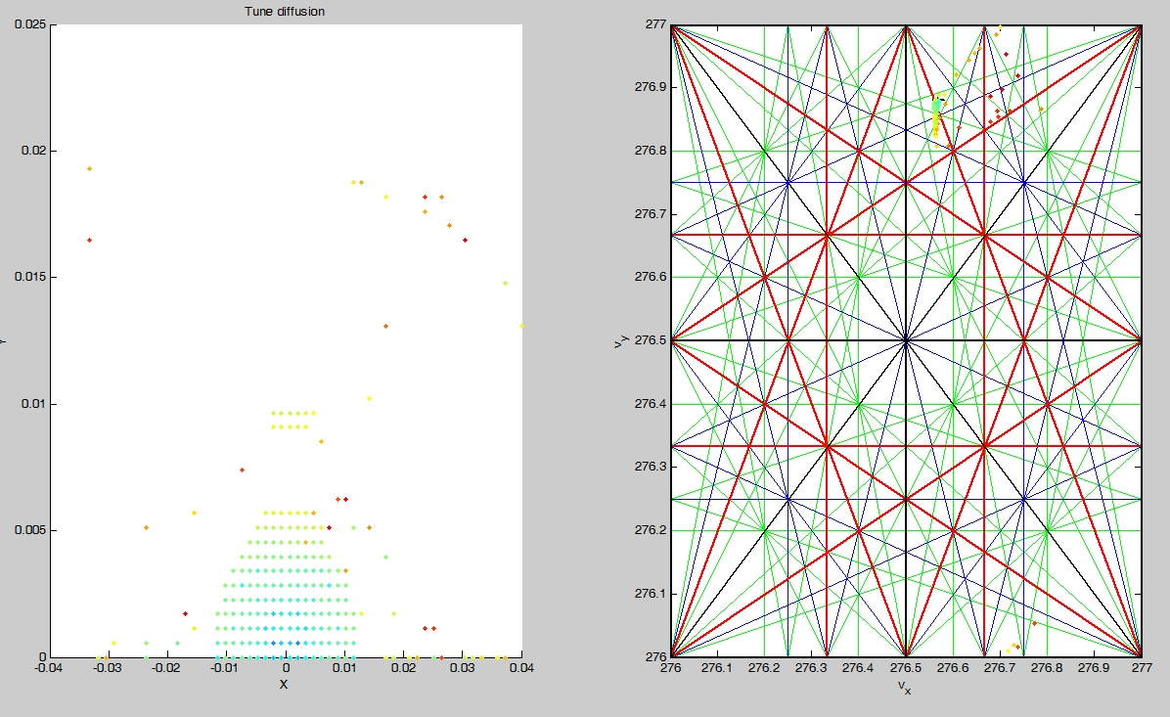
X=48.6sigma Y=824.8sigma@0.5%
X=24.3sigma Y=421.4sigma@1%

Slide 8
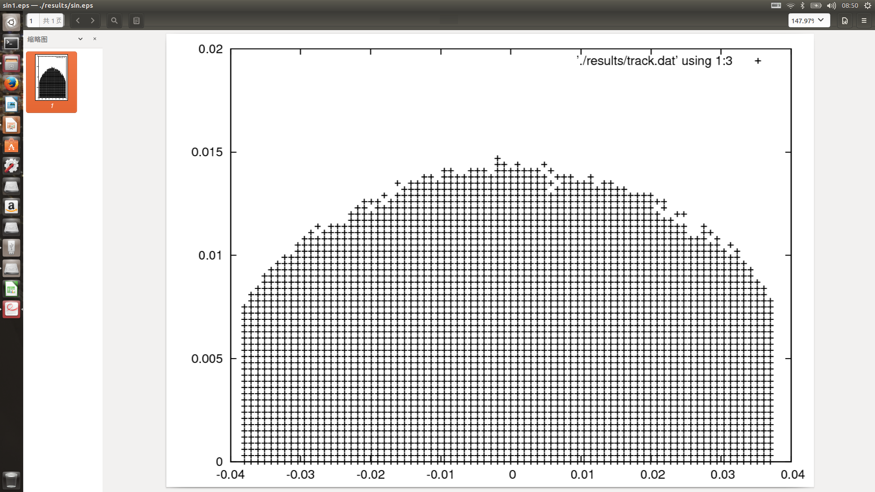
DA from my own code

Slide 9
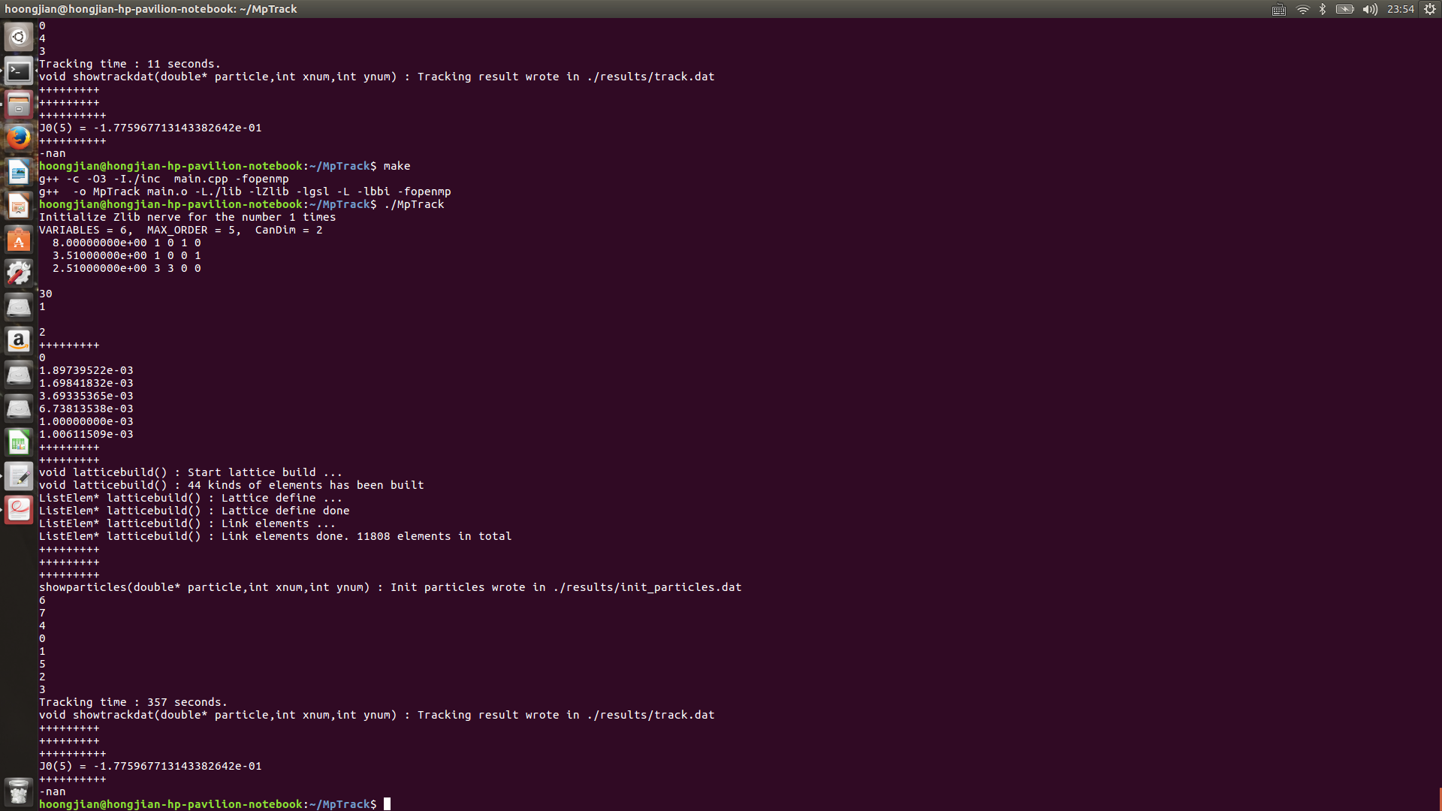
Less than 6 min with 8 core@i7_6700Q

Slide 10
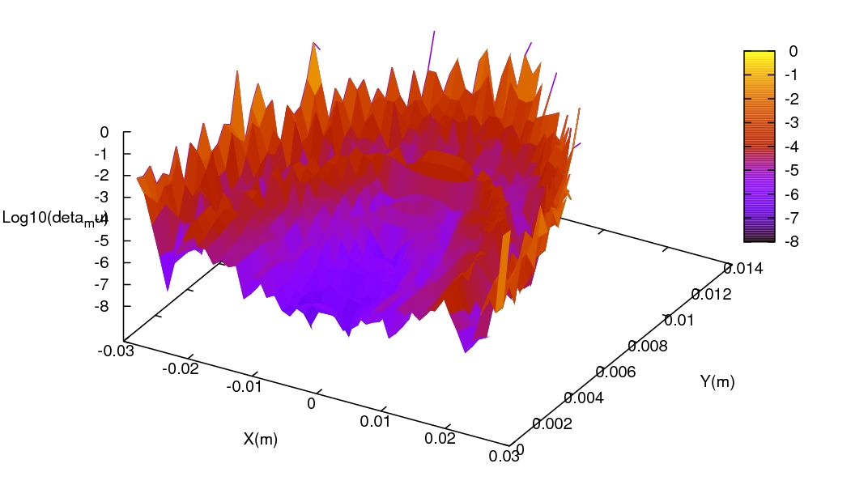
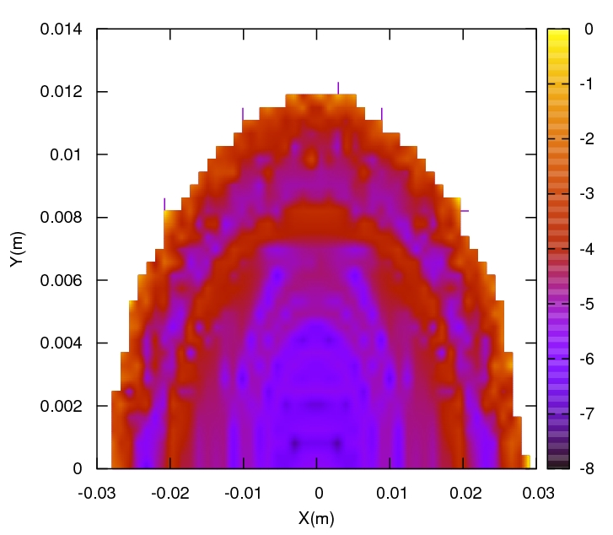
256 turns in 109 seconds

Slide 11
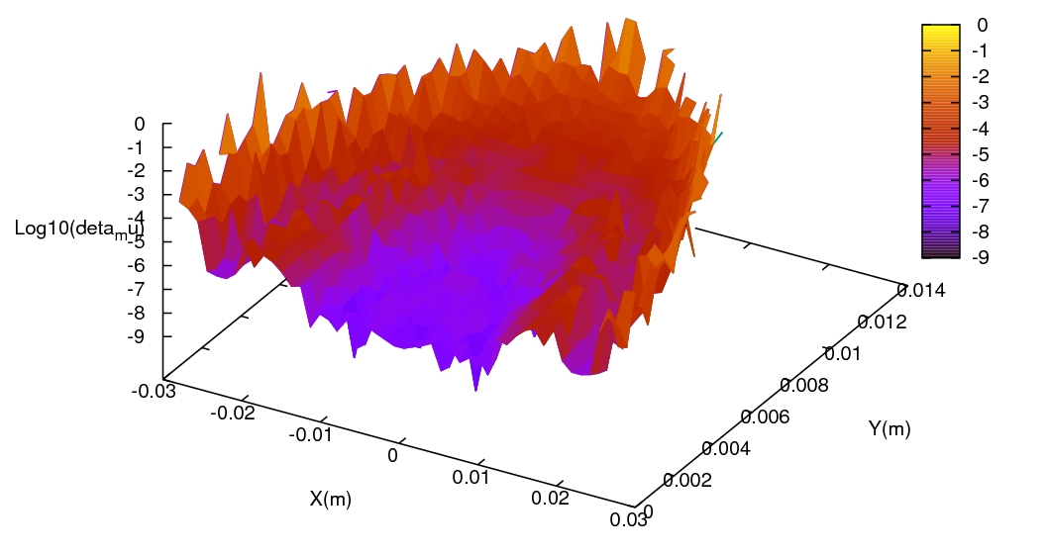
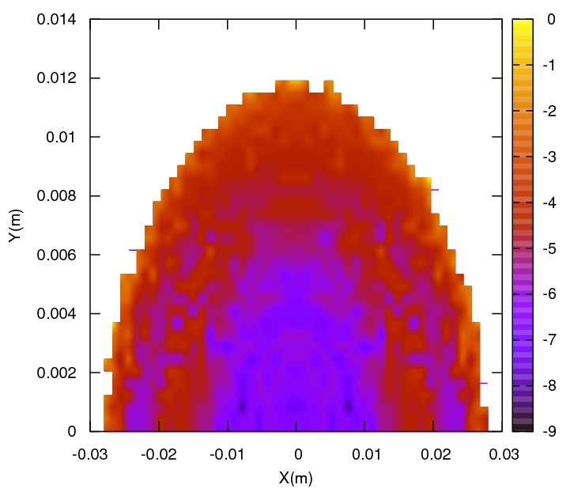
512 turns in 219 seconds

Slide 12
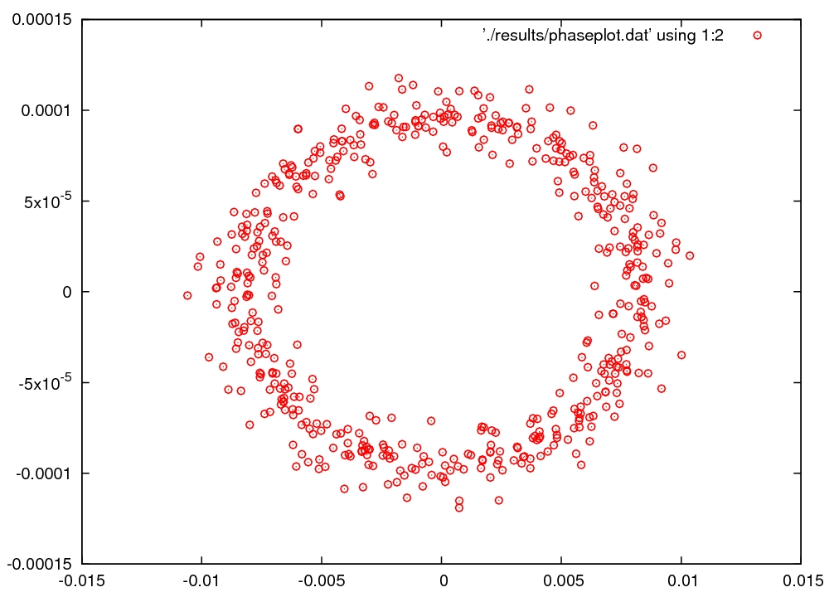
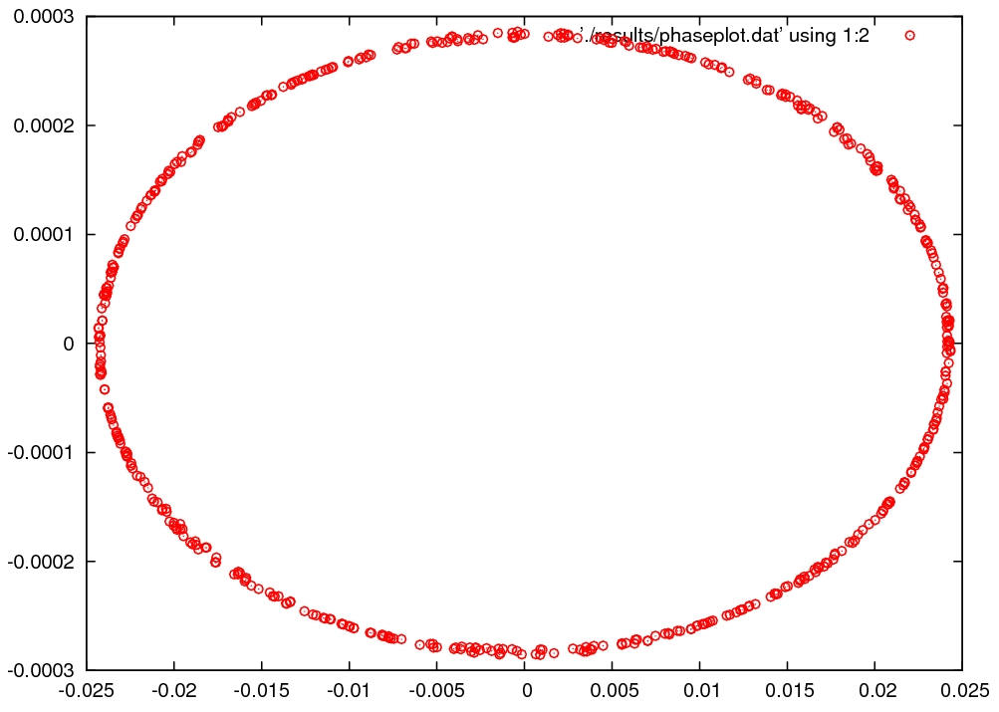
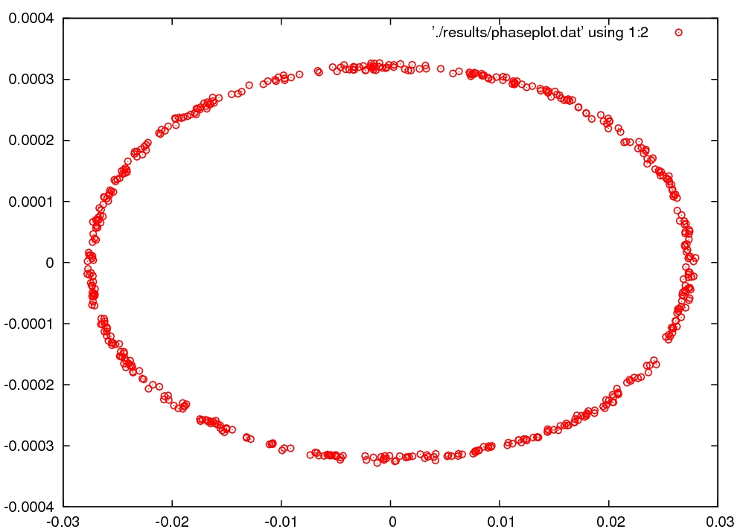
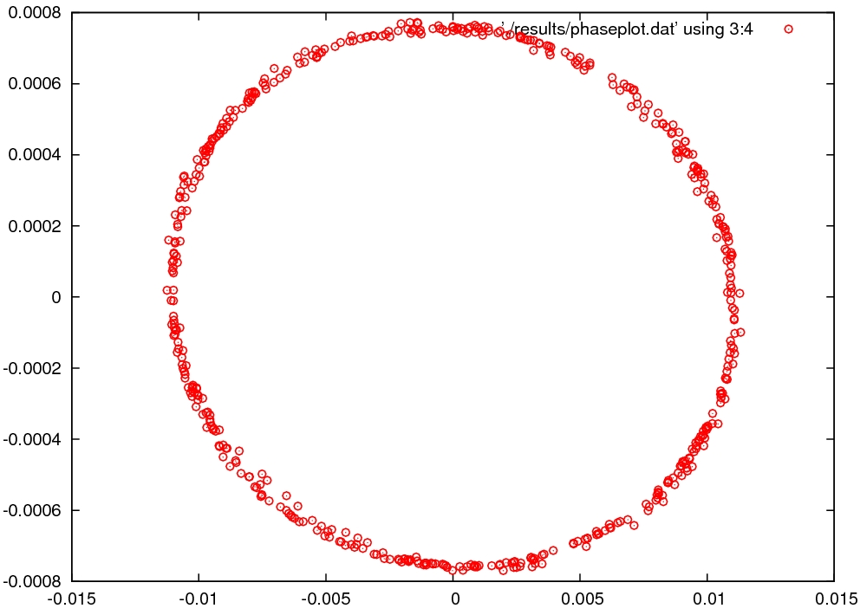
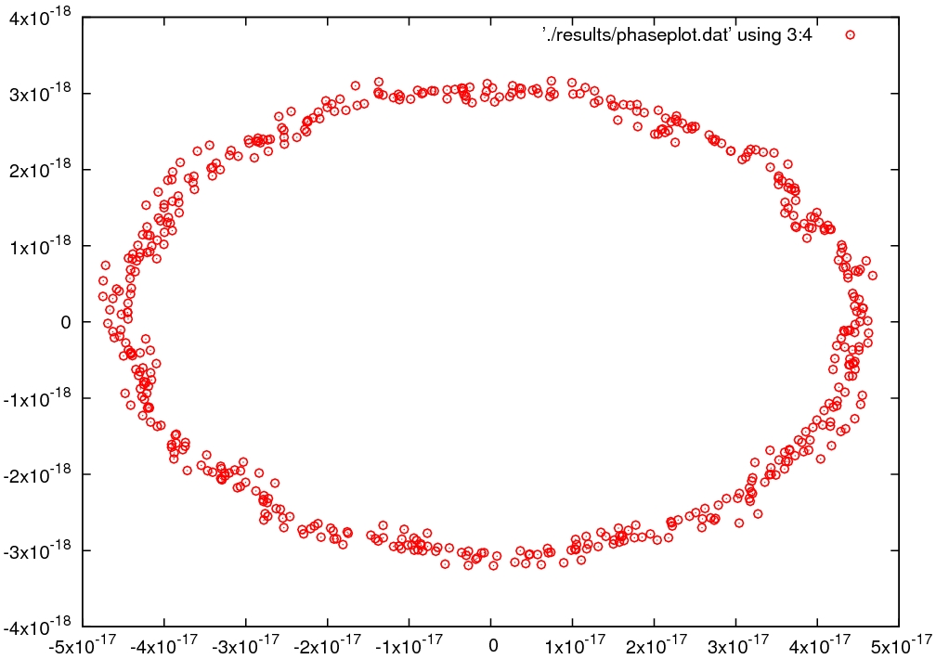
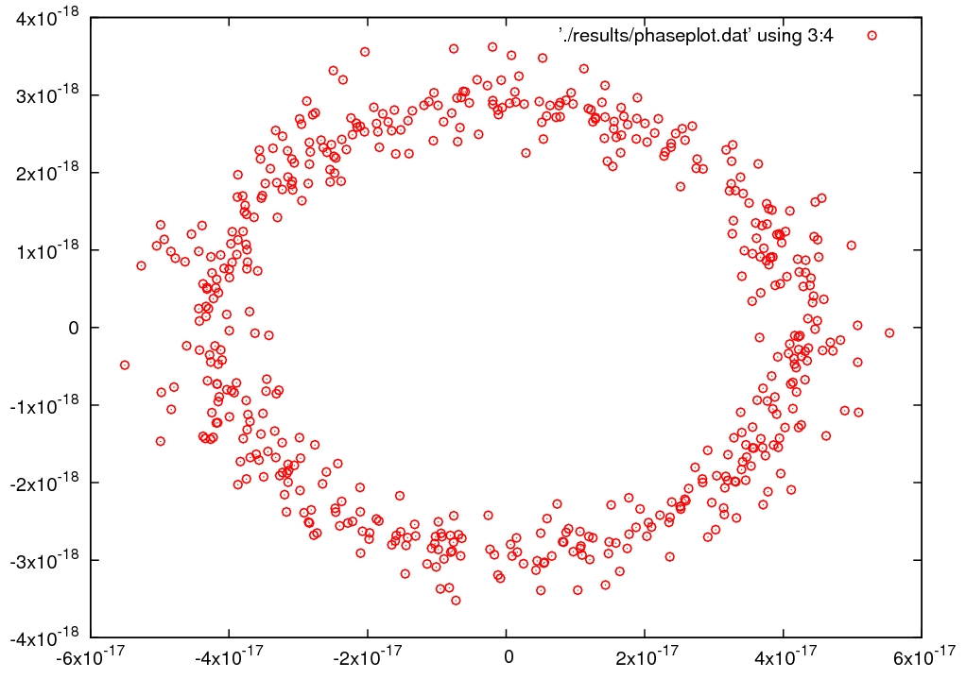
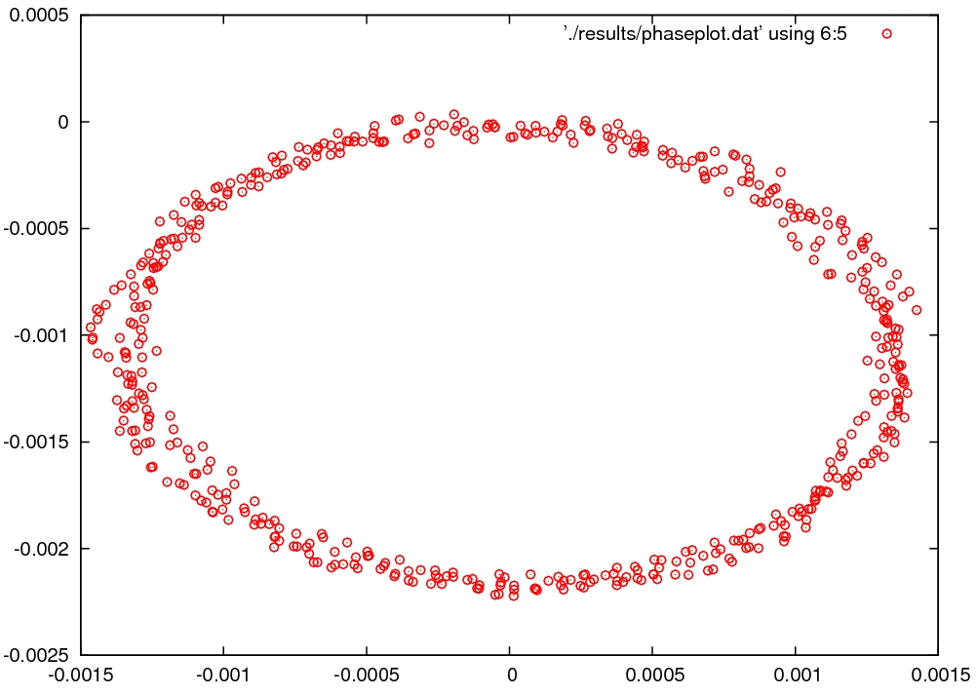
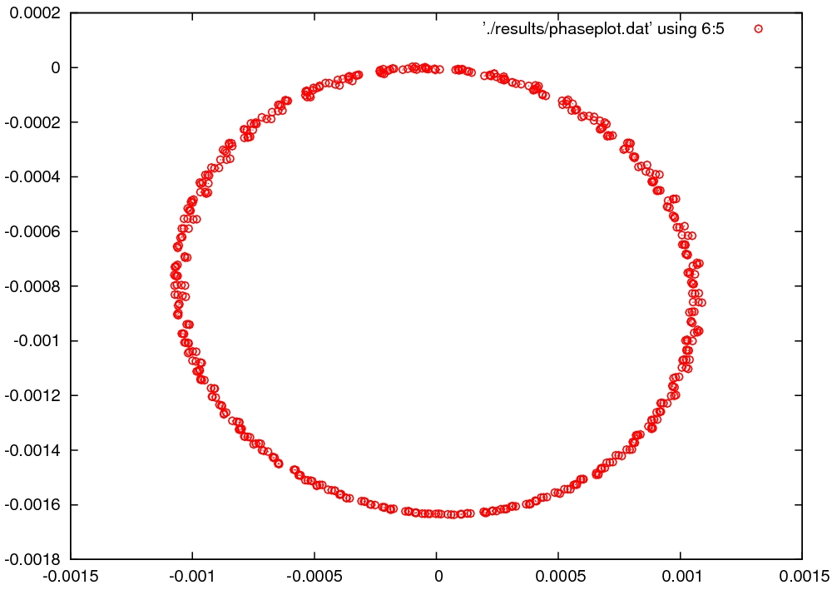
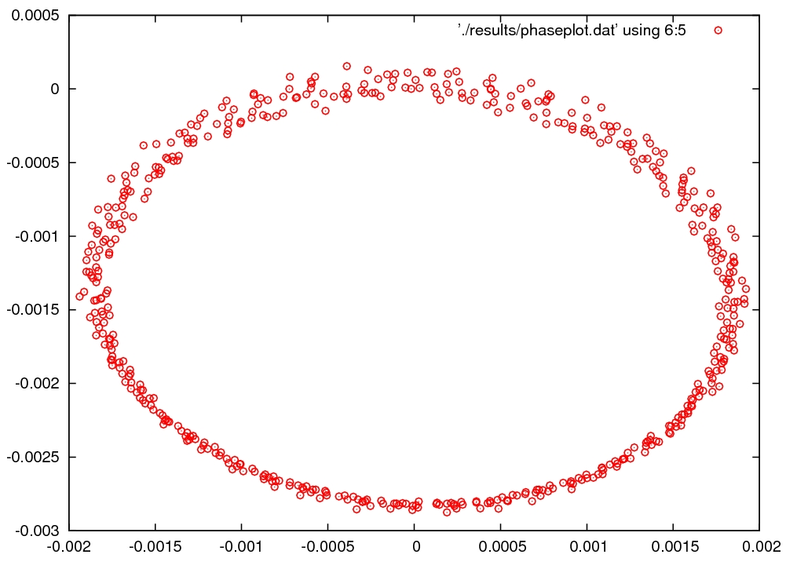
Phase space plot

Slide 13
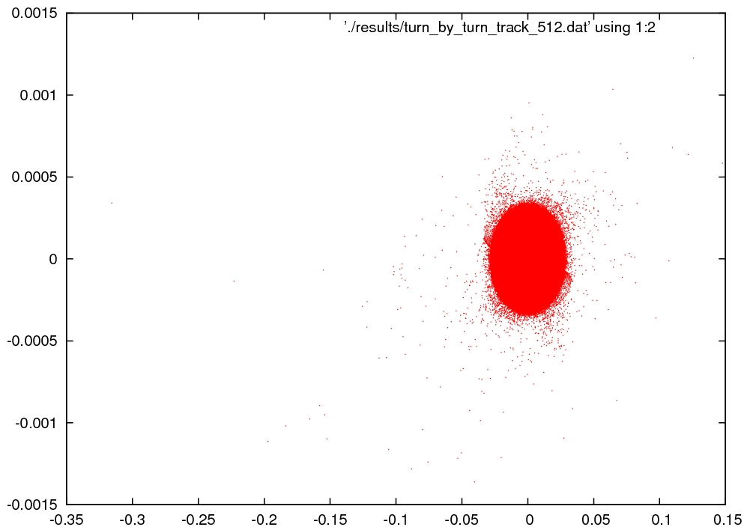

Slide 14
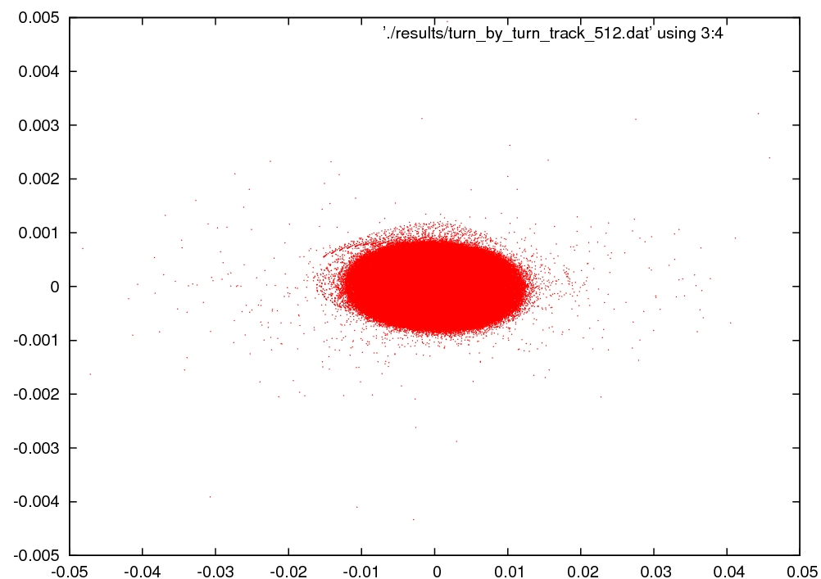

Slide 15
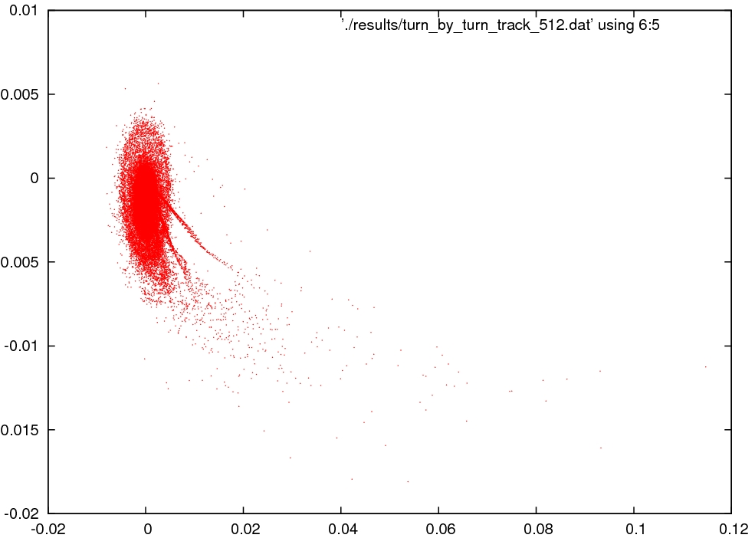

Slide 16
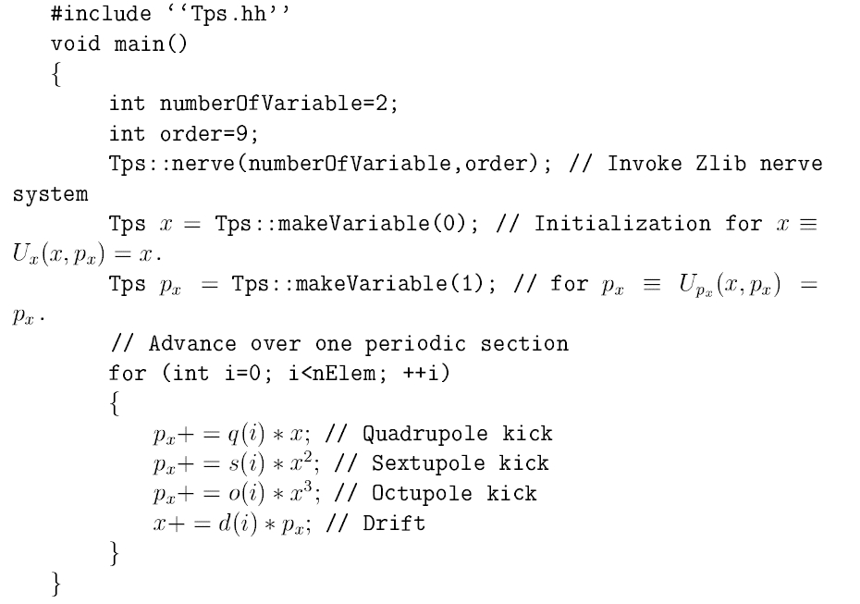
Difficulties
At begining, we want to use my own element simulator and link to Zlib to obtain the one-turn-map.
Zlib is the most suitable to this situation, with high efficiency and convenient.
The picture below shows the idea how to obtain one-turn-map using Zlib.(From Yan Yitong’s reprot)

Slide 17
Difficulties
When we check the results from Zlib carefully, we find that Zlib always lose the first order in some Tps operation(such as ‘*’ and ‘/’).
I read Yan’s papers and try to understand this result. Maybe it is because his tracking scheme.
We know the core idea of Zlib, and I can also write a library like Zlib. But it is little far from accelerator physics.
Now I am try to change his code. A little difficult, without handbook and comment.
Solutions:
change the simulator
Use some symbol libraries.
All of these will lose efficiency.

Slide 18
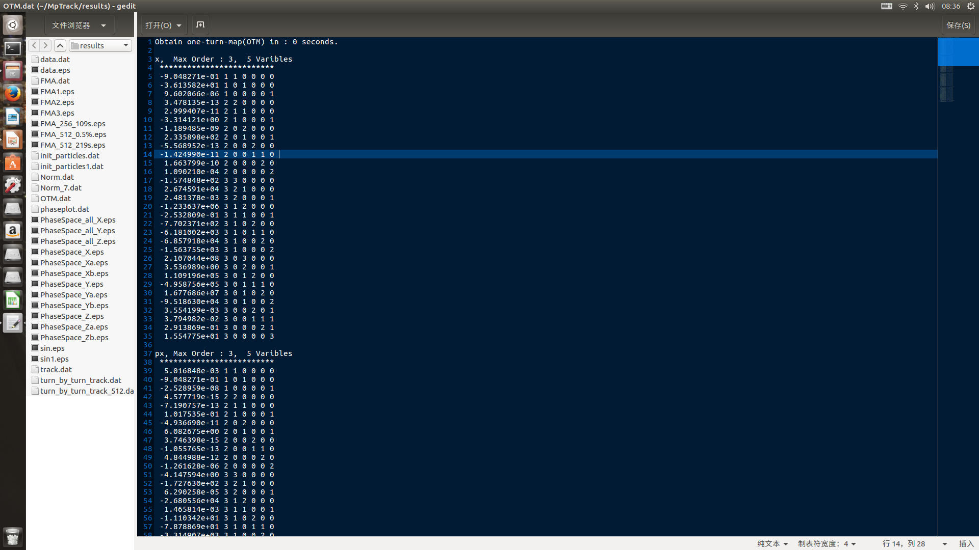

Slide 19
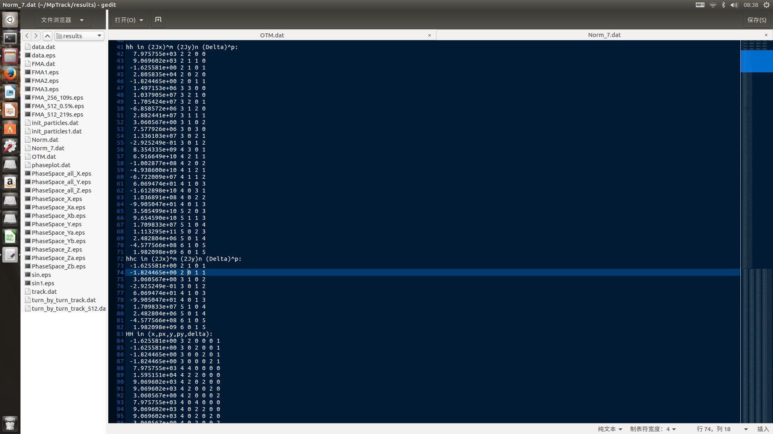

Slide 20
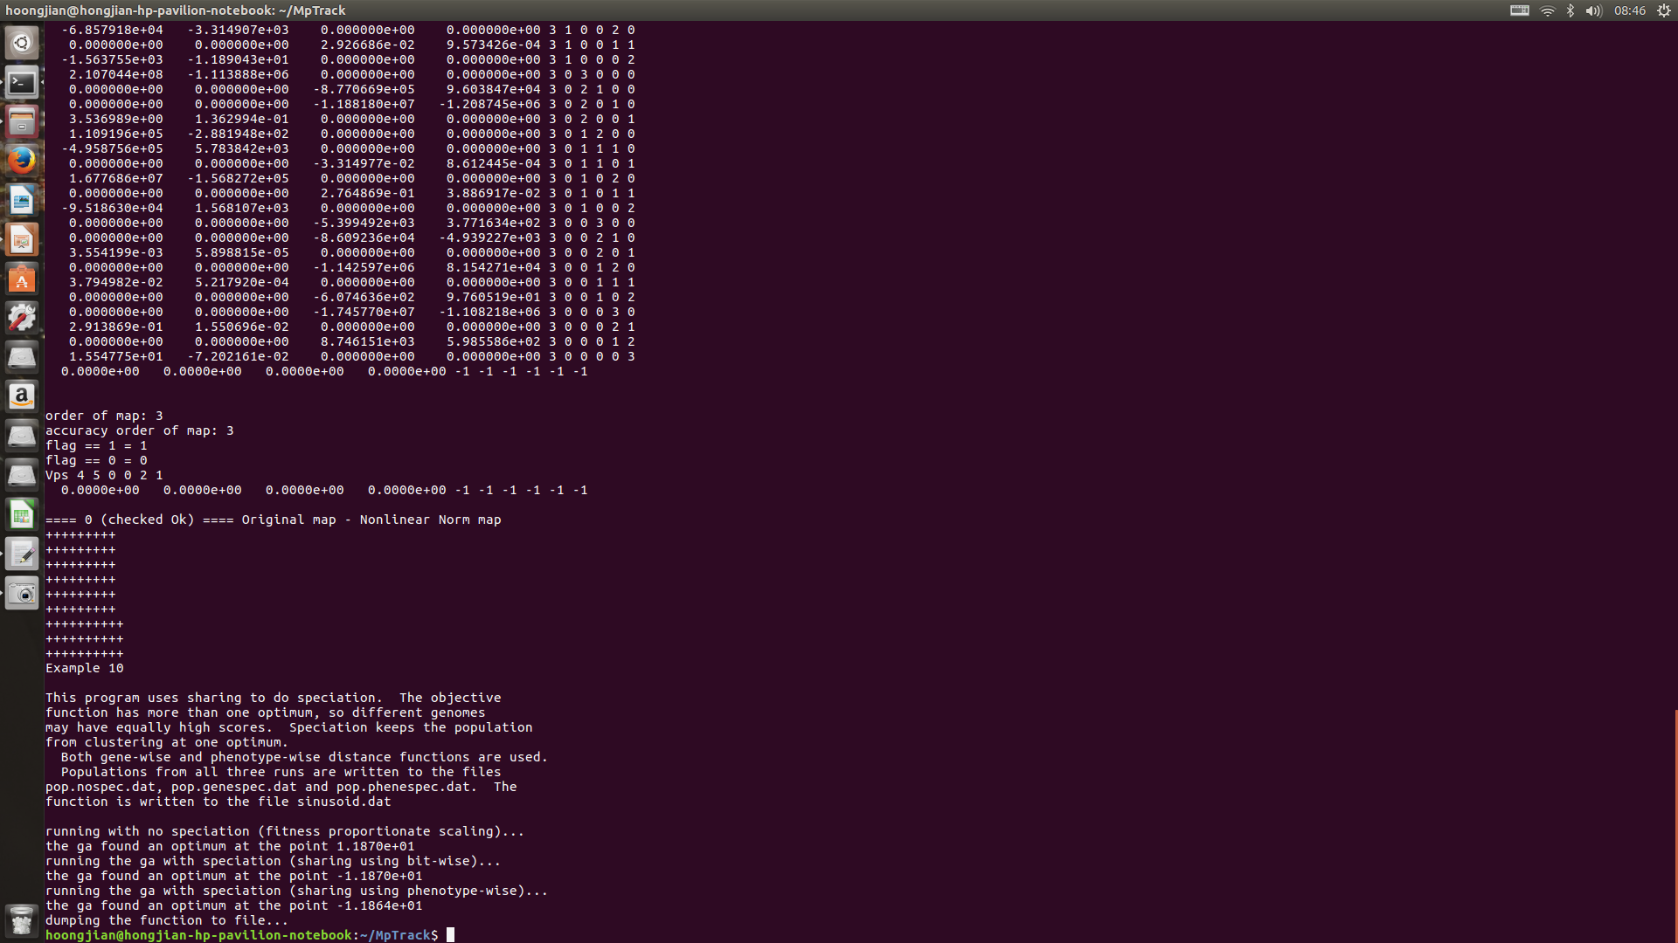

Slide 21
