Slide 1
CEPC injector beam dynamics
Guoxi Pei , Xiaoping Li, Shilun PEI, Jingru Zhang, Cai MENG, Xiangjian Wang
Institute of High Energy Physics, CAS, Beijing

Slide 2
Main parameters of Injector
Parameter | Symbol | Unit | Value
e⁻ /e⁺ beam energy | E_{e-}/E_{e+} | GeV | 6
Repetition rate | f_{rep} | Hz | 50
e⁻ /e⁺ bunch population @ 6 GeV | Ne-/Ne₊ |  | 2×10¹⁰
Energy spread (e⁻ /e⁺ ) | σ_{E} |  | <1×10⁻³
Emitance (e⁻ /e⁺ ) |  |  | 0.3 mm⋅ mrad
e⁻ beam energy on Target |  | GeV | 4
e⁻ bunch charge on Target |  | nC | 10

Slide 3
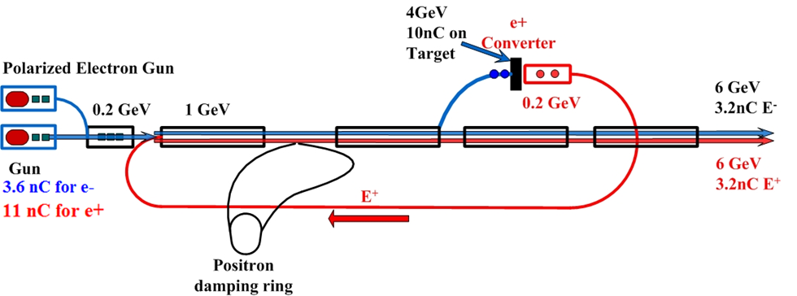
Layout of Injector
Injection time
Accelerating gradient@ different section: different accelerating tube
SLED (200 MeV-1.1GeV without SLED, Gradient?)
1.1 GeV damping ring

Slide 4
Capture RF system of positron
SuperKEKB
CEPC
80 MW
可以用到多高的梯度？
按照scale，可以用到20 MV/m
40 MW

Slide 5
Positron capture
r=15 mm
18 MV/m

Slide 6
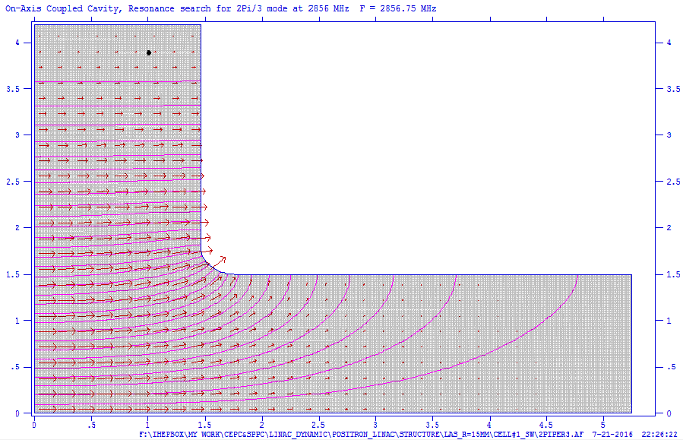
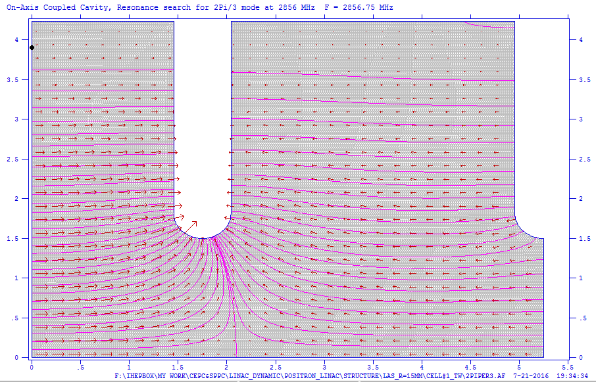
Large aperture accelerating tube

Slide 7
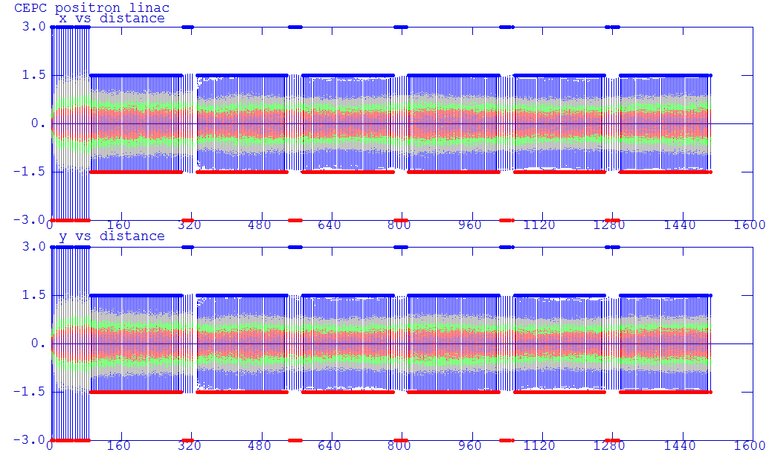
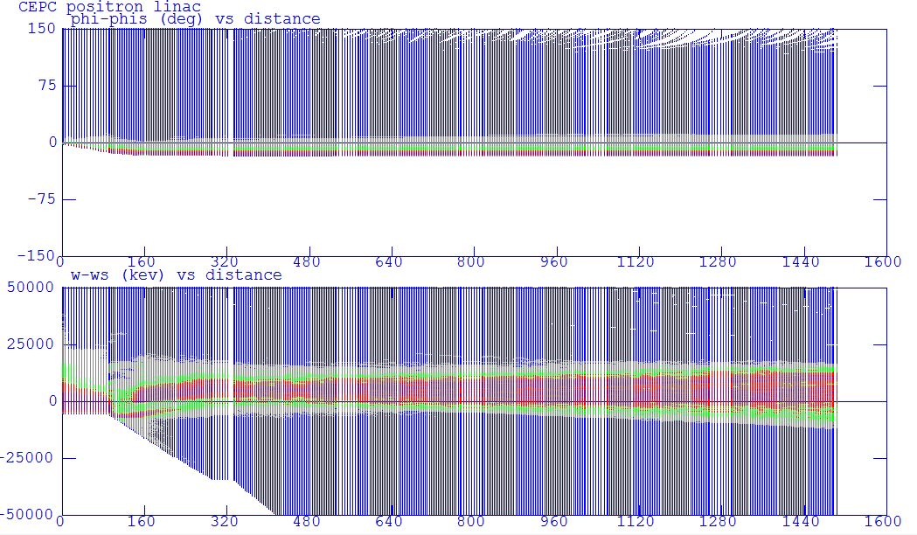
Beam envelope

Slide 8
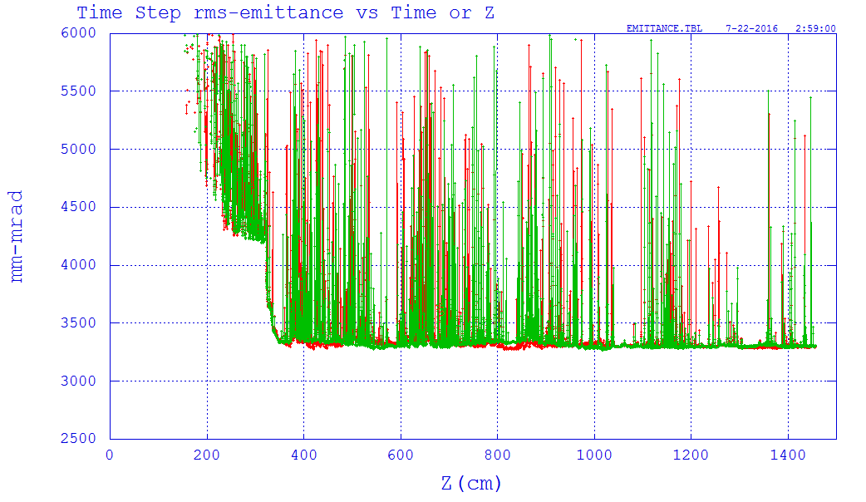
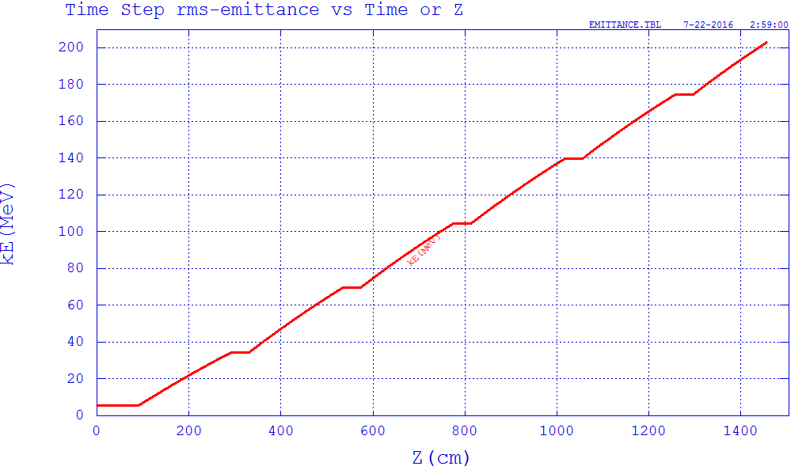
Emittance & Energy

Slide 9
Beam loss

Slide 10
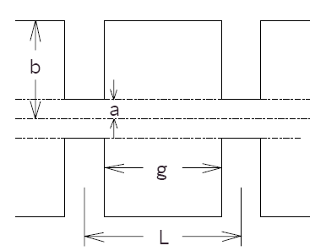
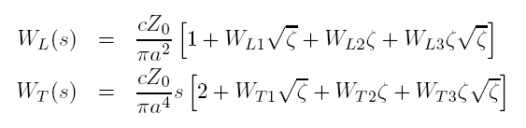
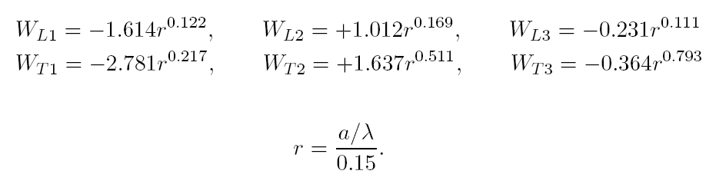

Longitudinal Short-Range Wakefield
Yokoya's wakefield model for periodic linac structure:

Slide 11
Longitudinal Short-Range Wakefield
Type | Freq. | 2a | 2b | t | L | Mode
 | MHz | mm | mm | mm | mm
S-band | 2856.75 | 22.6568 | 82.6276 | 5.842 | 34.9803 | 2π/3
C-band | 5713.5 | 14.2293 | 45.606 | 4.5 | 19.6764 | 3π/4

Slide 12
S-band simulation

Slide 13
S-band simulation

Slide 14
C-band simulation

Slide 15
Input condition
&bunched_beam
bunch=%s.bun
n_particles_per_bunch = 5000
emit_nx=0.003
emit_ny=0.003
sigma_dp=0.005
sigma_s=0.0008
use_twiss_command_values=1
one_random_bunch =1
distribution_cutoff[0] =3,3,3
distribution_type[0] =gaussian,gaussian,gaussian !for guass distribution
&end
82.3

Slide 16
Input condition
85.7

Slide 17
Input condition
85.9

