Slide 1
Work summary
Sha Bai
CEPC AP meeting
2016-07-29

Slide 2
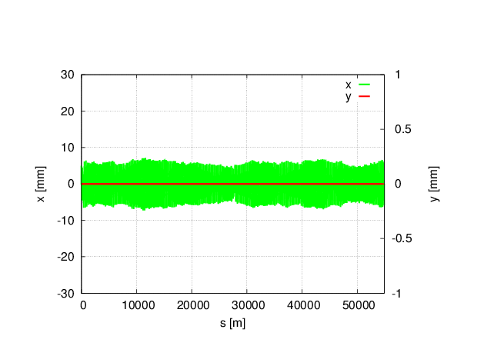
Magnet field error on DA in CEPC single ring
no error
With all (B,Q,S) B*L field errors, whole ring including FFS.
Tune has changed a lot: μ_{x}=0.0510854 μ_{y}= 0.1526778
Orbit correction and tune adjust are needed
Bend set to bend, and Quad and Sext set to be MULT
Tracking in 240 turns, coupling factor κ=0.003 for ε_{y}
Could be cured by adjusting the current during commissioning

Slide 3
Multipole errors effect on DA in CEPC single ring
Bend multipole errors (whole ring including FFS)
Quad multipole errors
(whole ring including FFS)
Sextupole multipole errors(whole ring including FFS)
(B,Q,S)multiple errors
(whole ring including FFS)
Off-momentum DA is not changed obviously, with 2% (1σ_{x}, 7σ_{y}), on-momentum DA is reduced to one third of the original.
Tune is kept, no effect on tune
Orbit is kept to be zero, no effect on orbit
Bend is set to be bend, but quadrupole and sextupole are set to be MULT
Tracking in 240 turns, Coupling factor κ=0.003 for emitty
Multipole errors can not be cured during commissioning, but could be accepted due to the not obvious change of off-momentum DA.

Slide 4
Magnet field error on DA in CEPC partial double ring
Main effect coming from the bending magnet
With bend B*L error
(whole ring including FFS)
μ_{x}= 0 μ_{y}= 0
Orbit in X
With bend B*L error
(whole ring including FFS)
Orbit in Y
With bend B*L error
(whole ring including FFS)
no error
With bending magnet field errors, horizontal orbit has changed a lot, but vertical has no change
Tune has changed to be an integer resonance, beam is not stable.
Orbit correction is needed in horizontal
Tracking in 240 turns, coupling factor κ=0.003 for ε_{y}
Could be cured by adjusting the current during commissioning

Slide 5
Multipole errors effect on DA in CEPC partial double ring
Multipole errors of all magnets
Multipole errors of bend
Multipole errors of quadurpoles
Multipole errors of sextupoles
Multipole errors reduce DA a little bit , but not much. It seems to have not much effect on DA, especially of off-momentum DA.
Orbit has no change due to multipole errors.

Slide 6
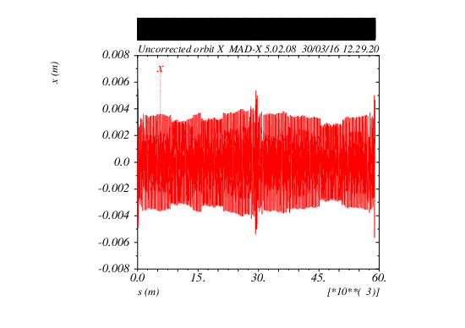
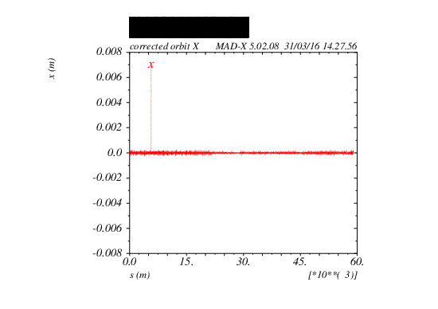
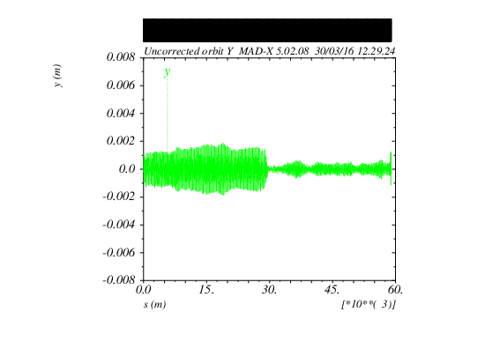
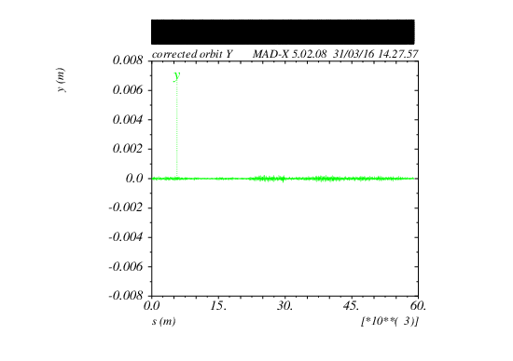
Orbit correction result
Before correction
After correction
Lattice版本：
CEPC-ARC1.0-PDR1.0-FFS (WD1.0)

Slide 7
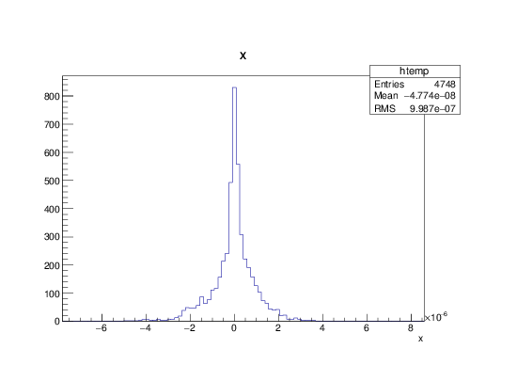
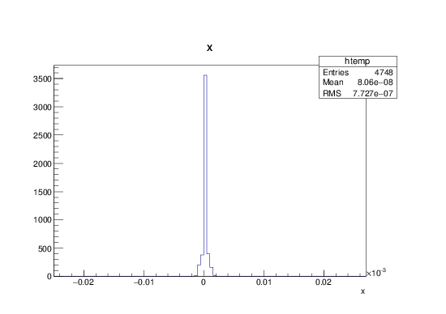
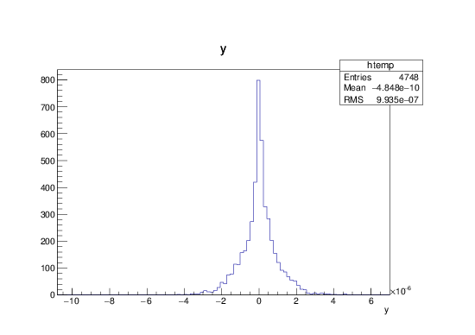
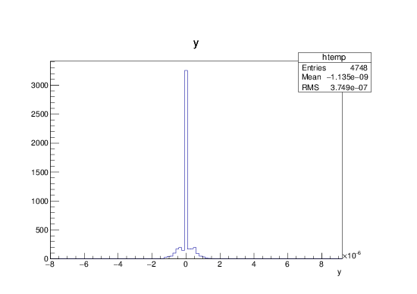
BPM readings and correctors strength statistic
BPM readings statistic
Correctors strength statistic
X CORRECTION:
about 1700 correctors used
Max strength ~ 23urad
RMS ~ 0.77urad
X CORRECTION
SUMMARY:
RMS before correction
2.127 mm
RMS after correction
0.0009987 mm
Y CORRECTION:
about 1700
correctors used
Max strength ~ 6.7urad
RMS ~ 0.37urad
Y CORRECTION
SUMMARY:
RMS before correction
0.6423 mm
RMS after correction
0.0009935 mm

Slide 8
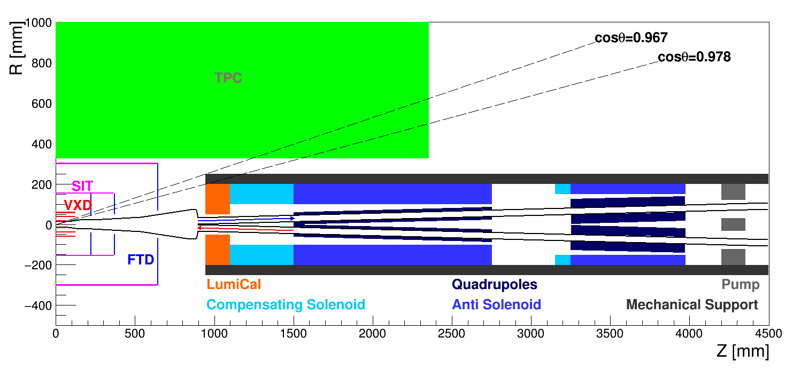
CEPC partial double ring IR layout
Background study in the preliminary lattice design: radiative Bhabha scattering, beamstrahlung, synchrotron radiation, Beam-gas scattering, beam thermal photons scattering.
Solenoid compensation was first tried in the preliminary lattice design，13T compensating solenoid was designed.

Slide 9
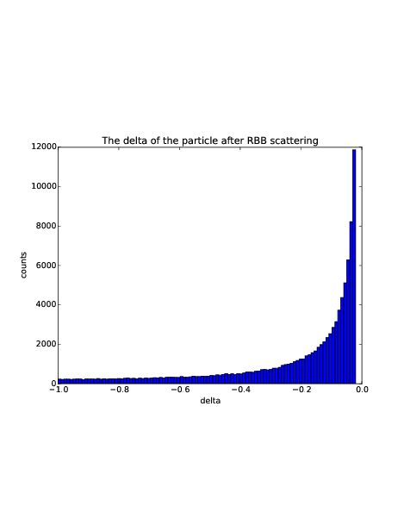
RBB Generator
Generate 100000 particles
~ energy spread
Radiative Bhabha scattering
蒙卡随机投点法
dσ/dp
.
.
.
.
.
. .
.
.
.
.
.
.
0
1
dp
The RBB generator using a Monte-Carlo random point method: randomly generate a two-dimention coordinate, x/y without any relationship
Energy spread can only be used when point within the function curve

Slide 10
Lost particles statistic
RBB generated at IP1, tracking for one turn in SAD
Lattice版本：CEPC-ARC1.0-PDR1.0-FFS(WD1.0)
Gaussian distribution energy spread adding to the 100000 particles generated by RBB generator
Only set aperture in Final doublet ~ 1.7cm in radius
The number of particle lost in the downstream of 1th turn is: 5153
The number of particle lost in the upstream of 1th turn is: 5651

Slide 11
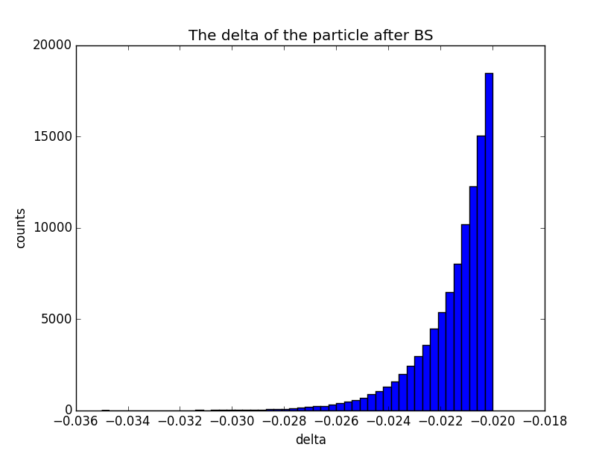
Beamstrahlung events
与RBB输出的粒子的能散相比，beamstrahlung效应随能散呈指数增加，所以绝大多数的粒子的能散都分布在略大于百分之二的区域里
Generate 100000 particles
~ energy spread

Slide 12
Lost particles statistic
BS generated at IP1, tracking for one turn in SAD
Gaussian distribution energy spread adding to the 100000 particles generated by BS generator
Only set aperture in Final doublet ~ 1.7cm in radius
The number of particle lost in the downstream of 1th turn is: 0
The number of particle lost in the upstream of 1th turn is: 8728
Most of particles lost at the entrance of QF1
Particles lost too much, no need to do multi-turn tracking
IR lattice should be improved
Lattice版本：CEPC-ARC1.0-PDR1.0-FFS(WD1.0)

Slide 13
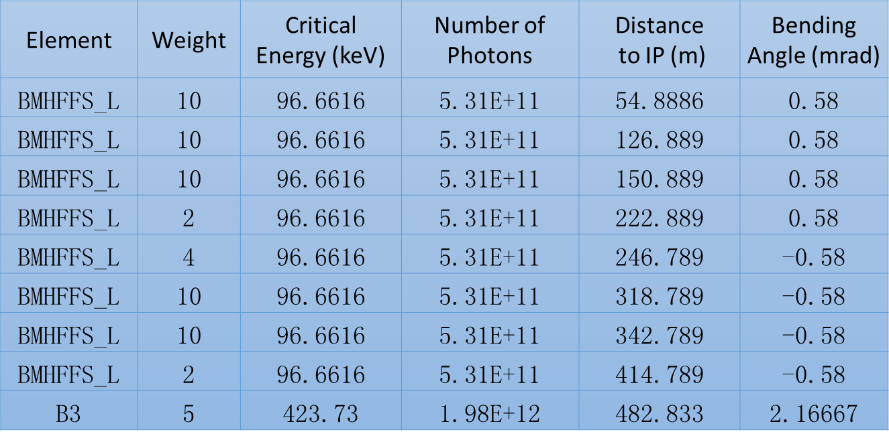
Synchrotron radiation from bending magnets
Lattice版本：CEPC-ARC1.0-PDR1.0-FFS(WD1.0)
Critical energy of bending magnets in FFS are about ~ 100keV
Could be accepted by detector and radiation protection

Slide 14
Beam-Gas Inelastic scattering generated events
Generator model:
particles energy change but direction no change.
Generate 100000 particles
~ energy spread

Slide 15
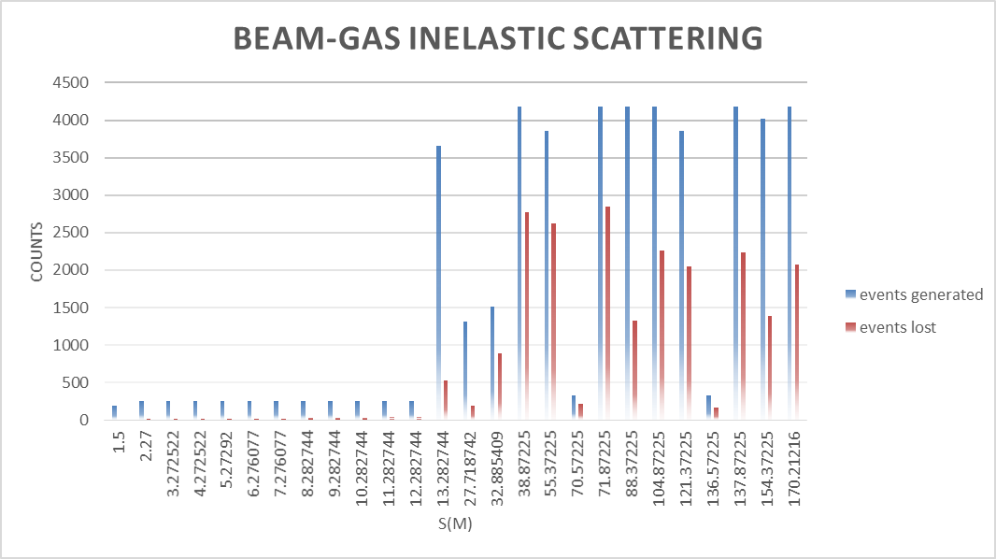
Lost particles statistic
Events generated in each ~1m region , tracking for one turn in SAD
Lost particles statistic in ~200m
Paticles lost little near IP region
Most particles lost in upstream
Put in detector to do next analysis

Slide 16
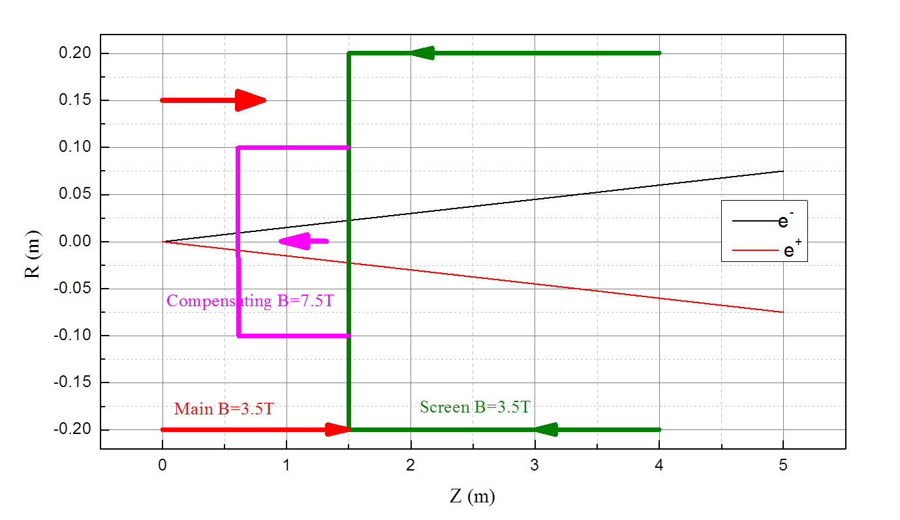
Final Focus layout-sketch of solenoids
Compensating solenoid is located between IP and QD0
crossing angle α = 30 mrad
Radius of: Length:
- compensating solenoid R = 0.1 m L=0.7m
- screening solenoid R = 0.15~0.2 m L=2.6m

Slide 17
Compensating and screening solenoids
Item | Compensating Solenoid | Compensating Solenoid | Screening-Solenoid(QD0)
Central field (T) | 7.5 | 5.25 | 3.5
Length (m) | 0.7 | 1 | 2.6
Conductor Type | NbTi-Cu Conductor 4×2mm
Coil turns | 2450 | 2500 | 6500
Current density (A/mm | 220 | 210 | 137.5
Coil inner diameter (mm) | 200 | 200 | 300
Coil out diameter (mm) | 256 | 240 | 340

Slide 18
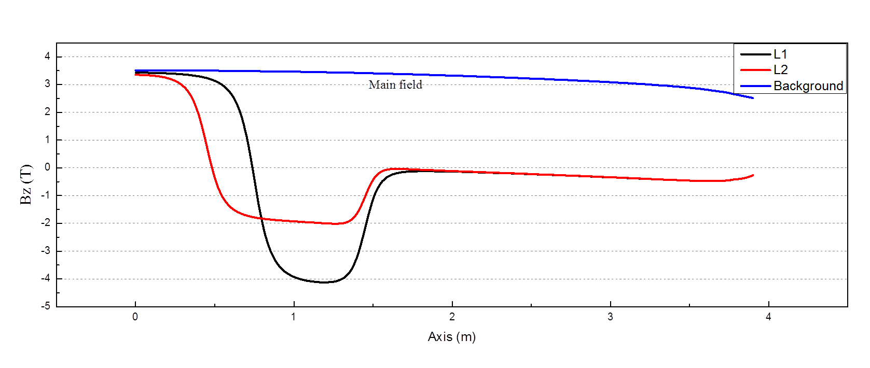
Variation of main and compensating solenoids lengths
Area of residual field
B_comp_max
Geom.length:
L1 = 0.7m
L2 = 1m
Conditions:
B_main*L_main+B_comp*L_comp=0
L* = L_main +L_comp = 1.5m

Slide 19
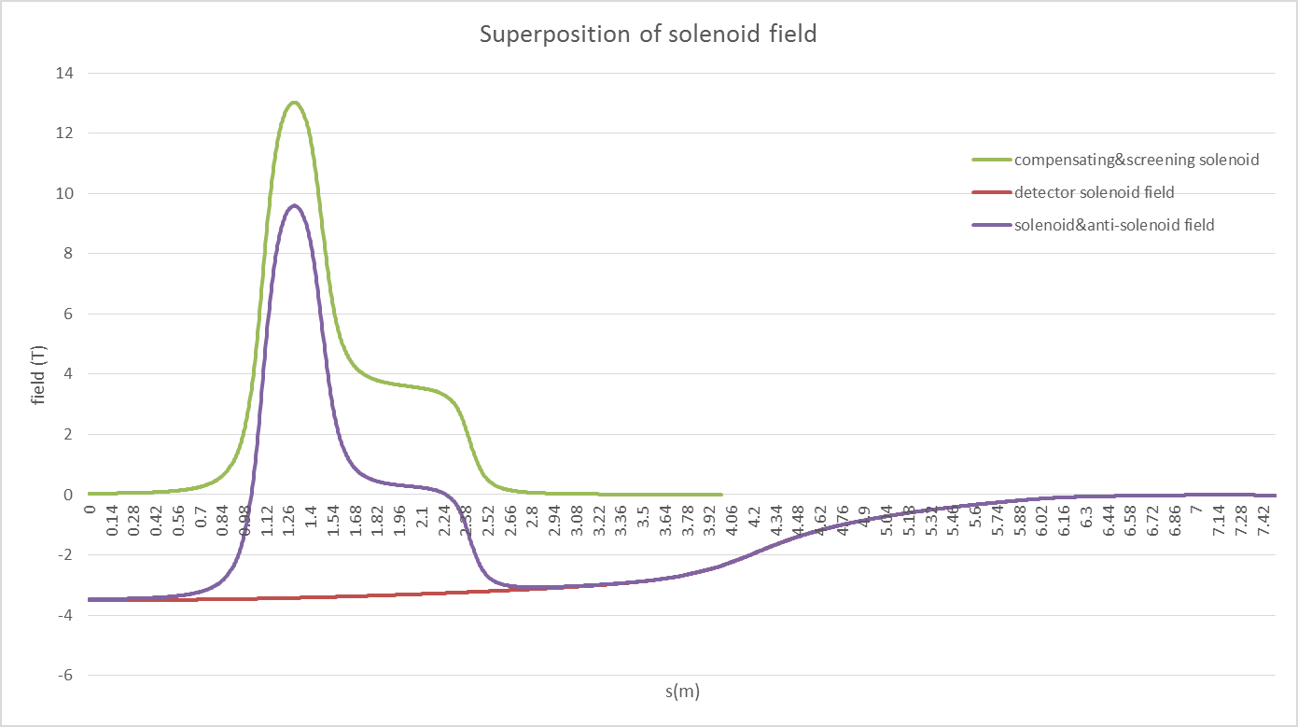
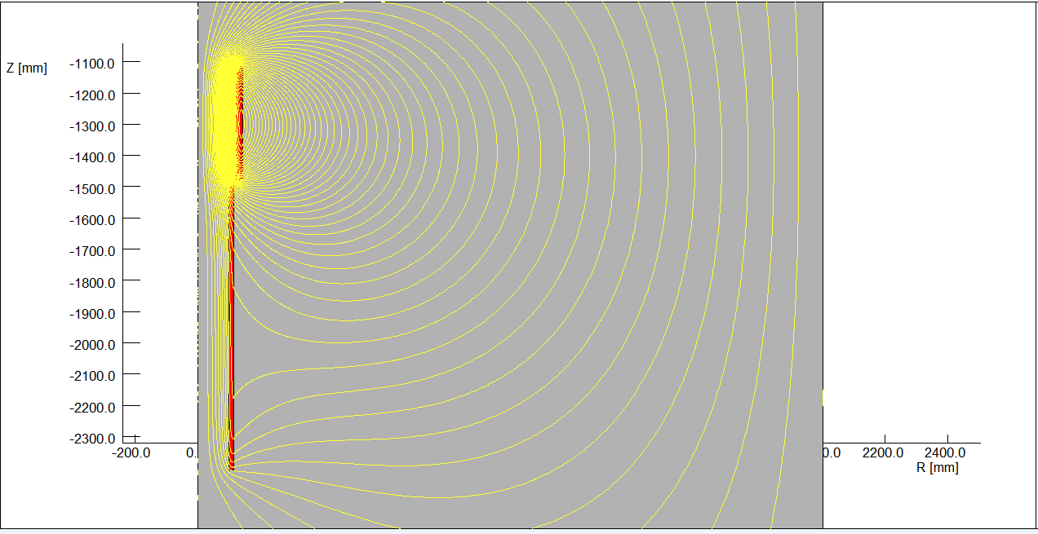
13T compensating solenoid

Slide 20
Conclusion and Prospect
The error effect on DA was studied, and orbit correction was done. The DA after orbit correction will be worked out in near future.
Background was simulated, which is depend on the lattice IR design.
13T compensating solenoid is under designing, which is to shorten the length of compensating solenoid to avoid influence on Lumical.

