Slide 1
QGP fluid + jet model
Collective Flows and Hydrodynamics
in High Energy Nuclear Collisions
Dec. 14-15, 2016,
Hefei, China
Tetsufumi Hirano
Sophia Univ.

Slide 2
Contents
1. Introduction
2. QGP fluid + jet model
3. Momentum transport away from jet
4. gamma-jet events
5. Summary

Slide 3

Jet quenching
CMS Collaboration (Quark Matter 2011)
d’Enterria, arXiv:0902.2011
Di-jet asymmetric event
$E\sim 200 GeV$ jet dragged by medium with
(possibly) $T\sim 300 MeV$ in a few femtometer
→ Jet quenching in heavy ion collisions

Slide 4
Lost energy?
Jet quenching
→ One of the main topics in heavy ion physics
How can this happen?
What can we learn from this?
Bjorken (1983), Gyulassy, Plumer (1990), Gyulassy, Wang (1994),…
Medium (Hydrodynamic) response to jet quenching
Where the lost energy and momentum go?
Stöcker et al.(2005), Casalderrey-Solana et al.(2005), Chaudhuri et al.(2006), Betz et al.(2009), G.Y.Qin et al.(2009), Neufeld et al.(2010),…

Slide 5
STAR di-hadron data in 2005
Double humped structure?
Lost energy transported through medium?
Appearance of Mach cone?
F. Wang (STAR), talk at QM2005
Our community stimulated by this very first data

Slide 6



Mach cone and Mach angle
Shock-wave front
Moving super-sonic
source ($v>c_{s}$)
Mach angle
$c_{s}=\sqrt{\frac{∂P}{∂e}}$: Sound velocity
$$\sin{θ_{M}}=\frac{c_{s}}{v}$$
→Information about EoS

Slide 7



Linearized hydrodynamics
Q) Derive the following linearized hydrodynamic
equations within ideal hydrodynamic approximation.
$$e\left(x,t\right)=e_{0}+δe\left(x,t\right), v\left(x,t\right)=0+δv(x,t)$$
$$\frac{∂}{∂t}δe\left(x,t\right)=−\left(e_{0}+P_{0}\right)∇⋅δv(x,t)$$
$$\frac{∂}{∂t}δv\left(x,t\right)=−\frac{c_{s}^{2}}{e_{0}+P_{0}}∇δe(x,t)$$
$$\left(\frac{1}{c_{s}^{2}}\frac{∂^{2}}{∂t^{2}}−∆\right)\left(\begin{matrix}δe\left(x,t\right) \\ δv\left(x,t\right)\end{matrix}\right)=0$$
Wave equations

Slide 8
Contents
1. Introduction
2. QGP fluid + jet model
3. Momentum transport away from jet
4. gamma-jet events
5. Summary

Slide 9




Energy-momentum conservation
$$∂_{μ}T_{tot}^{μν}=∂_{μ}\left(T_{fluid}^{μν}+T_{jet}^{μν}\right)=0$$
$$∂_{μ}T_{fluid}^{μν}=J^{ν}$$
$$∂_{μ}T_{jet}^{μν}=−J^{ν}$$
jet
$$J^{ν}$$
fluid
Exchange of energy and momentum between fluid and jet

Slide 10




Jet part
$$∂_{μ}T_{jet}^{μν}=−J^{ν}$$
$$T_{jet}^{μν}=\int{Dp p^{μ}p^{ν}f_{jet}(p,x)}$$
$$J^{ν}=\int{Dp p^{ν}\frac{df\left(p,t\right)}{dt}δ^{\left(3\right)}\left(x−x(p,t)\right)}$$
Information about how partons lose their energy and momentum
For a sophisticated model of ${df}/{dt}$,
see N.-B.Chang and G.Y.Qin, PRC 94,024902 (2016)
and Y.Tachibana, talk at Hard Probes 2016.

Slide 11



Simplified source terms
$$∂_{μ}T_{fluid}^{μν}=J^{ν}=\sum_{i}{J_{i}^{ν}}$$
Energy-momentum tensor of the QGP fluid
Energy and momentum
deposited from jets
Assumption: Instantaneous thermalization of deposited energy and momentum
$$J_{i}^{μ}\left(x\right)= −\frac{dp_{i}^{μ}}{dt}δ^{\left(3\right)}\left(x−x_{i}\left(p_{i},t\right)\right)$$
$$x_{i}(t)=x_{i}(t=0)+\frac{p_{i}}{p_{i}^{0}}t$$

Slide 12




Energy loss of a parton
Simple assumptions
Energy loss prop. to the number of scattering centers (parton density in QGP)
Massless parton gas $ρ ∝T^{3}$
$$\frac{dp_{i}^{0}}{dt}=−{\left(\frac{T\left(t, x_{i}\left(t\right)\right)}{T_{0}}\right)}^{3}{\left.\frac{dE}{dl}\right|}_{0},$$
$$\frac{dp_{i}}{dt}=\frac{p_{i}}{p_{i}^{0}}\frac{dp_{i}^{0}}{dt}$$
${\left.\frac{dE}{dl}\right|}_{0}$: Parton energy loss at $T=T_{0}$
Need information along trajectory of jets

Slide 13

Mach cone formation in non-linear 3-D ideal hydrodynamics
Background temperature
$$T=0.3 GeV$$
Typical structure
Mach cone
Diffusion wake (from momentum deposition)
Vortex ring
Y.Tachibana, Ph.D thesis (2015)

Slide 14
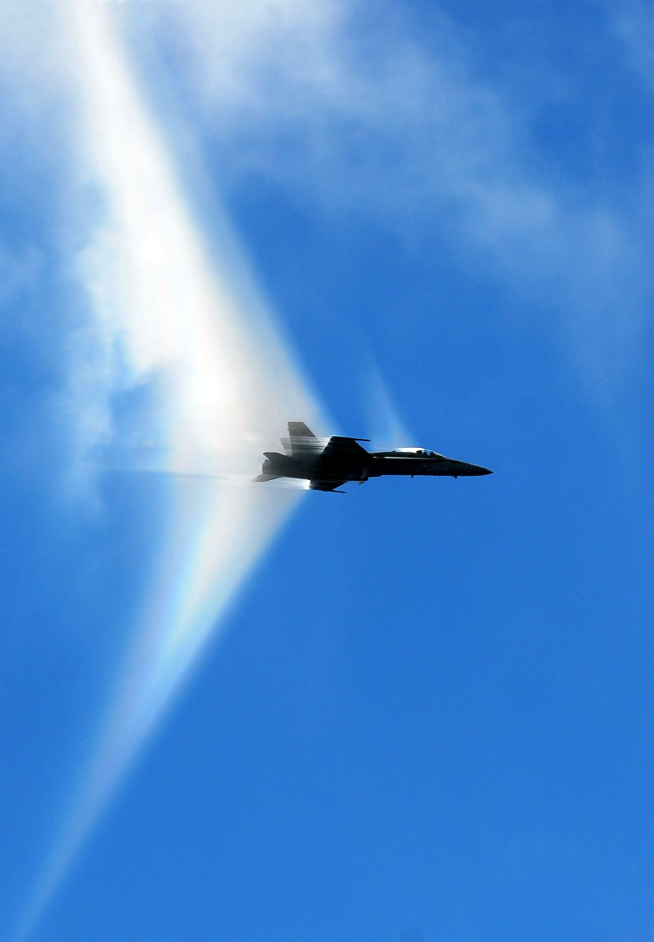

Vapor to moisture
Atmospheric water vapor
$$c_{s}≈1200km/h$$
Condensation to liquid
due to rapid decrease of
pressure
http://twistedsifter.com/2012/06/pictures-of-airplanes-breaking-the-sound-barrier/

Slide 15
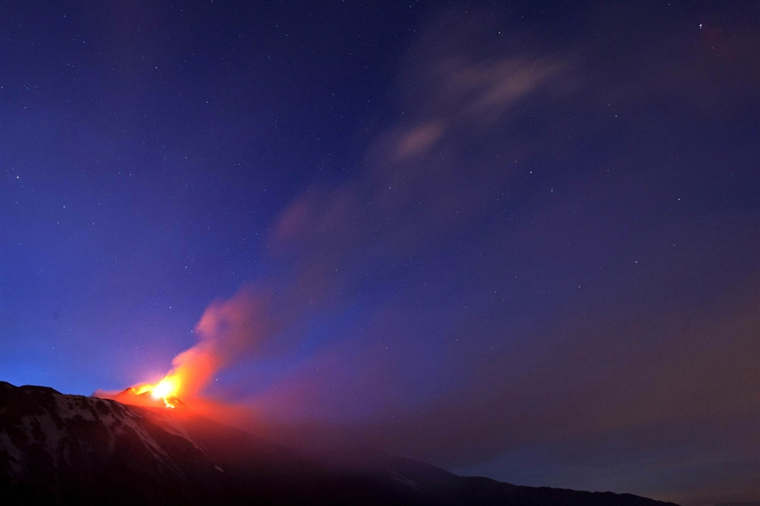
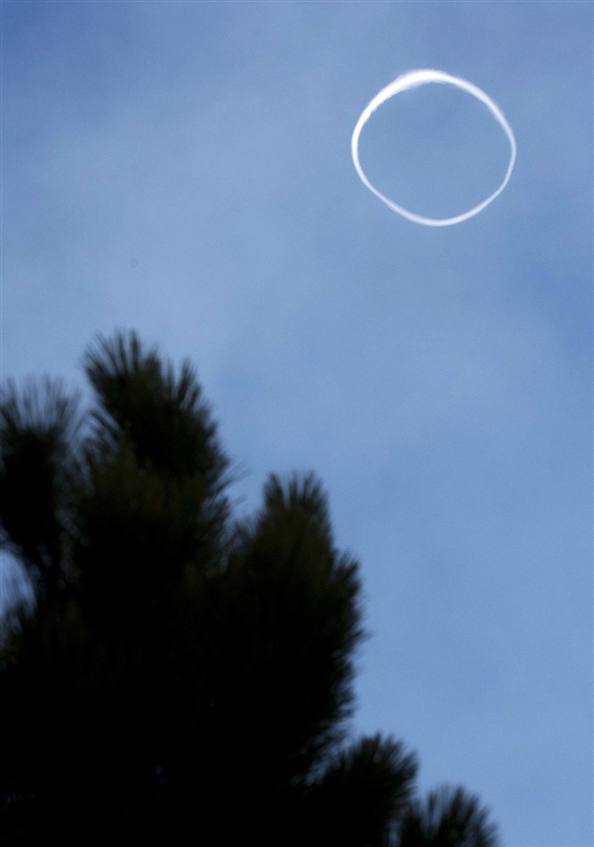
April 13, 2013 at Mt. Etna
http://photoblog.nbcnews.com/_news/2013/04/12/17720274-mount-etna-blows-smoke-ring-during-volcanic-eruptions

Slide 16

Importance of momentum deposition
Torrieri, arXiv:0901.0230
Pure energy deposition
→ Double peaks can be seen at some $p_{T}$
Pure momentum deposition
→ No double peaks
Importance of form of source function

Slide 17
Current understanding
J. Jia (ATLAS), talk at QM2011
F. Wang (STAR), talk at QM2005
Mach cone picture gone!? Higher harmonics!

Slide 18
Contents
1. Introduction
2. QGP fluid + jet model
3. Momentum transport away from jet
4. gamma-jet events
5. Summary

Slide 19
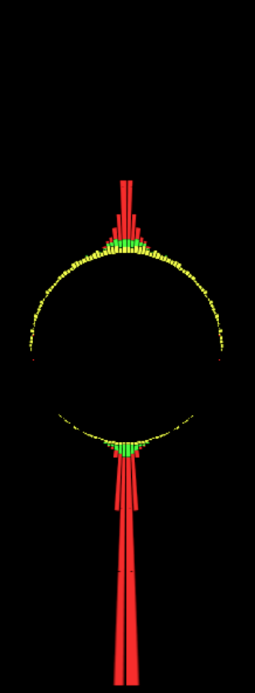





“A New Hope”
In-cone
Out-of-cone
$$p_{T,2}$$
CMS, PRC 84, 024906 (2011)
$$A_{J}=\frac{p_{T,1}−p_{T,2}}{p_{T,1}+p_{T,2}}$$
$$p_{T}^{∥}=\sum_{i}{−p_{T}^{i}\cos\left(φ_{i}−φ_{LeadingJet}\right)}$$
$$p_{T,1}$$
Leading jet energy balanced by
out-of-cone soft particles
Large angle emission away from jet axis
Azimuthal angle dist. of $p_{T}$

Slide 20
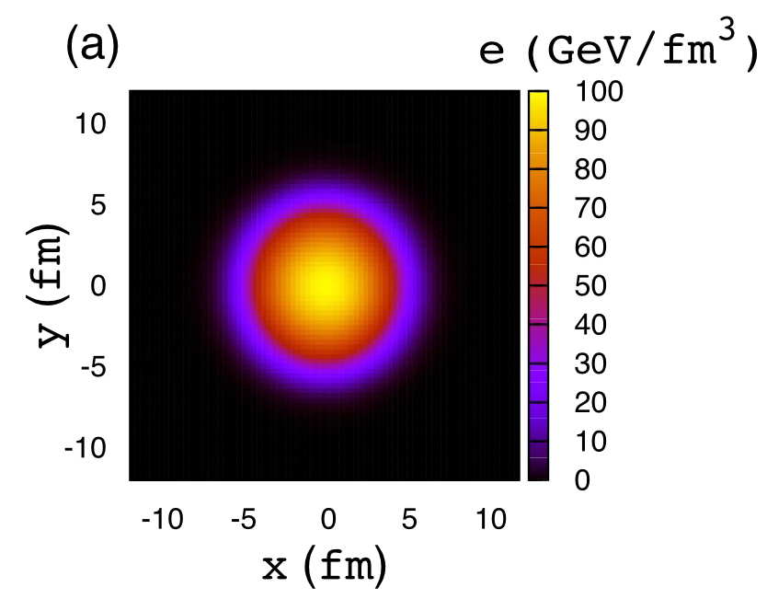


Distorted Mach cone
Movies: Courtesy of Y.Tachibana
Production point of jet
$\left(x_{0}, y_{0}\right)=\left(3, 0\right)[fm]$
Non-sharp shock front
due to radial flow
$A_{J}$ controlled by position
of production points
See also, Satarov, Stöcker, Mishustin (2005)

Slide 21
EoS dependence
Ideal gas
(Conformal matter)
Lattice EoS
(Wuppertal Budapest)
The softer EoS, the larger emission angle

Slide 22







Hydro to particles
One-particle distribution from a fluid element
F.Cooper, G.Frye (1974)
$$E\frac{d^{3}ΔN}{d^{3}k}=\frac{g}{{\left(2π\right)}^{3}}\frac{k⋅Δσ}{exp\left[k⋅u/T_{fo}\right]±1}$$
$$Σ:T\left(x\right)=T_{fo}$$
$${Δσ}^{μ}$$
$$T_{fo}=145 MeV$$
$$N^{μ}$$
Thermal dist. in switching hypersurface $Σ$
boosted by fluid velocity $u^{μ}$
$$p_{T}^{∥}=\sum_{i}{−p_{T}^{i}\cos\left(φ_{i}−φ_{LeadingJet}\right)}$$

Slide 23
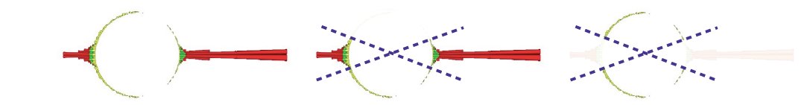
Results from QGP fluid + jet model
Y.Tachibana, TH, PRC 90, 021902 (2014)
CMS data
Transport of momentum away from jet axis
→ Qualitatively similar to CMS results

Slide 24
Contents
1. Introduction
2. QGP fluid + jet model
3. Momentum transport away from jet
4. gamma-jet events
5. Summary

Slide 25
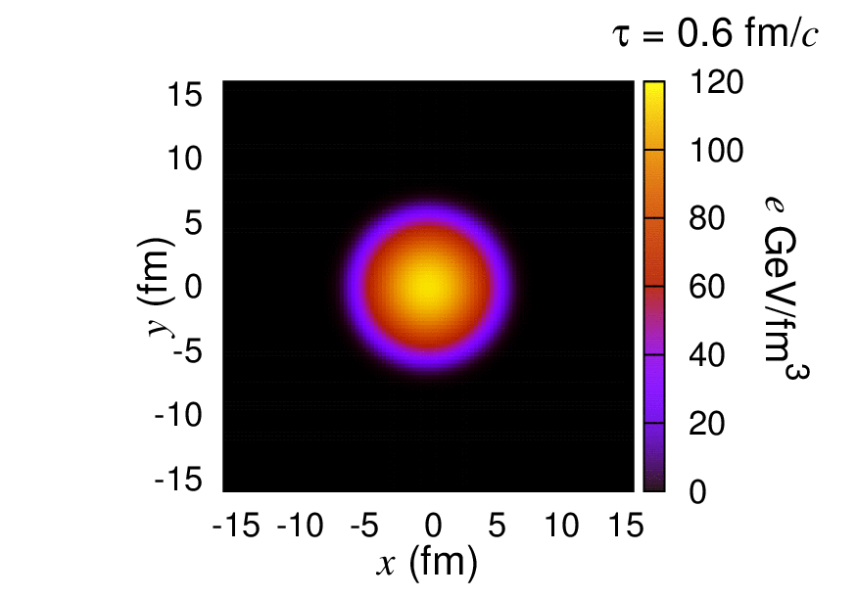



Jet propagation in $γ$-jet event
Movies: Courtesy of Y. Tachibana
Production point of jet
$\left(x_{0}, y_{0}\right)=\left(3, −3\right)[fm]$
Momentum of jet
$\left(p_{0,x}, p_{0,y}\right)=\left(−200, 0\right)[GeV]$
Mach cone pushed by radial flow
Satarov, Stöcker, Mishustin (2005)

Slide 26

Snapshots of energy density distribution ($τ=12 fm$)
Initial position
Initial momentum
Mach cone clearly tilted in an off-central jet path

Slide 27





Initial conditions for $γ$ and jet
Momentum distribution
$$\frac{dσ}{dp_{T, jet}dη}=\frac{1}{p_{0}}{\left(\frac{p_{0}}{p_{T, jet}}\right)}^{α}$$
$p_{0}=205 GeV$, $α=6.43$
ATLAS (2015)
*No cold nuclear matter effects
$$φ_{p}=π$$
for jet
Back-to-back at LO
$$φ_{p}=0$$
for gamma
Spatial distribution
Binary collision distribution

Slide 28
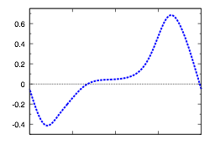
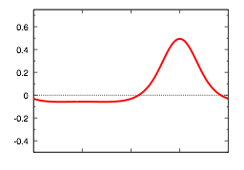




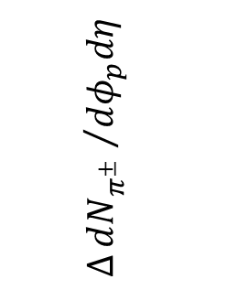


Azimuthal angle distribution in
$γ$-jet event
$$∆\frac{dN_{π^{±}}}{dφ_{p}dη}=\frac{dN_{π^{±}}}{dφ_{p}dη}−{\left.\frac{dN_{π^{±}}}{dφ_{p}dη}\right|}_{no jet}$$
*No contribution from jet fragmentation
event average
$$∆{dN_{π^{±}} }/{dφ_{p}dη}$$
single event
$$γ$$
$$\left(x_{0}, y_{0}\right)=\left(3, −3\right)[fm]$$
bump
-¼/2
0
¼/2
¼
3¼/2
$$φ_{p}$$
Dip
$$p_{T, jet}>80 GeV, 1<p_{T}<2 GeV$$

Slide 29
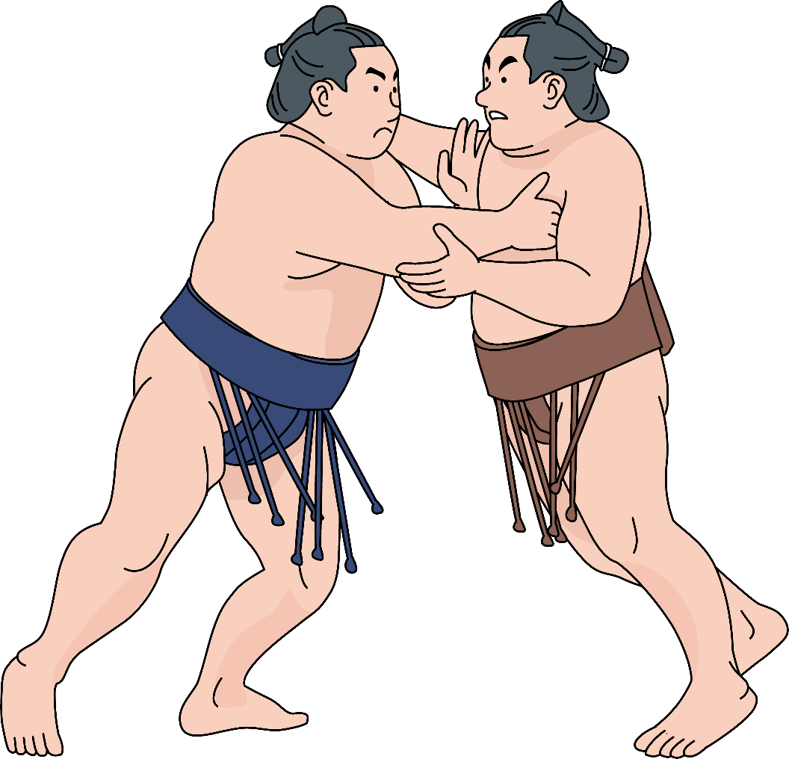
Interplay between Mach cone and collective expansion
Mach cone
direction
(≠ jet direction)
Radial expansion
Suppressed radial expansion → Dip in $dN/dφ_{p}$

Slide 30
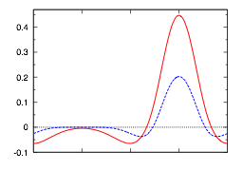

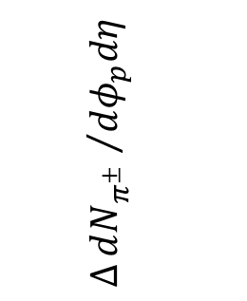






Triggered event average
$p_{T, jet}=100$ - $110 GeV$
$p_{T, jet}=110$ - $120 GeV$
$$y_{0}>0$$
$$∆{dN_{π^{±}} }/{dφ_{p}dη}$$
$$1<p_{T}<2 GeV$$
$$y_{0}<0$$
-¼/2
0
¼/2
¼
3¼/2
$$φ_{p}$$
Trigger condition
Distribution of jet production point with triggers
$$110<p_{T, γ}<120 GeV$$
Constraint on the jet path

Slide 31
Contents
1. Introduction
2. QGP fluid + jet model
3. Momentum transport away from jet
4. gamma-jet events
5. Summary

Slide 32

Summary
Hydrodynamic response to jet propagation by using QGP fluid + jet model
→ Interplay between Mach cone and background collective flow
Di-jet asymmetric events
  Lost energy and momentum transported by expanding medium
$γ$-jet events
  Dip in azimuthal distribution
  Possibility to constrain the jet path in triggered events

Slide 33

多谢

Slide 34
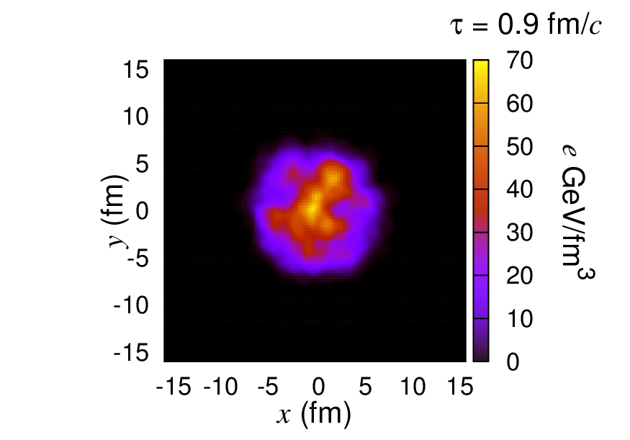
More realistic bulk evolution
Bumpy profile case
(Just for demonstration, not used in analysis)

