Slide 1

Collective dynamics in A+A collisions
Jiangyong Jia
Stony Brook University & Brookhaven National Laboratory
Dec 13-15, 2016, Hefei, China

Slide 2

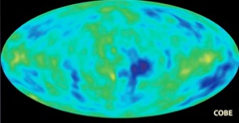
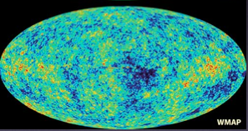
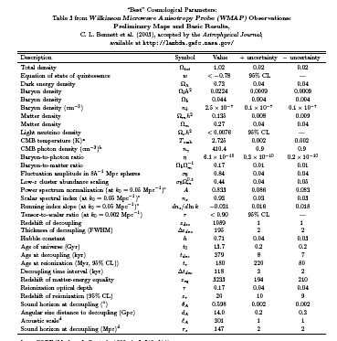
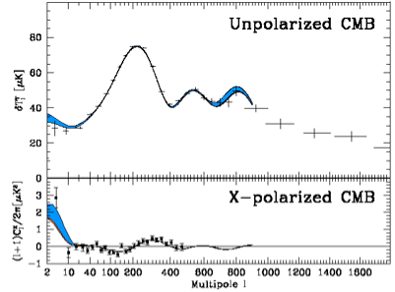
What can we learn from correlation measurements?
Penzias, Wilson 1964
COBE, 1992
WMAP, 2003
<T>=3K
ΔT/T~10⁻⁵K
ΔT(ϕ,θ)/T
Power spectra

Slide 3
Fluctuations, Correlations and Collective flow
Response of medium to perturbations→Correlations/collectivity
  Essential for understanding the nature of initial state and medium properties
Represent the correlation content via appropriate observables.
  Power spectra in azimuthal direction → Flow coefficient v_{n}
  Power spectra in longitudinal direction → Legendre coefficient a_{n}
Comparison between experiment/theory to disentangle
  Initial state fluctuations or final state interactions (medium properties)

Slide 4
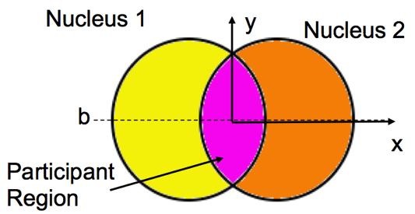
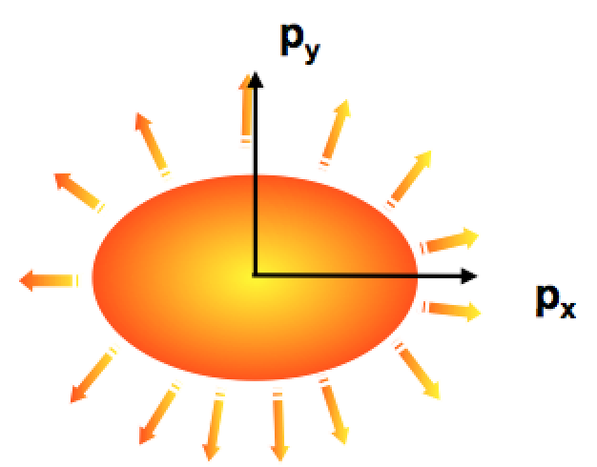
A brief history of flow correlations (2000-2016)
2000
hydrodynamics

Slide 5
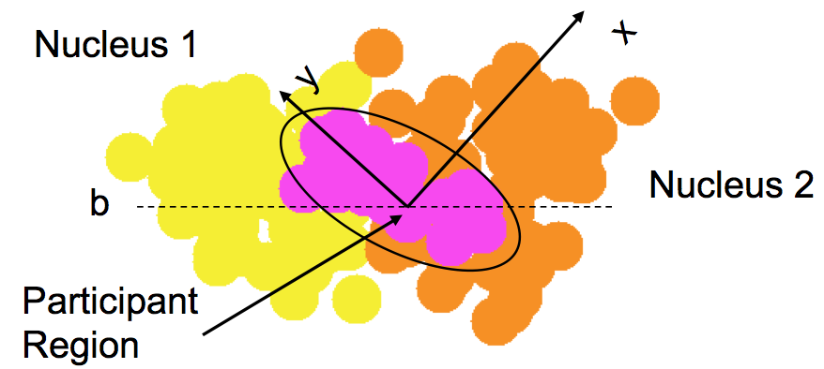
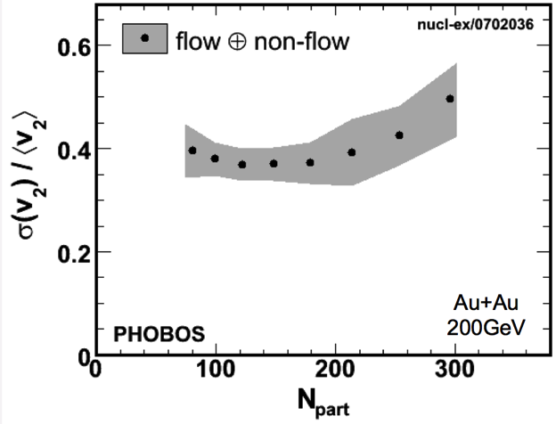
A brief history of flow correlations (2000-2016)
2000
hydrodynamics
hydrodynamics
2006
Relative v₂ fluctuations σ(v₂)/v₂ ~ 40%
Maximum is

Slide 6
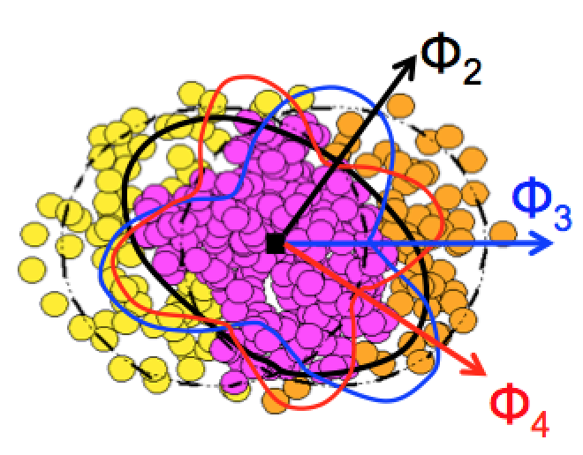
A brief history of flow correlations (2000-2016)
2000
hydrodynamics
hydrodynamics
2006
2010
hydrodynamics

Slide 7
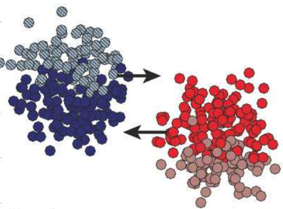
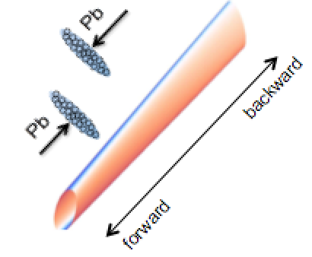
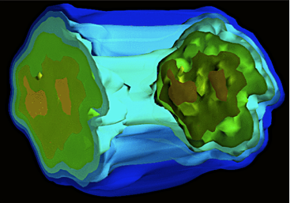
A brief history of flow correlations (2000-2016)
2000
hydrodynamics
hydrodynamics
2006
2010
hydrodynamics
2015
hydrodynamics
What are the transverse/longitudinal structure of sources & final state dynamics?

Slide 8
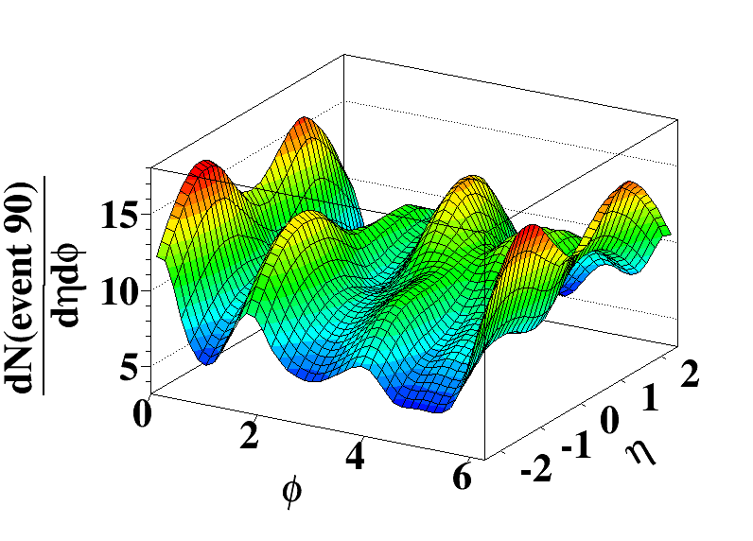
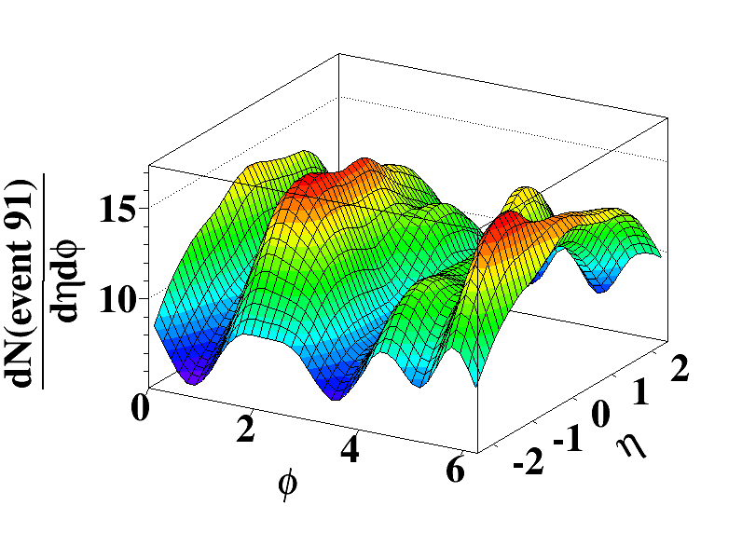
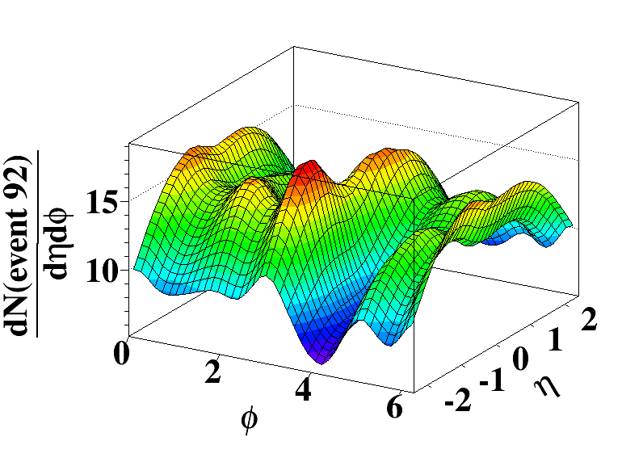
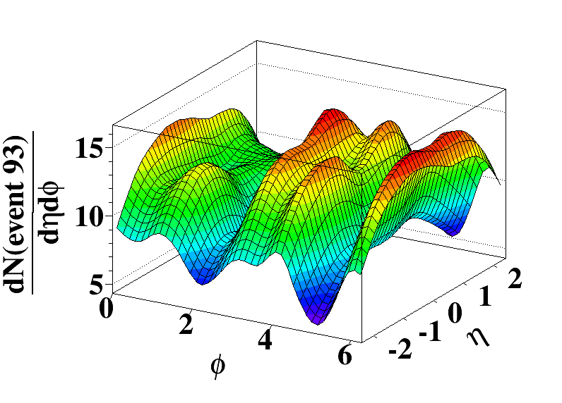
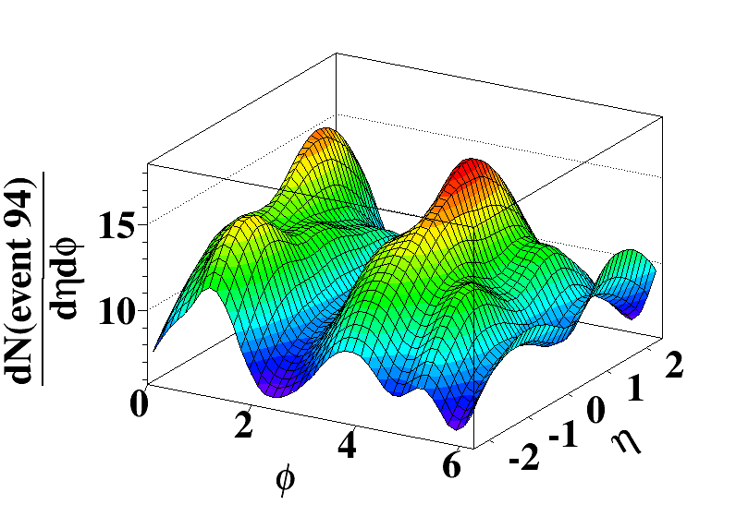
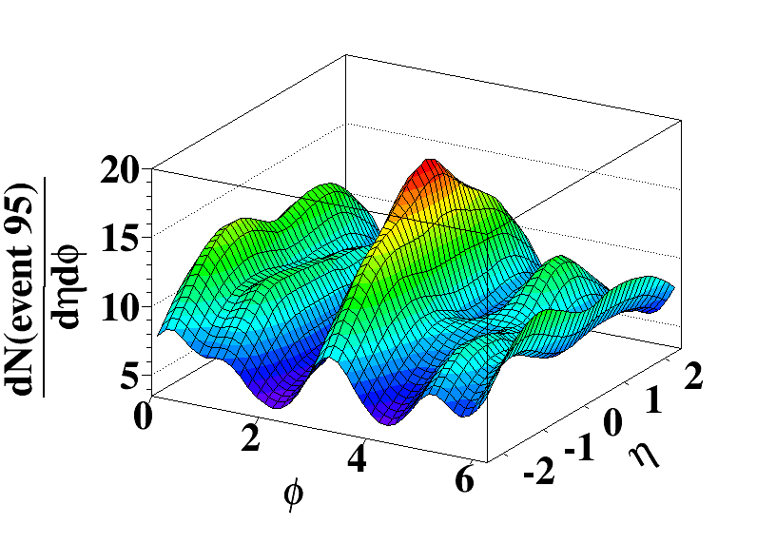
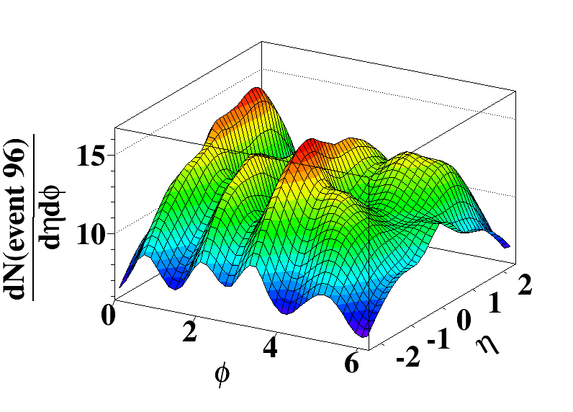
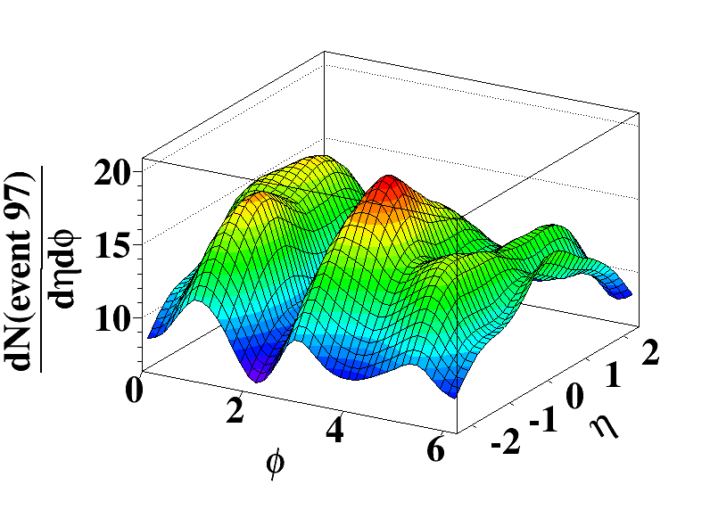
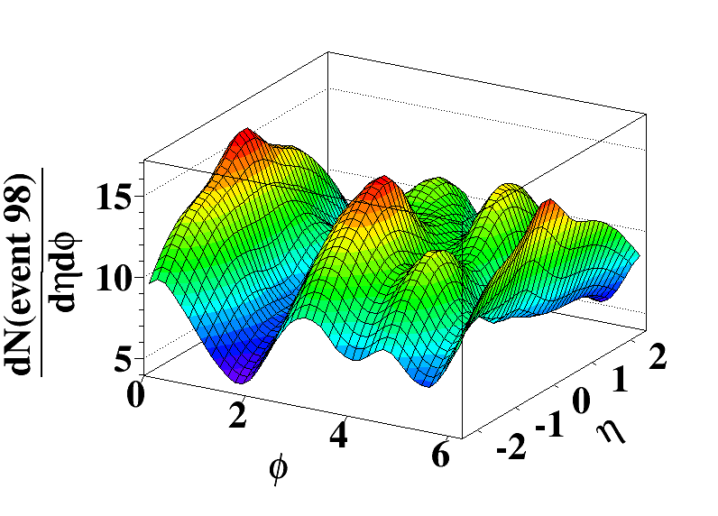
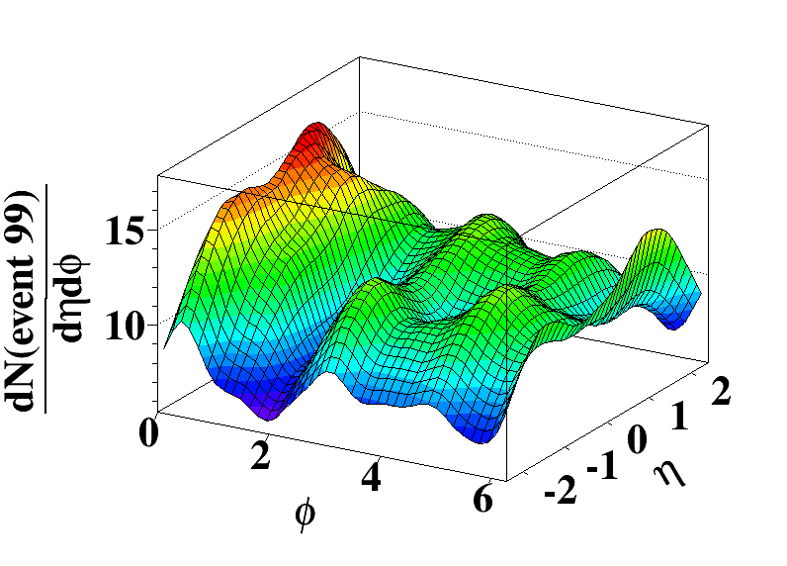
Event-by-event transverse & longitudinal dynamics
Curtsey of L.Pang and X.N Wang, EbyE 3D hydro+AMPT condition

Slide 9
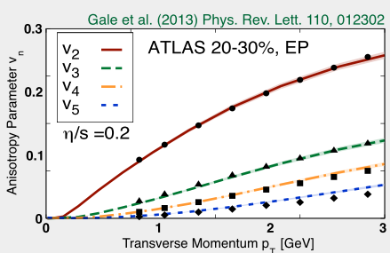
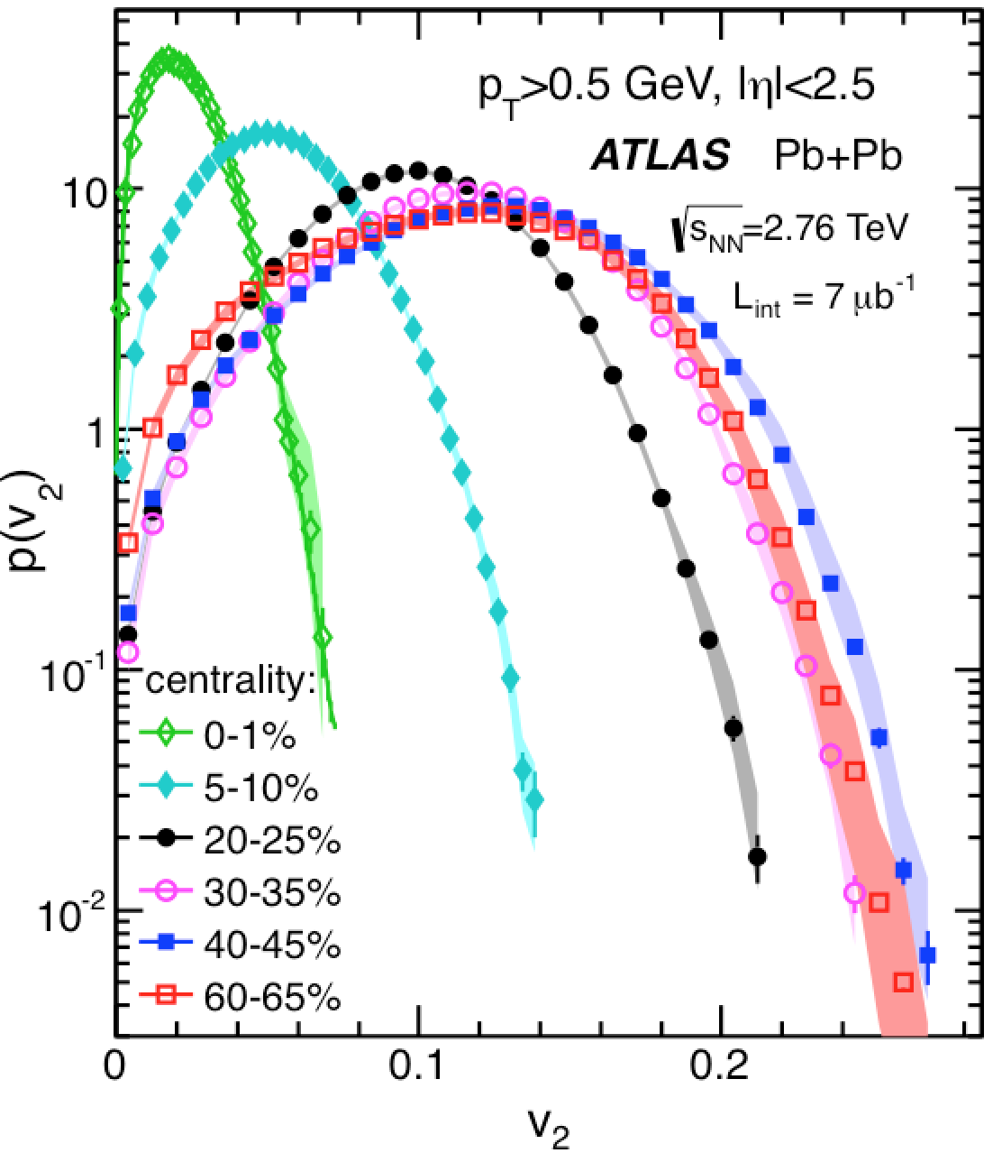
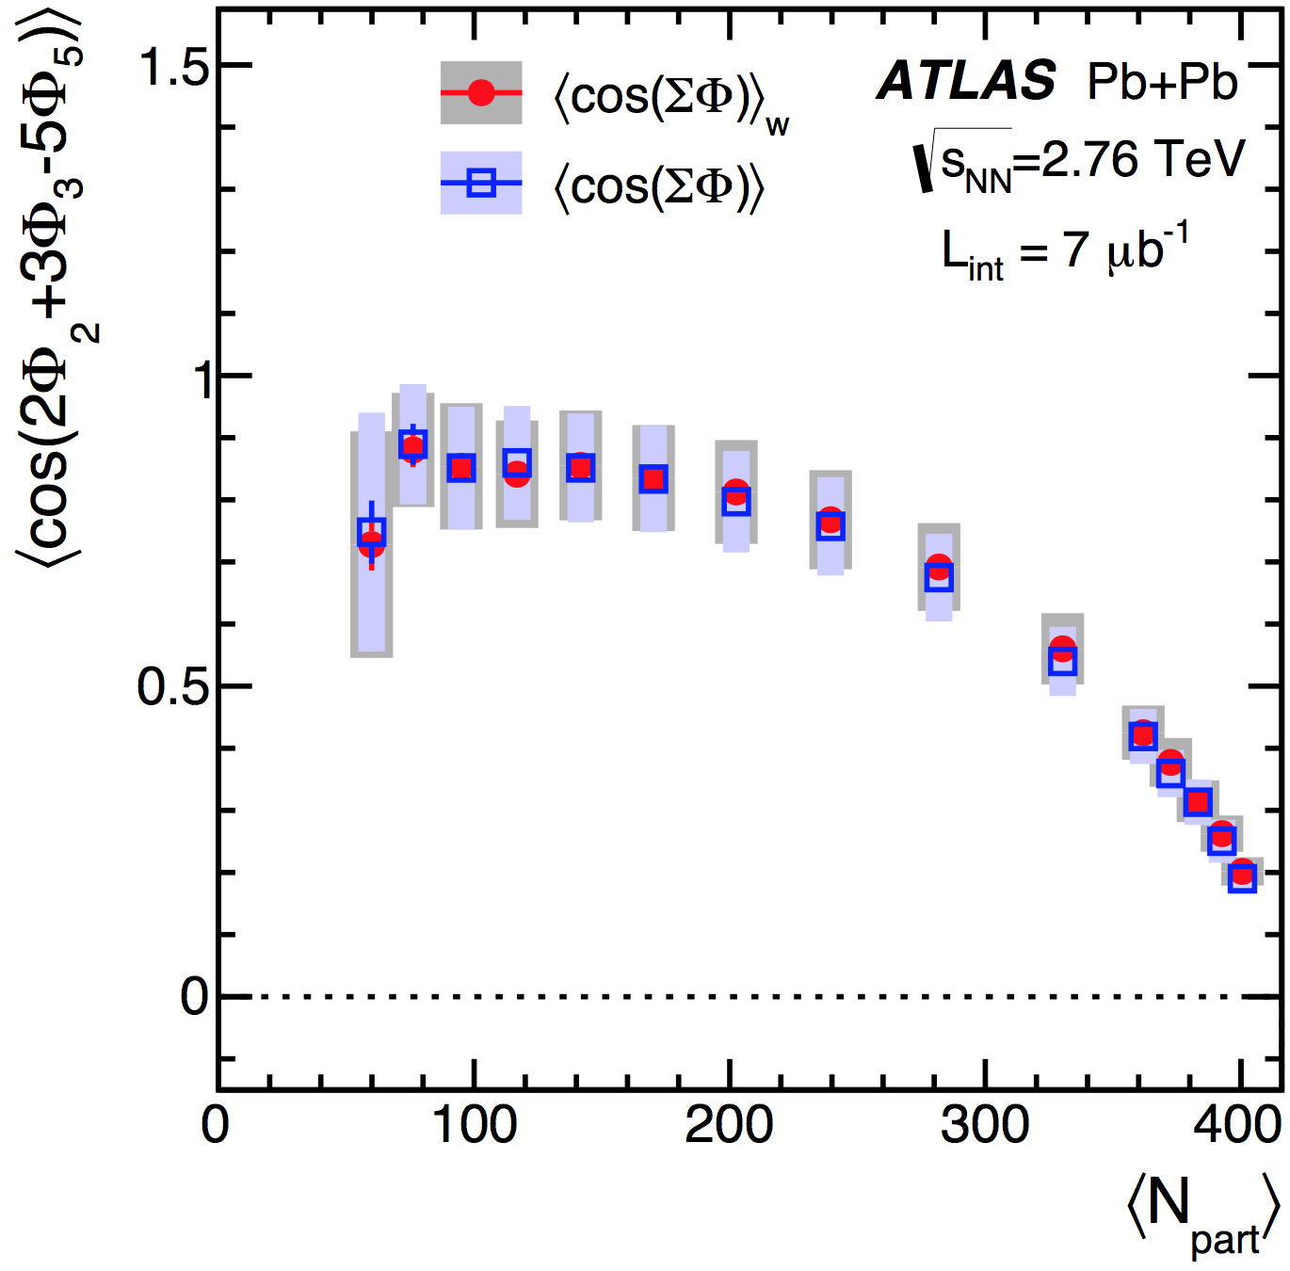
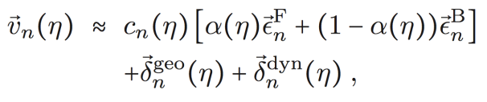
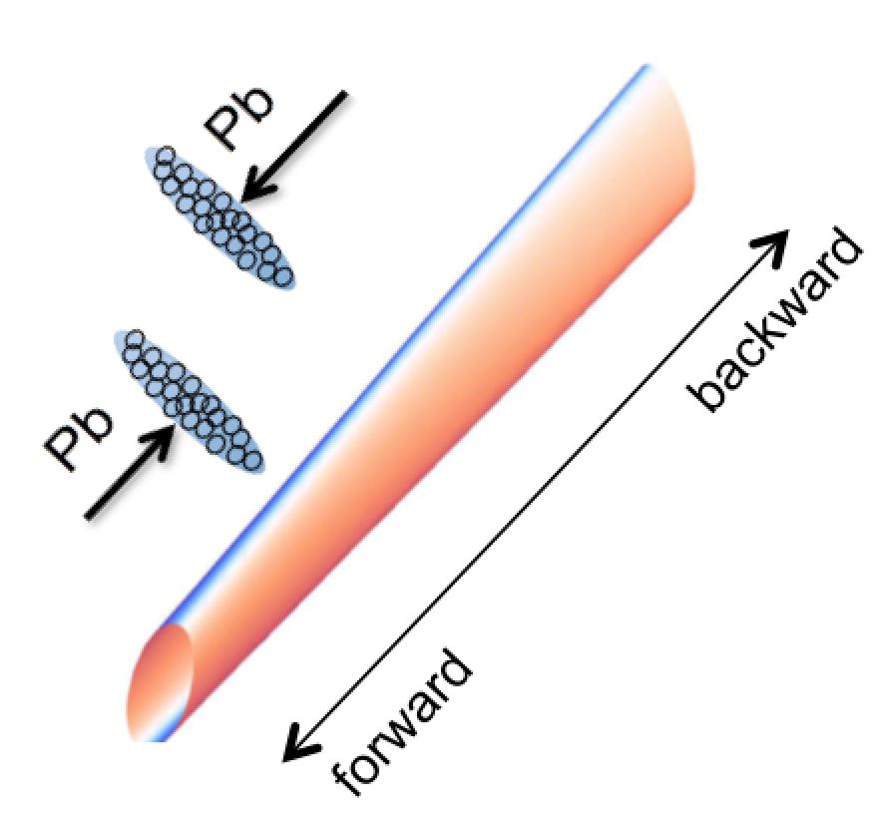
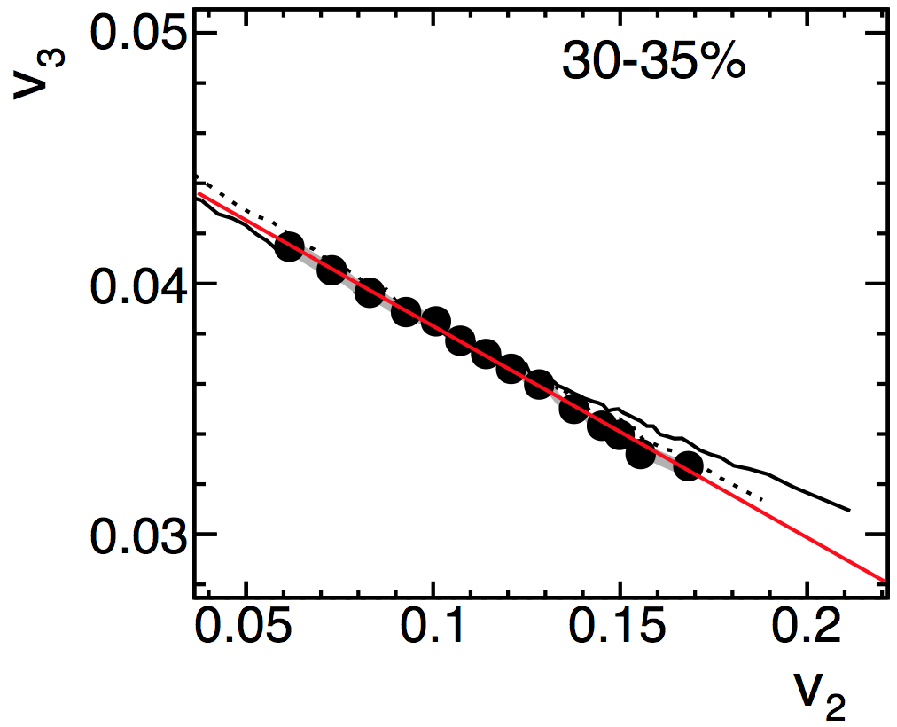
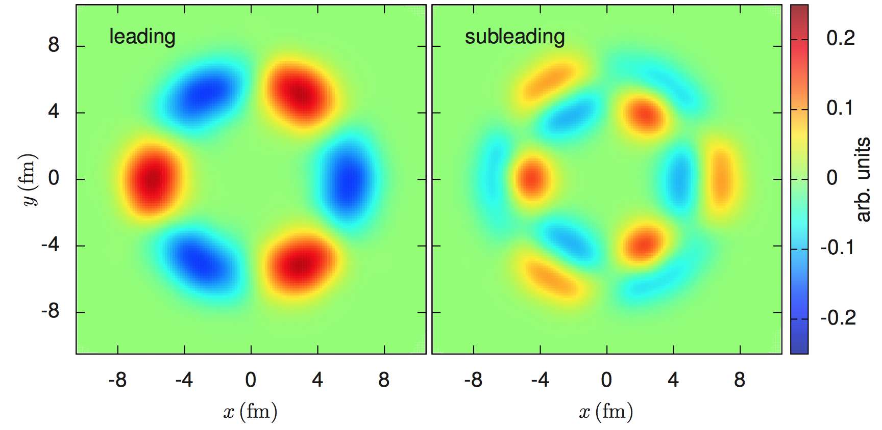
Plan
Transverse shape fluctuations:
Event-averaged flow
Transverse shape fluctuations:
event-by-event flow fluctuations
flow fluctuations in longitudinal direction
p(v_{n})
p(Φ_{n},Φ_{m}), p(Φ_{n},Φ_{m,}Φ_{L})
flow fluctuations in radial direction
p(v_{n},v_{m})

Slide 10
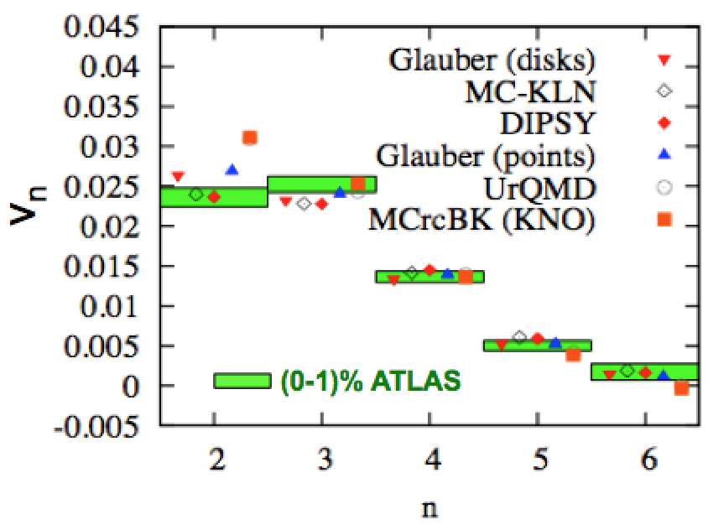
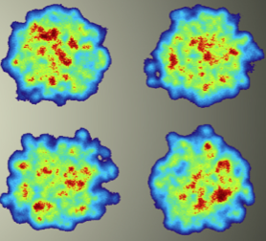
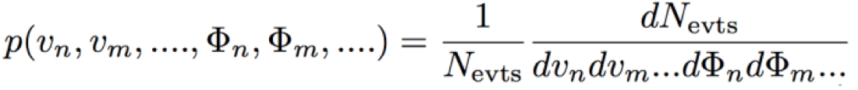
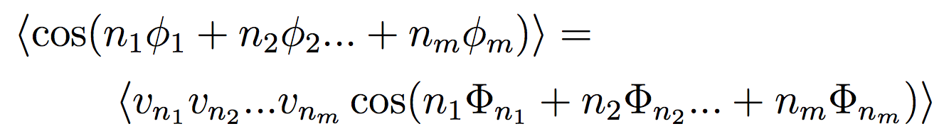

Initial structure and transverse dynamics
Event-averaged n=1- 6 (2010-2013)
via two-particle correlations
New observables (2013-2016):
Event-by-event distribution of flow amplitudes, v_{n}, and phases, Φ_{n}.
Accessed via multi-particle correlators:

Slide 11
Event-averaged v_{n} & two-particle correlation method

Slide 12
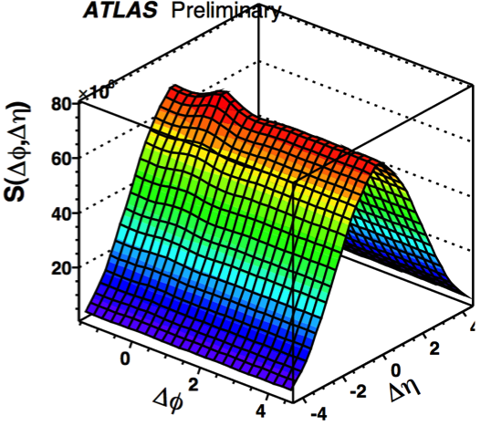
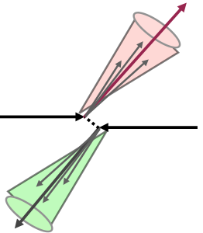
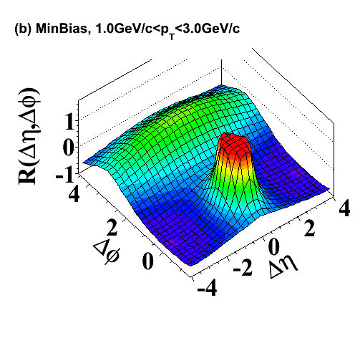
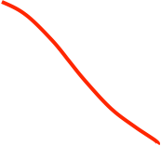
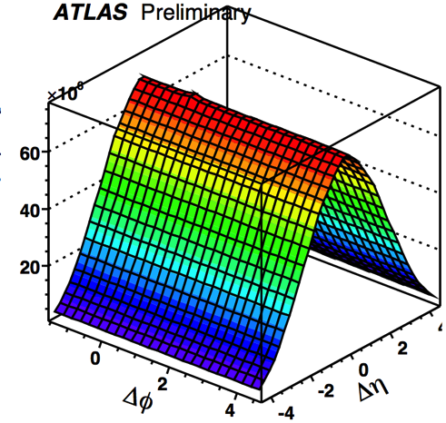

Two-particle correlation in pp
Signal distribution
“Away-side” (Δϕ ~ π) jet correlations: particle pairs between back-to-back jets. Mostly momentum conservation -cos(Δϕ)
Ratio
signal/background
R-1
Background distribution
“Near-side” (Δη,Δϕ ~ 0) peak: particle pairs from single jet
pp dominated by jet-like (or non-flow) correlation

Slide 13
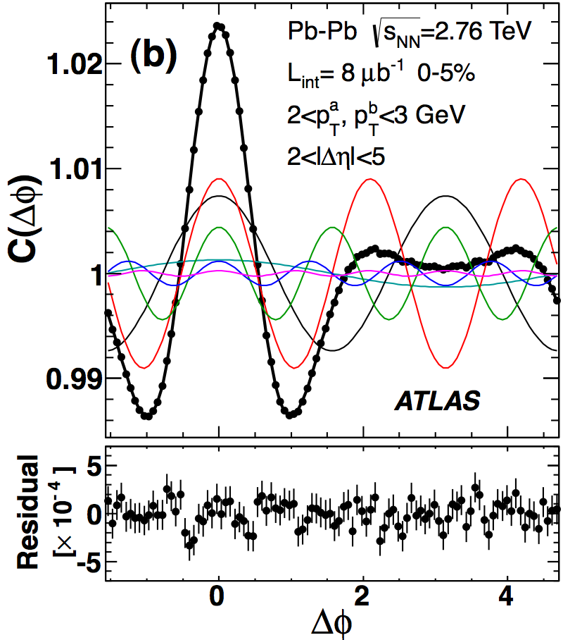
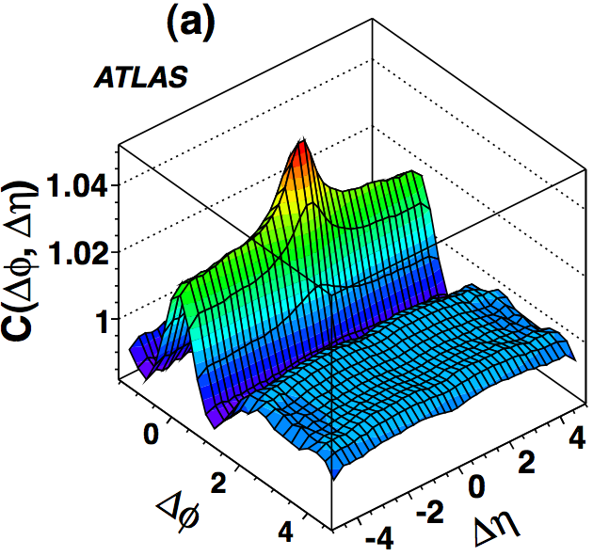
Two-particle correlation in A+A
|Δη|>2
Hydrodynamic flow+X?
Long-range structures (“ridge”) exhausted by first six harmonics
Flow extracted by assuming the factorization:
Measure the root-mean square of v_{n}:
Notes:
Not prove factorization yet

Slide 14

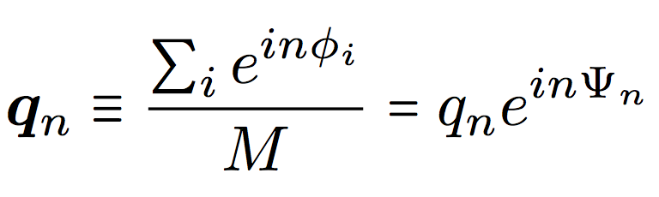
Scalar-product method
Flow has magnitude v_{n} and direction Φ_{n}, also called flow vector
B
tracks
A
Can be estimated from M particle in a subevent → observed flow vector
, Ψ_{n} is called event plane
Scalar product method (use this whenever possible)
  q_{n}(pt,η) are per-particle flow vector for tracks in given p_{T} and η
  If event-by-event flow fluctuation p(v_{n}) do not depend on p_{T}, η. then v_{n}^{A} cancels out.
It works because
What is measured is the root mean square value
  Intrinsically a ratio of two 2PCs, each one obtained with a gap,
  Also assumes factorization 2PC to single particle v_{n}
Notes:
Breaks when transverse/longitudinal decorrelation are large

Slide 15
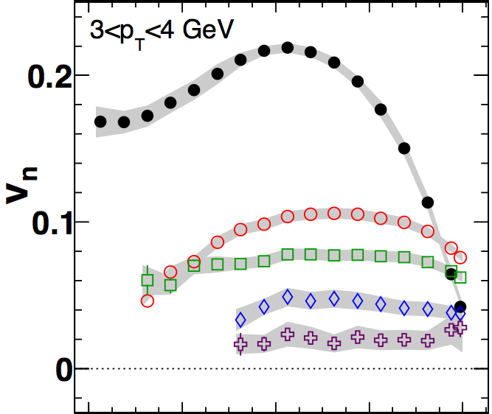

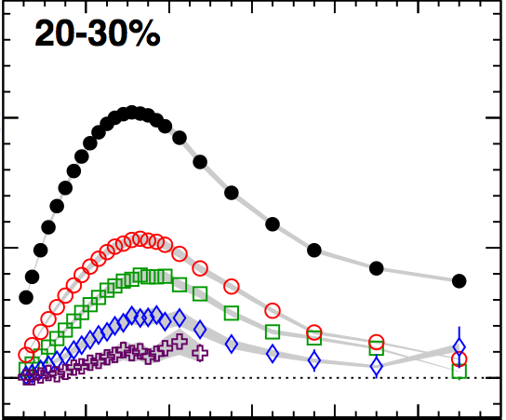
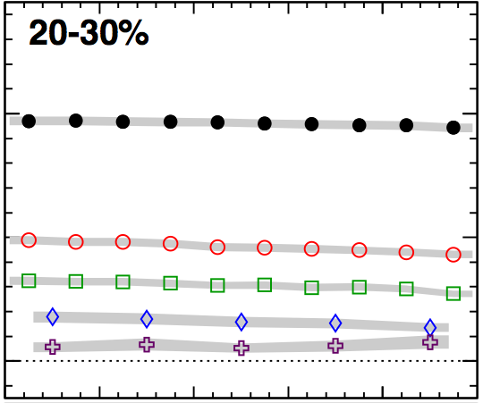
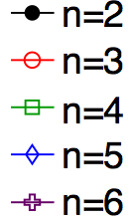





Event-averaged flow: v_{n}(η,p_{T},cent)
Features of long-range harmonic flow (|Δη|>4)
  v_{n} coefficients rise and fall with centrality
    → response to ε_{n} and viscous damping
  v_{n} coefficients rise and fall with p_{T}.
    →transition from hydrodynamic region to jet quenching region
  v_{n} coefficients are ~boost invariant
Notes:
eta

Slide 16
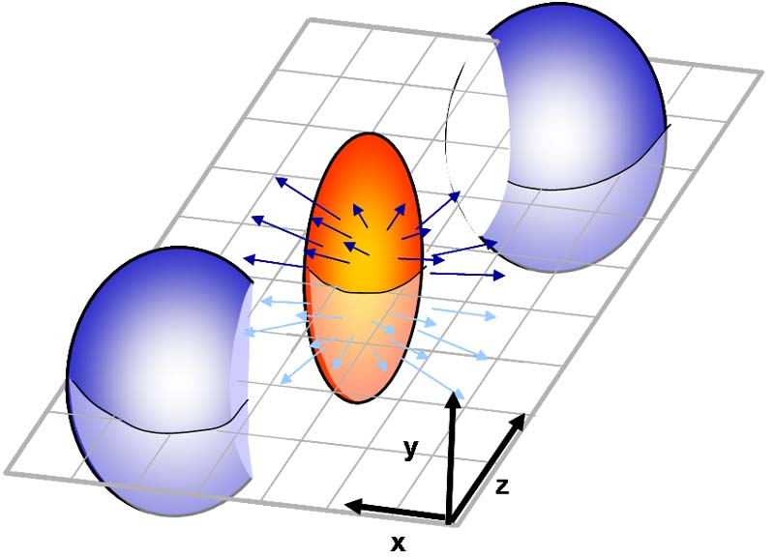
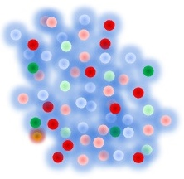
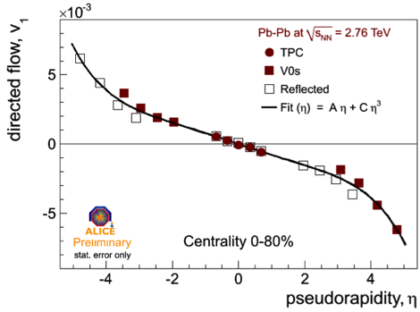
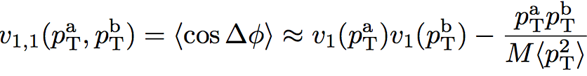
How about v₁ from fluctuation (dipolar flow)?
Directed (odd component) flow
vanishes at η=0
Dipolar (even component) flow
from initial density fluctuations
~boost invariant in η
Φ₁
arXiv:1203.0931
1010.1876
Momentum of each particle need to be balanced by other particles
Thus:

Slide 17
Compare with v₂ and v₃
Extract v₁ by fitting v_{1,1} with the function:
v₁
  v₁ comparable to v₃ but peak at higher p_{T}.
  v₁ is no-zero at higher p_{T}, jet-quenching from dipolar initial geometry?

Slide 18
Event-by-Event fluctuations

Slide 19
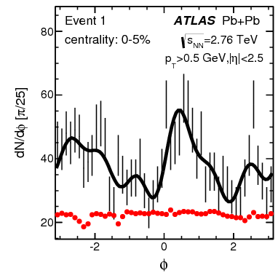






EbyE initial structure and harmonic flow
What is the nature of the initial state fluctuation?
How are (ε_{n},Φ_{n}*) transferred to (v_{n}, Φ_{n}) event-by-event?
What is the nature of final state (non-linear) dynamics?
  Non-linear→mode-mixing/interaction between e.g. v₂ and v₄.

Slide 20




Event-by-event v_{n} fluctuations
v_{NΔ}=<cosnΔϕ>

Slide 21



Event-by-event observables
Many little bangs
1104.4740, 1209.2323,1203.5095 ,1312.3572,
1407.6057
Moments /

Slide 22
Event-by-event observables
Many little bangs
1104.4740, 1209.2323,1203.5095 ,1312.3572
1407.6057
Moments /
Also access via multi-particle correlations/cumulants:

Slide 23
Some selected results

Slide 24






Non-Gaussianity from p(v₂) and cumulant
H. Niemi QM14
ATLAS Data
B-G fit
Non-Gaussian behavior
Reflected by a 1-2% change beyond 4th order cumulants
  non-gaussianty in p(ε₂)
  non-linearity of response to ε₂, related to small scale structures in xy?
1511.03896 and 1408.0921
Also used to calc. more details of p(v₂) shape, such as skewness
1608.01823

Slide 25

How are (ε_{n},Φ_{n}*) transferred to (v_{n}, Φ_{n})?
Flow response is linear for v₂ and v₃:

Slide 26




How are (ε_{n},Φ_{n}*) transferred to (v_{n}, Φ_{n})?
Flow response is linear for v₂ and v₃:
Higher-order v_{n} arises from ε_{n} and lower-order flow:
Ollitrault, Luzum,
Teaney, Li, Heinz,Chun….
arXiv:1403.0489

Slide 27


p(v_{n},v_{m}) via symmetric cumulant
>0 correlation
<0 anti-correlation
1604.07663
p(v_{n},v_{m})
v₂-v₄ correlation reflects mode-mixing from final state
v₂-v₃ anti-correlation reflects ε₂-ε₃ from initial state

Slide 28








p(v_{n},v_{m}) via event-shape engineering tech.
Select events with same geometric size but different ellipticity
Directly observe the functional form of the correlation (more info that symmetric cumulant)
arXiv:1208.4563, 1311.7091
Expected quadratic corr. for v₂-v₄ , linear corr. for v₂-v₅ →final state mode-mixing
anti-correlation v₂-v₃ →anti-correlation of ε₂-ε₃ from initial state
centrality
Notes:
Animation!!!

Slide 29





Application of EbyE distributions
Gale, Jeon, Schenke, Tribedy, Venugopalan 1209.6330
Niemi, Eskola, Paatelainen 1505.02677
p(v₂,v_{m})
p(Φ₂,Φ₄)
p(v₂)
p(v₃)
p(Φ₂,Φ_{3,}Φ₅)
p(v₄)
1) Initial state e.g ε_{n}
2) Hydro response: (ε_{n},Φ_{n}*)→(v_{n}, Φ_{n})
3) Final state mode-mixing: e.g v₂ vs v₄
Measured distributions used to tune hydrodynamic models

Slide 30

But how did we get here?
Robust experimental methods

Slide 31













Obtaining p(v_{n}) via unfolding
Flow vector in each event has flow and non-flow contribution
Estimating non-flow from sub-events
1304.1417,1305.2942
A
B
η

Slide 32

Obtaining p(v_{n}) via unfolding
Flow vector in each event has flow and non-flow contribution
Estimating non-flow from sub-events
1304.1417,1305.2942
“Unsmear” p(q_{n}) by p(s_{n}) to get p(v_{n})

Slide 33
Probability distribution of v_{n}
v₂
v₃
v₄
v₂, v₃, v₄ distributions for various centrality intervals
Fully corrected for detector effects, and unfolded for limited statistics

Slide 34

EbyE fluctuation via multi-particle correlations
2PC
4PC
3PC
5PC
In complex notation:

Slide 35




Calculating the multi-particle correlator
m-particle corr. use m-nested-loop to remove duplicates:
  Impractical for HI events with thousands of tracks
ϕ_{k1}≠ϕ_{k2}≠ϕ_{k3}≠…
See: 1312.3572
Expands into q vectors of different order
M pairs with ϕ₁=ϕ₂
2PC
4PC
ϕ₁=ϕ₃ & ϕ₂=ϕ₄ or ϕ₁=ϕ₄ & ϕ₂=ϕ₃
ϕ₁=ϕ₂=ϕ₃≠ϕ₄ +permu..
ϕ₁ = ϕ₂ or ϕ₃ = ϕ₄
ϕ₁=ϕ₂=ϕ₃=ϕ₄
6PC
ϕ₁ or ϕ₂ = ϕ₃ or ϕ₄
ϕ₁=ϕ₂ & ϕ₃=ϕ₄
Similar formula exists for symmetric cumulants

Slide 36



Multi-particle cumulant for v_{n}
nucl-th/0007063,0105040
In general, 2k-particle cumulant is obtained by combining correlators involving 2k- or less number of particles
  e.g. four-particle cumulant removes all two-particle correlations
  Claim: reduce correlations involving a few particles, i.e. non-flow
  Note: 2-particle cumulant have no lower-order non-flow to remove:
Six-particle Cumulant
Consider all six-particle correlations
Sorry
no plot

Slide 37

Non-flow
Correlations between a few particles in limited ϕ and η
  Breaks factorization to single particle v_{n}.
  Denote as δ₂ for two-particle non-flow correlations
Assume non-flow is uncorrelated with flow
Ramond snellings

Slide 38

Non-flow in four-particle cumulant
Only two particles from one non-flow source
four particles from same non-flow source
two from one non-flow source, the other two from a different non-flow source
Therefore:
s₂~1/M, s₄~1/M³

Slide 39



Multi-particle cumulant for v_{n}
Use short-hand notation <<2k>>:
Higher-order cumulant:
If v_{n} does not fluctuate:
Therefore flow from cumulant is DEFINED as:
They reflects p.d.f of p(v_{n}), v_{n}{2k} is not always defined this way
Example:

Slide 40




v₂{2k} for realistic p(v_{n}) in large system
In large system with many participating nucleons, p(ε_{n}) is close to 2D Gaussian (central-limit theorem), and since v_{n}∞ ε_{n}, so does p(v_{n})
Obtain Bessel-Gaussian function after integrating out ϕ
v_{n}⁰ is component associated with average geometry
For which cumulants have simple expression
Well defined if close to Gaussian

Slide 41

Summary I
Detailed differential measurement of v_{n}(p_{T},η,cent) for n=1-6
Ongoing measurements on event-by-event observables
Together, they:
  Constrain the initial state geometry fluctuations
  Provide insight on EbyE mapping from (ε_{n},Φ_{n}*) to (v_{n}, Φ_{n})
  Provide information on the nature of final state non-linear dynamics
Precision measurements require robust methods
  Two-particle and multi-particle correlations, multi-particle cumulants, scalar product method, unfolding….

Slide 42
2. Radial excitation and sub-leading flow
42
Transverse shape fluctuations:
Event averaged flow
Transverse shape fluctuations:
event-by-event flow fluctuations
p(v_{n})
p(Φ_{n},Φ_{m}), p(Φ_{n},Φ_{m,}Φ_{L})
flow fluctuations in radial direction
p(v_{n},v_{m})

Slide 43

p_{T}-dependent flow fluctuation and factorization
It was observed that the 2PC v_{n,n} does not factorize into single particle v_{n} as a function of p_{T}, especially for v₂ in central collisions
arXiv:1203.3087
Notes:
heinz

Slide 44


p_{T}-dependent flow fluctuation and factorization
Ollitrault saw v_{n} angle and amplitude fluctuates in p_{T} in EbyE hydro
Breaking is largest for v₂ in ultra-central Pb+Pb collisions
  Also depends strongly on PID
Much smaller for other harmonics and in other centralities
QM2012
1302.3535
Notes:
heinz

Slide 45



Radial excitation and sub-leading flow
arXiv:1410.7739,1501.03138, 1509.07492
ε₂
ε₃
ε₄
Space-momentum correlation
No-unique mapping between ε_{n} and v_{n}, though
  ε_{n} defined by different r^{m} weights → radial degrees of freedom.
Related to flow angle and amplitude fluctuates in p_{T}
Decompose the v_{n}(p_{T}) into principle modes

Slide 46
Radial excitation and sub-leading flow
arXiv:1410.7739,1501.03138, 1509.07492
Magnitude and phase of leading and subleading modes fluctuates independently.
No-unique mapping between ε_{n} and v_{n}, though
  ε_{n} defined by different r^{m} weights → radial degrees of freedom.
Related to flow angle and amplitude fluctuates in p_{T}
Decompose the v_{n}(p_{T}) into principle modes
Notes:
Flucutation is also differential

Slide 47

Radial excitation and sub-leading flow
arXiv:1410.7739,1501.03138, 1509.07492
No-unique mapping between ε_{n} and v_{n}, though
  ε_{n} defined by different r^{m} weights → radial degrees of freedom.
Related to flow angle and amplitude fluctuates in p_{T}
Decompose the v_{n}(p_{T}) into principle modes
Notes:
Flucutation is also differential

Slide 48

Radial excitation and sub-leading flow
arXiv:1410.7739,1501.03138, 1509.07492
No-unique mapping between ε_{n} and v_{n}, though
  ε_{n} defined by different r^{m} weights → radial degrees of freedom.
Related to flow angle and amplitude fluctuates in p_{T}
Decompose the v_{n}(p_{T}) into principle modes
Notes:
Flucutation is also differential

Slide 49







Transverse size fluctuation & <pT>
Radial size fluctuations modulate the p_{T} spectrum
Piotr Bozek 1203.1810
Estimated in EbyE hydro via PCA
1509.07492
Correlation between v_{n} and <pt> fluc: 1601.04513
Event-plane flow v₂^{EP}(p_{T}).
A. Mazeliauskas D. Teaney
Coupling between v₂^{EP}(p_{T}) and radial flow fluctuation (i.e. v₀²), still in plane
Radial excitation of ε_{2,} phase uncorrelated with EP

Slide 50
Summary II
Flow magnitude and phase of a given order fluctuates in p_{T} space
  Breaks the flow factorization from two-particle v_{n,n} to single particle v_{n}.
  Especially important for v₂ in central collisions, not for v₃ and above
  Factorization of v₁ is not studied!
Reflects the radial structure of the initial geometry.
  Size fluctuation→<p_{T}> fluctuation
  Subleading flow of v_{n} depends on radial excitation of ε_{n},
  Subsub-leading v_{n} from mixing between v_{n} and <p_{T}> fluc. (important for n=2)
Deserve detailed experimental investigations

Slide 51
3. Longitudinal fluctuations
Transverse shape fluctuations: Event averaged flow
Transverse shape fluctuations:
event-by-event flow fluctuations
flow fluctuations in longitudinal direction
p(v_{n})
p(Φ_{n},Φ_{m}), p(Φ_{n},Φ_{m,}Φ_{L})
flow fluctuations in radial direction
p(v_{n},v_{m})

Slide 52









Nature of sources seeding these long-range collective ridges?
Frozen PDF fluctuation
Frozen PDF fluctuation
How many sources, their sizes & transverse distribution?
transport in rapidity?

Slide 53



Nature of sources seeding these long-range collective ridges?
Pb+Pb
p+p
MPI: n_{f}≠n_{b}
Forward-backward flow/multiplicity correlations provide a handle
Notes:
entropy are produced early in collision

Slide 54

Three types of longitudinal correlations
Fluctuation of sources in two nuclei → fluc. of size and transverse-shape
Consequences:
d
Asymmetry in multiplicity
Asymmetry in flow magnitude
Torque/twist of flow plane
not a de-correlation

Slide 55
Two-particle correlation observables
Most general form in angular space: C(η₁, η₂, Δϕ)
FB Multiplicity fluctuation
FB flow fluctuation
ATLAS observable
CMS observable:
Driven by N_{part} asymmetry
Driven by twist & asymmetry of ε_{n}

Slide 56


2nd-order flow in PbPb
e
Linear function except in most central collisions
Slope decreases then increases from central to peripheral

Slide 57

3rd-order flow in PbPb
Slope ~ independent of centrality

Slide 58

Compared PbPb with pPb
pPb
PbPb
Stronger effect in pPb!
require sub-nucleonic dof.
What about HM pp?
Notes:
How about pp?

Slide 59

Revisit the v_{n}(η) measurement
Relies on 2PC & factorization assumption: V_{nΔ}(η₁,η₂)=v_{n}(η₁)v_{n}(η₂).
  When quoting v_{n}(η), don’t forget the reference particle, e.g in SP method:
Distinguish different components of η dependence
  Intrinsic v_{n}(η)
  Relative fluct. between v_{n}(η₁) and v_{n}(η₂)
  Event-plane decorrelation, Ψ_{n}(η₁) ≠ Ψ_{n}(η₂)
Hydro calc need to include these effects
Notes:
No boost invarance

Slide 60

The fallacy of factorization assumption in η
-η_{ref}
η_{ref}
Observation: v_{n} always decreases away from reference particle

Slide 61
The fallacy of factorization assumption in η
-η_{ref}
η_{ref}
Observation: v_{n} always decreases away from reference particle
symmetrized result is smaller than truth

Slide 62


Stronger bias at RHIC
Phobos Au+Au 200 GeV
Measure V_{nΔ}(η₁,η₂) instead of only the factorized form!
  Systematic separation of the short-range and various components of flow.
  Complete information on collectivity in 3+1D.
Notes:
PCA and

Slide 63

0th-order: FB multiplicity asymmetry
dN/dη shape in pPb reflects asymmetry in num. of F-B sources
Pb
p
matter
arXiv:1508.00848
Measure FB asymmetry fluctuation event-by-event?

Slide 64

Pseudorapidity correlation function
Single particle distribution
Mixed events
Disentangles statistical fluctuation from dynamical fluctuation
Can also do multi-particle correlations:
Bzdak, Bozek, Broniowski1509.02967,1509.04124

Slide 65
Leading-order contribution
Single particle distribution
Event 1
R_{S}
Event 2
Mixed events
η
Disentangles statistical fluctuation from dynamical fluctuation
Can also do multi-particle correlations:
Bzdak, Bozek, Broniowski1509.02967,1509.04124

Slide 66






Properties of multiplicity correlation
Short-range correlation
=
Δη=η₁-η₂~0
Long range correlation
=
See Mingliang Zhou’s talk
Consistent with

Slide 67



Dependence on N_{ch} and collision systems
SRC
LRC
SRC controlled by num. of sources
LRC controlled by FB asymmetry of sources
Expect 1/√N for independent-source emission

Slide 68


Dependence on N_{ch} and collision systems
SRC
LRC
SRC controlled by num. of sources
LRC controlled by FB asymmetry of sources
Expect 1/√N for independent-source emission
Fit with
SRC: more pair/source for smaller system
LRC: 1/√N behavior independent of collision system

Slide 69


Compare with PYTHIA8 and EPOS-LHC
Tuned to dN/dη and N_{ch}
distribution via MPI
Models:
  Over-estimate the SRC
  Under-estimate the LRC

Slide 70
Summary III
Longitudinal correlations provide info on non-boost-invariant initial conditions & rapidity transports in pp, pA and AA collisions
Longitudinal flow correlations
  Consistent with rapidity-dependent mixing of initial condition controlled by projectile and target sources.
  Important to separate different components of flow
  They need to be properly included in all 3+1D ebye hydro models
Longitudinal multiplicity correlations
  Long-range correlations scale as c/√N_{ch} in dependent of collision system
  Information on the particle production sources?

Slide 71
Backup

Slide 72


Dipolar flow and expected trend in v_{1,1}
Dipolar flow itself also conserve momentum
  →not a finite number effect!!
  →change sign at ~ <p_{T}²>/<p_{T}>
Expected v_{1,1} contribution from dipolar flow
  a,b both at high p_{T} → positive and increase with p_{T}^{a,b} (convex shape)
  a,b both at vey low p_{T}→ positive
  a at low p_{T}, b at high p_{T}→ negative, more negative at higher p_{T}^{b} (concave shape)
Do we see these trends in the data?

Slide 73






p_{T} dependence of v_{1,1}=<cosΔϕ>
Peripheral collisions (MC dominated): v_{1,1} negative, linear in p_{T}ª,p_{T}^{b}.
Central collisions (dipolar flow dominated): v_{1,1} positive in 1.5-6 GeV range, but on top of a negative MC component
Cross each other at p_{T} ~ 1.5 GeV → where dipolar flow ~ zero.

Slide 74
Separate asymmetry and twist contributions
Select asymmetry and twist based on eccentricity vector in AMPT
  Cut on asymmetry : Δε₂= ε₂^{F}- ε₂^{B}, cut on twist: ΔΨ₂= Ψ₂^{F}-Ψ₂^{B}
AMPT b=8fm
4.4<|η_{b}|<5
Small asym, small twist
Large asym, small twist
Small asym, large twist
Large asym, large twist
  asymmetry contribution > 50% of the twist contribution.

Slide 75


Ultra-central collisions
The strange v₂(p_{T}) shape!
Linear response dominates:
Models have difficulty explain v₂≈v₃

Slide 76

Ultra-central collisions
L. Pang 0-5%
The strange v₂(p_{T}) shape!
Linear response dominates:
Models have difficulty explain v₂≈v₃
  Importance of nucleon-nucleon correlation and bulk viscosity?
  Radial excitation of the overlap region and sub-leading flow?

Slide 77


Multi-particle cumulant v_{n}{2k} in Pb+Pb
Provide information about the underlying p(v_{n}) distribution
v₂{4}~v₂{6}~v₂{8}➔ Gaussian fluctuation around mean v₂⁰:

Slide 78



Comparison with AMPT model: arxiv:1203.3410
Arxiv1203.3410
HIJING
|Δη|>1.5
HIJING+Final state inter.
HIJING only need momentum conservation, while AMPT need both
  The complex p_{T} dependence of v_{1,1} naturally generated from final state interactions

