Slide 1
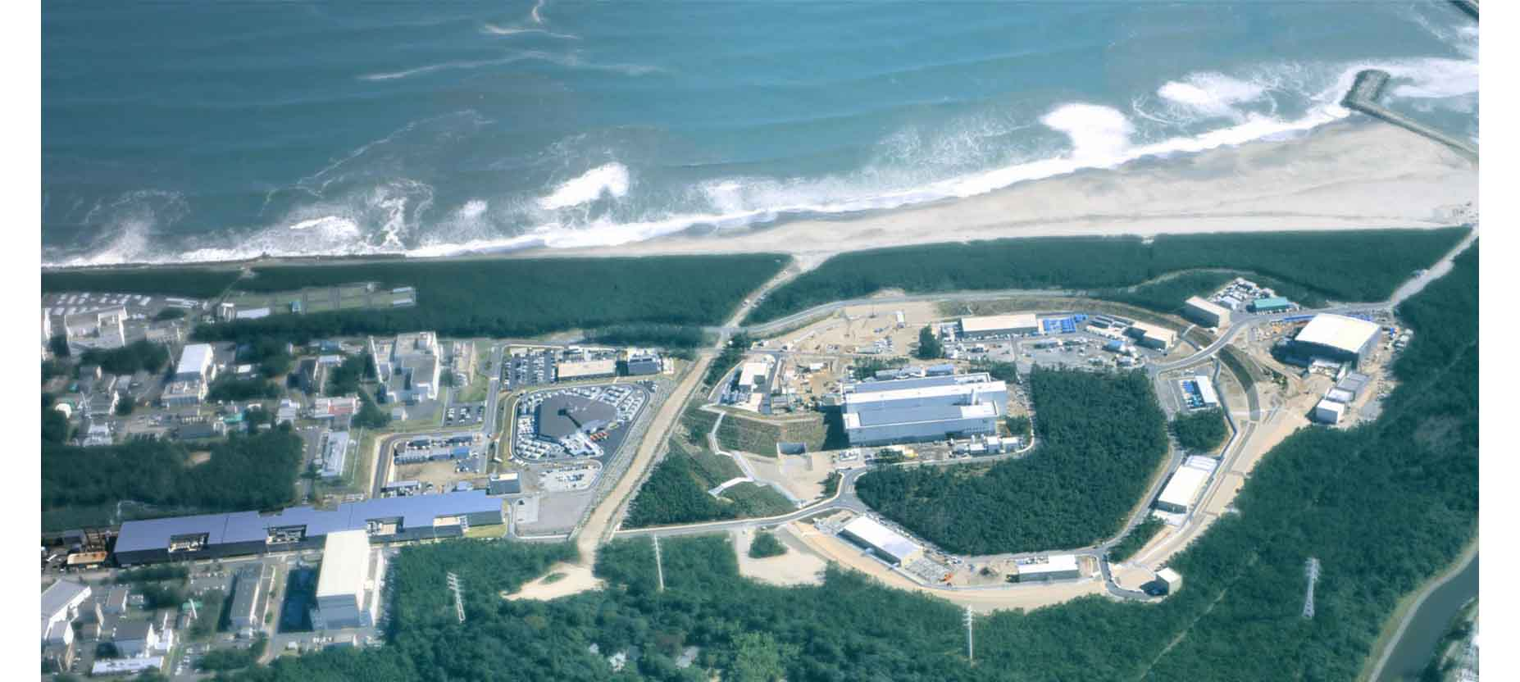
PANIC2017
2017.9.3
Hadrons in medium
Tohoku University
H. Tamura
J-PARC

Slide 2
PANIC2017
2017.9.3
Hadrons in medium
Contents
Introduction
Hyperons in medium
2.1 Ξ hypernuclei
2.2 Precise spectroscopy of Λ hypernuclei
----Charge symmetry breaking---
Anti-kaons in medium
4. Summary
J-PARC

Slide 3
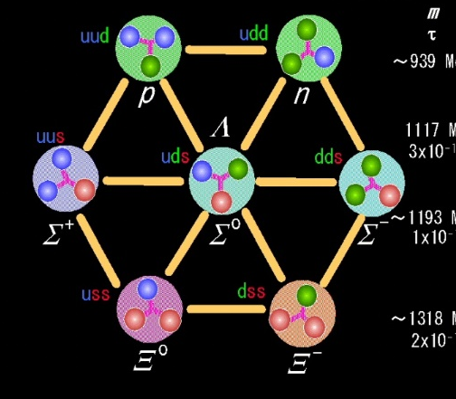
Introduction

Slide 4

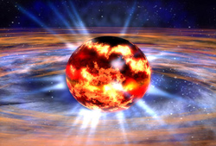
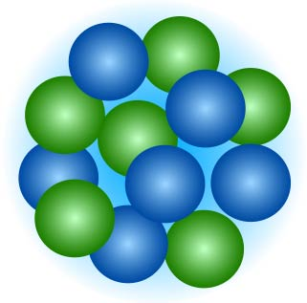
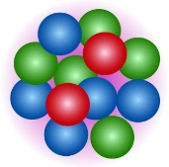
Basic questions in low energy QCD
QCD
Quarks/gluons
“Hadrons in nuclei”
A key to bridge
hadrons and nuclei to QCD
How are hadrons formed
from quarks and gluons?
How hadrons behave in nuclear matter?
How the hadron-hadron interactions (incl. nuclear force) should be understood?
Does hadron structure change in nuclear matter?
Hadrons
How are nuclei formed from hadrons?
How do nuclear matter properties change at higher density?
Nuclei
Neutron stars

Slide 5
■ γ spectroscopy of Λ hypernuclei
⁴_{Λ}He γ-ray observed ⁴_{Λ}H γ-ray, ⁷_{Λ}Li B(M1), …
■ Λ hypernuclear spectroscopy via (e,e’K⁺)
⁷_{Λ}He, ¹⁰_{Λ}Be, ¹²_{Λ}B high res. Spect. ⁴⁰_{Λ}K, ⁴⁸_{Λ}K
■ Decay pion spectroscopy of Λ hypernuclei
⁴_{Λ}H mass from ⁴_{Λ}H -> ⁴He + π⁻
■ Lifetime of light Λ hypernuclei via HI beams
Surprisingly short ³_{Λ}H lifetime
Recent results and plans on “hadrons in nuclei”
■ (Partly) took data
■ running
■ Under preparation
S=-1 hypernuclei
S=-2 hypernuclei
■ Emulsion experiments
Ξ ⁻ ¹⁴N bound state observed
■ ■ Ξ hypernuclear spectroscopy
¹²_{Ξ} Be observed
■ ■ Ξ atom X rays
■ Unbound H dibaryon search
J-PARC
J-PARC
KEK
JLab
J-PARC
J-PARC
MAMI
J-PARC
GSI, STAR, ALICE
K^{bar} nuclei
J-PARC
■ K⁻pp via ³He(K⁻,n) K-pp spectrum measured
■ K⁻pp via d(π⁺,K⁺) K-pp like bump observed
■ K-pp studies (HADES)
■ ■ K-N, N-Nucleus (KLOE/AMADEUS)
■ ■ K-d, K-He atom X rays
Other mesons in nuclei
■ pionic nuclei
■ η’ mesonic nuclei
■ Vector meson mass in nuclei
J-PARC
RIBF
GSI
DAΦNE
GSI
J-PARC,…
DAΦNE, J-PARC

Slide 6
2. Hyperons in nuclei
2.1 Ξ hypernuclei

Slide 7
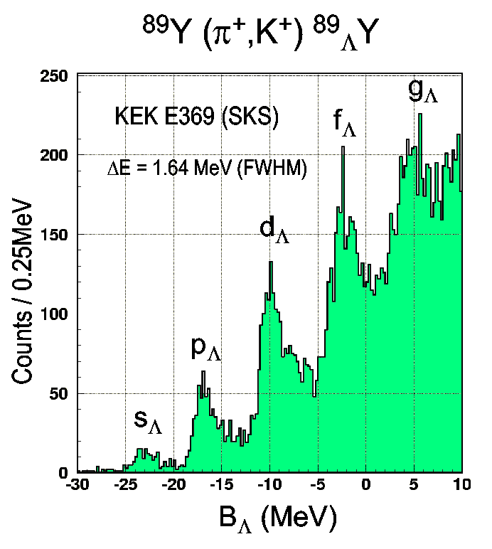
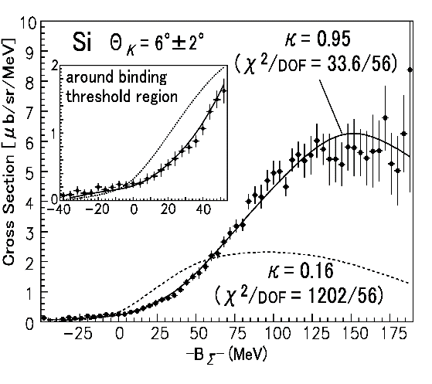
Are hyperons bound in nuclei?
Hotchi et al., PRC 64 (2001) 044302
✔Λ 40 Λ hypernuclei from ³_{Λ}H to ²⁰⁸_{Λ}Pb with ~80 excited states have been experimentally produced.
U_{Λ} = -30 MeV (c.f. U_{Ν} = -50 MeV)
-> Should appear in neutron stars
×Σ No bound systems observed
(one exception: ⁴_{Σ}He)
Potential looks strongly repulsive.
U_{Σ} ~ +30 MeV
Noumi et al., PRL 87(2002) 072301
-> Does not appear in neutron stars
? Ξ No definite data exists

Slide 8
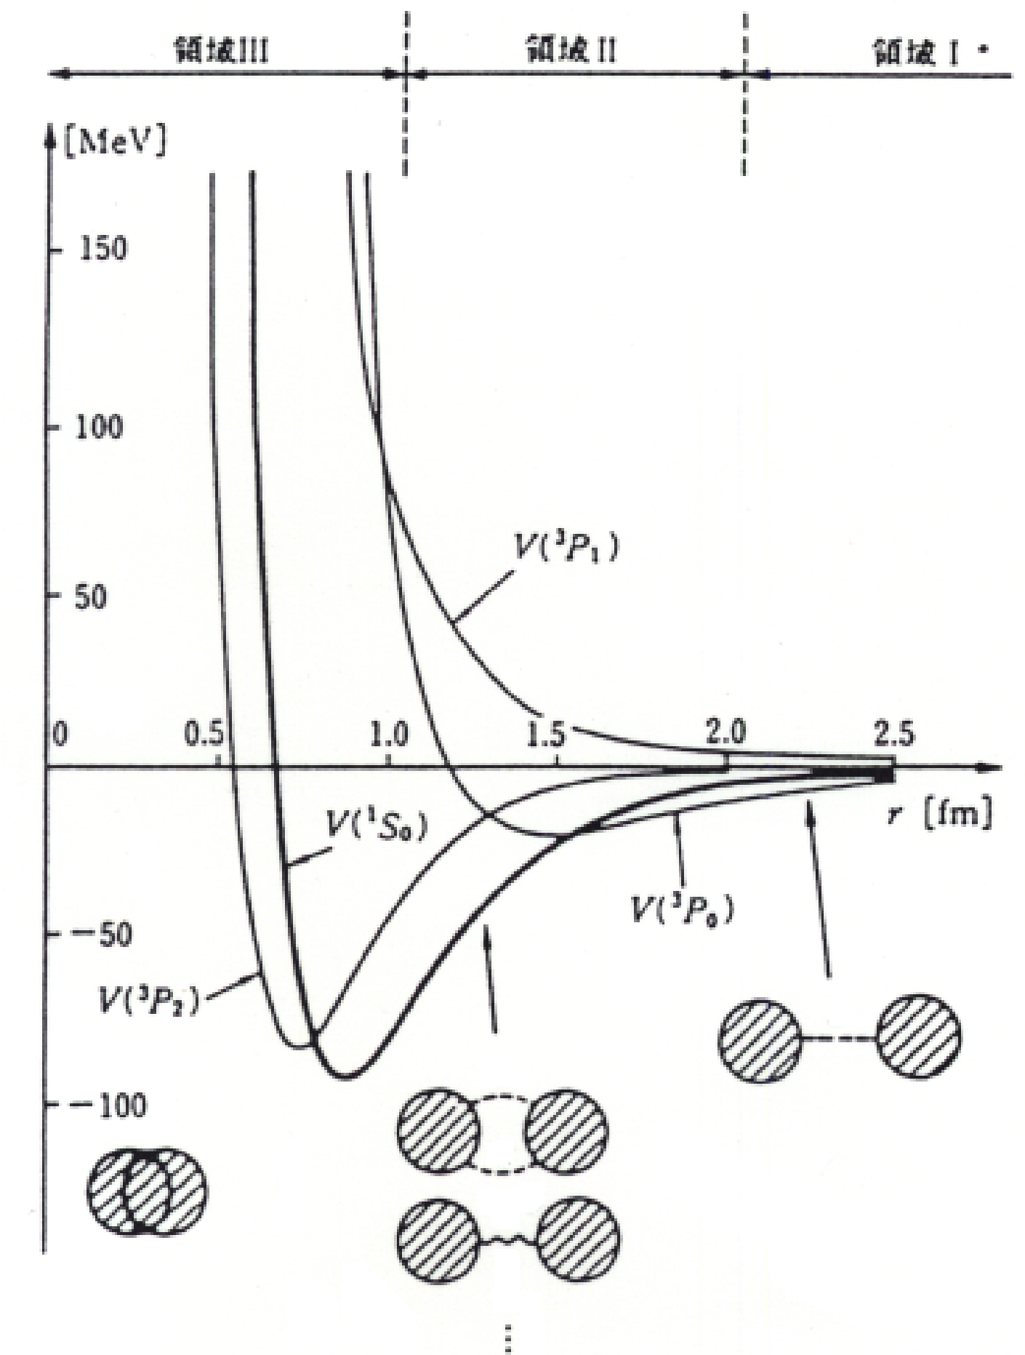

Key questions in nuclear force
Origin of the repulsive core ?
The short-range strong repulsion well cancelled by the long-range strong attraction. Why?
How should we understand Baryon-Baryon forces in a unified way?
How is the high density matter in neutron stars?
=> Give answers by extending
NN -> BB forces
nuclear matter -> baryonic matter
from textbook by Tamagaki
2π
π
h/m_{π}c = 1.4 fm
ω, ρ, σ...
Quark-gluon picture?
meson exchange picture
π
Lattice QCD

Slide 9
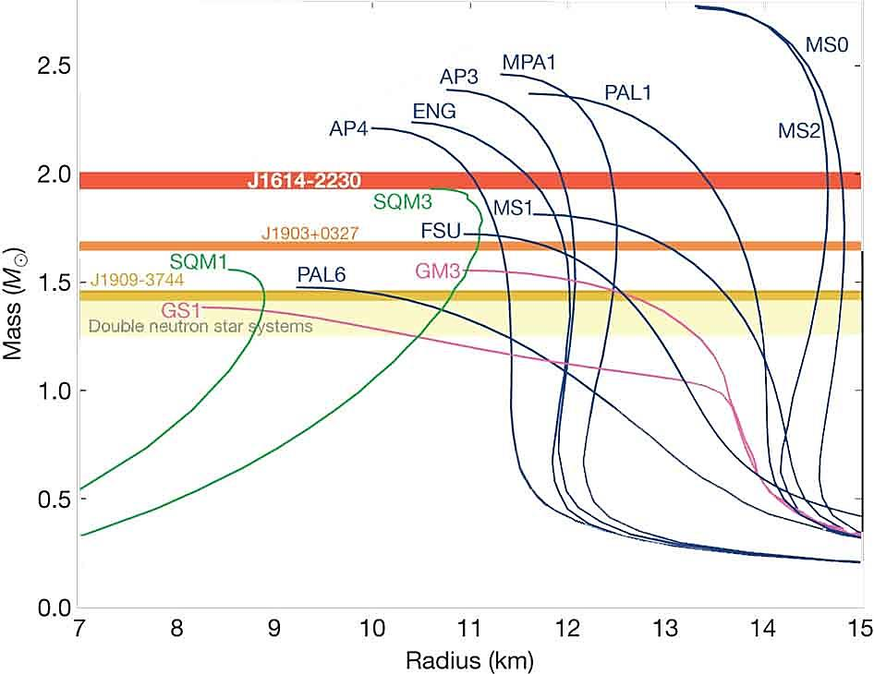
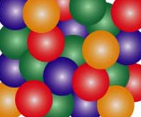
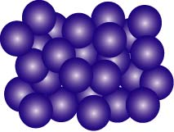
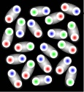
“Hyperon puzzle” in neutron stars
Hyperons (Λ at least) must appear at ρ ~ 2 ρ₀
EOS’s with hyperons or kaons too soft -> cannot support M > 1.5 M_{sun}
Heavy NS’s (~2.0 M_{sun}) were observed.
=> Unknown repulsion at high ρ
Strong repulsion in three-body force including hyperons,
NNN, YNN, YYN, YYY ?
Phase transition to quark matter ?
(quark star or hybrid star)
PSR J1614-2230 (2010) 1.97±0.04 M_{sun}
PSR J0348-0432 (2013) 2.01±0.04 M_{sun}
Ignore hyperons
M
×
Λ
??
n
n
p
Ξ
+Hyperons
NS mass
We need to know YN, YY, K^{bar}N interactions
both in free space and
in nuclear medium
Quark matter
NS radius (km)

Slide 10

“Kiso event”
Discovery of Ξ-nuclear bound system
Newly developed
“Overall scanning method”
applied to KEK E373 emulsions
K. Nakazawa et al. PTEP 2015, 033D02
e⁻
⁸Li
p
α
⁸Be
d
α
p
=
−
:
−
The first evidence for a deeply bound Ξ state -> Ξ⁻-nucleus is attractive

Slide 11
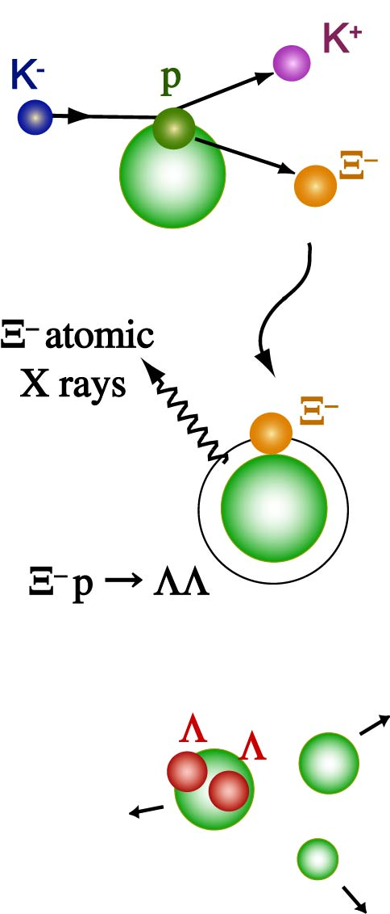
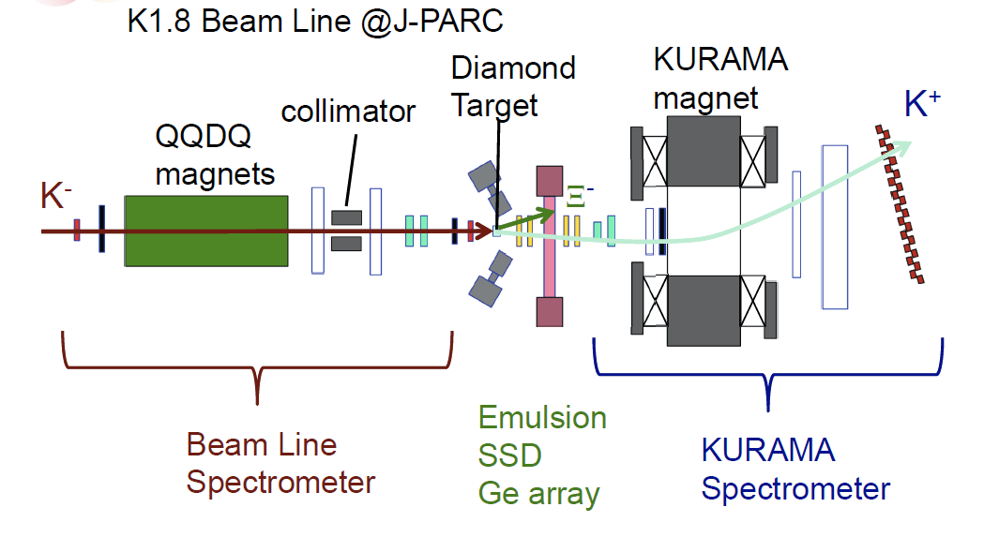
More S=-2 events with emulsion
J-PARC E07
K. Nakazawa et al.
Measure tracks
by counters
Collect ~10² ΛΛ hypernuclear events from ~10⁴ Ξ⁻_{stop}
  Confirm ΛΛ interaction strength
  More Ξ-nuclear events -> Ξ-N interaction
Measure Ξ⁻ -atomic X-rays with Ge detectors
  Shift and width of X-rays -> Ξ-nuclear potential
  Stopped Ξ⁻ events identified from emulsion image
  –> almost no background
Ξ production
Ξ absorption
Fragmentation
Finished beam irradiation this June.
Results will appear soon.
Weak decays
π⁻
p
Λ→ Nπ, ΛN→NN

Slide 12
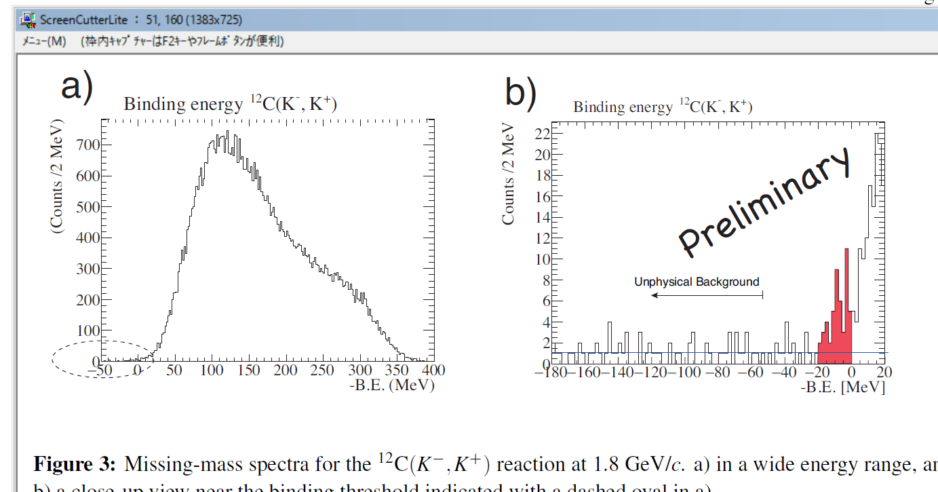

Rather deep bound states
Ξ-Hypernuclear Spectroscopy via (K⁻,K⁺) Reaction
Nagae et al., J-PARC E05
¹²C (K⁻,K⁺) ¹²_{Ξ}Be with SKS spectrometer
( K⁻ p -> Ξ⁻ K⁺ on ¹²C target)
T. Nagae et al., PoS INPC2016 (2017) 038
K⁻p→K⁺Ξ⁻ 6000 Ξ⁻/day at J-PARC !!
ΔE～5.4 MeV fwhm
QFΞ
If U_{Ξ} is as deep as U_{Λ} , both Λ and Ξ⁻ should appear at ρ ~2 ρ₀
-> ”Hyperon puzzle” more difficult to solve.
Extremely strong three-body YNN force necessary,
or, deconfined quark matter exists?
(CH2)

Slide 13
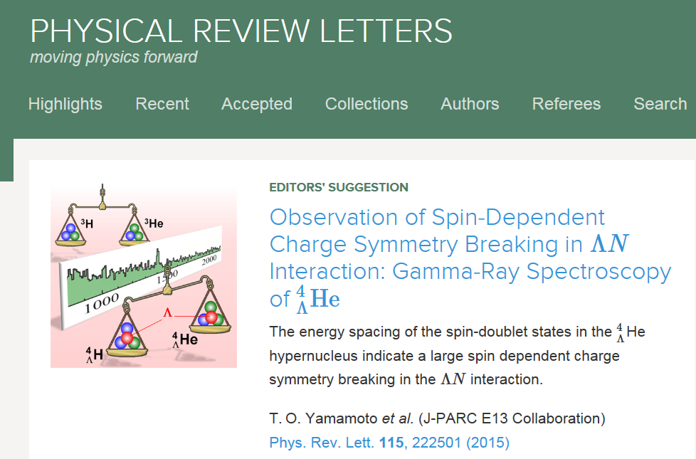
2.2 Precise spectroscopy of
Λ hypernuclei
-- Charge symmetry breaking--

Slide 14
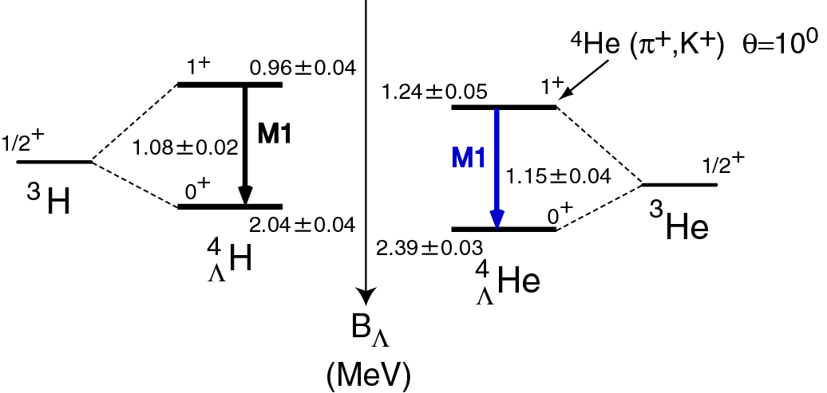
A large Charge Symmetry Breaking (CSB) effect
in A=4 hypernuclei ??
CSB in NN force (pp ≠ nn)
=> B(³H) - B(³He) – EM effect ~70 keV
Measure
with Ge
CSB in ΛN force (Λp ≠ Λn)
B_{Λ}(⁴_{Λ}H) - B_{Λ} (⁴_{Λ}He) = -350 keV ?
Bedjidian et al.
PLB 62 (1976) 467
PLB 83 (1979) 252
³H + Λ
0
³He + Λ
YN interactions models
B_{Λ}(⁴_{Λ}H) - B_{Λ} (⁴_{Λ}He) = 0-70 keV
Old NaI data
low statistics
(K⁻,π⁻ )
1.09±0.02
1.15±0.04
Measure using weak decay pion
Λ
p
⁴_{Λ}H
⁴_{Λ}He
n
Old emulsion data
no systematic error
M. Juric et al. NPB 52 (1973) 1
Experimental confirmation awaited

Slide 15
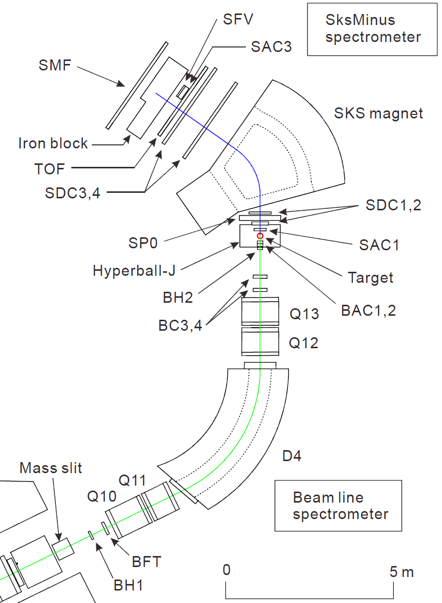
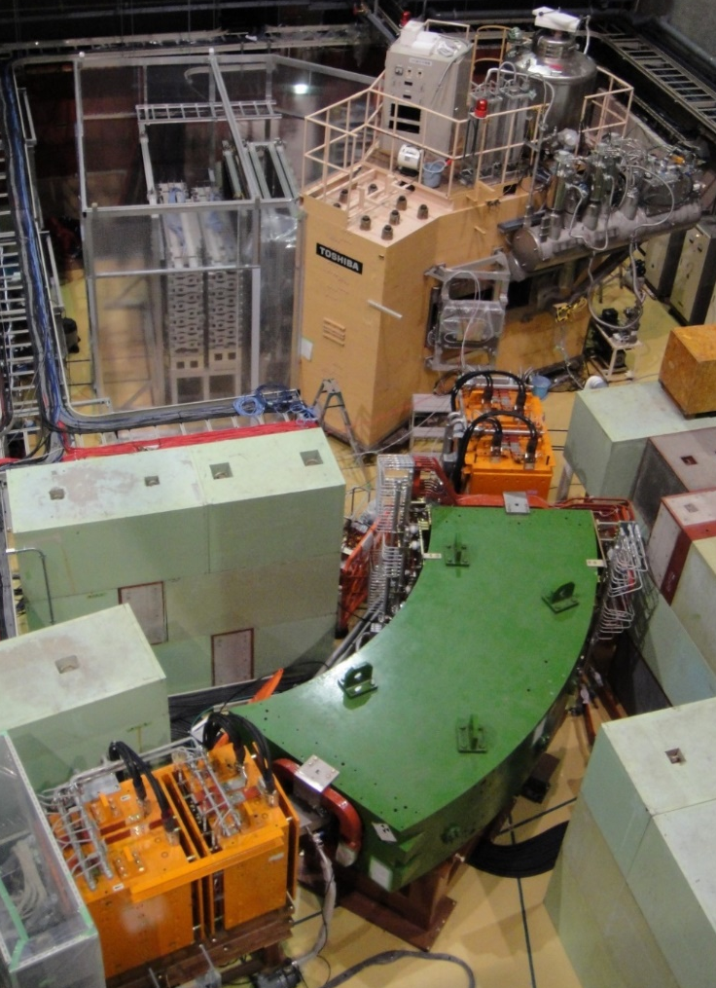
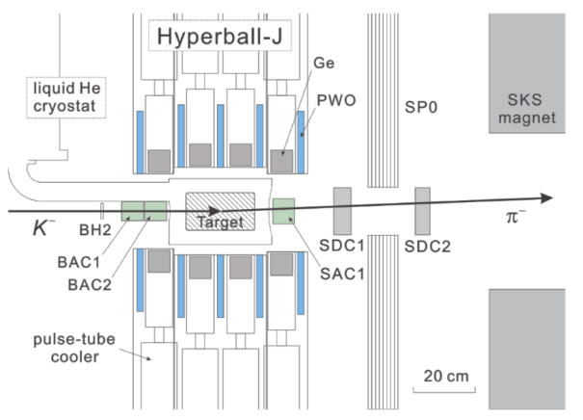
Setup at J-PARC K1.8
Pion spectrometer“SksMinus”
π⁻
  (2.5 T)
Tag production of hypernuclei
Detect γ-rays from hypernuclei
Ge array
“Hyperball-J”
K－
K1.8 Beamline
Spectrormeter
Notes:
この図がJ-PARCのK1.8ビームラインにおけるE13実験のセットアップとなっています。
大強度のK－ビームをこちらに配置した標的に照射して（K－,π-）反応でハイパー核を生成し、
その後に放出されるガンマ線を測定します。
（animation）
E13実験は、反応－γ同時計測実験であり、
ビームラインスペクトロメータでビームK粒子、
散乱粒子スペクトロメータ「SksMinus」を用いて散乱π粒子を運動量解析して
ハイパー核生成をタグし、
それと同時に、新しいGe検出器群「Hyperball-J」でハイパー核からのガンマ線を測定します。
Hyperball-Jの性能については本学会初日に山本が報告しました。
収量を考慮して、
4Heハイパー核については液化4He標的と運動量1.5GeV/c、
19Fハイパー核についてはHF標的と運動量1.8GeV/cを採用しました。
(animation)
本講演では、このスペクトロメータの性能について報告します。

Slide 16
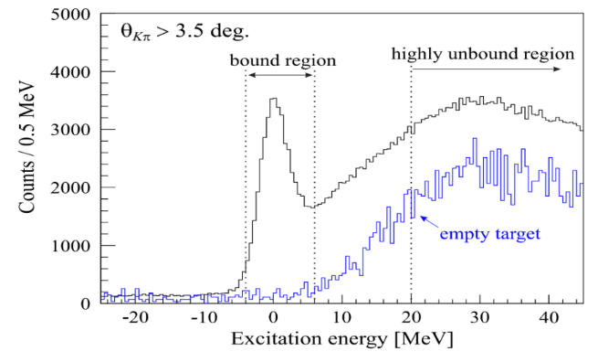
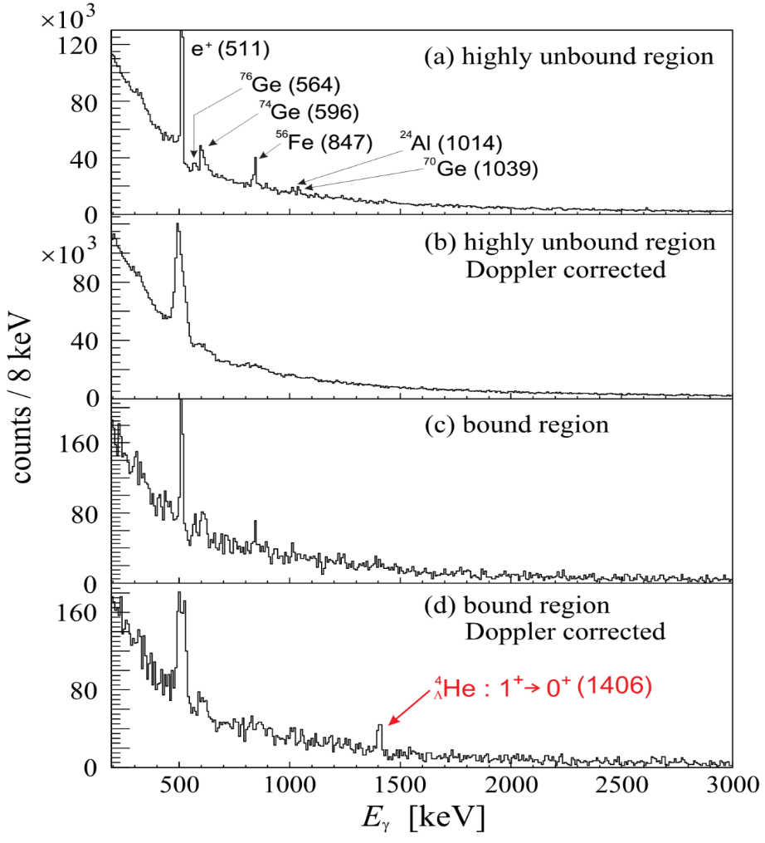
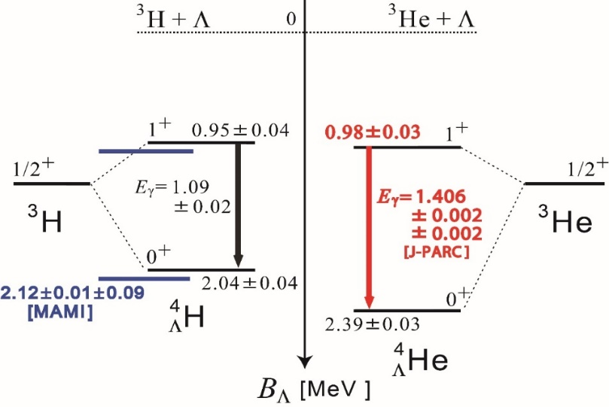
Result
⁴_{Λ}He (0⁺ + 1⁺)
Missing mass of ⁴He(K⁻,π⁻)
γ-ray energy (keV)
A peak observed at
1406±2±2 keV
Rather well determined
By three experiments.
T.O. Yamamoto et al.,
PRL 115 (2015) 222501
A large CSB effect ( ~300 keV) confirmed only by γ-ray data

Slide 17
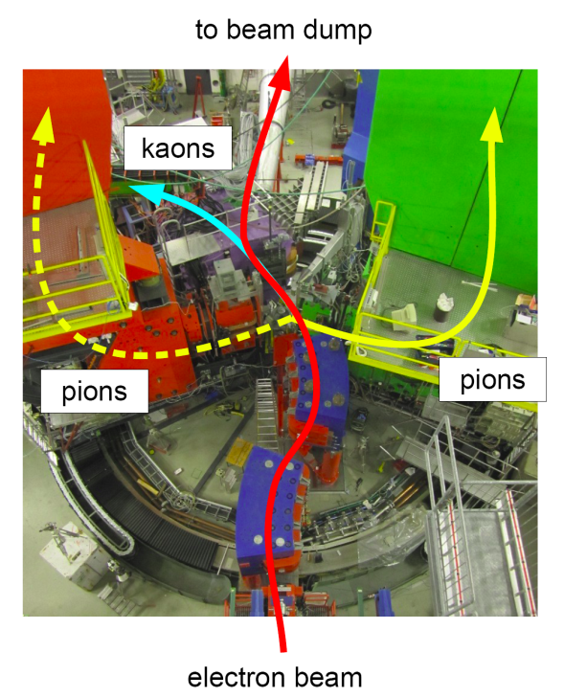
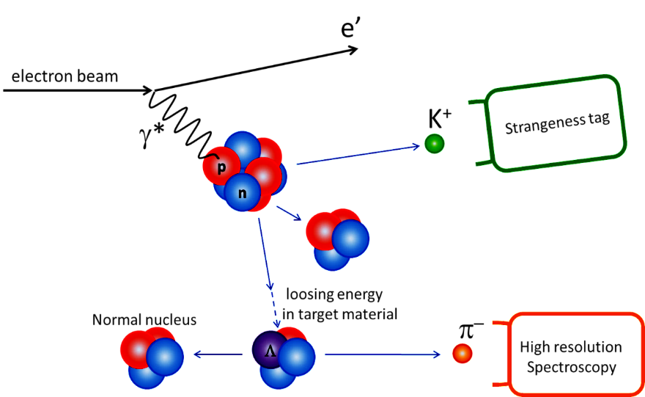
Decay-pion spectroscopy of hypernuclei with electron beams
Slide by P. Achenbach
γ∗ p -> Λ K⁺
fragmentation
~100 MeV/c
MAMI
weak decay
⁴_{Λ}H etc.
Two-body decay at rest ⇒ mono-energetic pions
An independent method for precise mass measurement

Slide 18
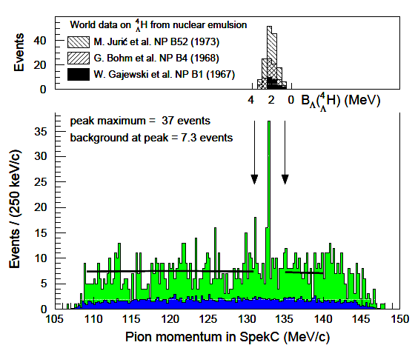
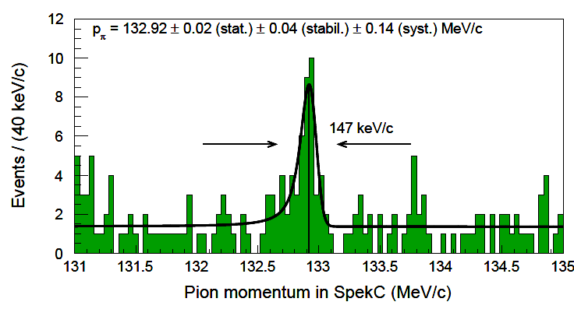
Decay-pion spectrum
Slide by P. Achenbach
Emulsion data in binding energy scale
=> B_{Λ} [ ⁴_{Λ}H ] = 2.12±0.01±0.09 MeV
Present data
⁴_{Λ}H -> ⁴He + π⁻
decays of quasi-free produced hyperon
A. Esser et al., PRL 114 (2015) 12501
accidental background
New method of precise mass measurement developed.

Slide 19
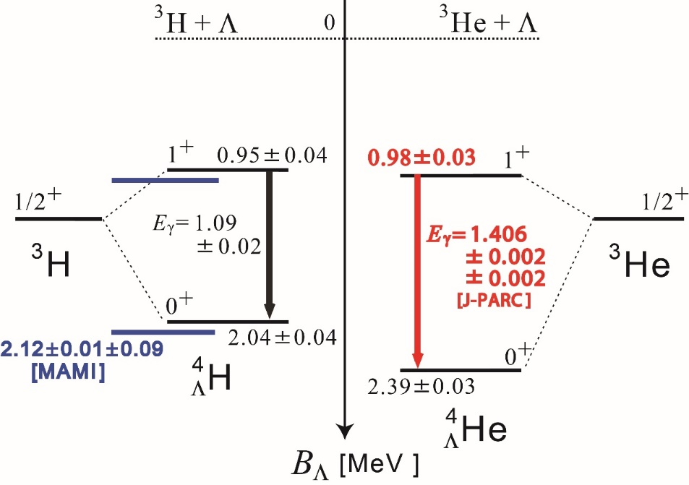
Combined Results
A. Esser et al.,
PRL 114 (2015) 12501
T.O. Yamamoto et al.,
PRL 115 (2015) 222501
ΔB_{Λ}(1⁺) : 0.03±0.05 MeV
0.11±0.09 MeV
ΔB_{Λ}(0⁺) : 0.35±0.05 MeV
0.26±0.09 MeV
B_{Λ} [ ⁴_{Λ}H(0⁺) ] is confirmed, suggesting the emulsion ⁴_{Λ}He(0⁺) data also reliable.
Large spin dependence in CSB found.
N
Λ
ΛΣ
coupling
π
Recent theories: This CSB effect is sensitive to ΛN-ΣN coupling.
Σ⁰
A. Gal, PLB 744 (2015) 352
D. Gazda and A. Gal, PRL 116 (2016) 122501
N
Λ
CSB

Slide 20
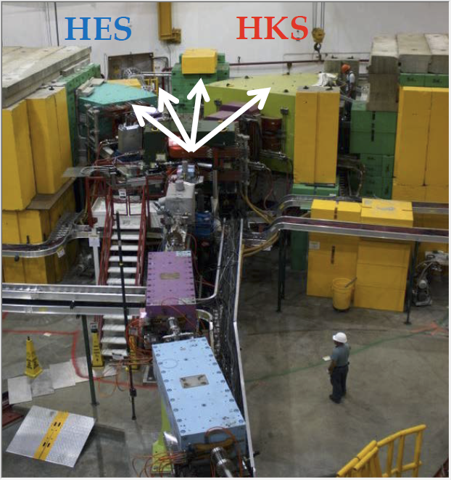
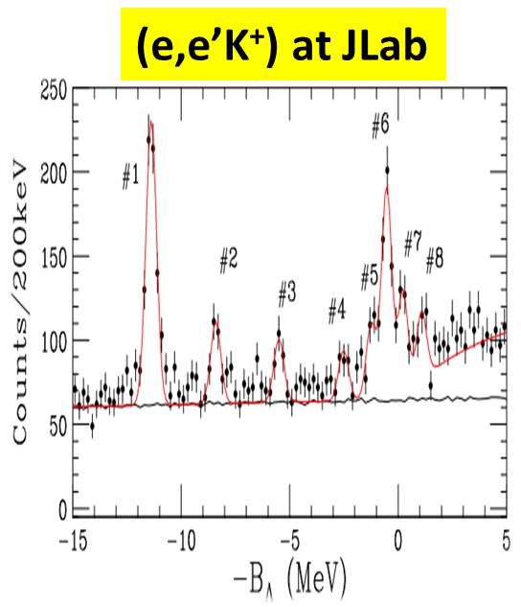
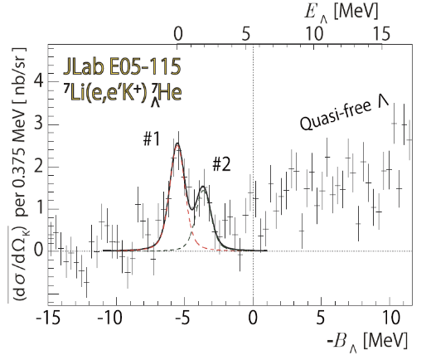
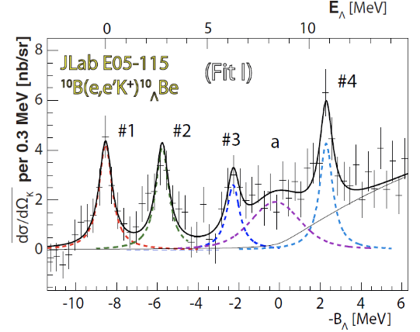
JLab (e,e’K⁺) spectroscopy
Jlab E05-115
¹²_{Λ} B
L. Tang et al.,
PRC90 (2014) 034320
ΔE = 0.5 MeV (FWHM) achieved
Jlab Hall C
Accuracy of
absolute energy
in (e,e’K⁺)
~ 100 keV
(π⁺,K⁺), (K⁻,π⁻ )
~ 1 MeV
⁷_{Λ} He
¹⁰_{Λ} Be
T. Gogami et al., PRC 94 (2016) 21302(R)
T. Gogami et al., PRC 93 (2016) 034314

Slide 21
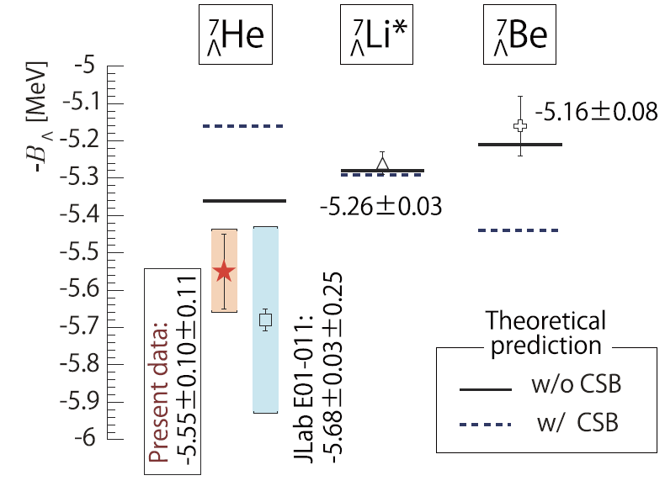
CSB in p-shell hypernuclei (A=7)
Emulsion data
Emulsion + γ-ray data
Phenom. CSB int.
which accounts for A=4
(Hiyama et al.)
T. Gogami et al., PRC 94 (2016) 21302(R)
High-resolution (e,e’K⁺) spectroscopy at Jlab plays important roles to understang the origin of CSB effect

Slide 22
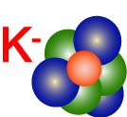

3. K^{bar} in nuclei
p
p
K⁻

Slide 23
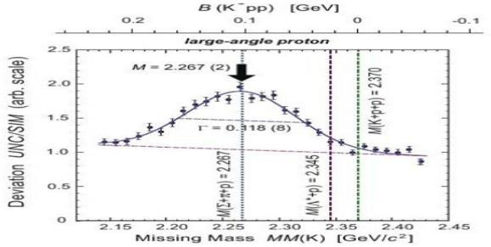
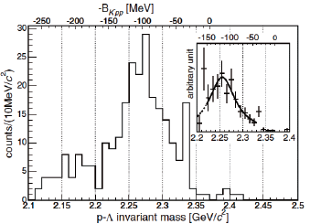
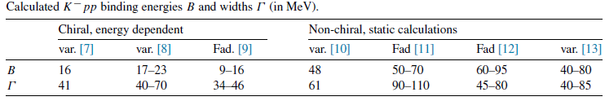


p
K- in nuclei: Introduction
p
K⁻
K^{bar}N interaction
  Strongly attractive (K⁻p atomic X-ray shift and low energy K⁻ p scattering)
  Λ(1405) can be interpreted as a K⁻p bound state
K⁻pp bound state
  The simplest K^{bar}-nucleus
  Theories not converged
K^{bar} in matter
  K⁻ condensation in NS?
  K^{bar}-nucleus may be a dense
  cold matter
B_{K}~ 100 MeV
FINUDA
Stop K⁻ on
^{6,} ⁷Li+¹²C
DISTO
p + p, Tp=2.85GeV
M.Agnello et al., PRL 94, 212303 (2005)
T.Yamazaki et al., PRL 104, 132502 (2010)

Slide 24
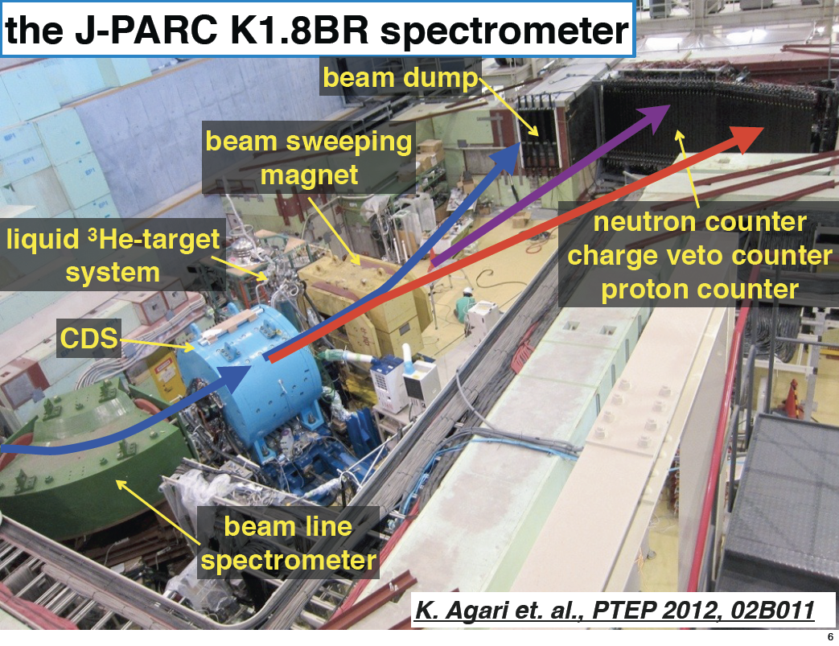
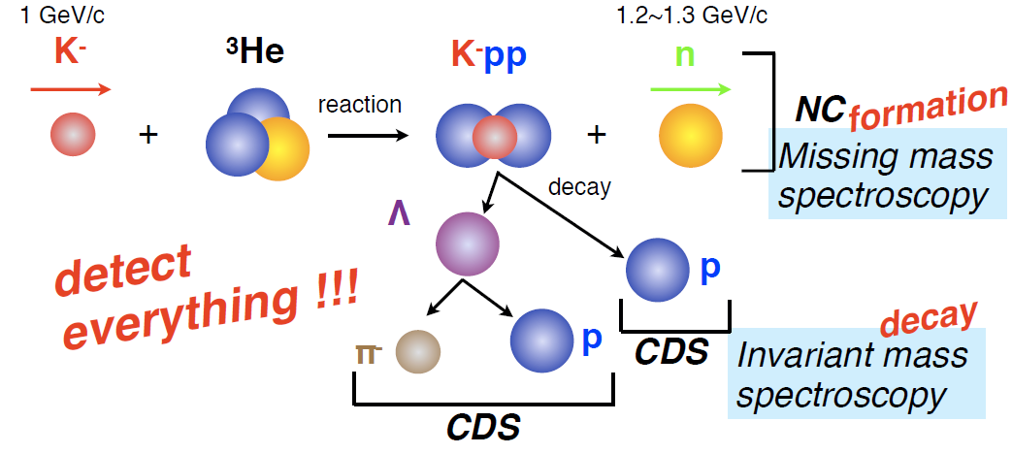
J-PARC E15 (Iwasaki et al.)
Slide by Sakuma
Search for K^{bar}NN via ³He(in-flight K⁻,n) reaction
K1.8BR line
p_{K} = 1 GeV/c
=> Small mom. trans. to K⁻
Easily captured by NN
K. Agari et al.
PTEP 2012, 02B011
two-nucleon absorption
hyperon decays
CAN be discriminated kinematically

Slide 25
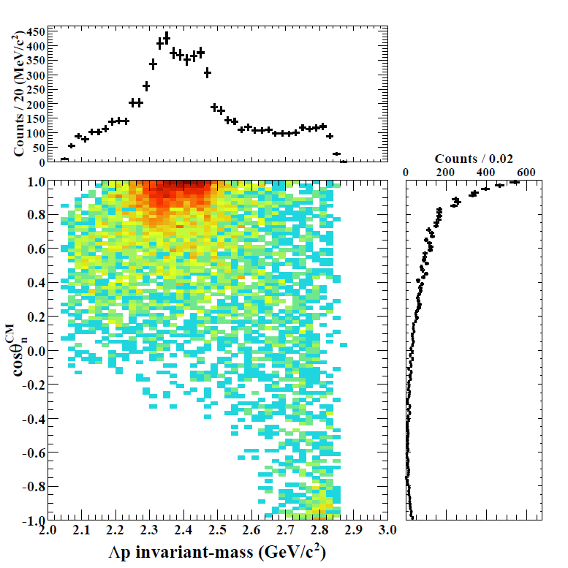
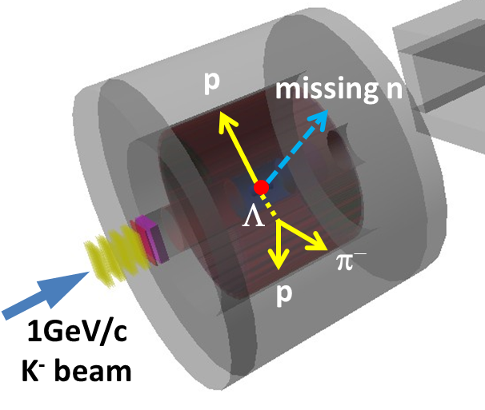
Results of ³He(K⁻,Λp)n
Slide by Sakuma
IM(Λp)
Structures around the Kpp threshold can be seen
= bound-state + QF
M(K+p+p)
preliminary
Structures are concentrated in forward-n region
= small momentum-transfer
detector
acceptance
cos(θ_{n})

Slide 26
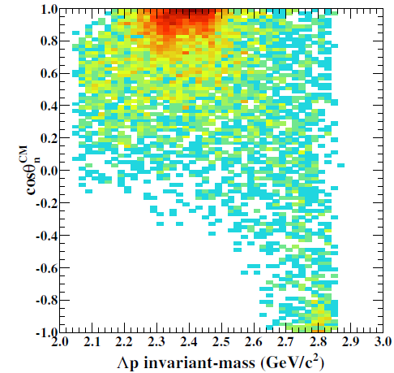
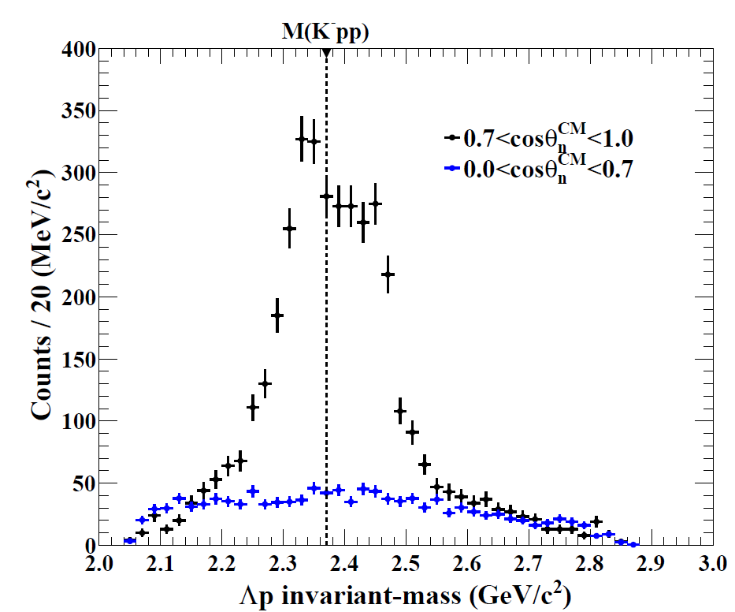
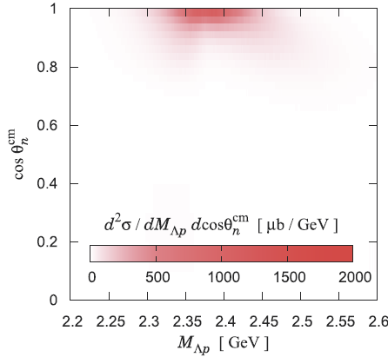
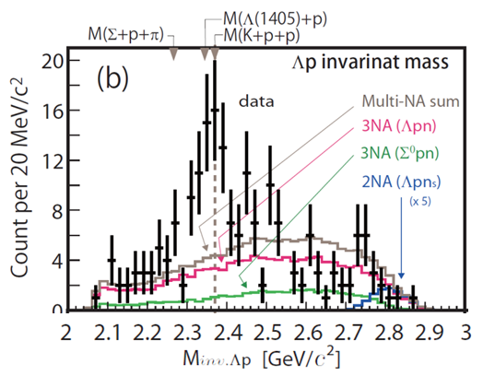
Λp Invariant Mass
Slide by Sakuma
𝟎.𝟕<𝐜𝐨𝐬𝜽_{𝒏}^{𝑪𝑴}<𝟏.𝟎
𝟎.𝟎<𝐜𝐨𝐬𝜽_{𝒏}^{𝑪𝑴}<𝟎.𝟕
Below M(Kpp)
→ Bound-state!?
Above M(Kpp)
→ QF = [Quasi-elastic K] x [KNN→Λp]
detector
acceptance
𝟎.𝟕<𝐜𝐨𝐬𝜽_{𝒏}^{𝑪𝑴}<𝟏.𝟎
preliminary
E15^{1st}
missing acceptance
(𝟎.𝟎<𝐜𝐨𝐬𝜽_{𝒏}^{𝑪𝑴}<𝟎.𝟕)×𝟎.𝟒𝟕
performed in 2013
Y. Sada, et al, PTEP 2016, 051D01
QF
Flat distribution
prop. to phase space
→ Point like 3NA?
B.S.
Sekihara, Oset, Ramos,
PTEP(2016)123D03
Similar to Sekihara’s most updated calculation based on chiral unitary model
=> It is a K⁻pp candidate

Slide 27
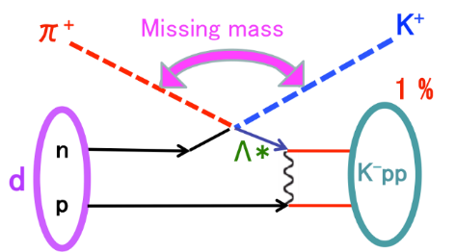
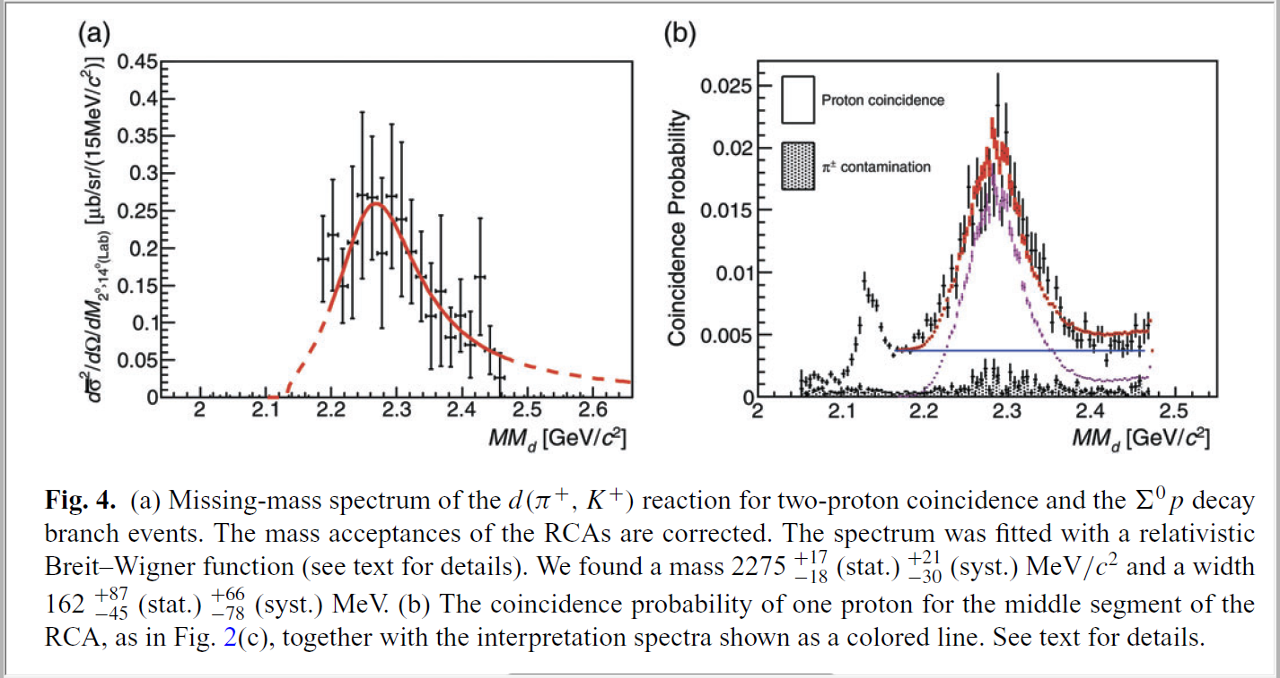
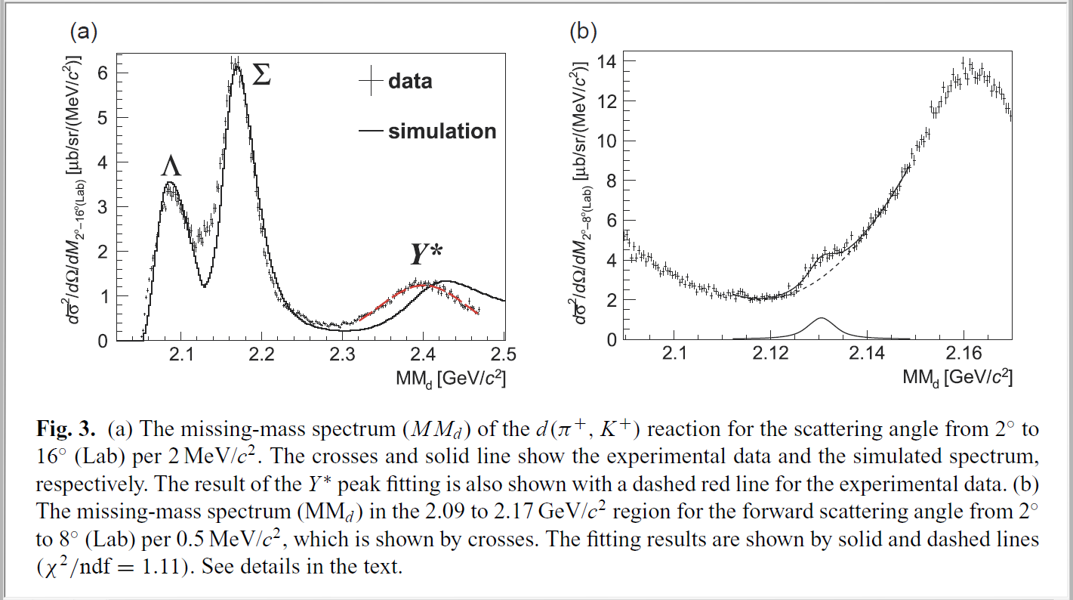
J-PARC E27 (Nagae et al.)
Search for K^{bar}NN via d(π⁺, K⁺) reaction
P_{π} = 1.7 GeV/c
K⁻pp is produced via a Λ(1405) doorway.
π⁺ + n → Λ(1405) + K⁺
Λ(1405) + p → K⁻pp -> Λp, Σ⁰p ?
(→quasi free Λ*）
Ichikawa et al., PTEP 2015 (2015) 021D01
2 protons in coin
Σ⁰p mode
1 proton in coin
M =
, Γ =
What is the deep (B_{K}~ 100 MeV) broad bump seen in three experiments?
Two different “K⁻pp”-like (B=2, S=-1) states ?? Open question.

Slide 28
4. Summary
Recent highlights on “Mesons in nuclear medium”
Ξ−nucleus bound systems observed
  Ξ⁻ ¹⁴N bound system observed in emulsion (Kiso event).
  ¹²C(K-,K+) ¹²_{Ξ}Be spectrum shows bound state events.
  “Hyperon puzzle” is more serious
Large CSB effect in A=4 Λ hypernuclei confirmed
  Precise ⁴_{Λ}He(1⁺->0⁺) γ-ray measurement
  Precise ⁴_{Λ}H mass measurement via ⁴_{Λ}H-> ⁴He + π⁻
New data for K-pp bound systems obtained
  ³He(K⁻,Λp)n spectrum exhibits a peak at B_{K} ~ 40 MeV
  Broad bump at B_{K} ~ 100 MeV in d(π⁺,K⁺) reaction
Future
New experiments at JLab/J-PARC + J-PARC Hadron Hall extension
=> Nuclear density dependence of YN interaction in nuclear matter
=> solve hyperon puzzle

