Slide 1

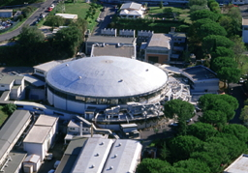

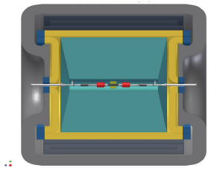

AMADEUS: Experiments on Antikaon Interactions with Nucleons and Nuclei
SMI – STEFAN MEYER INSTITUTE
J. Marton for the AMADEUS Collaboration
Stefan Meyer Institute (SMI) Vienna, Austria
WWW:OEAW.AC.AT/SMI
JM PANIC 2017

Slide 2
Motivation
The antikaon (K⁻) interaction with nucleons and nuclei represents an interplay between explicit and spontaneous chiral symmetry breaking
The character of the antikaon-nucleon/nuclei interaction at low energy is attractive and absorptive
Exotics in the strangeness sector exist, e.g. Λ(1405)
Existence of (dense) baryonic matter, bound strong interaction with strangeness?
Role of strangeness in compact stars (neutron stars)

Slide 3
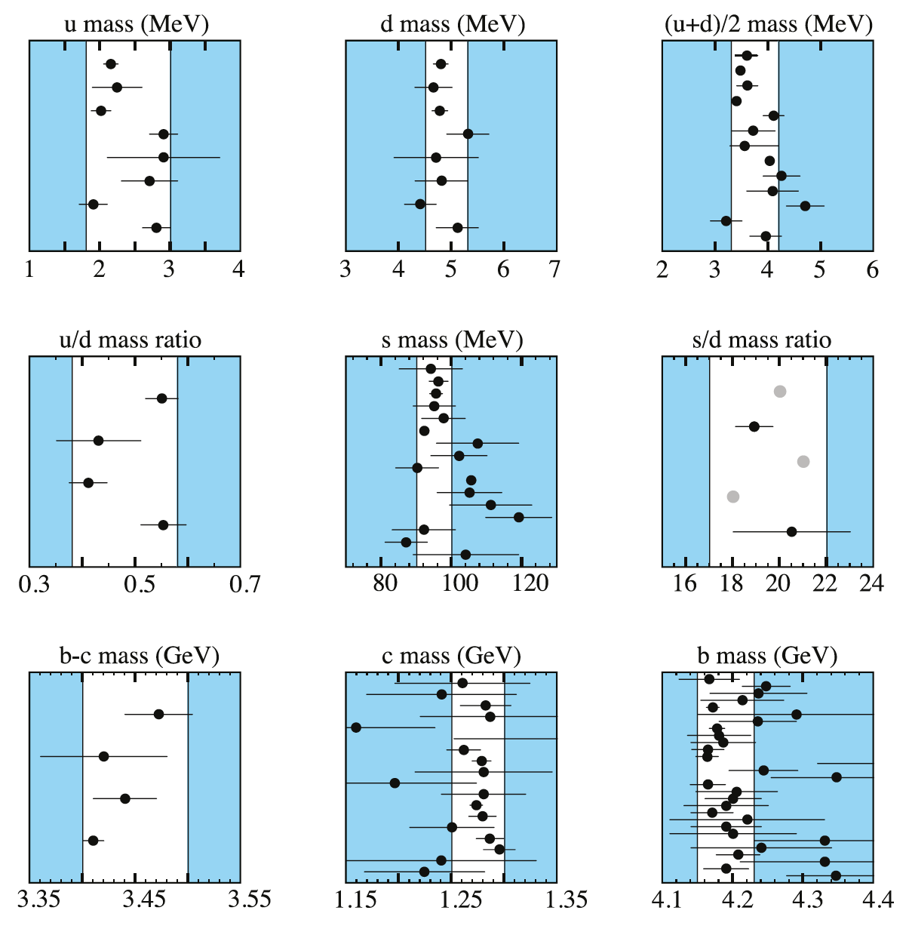
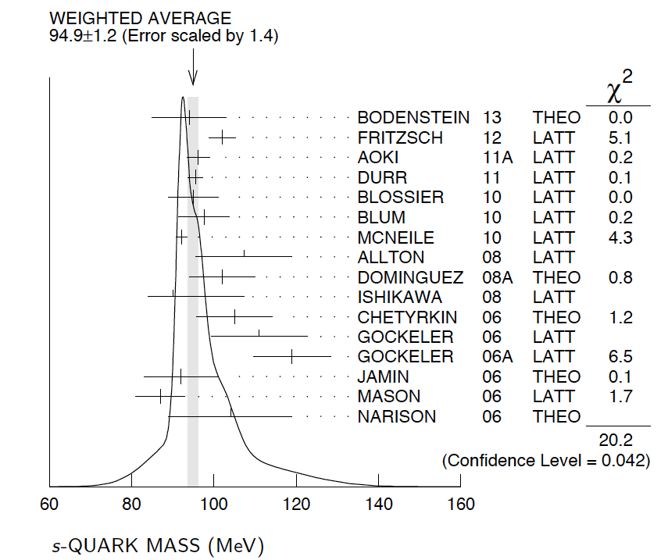
Strangeness
Strange quark – not light but not heavy
Kaonic atoms →
Spontaneous and explicit
Chiral symmetry breaking in
low-energy QCD

Slide 4
Low-energy QCD in the u-d-s sector
Chiral perturbation theory: interacting systems of N-G bosons
(pions, kaons) coupled to baryons works well for pp, pN, K⁺N ..
NOT for K⁻N !!
K⁻ = (su) strangeness = -1 , K⁺ = (us) strangeness = +1
- the sub-threshold region is dominated by resonances →
complex multichannel dynamics
Λ(1405) just below KN threshold (1432 MeV)
Non-perturbative Coupled Channels approach: Chiral Unitary SU(3) Dynamics
phenomenological KN and NN potentials

Slide 5
Antikaon interaction at threshold
Absorption processes
Bound states
KN threshold
1432 MeV
Scattering
Σ(1385)
Λ(1405)
SIDDHARTA
Kaonic hydrogen
Kaonic deuterium
AMADEUS

Slide 6
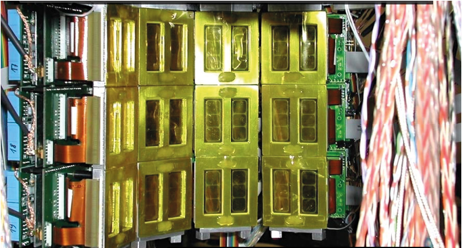
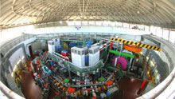
Some solved/open problems in K_{bar}N interaction
Solved problems:
Kaonic hydrogen/deuterium: 1s state shift/width
→ essential input for theory by SIDDHARTA
Kaonic helium: 2p state shift puzzle solved
Open issues:
K_{bar}N interaction attractive and absorptive (K_{bar}N potential attractive and absorptive according to theory confirmed by kaonic atoms) – but how strong?
Bound states, Λ(1405), kaonic nuclei like K⁻pp
Absorption of K_{bar} in nuclei
Role of strangeness in compact stars
Kaonic deuterium shift, width -
K⁻n interaction

Slide 7
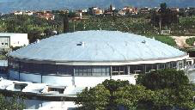
DAΦNE: Unique source of antikaons
Antikaons (kaons) from the Φ vector meson decay – nearly mono-energetic K⁻ (127MeV/c≈16 MeV)
≈50% branching of the two-body decay
Φ→K⁺K⁻
Low hadronic background kaon source
Ideal for experiments on kaonic atoms and low-energy antikaon interactions on nuclei (AMADEUS)

Slide 8
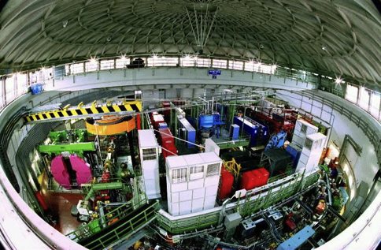
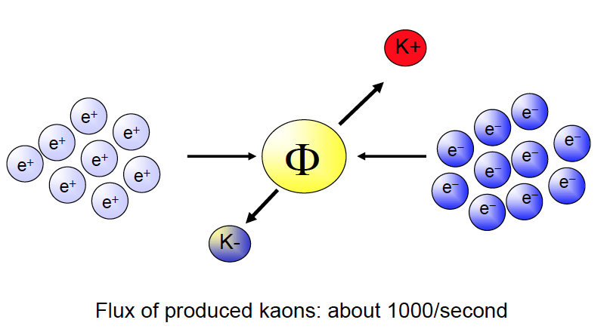
DAΦNE:
Φ Factory of LNF-INFN
Double anular electron-positron collider producing Φ (1020 MeV) resonantly

Slide 9
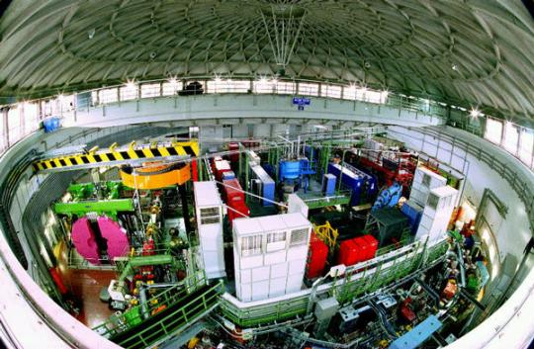
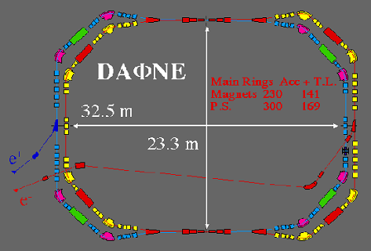
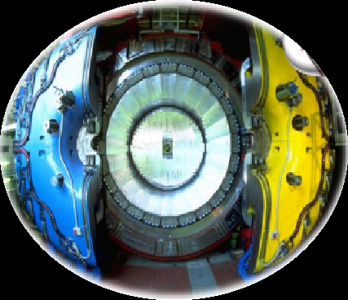
AMADEUS & DAΦNE
AMADEUS & DAΦNE
DAΦNE
double ring e⁺ e⁻ collider working at C.M. energy of φ,
producing ≈ 1000 φ /s
φ → K⁺ K⁻ (BR = (49.2 ± 0.6)%)
low momentum Kaons
≈ 127 Mev/c
back to back K⁺ K⁻ topology
AMADEUS step 0 → KLOE 2004-2005 dataset analysis (ℒ = 1.74 pb⁻¹)
Cylindrical drift chamber with a 4π geometry and electromagnetic calorimeter
96% acceptance
optimized in the energy range of all charged particles involved
good performance in detecting photons and neutrons checked by kloNe group
[M. Anelli et al., Nucl Inst. Meth. A 581, 368 (2007)]
KLOE

Slide 10
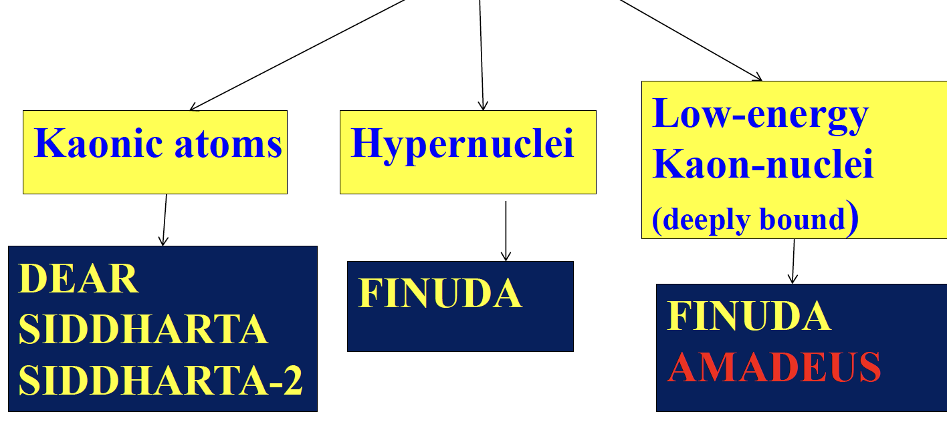
DAFNE collider: Strangeness nuclear physics research

Slide 11
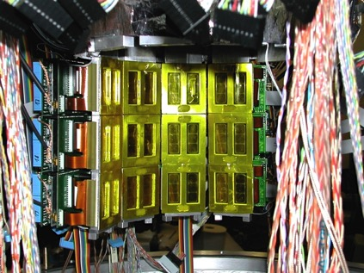
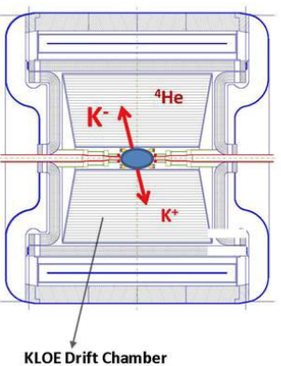
Hadron physics with strangeness at DAFNE/LNF-INFN
SIDDHARTA AMADEUS

Slide 12
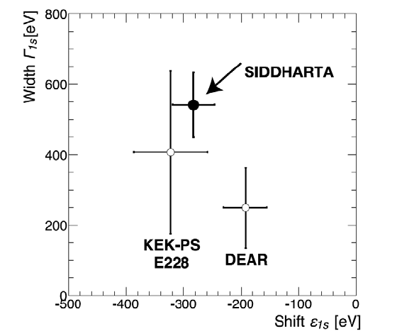
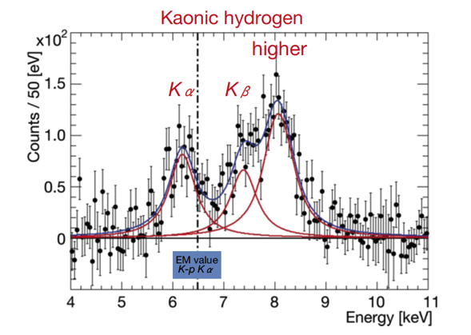
K⁻p result SIDDHARTA
X-ray spectrum with background subtracted
ε_{1S}= −283 ± 36(stat) ± 6(syst) eV
Γ_{1S}= 541 ± 89(stat) ± 22(syst) eV
Physics Letters B704 (2011) 113

Slide 13
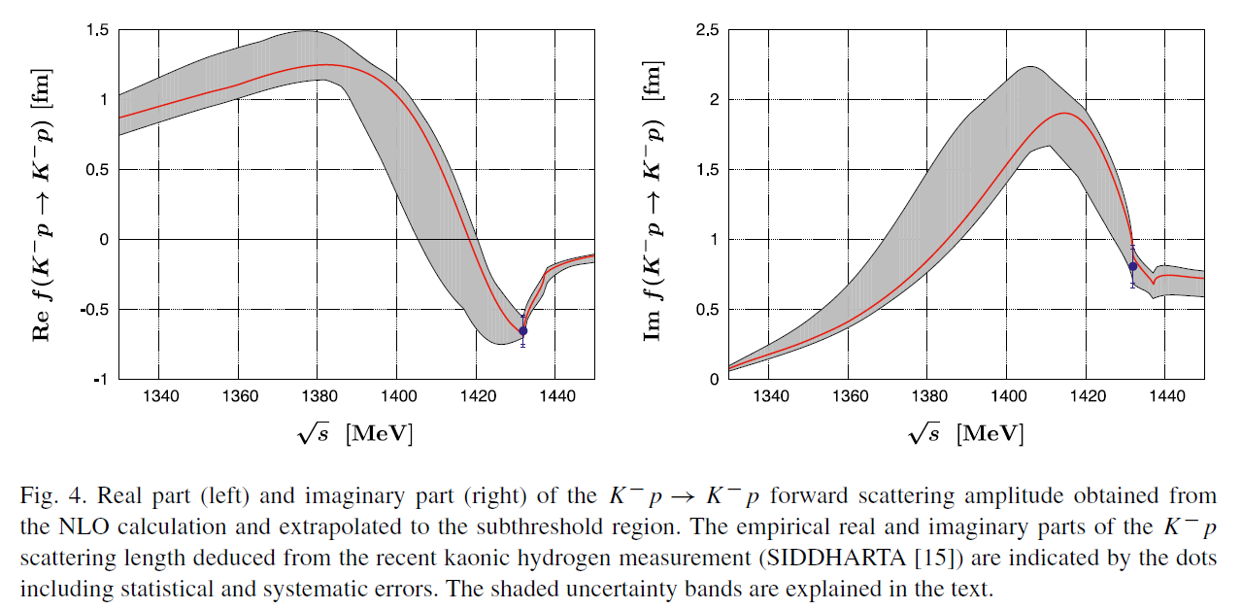
Impact of SIDDHARTA on antikaon-nucleon interaction
near threshold
Chiral SU(3) theory of antikaon-nucleon interactions with improved threshold constraints
Y. Ikeda, T. Hyodo and W. Weise, Nucl. Phys. A881 (2012) 98-114.

Slide 14
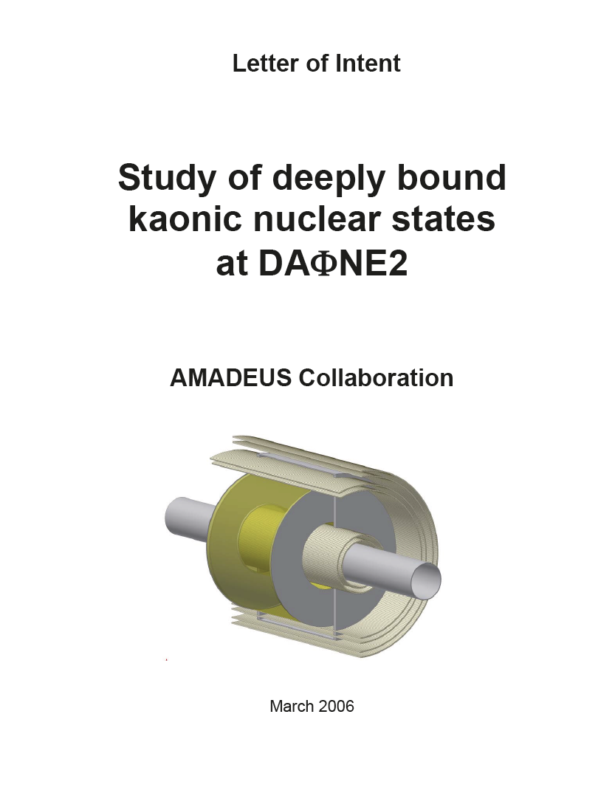
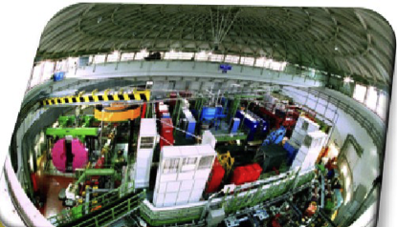
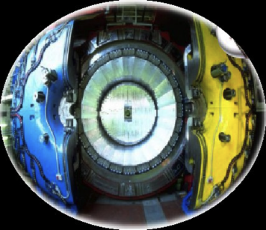
DAΦNE kaon source + KLOE
Powerful combination of DAFNE with the detector system of KLOE (96% acceptance)
Very good performance for the detection of charged and neutral particle in the relevant energy range

Slide 15


AMADEUS
AMADEUS collaboration
lnf.infn.it/esperimenti/siddharta
and
LNF-07/24(IR) Report on lnf.infn.it web-page (Library)
AMADEUS started in 2005 and
was presented and discussed in all the LNF Scientific Committees
Antikaon Matter At DAΦNE: Experiments with Unraveling Spectroscopy
EU Fundings FP7 – HP2 and HP3:
Network WP9 – LEANNIS;
WP24 (SiPM JRA);
WP28 (GEM JRA)

Slide 16
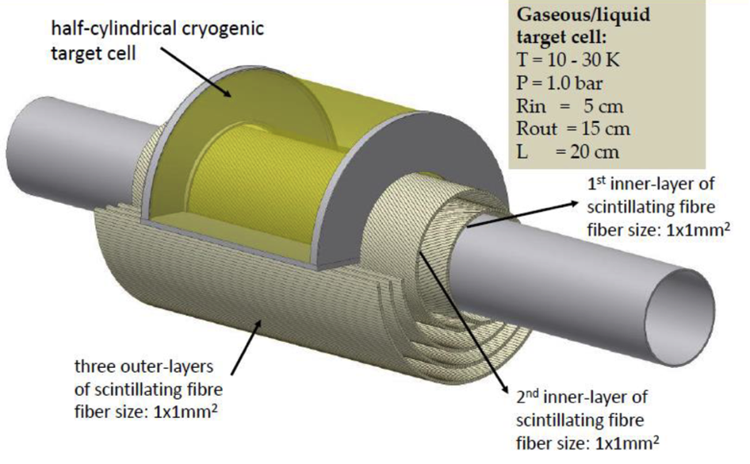
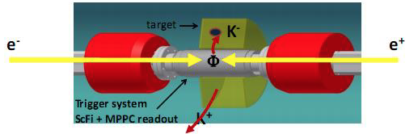
Possible AMADEUS Setup
Axial magnetic field: 0.5T

Slide 17
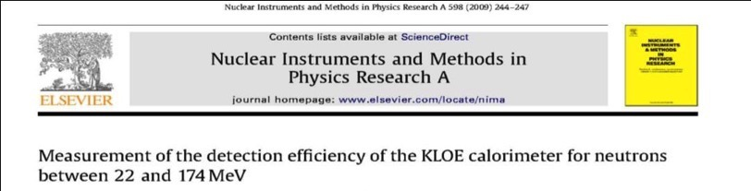
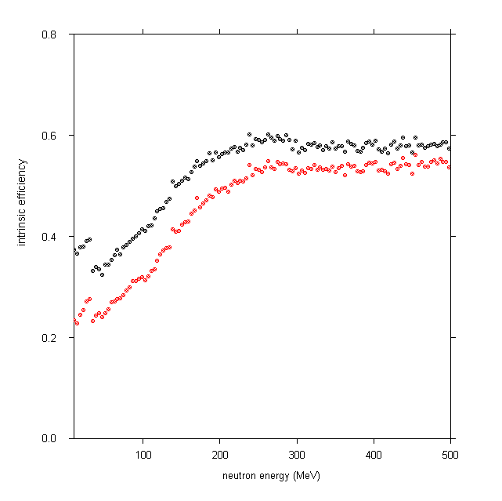
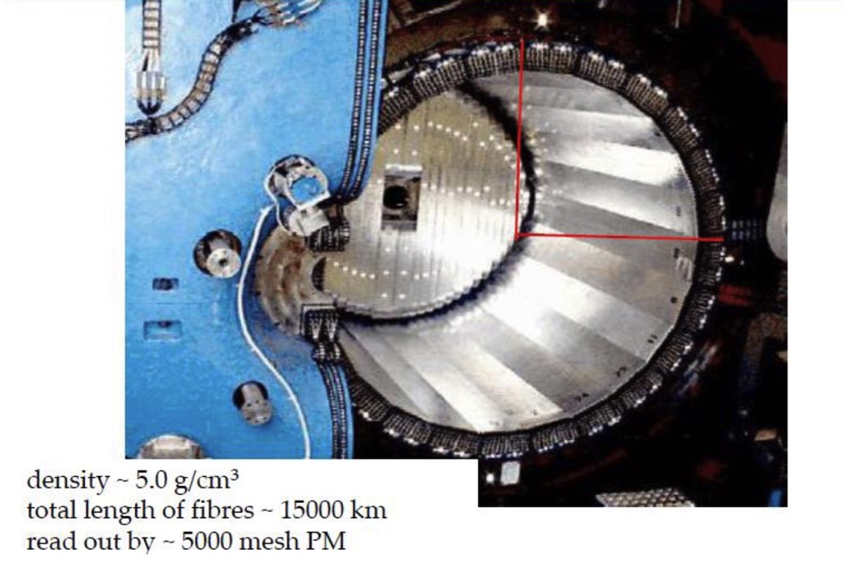

Calorimeter
1 MeV thres
3 MeV thres
98 % solid angle coverage

Slide 18
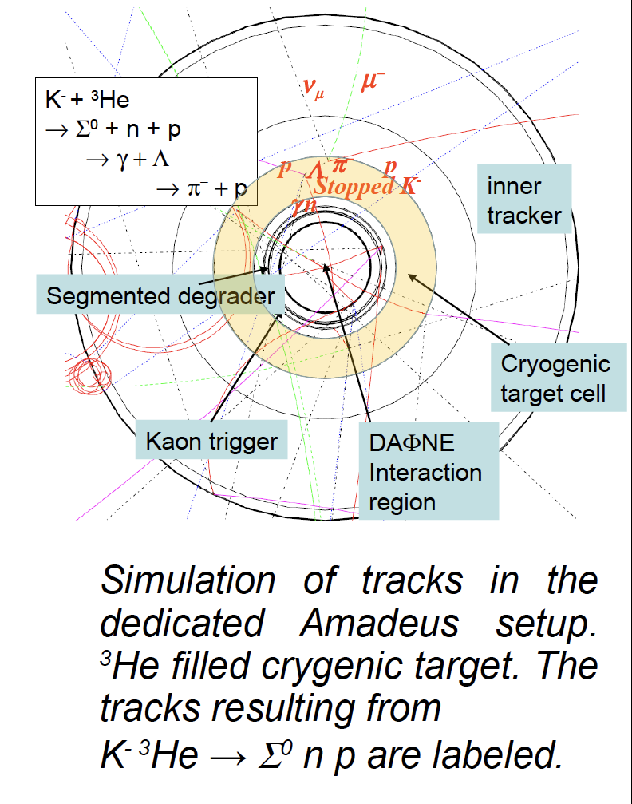
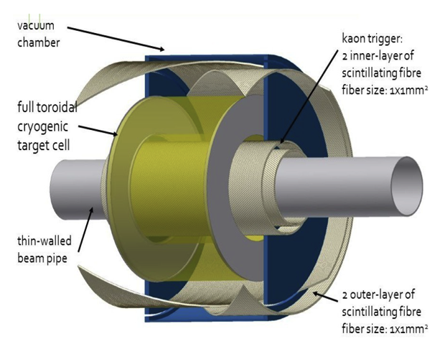
AMADEUS setup: Example K⁻ absorption on ³He
MC simulation of tracks in
A dedicated AMADEUS setup
With a ³He cryogenic target.
Tracks after K⁻ reaction on ³He.

Slide 19
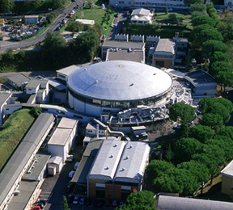

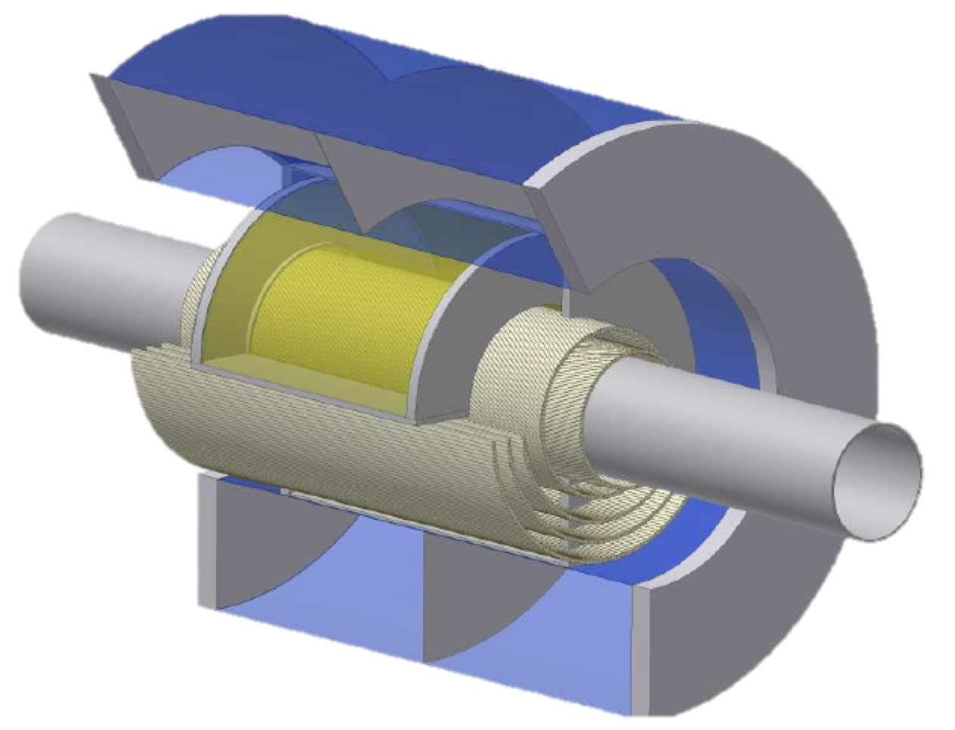
Kaon scattering
Subthreshold resonances
Antikaon nuclear absorption
AMADEUS- a laboratory
for low-energy kaon physics
Antikaon bound states
Hypernuclear physics
Consequences of strangeness
for dense baryonic matter (neutron stars)?

Slide 20
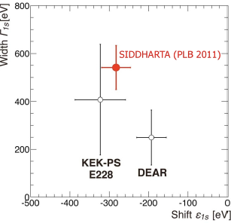
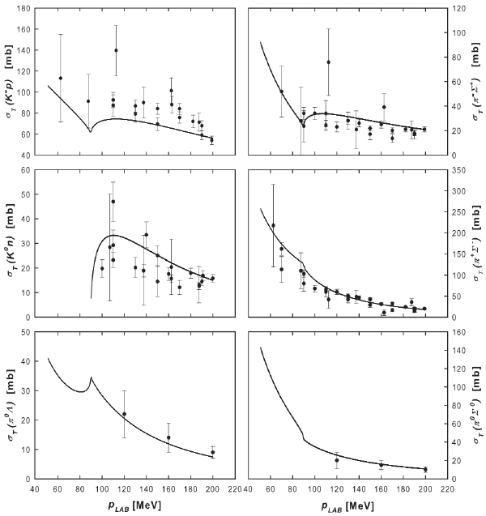
Kaon/antikaon scattering
Data at low momenta (<100 MeV/c) missing
Threshold data from kaonic hydrogen
→ SIDDHARTA
The region between threshold and
≈100 MeV → terra incognita

Slide 21
The Λ(1405) case
BUBBLE CHAMBER search of the Λ(1405):
- O. Braun et al. Nucl. Phys. B129 (1977) 1
K- induced reactions on d → Σ⁻ π⁺ n the resonance is found 1420 MeV
- D. W. Thomas et al., Nucl. Phys. B56 (1973) 15
pion induced reaction π⁻ p → K⁺ π Σ the resonance is found 1405 MeV
- R. J. Hemingway, Nucl. Phys. B253 (1985) 742
K⁻ p → π⁻ Σ⁺(1660) → π⁻ (π⁺ Λ(1405)) → π⁻ π⁺ (πΣ) 4.2 GeV
analysed by Dalitz and Deloff M = 1406.5 ± 4.0 MeV, Γ = 50 ± 2MeV

Slide 22
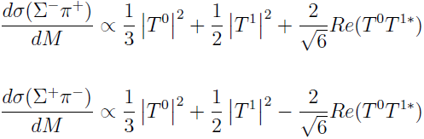

The Λ(1405) case
THE “LINE-SHAPE” OF THE Λ(1405) DEPENDS ON THE OBSERVED CHANNEL !!
THE CLEANEST SIGNATURE OF THE Λ(1405) IS GIVEN BY THE NEUTRAL CHANNEL:
- free from isospin interference
- pure I = 0, no Σ(1385) contamination.

Slide 23
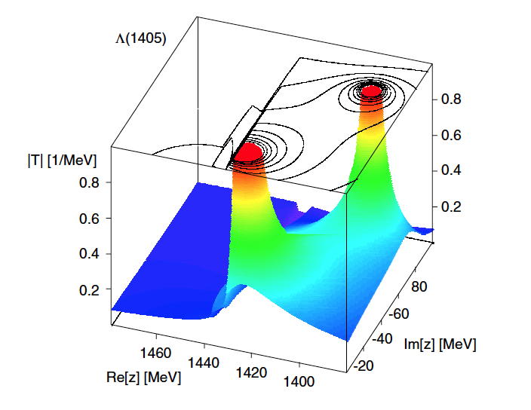
Nature of Λ(1405)?
PDG, Phys. Rev. D86 (2012)
Λ(1405) one- or two-pole object??
πΣ dominant
K_{bar}N dominant
T. Hyodo, D. Jido, Prog. Part. Nucl. Phys. 67 (2012) 55-98

Slide 24
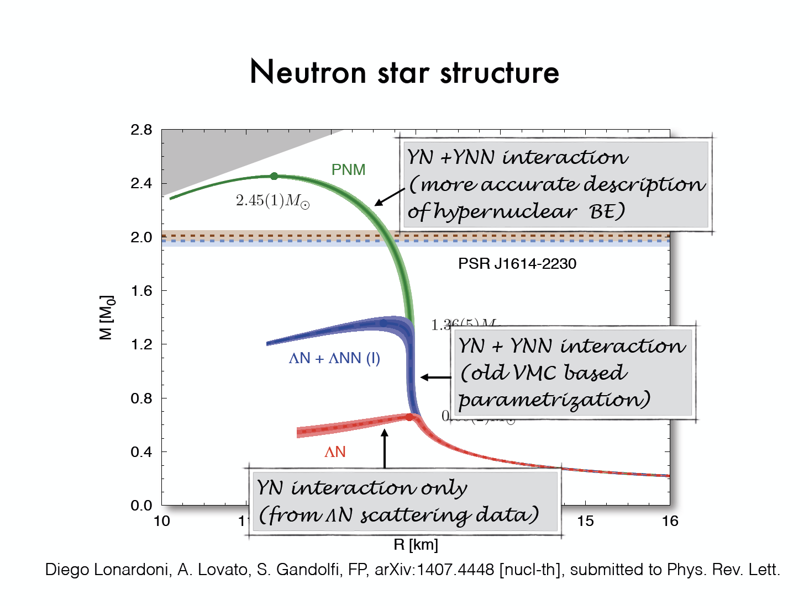
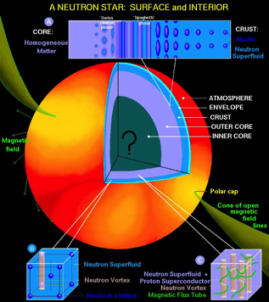
Strangeness in Neutron Stars?
YN + YNN interaction
Quantative understanding open
Neutron stars: Gravity meets QCD
Understanding cold dense nuclear matter
Diego Lonardoni, Alessandro Lovato, Stefano Gandolfi, and Francesco Pederiva,
Phys. Rev. Lett. 114 (2015), 092301

Slide 25
Pre-AMADEUS
Analysis of KLOE data: Antikaon interaction in the DC gas and stopped antikaons in a pure carbon inlay

Slide 26
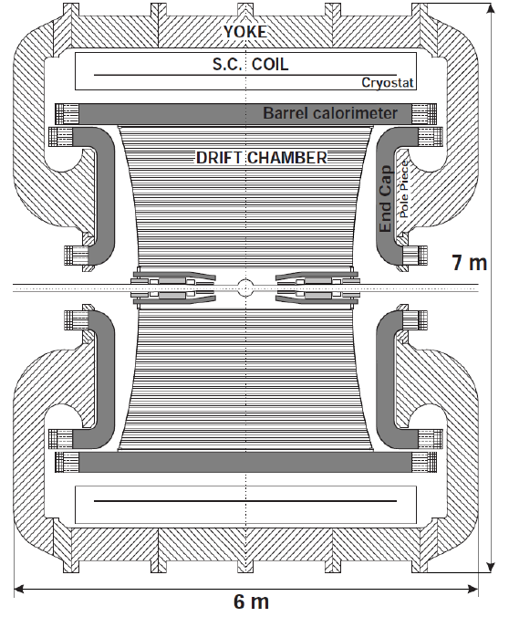
K⁻ absorption on light nuclei from the materials of the KLOE detector
DC gas (90% He, 10% C₄H₁₀) & DC wall (C + H)
AT-REST (K⁻ absorbed from atomic orbit) or IN-FLIGHT (p_{Κ}~100MeV)
Advantage:
excellent resolution ..
σ_{pΛ} = 0.49±0.01 MeV/c in DC gas
σ_{mγγ} = 18.3±0.6 MeV/c²
Disadvantage:
Not dedicated target → different nuclei contamination → complex interpretation .. but → new features .. K⁻ in flight absorption.
K⁻
K⁺

Slide 27
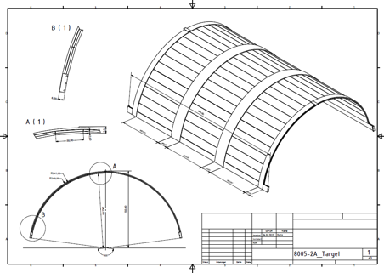
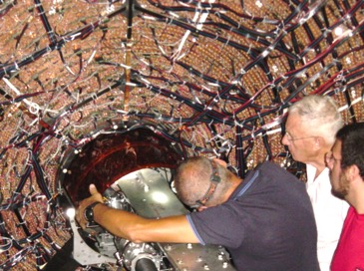
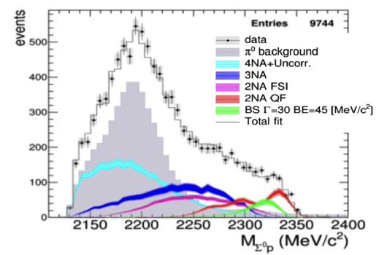
Pre-AMADEUS
Analyses of KLOE data
collected 2004 – 2005
Special setup with a pure carbon “target” inserted into KLOE (2012) – gain in statistics (90 pb⁻¹), K- absorption in carbon at rest)
Investigation of topics:
  Λp, Σ⁰p from 1NA or 2NA (single/double nucleon absorption), search for K⁻pp
  Λ-d nuclear absorption and search for K⁻ppn, Λ-t
  Λ(1405) → Σ⁰π⁰ and Λ(1405) → Σ⁺π⁻
  ΣN/ΛN internal conversion rates
R&D for optimized setup

Slide 28
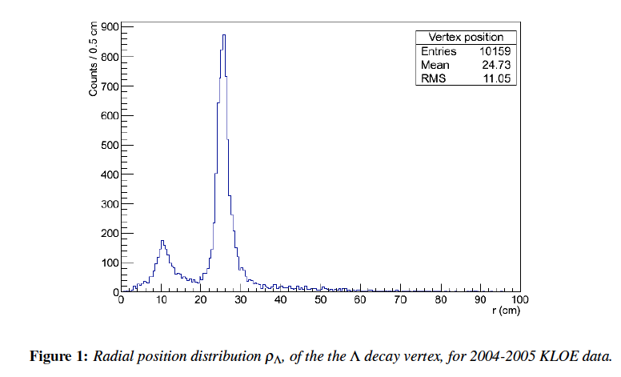
Radial distribution Λ(1116) decay
Beryllium sphere 5 cm
Aluminated Be pipe 10cm
DC entrance wall 25cm
DC gas 25-200 cm
Dc gas events

Slide 29
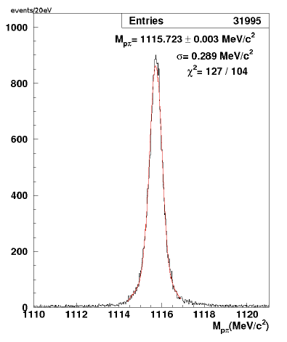
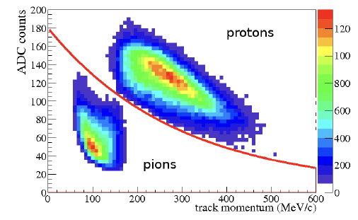
Data analysis: Λ(1116) selection
Selected pions
Selected protons
dE/dx (ADC counts) - momentum
M_{pπ-} invariant mass spectrum

Slide 30
The scientific goals
Low energy QCD in strangeness sector is still waiting for experimental conclusive constrains on:
1) K-N potential → how deep can an antikaon be bound in a nucleus?
- U_{ΚΝ} strongly affects the position of the Λ(1405) state → we investigate it through (Σ−π)⁰ decay --- Y π CORRELATION
- if U_{ΚΝ} is strongly attractive then K⁻ NN bound states should
appear → we investigate through (Λ/Σ−N) decay --- Y N
Correlation
2) Y-N potential → poor experimental information from scattering date
- U_{YΝ} determines the strength of the final state YN (elastic & inelastic)

Slide 31
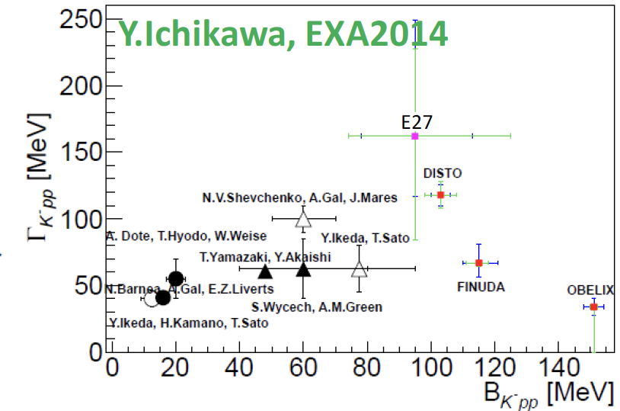
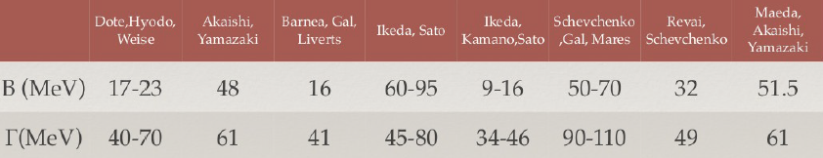
Quasi-bound kaonic nuclei ?
Decay widths and binding energies from
experiment and theory:
The present knowledge
from experiment and theory is still insufficient to
make a clear statement about quasi-bound kaonic nuclear systems
Experiments so far:
FINUDA
KEK
DISTO
FOPI
HADES
OBELIX
J-PARC E15, E27
Future: AMADEUS
Theory

Slide 32
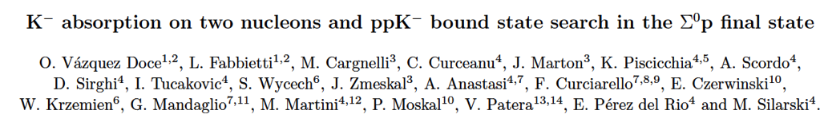
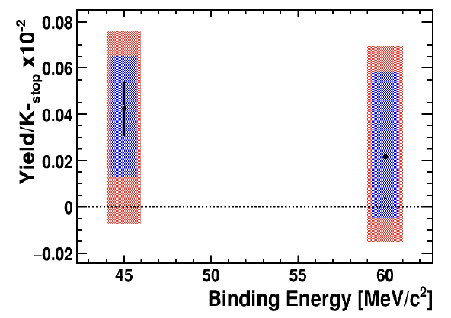
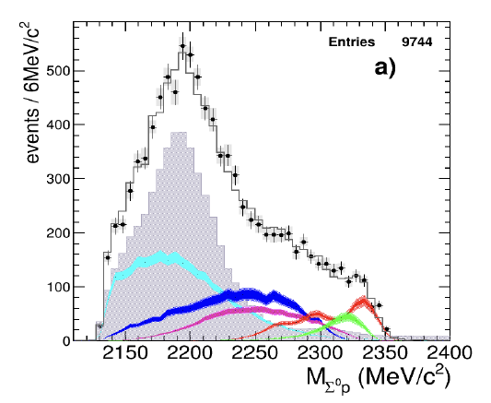
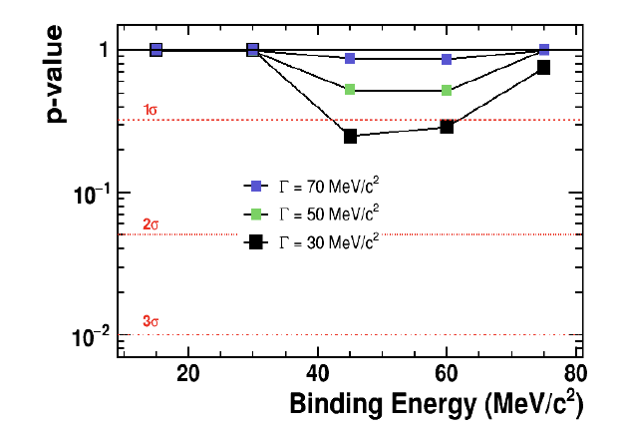
Recent results from Pre-AMADEUS
L_{int}= 1.74 fb⁻¹
K⁻_{stop} = 3.25 10⁸
K-pp ?
ppK⁻/K−stop=(0.044±0.009stat+0.004−0.005syst)·10⁻²
Significance 1σ –
not sufficient to claim
ppK⁻ observation
Physics Letters B, Volume 758, 10 July 2016, Pages 134-139

Slide 33
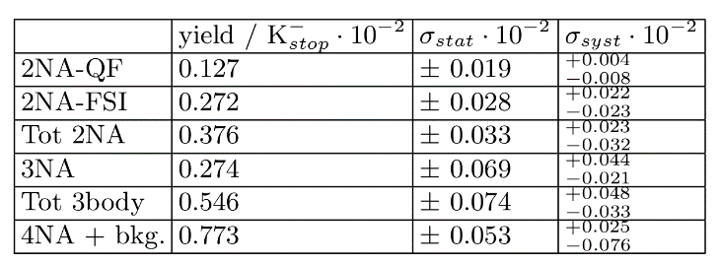
Absorption results
...is there room for the signal of a ppK- bound state?

Slide 34


Slide 35

Evaluation of the significance of the ppK- signal
For B.E. = 45 MeV/c2, Width = 30 MeV/c2
F-test to evaluate the addition of an extra parameter to the fit:
Significance of “signal” hypothesis w.r.t “Null-Hypothesis” (no bound state)

Slide 36
Summary
The Pre-AMADEUS program demonstrated already the enormous potential of the KLOE detector for strangeness nuclear physics.
K⁻
K⁺
The dedicated AMADEUS setup could provide a
powerful laboratory for experimental studies of antikaon induced reactions employing low-energy or stopped kaons reacting in targets (feasibility of active targets, TPC).

Slide 37


Thank you for your attention

Slide 38

Antikaon absorption in nuclei

Slide 39
Pre-AMADEUS studies with KLOE data
Study of antikaon interaction in nuclear matter following K⁻ absorption in the DC gas (or structure materials)
KLOE drift chamber (DC) gas: mainly ⁴He (90% ⁴He, 10% isobutane C₄H₁₀)
0.1% K⁻ stop in the DC gas (Monte Carlo, data analysis)
Enables the study of K⁻ absorption and searches for bound states (e.g. with 2 fb⁻¹ hundreds of kaonic clusters) – analysis of Λ/Σ – p,d, t correlations
However: Analysis complicated due to material mix
KLOE Drift Chamber (DC)

Slide 40



AMADEUS
AMADEUS

Slide 41

Hypernuclear studies: Neutron-rich hypernuclei
Neutron-rich hypernuclei produced by stopped K⁻
Studies of mesonic and non-mesonic decays
→ detection of charged and neutral particles
(e.g. π⁰ spectroscopy)
Examples

