Slide 1
HOM damper and coupler
孟繁博、郑洪娟

Slide 2
Design requirement
Cut off TE11：1126MHz
Cut off TM01：1471MHz
Beam stability:
HOM Qe~10⁴
HOM power:
If beam spectrum coincide with HOM, the requirement for Qe should less than 10³. (For TM011, if resonance happen, Pt=300W (Qe=10³))
Maximum power: 1 kW
Dangerous monopole: aroud1200MHz
Dangerous dipole: 800MHz~900MHz, 1200MHz

Slide 3
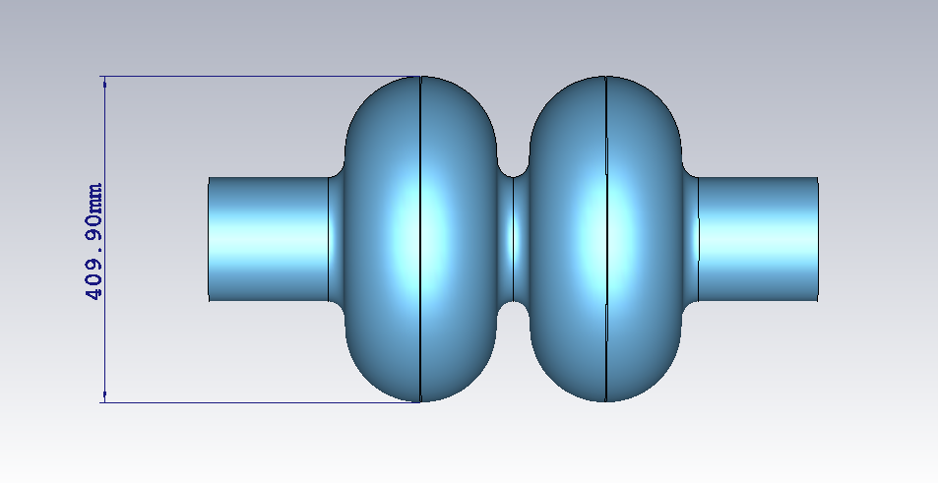
Useful field mode in beam pipe
TE11
TM01
Cutoff frequency (GHz)
R_{pipe} (mm) | TE11 | TM01
78 | 1.126 | 1.47
90 | 0.9757 | 1.274
100 | 0.8782 | 1.148
110 | 0.7986 | 1.043
E field
E field
H field
H field

Slide 4
Frequency band division for damper and coupler
1) 800MHz~900MHz: dipole only
2) ≈1200MHz: monopole (TM011?), dipole
TM011 can be coupled by TM01 mode in pipe.
TE11 mode is useless for TM011.
Solution 1:
Use coupler for both frequency band, 800~900MHz and 1200MHz.
R_{pipe} should be larger than 100mm, to couple the TM011.
Good: small pipe (78mm)
Bad: hard to design coupler covering two band
Solution 2:
Use coupler for 800~900MHz, and damper for 1200MHz
Good: coupler focus on one band, easy to design
Bad: large pipe
Maybe better

Slide 5
Next step for damper
Decide the diameter of beam pipe, with the cavity group
Calculate the Qe of pipe for the TM011, and the other dangerous mode
Simulation with ferrite on the pipe, to get the Ql of the cavity &pipe system
……

Slide 6
TLM & Matrix methods for coupler design
HOM coupler part written by 洪娟
To design the coupler from equivalent circuit concept. Then transform to transmission line models (TLM).
To simplify the HOM coupler design by ABCD matrix.

Slide 7
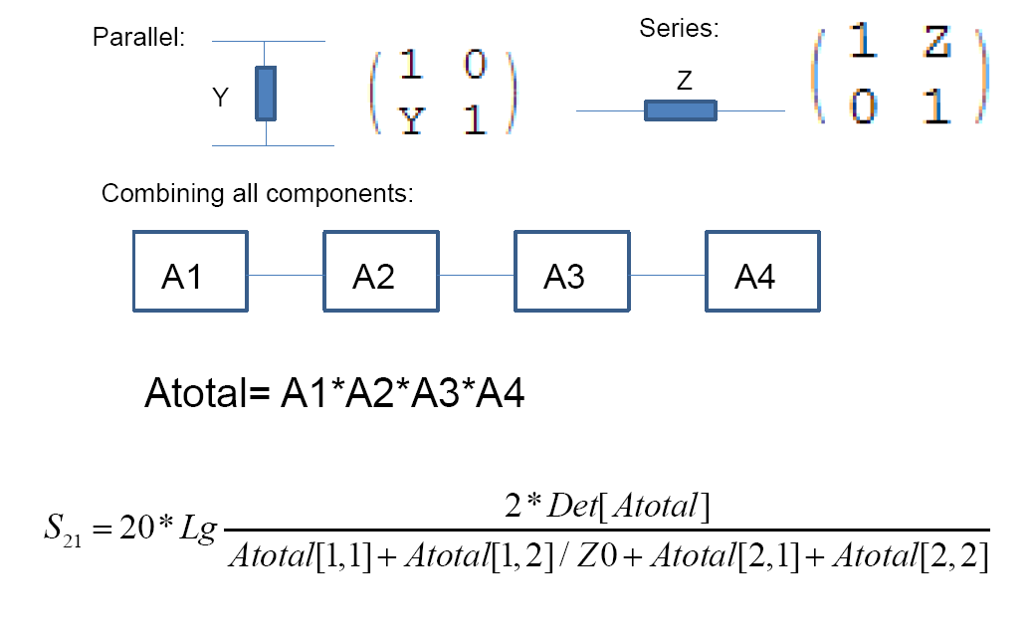
Matrix methods for coupler design (W. Xu)
Atotal[1,2]/Z0+Atotal[2,1]Z0
S21式用于输入和输出端口的特性阻抗相等的情况。(right?)
[1] W. XU. HOM coupler design for High current SRF cavities. 2010.10.11
[2] David M. Pozar. Microwave Engineering, Publishing House of Electronics Industry, Beijing. p160

Slide 8
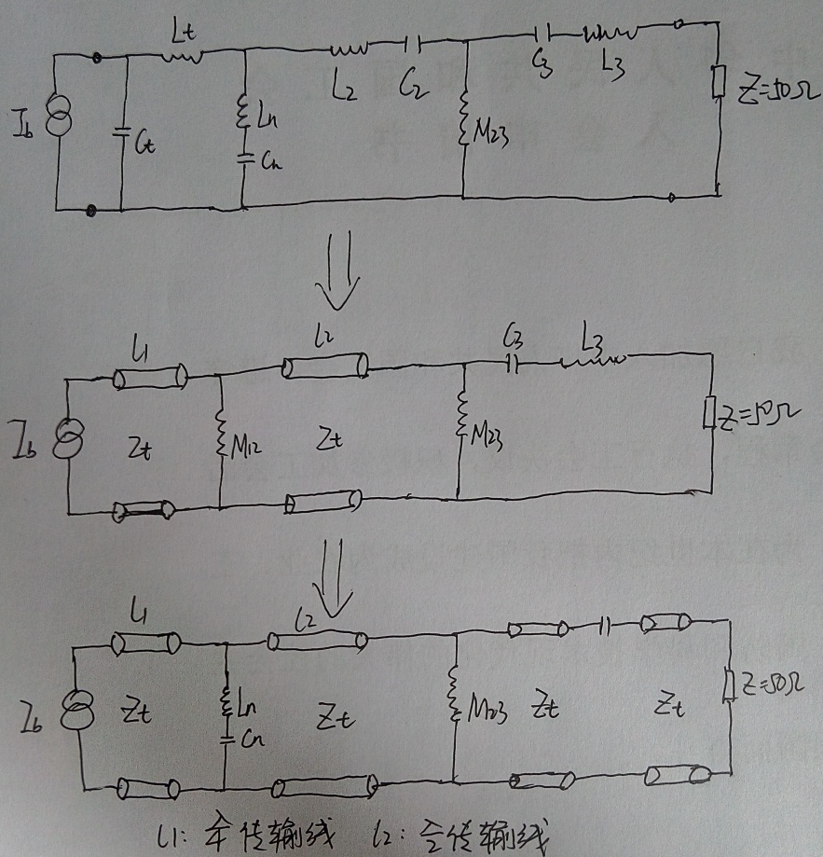
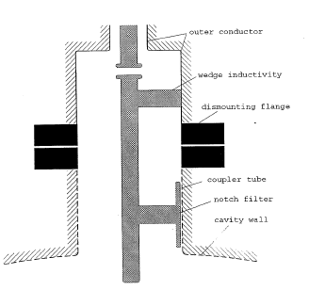
RF Characteristics-Design Progress
The values for the untuned transmission line equivalent circuits are:
Ct=2.69pF, Lt=33.76nH, Ln=15.94nH, Cn=3.76pF, L2=9.08nH, C2=0.85pF, M23=7.45nH, C3=1.37pF, L3=19.01nH, Zt=112 Ω, Z=50 Ω
LHC broadband coupler

Slide 9
RF Characteristics-Design Progress
Optimization need to be done
Fundamental mode rejection
Extraction of higher order mode passband.
……
3D model
Numerical simulation
Practical adjustment
……

