Slide 1
650MHz-Cryomodule for CEPC
2016.09.13

Slide 2
基本结构的选择
XFEL, ILC, LCLS-II style
Cavity string supported from gas helium return pipe
Atlas, FRIB, ADS-Injector-II
Cavity string support from top plate of rectangular vessel
SNS, ESS
Cavity string supported using tension elements, with and without space frame
SPL
Cavities supported by the input coupler
SSR1 , ADS-Injector-I
Cavities supported by posts，and put them on the strongback

Slide 3
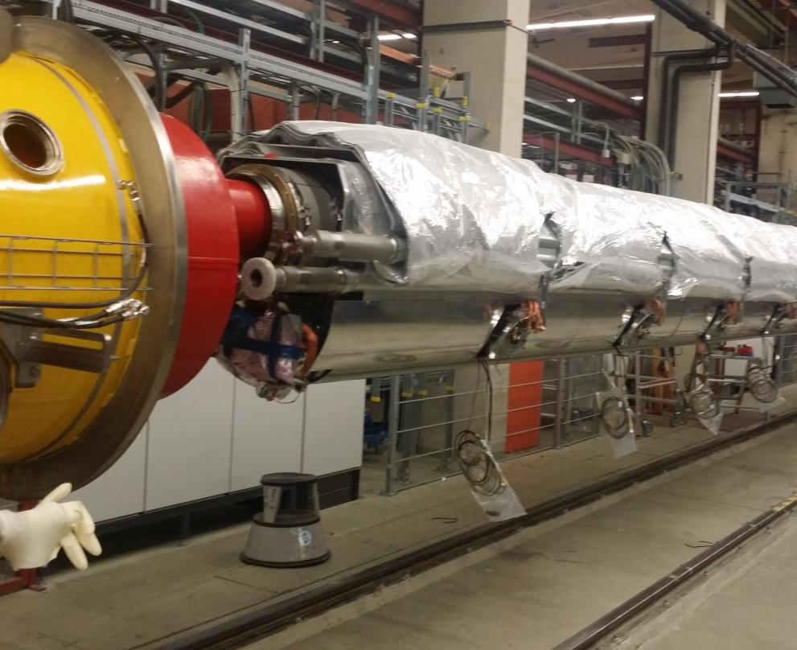
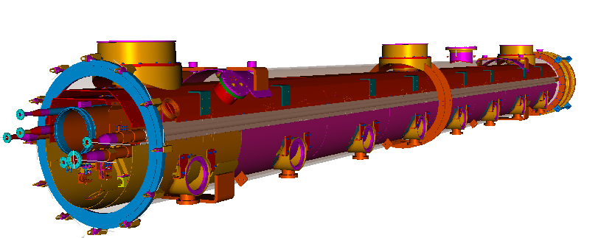
Configurations – EXFEL, ILC, LCLS-II

Slide 4
Configurations – XFEL, ILC, LCLS-II

Slide 5
Configurations – XFEL, ILC, LCLS-II

Slide 6
Configurations – XFEL, ILC, LCLS-II

Slide 7
Configurations – XFEL, ILC, LCLS-II

Slide 8
Configurations–FRIB, ADS-Injector-II

Slide 9
Configurations – Atlas, FRIB, etc.

Slide 10
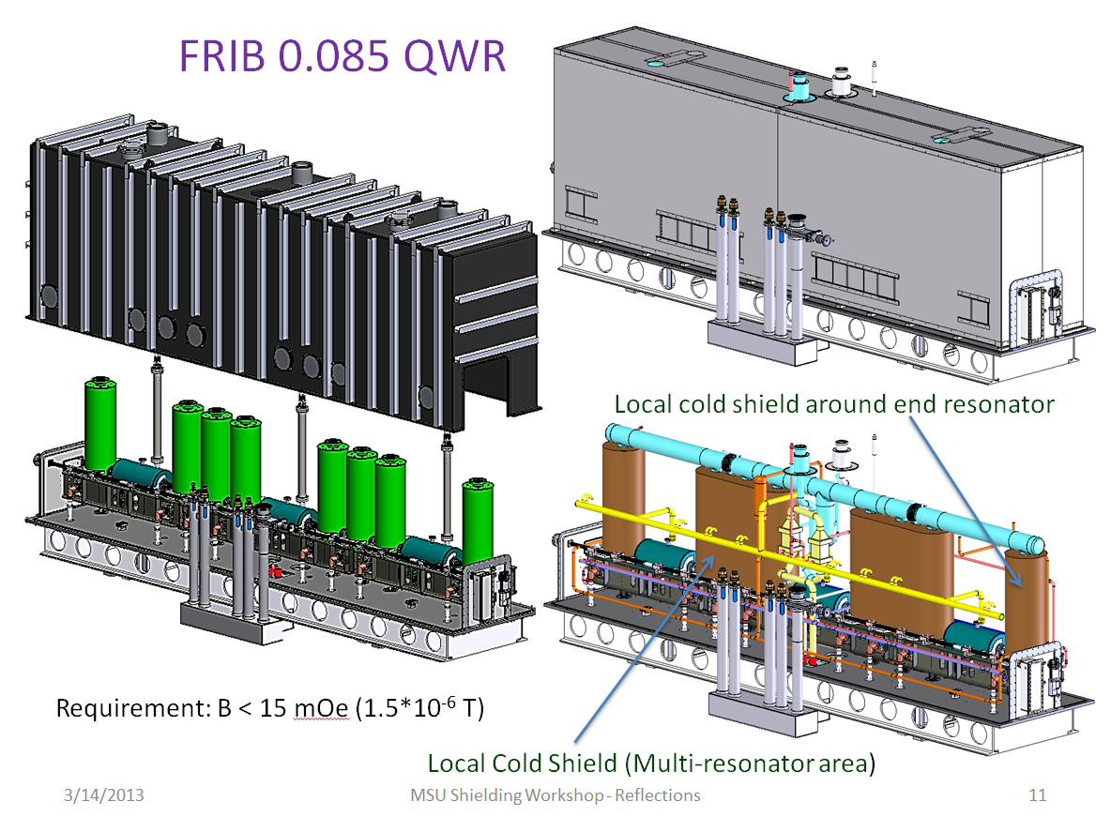
Configurations – Atlas, FRIB, etc.

Slide 11
Configurations – Atlas, FRIB, etc.

Slide 12
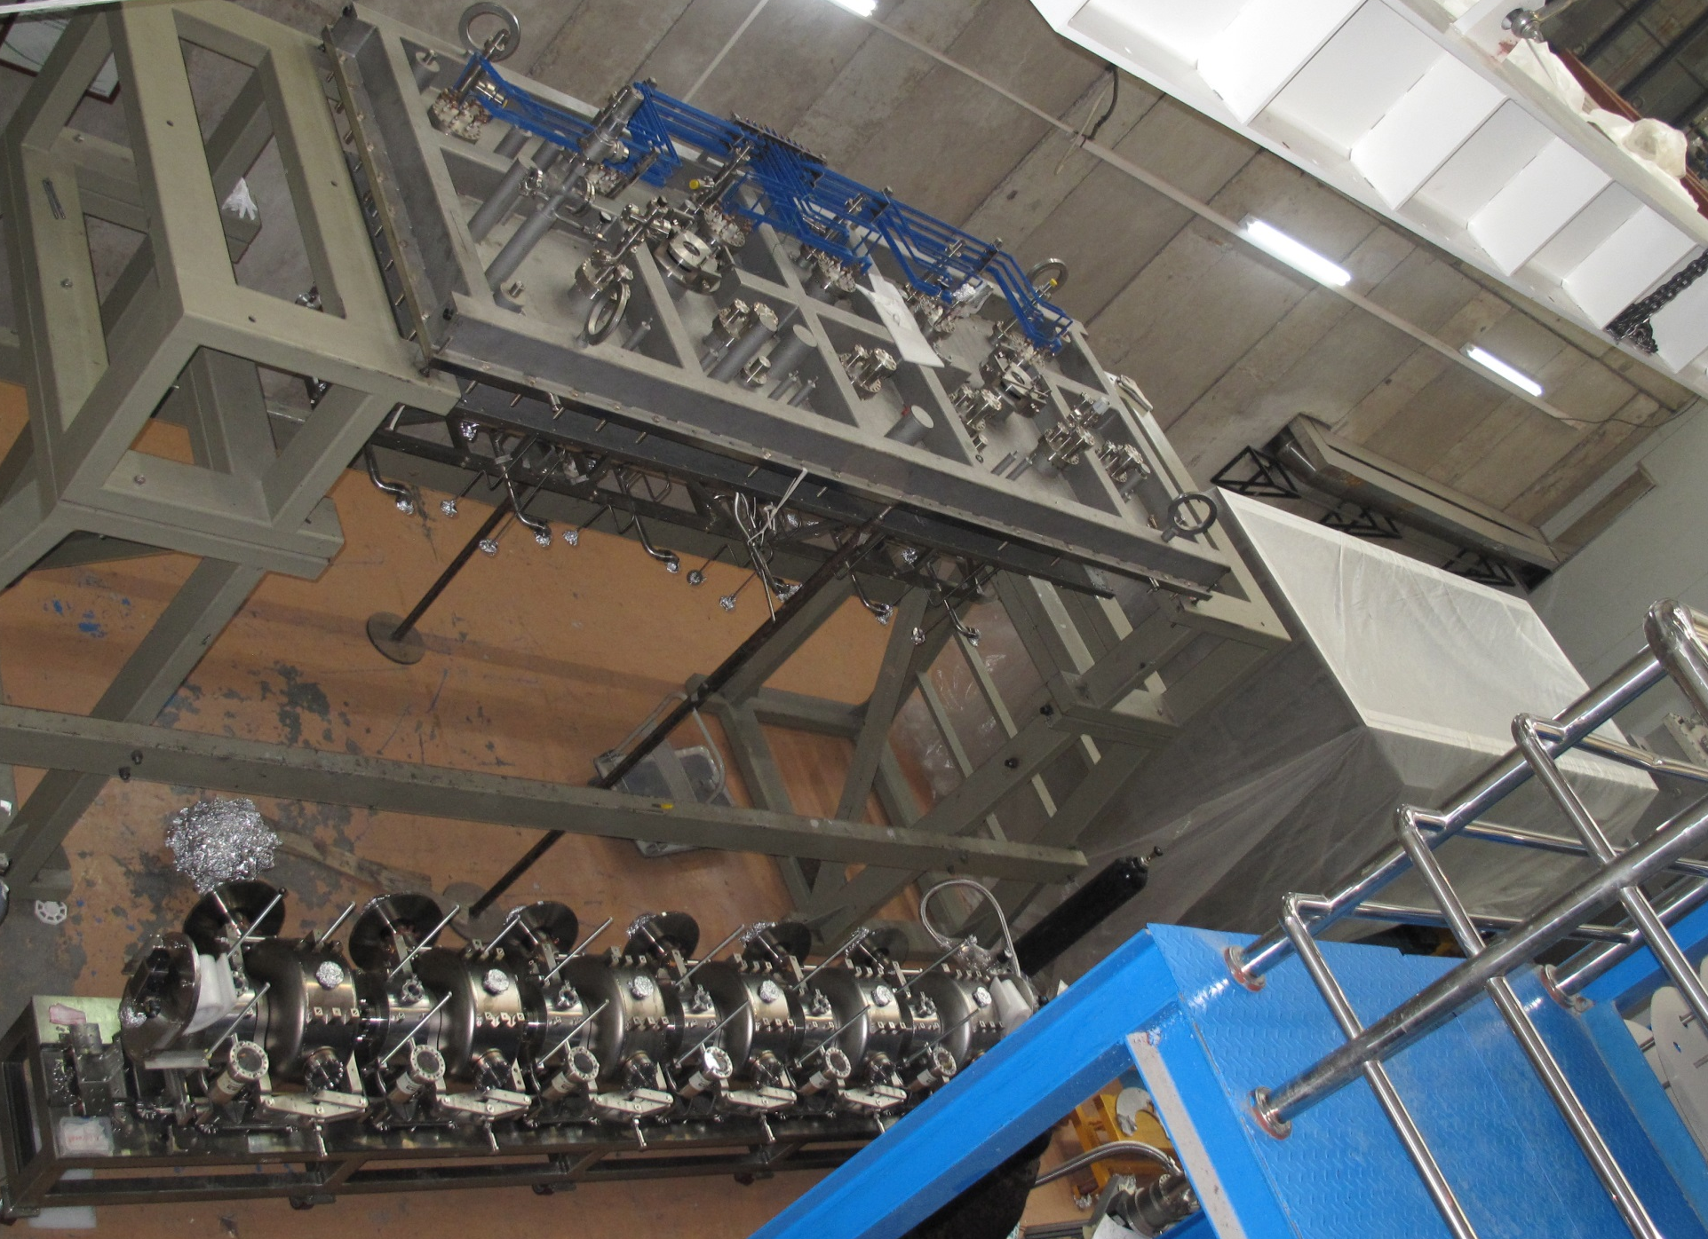
Configurations – Atlas, FRIB, etc.

Slide 13
Configurations – SNS, ESS, etc.

Slide 14
Configurations – SNS, ESS, etc.

Slide 15
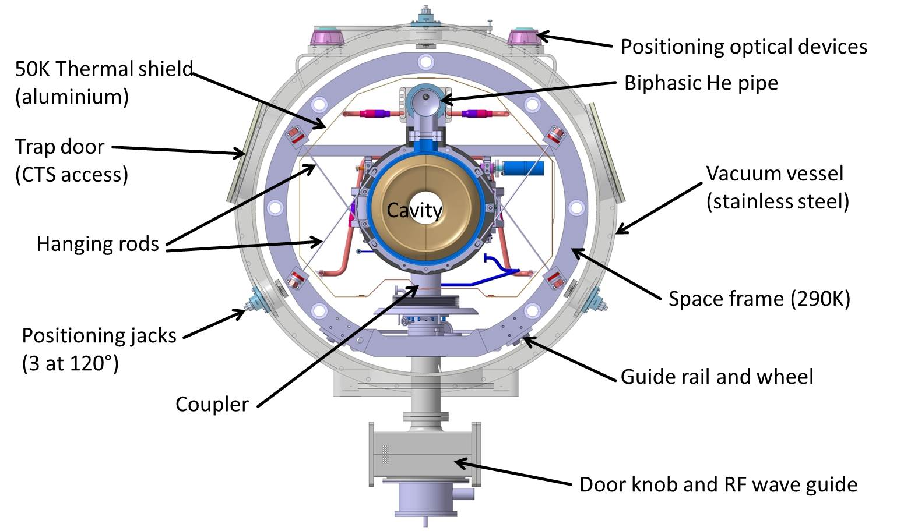
Configurations – SNS, ESS, etc.

Slide 16
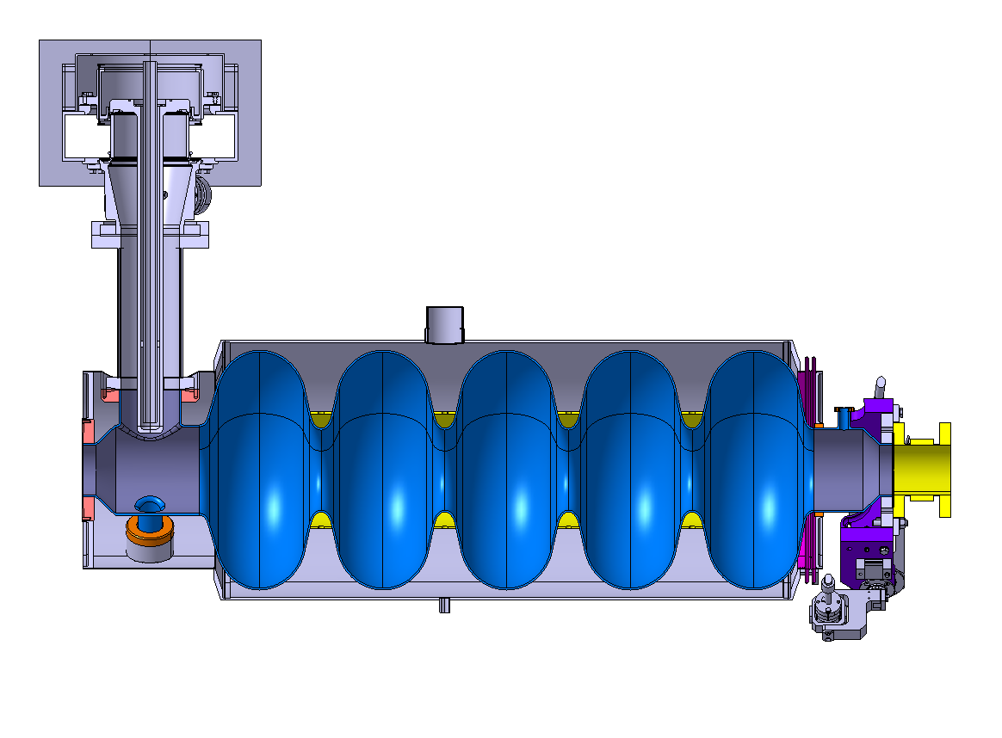
Configurations – SPL

Slide 17
Configurations – SSR1 cryomodule

Slide 18
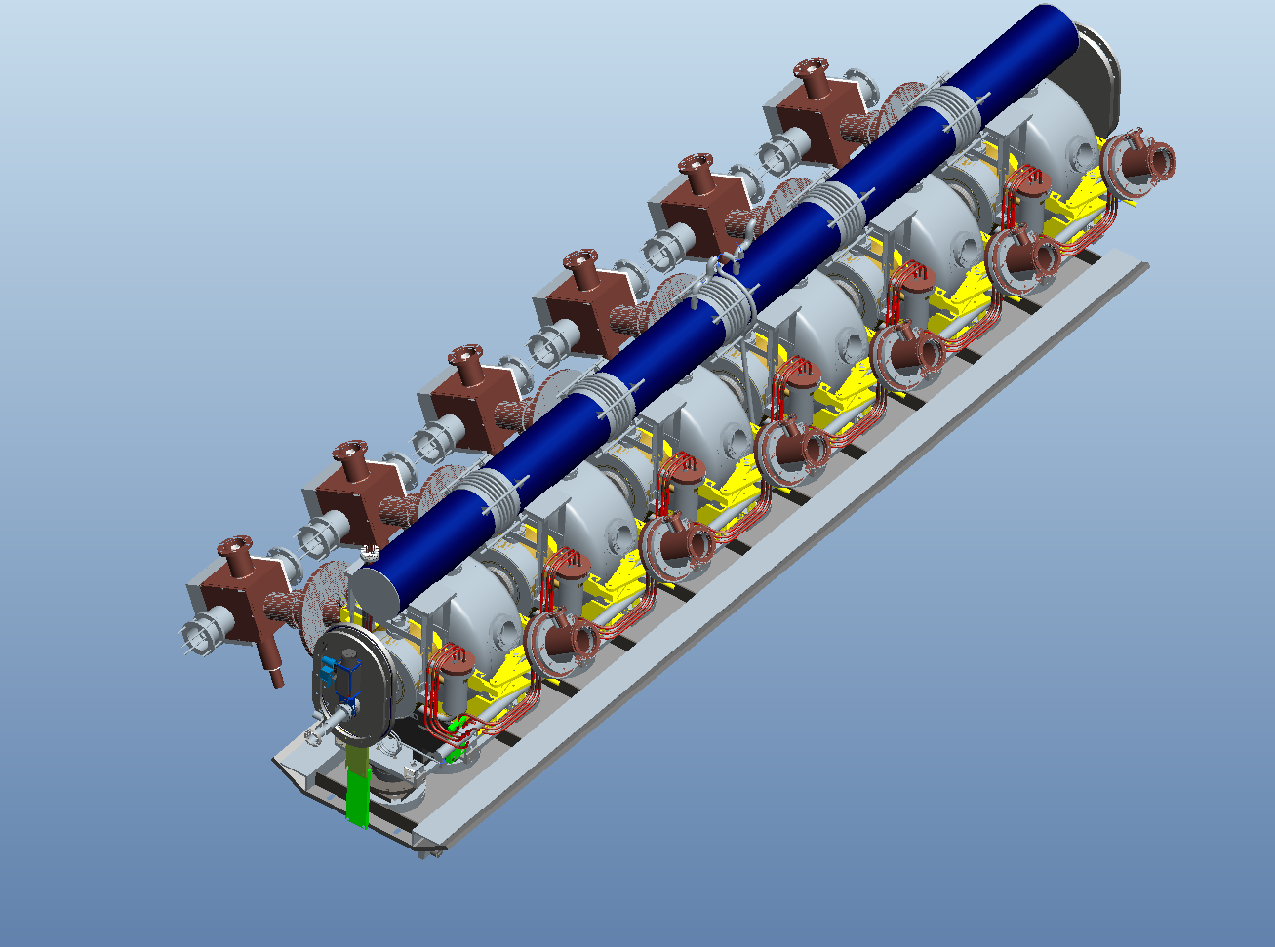
Configurations – ADS-Injector-I

Slide 19
Configurations – ADS-Injector-I

Slide 20
Configurations – ADS-Injector-I

Slide 21
结构形式比较
Concept 1
Vacuum vessel closed at both ends
Room temperature strongback – cavities supported from bottom
Strongback is inside the vacuum vessel, outside the thermal shield
Support post(s) for each cavity
Concept 2
Vacuum vessel closed at both ends
Cavity support similar to XFEL – cavities hanging from return pipe
Support posts attached to return pipe not cavities

Slide 22
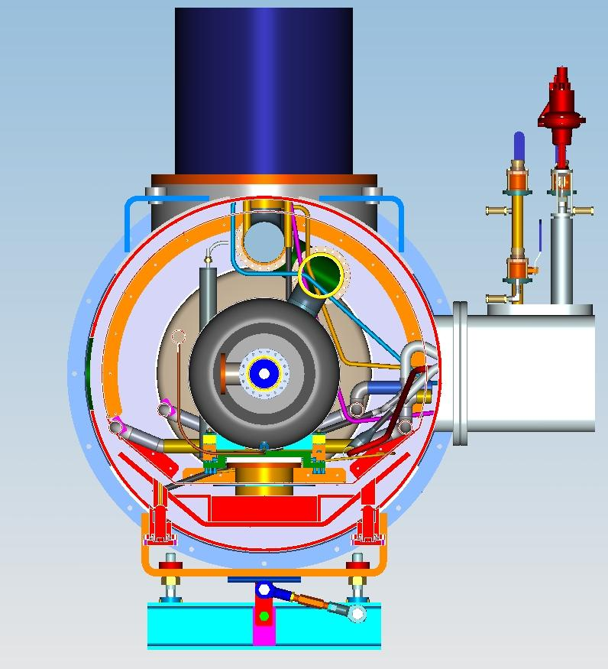
Concept 1
Heat exchanger enclosure
Thermal shield
Vacuum vessel extension for bayonets, cryo valves, etc.
Support post
Strongback

Slide 23
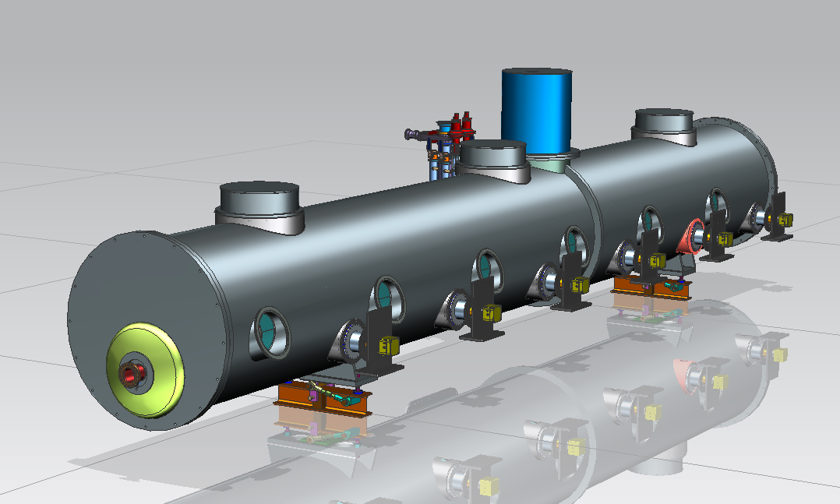
Low and High-β cryomodule general configuration
Heat exchanger
Bayonets connections,
cryogenic valves, etc.
Power couplers
Ports to access tuner
motors
Beam pipe

Slide 24
Concept 1
Illustration only – not representative of actual cavity string
He reservoir
with level sensor
650 Cavity with 2-phase pipe
Warm up cool
down pipe
Strong back with
supports
4K circuit for intercepts
Thermal shield

Slide 25
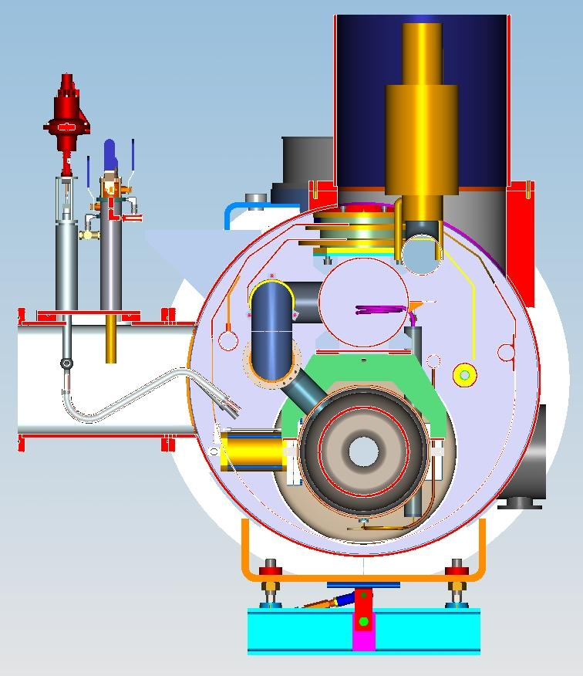
Concept 2
Heat exchanger
300 mm pipe
Thermal shield
He 2-phase pipe
650 MHz cavity
Bayonets, cryo valves, etc.
Vacuum vessel
Coupler port

Slide 26
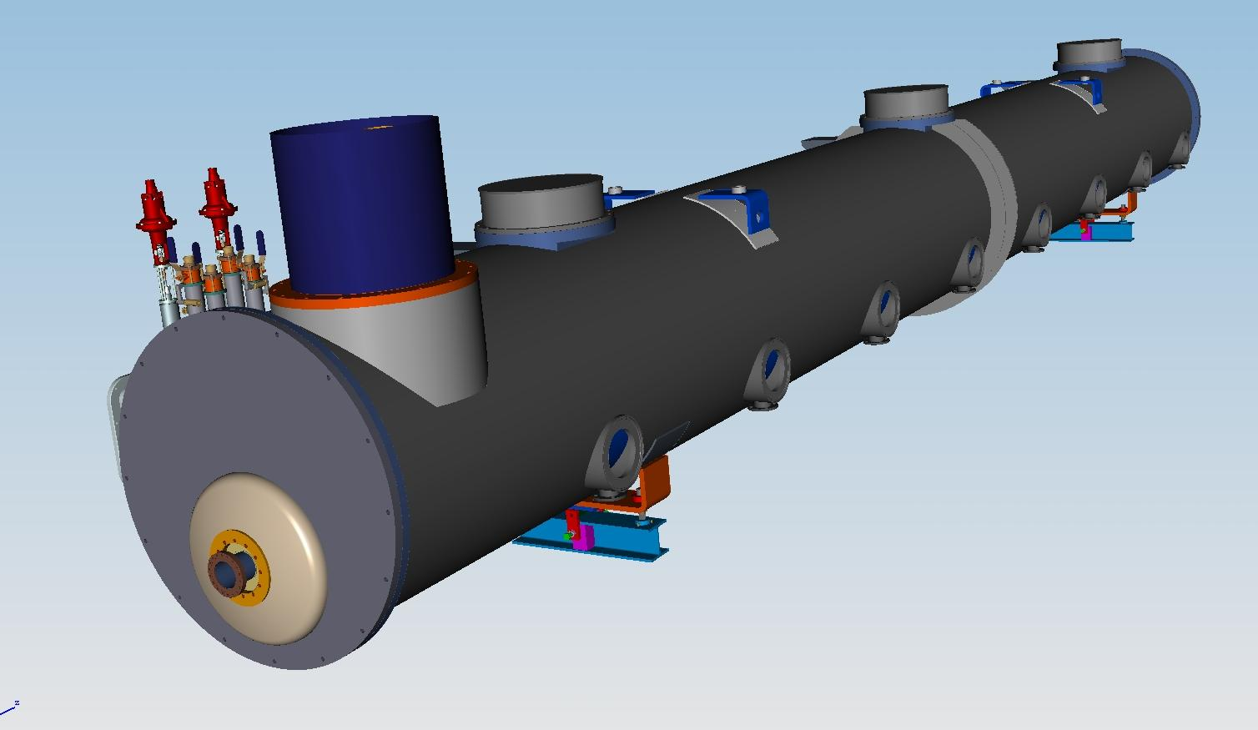
Concept 2
Cold mass supports:
Fix
Sliding
Heat exchanger
Coupler ports
Beam pipe
Illustration only – not representative of actual cavity string

Slide 27
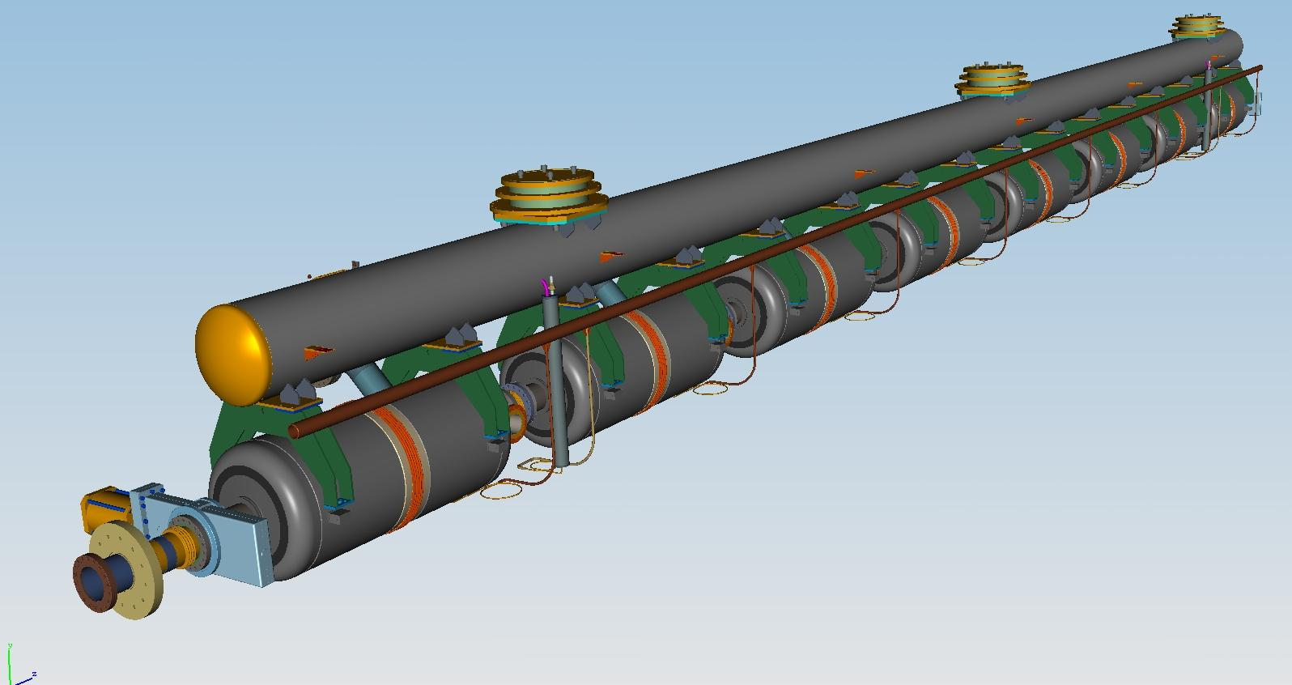
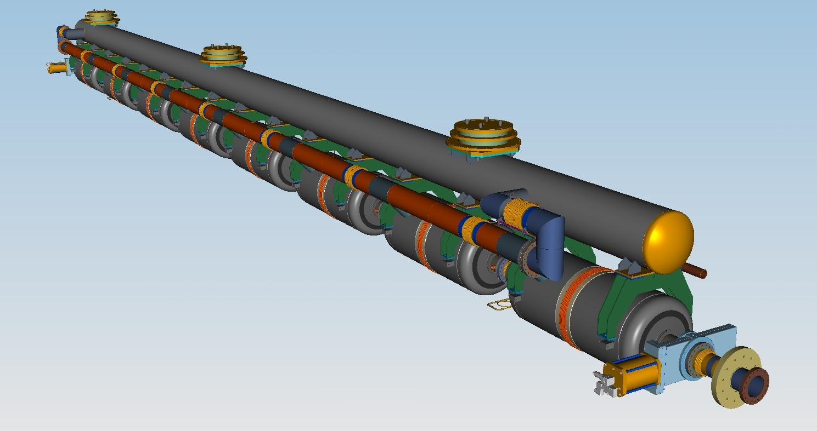
Concept 2
He reservoir with level sensor
Warm up cool down pipe
Illustration only – not representative of actual cavity string

Slide 28
Cryomodule design concepts - Pros and cons
Concept 1 (room temperature strongback)
Many design features common with the current SSR1 cryomodule design
Coupler port locations are fixed with respect to the vacuum vessel
Support system not subject to thermal distortions during cooldown
To date, unproven
Concept 2 (XFEL-like design)
Design concepts are direct descendants of the XFEL design
Could possibly use tooling common to XFEL-like cryomodules
Coupler positions change during cooldown
Support pipe can distort during cooldown

Slide 29
High-β cryomodule
Heat exchanger
Check valve
Gate valve
Tuner access ports

Slide 30
High-β cryomodule
2-phase manifold
Support posts
Strongback

Slide 31
High-β cryomodule

Slide 32
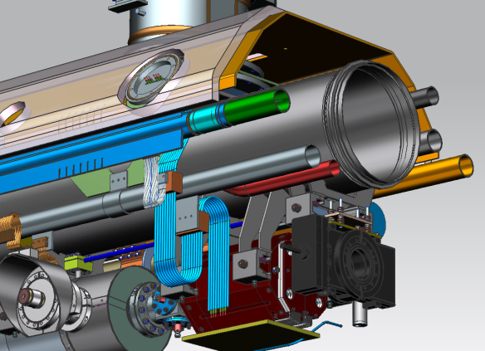
3.CEPC-SPPC/650MHz超导腔低温恒温器
Concept 1
Concept 2

Slide 33
3.CEPC-SPPC/650MHz超导腔低温恒温器
采用哪种型式？
1）首先确定耦合器的位置，漏热。
2）各个束流设备的型式、要求、漏热。
3）各个设备的接口

Slide 34
THANKS

