Slide 1

HOM coupler size
Hongjuan Zheng

Slide 2
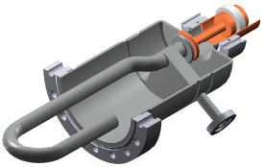
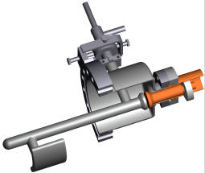
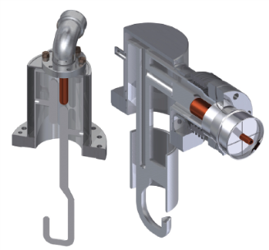
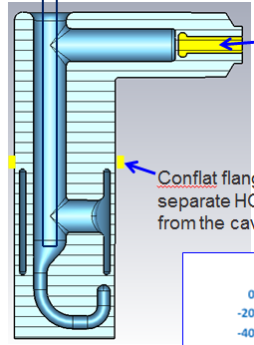
Damping Scheme for Crab Waist Design
When HOM power and high frequency modes behavior are determined, we could choose the damper.
In the crab waist case, the maximum HOM damping is 0.9 kW per cavity. In ideal case, 80 % above cut-off frequency of the 156 mm beam pipe.
Coaxial: notch filter BW and tuning, cooling, feedthrough antenna heating, RF connection heating, cable heating …LEP/LHC-type, LHC-HL, BNL ERL& eRHIC HOM coupler for the kW level power capacity.
KEKB and SuperKEKB ferrite HOM absorbers 20 kW at RT.
LHC narrowband and broadband coupler: design value—1 kW, test—600 W (4.5K)
HL-LHC 2nd harmonic cavity(800 MHz): 2 hook +2 probe/cavity. 525 W/ hook & 61 W/probe
LEPII: 850 W /coupler (CW test)
HL-LHC 400MHz crab & DQW cavity: design value—1 kW

Slide 3
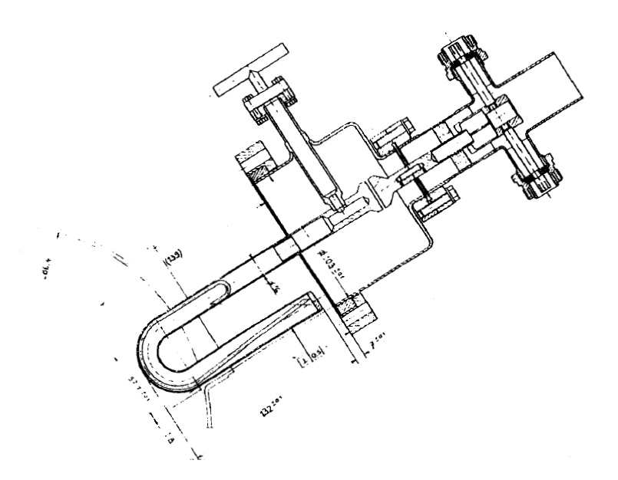
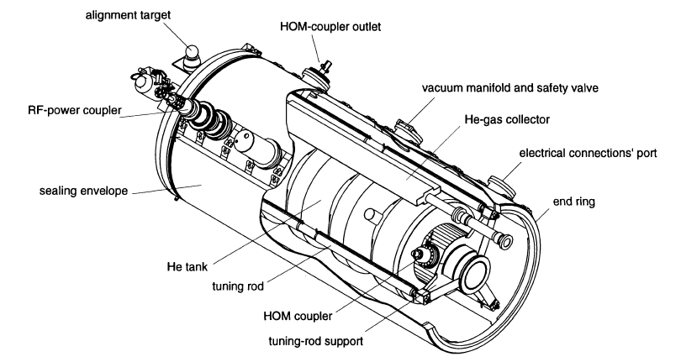
LEPII
Φ=286.4mm
Φ=200mm
Φ=100mm
Beam tube penetration:
H=286.4/2-(240-139)m
=42.2mm
Φ=16mm
Φ=103±0.1mm
h=96.8mm
h=139mm

Slide 4
LHC
Beam tube: Φ=300mm
Φ=103mm
Φ=103mm
h=317mm
h=234mm
h≈118mm
Φ=16mm
h≈89mm
Beam tube penetration:
H=42.2mm
(same with LEP)

Slide 5
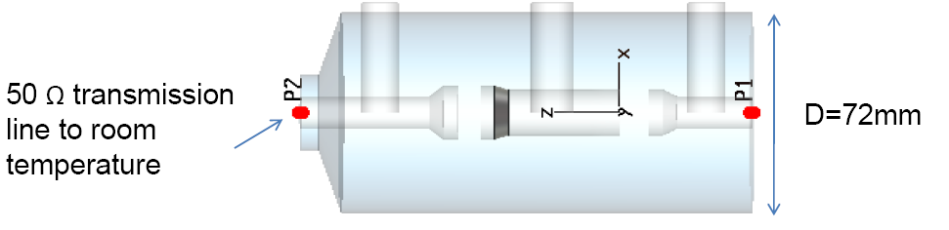
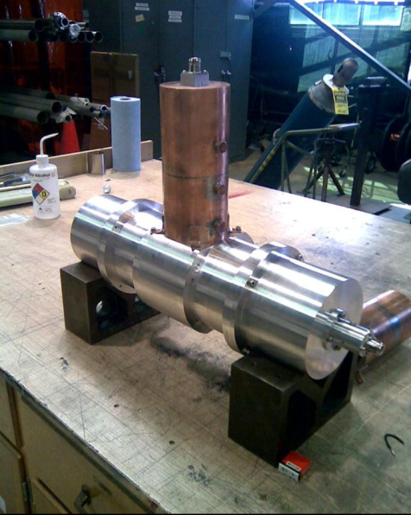
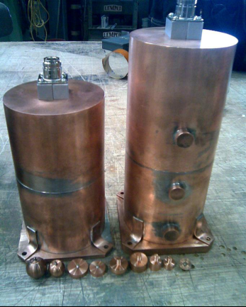
HOM coupler design for High current SRF cavities (Wencan XU )

Slide 6
IHEP-02 1.3GHz low loss
Beam tube: Φ=80mm
Main coupler:
Φ=60mm
Φ=40mm

Slide 7
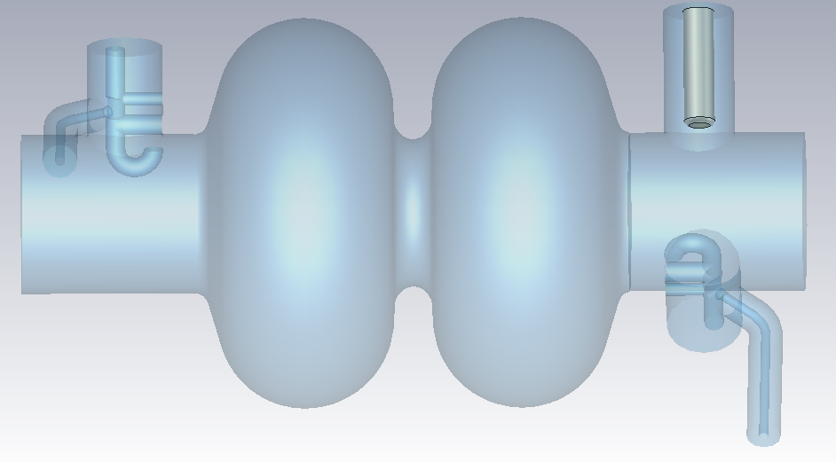
CEPC 2-cell
Beam tube: Φ=156mm
Below cut off:
2 monopole+2 dipole
高次模耦合器内径
内导体采用液氦冷却，则内导体直径不能太小
高次模耦合器与端腔iris距离
液氦槽焊接余量
基模漏场
可拆卸法兰位置影响因素
？
Φ=80mm
高次模外筒内径：70~80mm??

