Slide 1

Electronics, trigger and data acquisition systems for the INO ICAL experiment
Satyanarayana Bheesette
For and on behalf of the INO/ICAL Electronics team
S.Achrekar¹, S.Aniruddhan³, N.Ayyagiri¹, A.Behere¹, N.Chandrachoodan³, V.B.Chandratre¹, Chitra³, D.Das¹, S.Dasgupta⁵, V.M.Datar⁵, U. Gokhale⁵, A.Jain¹, S.R.Joshi⁵, S.D.Kalmani⁵, N.Kamble¹, S.Karmakar⁶, T.Kasbekar¹, P.Kaur⁵, H.Kolla¹, N.Krishnapura³, P.Kumar³, T.K.Kundu⁶, A.Lokapure⁵, M.Maity⁶, G.Majumder⁵, A.Manna¹, S.Mohanan¹, S.Moitra¹, N.K.Mondal⁴, P.M.Nair¹, Abinaya.P³, S.Padmini¹, N.Panyam⁵, Pathaleswar⁵, A.Prabhakar³, M.Punna¹, M.Rahaman⁶, S.M.Raut¹, K.C.Ravindran⁵, S.Roy⁶, Prafulla.S¹, M.N.Saraf⁵, B.Satyanarayana⁵, R.R.Shinde⁵, S.Sikder¹, D.Sil⁵, M.Sukhwani¹, M.Thomas², S.S.Upadhya⁵, P.Verma⁵, E.Yuvaraj⁵
¹Bhabha Atomic Research Centre, Trombay, Mumbai, 400085, INDIA
²Electronics Corporation of India Limited, Veer Savarkar Marg, Mumbai, 400028, INDIA
³Indian Institute of Technology Madras, IIT P.O., Chennai, 600036, INDIA
⁴Saha Institute of Nuclear Physics, Bidhan Nagar, Kolkata, 700064, INDIA
⁵Tata Institute of Fundamental Research, Homi Bhabha Road, Mumbai, 400005, INDIA
⁶Visva-Bharati, Santiniketan, 731235, INDIA

Slide 2
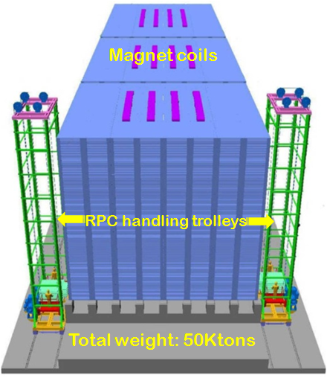
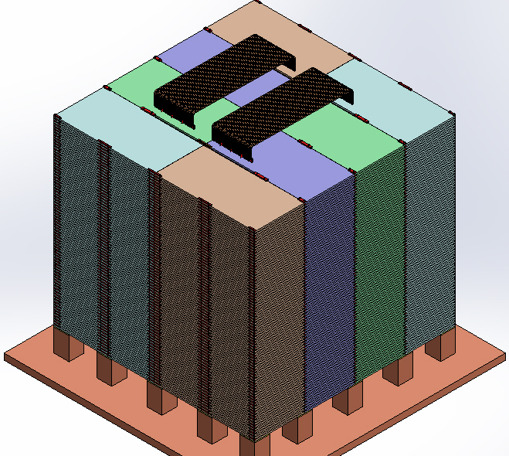
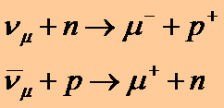
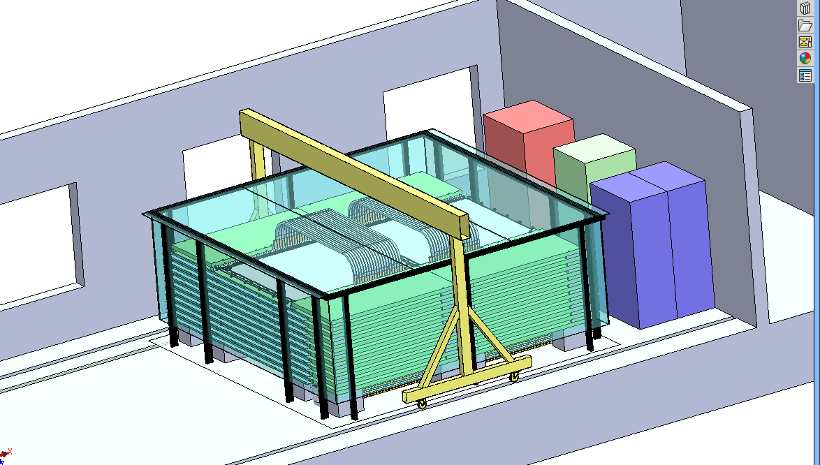
ICAL, e-ICAL and m-ICAL

Slide 3
ICAL, e-ICAL and m-ICAL
Parameter | ICAL | e-ICAL | m-ICAL
No. of modules | 3 | 1 | 1
Module dimensions | 16.2m×16m×14.5m | 8m×8mx2m (90:1) | 4m×4mx1m (720:1)
Detector dimensions | 49m×16m×14.5m | 8m×8mx2m | 4m×4mx1m
No. of layers | 150 | 20 | 10
Iron plate thickness | 56mm | 56mm | 56mm
Gap for RPC trays | 40mm | 40mm | 45mm
Magnetic field | 1.3Tesla | 1.3Tesla | 1.3Tesla
RPC dimensions | 1,950mm×1,910mm×24mm | 1,950mm×1,910mm×24mm | 1,950mm×1,910mm×24mm
Readout strip pitch | 30mm | 30mm | 30mm
No. of RPCs/Road/Layer | 8 | 4 | 2
No. of Roads/Layer/Module | 8 | 4 | 1
No. of RPC units/Layer | 192 | 16 | 2
No. of RPC units | 28,800 (107,266m²) | 320 (1,192m²) (90:1) | 20 (74.5m²) (1440:1)
No. of readout strips | 3,686,400 | 40,960 (90:1) | 2,560 (1440:1)

Slide 4
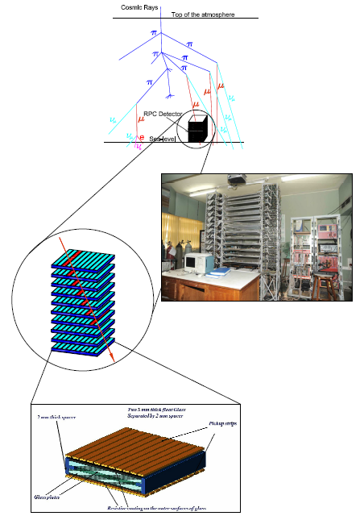
Functions of ICAL electronics
Signal pickup and analog front-end
Strip hit latch
Pulse shapers, timing units
Background noise rate monitor
Digital front-end and calibration
Data network architecture
Multilevel trigger system
Backend data concentrators
Event building, data storage systems
On-line data quality monitors
Slow control and monitoring
  Gas system, magnet, power supplies
  Ambient parameters
  Safety and interlocks
Remote access to detector and data
Particles produced in the neutrino interactions pass through alternating layers of iron plates and RPCs, leaving tracks in the latter. Tracks bend as per the charge of the produced particles, due to the ICAL’s magnetic field.

Slide 5
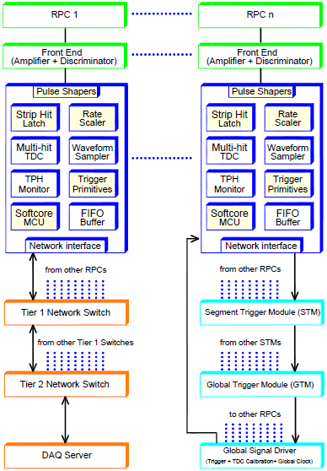
Sub-systems of ICAL electronics
Analog Front-ends
TDC ASIC
Digital Front-Ends
Trigger System
Global services, calibration and synchronisation units
Data network and backend hardware
Backend DAQ software
Low voltage system
High Voltage module
Electronics integration

Slide 6
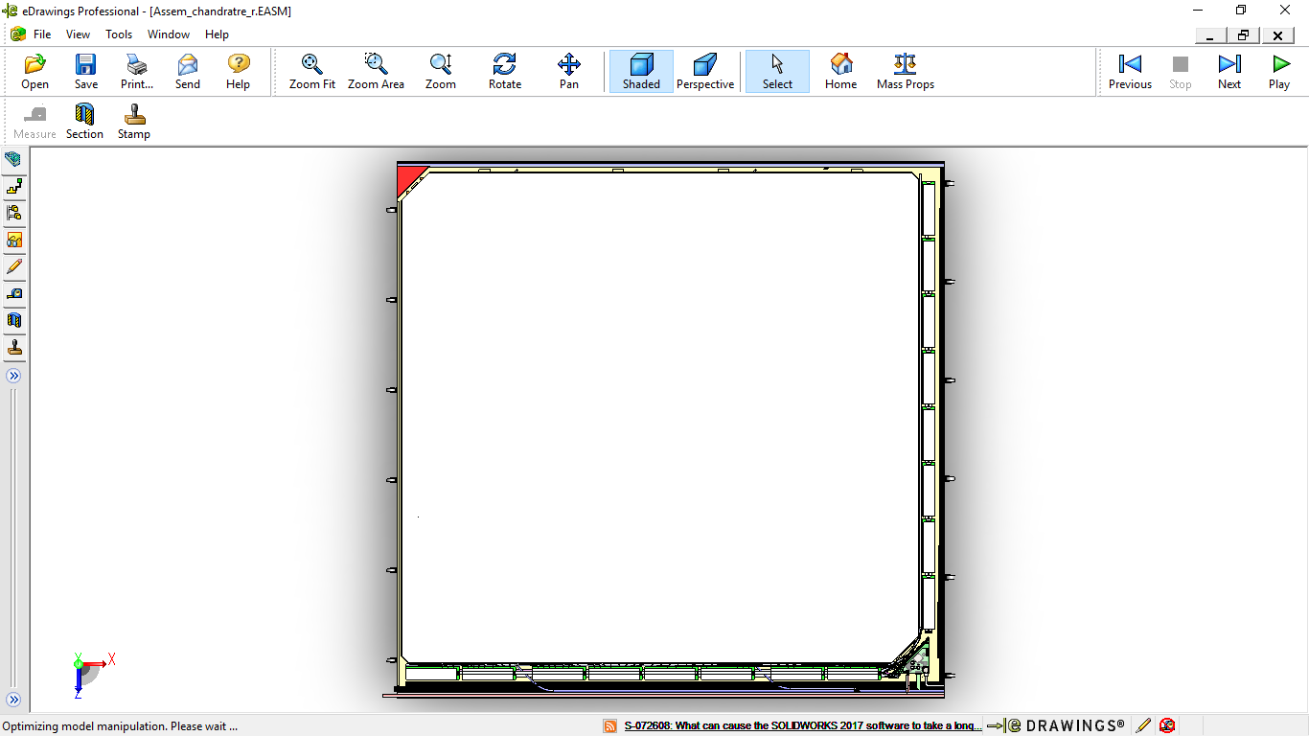
High voltage supply
Y-Side analog front-end (8 boards)
Outline of an RPC detector
Detector size: 1,950mm×1,910mm×24mm
Pickup strips: 128 (64 each of X- & Y-planes)
Digital front-end
X-Side analog front-end (8 boards)

Slide 7
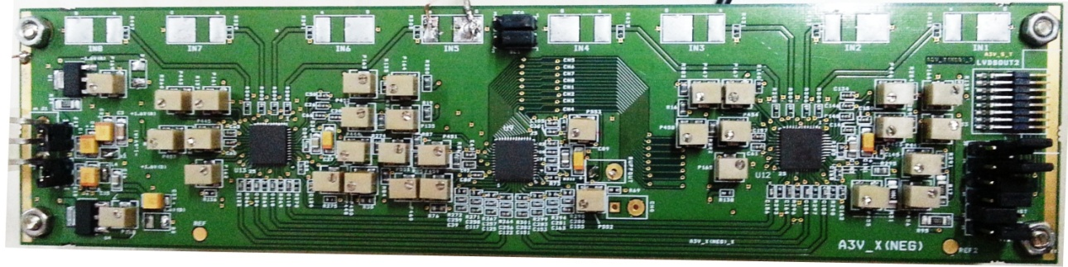
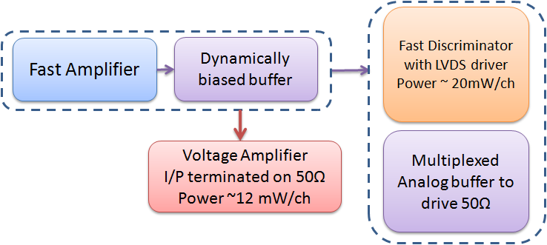
Analog Front-End boards with Anusparsh ASICs
Combined mask set for Amp and Disc ASICs. 15 wafers in production for 16,600 amp and 8,300 disc ASICs.
ASICs designed using 0.35µm SiGe BiCMOS process and packaged in QFN-48.
Dynamically biased flipped voltage follower

Slide 8
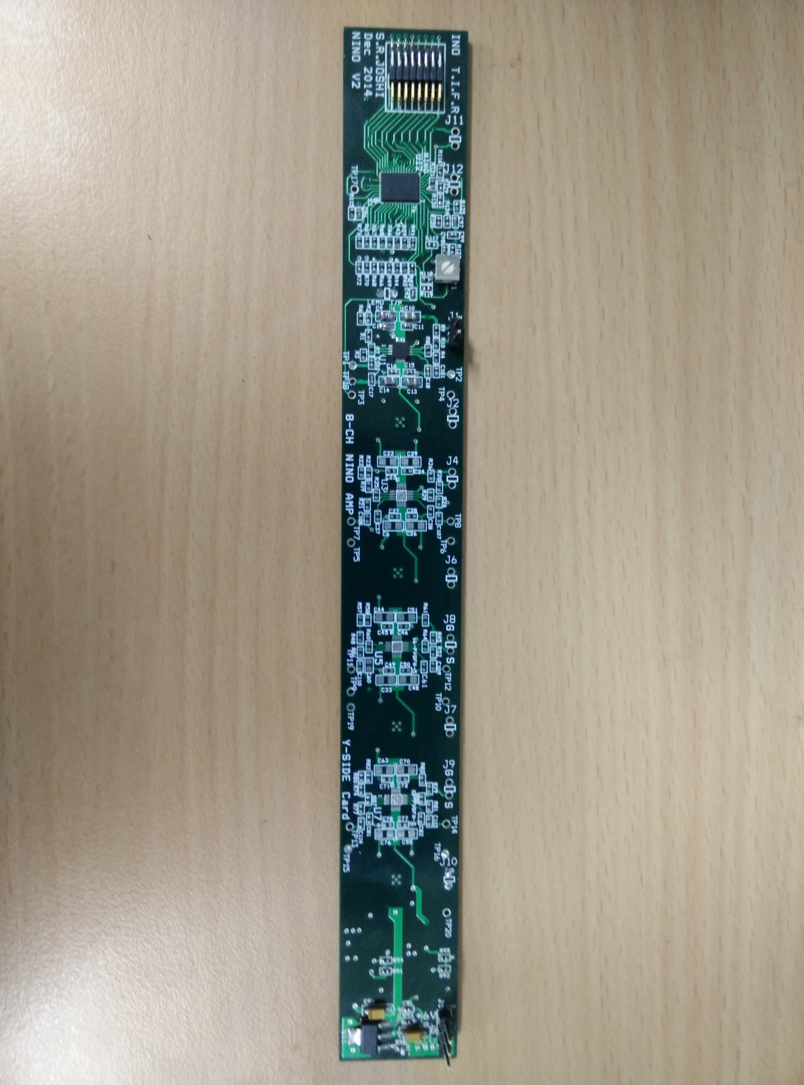
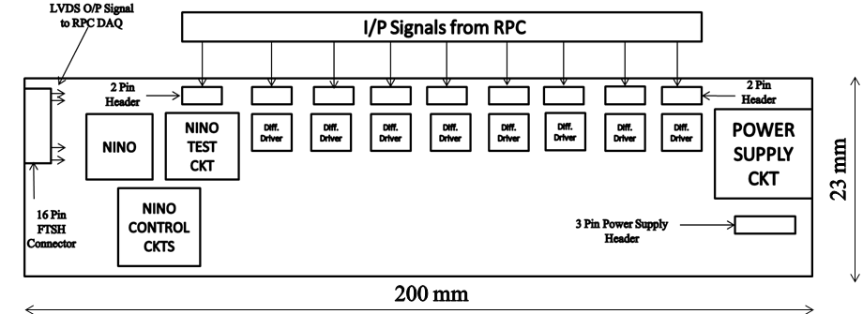
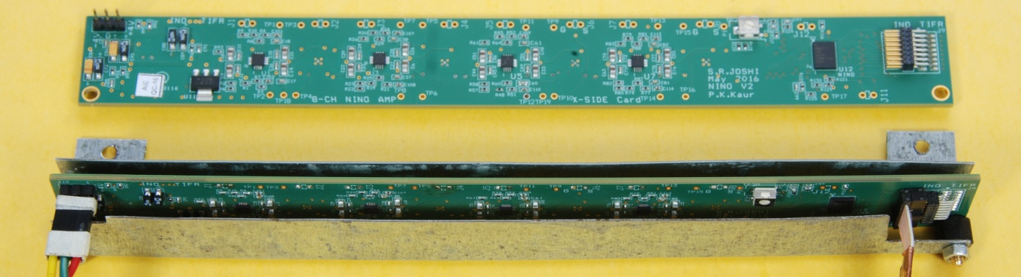
Analog Front-End boards with NINO ASICs
Accepts inputs from 8 pickup strips of an SRPC.
8 differential drivers of unity gain.
One NINO chip with threshold control and other accessory circuits.
8

Slide 9
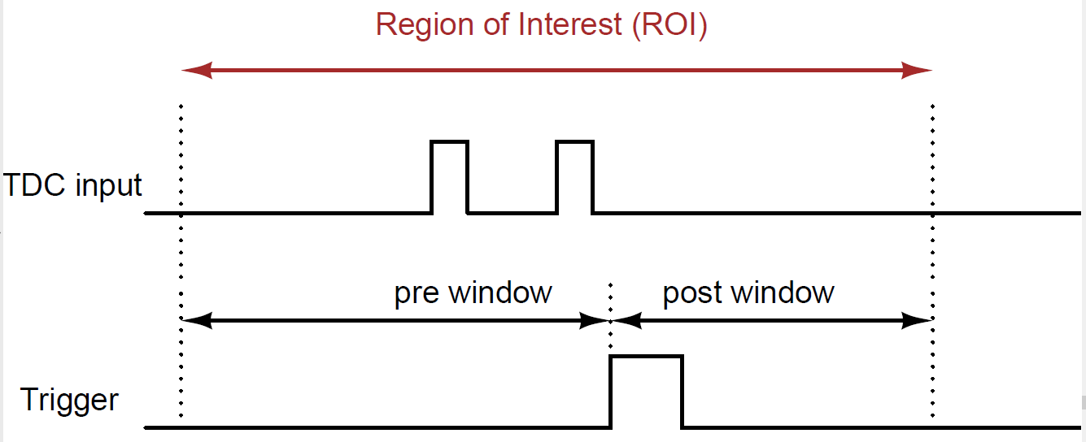
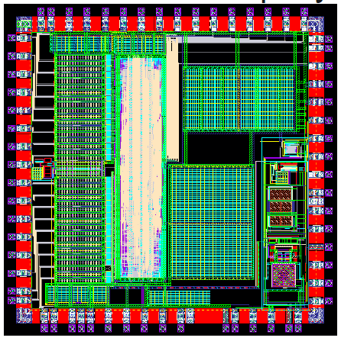
ICAL’s TDC ASIC
Principle
  Two fine TDCs to measure start/stop distance to clock edge (T1, T2)
  Coarse TDC to count the number of clocks between start and stop (T3)
  TDC output = T3+T1-T2
Features and specifications
  UMC 130nm technology, QFN64 package, 3.2mm×3.2mm in size
  Input clock: 10MHz (250MHz to DLL internally generated by PLL)
  16 hit channels, 1 trigger and 1 calibration channel
  Four paired time stamps: leading edge 65.5µs (125ps), pulse width 64ns (250ps)
  Readout buffers: 91 locations
  32-bit/hit, data on 4-and 11-line SPI bus.
  Self test features

Slide 10
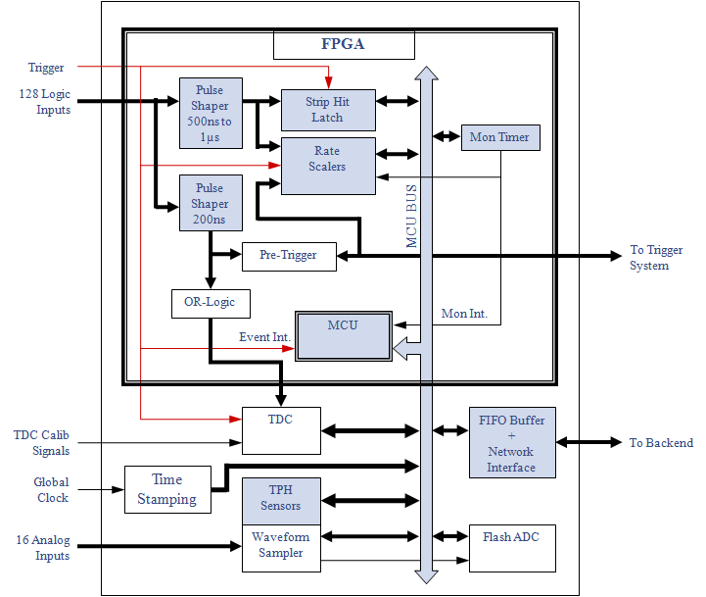
DFE module – the workhorse
Unshaped, digitized, LVDS RPC signals from 128 strips (64x + 64y)
16 analog RPC signals, each signal is a summed or multiplexed output of 8 RPC amplified signals.
Global trigger
TDC calibration signals
TCP/IP connection to backend for command and data transfer.

Slide 11
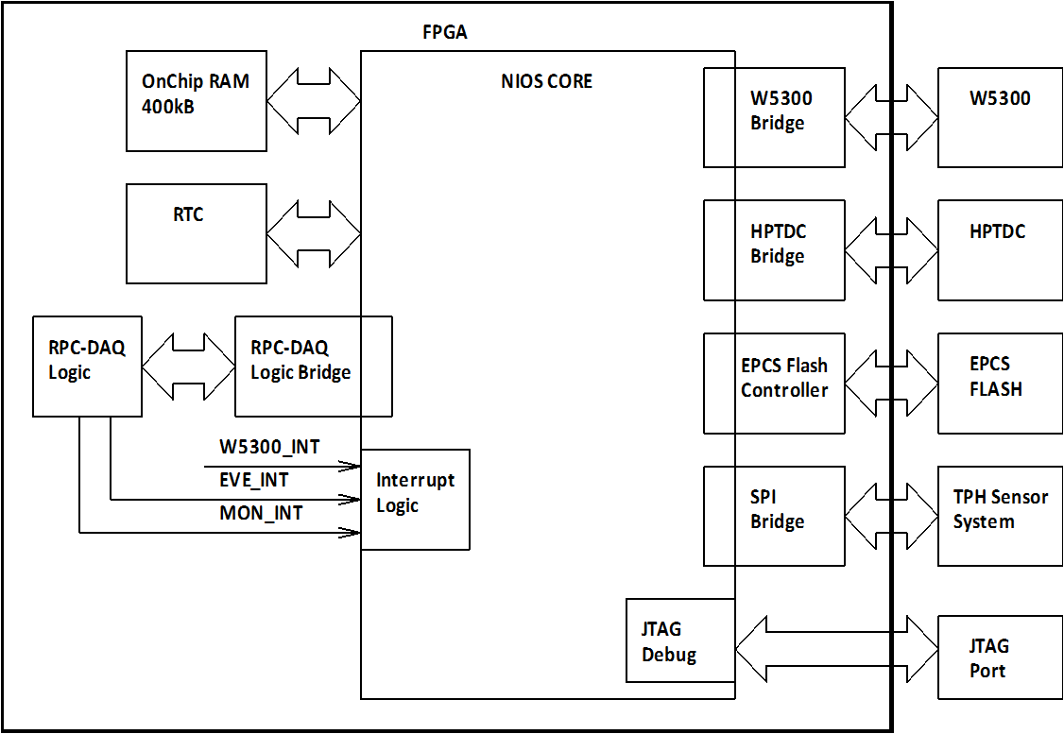
Soft-core processor
(EP4CE115F780)
Event data acquisition
Monitoring data acquisition
Command interface
Remote system upgradation
HV control and Monitoring
Read/Write Hardware register access
Flash memory Access
TDC JTAG Access
Wiznet Network Interface

Slide 12
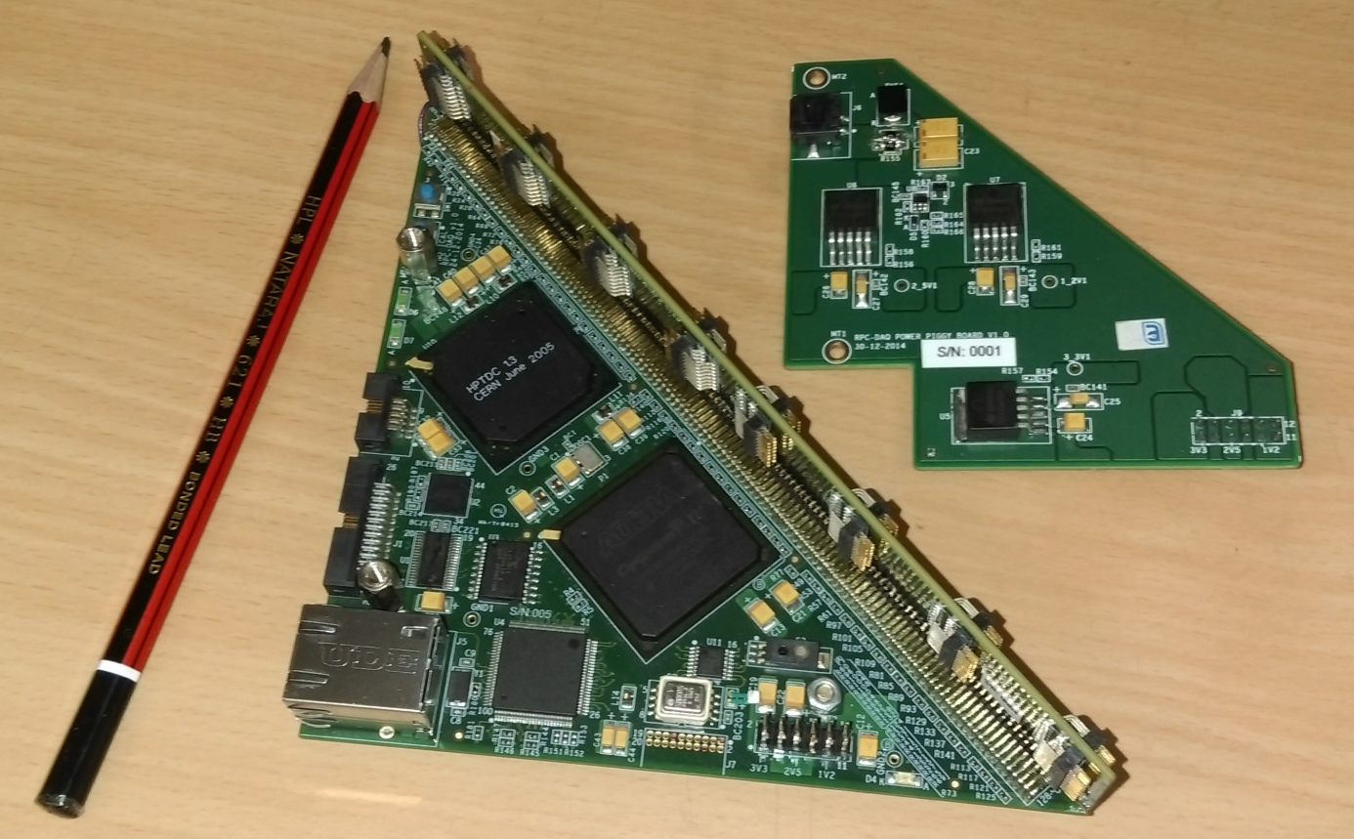
DFE module
Altera Cyclone 4
HPTDC
Wiznet 5300
Three boards

Slide 13
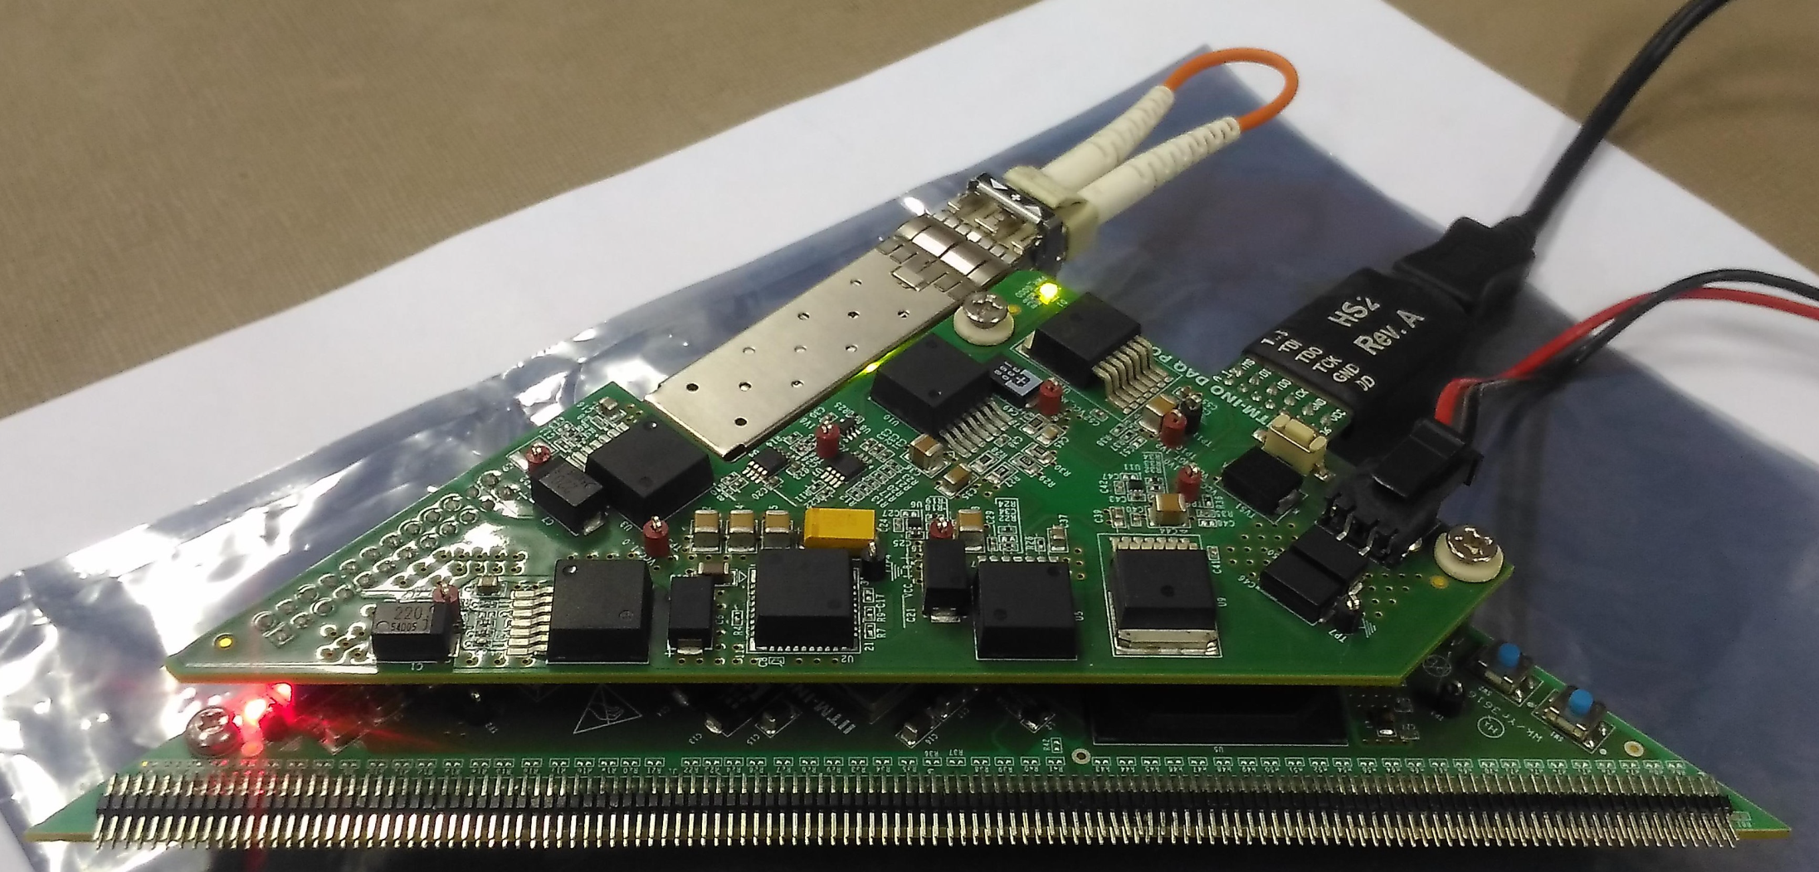
DFE with optical data interface
Xilinx Kintex-7 FPGA (XC7K160T-2FFG676I) and Aurora 64B66B IP core
SFP module (AFBR-709SMZ), 10Gb Ethernet, 850 nm, 10GBASE-SR/SW

Slide 14
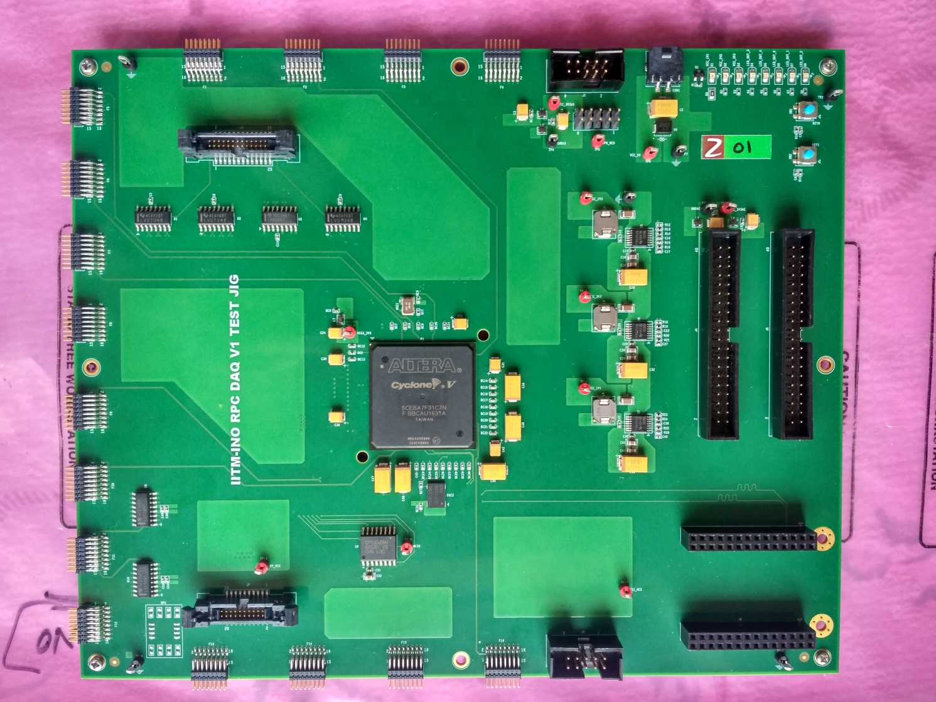
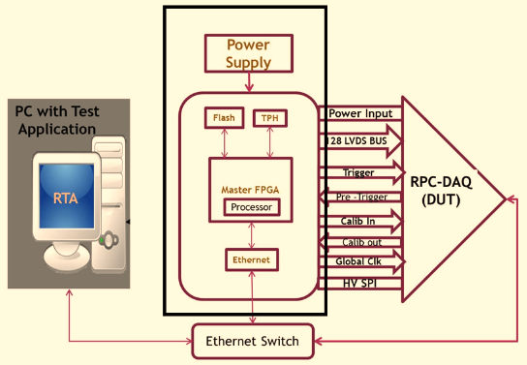
Test jig for DFE production QC

Slide 15
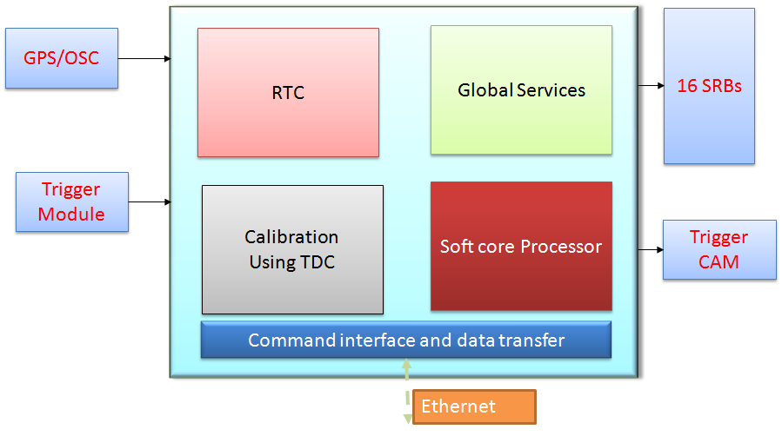
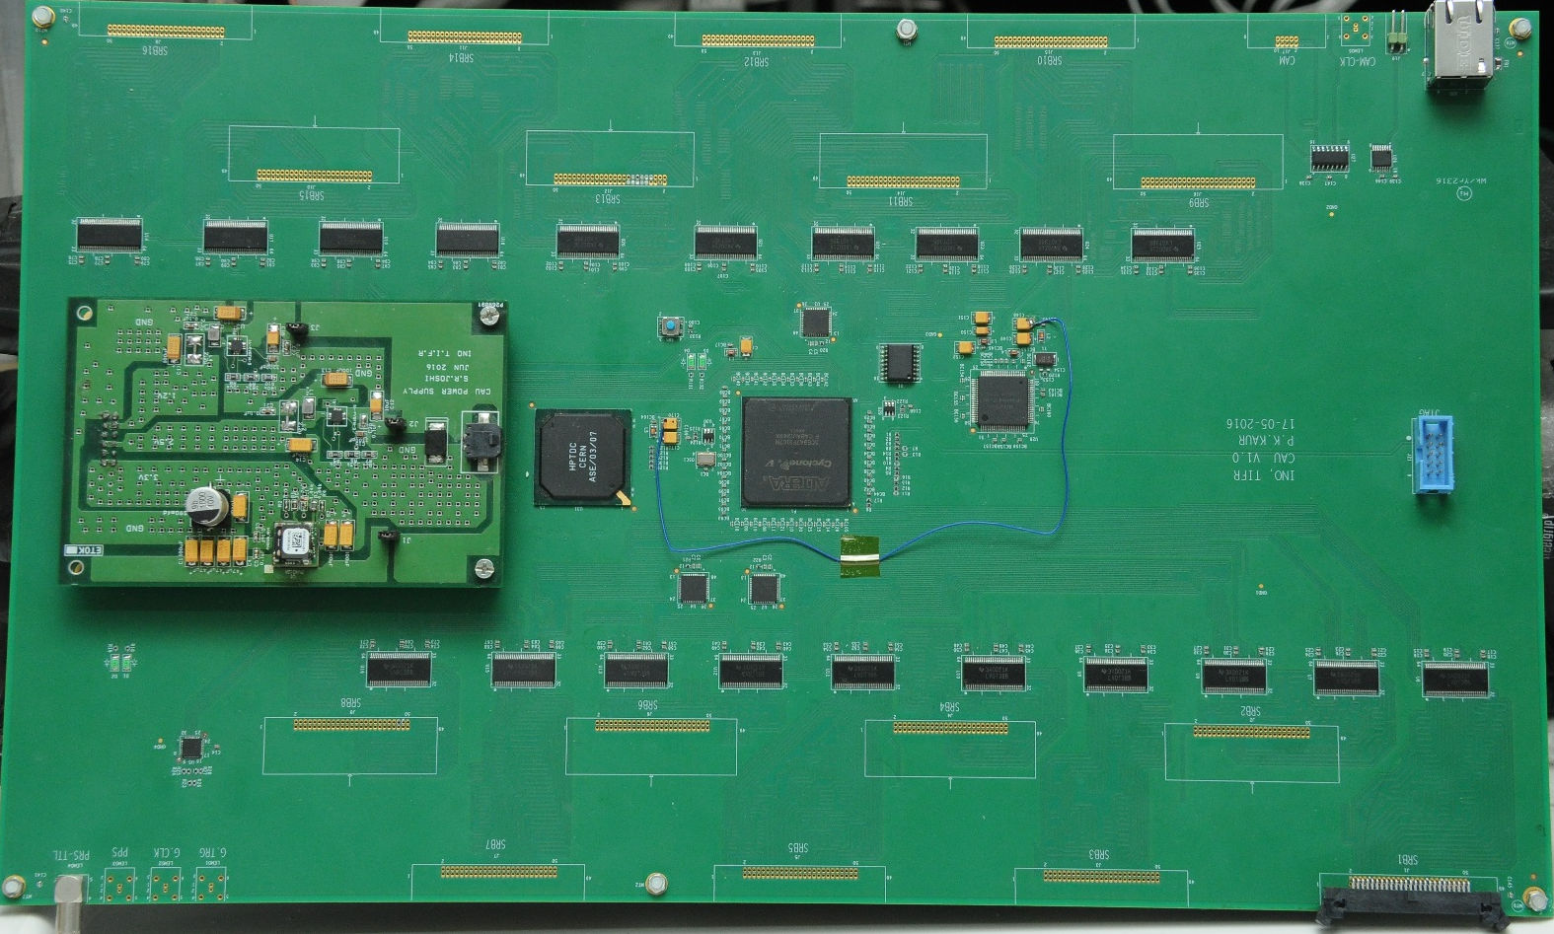
Calibration module

Slide 16
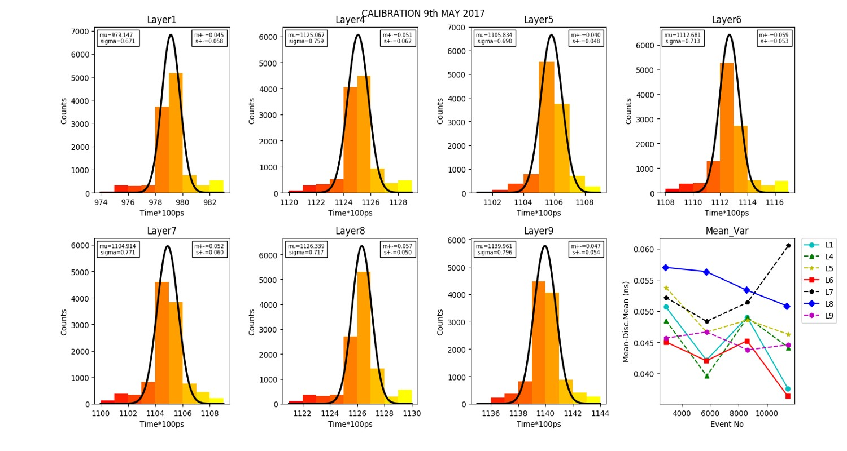
Performance of calibration module

Slide 17
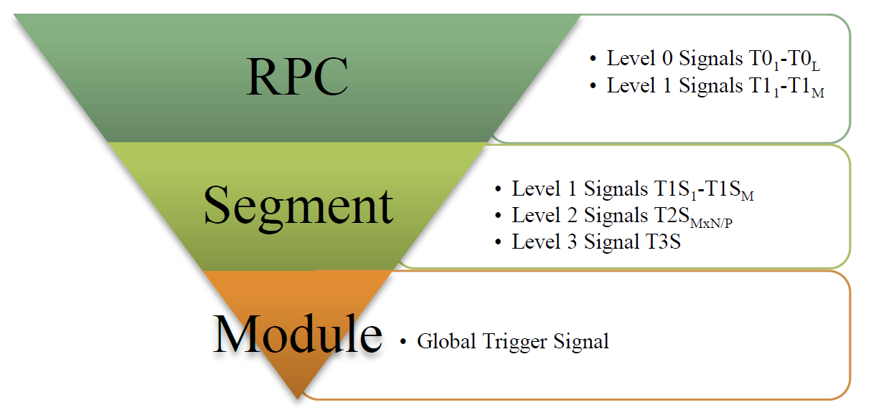
ICAL trigger scheme
Insitu trigger generation. Autonomous; shares data bus with readout system
For ICAL, trigger system is based only on topology of the event; no other measurement data is used
Huge bank of combinatorial circuits; Programmability is the game, FPGAs, ASICs are the players
Distributed
architecture

Slide 18
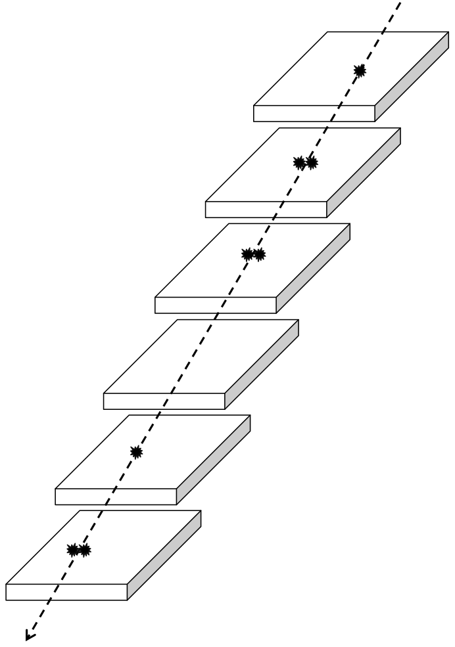
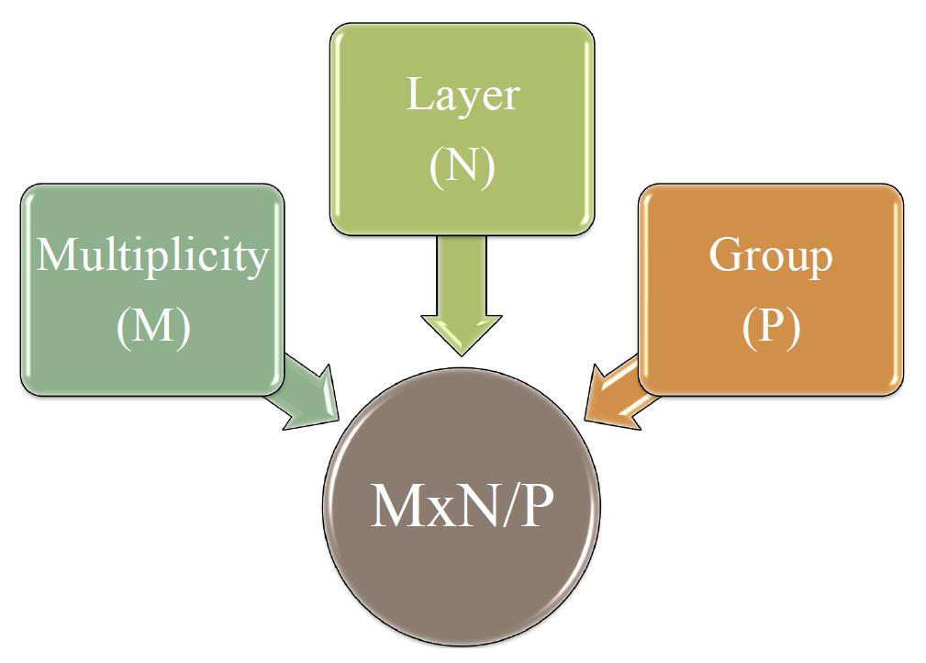
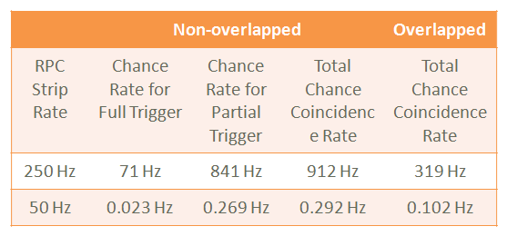
Trigger criteria

Slide 19
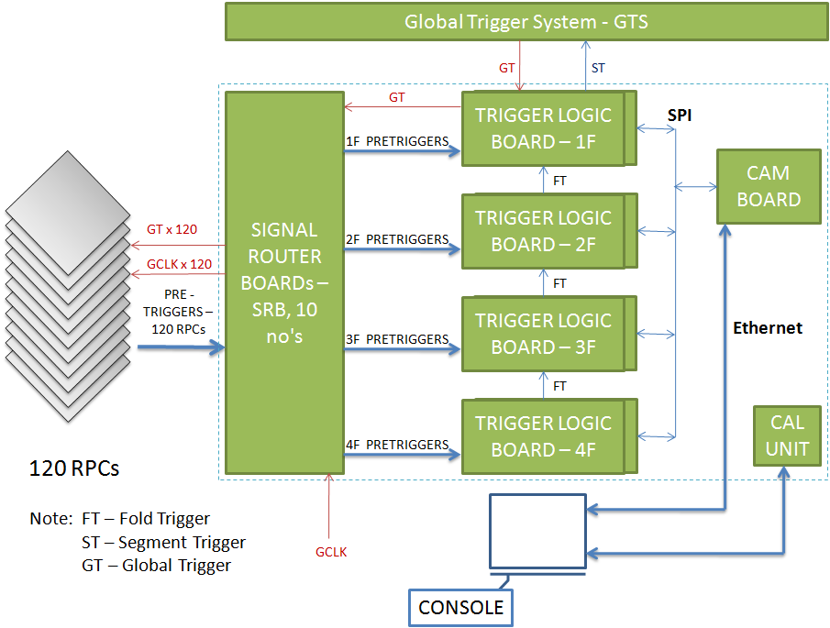
Trigger system for e-ICAL

Slide 20
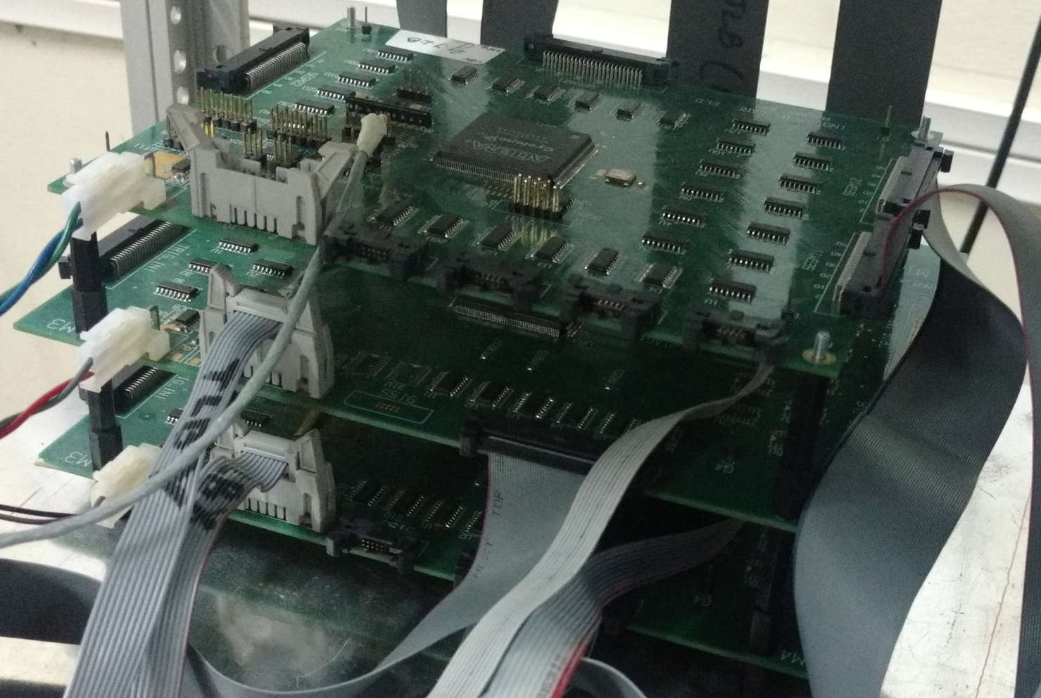
Trigger system with m-ICAL
Signal Router Board (SRB)
Trigger Logic Board (TLB)
Global Trigger Logic Board (GTLB)
Control and Monitoring Board (CAM)

Slide 21
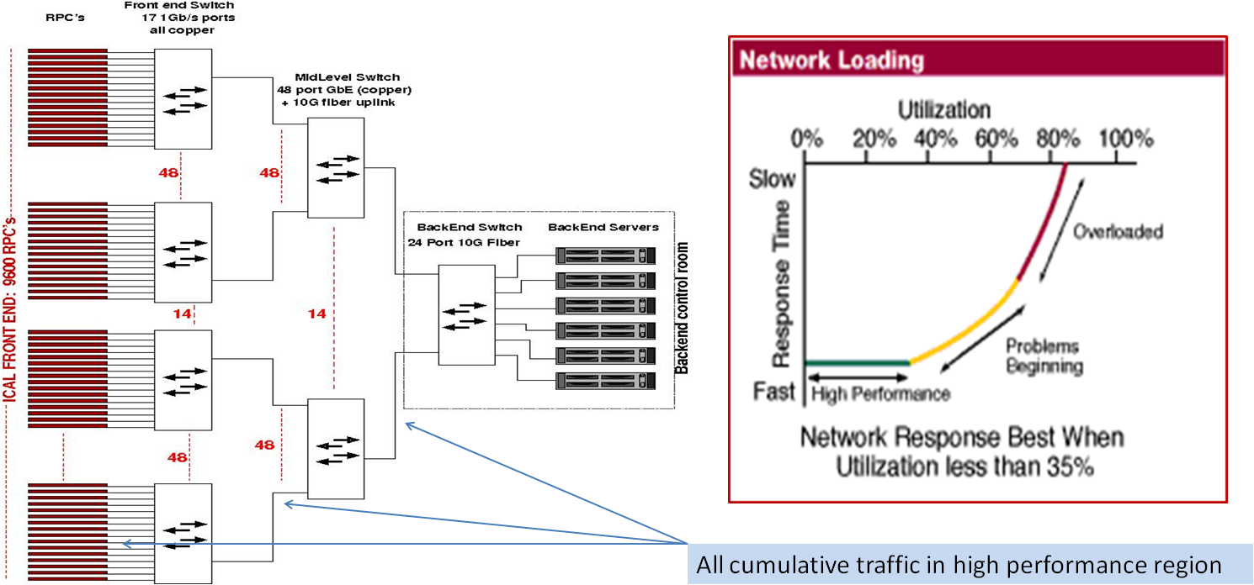
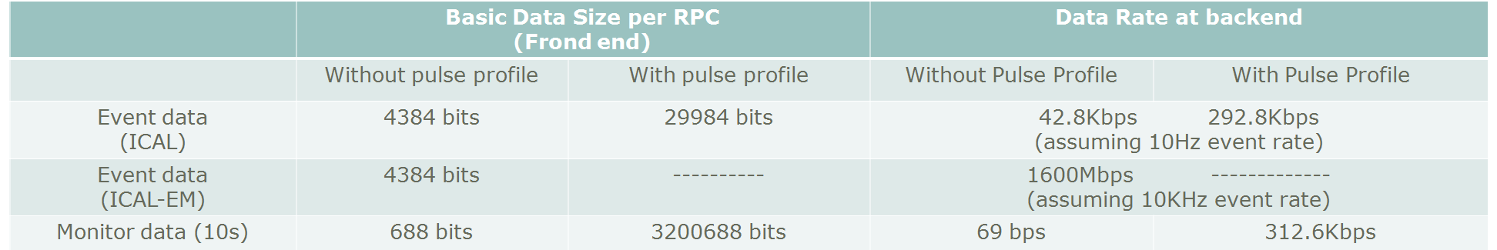
Overview of ICAL data LAN
ICAL RPCs constitute a massive LAN with 30K nodes!

Slide 22
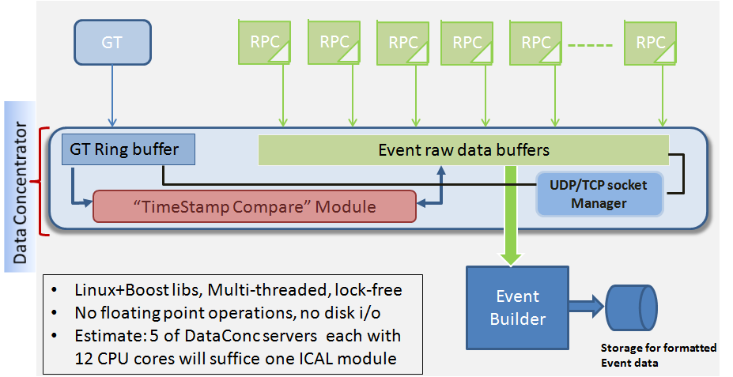
Back-end data concentrator hardware

Slide 23
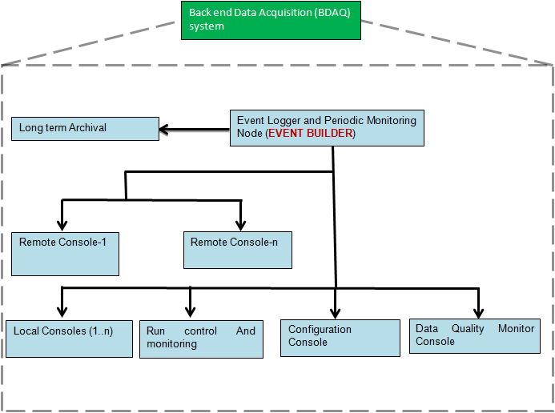
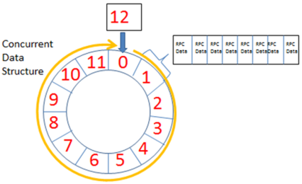
Back-end DAQ software
Data recording, DQMs, Visualization and Control
Receives raw event (RPC) data that is pushed to it by the Data Concentrator.
Combines raw data from various RPC’s into a single chunk of “event data” based on Event Number.
Writes into ROOT format files into short term high speed RAID based storage.

Slide 24
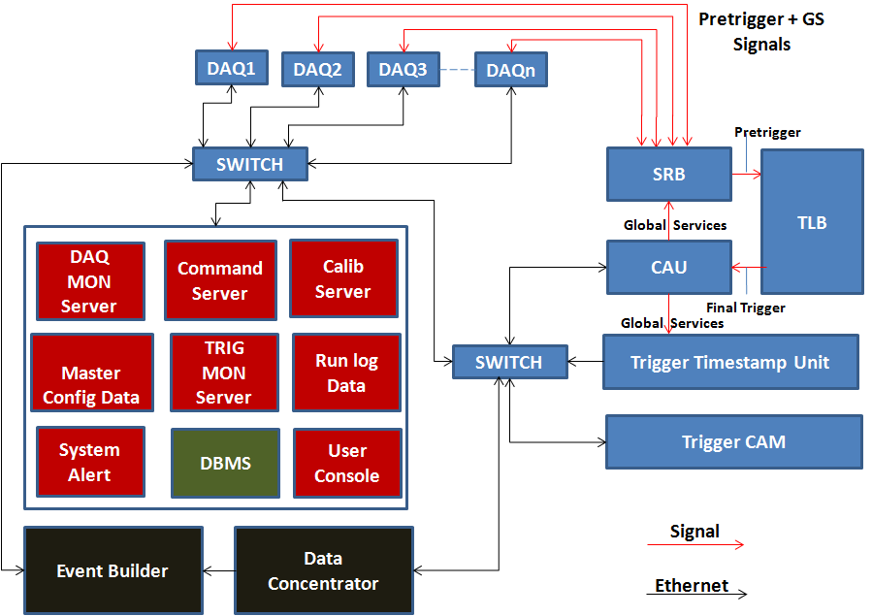
System integration

Slide 25
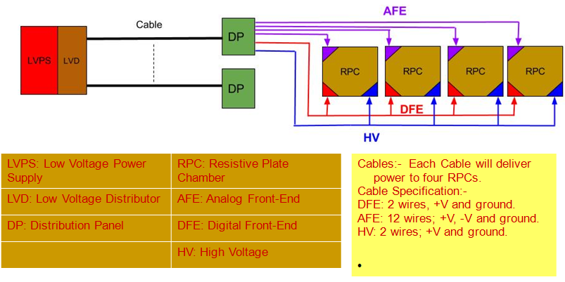
LV Power Supply and distribution
Design scheme is complete. Prototyping is in progress.

Slide 26
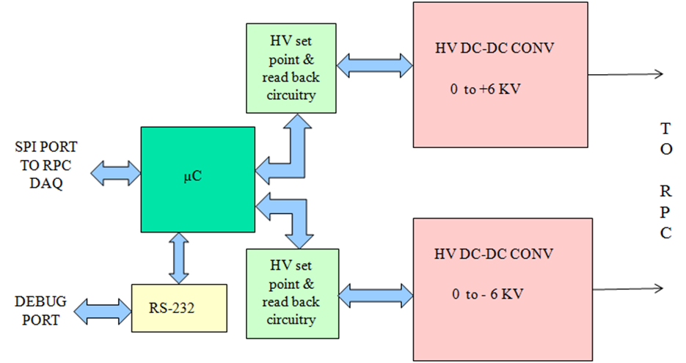
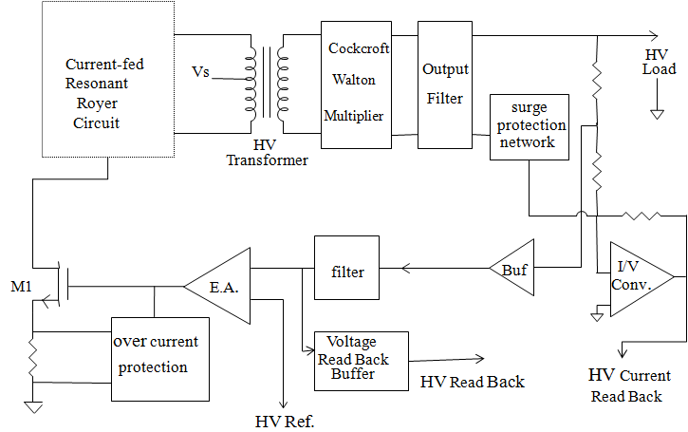
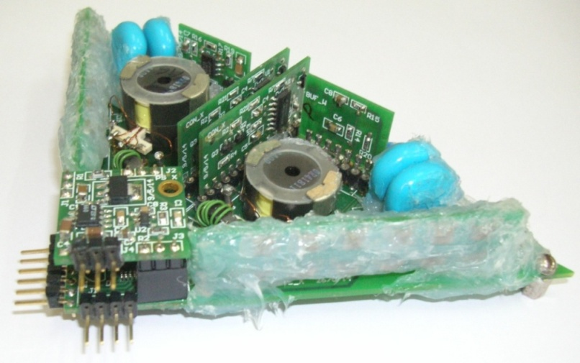
High voltage power supply
Output voltage adjustable in the range ± 0-6KV (to generate 0-12KV) with output current up to 2µA.
HV load regulation: better than 0.1% F.S
Output ripple/noise voltage: within 200 mV (p-p).
Adjustable HV Ramp rate 10-1000 Volts/ sec, HV on/off control, HV output read back facility.
HV load current read back facility with a resolution of 5 nA.
Required LV Input supply: 12V @200mA
Ambient fringe magnetic field: 500 gauss

Slide 27
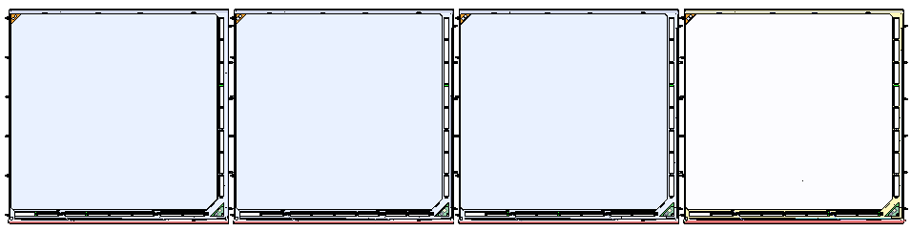
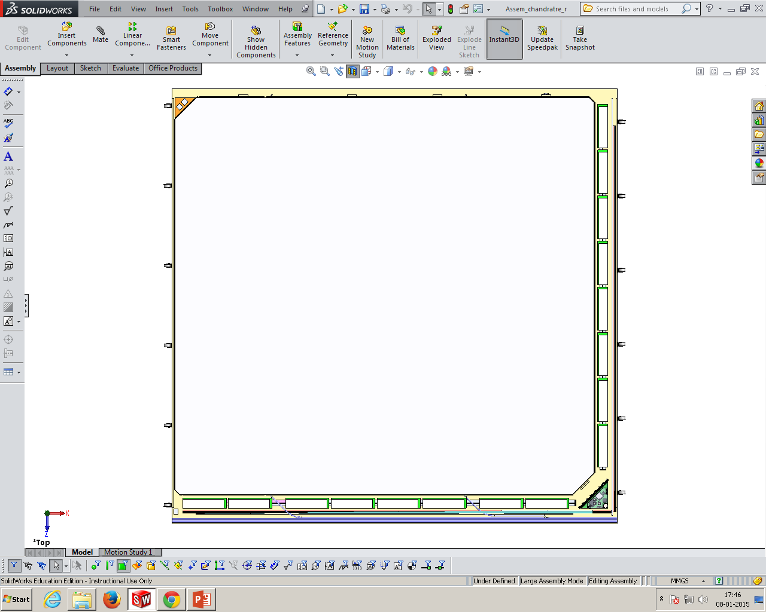
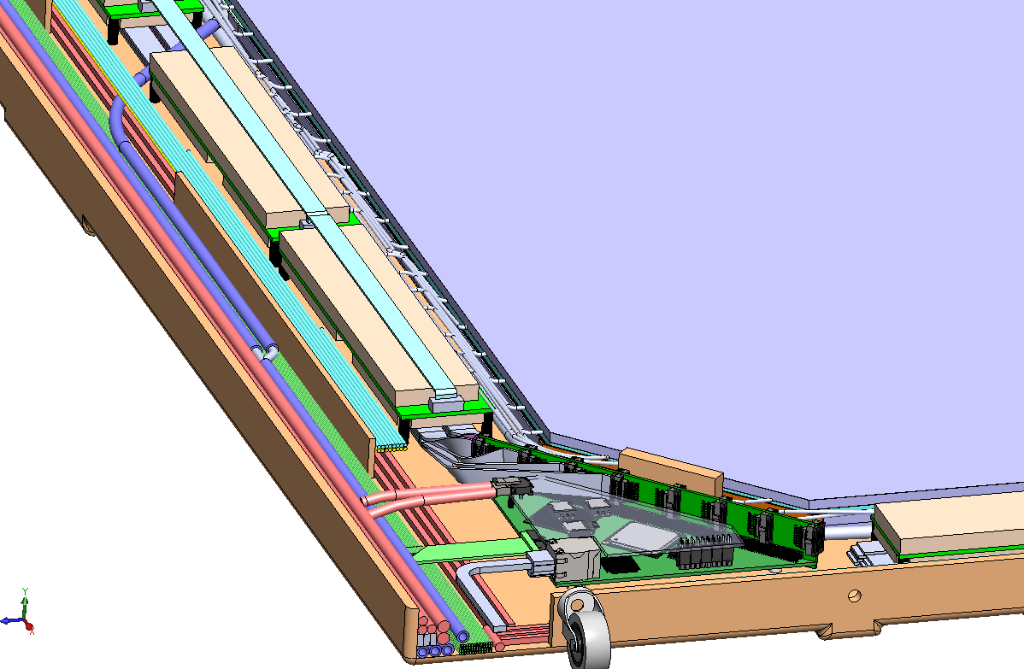
Integration of electronics in RPC

Slide 28
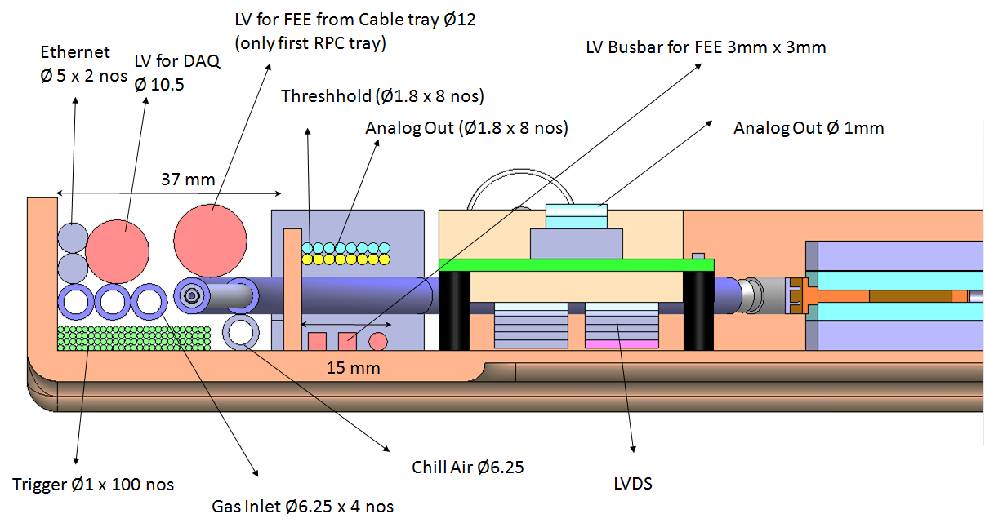
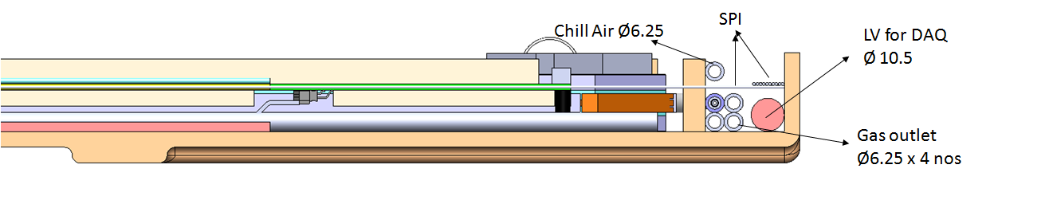
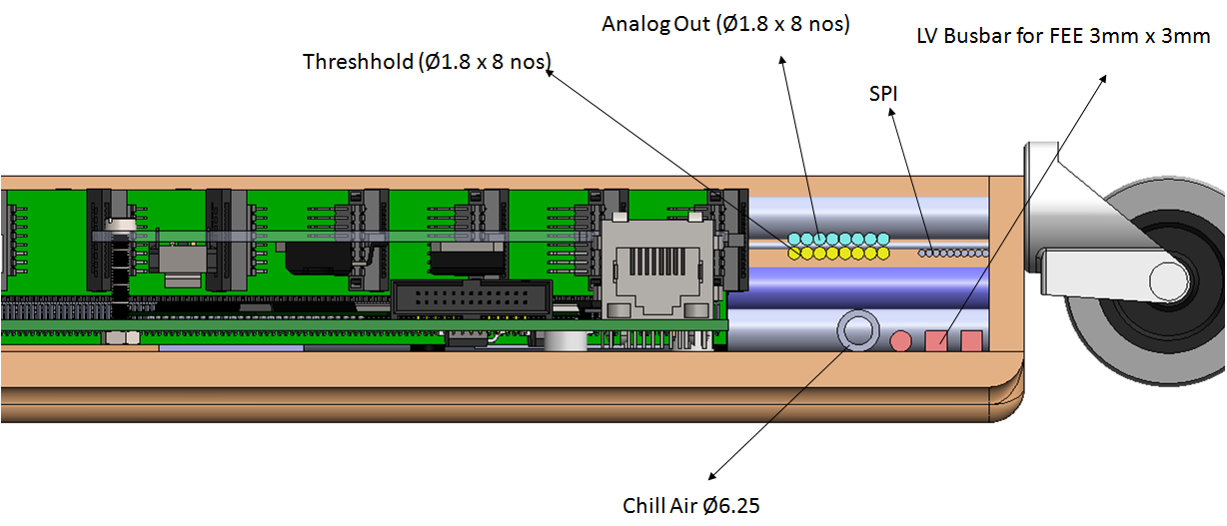
Side views of the RPC tray

Slide 29
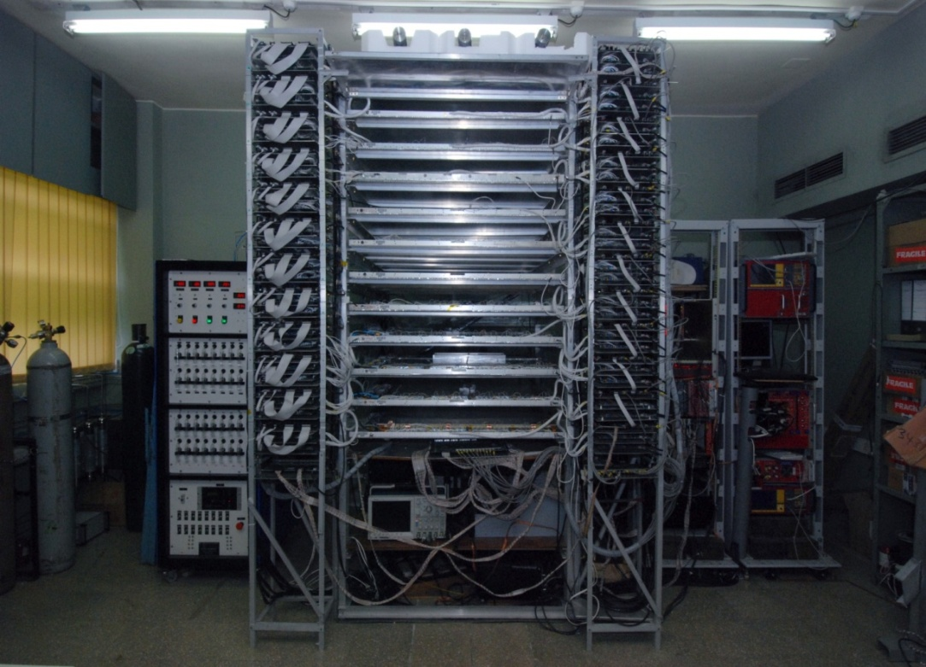
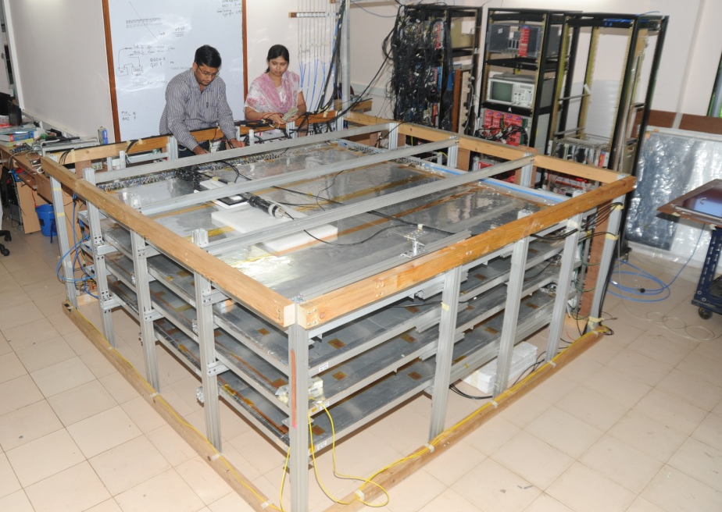
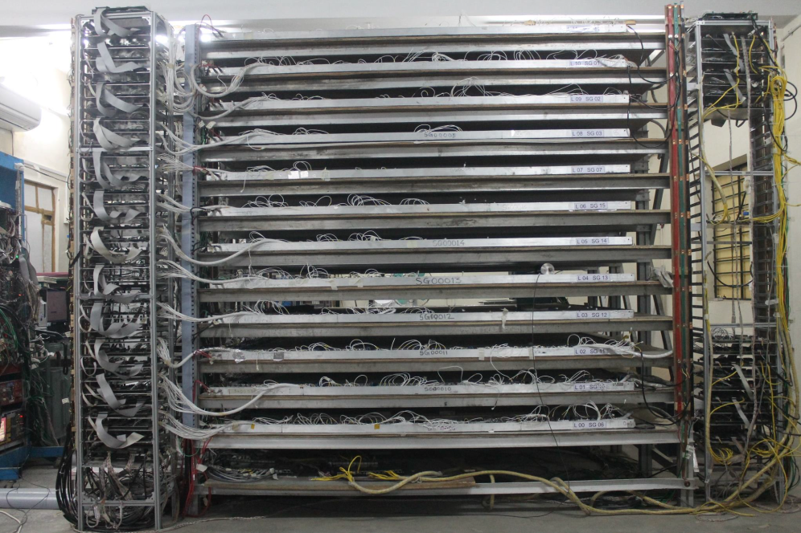
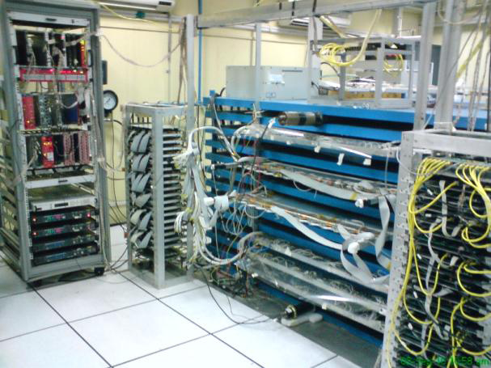
ICAL Prototype detectors
1m × 1m RPC stack in TIFR
2m × 2m RPC test stand in TIFR
2m × 2m RPC stack in Madurai
1m × 1m RPC stack in VECC
Operating 24×7 for many years

Slide 30
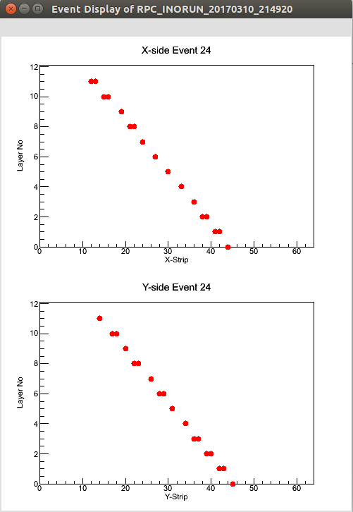



Some results from prototypes

Slide 31
Status and future outlook
Design of baseline ICAL detector electronics completed, reviewed.
Prototypes and limited quantities of various components and modules were produced, technologies and vendors identified.
They are all tested, and are being used to read many ICAL prototype detectors, including the m-ICAL which is currently under construction.
The project (ICAL) and the e-ICAL are delayed, hence large scale production of its electronics is put on hold.
Meanwhile, revisions and upgrades – or even new architectures, of various components are being worked out.

