Slide 1
New Study for SiPMs Performance in High Electric Field Environment
Tamer Tolba

Slide 2
Outline
Introduction.
Objectives.
The LXe Setup.
Preliminary Results with light.
Preliminary Results in Dark.
I-V curve studies.
Conclusion and outlook.

Slide 3
Introduction
SiPMs technology is “relatively” new technology, hence not all its properties are examined under the exposure to extreme working environments!
Many features (compact size, low DCR at cold and low radioactivity) make the SiPMs very attractive photo-sensors to be considered in various low background applications working in cryogenic environment, especially the liquefied noble-gas detectors used in dark matter searches or neutrino physics (e.g. nEXO).
The SiPMs are known to be stable against the change in the surrounding magnetic field strengths, but little is know about their behavior in different electric field strengths.
In the current nEXO concept design, the SiPM array will be located behind the field shaping rings (Guofu Cao talk [212] R2 May 23rd). This will lead the SiPM devices to be exposed to different electric field strengths along the drift axis of the detector. The preliminary electrostatic simulations show that the SiPMs will be exposed to electric field values as high as 15 – 25 kV/cm

Slide 4
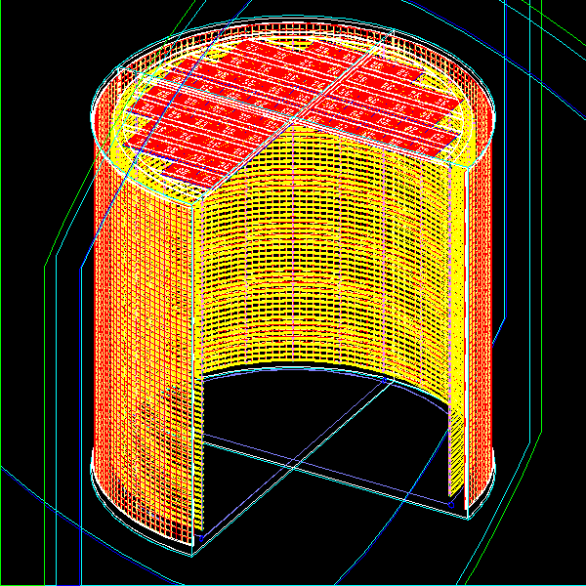
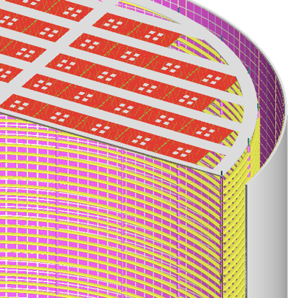
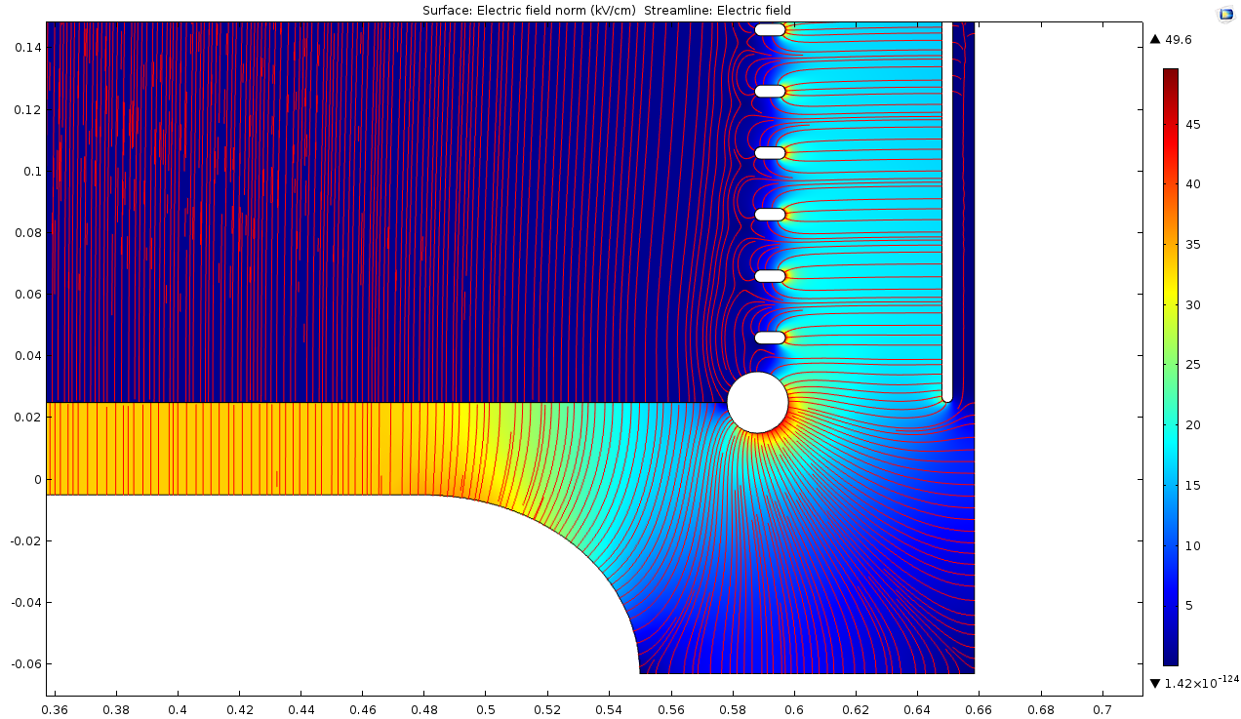
nEXO Light Readout R&D
Anode
SiPMs
SiPMs
Field shaping
rings
Cathode
E field strength map zoomed in to cathode area
TPC Vessel
30 kV/cm
SiPM
plane
20 kV/cm
SiPMs plane in nEXO ➔ Exposed to high electric field values.
Effect on SiPM performance (Gain, PDE, correlated noise, physical damage …)!!!

Slide 5
Objectives
In this work, we perform new study on the SiPMs performance under the influence of the exposure to high electric field value.
Two serious concerns will be addressed:
Any change in the SiPM properties/performance (gain and correlated noises (e.g. cross-talks, dark noise, etc.)) at different electric field values compared to that at the absence of elec. field.
Any physical damage to the body of the sensors, due to the possible discharges caused by the high E fields.
Discharges/breakdowns that leads to not run the detector at the designed operating voltage/drift field.

Slide 6
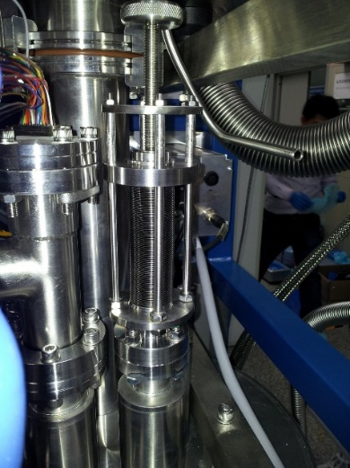
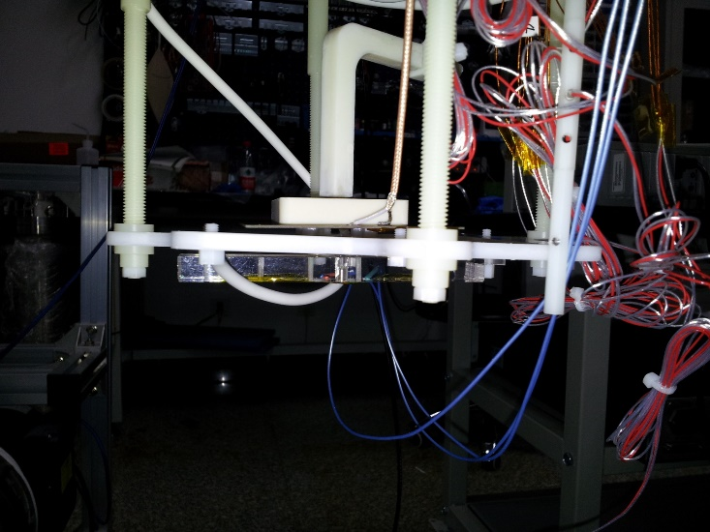
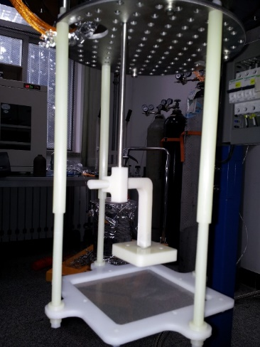
LXe setup
Reality
Design
Can be used with Xe, CF4 and Ar.
Very reliable internal structure design ➔ can be adapted to hold different internal setups.
Moving bellow ➔ applying electric field strengths up to ~ 200 kV/cm (with max. 20 kV out put power supply).
Moving
bellow
SiPM
5mm
Cathode
4.5mm
UV LED
Internal
structure

Slide 7
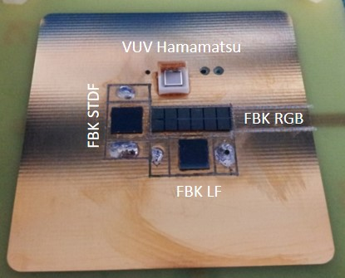
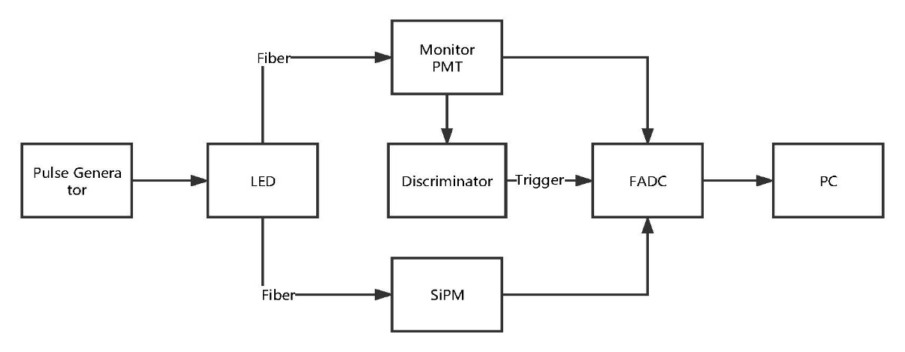
Data taking, acquisition and analysis
Three SiPMs from two different vendors, in which nEXO experiment is interested in, are tested:
FBK VUV Low Field SiPM: 2x2 array of 2.98x2.78 mm² SiPMs of filling factor ~ 73%, with pixel size 25x25 µm², forming ~ 5.96x5.56 mm² QUAD Chip. They are VUV sensitive, working in cryogenic environment and provided as bare chips.
FBK RGB-HD SiPM: 2x6 array of 2.25 x 2.25 mm² SiPMs of filling factor ~ 72.5%, with pixel size 25 x 25 μm²
and total chip size: ~15.3 x 4.95 mm². These SiPMs are UV sensitive, working in cryogenic environment and provided
as bare chips.
Hamamatsu VUV3 SiPM: one SiPM chip of size 3.4x3.4 mm² with pixel size 50 µm and filling factor ~ 50%.
This SiPM is VUV sensitive, working in cryogenic environment but not provided as bare chips.
Two sets of data were collected in LCF4 @ -125 °C.
With different electric field values; 0, 6, 12, 18, 24 and 30 kV/cm.
The two data sets are based on the lightning condition;
➔ The first data set collected in dark.
➔ The second data set collected used a blue light (~ 465 nm) LED. A PMT outside
the chamber that is used to monitor the stability of the LED light.

Slide 8
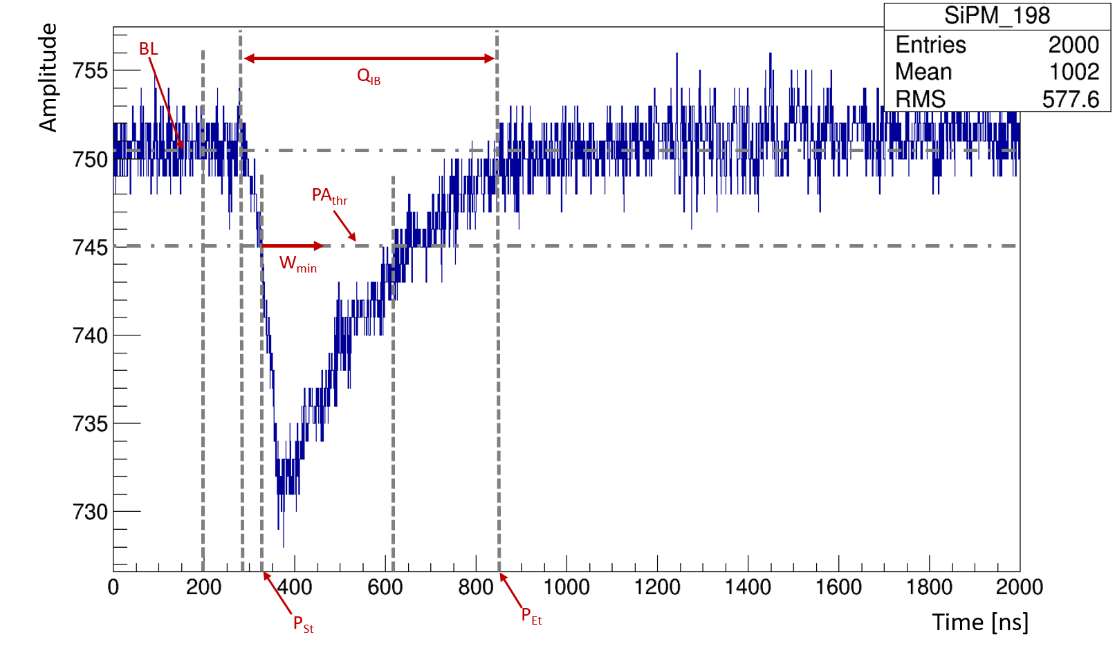
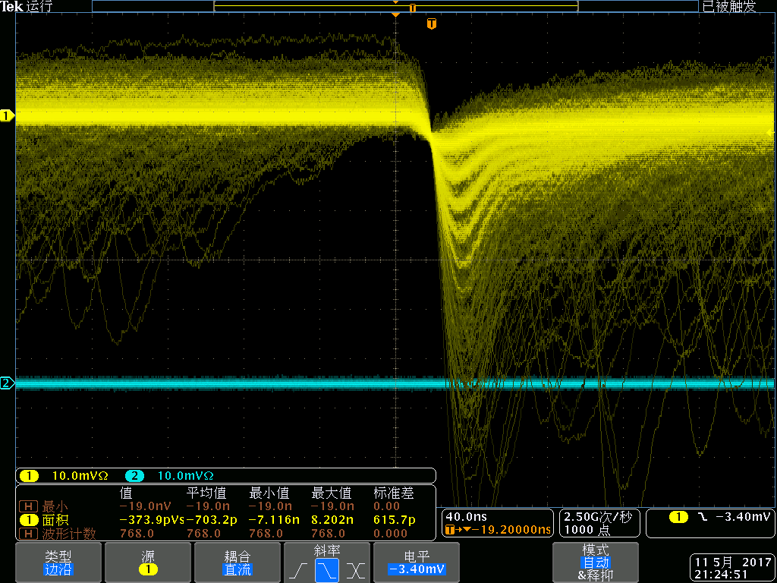
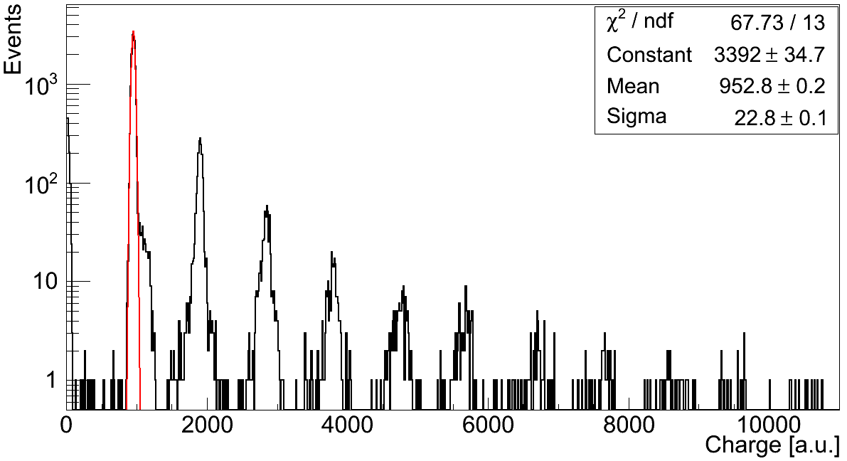
For efficient pulse selection, a multi-steps pulse finding algorithm has been applied.
The selection algorithm set specific constraints on the pulse width and amplitude.
The total charge (Q_{tot}) collected by the light sensors (SiPMs and PMT), is then calculated.
The Q_{tot}-SiPM is corrected by the corresponding Q_{tot}-PMT value.
Example for single photoelectron spectrum for the Hamamatsu VUV3 SiPM @ E field = 18 kV/cm

Slide 9
Preliminary Results

Slide 10
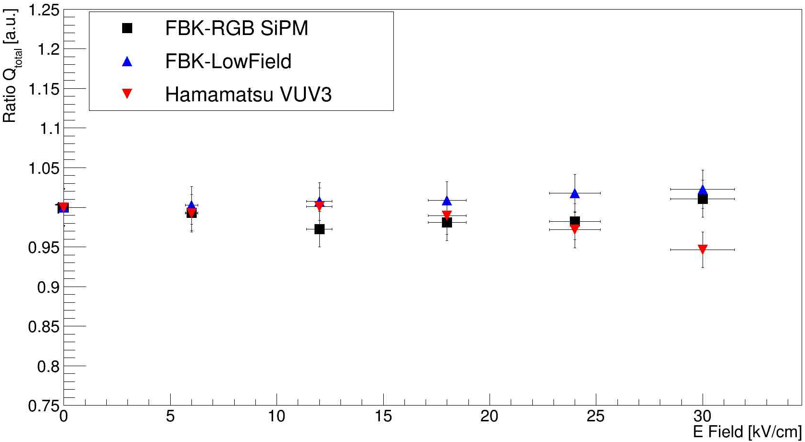
Total charge “relative gain” stability in different elec. field values
with light (corrected by the PMT and normalized to the 0 kV/cm data)
Preliminary

Slide 11
Total charge “relative gain” stability in different elec. field values
with light (corrected by the PMT and normalized to the 0 kV/cm data)
The relative total charge, RQ_{tot(HV)}, includes the relative gain and the detection efficiency of each SiPM.
At this stage, the two components are indistinguishable.
Preliminary

Slide 12
Total charge “relative gain” stability at different elec. field values
in dark (normalized to the 0 kV/cm data)
The study of the SiPMs performance in dark is essential to examine their relative gains stability at different electric field values.
Moreover, this examination provides direct picture on the stability of the devices detection efficiency at the different electric fields.

Slide 13
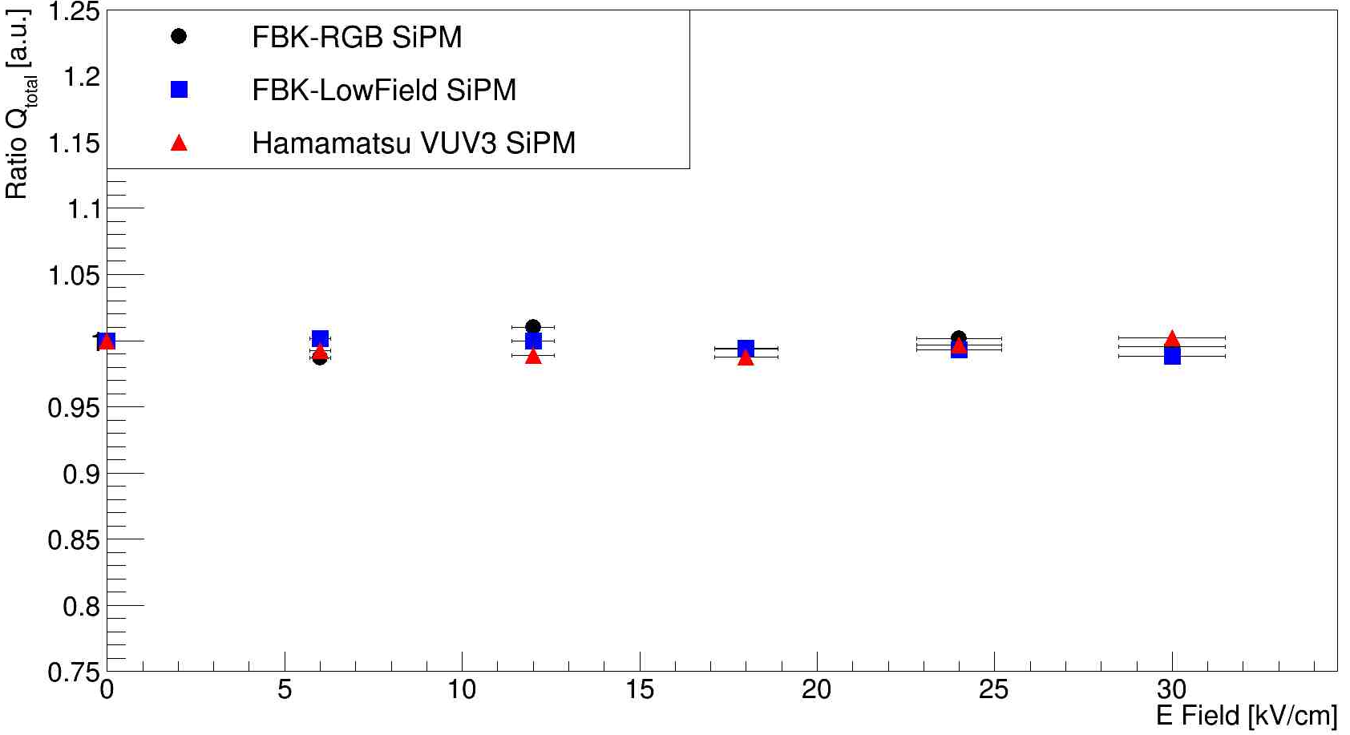
Total charge “relative gain” stability at different elec. field values
in dark (normalized to the 0 kV/cm data)
The study of the SiPMs performance in dark is essential to examine their relative gains stability at different electric field values.
Moreover, this examination provides direct picture on the stability of the devices detection efficiency at the different electric fields.
Preliminary

Slide 14
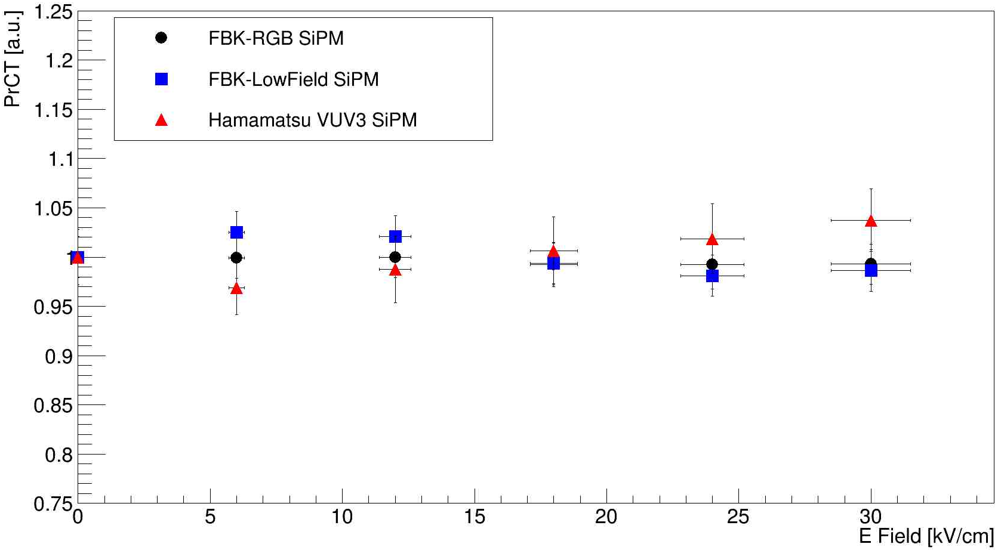
Cross-talk probability stability at different elec. field values
in dark (normalized to the 0 kV data)
$${Pr}_{CT}=\frac{No. of pulses with ≥2pe level}{No. of pulses with ≥1pe level}$$
Preliminary

Slide 15
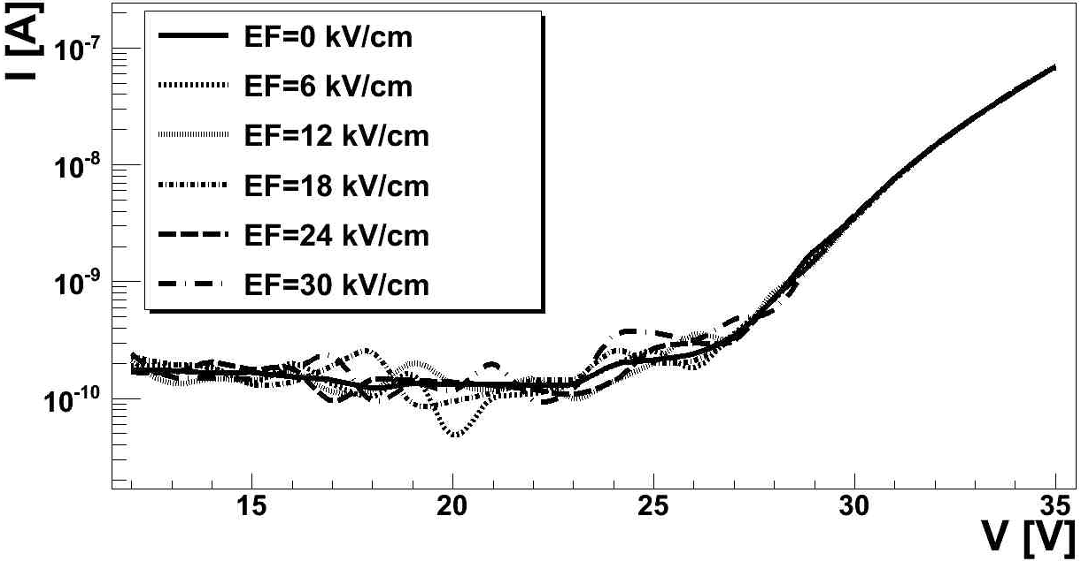
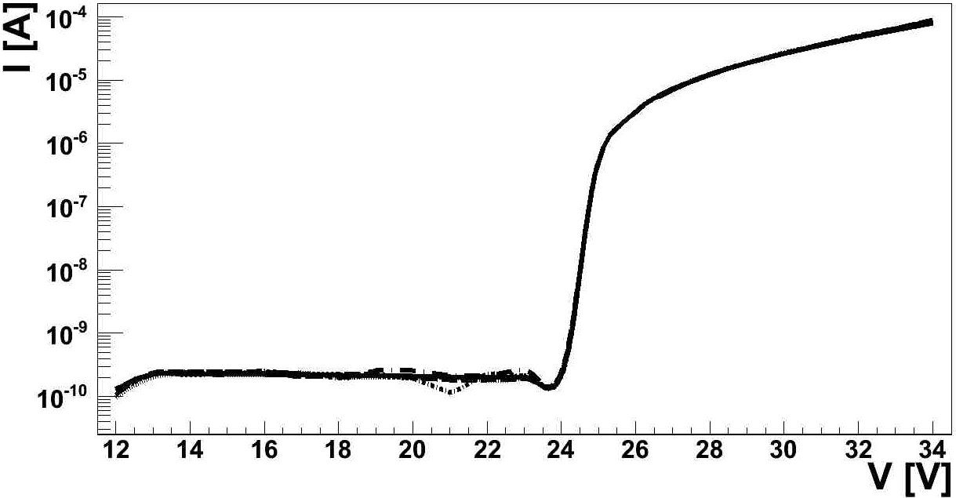
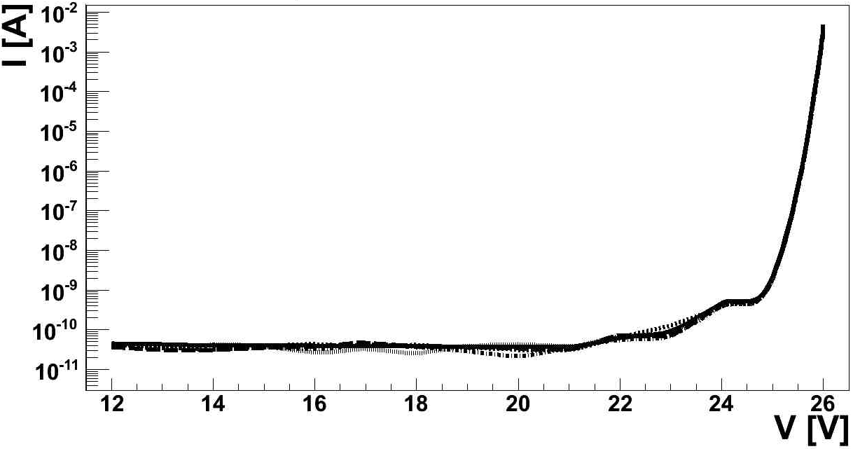
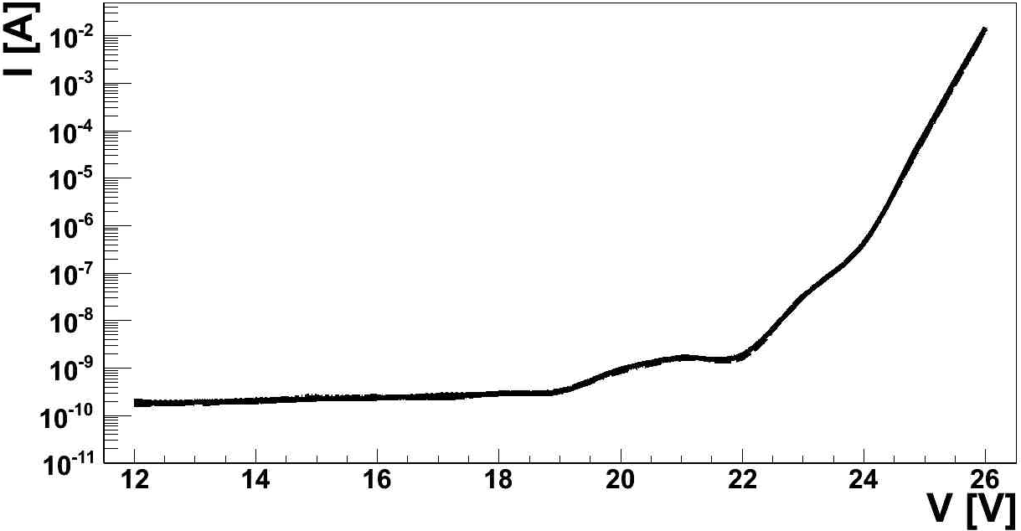
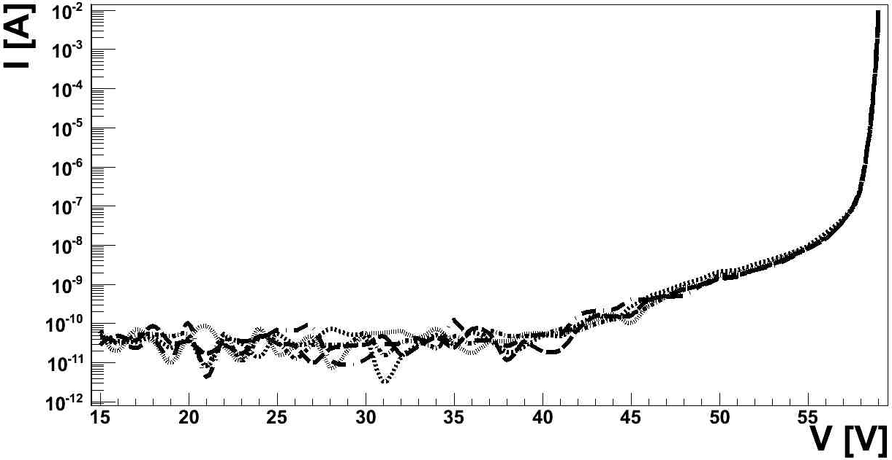
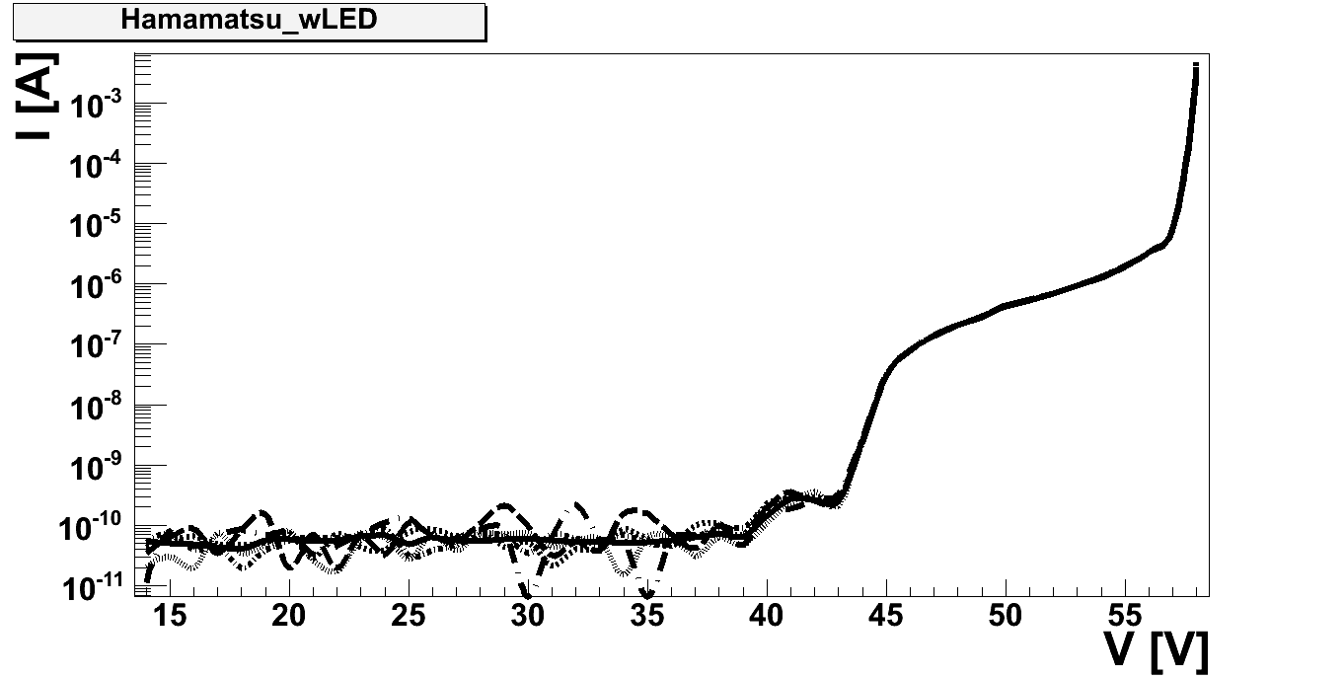
Dark
I-V curve studies
With light
FBK-RGB
Preliminary
Preliminary
FBK-Low Field
Hamamatsu VUV3

Slide 16
Conclusion/Outlook
The SiPM devices understudy show an excellent stability for the light collection under the influence of different electric field strengths, up to 30 kV/cm.
The analysis is still ongoing to estimate the after-pulse and the delayed cross-talks.
No strong discharges recorded and no damages observed on the bodies of the devices.
More investigations are needed at higher (extreme) electric field strengths (~ 200 kV/cm) to examine the ultimate capabilities of the SiPMs.

Slide 17
Spare

Slide 18
SiPMs technical details
- FBK-STD SiPM, as the range of operating voltage of this device is reduced a lot in cryogenic temperatures that leads to poor performance. Hence, the results will not be reported.
- FBK VUV Low Field SiPM: 2x2 array of 2.98x2.78 mm² SiPMs of filling factor ~ 73%, with pixel size 25x25 µm², forming ~ 5.96x5.56 mm² QUAD Chip. The breakdown voltage of these SiPMs at 150 °K is ~ 22.7 V (compared to V_{bd} at room temperature of ~ 27 V), and were operated at ~ 2.5 V overvoltage. They are VUV sensitive, working in cryogenic environment and provided as bare chips.
- FBK RGB-HD SiPM: 2x6 array of 2.25 x 2.25 mm² SiPMs of filling factor ~ 72.5%, with pixel size 25 x 25 μm² and total chip size: ~15.3 x 4.95 mm². The breakdown voltage of these SiPMs at 150 °K is 24 V (compared to V_{bd} at room temperature of ~ 28.5 V), and were operated at ~3 V overvoltage. These SiPMs are UV sensitive, working in cryogenic environment and provided as bare chips.
- Hamamatsu VUV3 SiPM: one SiPM chip of size 3.4x3.4 mm² with pixel size 50 µm and filling factor ~ 50%. The breakdown voltage of these SiPMs at 150 °K is ~ 44 V (compared to V_{bd} at room temperature of ~ 51.8 V), and was operated at ~ 4 V overvoltage. This SiPM is VUV sensitive, working in cryogenic environment but not provided as bare chips.

Slide 19
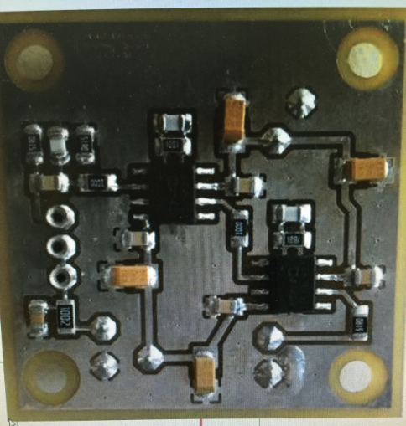
Cold Electronics
Two types of preamplifiers were used to deliver the bias voltage to the SiPMs and to transmit the output signal from the SiPMs to the digitizer unit;
the first is commercial AMP 0604 preamplifier manufactured by Photonique, used with the Hamamatsu SiPM, and was placed outside the chamber (in room temperature).
Two custom made preamplifiers designed and constructed by EXO-Erlangen group at the Erlangen Center for Astroparticle Physics – Germany. These are used with the FBK SiPMs, and were placed inside the chamber in the CF4 gas phase.
The two preamplifiers are with very close properties; both are current sensitive, with supply voltage ~ 4 - 10 V, signal rise time ~ 5 ns, relatively large band width ~ 100 – 400 ns and gain 10x - 40x.
The output signals collected by the SiPMs are processed by a 4-channels CAEN DT5751 digitizer unit [8], with embedded field programmable gate array (FPGA). The ADCs maximum sampling rate ~ 1 GHz with 10 bit resolution.

Slide 20
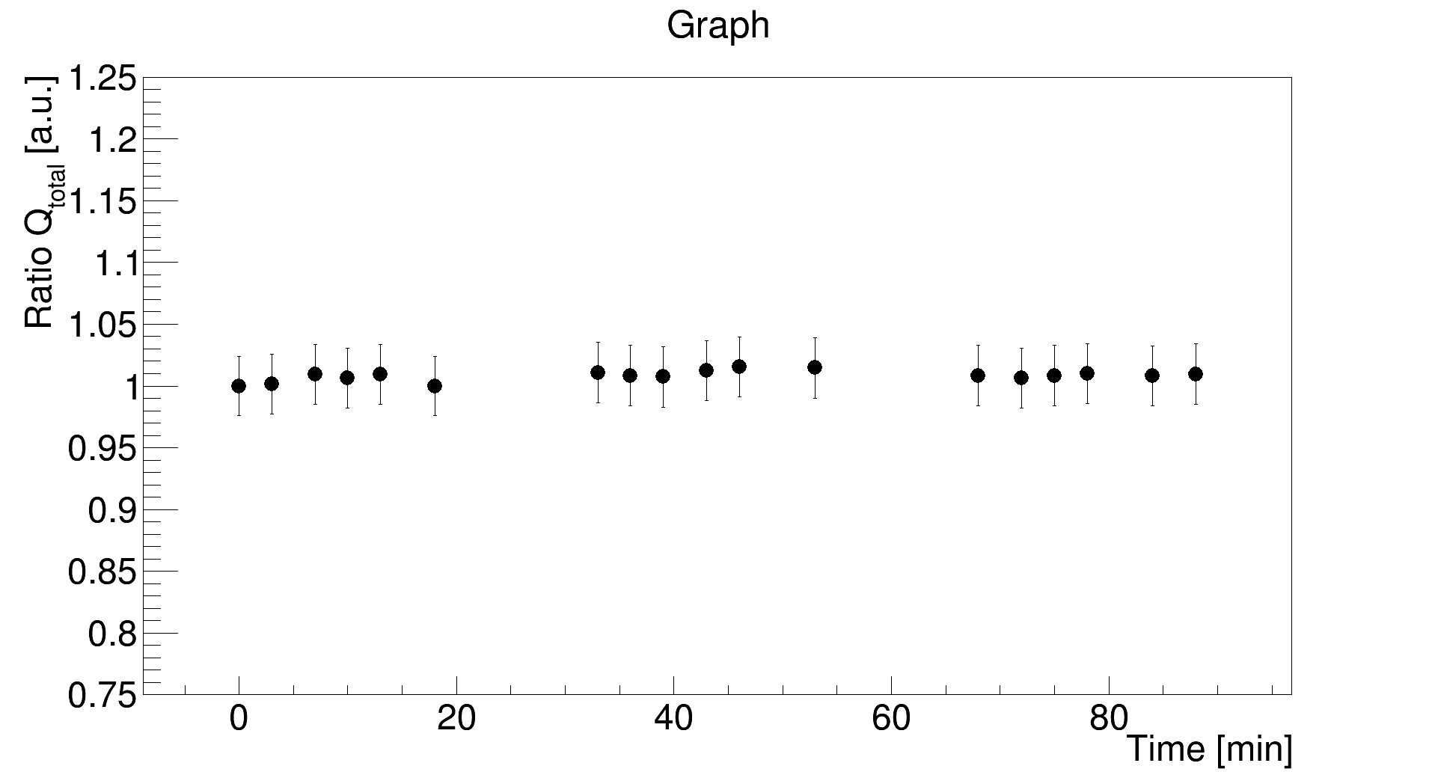
PMT stability vs time

