Slide 1




The TORCH PMT:
A close packing, long life MCP-PMT for Cherenkov applications with a novel high granularity multi-anode
James Milnes
TIPP 2017, Beijing, China, May 22 - 26 2017

Slide 2
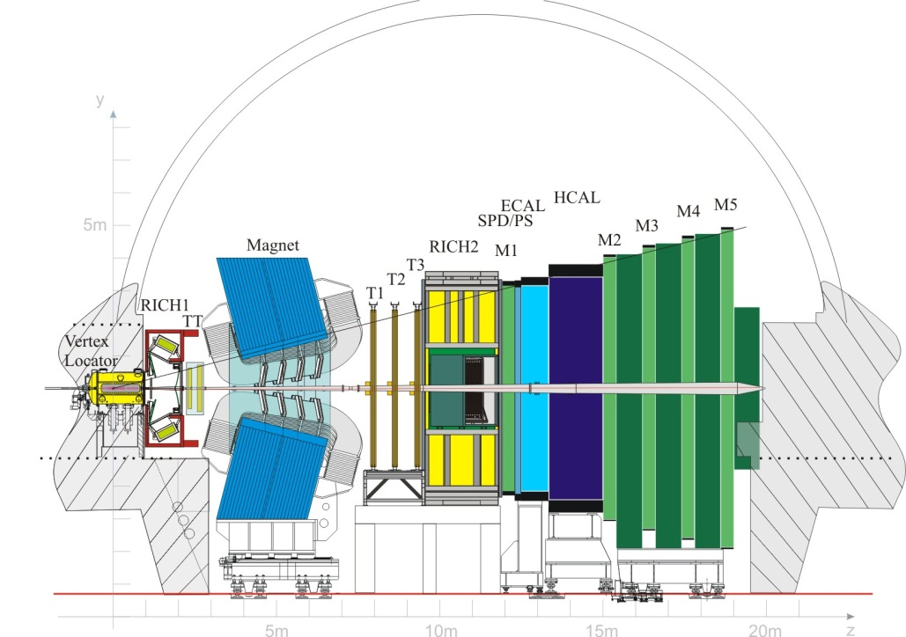
TORCH - Motivation
TORCH is an ERC funded R&D project
Proposal to upgrade LHCb Particle ID capabilities in 2-10 GeV/c region
See talk by Roger Forty (Thursday 9.00 am)
TIPP 2017, Beijing, China, May 22 - 26 2017
Notes:
TORCH is a proposed upgrade to the LHCb detector at CERN, to supplement the particle ID capabilities in the momentum range 2-10GeV/c
Particle are identified by measuring their time of flight from the interaction point, which allows calculation of their mass (hence their identity) since momentum is known from other detectors in LHCb.

Slide 3
The TORCH PMT
In November 2012 Photek started the development of the TORCH (Timing Of internally Reflected CHerenkov photons) PMT
A collaboration with CERN and the Universities of Oxford and Bristol for the LHCb upgrade due around 2023
Technical aims:
  A lifetime of 5 C/cm² of accumulated anode charge or better
  A multi-anode readout of 8 x 128 pixels
    Fine pitch resolution target σ = 0.12 mm
  Close packing on two apposing sides with a fill factor of 88% or better
    53 mm working width within a 60 mm envelope
TIPP 2017, Beijing, China, May 22 - 26 2017

Slide 4
MCP-PMT Lifetime
Standard MCP detectors suffer from sensitivity loss after prolonged exposure:
  An MCP has a very large surface area
  Prolonged electron bombardment of this surface releases material that is ionised
  These ions are drawn back to the photocathode and reduce sensitivity
Solution is now well known:
    Conformal coating of Al₂O₃ or MgO through Atomic Layer Deposition
    Extensive study by Albert Lehmann
TIPP 2017, Beijing, China, May 22 - 26 2017

Slide 5
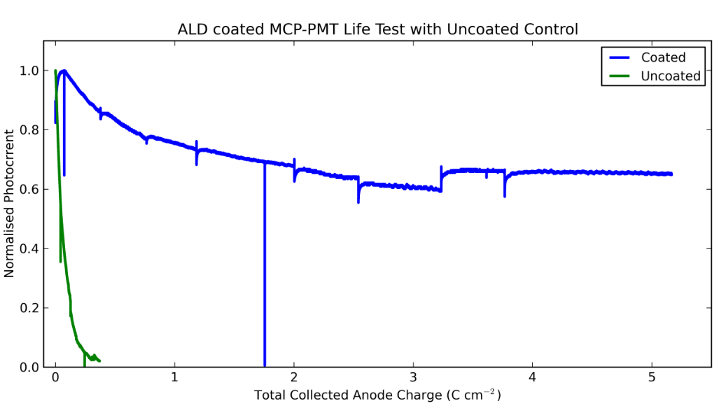
MCP-PMT Lifetime
Photek had already achieved the life time aim in previous work
Two PMT samples produced in 2011: Double-MCP, 10 mm diameter working area
  One with ALD coated MCPs, One control with standard MCPs
  Accelerated test: ~ 800 nA / cm² for ~ 14 weeks over small area
Photek have licensed Arradiance ALD technology for in-house coating of MCP substrates
Work presented by Conneely et al at VCI 2013
TIPP 2017, Beijing, China, May 22 - 26 2017

Slide 6
  High granularity multi-anode
For the TORCH project, how do we obtain position resolution beyond the pitch of the pads? – Proposed idea of charge sharing:
  Deliberately spread the charge footprint
  Charge is shared over multiple pads
  Charge is measured on each pad – needs charge measuring front-end
  Simple algorithm calculates the interpolated position
  Reduces channel count – crucial factor!
Cannot share over too many pads without compromising the occupancy level
  Important in a tube designed for high count rates
  Ideally share over 2 – 3 pads
TIPP 2017, Beijing, China, May 22 - 26 2017

Slide 7
  High granularity multi-anode
Thin ceramic insulator between resistive layer and pads
Image Charge technique is recognised way of spreading charge footprint
See Jagutzki et al, Proc. SPIE 3764
Charge footprint is typically 2 to 4 mm diameter once it reaches the external readout
Charge spread is too much for TORCH application
Solution is to have buried pads – patented idea co-authored by Photek and Jon Lapington of the University of Leicester
Charge cloud from MCP
The induced signal is A.C. coupled onto buried pads
Resistive layer collects the charge
VACUUM SIDE
AIR SIDE
TIPP 2017, Beijing, China, May 22 - 26 2017

Slide 8
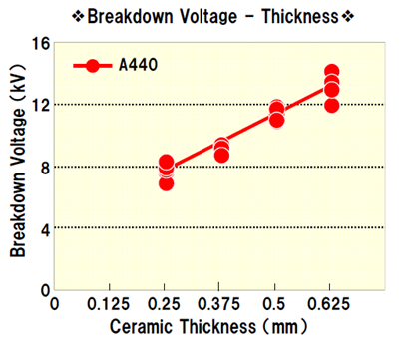
  High granularity multi-anode
Photocathode, -HV
Having A.C. coupled anodes allows the photocathode to be operated at 0 V
This removes any issues with charge-up on the input window
All year 2 prototypes (10 PMTs) were operated in this manner
Requires thin ceramic insulator to hold off ~ 4 kV
MCP input, -HV
MCP output, -HV
Anodes, 0 V
D.C. coupled anodes
Photocathode, 0 V
MCP input, +HV
MCP output, +HV
Resistive layer, +HV
Anodes, 0 V
A.C. coupled anodes
TIPP 2017, Beijing, China, May 22 - 26 2017

Slide 9
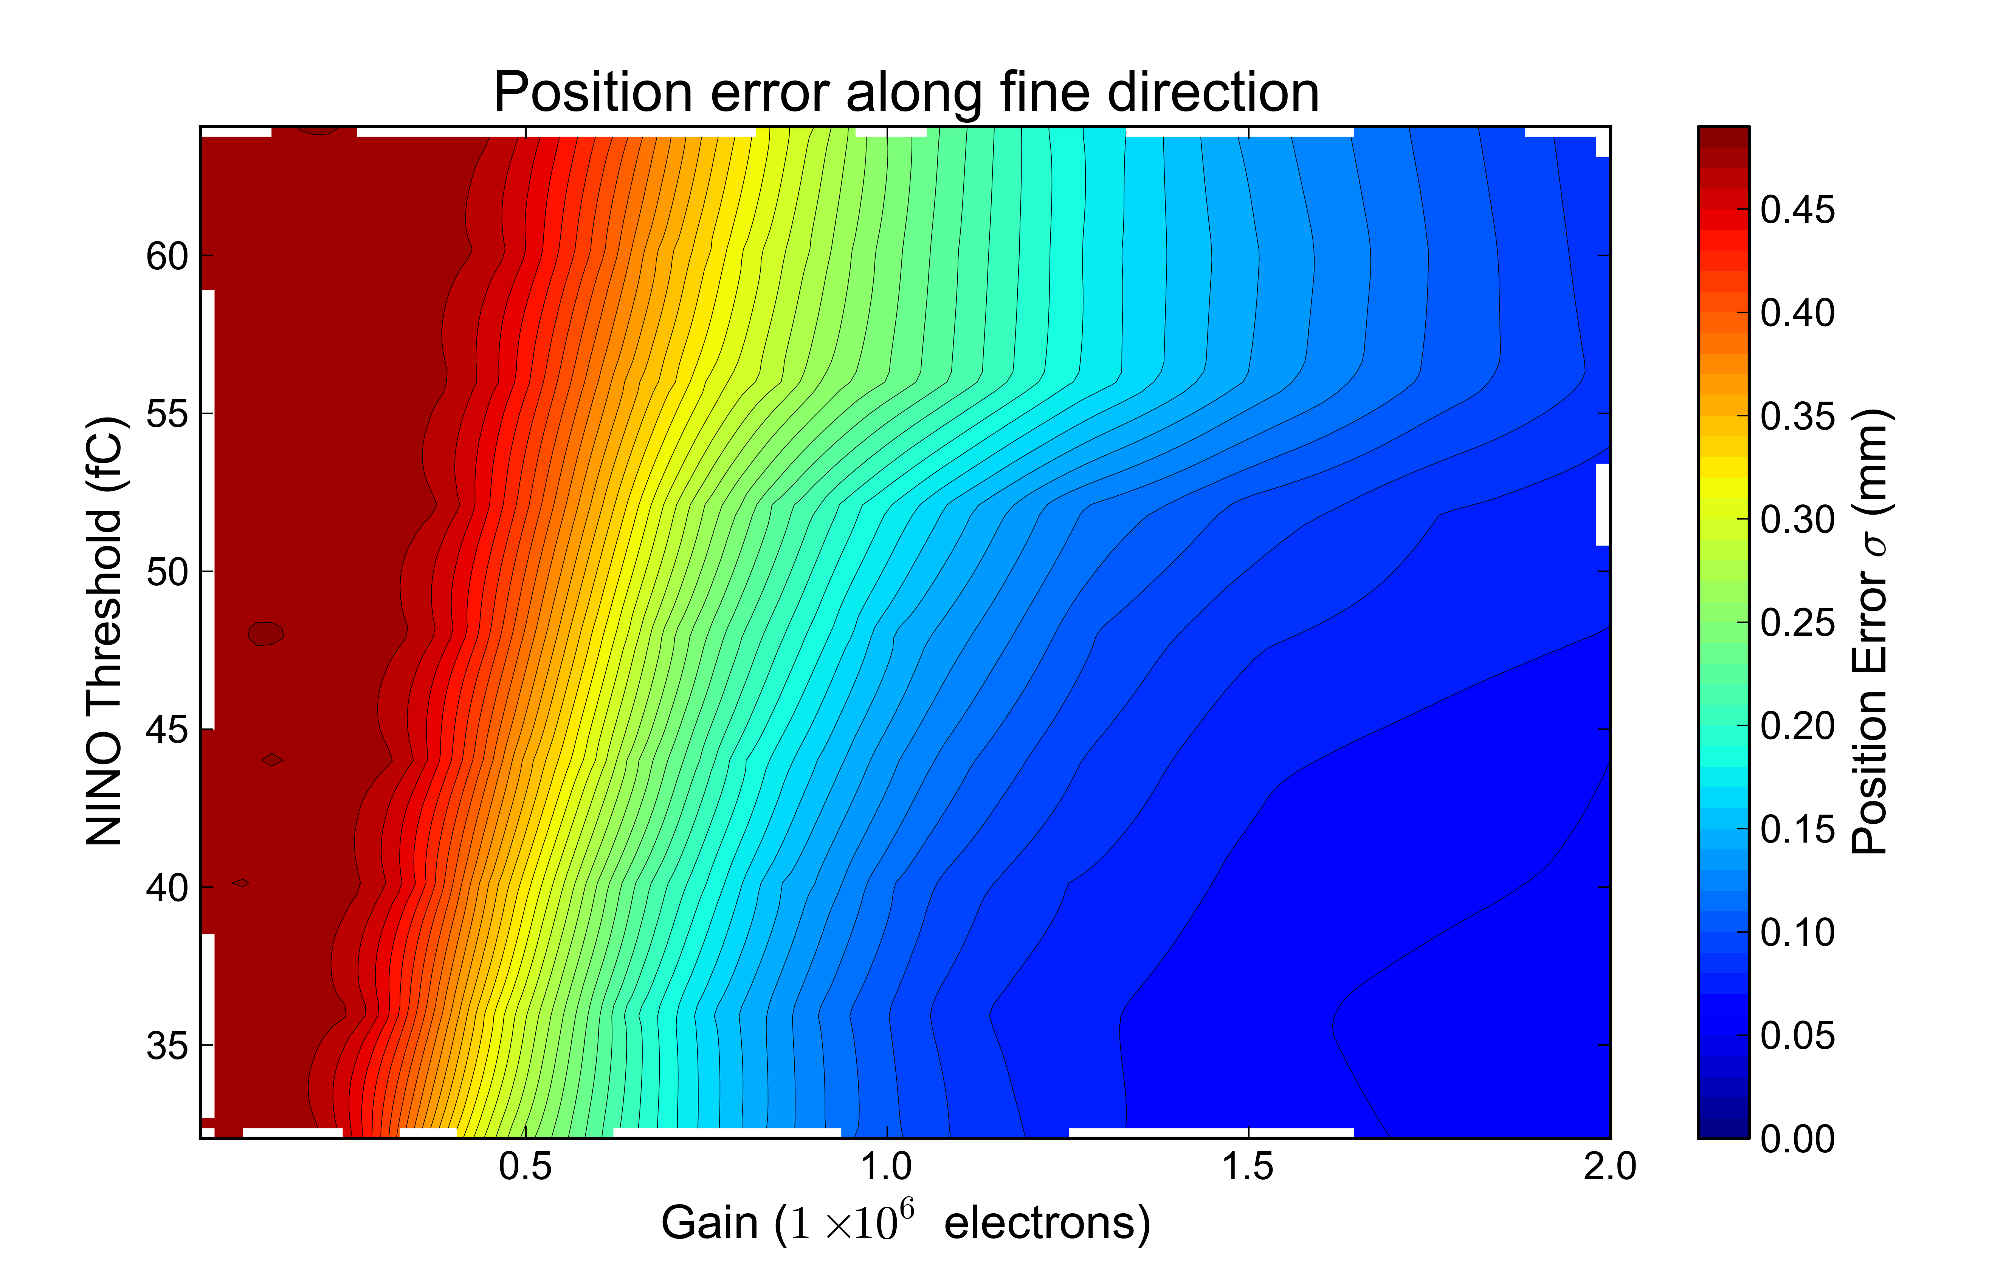
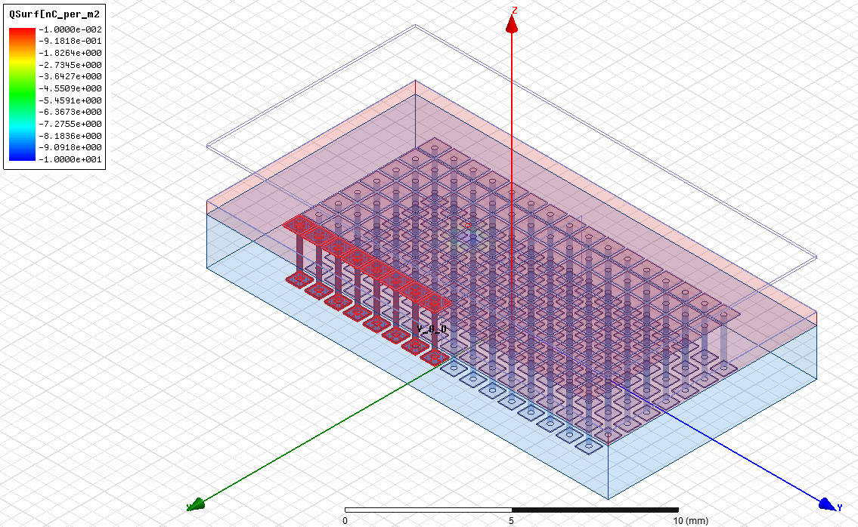
  High granularity multi-anode
ANSYS Maxwell modelling software used to optimise anode geometry
Model had to consider:
  Dimension of the thin insulator between the resistive layer and the buried pads
  Pulse Height Distribution (gain variation) and jitter of MCP charge cloud
  Threshold and other characteristics of the NINO front-end electronics
  Temporal profile of the MCP cloud profile
  The effect of the sheet resistance on charge footprint dispersion, and effects of electronics charge integration time
  These factors are then applied to an imaging algorithm to produce a predicted resolution
Modelling showed strong dependence on detector gain and NINO threshold
See Conneely et al JINST 10 C05003 (2015)
TIPP 2017, Beijing, China, May 22 - 26 2017

Slide 10
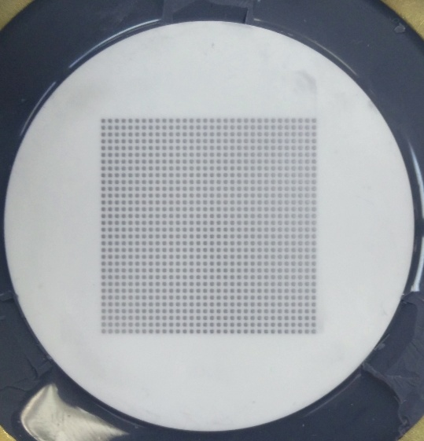
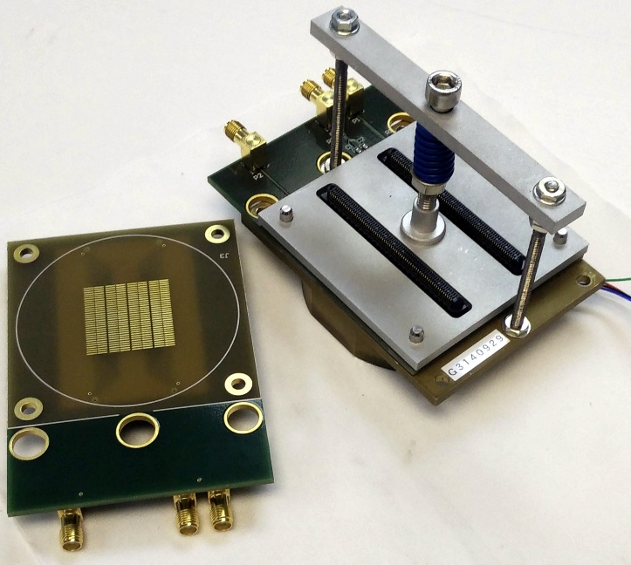
  High granularity multi-anode
First prototypes built with 32×32 multi-anode charge sharing anode in round format ~ 26 x 26 mm working area
Internal pad width 0.73 mm, pitch 0.83 mm
Year 2 deliverables for the TORCH project
In one direction 8 pads ganged together to create 32×4 layout
With charge sharing improve resolution to 64×4 pixel equivalent (or better)
These represent ¼ size of final detector (target 128 x 8)
Use mechanically applied Anisotropic Conductive Film (ACF) to connector detector output to readout PCB
TIPP 2017, Beijing, China, May 22 - 26 2017

Slide 11
  High granularity multi-anode
Test performed on University of Bristol laser scanning setup
~15 µm laser spot size
Use a 5 GHz, 40 GS/sec scope to sample output for four channels
Digitised pulse integrated to measure charge per pad
Charge histograms
Laser centred on this channel
TIPP 2017, Beijing, China, May 22 - 26 2017

Slide 12
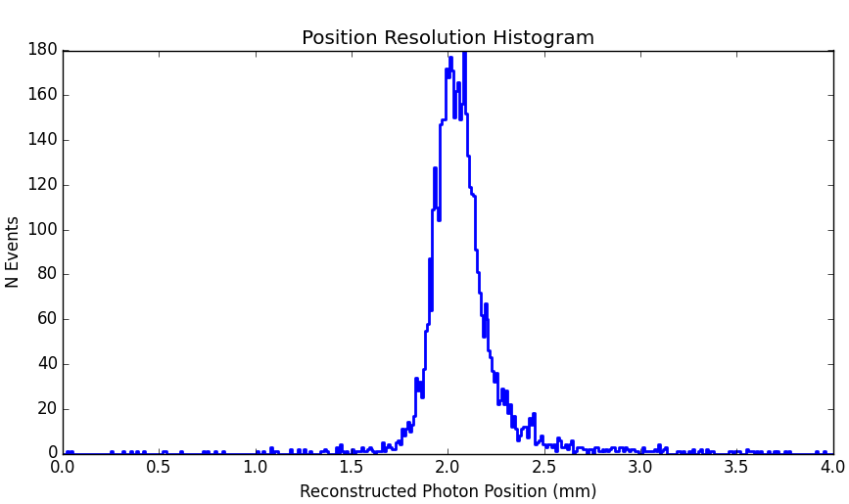
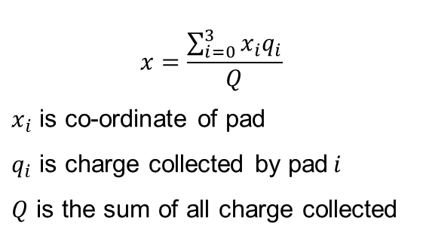
Position Resolution – Early Result
Applying imaging algorithm on event by event basis, with laser aligned in centre of 4 pixels
TORCH target σ = 0.12 mm
σ = 0.096 mm (0.225 mm FWHM) derived from pads on a 0.83 mm pitch
Measured on 4-channel oscilloscope
$$x=\frac{\sum_{i=0}^{3}{x_{i}q_{i}}}{Q}$$
$x_{i}$ is co-ordinate of pad
$q_{i}$ is charge collected by pad$i$
$Q$ is the sum of all charge collected
TIPP 2017, Beijing, China, May 22 - 26 2017

Slide 13
Position Resolution – NINO Measurement
Measurements using the NINO ASIC have proven difficult
  Each channel needs individual calibration for charge input / pulse width output using the time-over-threshold technique – threshold dependant
  Very susceptible to electronic noise
  Odd / even channels can behave differently
Despite these issues, an excellent result was achieved:
See L. Castillo García et al JINST 11 C05022 (2016)
TIPP 2017, Beijing, China, May 22 - 26 2017

Slide 14
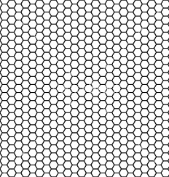
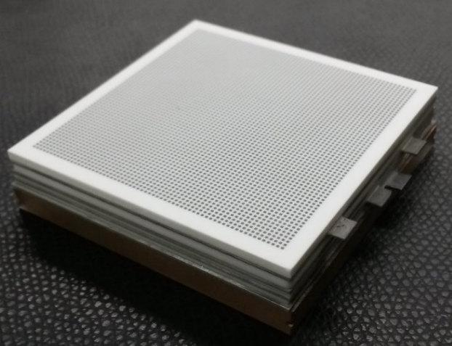
  Square Tube Development
Increased working area to 53 x 53 mm
Pad format now 64 x 64
DC coupled pad anode design developed in parallel
Our novel MCP fixing method allows short gaps between photocathode, MCPs and anode
Predicted gap between photocathode and MCP to be 1.5 – 2 mm
Predicted MCP – anode gap is 2.5 – 3 mm
Insulation
Vacuum Wall
3.5 mm
Fixing Mechanics
MCP
TIPP 2017, Beijing, China, May 22 - 26 2017

Slide 15
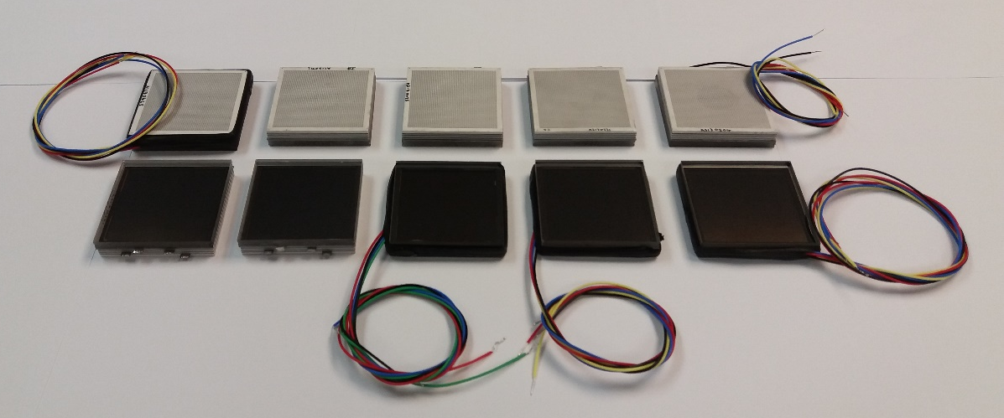
  Square Tube Development
PMT Serial Number | Cathode – MCP gap | PMT Serial Number | Cathode – MCP gap
A1170227 | 1.95 mm | A1170331 | 1.58 mm
A2170504 | 2.00 mm | A2170331 | 1.51 mm
A3170504 | 1.42 mm | A3170331 | 1.99 mm
A1170425 | 1.47 mm | A2170412 | 2.00 mm
A3170425 | 1.47 mm | A3170412 | 1.83 mm
TIPP 2017, Beijing, China, May 22 - 26 2017

Slide 16
Gain Distribution of Square PMTs
PHDs obtained by:
Contacting a 25 mm single tapered anode to the central output pads
Illuminating a central 13 mm diameter region with UV light
Subtract dark counts from the raw signal to show the true PHD
TIPP 2017, Beijing, China, May 22 - 26 2017

Slide 17
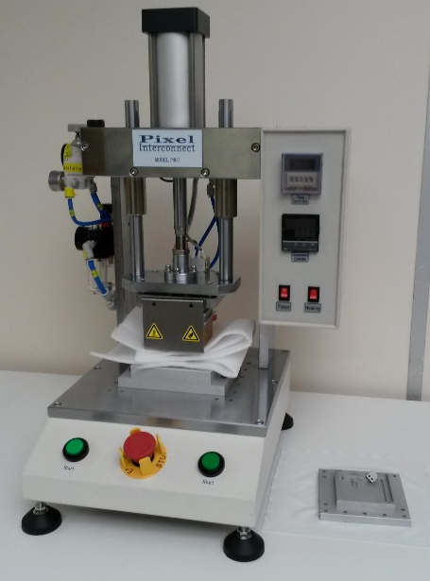
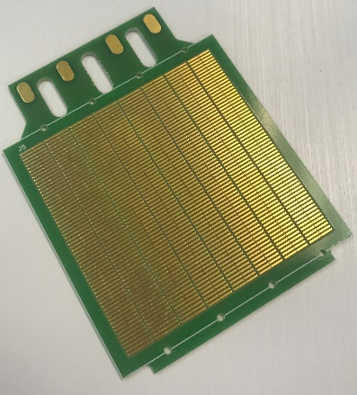
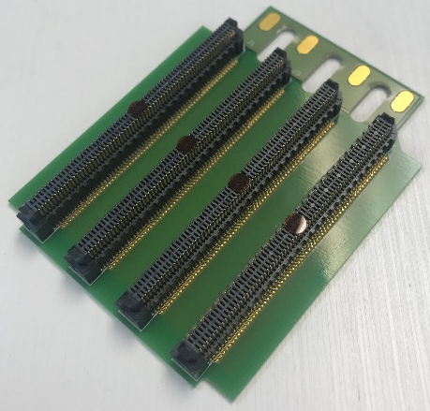
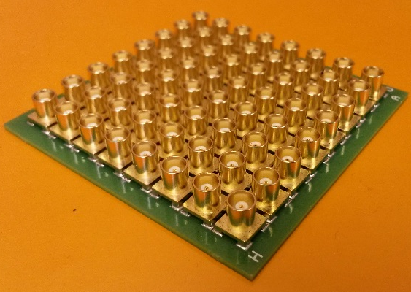
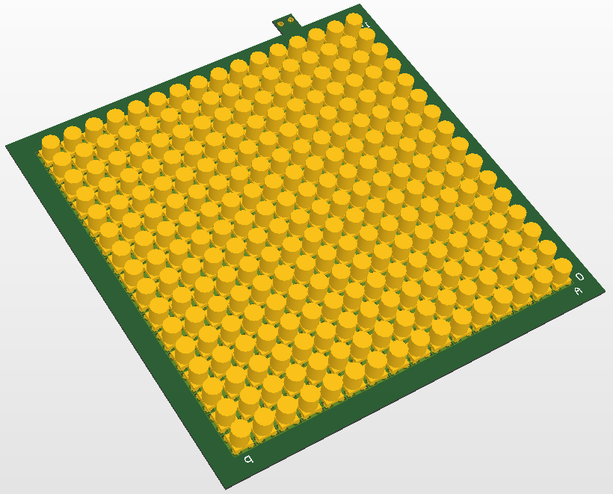
Commercial Square PMT
Unrealistic to individually connect all 4096 connections in 64 x 64 array to front-end electronics
However, this format gives flexibility to gang pads together
We have recently commissioned an ACF (anisotropic conductive film) kit to bond various PCB designs to the output pads of the PMT
Gang 8 x 8 pads together
8 x 8 array
e.g. MCX co-ax
Gang 4 x 4 pads together
16 x 16 array
e.g. SSMCX co-ax
Gang 8 x 1 pads together
8 x 64 array
e.g. Samtec 140-pin multi-way
TIPP 2017, Beijing, China, May 22 - 26 2017

Slide 18
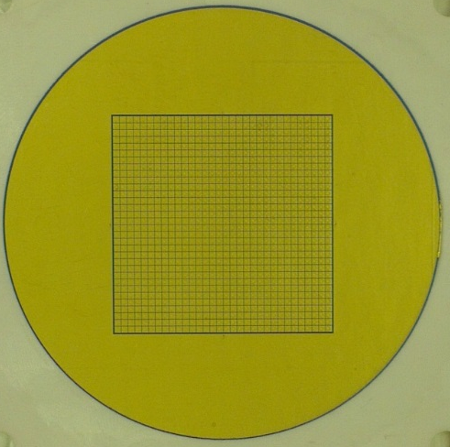
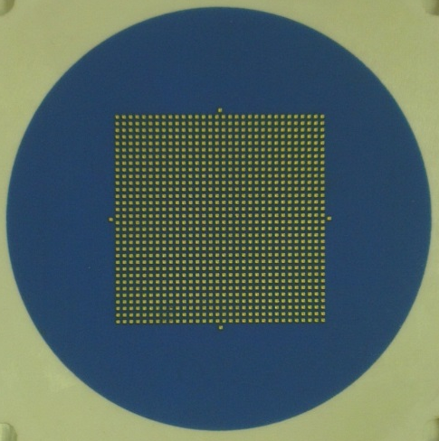
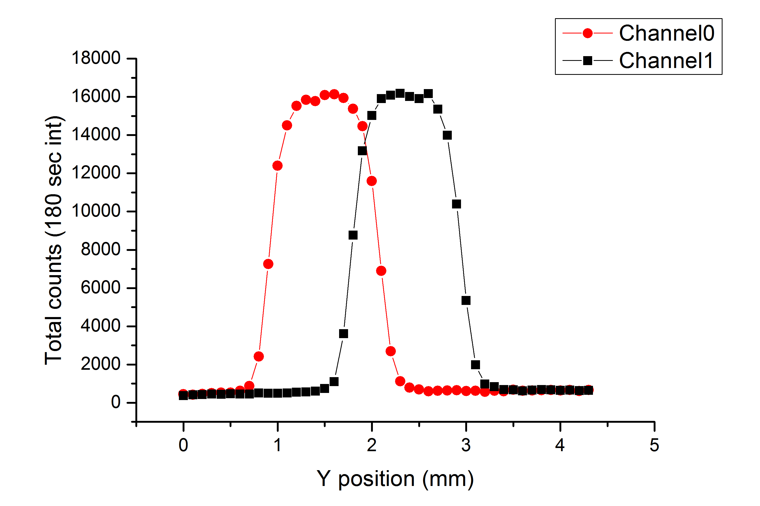
  Multi-Anode / TOFPET Camera System
Previous project (IRPics with University of Leicester) had produced a 40 mm round PMT with 32 x 32 pads, 0.75 mm wide on a 0.88 mm pitch
Multilayer ceramic with filled vias
Cross talk measured using single photon illumination at a gain of 5.5 × 10⁶, 0.2 mm FWHM laser spot
Vacuum side
Air side
TOFPET ASIC:
Sourced as alternative to NINO
Combined analogue frontend and TDC in single ASIC
64 channels per chip
< 100 ps rms with time over threshold correction
160,000 c/s per channel rate limit
TOFPET2 now available with 600,000 c/s and full charge integration per channel
TIPP 2017, Beijing, China, May 22 - 26 2017

Slide 19
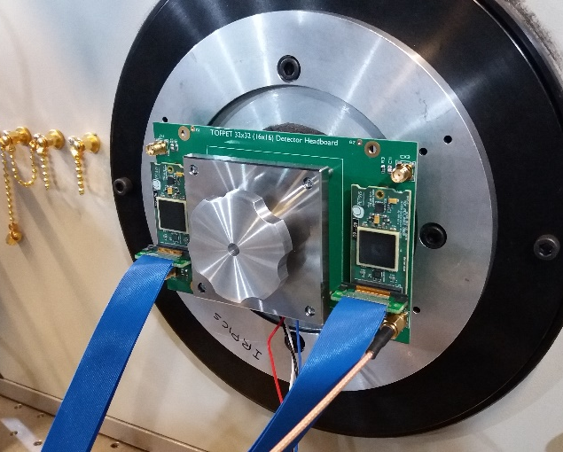
  Multi-Anode / TOFPET Camera System
Package containing 2 x TOFPET chips – 4 in total
Anode pads ganged into groups of 4
Using evaluation kit supplied by PETsys Electronics SA
16 x 16 channel system
Pre-production prototype
Available for site testing
32 x 32 PMT with mechanically compressed ACF
TIPP 2017, Beijing, China, May 22 - 26 2017

Slide 20
  Multi-Anode / TOFPET Camera System
Results of TOFPET chip with MCP-PMT
Thanks to Steve Leach & Jon Lapington (University of Leicester) for this data
Raw Data
Simple Linear Correction
Logarithmic plots of time-over-threshold vs arrival time
Single photon time resolution (black) with Gaussian fit (red)
Uncorrected σ = 225 ps
Corrected σ = 96 ps
TIPP 2017, Beijing, China, May 22 - 26 2017

Slide 21
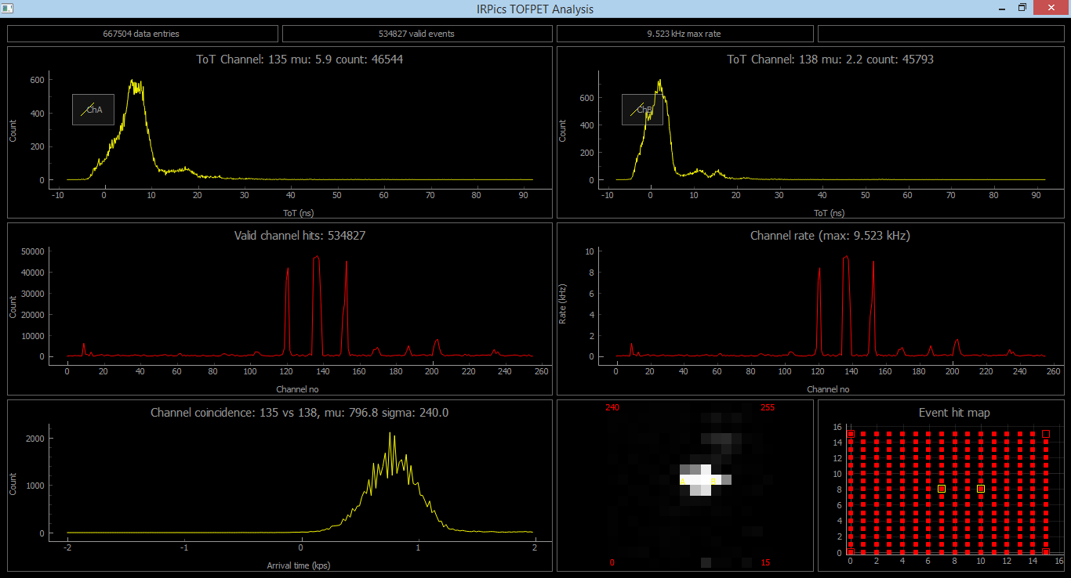
  Multi-Anode / TOFPET Camera System
Screenshot of provisional GUI:
TIPP 2017, Beijing, China, May 22 - 26 2017

Slide 22
  Summary
TORCH PMT developed at Photek
Currently packaging final ten PMTs for delivery to CERN
  Long lifetime
  64 x 64 multi-anode readout
  σ < 0.1 mm achieved in fine pitch direction through charge sharing algorithm and patented A.C. coupled anode design
  Square format dimension targets achieved
  Also produced direct coupled anode version
Multi-Anode / TOFPET prototype camera produced
  Current format is 16 x 16, could be expanded
  σ < 100 ps time resolution with ToT correction
TIPP 2017, Beijing, China, May 22 - 26 2017

Slide 23
With thanks to…
The members of the TORCH collaboration at the University of Bristol, CERN and the University of Oxford
The TORCH project is funded by an ERC Advanced Grant under the Seventh Framework Programme (FP7), code ERC-2011-ADG proposal 299175.
TIPP 2017, Beijing, China, May 22 - 26 2017

Slide 24
Thank you for listening
TIPP 2017, Beijing, China, May 22 - 26 2017

