Slide 1
Integration of Data Acquisition Systems of Belle II Outer-detectors for Cosmic Ray Test
S. Yamada(KEK), R. Itoh(KEK), K. Tomoyuki(KEK), Z. Liu(IHEP),
M. Nakao(KEK), S. Y. Suzuki(KEK), J. Zhao(IHEP)

Slide 2
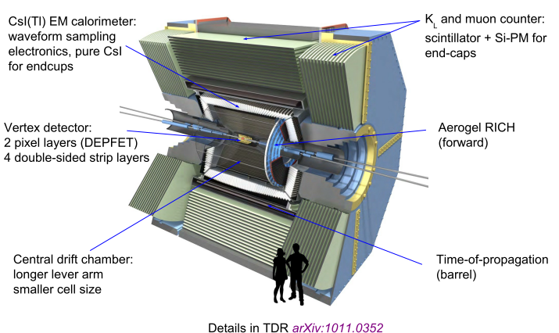
Belle II detector
It consists of 7 sub-detectors.
CDC, TOP, ECL and KLM were already installed.
CsI(Tl) crystal blocks
KLM
(KL and Muon detector)
Inner sub-detectors
resistive plate chamber
+scintillator
Vertex determination:
→ PXD, SVD
ECL
(Electromagnetic CaLorimeter)
PXD
(PiXel Detector)
ARICH
(Aerogel Ring Imaging Cherenkov Detector )
Outer sub-detectors
Tracking
→ CDC
Particle ID
→ TOP, ARICH
EM calorimeter
→ ECL
Muon, Klong
→ KLM
Aerogel radiator
SVD
(Silicon Vertex Detector)
CDC
(Central Drift Chamber)
TOP
(Time Of Propagation)
quartz radiator
Schedule of the Belle-II experiment :
2016 : phase I run ( accelerator commissioning and beam background study )
2018 Jan. : phase II run ( with the Belle II outer sub-detectors )
2018 Dec. : phase III run ( with the full Belle II detector )

Slide 3
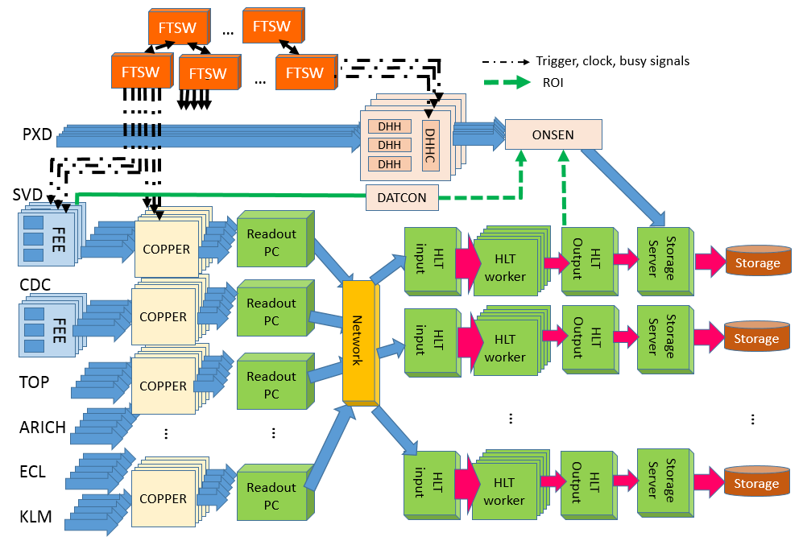
Schematic view of Belle II Data Acquisition System
Level1 trigger ～ 30kHz (max. value for DAQ development )
Trigger and
Timing distribution
PXD Data-reduction by Region of Interest
～ 30GB/s
ROI
～1GB/s
Inner sub-detectors
Common readout-system
for sub-detectors
Event-building w/o PXD
Combine with PXD data
and record
event-reduction
2-3GB/s
～ 3GB/s
Trigger rate
x1/3-1/5
1- 2GB/s
(analysis info. Is added)
Outer sub-detectors
X210
readout
boards
X40
Readout
PCs
x10 High Level Trigger+storage unit
HLT: ( 20nodes x 16cores )/ unit
1GbE/10GbE
switch
Common interface with FEEs of all sub-detectors except for the pixel detector
PXD event size is reduced online by Region of Interest obtained by track information.

Slide 4
How to integrate each FEE system with the Belle II DAQ system
Minimum DAQ setup (called as “Pocket DAQ”), which includes only COPPER readout boards and readout-PCs for the development of FEE firmware of each sub-detector
- Once readout of FEE at pocket DAQ becomes is achieved, in principle there should be no problem in the integration of the sub-detector DAQ to the Belle II DAQ system.
“Pocket DAQ” for each sub-detector
FEE development
Belle II DAQ at KEK experimental hall
High Level Trigger/
Storage
FTSW
network
Readout PC
After detector
installation
FTSW
Readout PC
COPPER
Readout
Board
COPPER
Readout
Board
trg/clk
FEE
trg/clk
FEE

Slide 5
Interface between FEE and backendDAQ : FEE side
Two interfaces between FEE and DAQ for readout
FEE and Trigger/Timing distribution network :
FEE and backend DAQ :
Common FPGA core (“belle2link core”) is implemented in FEE’s FPGA for the interface
Backend DAQ
Backend-DAQ
(DAQ gr.)
Trigger/clock
HSLB(High-speed serial link board)
FEE board
Register access
data
Trigger/clock
COPPER
belle2link core
Common for all sub-detectors
Optical fiber
FIFO
data
FPGA on
Front-end electronics board

Slide 6
Data transmission from FEE to backend DAQ
Belle2Link : (D. Sun et. all, hysics Procedia Volume 37, 2012, pp. 1933-1939 )
Unified high speed link which connects Front-End Electronics (FEE) and DAQ system for signal with data transmission based on Rocket I/O
FEE side : Functions for I/F with FEE and Trigger Timing Distribution on FPGA
DAQ side : High Speed Link Board(HSLB) as a data receiver
HSLB board
- Attached on COPPER readout board
- FPGA : Xilinx Virtex 5
input/output SFP : x 1 or 2
Line rate : 3.125Gbps
Developed by IHEP
FEE
Belle2Link
COPPER : data readout board
FPGA
data
GTP link
HSLB
(Virtex5)
data
A/D
conversion
FEE I/F
data
configutaion
by register access
COPPER I/F
HSLB
HSLB
HSLB

Slide 7
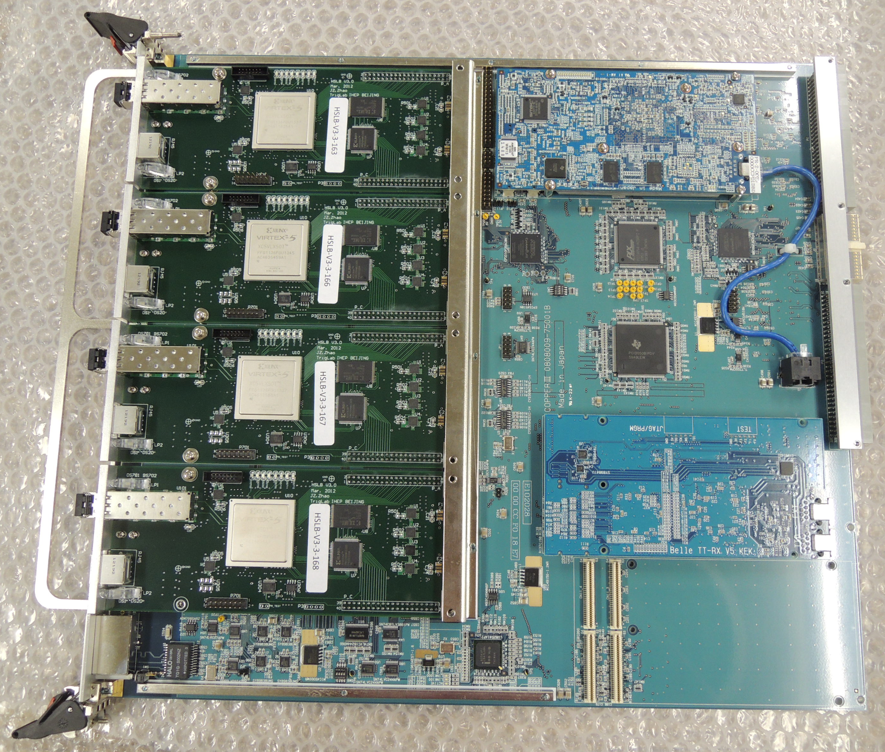
Interface between FEE and backend DAQ : backend side
Common readout-boards for sub-detectors (except for PXD)
CPU board on COPPER(COmmon Pipeline Platforms for Electronics Readout ) :
event-building of data from 4 HSLB boards, data-formatting and sening the data to readout PCs
Readout PC :
event-building from around 10 COPPERs, Data-corruption check and send the events to high level trigger PC farm
Front-end
Electronics
Read-out board (COPPER)
Readout PC
data
CPU card
HSLB
basf2
A/D
conversion
data
basf2
basf2
Belle2link
basf2
To event builder, HLT PC farm
HSLB
basf2
DeSerializer
Serializer
(partial) Event-builder
DeSerializer
Serializer
DeSerializer
Serializer
DeSerializer
HSLB
Serializer
DeSerializer
TTRX
Gigabit Ethenet
Serializer
Rocket I/O
based protocol
HSLB

Slide 8
High-rate test for TTD network and readout subsystem
Setup : barrel part of ECL and readout subsystem
Dummy triggers to 36 ECL FEE boards ->
The FEE sends event data to the back-end DAQ [18 COPPERs -> 7 readout PCs -> event builder on HLT input server ], where the data are discarded.
Dummy
Trigger
Inputs
FTSW
FTSW
FTSW
Readout PC 1
dumhslb
Des_ser_ROPC
ROPC
ECL FEE
dumhslb
ECL FEE
dumhslb
dumhslb
Des_ser_ROPC
dumhslb
dumhslb
HLT
input server
dumhslb
dumhslb
Partial Event builder
dumhslb
dumhslb
dumhslb
dumhslb
dumhslb
…
HSLB
dumhslb
dumhslb
dumhslb
PrPMC
COPPER
dumhslb
dumhslb
dumhslb
COPPER
dumhslb
dumhslb
HSLB
dumhslb
COPPER
dumhslb
COPPER
dumhslb
Data handler
dumhslb
COPPER
dumhslb
HSLB
COPPER
Barrel ECL detector
dumhslb
COPPER
dumhslb
HSLB
COPPER
…
…
…
eb0
Readout PC 7
/dev/null
dumhslb
Des_ser_ROPC
ROPC
dumhslb
dumhslb
dumhslb
dumhslb
Des_ser_ROPC
dumhslb
dumhslb
dumhslb
dumhslb
dumhslb
Partial Event builder
dumhslb
dumhslb
dumhslb
ECL FEE
HSLB
dumhslb
…
ECL FEE
dumhslb
dumhslb
PrPMC
COPPER
ECL FEE
dumhslb
dumhslb
ECL FEE
dumhslb
COPPER
ECL FEE
dumhslb
dumhslb
ECL FEE
HSLB
dumhslb
COPPER
ECL FEE
dumhslb
COPPER
ECL FEE
dumhslb
dumhslb
COPPER
dumhslb
Data handler
HSLB
COPPER
dumhslb
COPPER
dumhslb
HSLB
COPPER

Slide 9
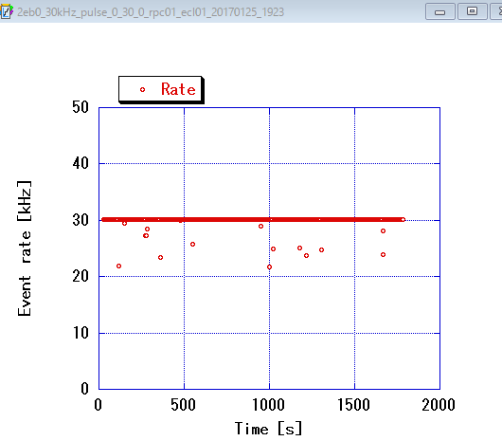
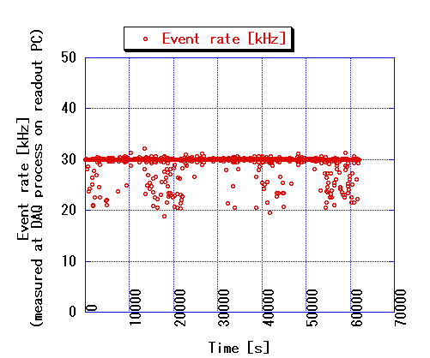
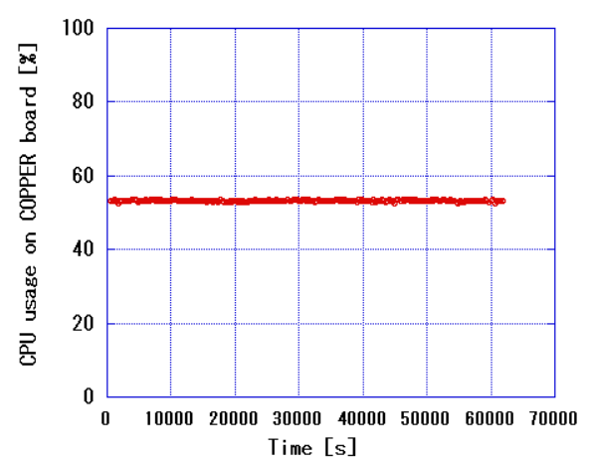
Results of the high-rate test (cont’d)
Throughput : about 33MB/s/COPPER ( the expected event size from MC )
Event size was adjusted by HIT threshold of ECL FEE
Total throughput for Barrel ECL : 600 MB/s
Constant 30kHz trigger -> efficiency = 99.2%
Pseudo-Poisson 30kH trigger -> efficiency = 98.2 %
The deadtime comes from trigger limitation (5trigger in 26us due to SVD FEE ).
Constant 30kHz trigger rate
Pseudo-Poisson 30kHz trigger rate
CPU usage on
a COPPER board
Efficiency = 99.2%
Efficiency = 98.4%
-> High efficiency(nearly 100%) was achieved !
9

Slide 10
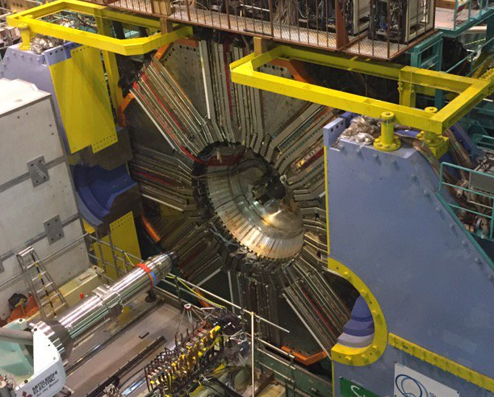
Belle II cosmic-ray test
Purpose : Detector and DAQ commissioning
Two types of data acquisition schemes
local run : each sub-detector’s data are taken independently
combined run : Combined data-taking with online event building
→ This local/global switching should be done in not only the commissioning period but actual Belle II experimental period. (daily calibration work etc. )
→ Should be smoothly switched w/o large modification of the setup
Detector roll-in last month
Schedule
 | Feb 2017 | Mar | Apr | May | Jun | Jul | Aug | Sep | Oct | Nov | Dec | Jan 2018
KLM
CDC
TOP
ECL
ARICH
Magnet ON
Cosmic ray test
Global
Cosmic ray test
Cosmic ray test
Detector roll-in
Cosmic ray test
Phase II run (beam collision)
Combined CRT
TIPP2017
Cosmic ray test
Assembly work and readout test
install

Slide 11
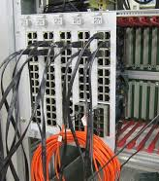
Trigger/Timing distribution(TTD) for Local/combined data-taking
Combined
Trigger
Source
Master
FTSW
Local
Trigger
Source
Combined data-taking with some of the sub-detectors
Belle II master FTSW can distribute common trigger over multiple sub-detectors.
Local data-taking at the same time
Each sub-detector TTD network has an input for local trigger source.
Since each sub-detector TTD network is separated with others, no need to modify cabling to switch local/combined data-taking
SVD
FTSW
CDC
FTSW
TOP
FTSW
…
KLM
FTSW
FEE
FEE
FEE
FEE
FEE
FEE
…
FEE
FEE
FEE
FEE
FEE
SVD
FEE
CDC
FEE
TOP
FEE
FEE
KLM
FEE
FTSW modules

Slide 12
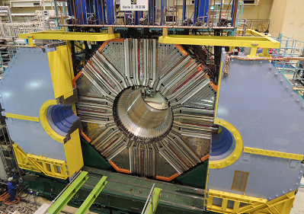
Back-end DAQ system for for Local/combined data-taking :
Front-end electronics and readout subsystem(COPPER + readout PC)
They can be running independently for each sub-detector
event builder, High level trigger :
hardware is not independent for each sub-detector
-> Virtually independent system running on the same hardware
-> Controlled by slow control system
Sub-detectors
Readout subsystem
PC farms
Data Quality
Monitor
FEE
FEE
FEE
COPPER
FEE
COPPER
FEE
COPPER
FEE
COPPER
ROPC
belle2link
COPPER
ROPC
ROPC
Event
builder
recording
HLT
Disk
Sub-detector1
Sub-detector2
Event
builder
recording
HLT
FEE
FEE
FEE
COPPER
FEE
COPPER
FEE
COPPER
FEE
COPPER
ROPC
belle2link
COPPER
ROPC
ROPC
Data Quality
Monitor

Slide 13
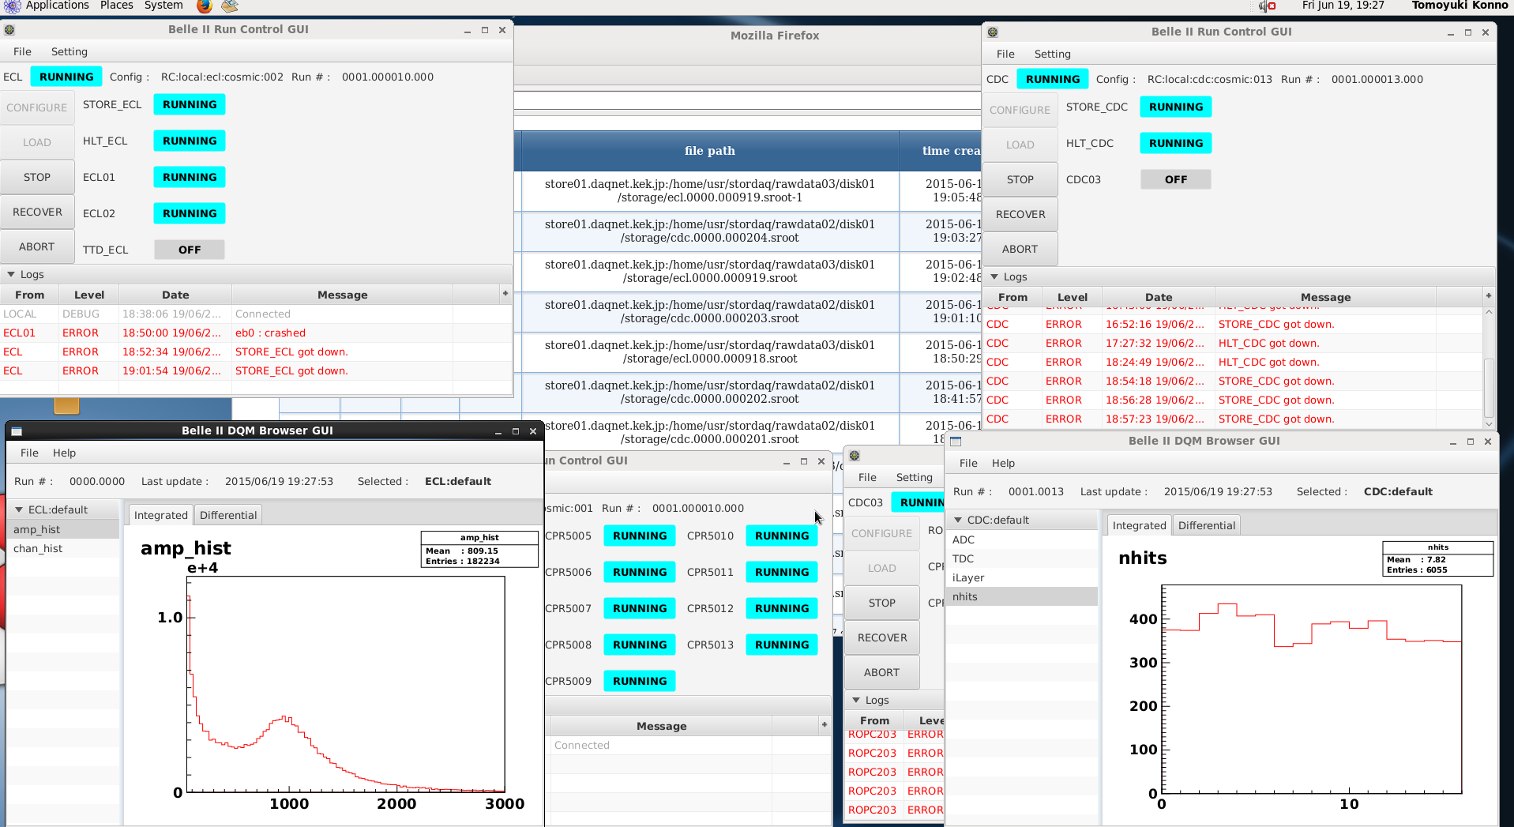
Run-control system for Local data-taking in parallel :
Two sub-detector data-taking (CDC and ECL) was performed in parallel
Each run control master manages each of the combined systems
Separate control/monitoring for each system
PC farm
PC farm
Slow control daemon
Shifter’s PC
Slow control daemon
Slow control
master
UI_ECL
UI_CDC
Slow control
master
COPPER
COPPER
Slow control daemon
Slow control daemon
Screenshot of data-taking for ECL and CDC
ECL run controller
CDC run controller
ECL Data Quality Monitor
CDC Data Quality Monitor

Slide 14
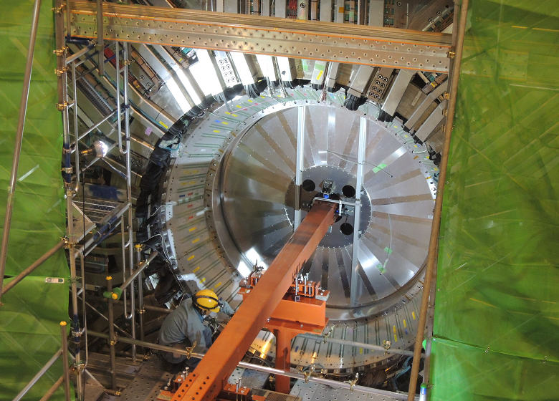
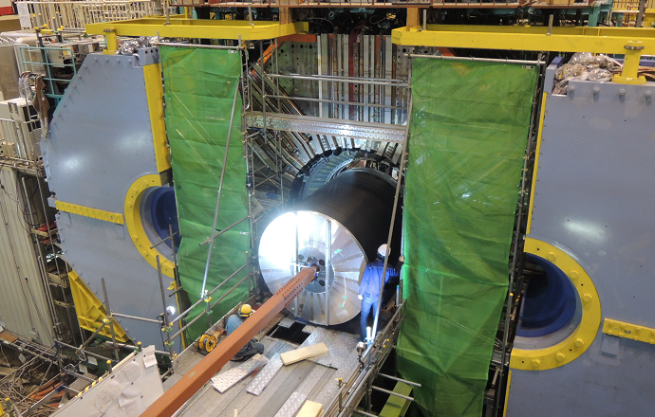
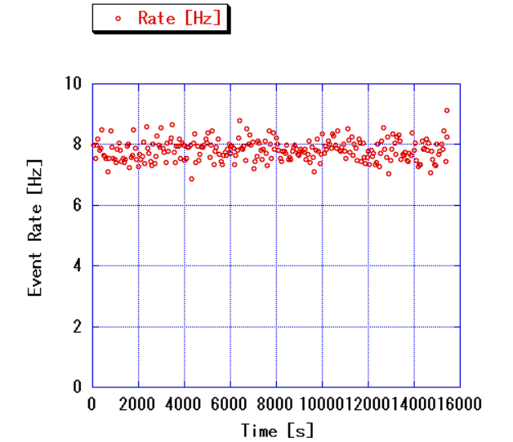
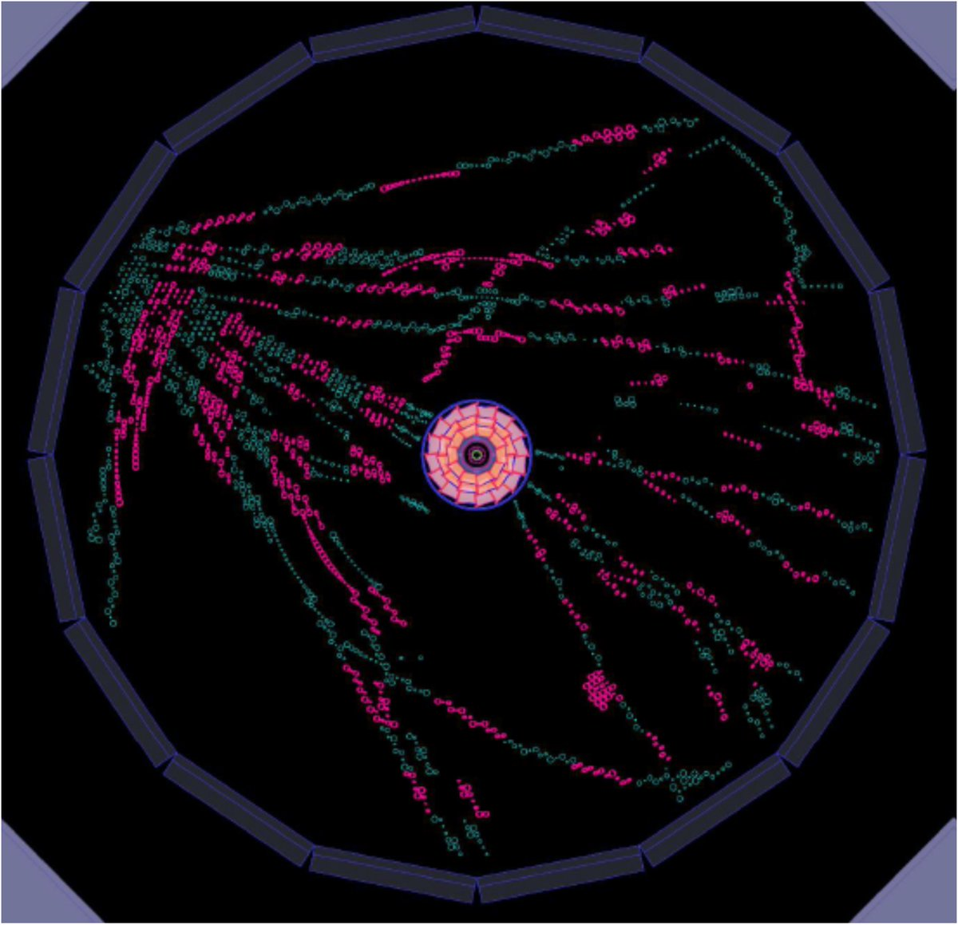
Cosmic ray data-taking with sub-detectors
CDC (Central Drift Chamber)
Installation of CDC
After the sub-detector installation, Data-taking from the full scale of CDC was performed.
75 x COPPER boards (link x 299)
Trigger source : scintillator and CDC’s TSF(Track Segment Finder) system
A CDC cosmic ray event from event-display
Shower event
Event rate

Slide 15
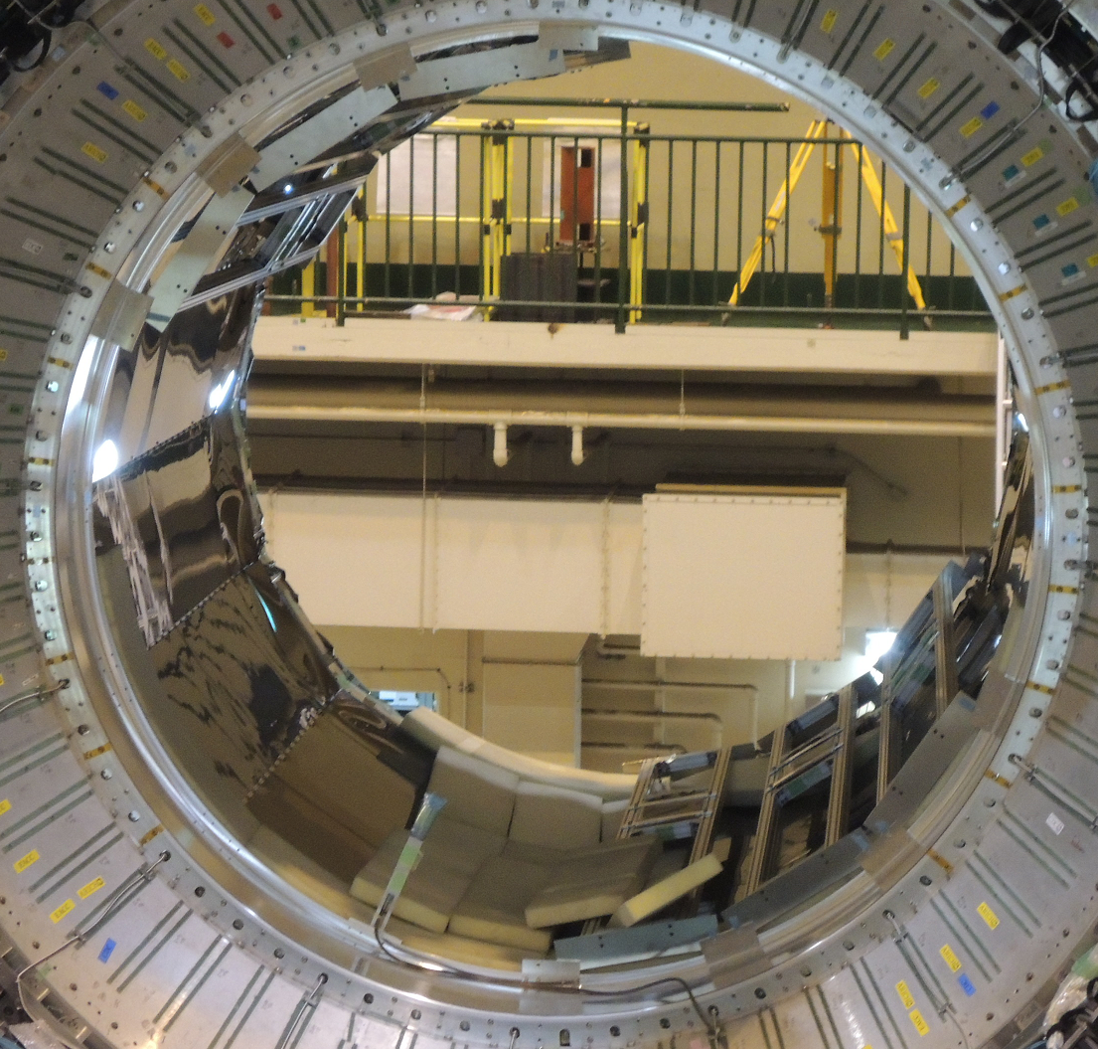
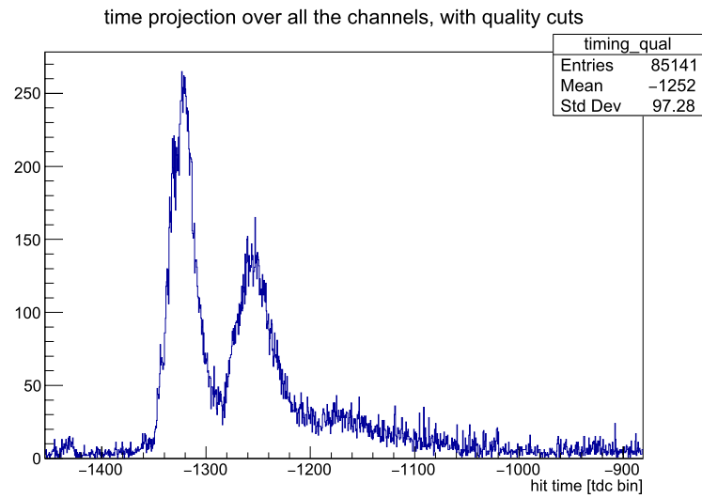
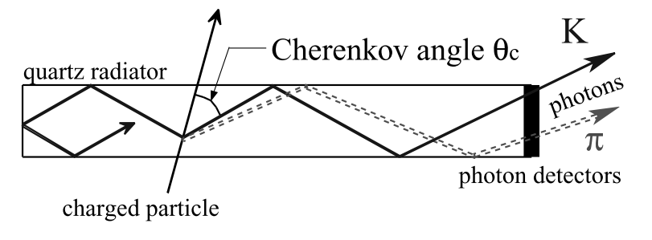
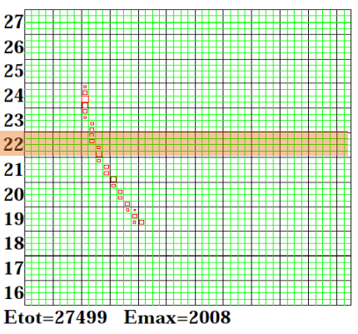
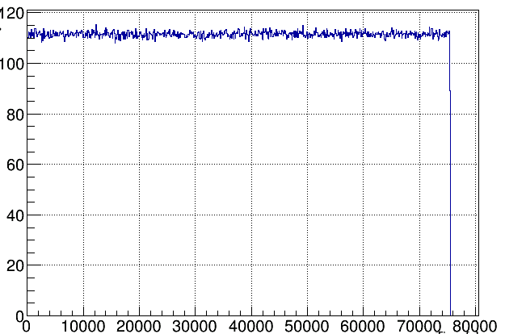
Cosmic ray data-taking with sub-detectors (Cont’d)
TOP (Time Of Propagation) counter
Quartz bar and ray of Cherenkov light
Hit timing distribution of cosmic ray events
direct
reflection
Preliminary
ECL (Electromagnetic Calorimeter)
Cross section of ECL
Cosmic ray event in Barrel blocks
Event rate
ECL cosmic ray test :
Event rate is about 110Hz.
Event rate [Hz]
Stable cosmic ray run was
achieved.
Time from run-start [s]
Each sub-detector’s DAQ was successfully integrated and start collecting cosmic ray events.

Slide 16
Summary
In the Belle II experiment, we started to take cosmic ray events with the installed sub-detectors for detector and DAQ commissioning.
DAQ integration for the cosmic ray test
Common interface between backend-DAQ and FEE for several sub-detectors
High rate test w/ dummy trigger was performed for barrel ECL with trigger rate of 30kHz
Partitioned DAQ components : (Trigger timing distribution, backend data-stream )
Local/combined data-taking can be easily switched.
Start taking cosmic ray evens w/ CDC, ECL, TOP, CDC+ECL+TOP combined

