Slide 1
Multi-layer ionization chamber for quality assurance and stopping power measurement
Dr. Francis Gagnon-Moisan :: Operations physicist :: Paul Scherrer Institut
Dr. Oxana ACTIS, Dr. Zema CHOWDHURI , Dr. Manuel DIETERLE, Mr. Michael EICHIN Dr. Stefan KÖNIG,
Prof. Damien Charles WEBER
TECHNOLOGY AND INSTRUMENTATION IN PARTICLE PHYSICS
23 May 2017

Slide 2
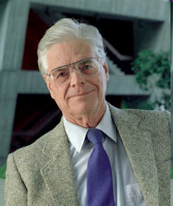
The idea of protons for cancer treatment
Robert R Wilson:
Radiological Use of Fast Protons
Radiology, 47:487-491 (1946)

Slide 3
The PT advantage
200
Tumor
Photons
10 MeV Linac
Protons
~150 MeV
150
Spread-Out
Bragg Peak
SOBP
Relative dose [%]
100
50
Critical
Organ
0
0
5
10
15
20
25
30
Penetration depth in water [cm]
Proton therapy vs. conventional radio therapy (photons):
Better dose conformation to target / tumor
Less dose to healthy tissue
Also important: multiple fields (2-3) and fractionation (30)

Slide 4
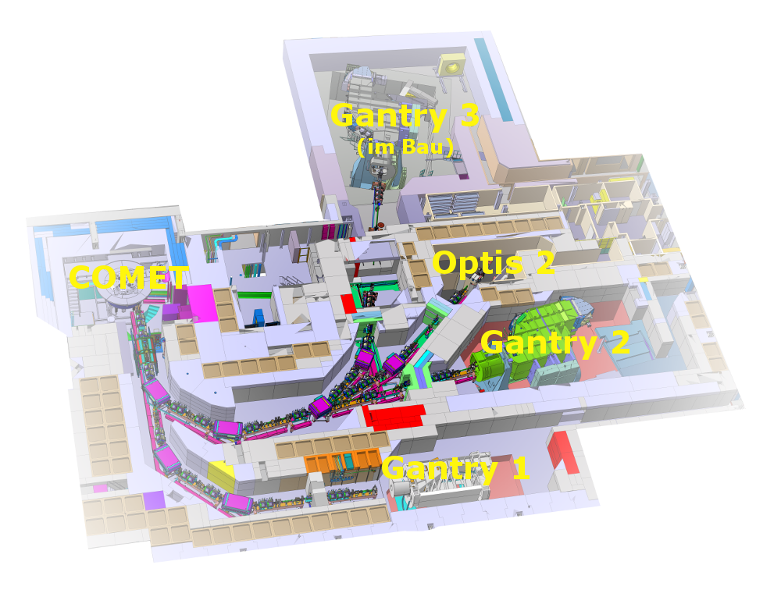

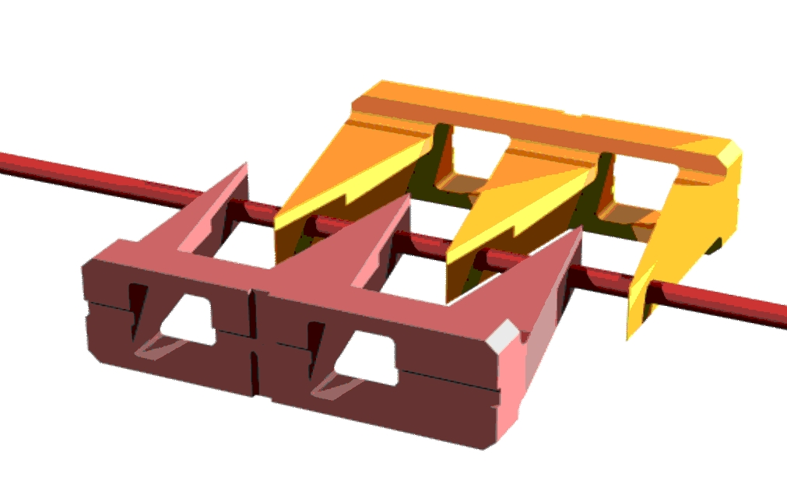
Fast changes of the beam energy
Gantry 2 and PROSCAN are optimized for fast energy changes:
Cyclotron provides fixed energy (250 MeV)
Fast mechanical degrader for energy modulation
Laminated magnets / dedicated power supplies
Intensity compensation concept
Need to consider magnetization and hysteresis effects
Realized:
~100 ms dead time for
range steps of 5 mm (in water)
Order of magnitude faster
than other systems
  Benefits:
Faster treatments
Potential for volumetric repainting
(Goal: 1-2 minute for 1 liter and
1 Gray with 10x rescanning)
Energy modulation in scintillator block

Slide 5
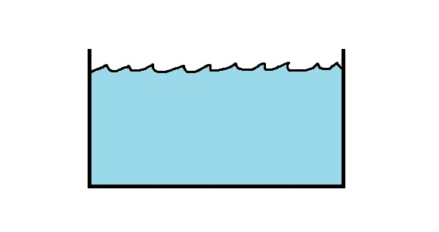
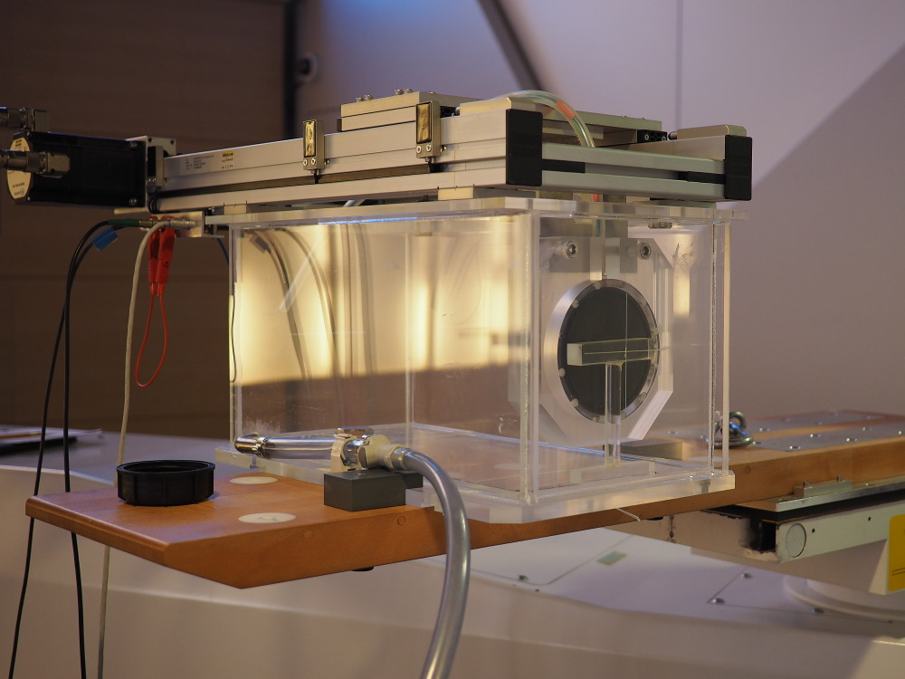
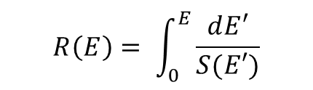
How to measure proton energy?
The most straightforward way is to measure the range in water
The proton range r₀ is defined as the depth where 50% of the protons have stopped
$$R\left(E\right)= \int_{0}^{E}{\frac{dE′}{S(E′)}}$$
Protons
R: projected range
E: energy
N: number of atom per unit of volume
S: stopping power
Dose
Depth
Measurement are slow (~several minutes)
Setup difficult to install and remove (e.g. activated water)
Solution: combine many detector all together
Protons

Slide 6
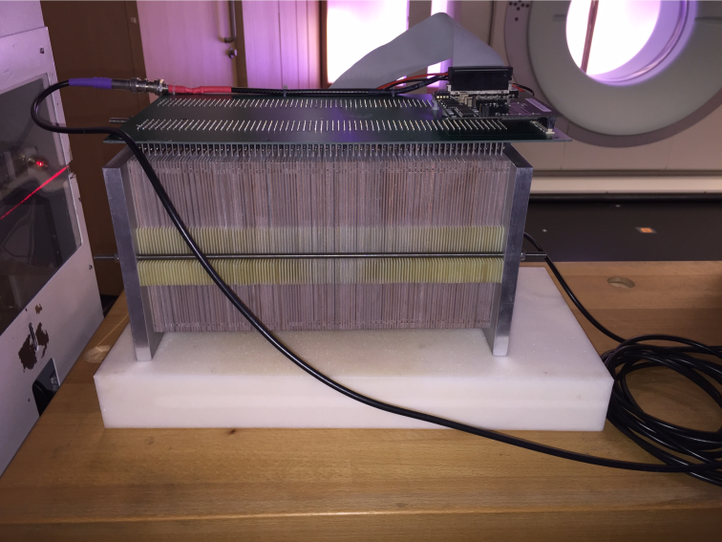
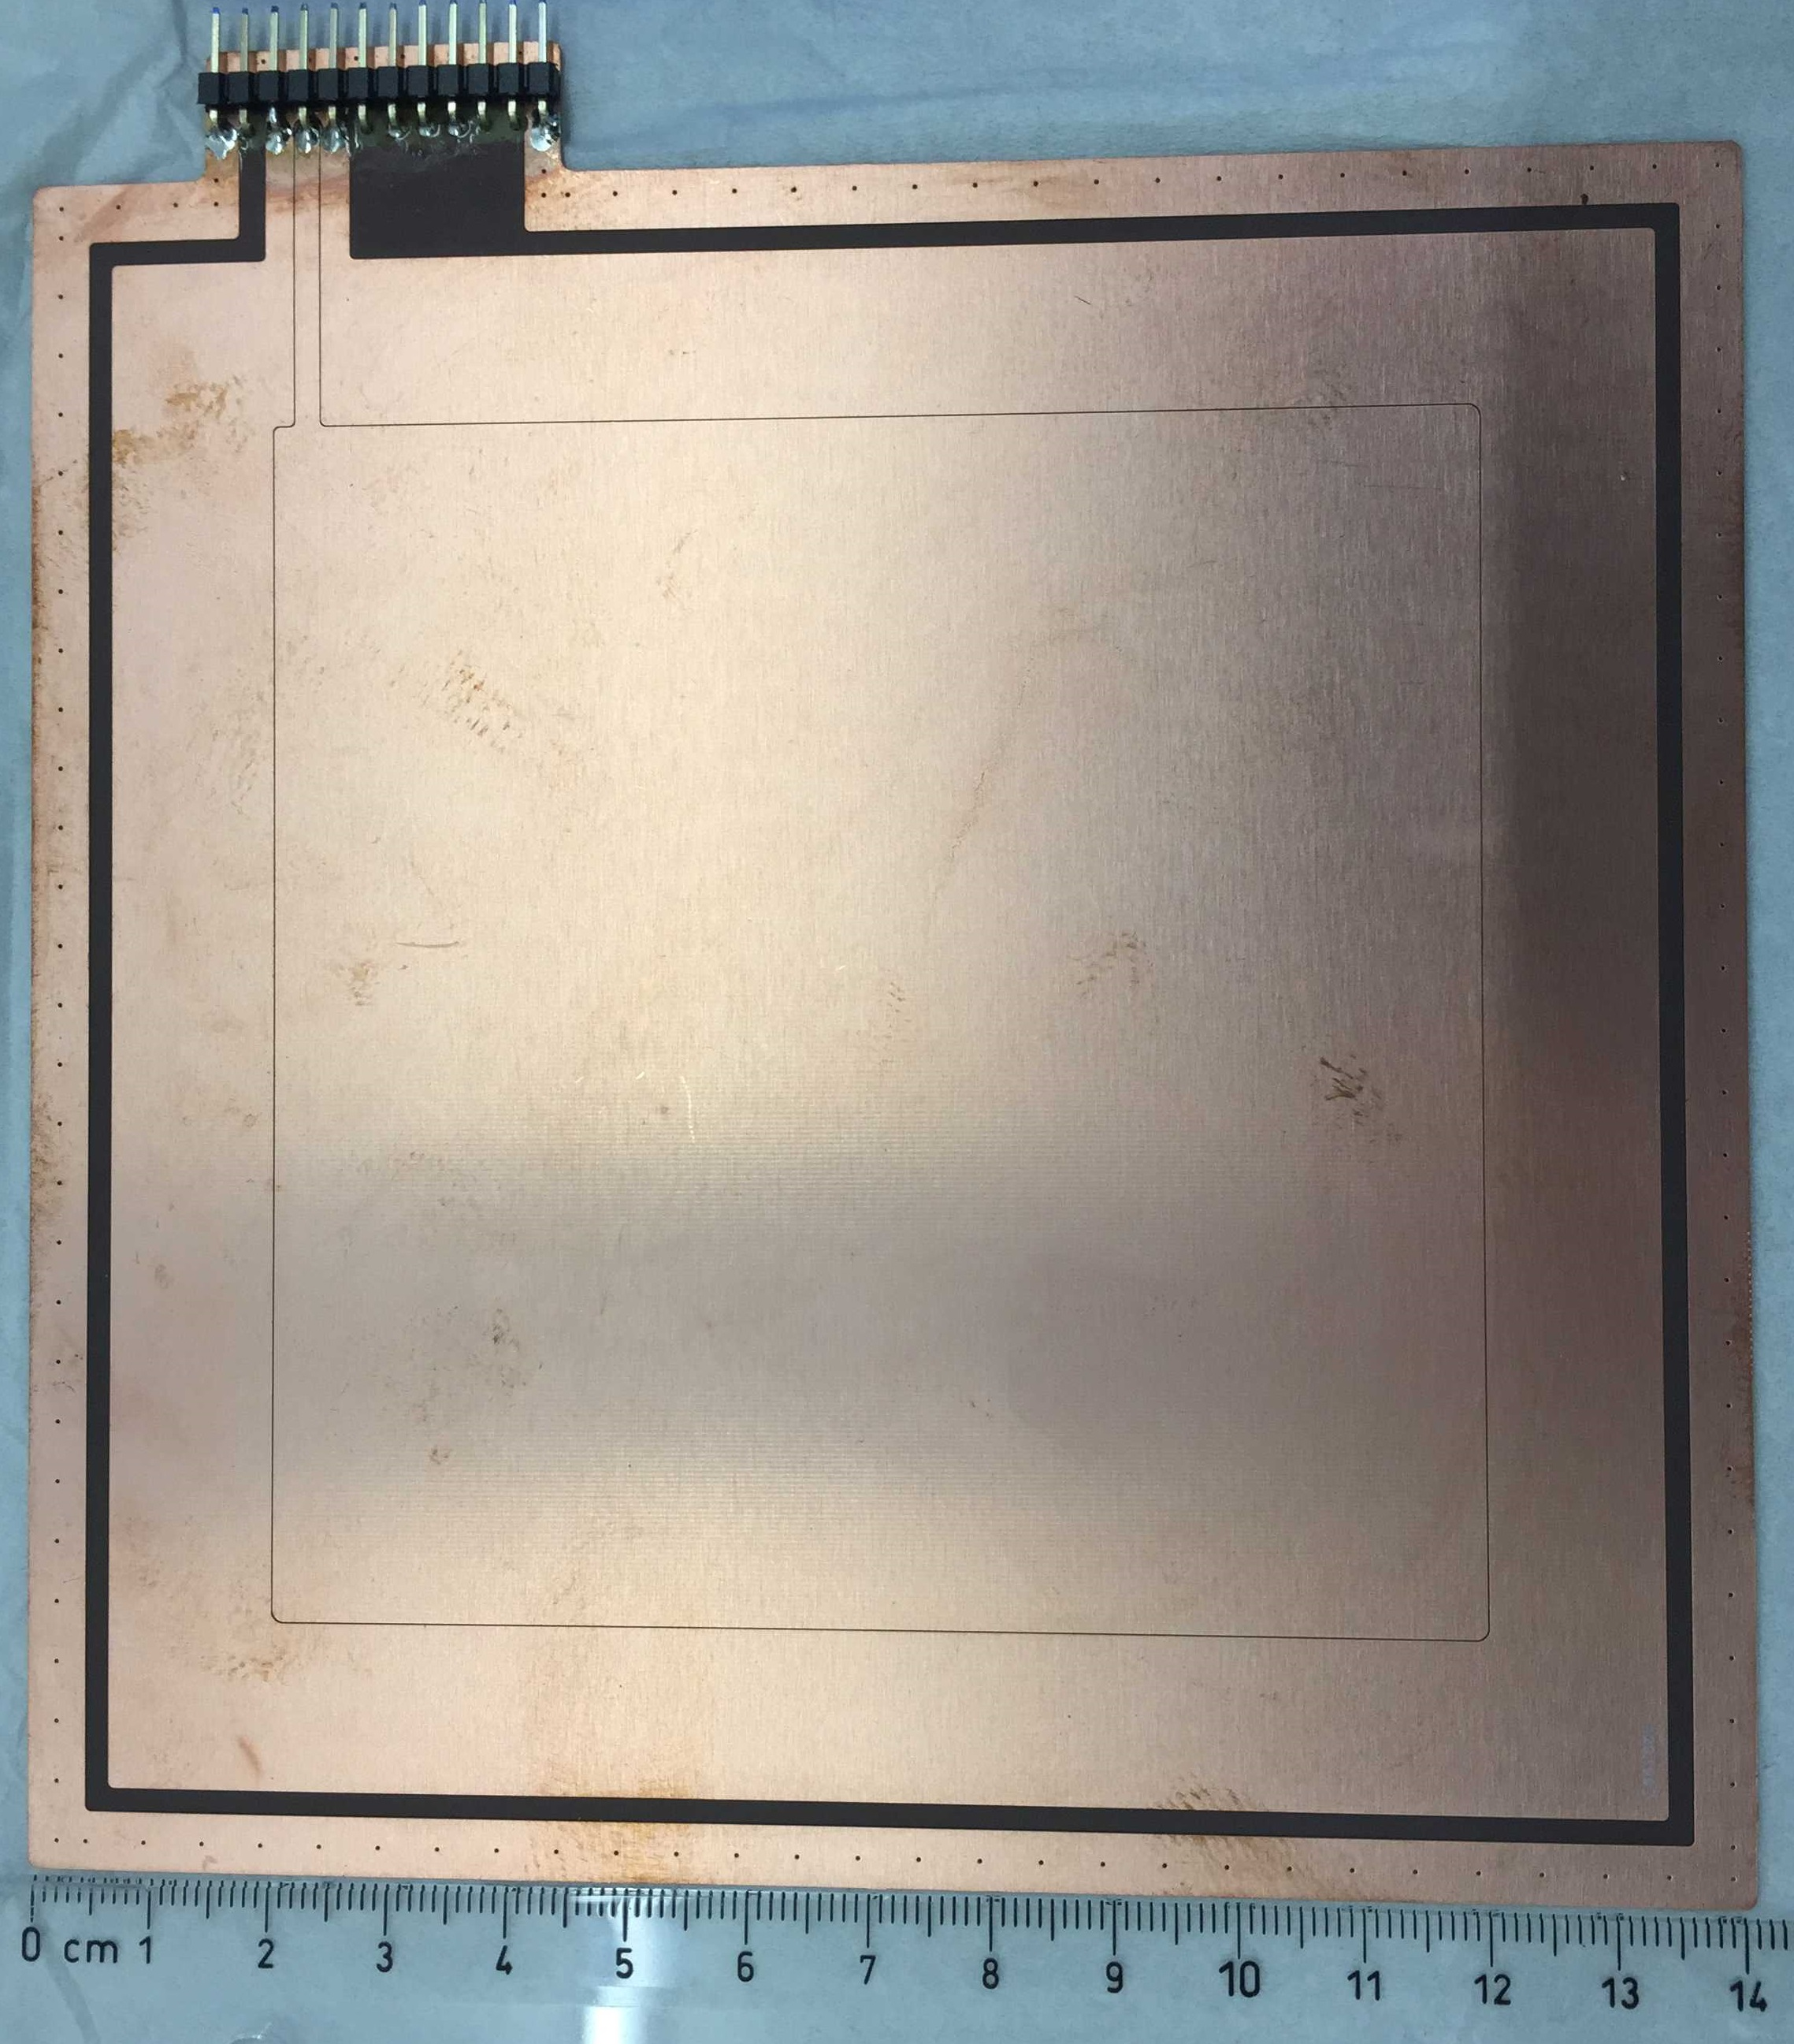
The multi-layer ionization chamber
The MLIC is made of:
128 plates : thickness 1mm
Air gap between electrodes = 1mm
      4 Cu layers of 12 μm
      FR4 core of 360 μm
Power alimentation to the MLIC
HV = -200V
The MLIC weight = 10.1 kg
Active area size: 100 mm x 100 mm
The WET for one IC : 2.16 mm
  Total WET : 277 mm (±1 mm)
  70 to ~200 MeV ready

Slide 7
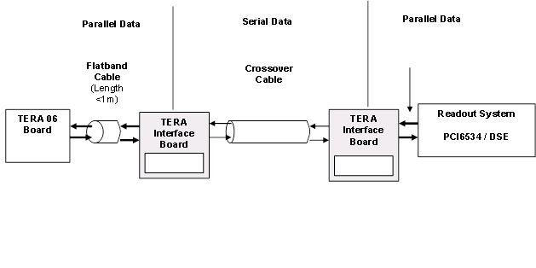
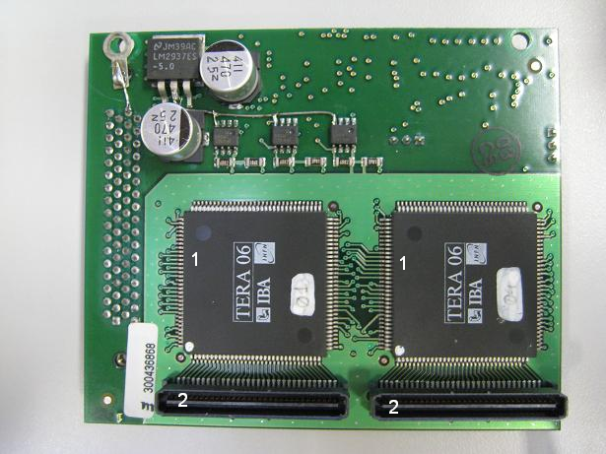
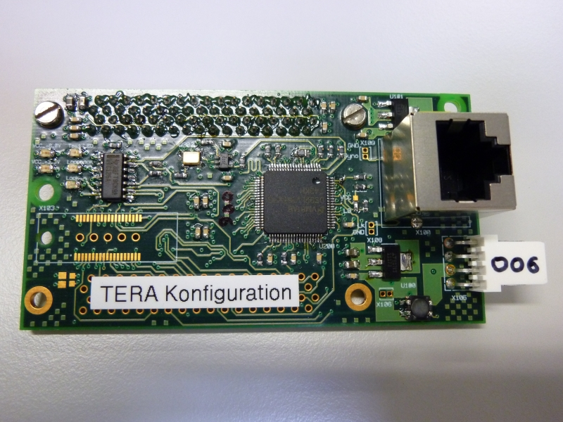
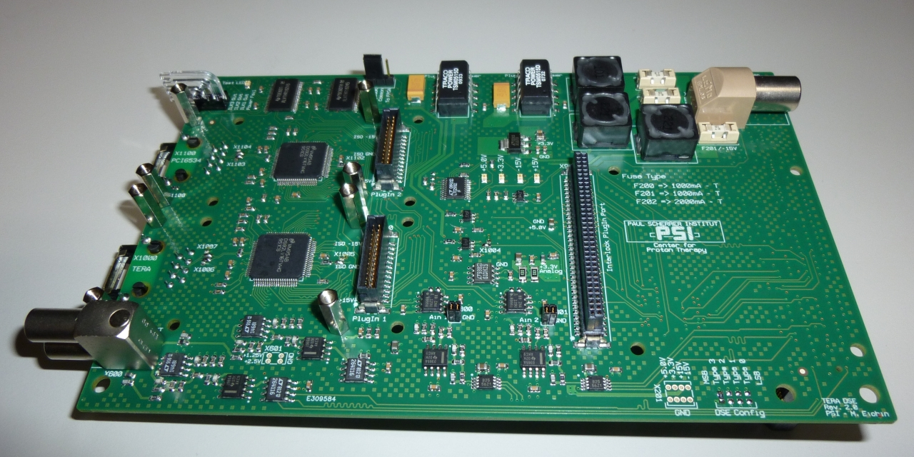
Integrated read-out system
Detector signal
TERA CHIP
  16 bits resolution, 64 channels / chip
  Current range : 1pA to 7.4 nA (minimal quantum of charge = 100fC)
  Sampling rate (parallel readout) : 10 MHz
Tera Interface : allows long distance communication via RJ-45 cable
Fully integrated in the therapy control system (TCS) : allow dose spot based analysis

Slide 8
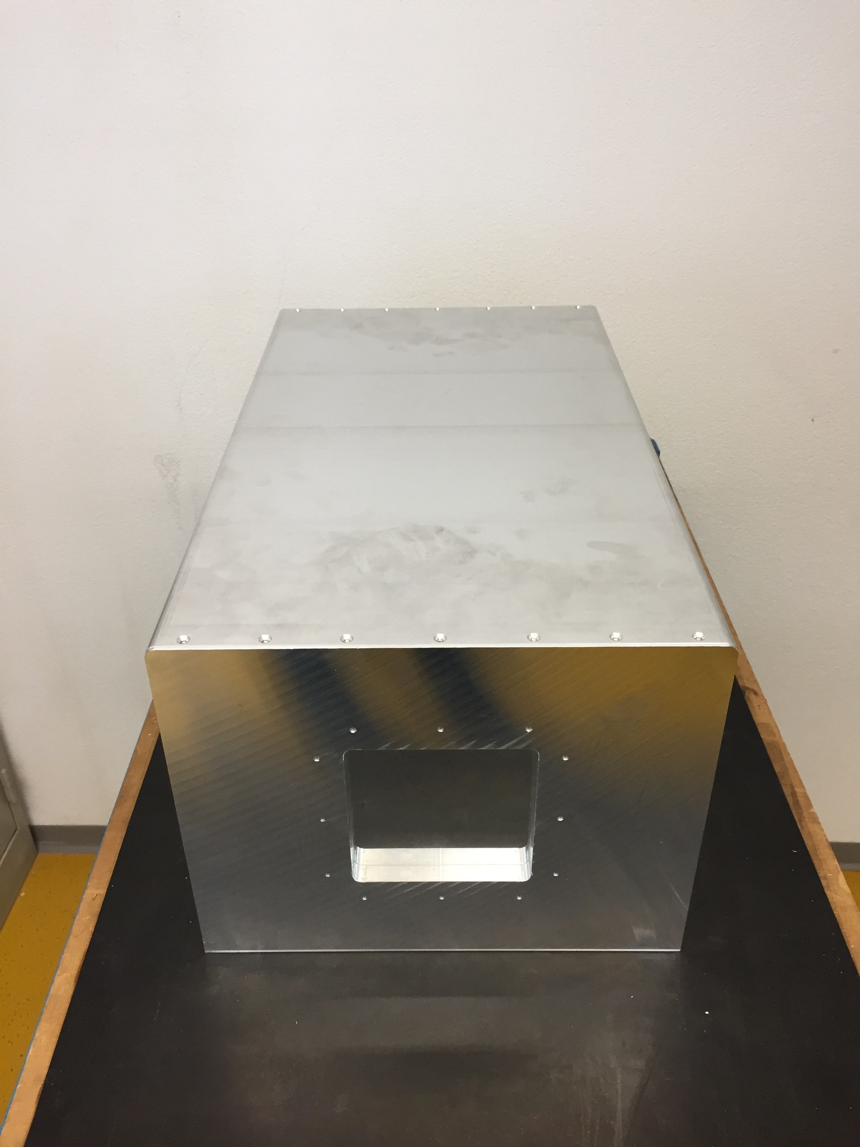
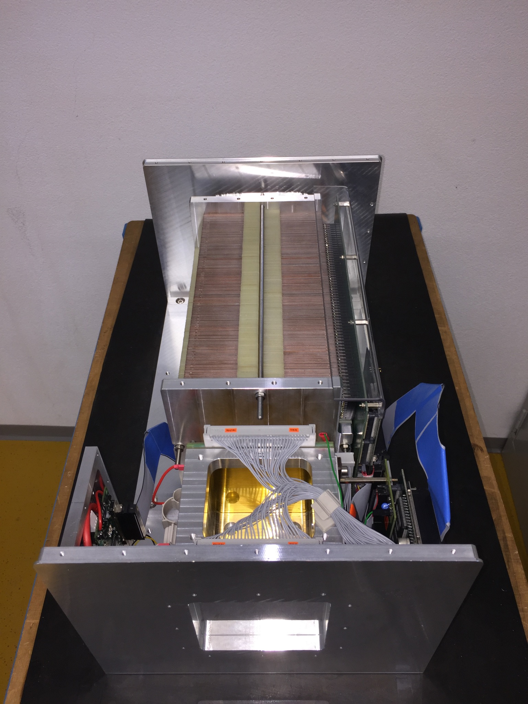
The new PSI MLIC: TIGER mark 2

Slide 9
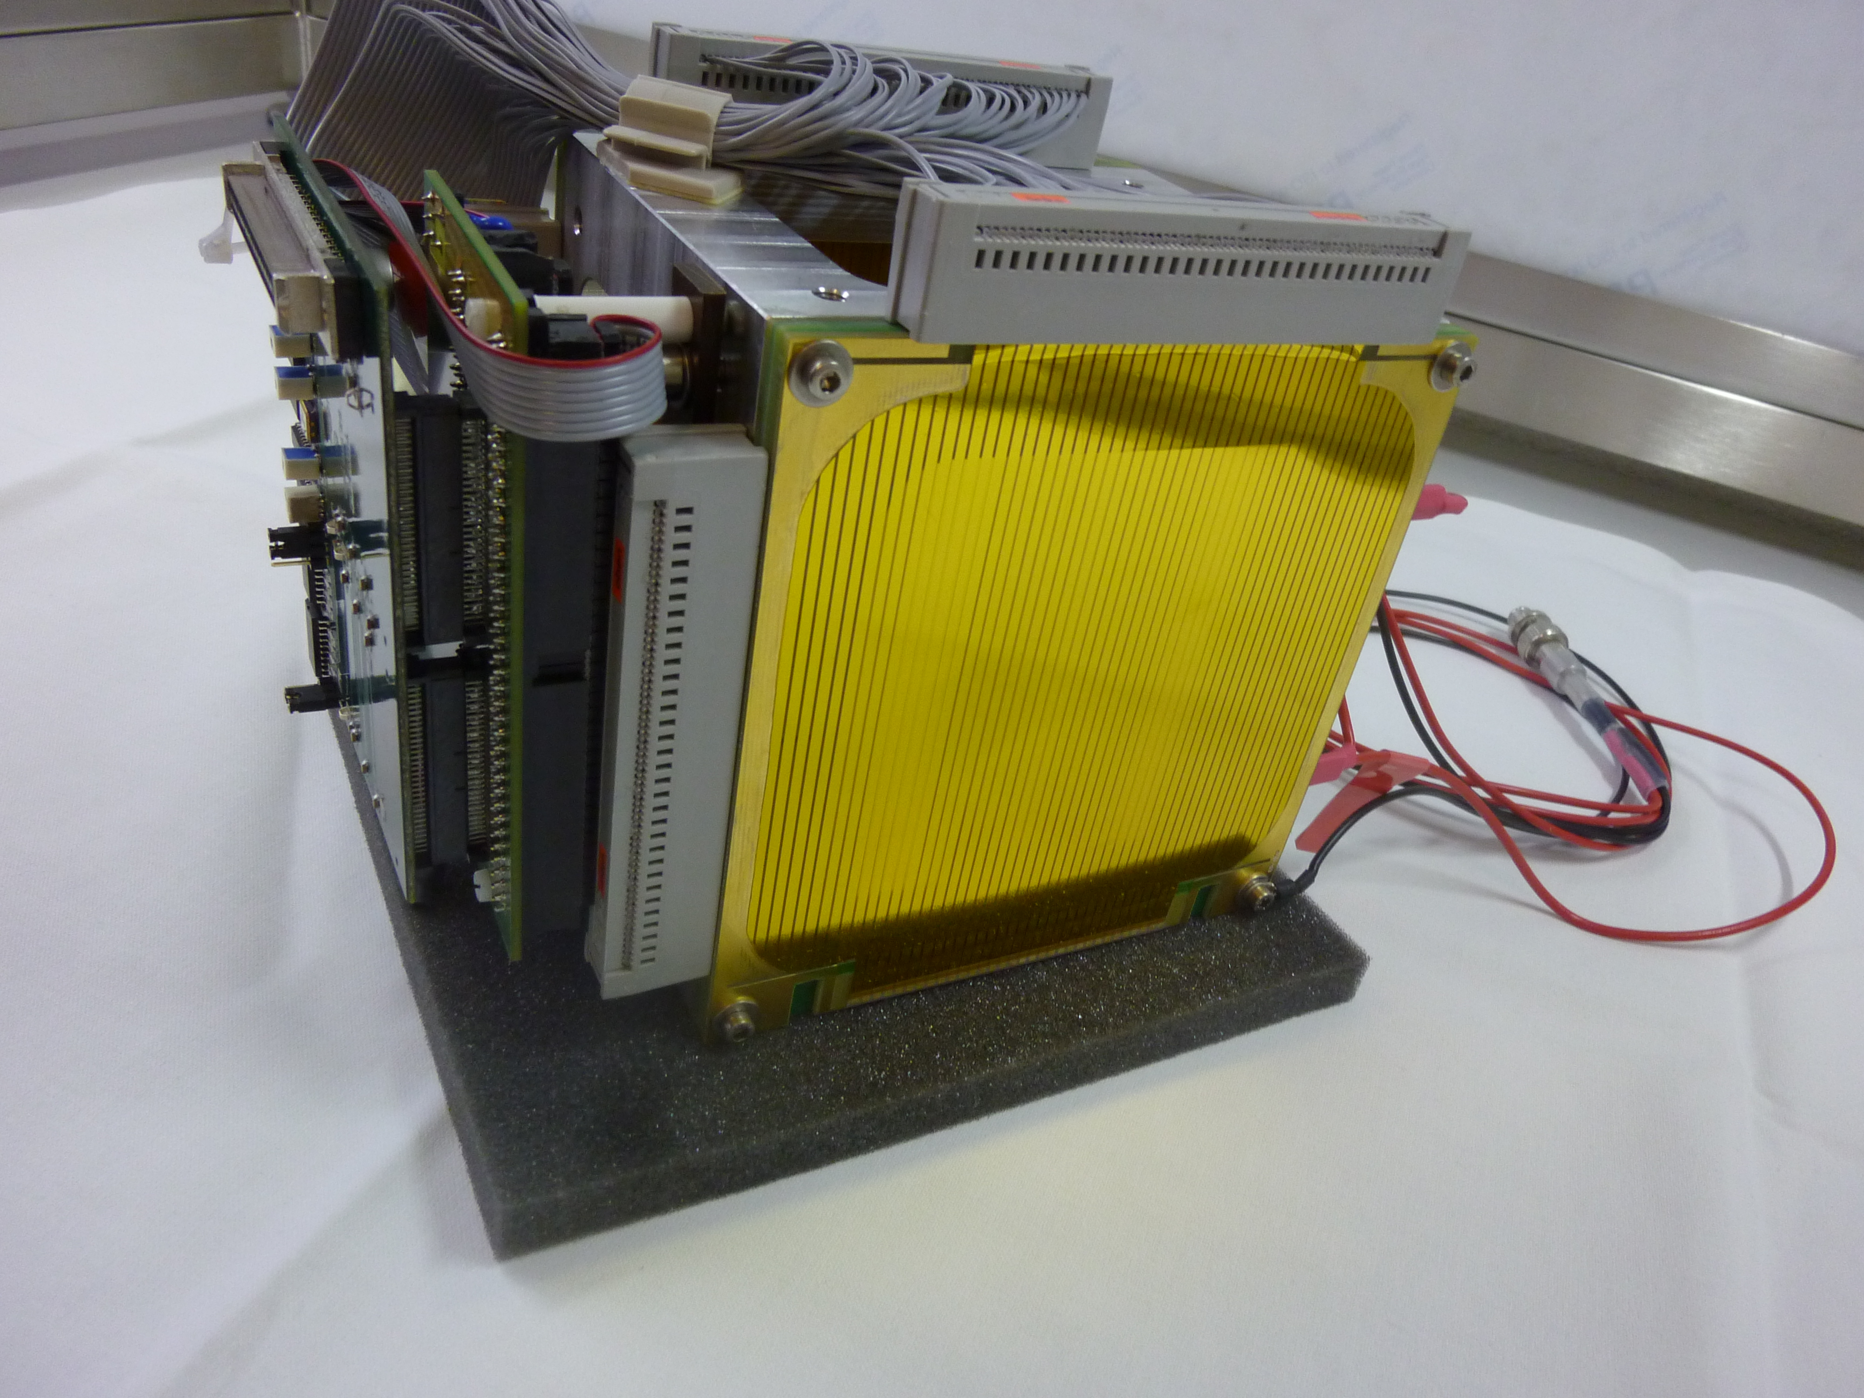
The MLIC for daily QA purposes
The daily quality assurance (QA) program of the Gantry 2 use the MLIC combined with a position sensitive strip chamber
Range measurement: MLIC (2)
Beam position & size :
Stripped ionization chamber (1)
Protons
(1) Stripped ionization chamber

Slide 10
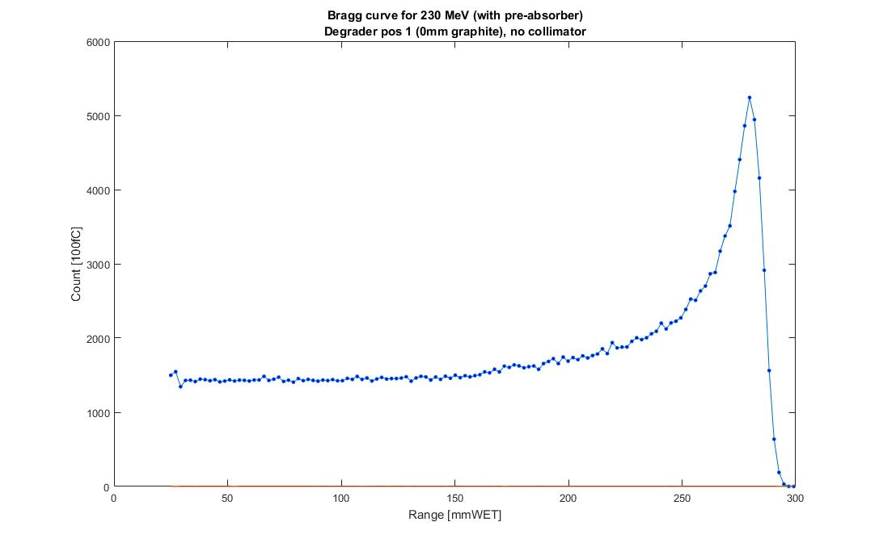
Range measurement
100%
80%
r₈₀
The range r₀ is evaluated at 80% (r₈₀) of the maximum of the Bragg curve, using a spline interpolation.

Slide 11
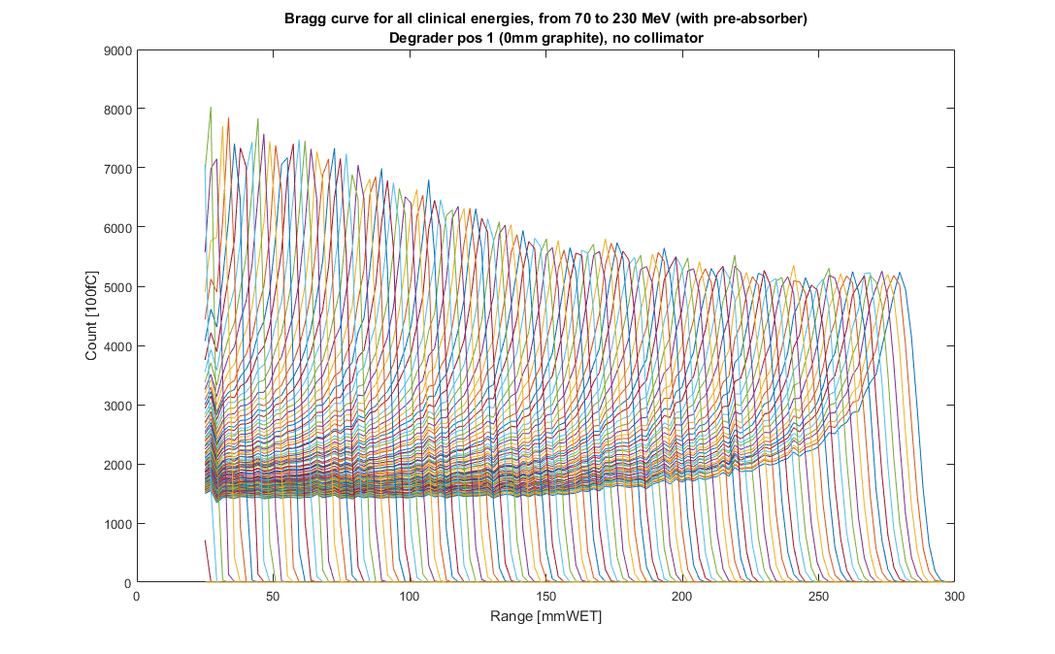
Range measurement
115 energies between 70-230 MeV
1 Bragg curve (1 energy) measurement takes ~150ms
Fast Matlab analysis

Slide 12
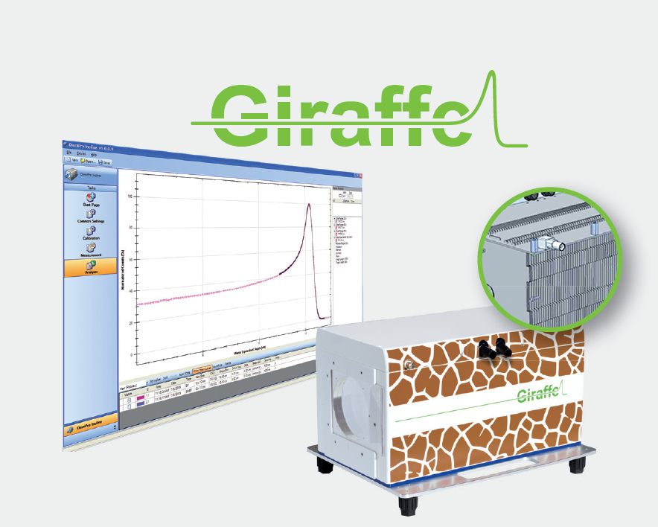
Why building our own device?
MLIC are commercially available from different vendors
Full integration in the therapy system provide unmatched readout and capabilities
Extensive customization possible (hardware and software)
Price : comparable devices cost ~150 000US $ vs 15 000US$ building your own
IBA Giraffe : https://iba-worldwide.com/

Slide 13
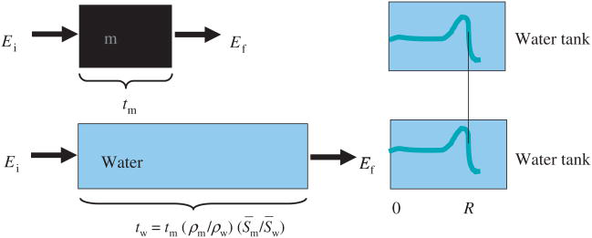
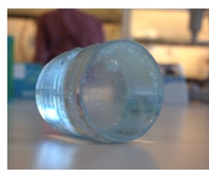
Stopping power measurements
Water Equivalence of material needs to be evaluated for treatment planning purposes.
Many materials are proprietary compounds
MLIC provide a fast, direct & reliable way to evaluate stopping power
Liquid fiducial marker applicability in proton therapy of locally advanced lung cancer.
Radiother Oncol. 2017 Mar;122(3):393-399

Slide 14
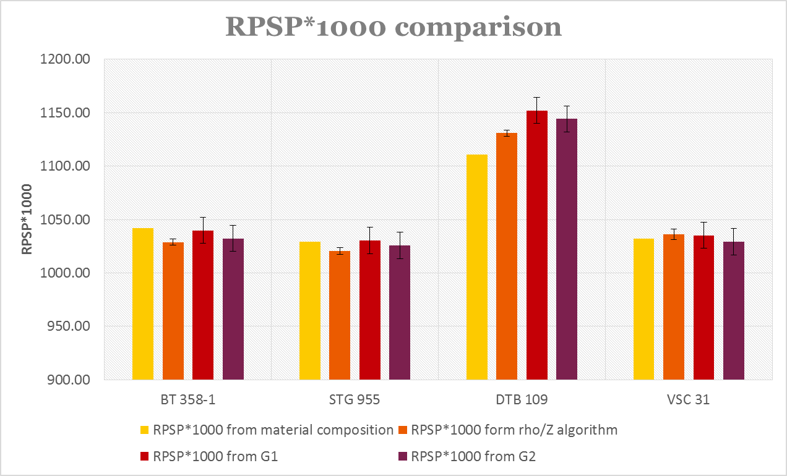
Stopping power evaluation comparison
Material | Substitute for
BT 358-1 | Brain
STG 955 | Soft tissue
DTB 109 | Trabecular bone
VSC 31 | Spinal cord
Relative Proton Stopping Power (RPSP) evaluated with 4 differents methods:
Reconstruction from material composition
Rho/Z algorithm from Dual Energy CT images
Water Equivalence measurement using Gantry 1 (single ionization chamber)
Water Equivalence measurement using Gantry 2 and new MLIC
Characterizing and validating DECT rho/Z algorithm for proton therapy application: an experimental study
F .Vitullo, Semester project, EPFL, ETH Zurich 2016-2017

Slide 15
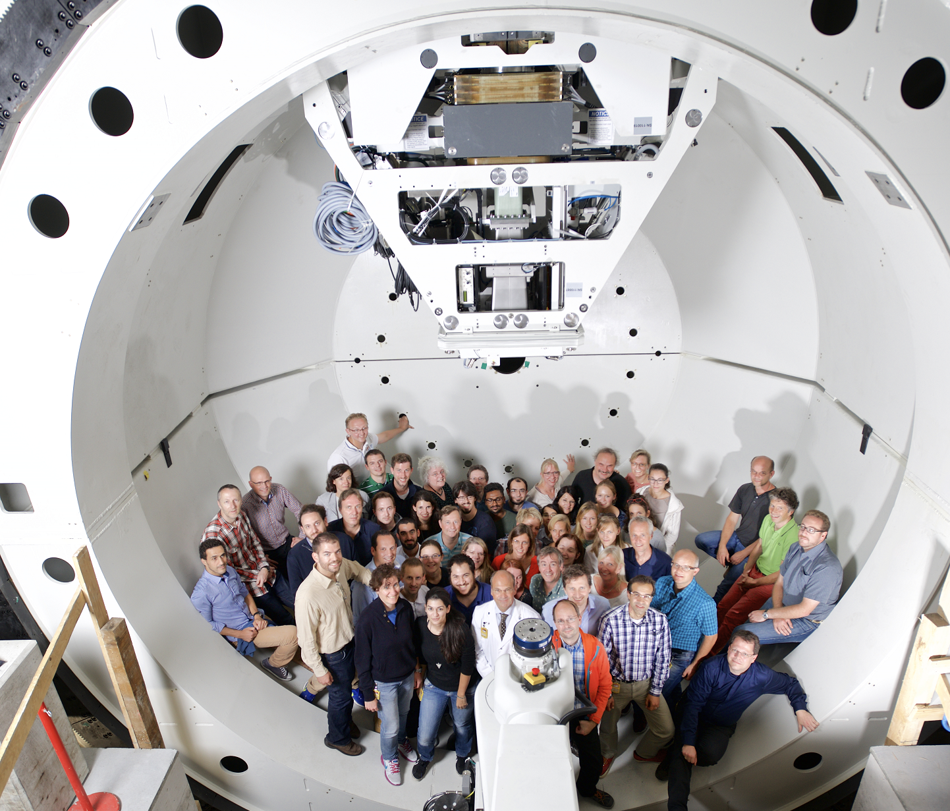
Conclusions
The MLIC developed at PSI provides an state of the art solution for proton therapy QA.
  Fast and reliable protons energy measurement
  Evaluation of exotic material stopping power needed for treatment planing.
Customization allows for further developement
  Fast energy change measurement
  Spread-Out Bragg peak evaluation
  Proton radiography

Slide 16
Wir schaffen Wissen – heute für morgen
My thanks go to Oxana Actis , Martin Grossmann, David Meer

Slide 17
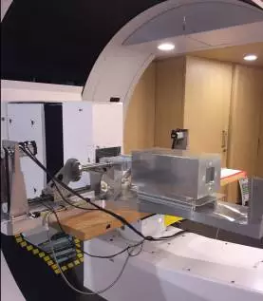
Further use
Degrader prototype testing for
Hefei CAS Ion Medical and Technical Devices Co., Ltd
http://mp.weixin.qq.com/s/iXgn_U0mf2wsyrr-pYA8aw

Slide 18



Introduction
GERMANY
FRANCE
ITALY

Slide 19
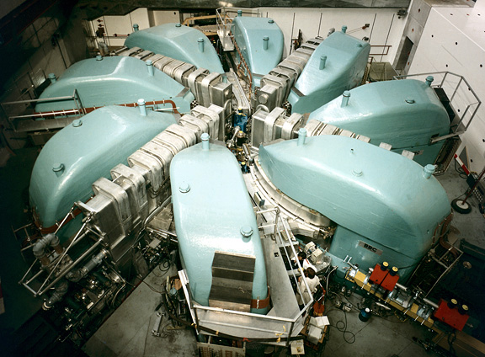
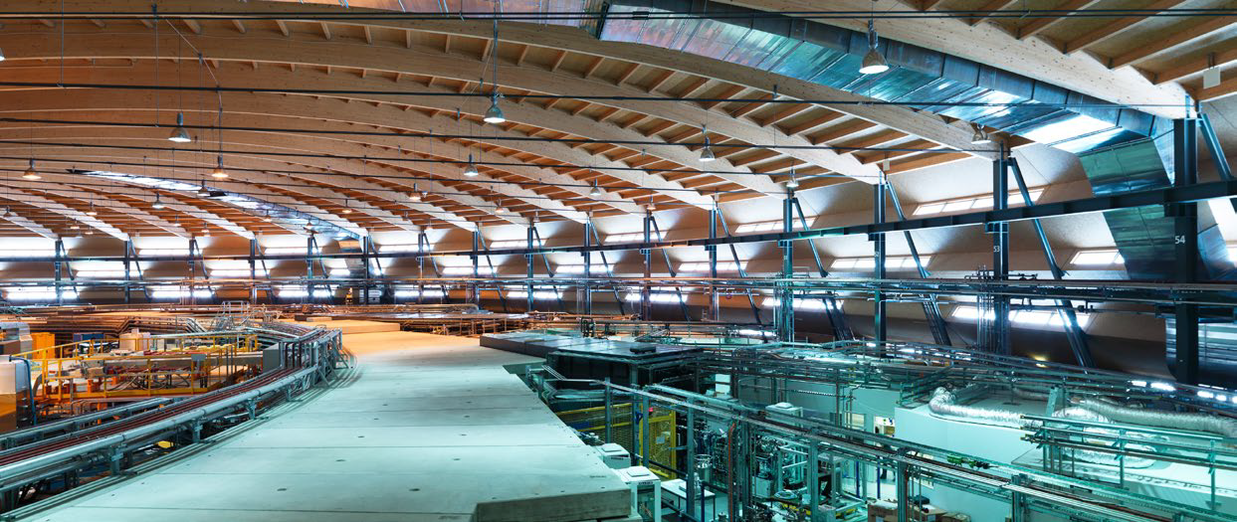
Introduction – The Paul Scherrer Institut (PSI)
PSI in numbers
1900 employees
Budget of 380M CHF (~380M US$)
The research at PSI
Material science
Energy and environnment
Health
The HEALTh research at PSI
The Center of Radiopharmaceutical Sciences
The Laboratory of Biomolecular Research
The Center for Proton Therapy

Slide 20
Introduction – The Center for Proton Therapy
~100 employees
  Physicist
  Medical Physicist
  Students (PhD, Master, apprentices)
  Engineers
  Medical doctors
  Radiologists
  Support employees
  OPTIS2 since 2009 (OPTIS since 1984)
  Gantry 1 since 1996!
  Gantry 2 since 2013
  Gantry 3 operational end 2017!
  Gantry 1 more than 1000 patients since 1996
  Gantry 2 over 50 patients treated
  OPTIS + OPTIS2 > 7000 patients

Slide 22
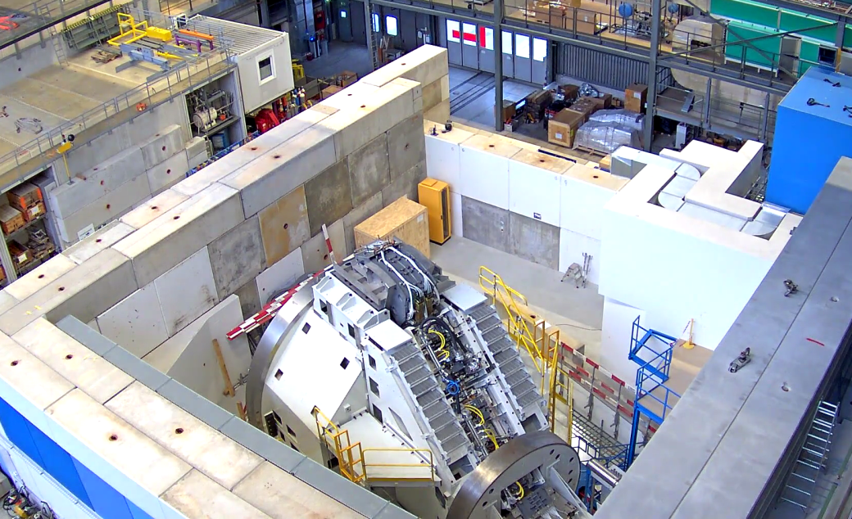
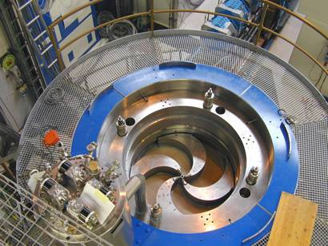
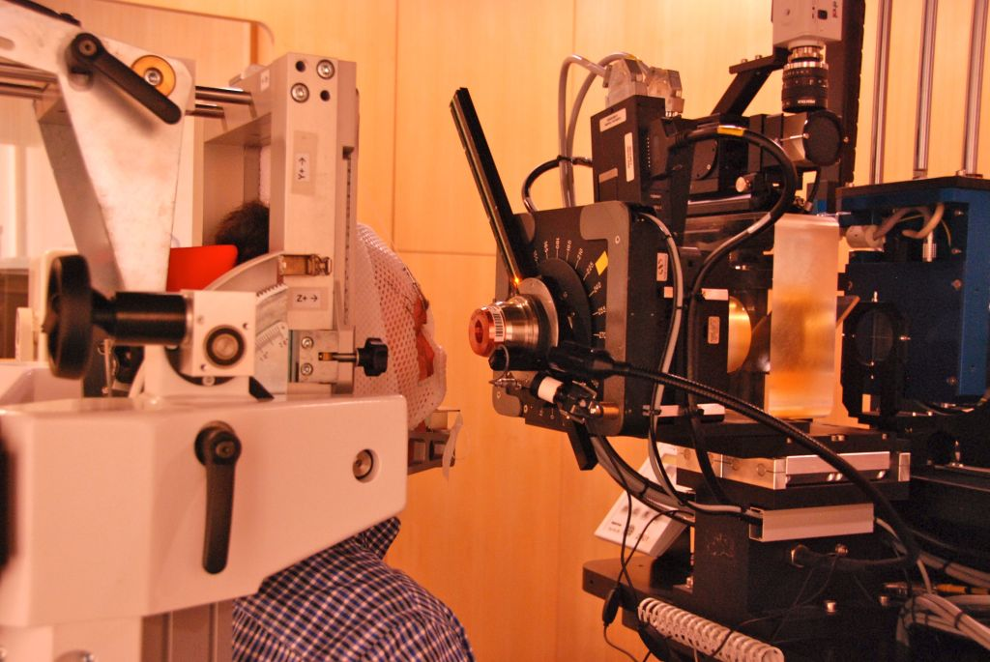
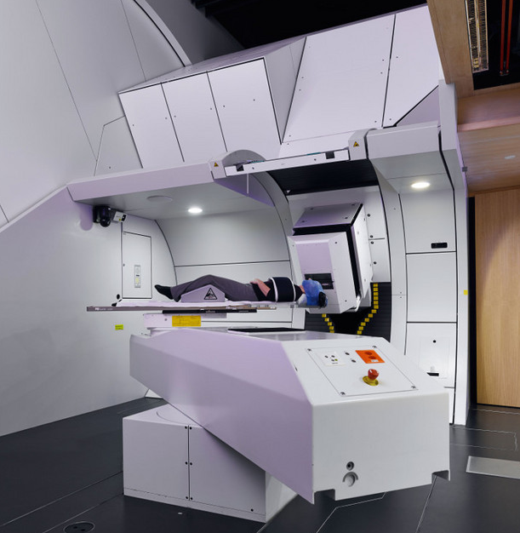
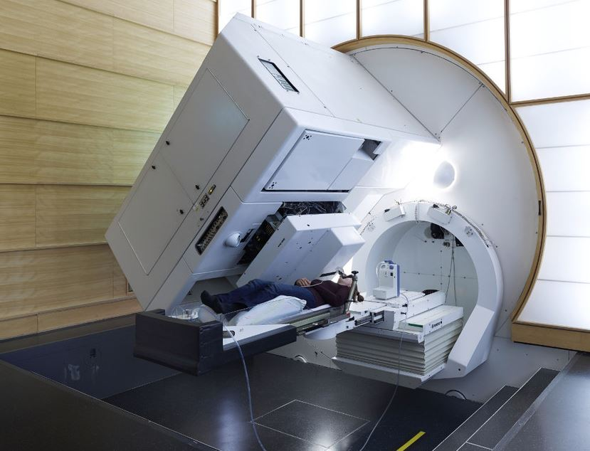
Introduction - Proscan

