Slide 1
Chromaticity Correction & DA Optimzation of PDRv4(wangdou) With MODE
ZHANG Yuan
16-08-26

Slide 2

Main Parameters
$β_{x}=0.25$m
$β_{y}=1.36$ mm
$ν_{x}=$319.21
$ν_{y}=$318.41

Slide 3
Chromatic Correction with sextupoles in arc test1
Variable range: (0.5, 1.5) of original strength
Notes:
Test1-many constraints

Slide 4
Chromatic Correction with sextupoles in arc test2
Variable range: (0.5, 1.5) of original strength
Notes:
Test2-only 2 constraints

Slide 5
Chromatic Correction with sextupoles in arc test3
Variable range: (0.2, 1.8) of original strength
Notes:
Test3, only 2 constraints

Slide 6
Chromatic Correction with sextupoles in arc test4
Variable range: (0.2, 1.8) of original strength
Notes:
Test4, only 2 constraints, delta-step=0.002 instead of 0.004

Slide 7
Chromatic Correction with sextupoles in IR test5
Variable range
Notes:
Test5, only 2 constraints, delta-step=0.002, ir sextupoles

Slide 8
Chromatic Correction with sextupoles in Arc
(test6)
Variable Range (0.2, 1.8)
DeltaP: (-0.01, 0.01) with step 0.001
It is possible to find solution
Notes:
Test6: variable range (0.2, 1.8)
@x3500, 8-15, 8:45+

Slide 9
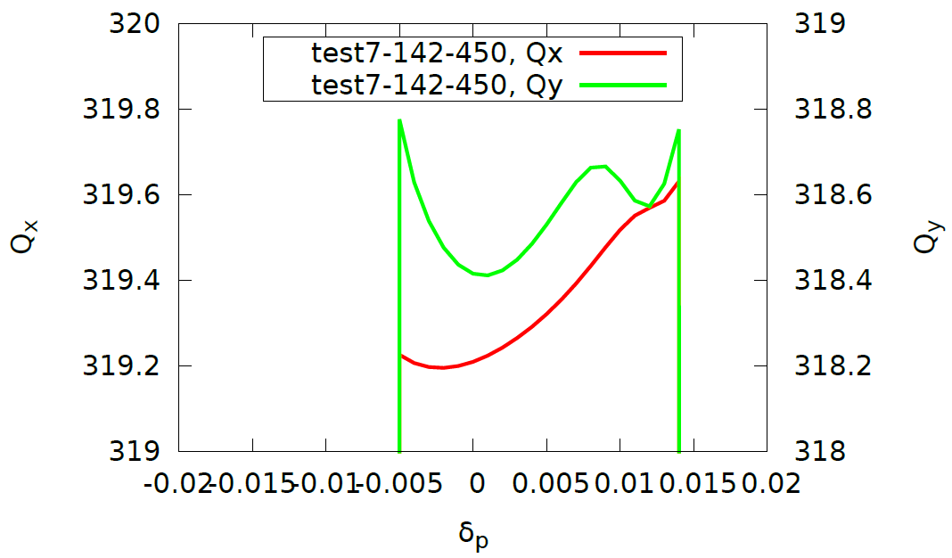
Chromatic Correction with sextupoles in IR
（test7，）
Same as test7, but use sextupoles in IR (not chromatic sextupoles)
Nearly no improvement comparing to test5
Notes:
@acc-ap06, 8-15, 10:00, ~17:00 自己中断

Slide 10
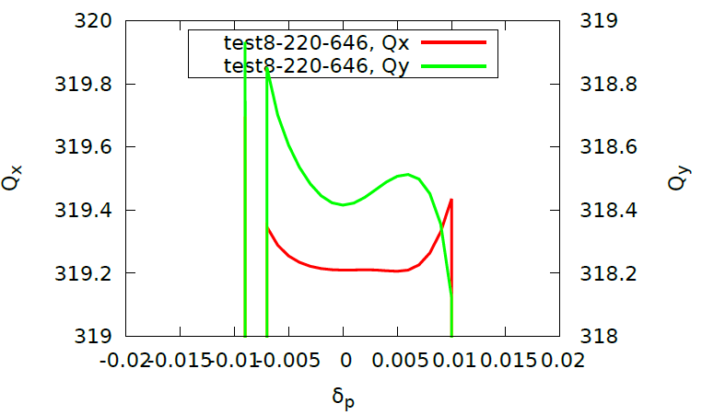
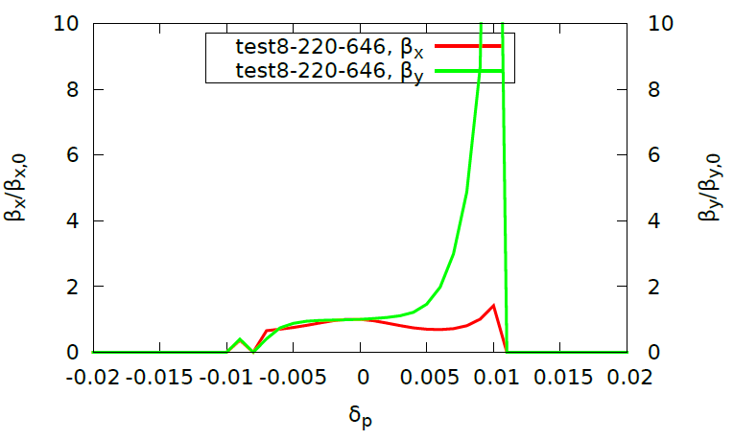

Chromatic Correction with Octupoles in IR
（test8，）
The 2nd order vertical chromaticity by a octupole: $\frac{k3}{8π}D_{x}^{2}β_{y}$
Maximum poleface magnetic field is 0.1~0.2T
Aperture of octupole is assumed as 20mm, Length: 1m
The maximum k3 is about 1000. [in SAD]
If we only use one octupole , the most effective one should be 50000
DeltaP: (-0.01, 0.01) with step 0.001
Bound: k3 (-1000,1000), constraint (-2000, 2000)
2nd order chromaticity: 16500
Notes:
@acc-ap06, 8-16, 8:55, 16:00 停止

Slide 11
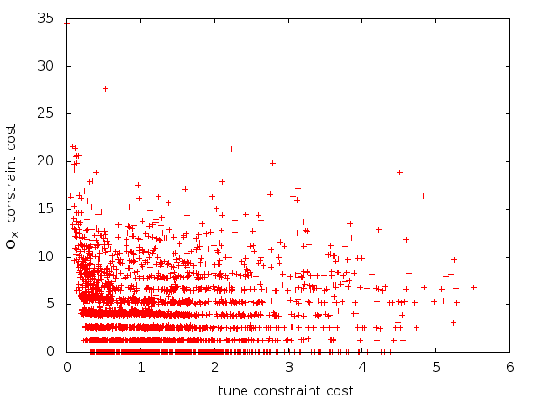
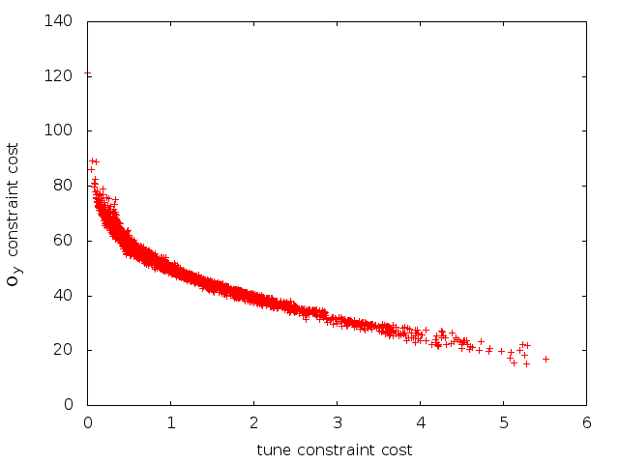

Chromatic Correction & DA with sextupoles in Arc
(test9@x3500, 8-16, 15:56)
Variable Range (0.1, 1.9)
DeltaP: (-0.01, 0.01) with step 0.001
Mismatch $Ω_{y}<1.5, Ω_{x}<1.25$
Failed to squeeze mismatch parameters
Notes:
基于 test6 的 lastparent.x
@8-17， 8:53， 似乎没有可能校正 mismatch parameter，可以进一步检查范围
@8-18, 7:54, 人为中断，ymismatch-min ~ 15

Slide 12
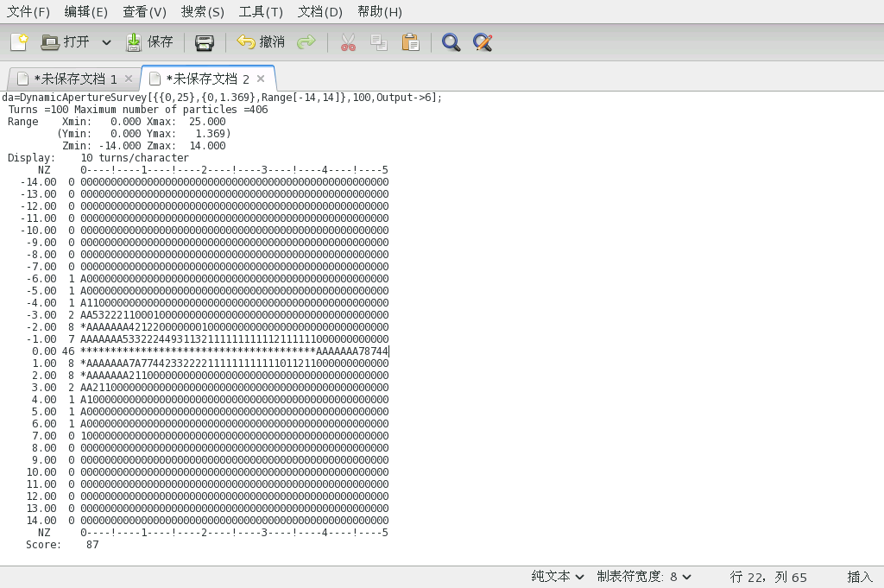
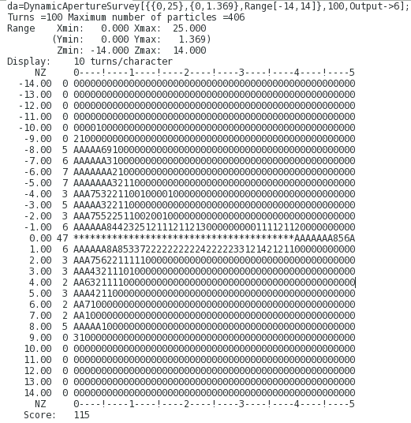
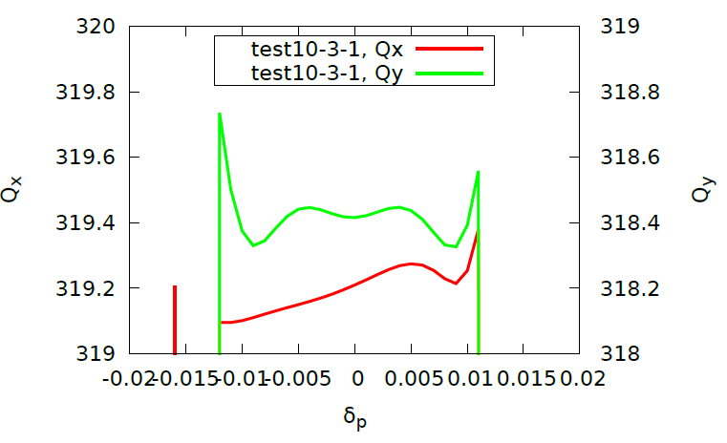
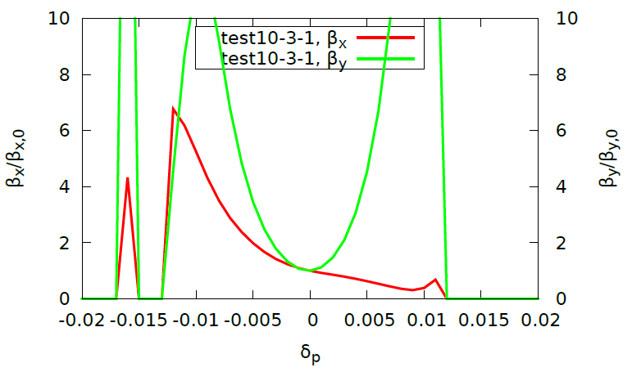
Chromatic Correction & DA with sextupoles in Arc
(test10)
Variable Range (0.1, 1.9)
DeltaP: (-0.01, 0.01) with step 0.001
Notes:
@cepcmpi, 8-16, 15:56
@acc-ap06, 8-16, 16:23， 放弃
基于 test6 的 lastparent.x

Slide 13
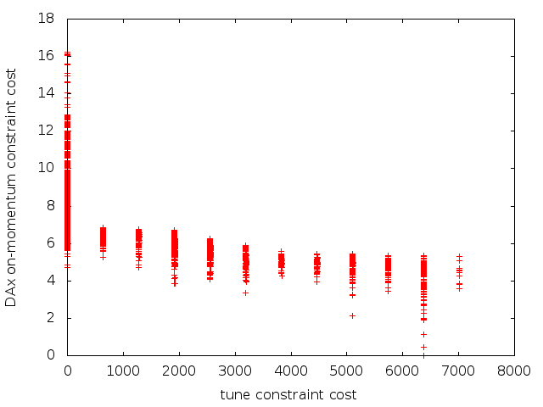
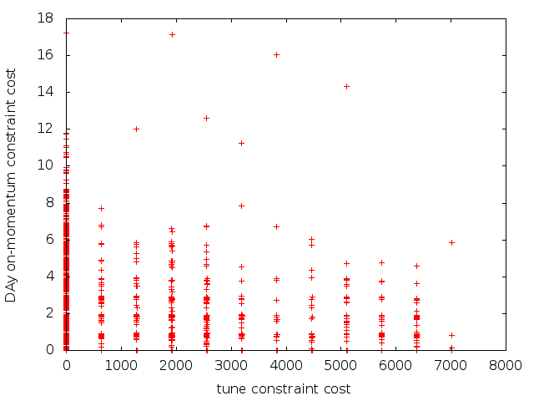
Chromatic Correction & DA with sextupoles in Arc/IR and Oct in IR
(test11)
与 test10 相同的con、obj
+ir sext, +ir oct
+Con2: on-momentum da of x > 20
+Con3: on-momentum da of y > 40
Notes:
@acc-ap05, 8-16, 17:50, 放弃
@cepcmpi, 8-16, 18:00

Slide 14
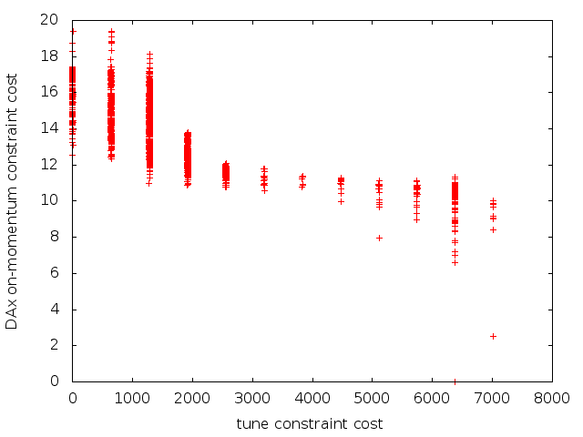
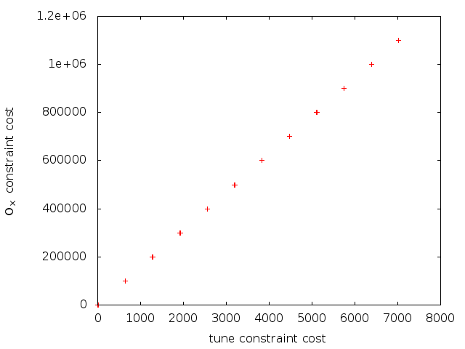

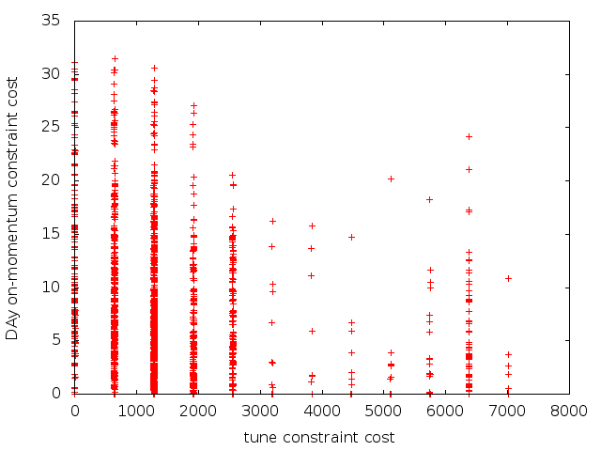
Test12 with sextupoles in Arc/IR and Oct in IR
Constraint: 基于 test11 + con-mistmatch
Bad convergence so far
Notes:
@acc-ap04, 20:20

Slide 15
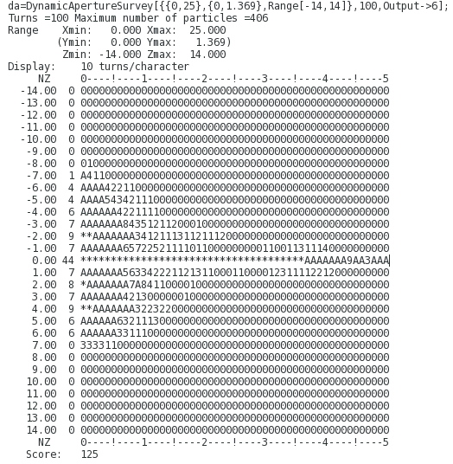
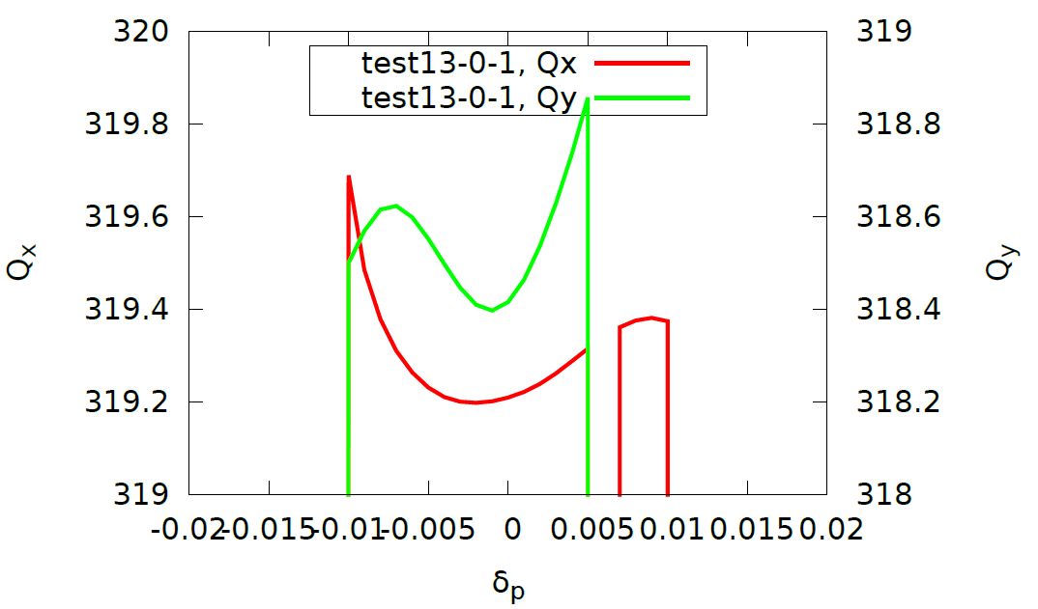
Test13 (arc sext)
只有一个目标孔径(X,Y)
DAPWIDTH=7, TURNS=100, RANGE[-14,14,2]
Notes:
@acc-ap05, 9:30

Slide 16
Test14 (arc sext + ir sext + ir oct)
只有一个目标孔径
Con1/con2, on-momentum x/y 孔径 > 20/40
Obj0/obj1 与 test13 相同
DAPWIDTH=7, TURNS=100, RANGE[-14,14,2]
Bad convergence so far
Notes:
@acc-ap06, 9:52

Slide 18
（new）TEST12 (arc+ir-sext+ir-oct) failed to achieve constraint objective
基于老版本的 test12(continue, with inimethod=3),
Con0：variable range
Con1: tune constraint in [-0.01,+0.01]
Con2: omega_y (mismatch parameter in y)
Con3: omega_x (mismatch parameter in x)
Con4: 100->50圈, DAPWIDTH=7, on-momentum x aperture > 20
Con5: 100->50圈, DAPWIDTH=7, on-momentum y aperture > 40
OBJ0: 100->50圈, DAPWIDTH=7, (-14:-1, 1:14)
OBJ1: 100->50圈, DAPWIDTH=7, (-14:-1, 1:14)
Notes:
@acc-ap05, ~/mode3/wd-pdr4-test12, 8-20, 18:50 结束，8-22 尝试继续运行的时候，显示不能写文件 tokens 过期。我在 crontab 中添加的 klog 命令好像经常不能更新 tokens

Slide 19
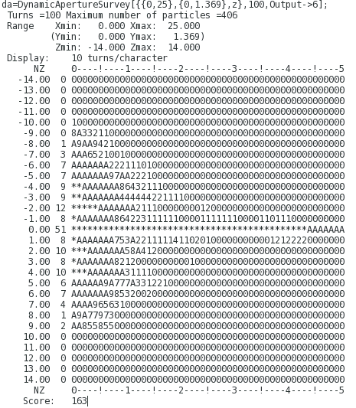
（new）TEST13 (arc)
基于老版本的 test13(continue, with inimethod=3)
Con0: 变量范围约束
Con1:-> obj0( 50 圈，-14:14)
Con2:-> obj1( 50圈，-14:14)
Notes:
@acc-ap04, ~/mode3/wd-pdr4-test13，一直在正常运行(8-22,7:57AM)

Slide 20
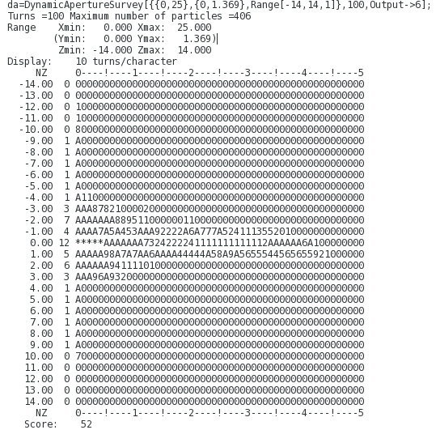
(new)Test14(arc+ir-sext+ir-oct)
基于老版本的 test14(continue, with inimethod=3)
Con1: 100->50 圈
Con2: 100->50 圈
Obj0: 100->50 圈, z={-14:-1, 1:14}
Obj1: 100->50 圈, z={-14:-1, 1:14}
Notes:
@acc-ap03, ~/mode3/wd-pdr4-test14,一直在正常运行(8-22,7:57AM)

Slide 21
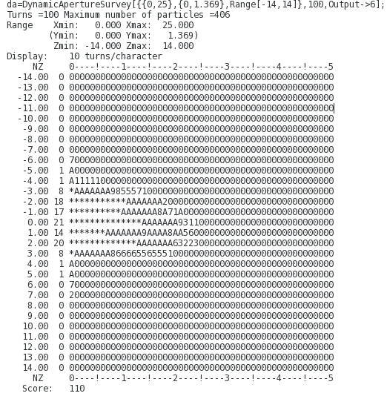
Test15, ir-sext (26)
No variable range constraint
con0: 100->50圈, DAPWIDTH=7, (-14:14)
con1: 100->50圈, DAPWIDTH=7, (-14:14)
Notes:
@acc-ap03, 8-22, 15:17, 手动中断 8-26, 8:00am

Slide 22

Test16, continue based on test13-new
No variable range constraint
con0: 50圈, DAPWIDTH=7, (-14:14)
con1: 50圈, DAPWIDTH=7, (-14:14)
Notes:
@acc-ap04, 8-22, 16:33

Slide 23

Test17 pdr-sext
Notes:
@acc-ap05, 8-23, 21:00, 8-24, 22:17 非人为中断

Slide 24
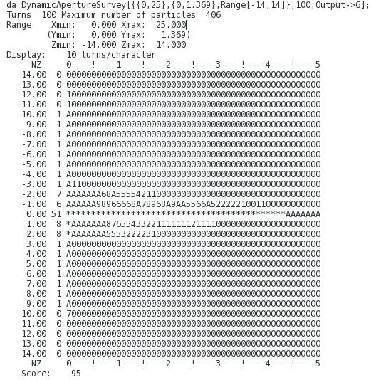
Test18， ir-chromatic-sext(wd !=0 )
Notes:
Acc-ap06, 8-23, 21:21， 手动中断，8-25,18:00

Slide 25
Symmetry of PDR
(there should be mirror-symmetry)
IP1-DOWNSTREAM:
SEPR, QFH, D5, B0_HALF, D5, QDH, QDH, D5, B0_HALF, D5, QFH, QFH, D5, B0_HALF, D5, QDH, QDH, D5, B0_HALF, D5, QFH, QFH, D2, SF1, D3, B0, D1, QDH, QDH, D1, B0, D1, QFH, QFH, D1, B0, D1, QDH, QDH, D1, B0, D1, QFH, QFH, D2, SF1, D3,
IP3- UPSTREAM
SD96, D3, B0, D1, QFH, QFH, D1, B0, D1, QDH, QDH, D1,
B0, D1, QFH, QFH, D1, B0, D1, QDH, QDH, D2, SD96,
D3, B0, D1, QFH, QFH, D5, B0_HALF, D5, QDH, QDH, D5, B0_HALF, D5,
QFH, QFH, D5, B0_HALF, D5, QDH, QDH, D5, B0_HALF, D5, QFH, SEPL,
Near RFC, BYPASS, there exist same problem.

Slide 26
RADCOD - on
Try to calc emit, no optics solution

