Slide 1

CEPC Damping Ring Design
Dou Wang, Cai Meng, Jie Gao
CEPC AP meeting, 2016.08.26

Slide 2
CEPC damping ring requirement
Energy: 1.1GeV
Storage time: 20ms
Injected emittance (normalized): 3500 mm-mrad, injected energy spread ~ 0.25%
Extracted energy spread <1×10-3
No strong requirement for the extracted emittance (<0.5ε_{inj})!

Slide 3
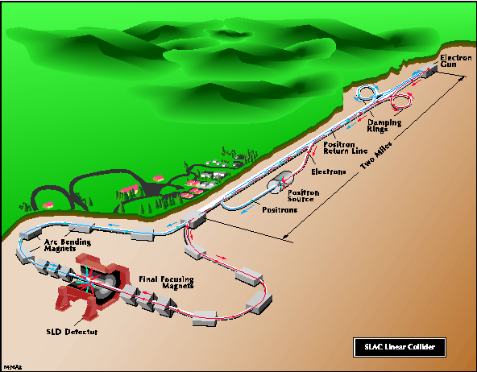
SLC damping ring
E=1.2GeV
C₀=35m
τ₀=17ms
B₀=2T

Slide 4
CEPC DR consideration
 | Case I | Case II
Energy (GeV) | 1.1
circumference | 35 | 70
Bending radius (m) | 1.57 | 4.57
B0 (T) | 2.34 | 0.8
U0 (keV) | 82.5 | 28.4
Damping time x/y (ms) | 3.1 | 18.1
Damping time z (ms) | 1.55 | 9.05
δ0 (%) | 0.075 | 0.044
εinj (mm.mrad) | 3500 | 3500
δinj (%) | 0.25 (1) | 0.25 (1)
δext (%) | 0.075 (0.075) | 0.047 (0.056)

Slide 5
Discussion with IHEPmagnet people

Slide 6
Overall Parameter estimation
 | Case III
Energy (GeV) | 1.1
circumference | 60
Bending radius (m) | 9.5
B0 (T) | 0.99
U0 (keV) | 28.4
Damping time x/y (ms) | 12.6
Damping time z (ms) | 6.3
δ0 (%) | 0.0489
εinj (mm.mrad) | 3500
δinj (%) | 0.25 (1)
δext (%) | 0.0493 (0.0506)

Slide 7
Optics design consideration
L=1.22m
= 219 mm.mrad

Slide 8
RF consideration
Chose f_{RF}=650MHz, bunch length < 3mm (10ms)
We get Vrf = 4.2*10⁷ σz =1.47mm hRF=4.9%

Slide 9
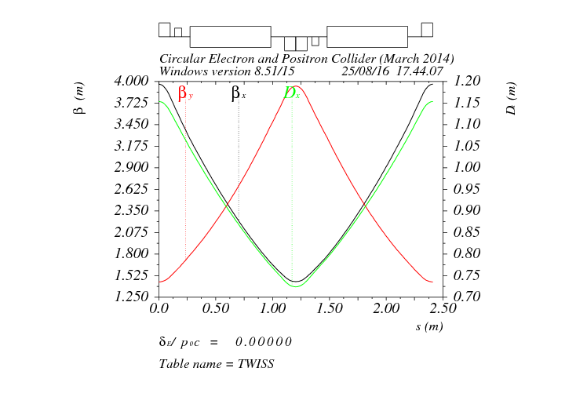
FODO cell in arc

Slide 10
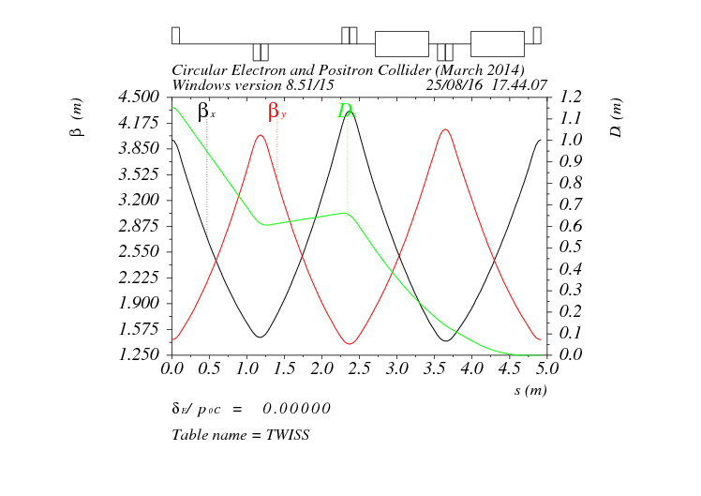
Dispersion supressor

Slide 11
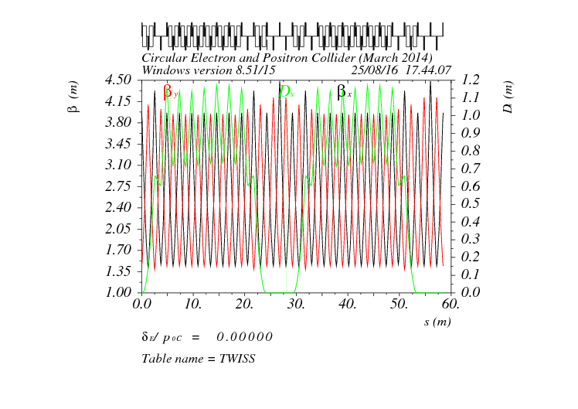
Whole ring
Circumference = 58.5m

Slide 12
Layout of CEPC DR

Slide 13
Lattice design result

Slide 14
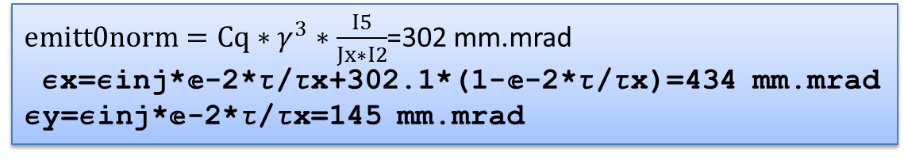
Beam parameter from real lattice
$emitt0norm=Cq∗γ^{3}∗\frac{I5}{Jx∗I2}$=302 mm.mrad
ex=einj*ã-2*t/tx+302.1*(1-ã-2*t/tx)=434 mm.mrad
ey=einj*ã-2*t/tx=145 mm.mrad

