Slide 1
Update on pretzel design
Geng Huiping
CEPC AP group meeting
2016.08.26

Slide 2
Contents
DA optimization result with MODE

Slide 3
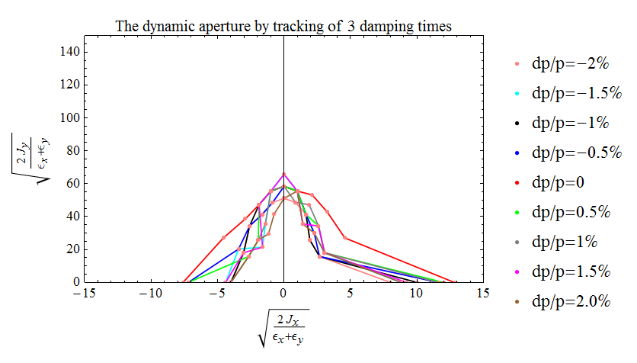
DA result directly from SAD matching (no FFS)
Horizontal: ~5σx (on momentum)

Slide 4
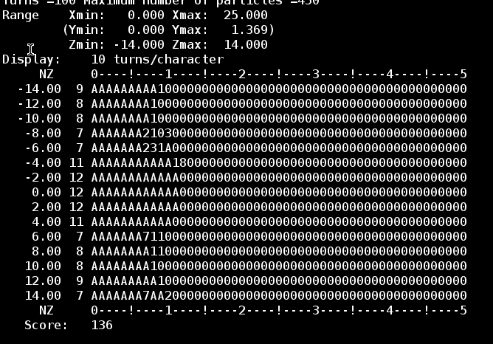
DA result directly from SAD matching (use 0.3% coupling)
Horizontal:
~5σx @0.0% dp/p
~4σx @2.0% dp/p

Slide 5
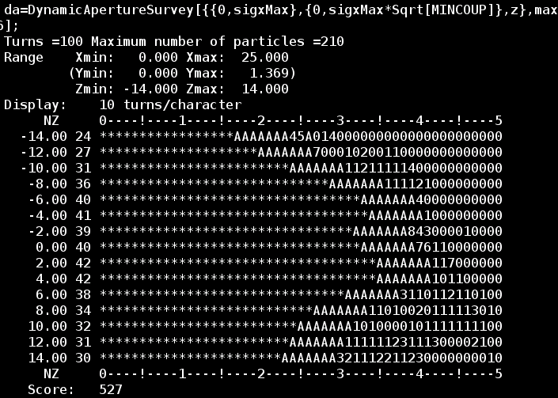
DA result after optimization
(about 3-4days)
Horizontal:
~20σx @0.0% dp/p
~15σx @2.0% dp/p

Slide 6
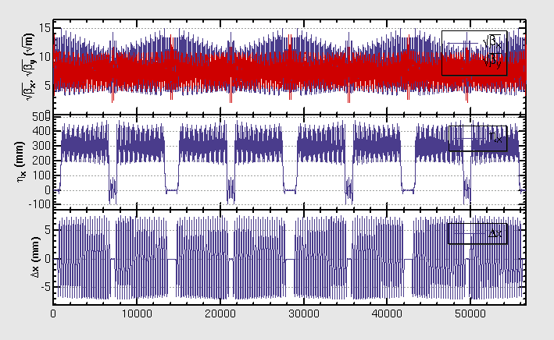
Beta, dispersion function and orbit of the optimized lattice

Slide 7
Next steps
Change layout of magnets to be symmetrical
Re-match
Optimize DA with MODE again
Add FFS

