Slide 1
DA after orbit correction
Sha Bai
CEPC AP meeting
2016-08-26

Slide 2
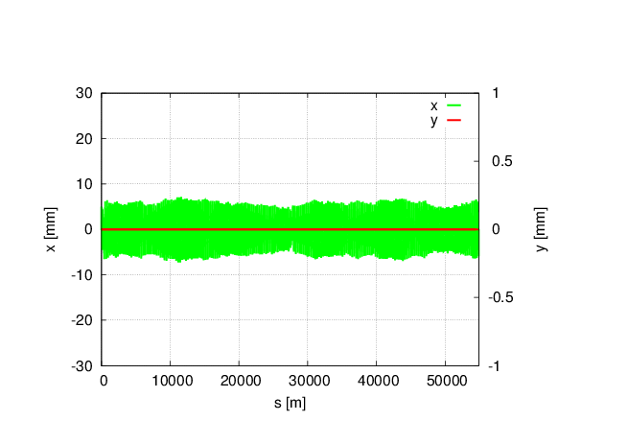
Magnet field error on DA in CEPC single ring
no error
With all (B,Q,S) B*L field errors, whole ring including FFS.
Tune has changed a lot: μ_{x}=0.0510854 μ_{y}= 0.1526778
Orbit correction and tune adjust are needed
Bend set to bend, and Quad and Sext set to be MULT
Tracking in 240 turns, coupling factor κ=0.003 for ε_{y}
Could be cured by adjusting the current during commissioning

Slide 3
Multipole errors effect on DA in CEPC single ring
Bend multipole errors (whole ring including FFS)
Quad multipole errors
(whole ring including FFS)
Sextupole multipole errors(whole ring including FFS)
(B,Q,S)multiple errors
(whole ring including FFS)
Off-momentum DA is not changed obviously, with 2% (1σ_{x}, 7σ_{y}), on-momentum DA is reduced to one third of the original.
Tune is kept, no effect on tune
Orbit is kept to be zero, no effect on orbit
Bend is set to be bend, but quadrupole and sextupole are set to be MULT
Tracking in 240 turns, Coupling factor κ=0.003 for emitty
Multipole errors can not be cured during commissioning, but could be accepted due to the not obvious change of off-momentum DA.

Slide 4
Magnet field error on DA in CEPC partial double ring
Main effect coming from the bending magnet
With bend B*L error
(whole ring including FFS)
μ_{x}= 0 μ_{y}= 0
Orbit in X
With bend B*L error
(whole ring including FFS)
Orbit in Y
With bend B*L error
(whole ring including FFS)
no error
With bending magnet field errors, horizontal orbit has changed a lot, but vertical has no change
Tune has changed to be an integer resonance, beam is not stable.
Orbit correction is needed in horizontal
Tracking in 240 turns, coupling factor κ=0.003 for ε_{y}
Could be cured by adjusting the current during commissioning

Slide 5
Multipole errors effect on DA in CEPC partial double ring
Multipole errors of all magnets
Multipole errors of bend
Multipole errors of quadurpoles
Multipole errors of sextupoles
Multipole errors reduce DA a little bit , but not much. It seems to have not much effect on DA, especially of off-momentum DA.
Orbit has no change due to multipole errors.

Slide 6
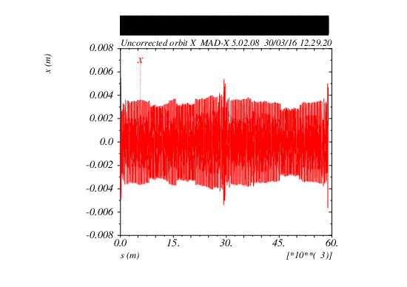
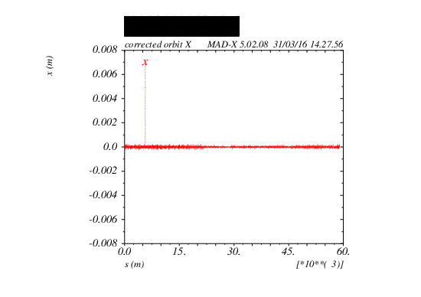
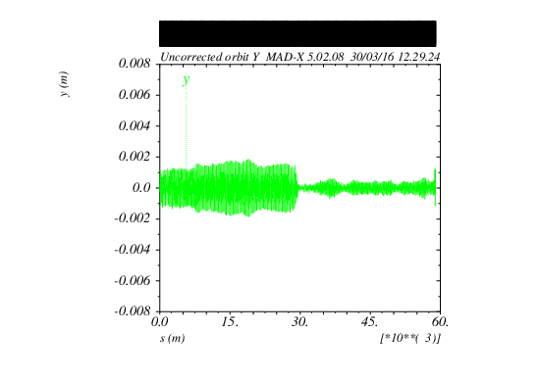
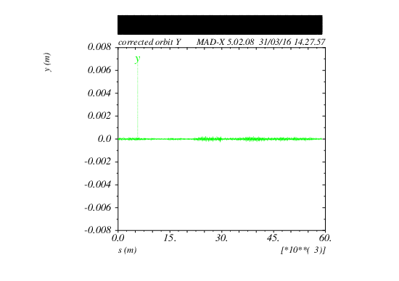
Orbit correction result
Before correction
After correction
Lattice版本：
CEPC-ARC1.0-PDR1.0-FFS (WD1.0)

Slide 7
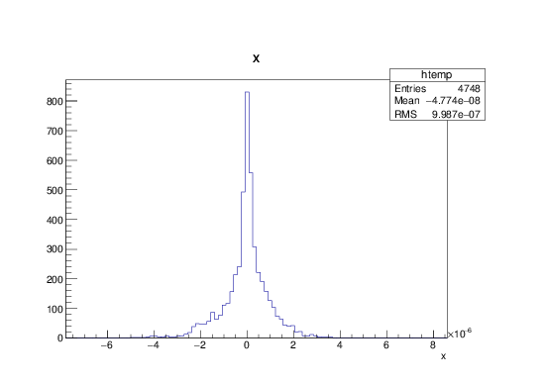
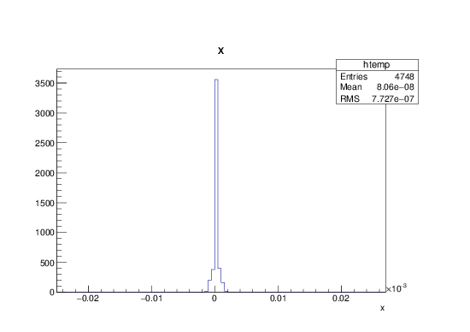
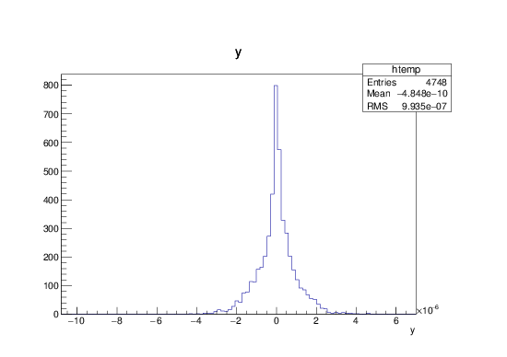
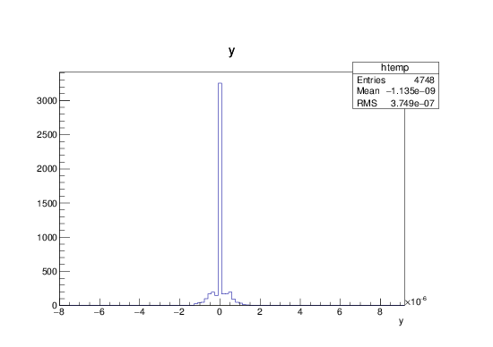
BPM readings and correctors strength statistic
BPM readings statistic
Correctors strength statistic
X CORRECTION:
about 1700 correctors used
Max strength ~ 23urad
RMS ~ 0.77urad
X CORRECTION
SUMMARY:
RMS before correction
2.127 mm
RMS after correction
0.0009987 mm
Y CORRECTION:
about 1700
correctors used
Max strength ~ 6.7urad
RMS ~ 0.37urad
Y CORRECTION
SUMMARY:
RMS before correction
0.6423 mm
RMS after correction
0.0009935 mm

Slide 8
DA after orbit correction
Lattice版本：CEPC-ARC1.0-PDR1.0-FFS (WD1.0)
No error
DA after orbit correction
(best seed)
DA after orbit correction
(worst seed)

Slide 9
Conclusion
Dynamic aperture can almost be recovered after orbit correction for most seeds.
For CEPC partial double ring, lattice version：CEPC-ARC1.0-PDR1.0-FFS (WD1.0), the error from multipoles has not much effect on dynamic aperture.

