Slide 1
Update on pretzel design
Geng Huiping
CEPC AP group meeting
2016.09.09

Slide 2
Contents
Insertion of FFS
DA optimization result with MODE

Slide 3
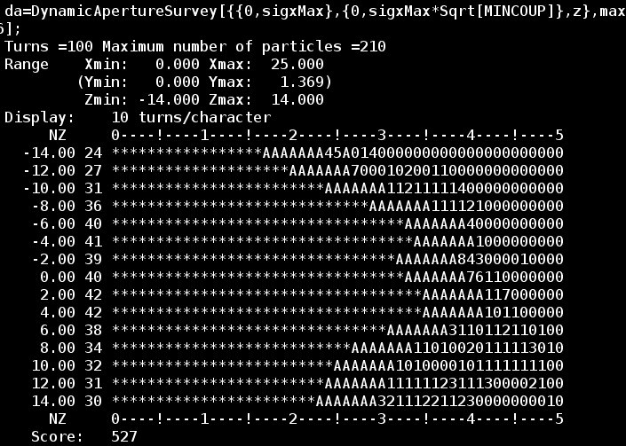
DA result after optimization (no FFS)
(about 3-4days)
Horizontal:
~20σx @0.0% dp/p
~15σx @2.0% dp/p

Slide 4
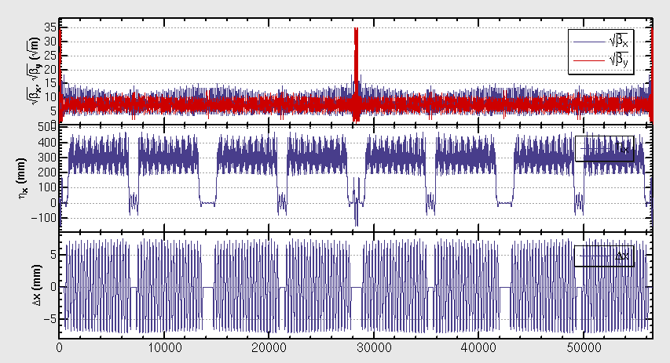
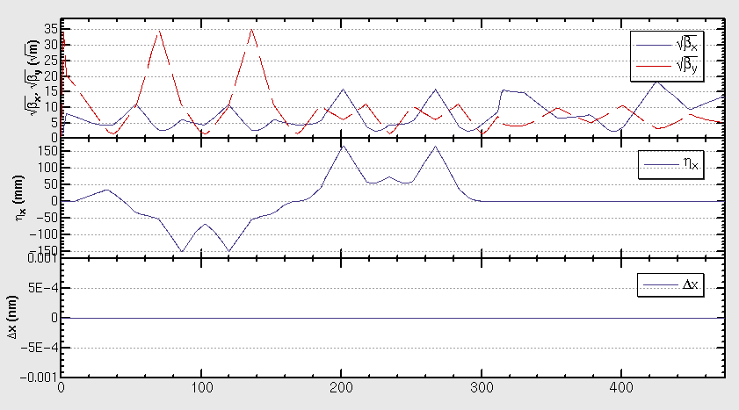
Combination with FFS
One version of FFS (which has been optimized for the ring without pretzel orbit) is inserted to the lattice with pretzel
The betatron and dispersion functions of the FFS are shown in the left plot
The whole lattice of the ring is shown in the right plot
Courtesy of Yiwei Wang, βy*=3mm

Slide 5
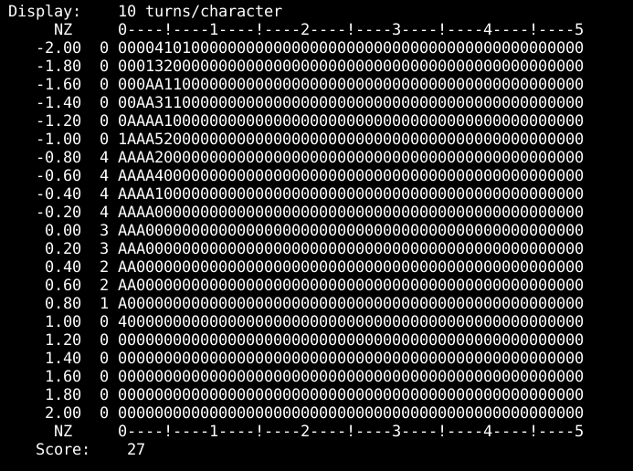
DA w/ pretzel and FFS
Optimize sextupoles in FFS only, does not converge…

Slide 6
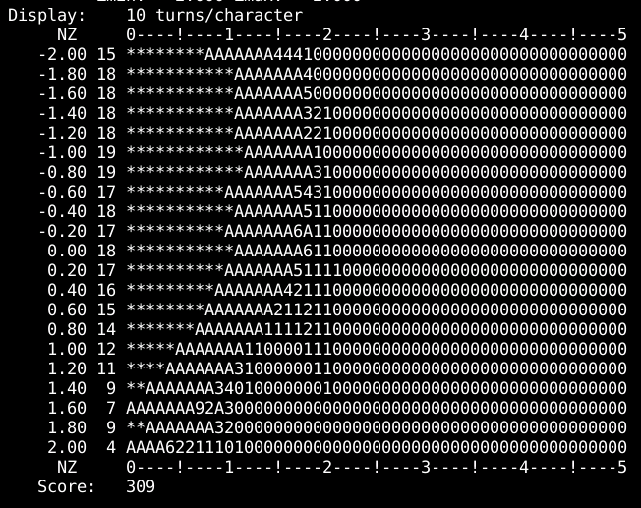
DA w/ pretzel and FFS
Optimize sextupoles in FFS and arc (2.5days)

Slide 7
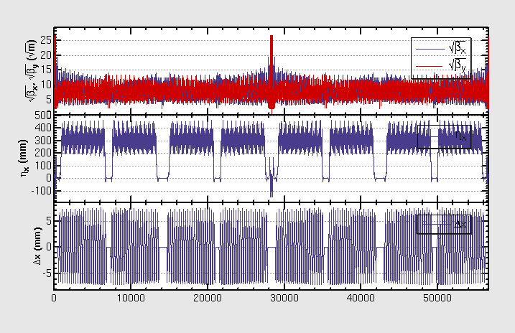
Beta functions of the lattice

Slide 8
Next steps
Change layout of magnets to be symmetrical
Re-match
Add FFS
Optimize DA with MODE again (Include both quadrupoles and sextupoles)

