Slide 1
Pretzel方案进展及计划
耿会平，张源，高杰， 王毅伟， 王逗， 徐刚， 秦庆，王娜，崔小昊，段哲，白莎，苏峰，边天剑
清华大学
“高能环形正负电子对撞机相关物理和关键技术预研究”项目启动会
2016年9月27日

Slide 2
Outline
Pretzel 方案研究最新进展
CDR report的内容及目标
CDR目标及计划
Summary

Slide 3
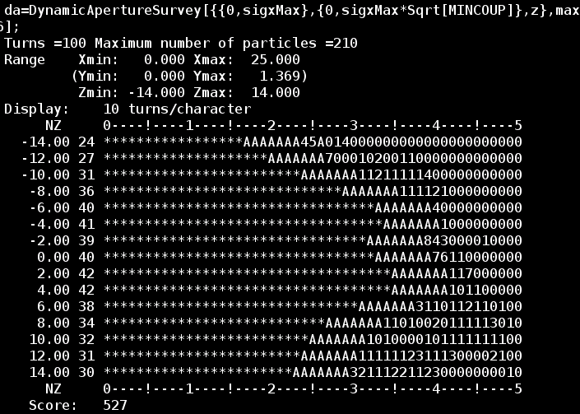
MODE优化结果( pretzel, no FFS)
DA result after optimization (about 3-4days), use 13 families of sextupoles
Horizontal:
~20σx @0.0% dp/p
~15σx @2.0% dp/p

Slide 4
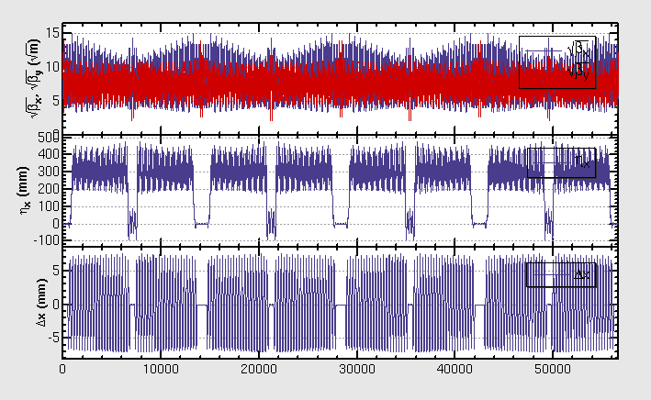
Constraints have been set for orbit, dispersion etc.
Beta, dispersion function and orbit of the optimized lattice

Slide 5
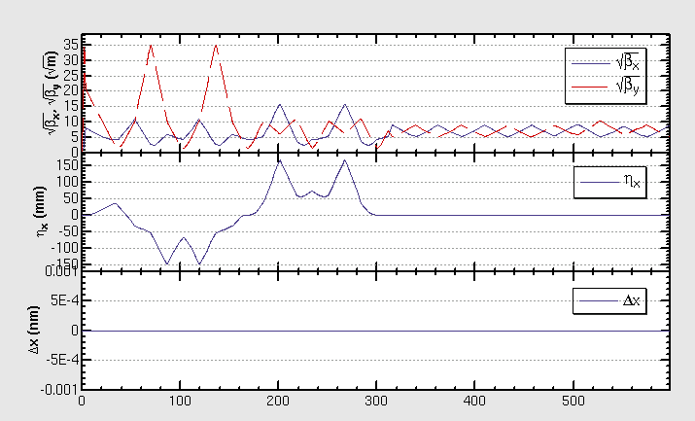
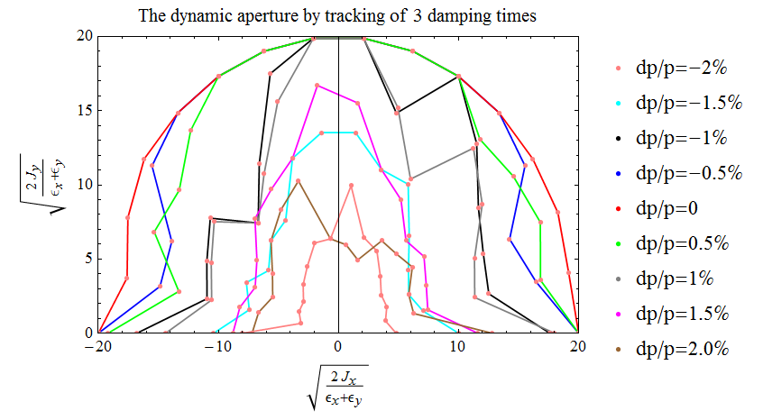
IR lattice to be combined with pretzel
A version of FFS design provided by Yiwei
DA (w/o pretzel) is ~20σx @0.0% dp/p, ~4σx @2.0% dp/p

Slide 6
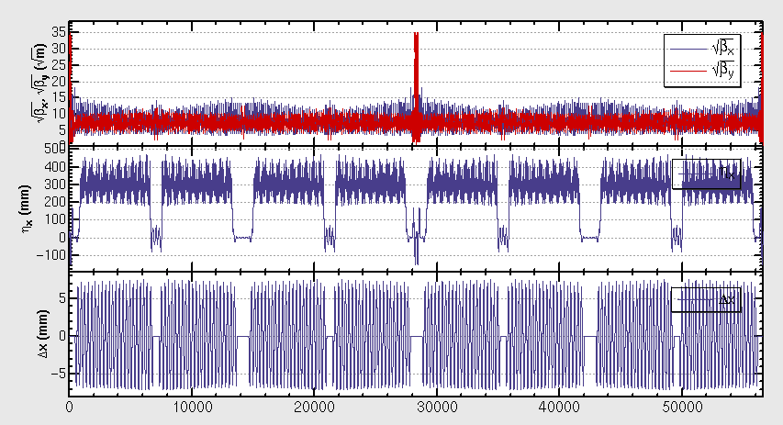
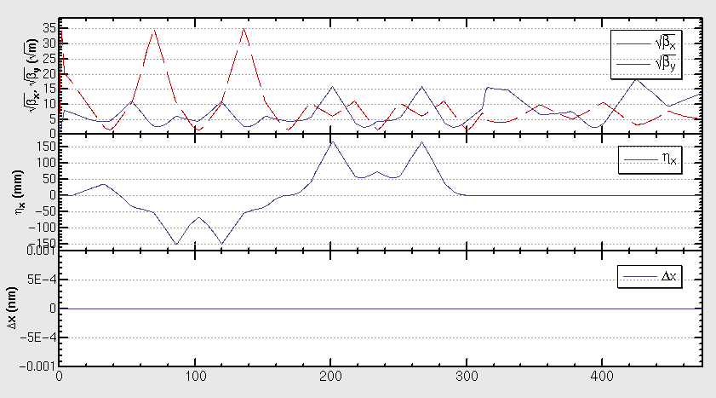
Combination with FFS
One version of FFS (which has been optimized for the ring without pretzel orbit) is inserted to the lattice with pretzel
The betatron and dispersion functions of the FFS are shown in the left plot
The whole lattice of the ring is shown in the right plot
Courtesy of Yiwei Wang, βy*=3mm

Slide 7
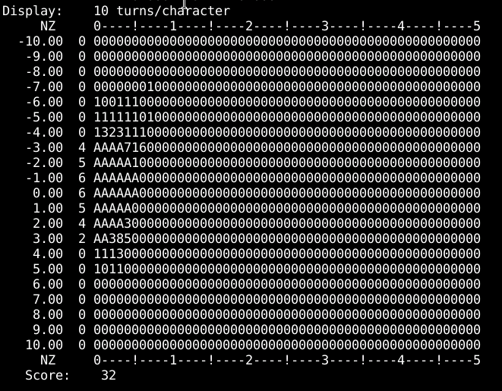
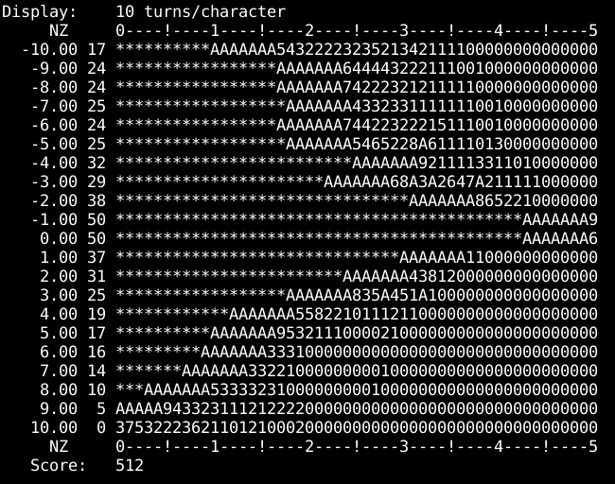
DA with pretzel and FFS
DA after direct combining with pretzel and FFS: ~2σx @0.0% dp/p
After optimization: ~20σx @0.0% dp/p, ~6σx @-1.4% dp/p
~20σx @0.0% dp/p, ~6σx @-1.4% dp/p

Slide 8
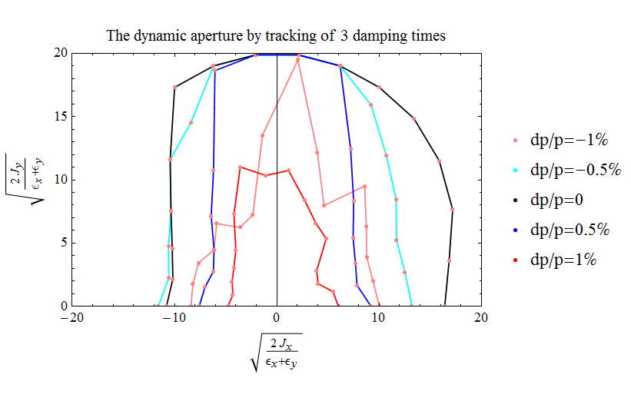
有/无pretzel时的动力学孔径对比（w/ FFS）
DA (w/o pretzel) is
~16σx @0.0% dp/p,
~6σx @1.0% dp/p
~0σx @2.0% dp/p
DA (w/o pretzel) is
~20σx @0.0% dp/p,
~6σx @1.0% dp/p
~4σx @2.0% dp/p

Slide 9
CDR report的内容及目标
Pretzel方案的具体设计
Pretzel方案中存在的物理问题及解决方法
主要指off center orbit问题及解决方法
Pretzel方案的动力学孔径的优化（w/o FFS）
目标: ~20σx @0.0% dp/p, ~5σx @2.0% dp/p
Pretzel方案的动力学孔径的优化（w/ FFS）
目标: ~20σx @0.0% dp/p, ~5σx @2.0% dp/p

Slide 10
Goal of Pretzel design in CDR
Realize beam separation of 50 bunches
Complete the correction of orbit effect
Reasonable DA w/o FFS
Reasonable DA w/o FFS with sawtooth effect
Try DA w/ FFS, error

Slide 11
Pretzel方案设计工作计划
用MODE优化现有lattice的孔径
增加Q铁作为自变量
优化工作点
FMA分析
优化FFS设计
改变直线节的结构（替换标准cell的FODO节）
优化六极铁分布在Q铁两侧的对称lattice
用六极铁和Q铁作为自变量
优化工作点
FMA分析
Sawtooth 效应
Error效应

Slide 12
Thank you !

