Slide 1
CEPC Partial Double Ring Lattice Design and DA Study
SU Feng GAO Jie WANG Dou WANG Yiwei Li Yongjun BAI Sha
BIAN Tianjian GENG Huiping ZHANG Yuan
Institute of High Energy Physics
高能环形正负电子对撞机相关的物理和关键技术预研究”项目启动会，2016.9.27

Slide 2
Outline
CEPC PDR Lattice Design Progress:
CEPC PDR Parameter and Lattice Layout
CEPC PDR ARC Length Consideration and Redesign
CEPC PDR DA Study ( NSGAII & DA Optimization)
CEPC APDR Scheme
CEPC Double Ring Scheme
Summary
CDR Report & CDR & Plan & Next to do

Slide 3
Outline
CEPC PDR Parameter and Lattice Layout

Slide 4
Parameter for CEPC partial double ring （wangdou20160918）
 | Pre-CDR | H-high lumi. | H-low power | W | Z
Number of IPs | 2 | 2 | 2 | 2 | 2
Energy (GeV) | 120 | 120 | 120 | 80 | 45.5
Circumference (km) | 54 | 61 | 61 | 61 | 61
SR loss/turn (GeV) | 3.1 | 2.96 | 2.96 | 0.58 | 0.061
Half crossing angle (mrad) | 0 | 15 | 15 | 15 | 15
Piwinski angle | 0 | 1.88 | 1.84 | 5.2 | 6.4
N_{e}/bunch (10¹¹) | 3.79 | 2.0 | 1.98 | 1.16 | 0.78
Bunch number | 50 | 107 | 70 | 400 | 1100
Beam current (mA) | 16.6 | 16.9 | 11.0 | 36.5 | 67.6
SR power /beam (MW) | 51.7 | 50 | 32.5 | 21.3 | 4.1
Bending radius (km) | 6.1 | 6.2 | 6.2 | 6.2 | 6.2
Momentum compaction (10⁻⁵) | 3.4 | 1.48 | 1.48 | 1.44 | 2.9
β_{IP} x/y (m) | 0.8/0.0012 | 0.272/0.0013 | 0.275 /0.0013 | 0.1/0.001 | 0.1/0.001
Emittance x/y (nm) | 6.12/0.018 | 2.05/0.0062 | 2.05 /0.0062 | 0.93/0.0078 | 0.88/0.008
Transverse σ_{IP} (um) | 69.97/0.15 | 23.7/0.09 | 23.7/0.09 | 9.7/0.088 | 9.4/0.089
ξ_{x}/IP | 0.118 | 0.041 | 0.042 | 0.013 | 0.01
ξ_{y}/IP | 0.083 | 0.11 | 0.11 | 0.073 | 0.072
V_{RF} (GV) | 6.87 | 3.48 | 3.51 | 0.74 | 0.11
f _{RF} (MHz) | 650 | 650 | 650 | 650 | 650
Nature σ_{z} (mm) | 2.14 | 2.7 | 2.7 | 2.95 | 3.78
Total σ_{z} (mm) | 2.65 | 2.95 | 2.9 | 3.35 | 4.0
HOM power/cavity (kw) | 3.6 | 0.74 | 0.48 | 0.88 | 0.99
Energy spread (%) | 0.13 | 0.13 | 0.13 | 0.087 | 0.05
Energy acceptance (%) | 2 | 2 | 2
Energy acceptance by RF (%) | 6 | 2.3 | 2.4 | 1.7 | 1.2
n_{γ} | 0.23 | 0.35 | 0.34 | 0.49 | 0.34
Life time due to beamstrahlung_cal (minute) | 47 | 37 | 37
F (hour glass) | 0.68 | 0.82 | 0.82 | 0.92 | 0.93
L_{max}/IP (10³⁴cm⁻²s⁻¹) | 2.04 | 3.1 | 2.01 | 4.3 | 4.48

Slide 5
CEPC Partial Double Ring Layout
1/2RF
1/2RF
IP1_ee
RF
RF
3.7Km
1/2RF
1/2RF
Bypass
about 42m
IP4_pp
IP2_pp
Bypass
about 42m
1/2RF
1/2RF
IP1_ee/IP3_ee, 3.7Km
IP2_pp/IP4_pp, 1132.8m
4 Short Straights, 141.6m
4 Medium Straights, 566.4m
4 Long Straights, 944m
2 Short ARC, 24*FODO, 1132.8m
4 Medium ARC, 112*FODO, 5286.4m
4 Long ARC, 124*FODO, 5852.8m
C=60830.4m
RF
RF
IP3_ee
1/2RF
1/2RF
SU Feng
2016.9.15

Slide 6
CEPC Partial Double Ring Layout
12
62.5urad
4.5m
B2
B1
614.4m
507.1m
65m
357.5m
307.2m
Full crossing angle 30mrad
15mrad
7.852m
IP
B4
Separator
1851.733m
B3
Version 1.0
sufeng
2016.9.15
For CEPC 120GeV beam:
Max. deflection per separator is 66μrad.

Slide 7
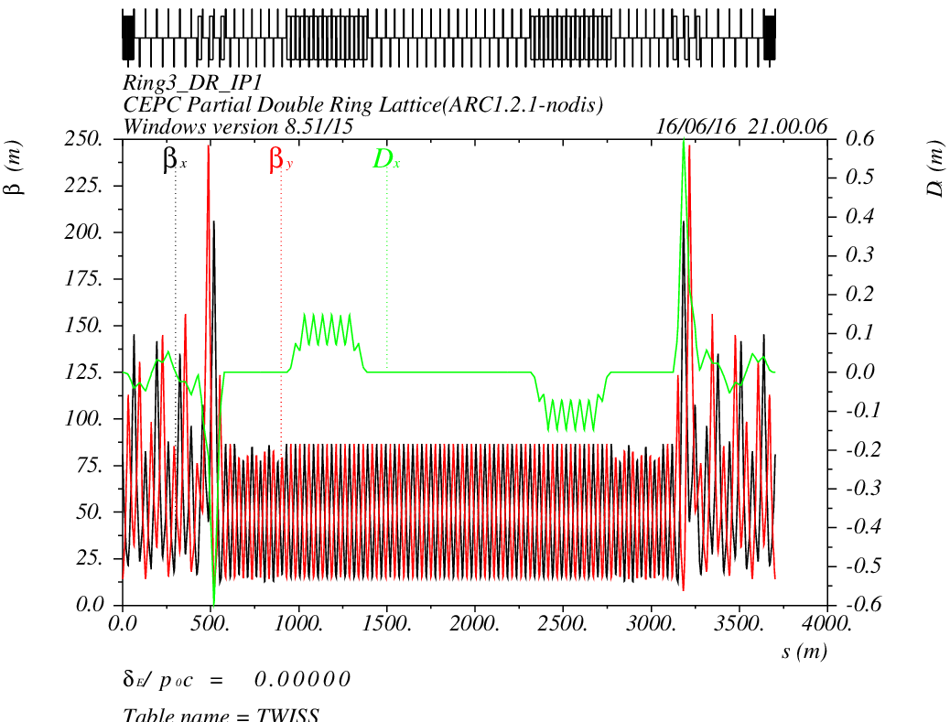
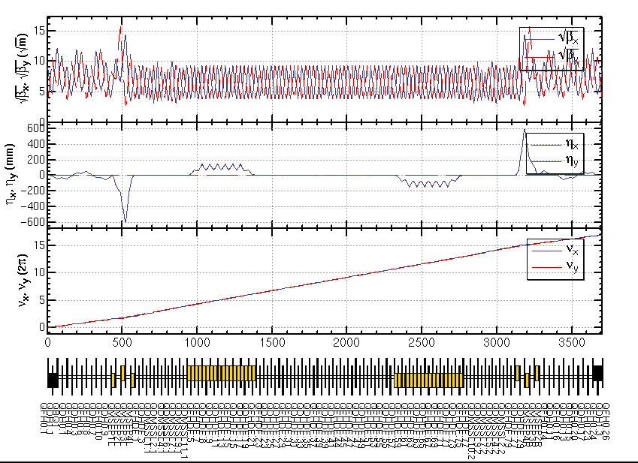
CEPC PDR1.0.3 noFFS

Slide 8
Outline
2. CEPC PDR ARC Length Consideration and Redesign

Slide 9
CEPC PDR ARC Length Consideration
The circumference should be also considered of SPPC requirement…
ARC+Straight (>= 53 Km)
ARC+Straight+PDR
ARC+Straight+PDR+FFS
Notes:
One possible Option

Slide 10
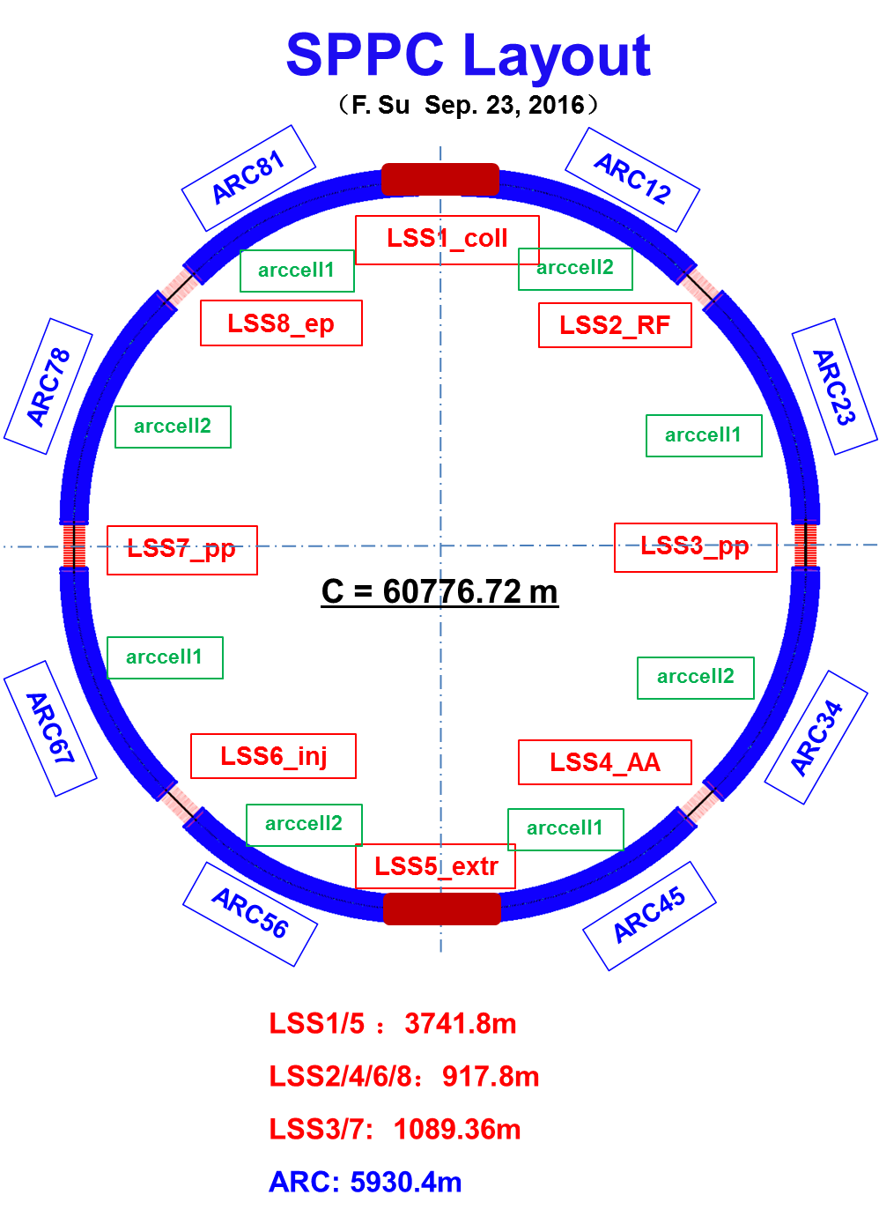
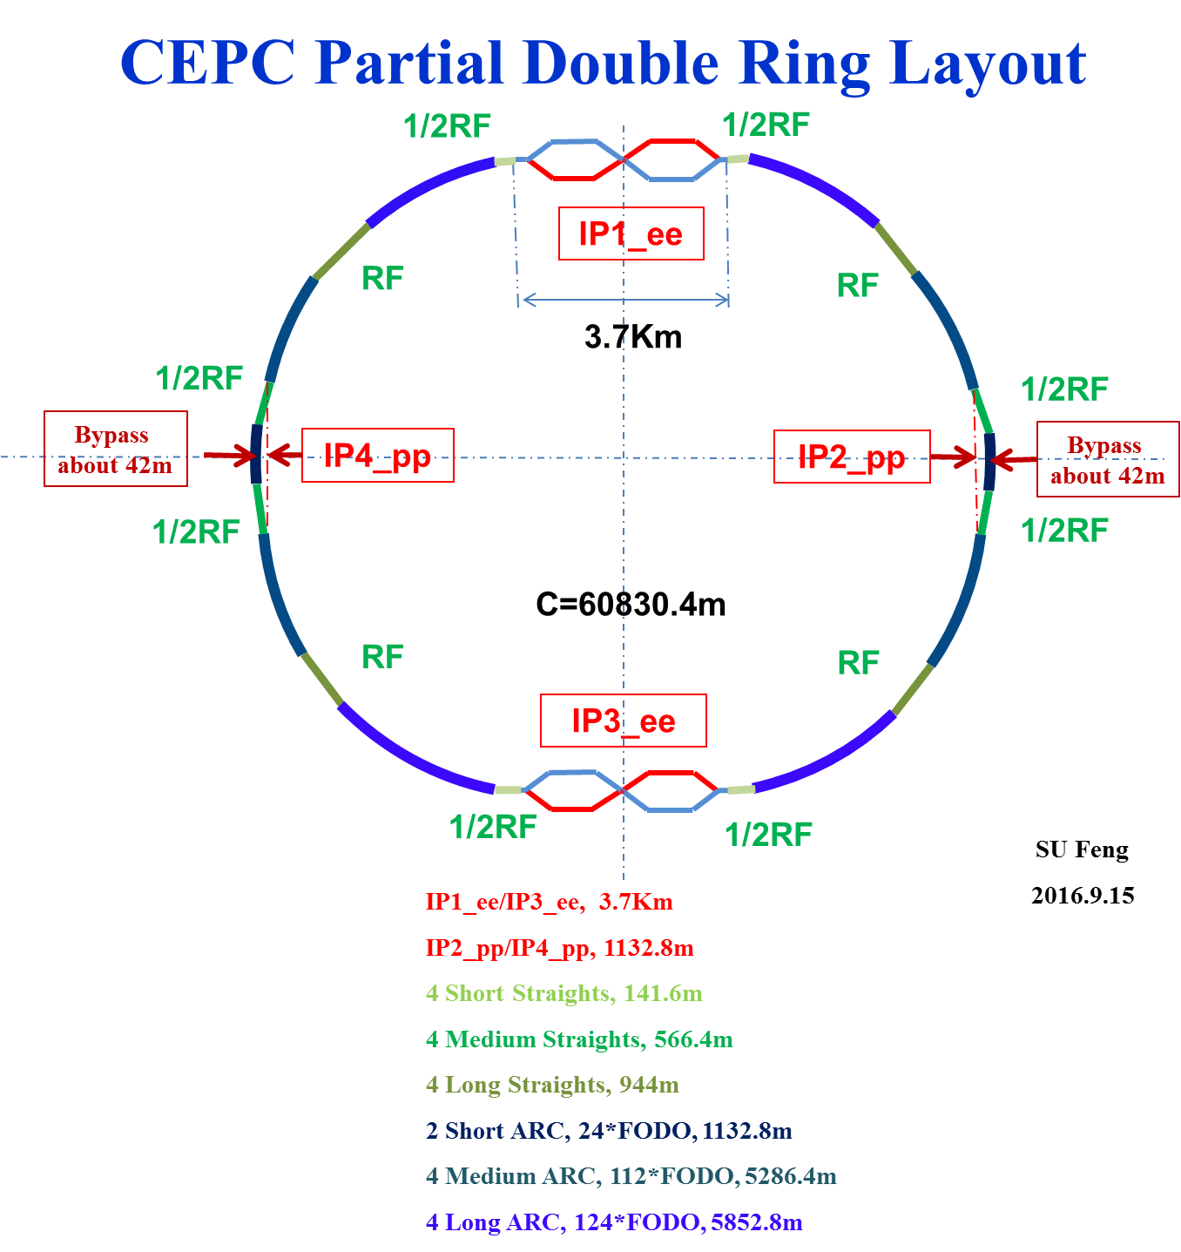
CEPC & SPPC Layout

Slide 11
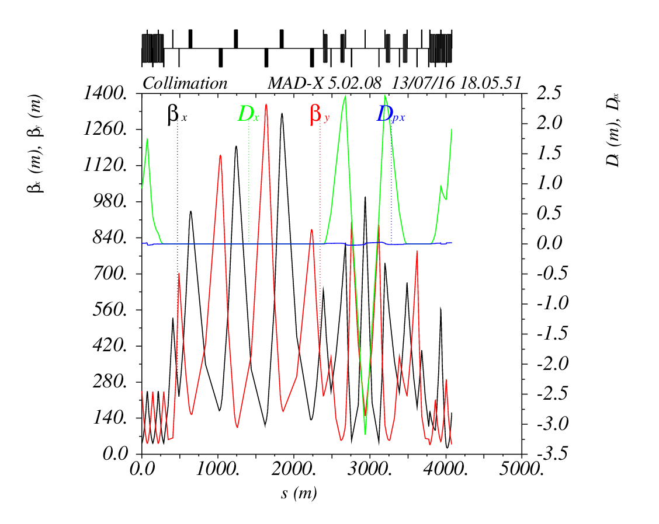
准直段Lattice 设计 （From Jianquan 2016.8.12）
3537.8m

Slide 12
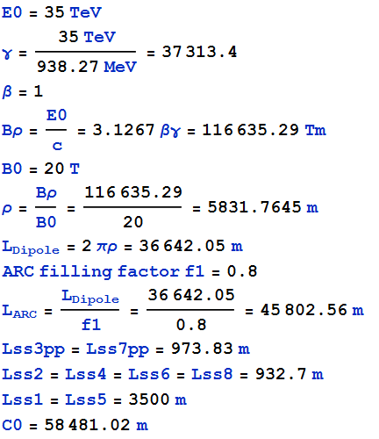
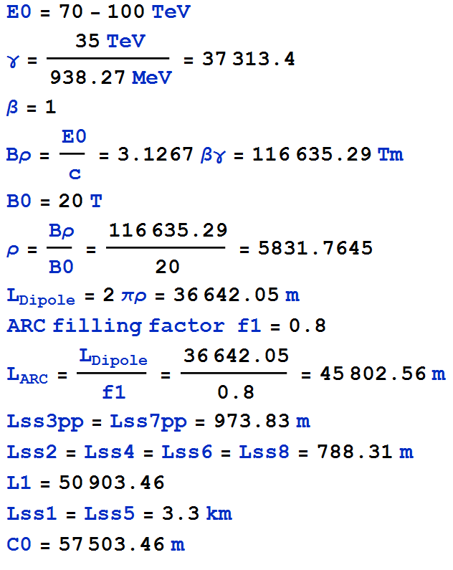
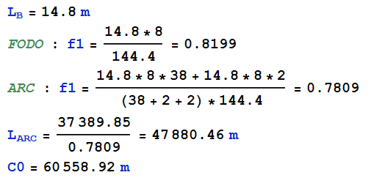
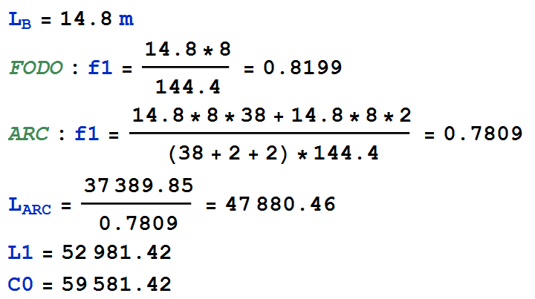
CEPC ARC Length According to SPPC
Theory：
In Practice：

Slide 13
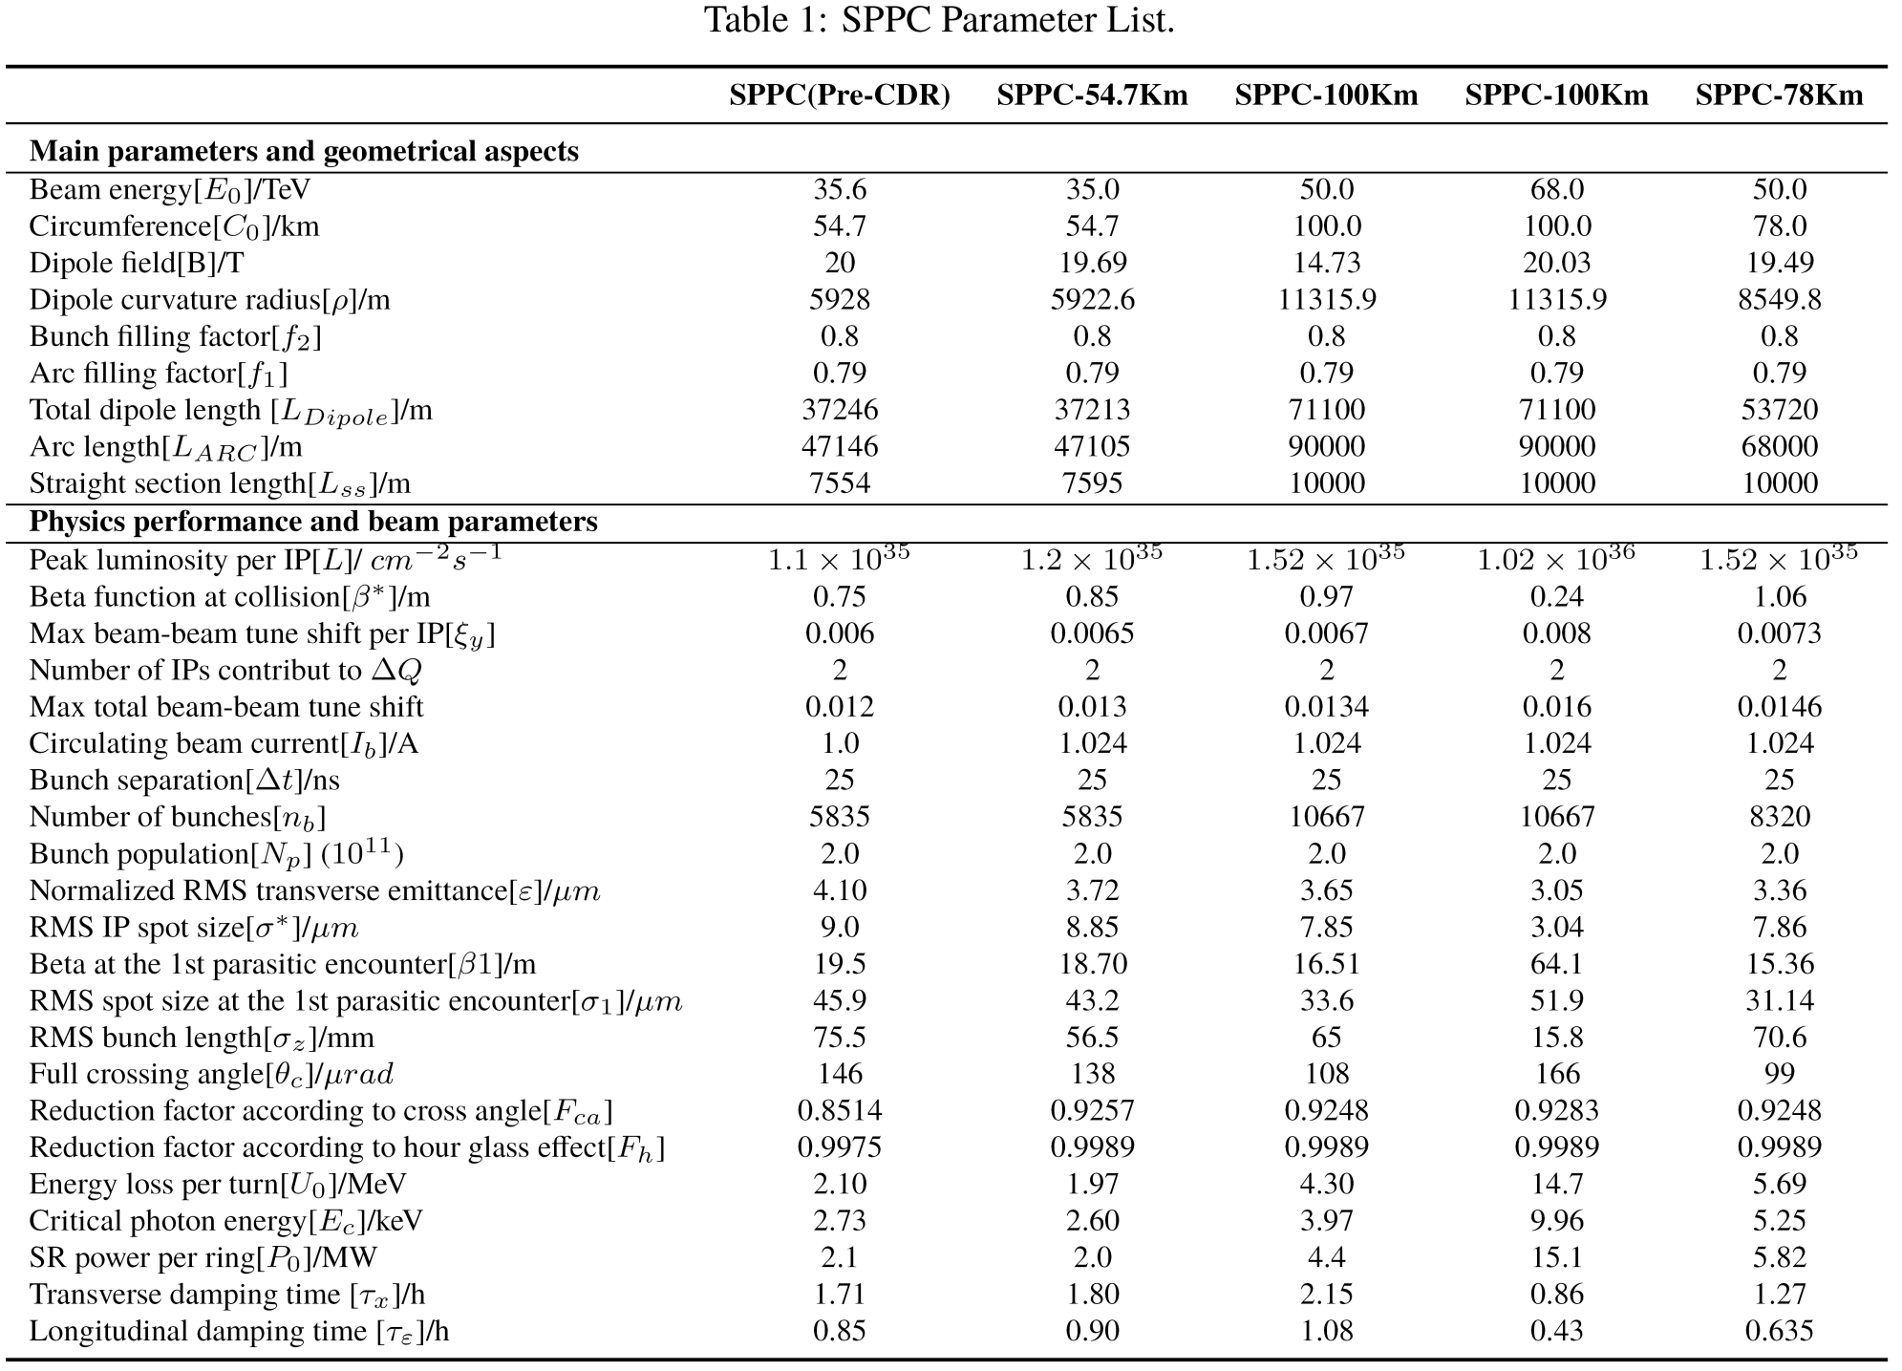
SPPC Parameter Choice and Optimize
Version 201503

Slide 14
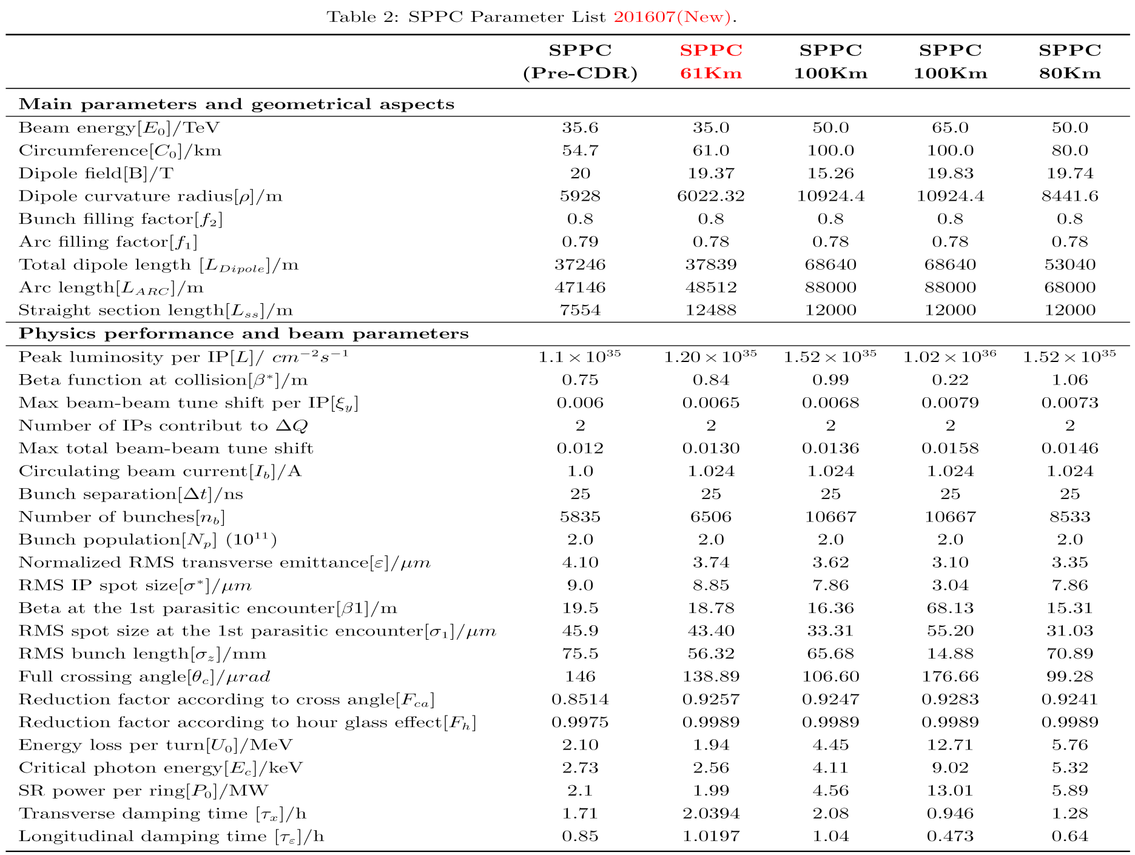
SPPC Parameter Choice and Optimize
Version 201607

Slide 15
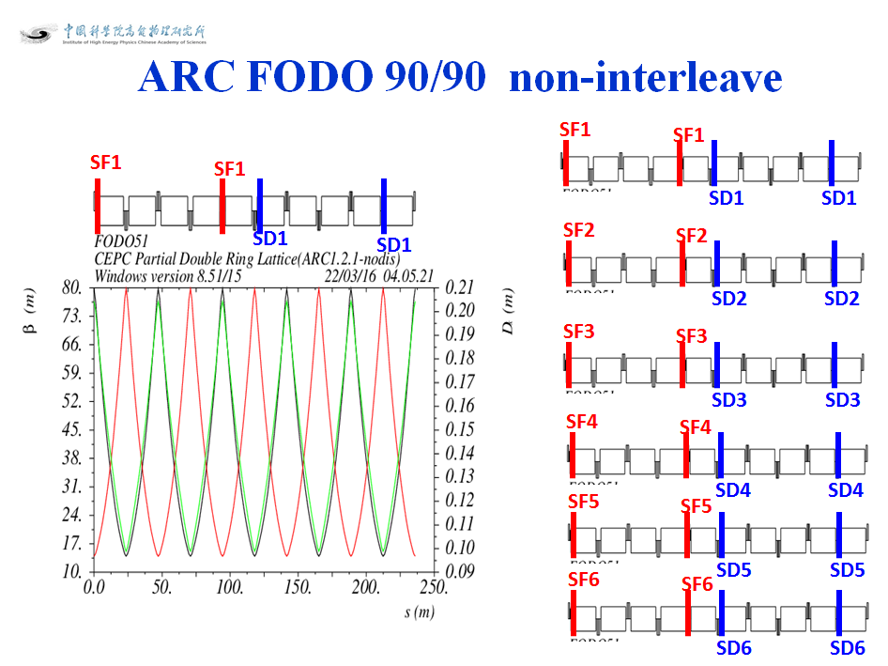
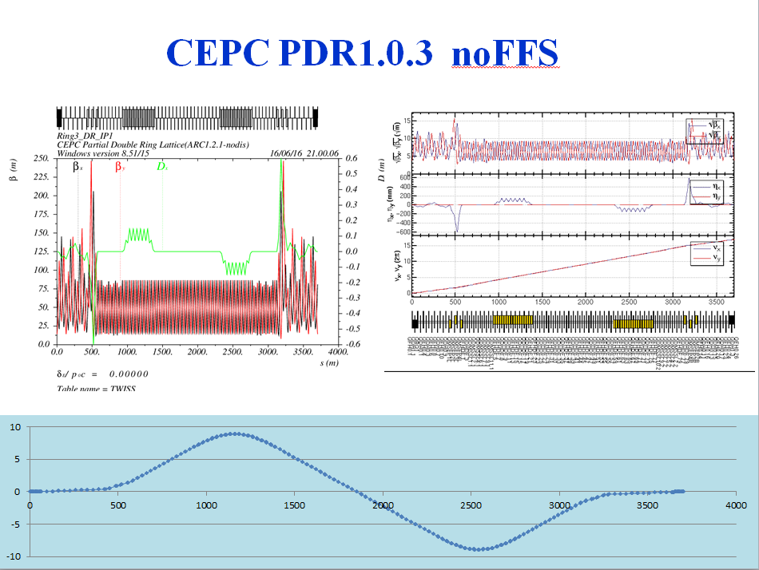

Slide 16
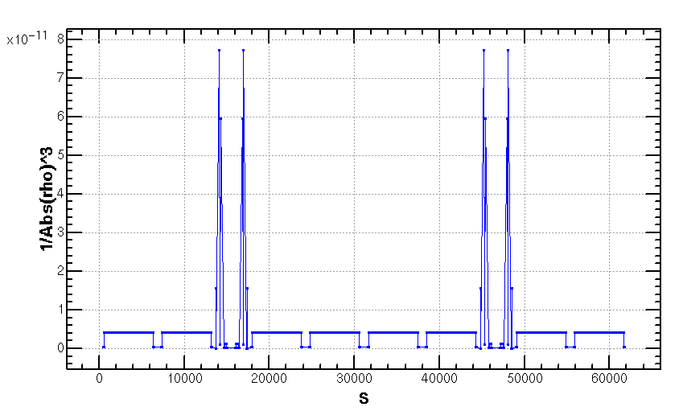
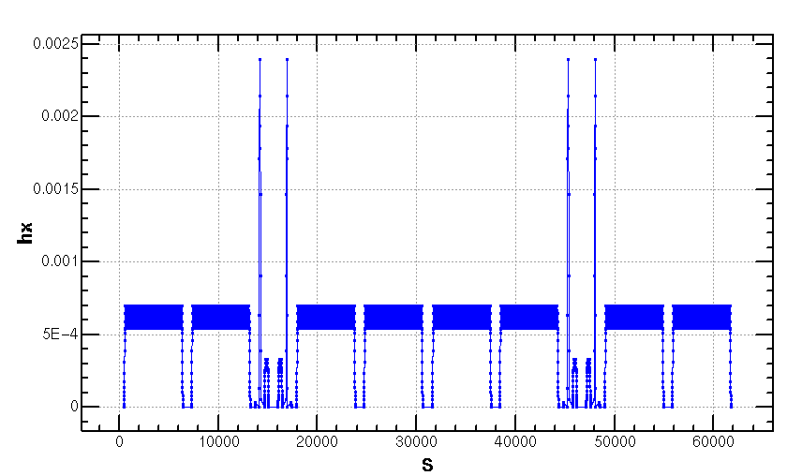
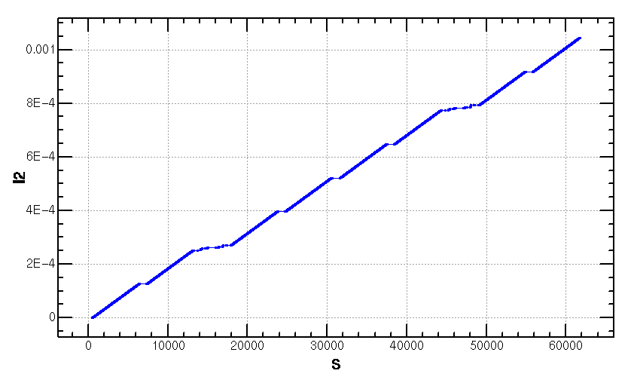
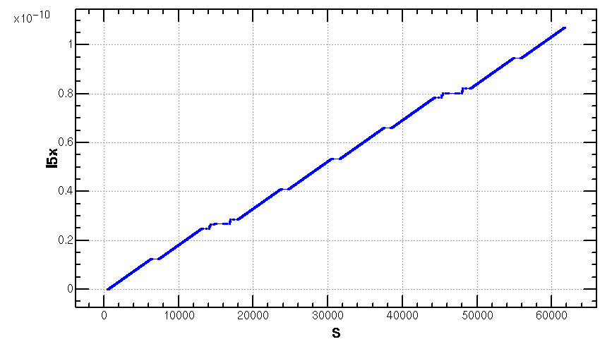
Emittance Increase (2.06nm->2.1668nm)
Notes:
Integration radius

Slide 17
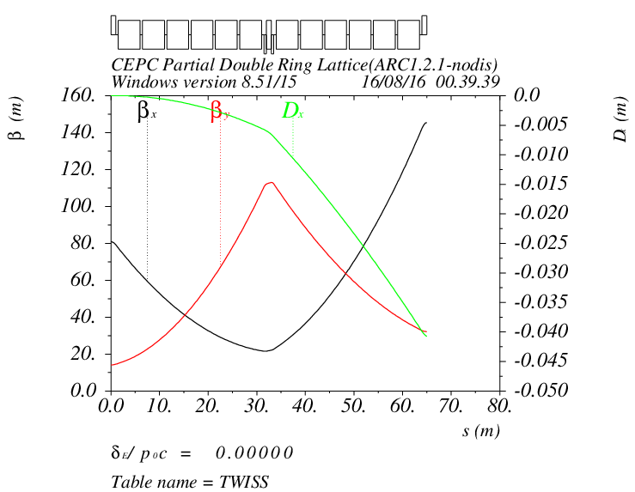
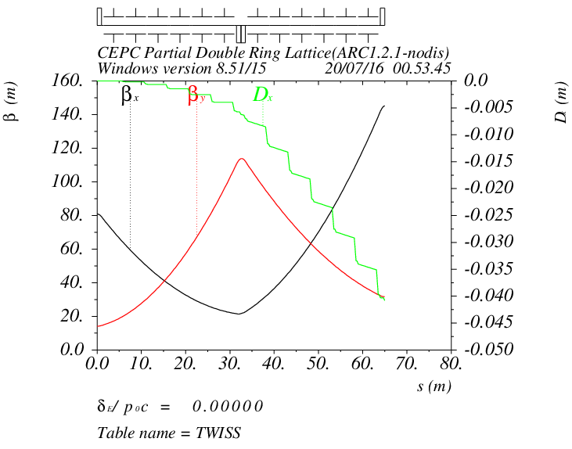
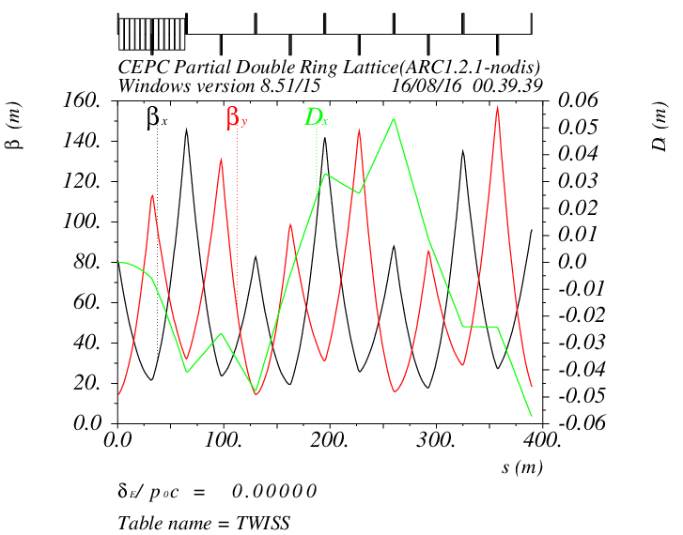
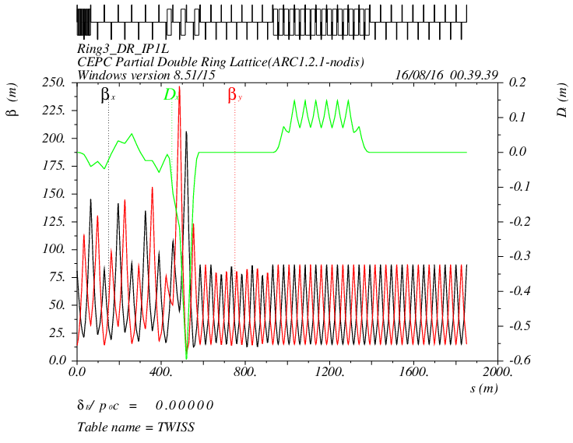
CEPC PDR1.0.3 noFFS

Slide 18
Parameters of Separators sufeng201605
Separator length | 4.5 | m
Electrode length | 4 | m
Maximum operating field strength | 1.875 | MV/m | 上限2MV/m
Beam energy | 120 | GeV
Maximum deflection per separator at 120GeV | 62.5 | urad | 微弧度
Number of separators per collision point | 12*2=24
Total number of separators (PDR) | 24*2=48
Total number of separators (APDR6) | 24*6=144
Total number of separators (APDR8) | 24*8=192
Notes:
Maximum operating field strength

Slide 19
According to CEPC Pre-CDR Magnet Parameter
Dipole magnets
Quantity | 1984
Maximum field strength(T) | 0.07
Magnetic gap (mm) | 80
Bending angle (mrad) | 3.17
Magnetic Length (m) | 18
Bending radius (m) | 6094
Good field region (mm) | 100
Core cross section (W*H) (mm) | 450*400
CEPC MQ
Quantity | 2304
Bore diameter (mm) | 100
Field Gradient (T/m) | 10
Magnetic Length (m) | 2.0
Core width and height (mm) | 700*700
Core length (mm) | 1960
CEPC MS | SD | SF
Quantity | 992 | 992
Aperture diameter (mm) | 120 | 120
Good field region (mm) | 100 | 100
Strength of sextupole field (T/m^2) | 180 | 180
Magnetic Length (m) | 700 | 400
Core width and height (mm) | 520 | 520
Length of iron core (mm) | 670 | 370
Super Conducting Q in CEPC IR | QF | QD
Field Gradient (T/m) | 304 | 309
Magnetic Length (m) | 1.25 | 0.72
Peak field in coil (T) | 7.2 | 7.1
Coil inner diameter (mm) | 40 | 40
Coil out diameter (mm) | 74 | 74
Cryostat diameter (mm) | 400 | 400
Coil mechanical length (mm) | 1500 | 950

Slide 20
Dipole Strength PDR1.0.3 without FFS
 | Angle(mrad) | L(m) | Rho(m) | Brho(E0/c)(T/m) | B(T) | Ek(KeV) | KeV/m
B0 | 3.205 | 19.6 | 6115.44 | 400 | 0.06541 | 626.349 | 31.956
BSepL | -0.0625 | 4.5 | -72000 | 400 | -0.00556 | 53.2 | 11.822
BMatch1L | -8.344 | 19.6 | -2348.99 | 400 | -0.1702 | 1630.66 | 83.1967
BMatch2L | 1.997 | 19.6 | 9814.72 | 400 | 0.0407 | 390.271 | 19.9118
BMatch3L | -7.653 | 19.6 | -2561.09 | 400 | -0.1562 | 1495.61 | 76.3069
B2 | 2.1428 | 19.6 | 9146.91 | 400 | 0.04373 | 418.764 | 21.3655
B3 | -2.1428 | 19.6 | -9146.91 | 400 | -0.04373 | 418.764 | 21.3655
BMatch3R | 7.653 | 19.6 | 2561.09 | 400 | 0.1562 | 1495.61 | 76.3069
BMatch2R | -1.997 | 19.6 | -9814.72 | 400 | -0.0407 | 390.271 | 19.9118
BMatch1R | 8.344 | 19.6 | 2348.99 | 400 | 0.1702 | 1630.66 | 83.1967
BSepR | 0.0625 | 4.5 | 72000 | 400 | 0.00556 | 53.2 | 11.822

Slide 21
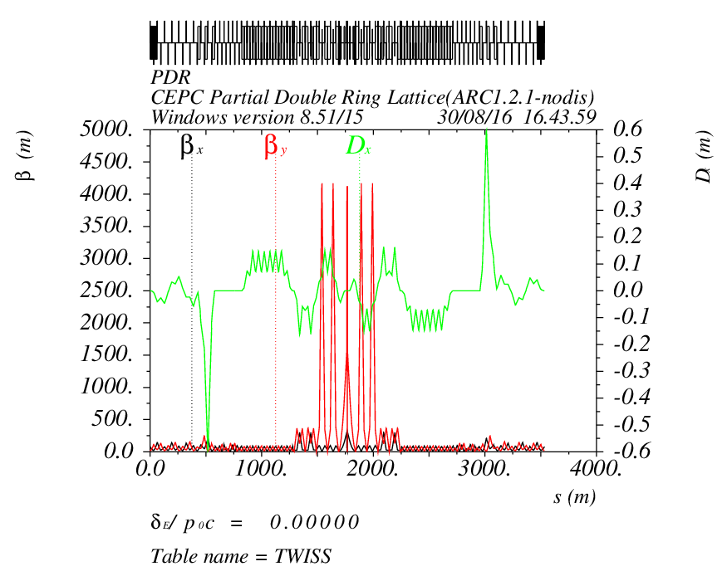
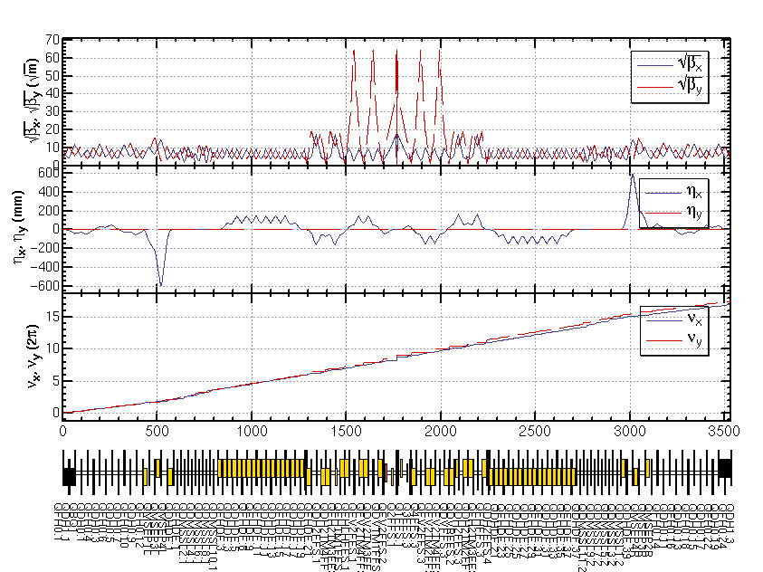
CEPC PDR1.0.3 with FFS (Yiwei20160817)

Slide 22
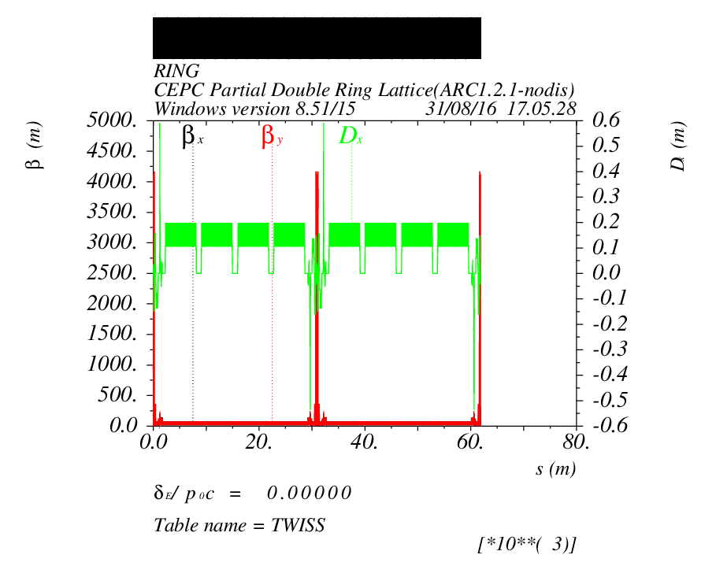
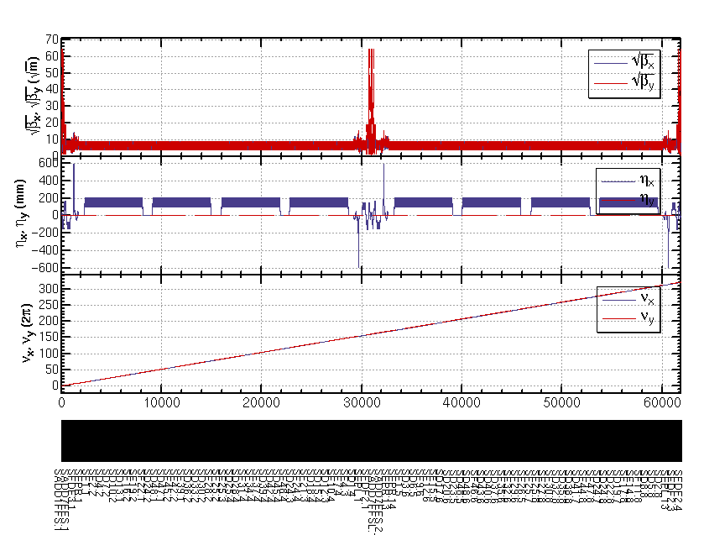
CEPC ARC+PDR_FFS

Slide 23
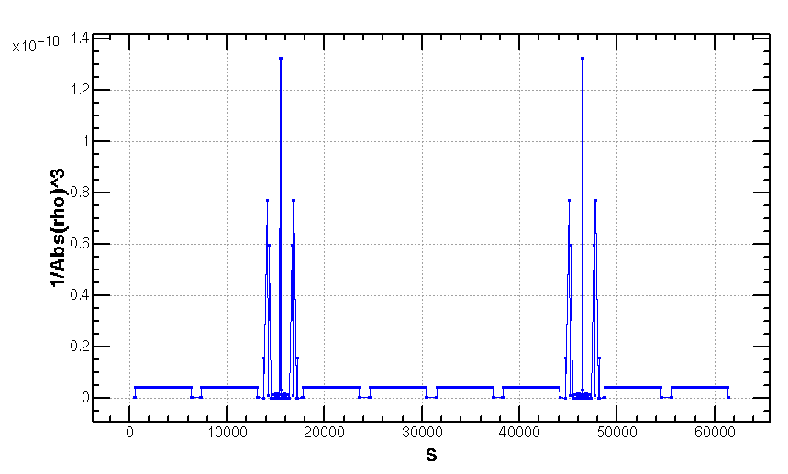
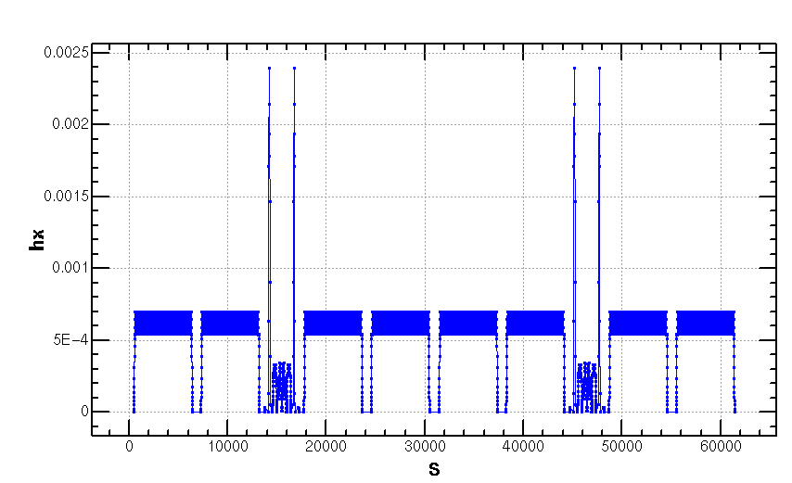
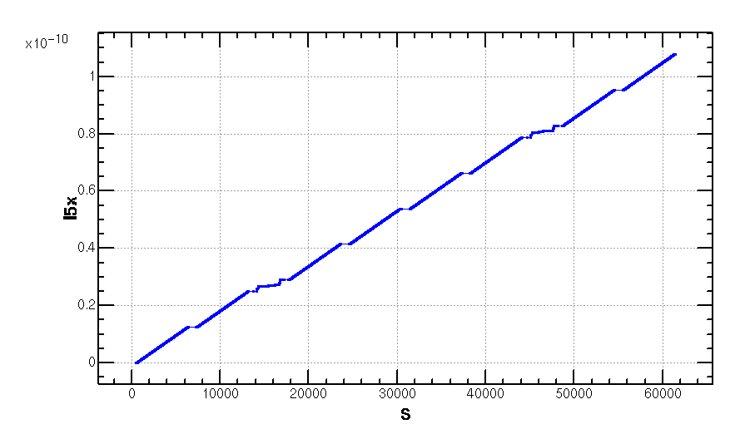
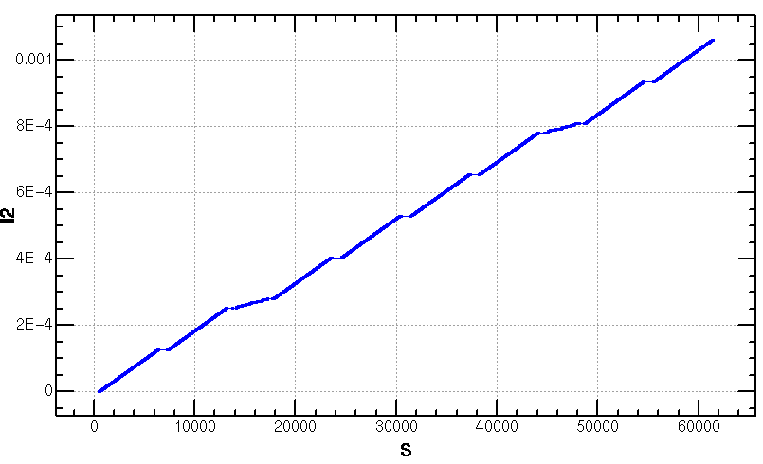
Emittance Increase (2.06nm->2.147368nm)
Notes:
Integration radius

Slide 24
Outline
3. CEPC PDR DA Study ( NSGAII & DA Optimization)

Slide 25
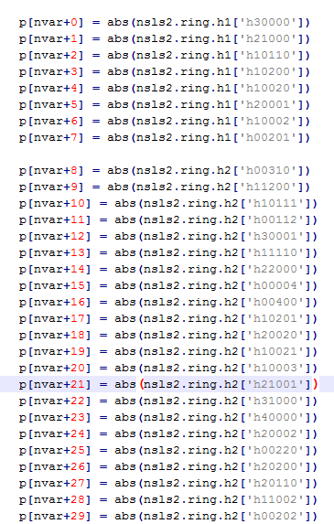
NSGA-II & DA Optimization
Objective
Variable
SF1.K2
SF2.K2
SF3.K2
SF4.K2
SF5.K2
SF6.K2
SD1.K2
SD2.K2
SD3.K2
SD4.K2
SD5.K2
SD6.K2
'npop': 500,
'ngen': 100,
'nobj': 30,
'nvar': 12,
200CPU
T1=40min
T2=70h
cepc_ndr_0099.txt
Notes:
algorithm

Slide 26
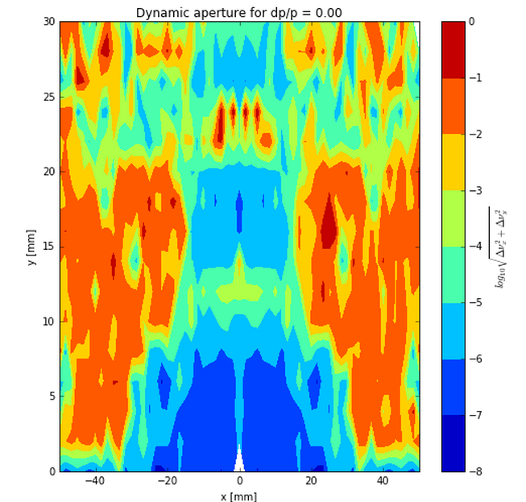
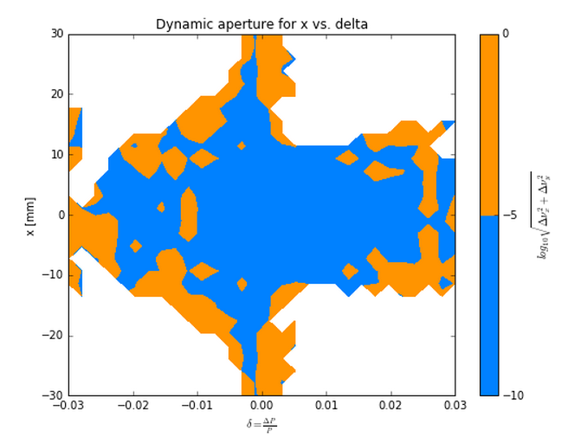
Nonlinear Driving Term (ARC)
Betx：80.992367
bety：14.172123
2nm
Sizmax：402.47um
Sigmay：9.22um
X：60 Sigma
Y：813 Sigma
2 groups

Slide 27
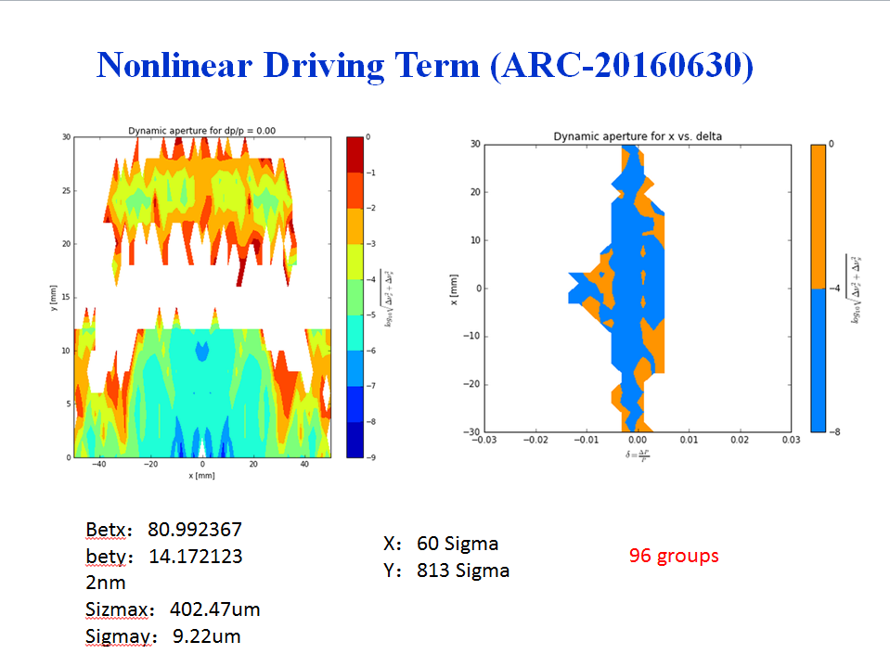

Slide 28
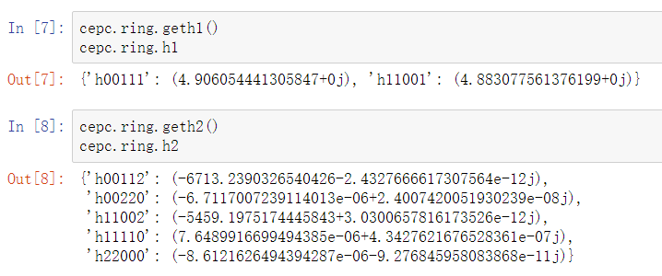
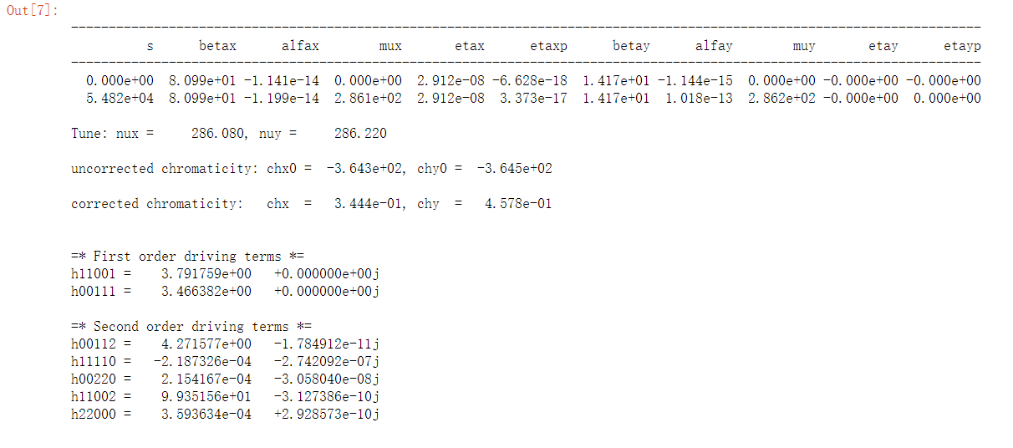
Nonlinear Driving Term (ARC)

Slide 29
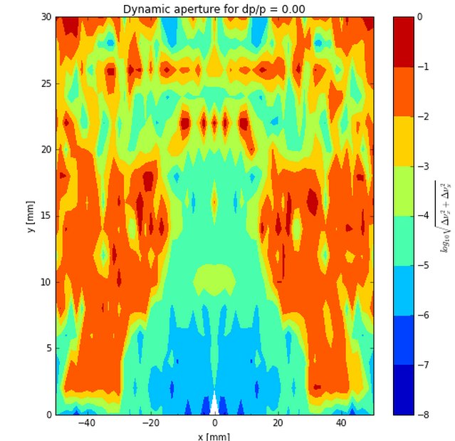
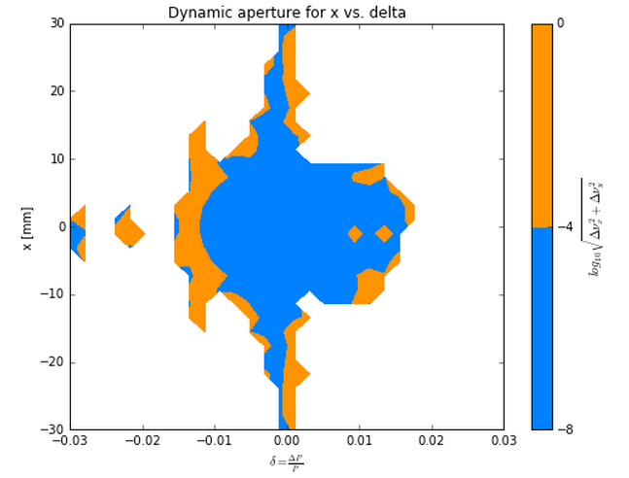
Nonlinear Driving Term (ARC_PDR_20160630)
Betx：80.992367
bety：14.172123
2nm
Sizmax：402.47um
Sigmay：9.22um
X：45 Sigma
Y：780 Sigma
2 groups

Slide 30
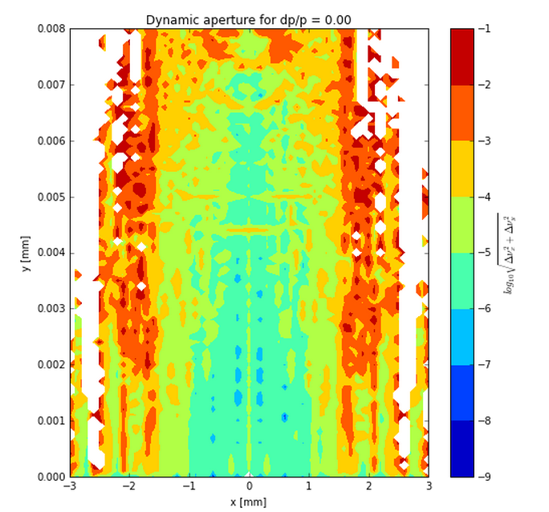
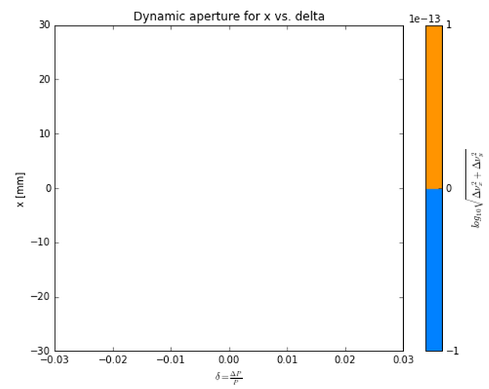
Nonlinear Driving Term (ARC_PDR_FFS_2016.08.29)
Betx：0.219915m
bety：0.001m
2.147368nm
Sizmax：21.731um
Sigmay：0.08026um
X：46 Sigma
Y：37 Sigma
2 groups

Slide 31
Outline
4. CEPC APDR Scheme

Slide 32
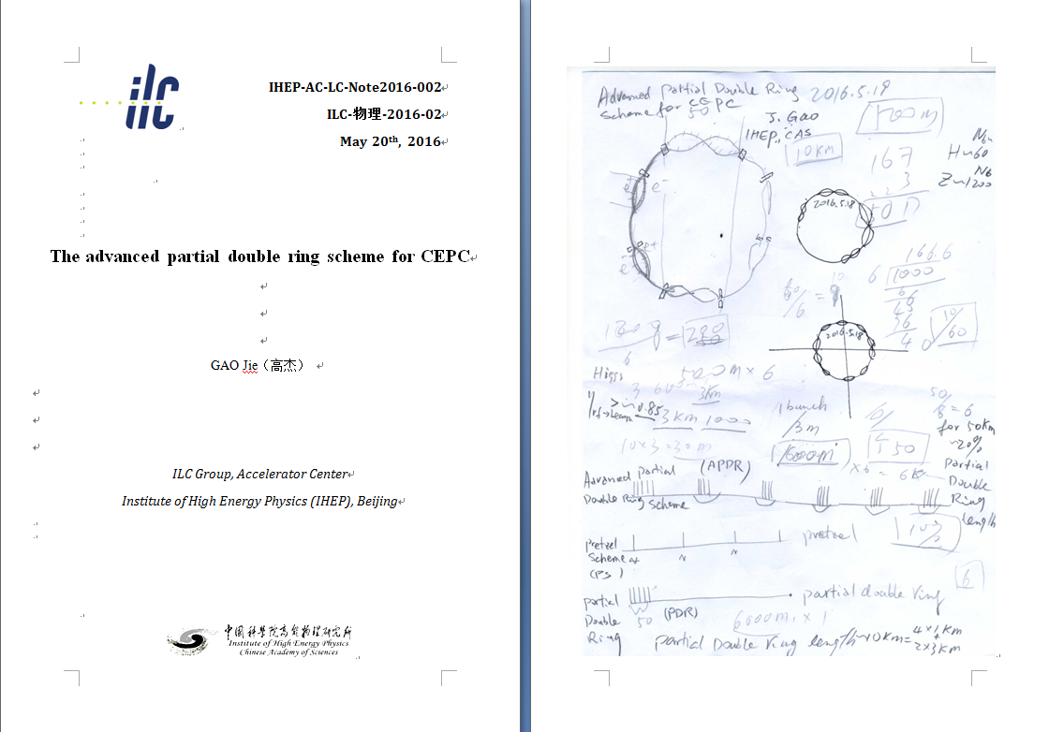
New idea：Advanced PDR （APDR）
To solve the big problem of RF system

Slide 33
CEPC Advanced Partial Double Ring Option I
1/2RF
1/2RF
ARC1
IP1_ee
RF
RF
ARC2
APDR
3Km
APDR
ARC3
1/2RF
1/2RF
Bypass
about 42m
C=62967.86m
IP4_pp
IP2_pp
ARC4
1/2RF
1/2RF
IP1_ee/IP3_ee, 2.968Km
IP2_pp/IP4_pp, 1132.8m
APDR, 1052.87m
4 Short Straights, 141.6m
4 Medium Straights, 566.4m
4 Long Straights, 1132.8m
4 ARC1, 124*FODO, 5852.8m
4 ARC2, 24*FODO, 1132.8m
4 ARC3, 79*FODO, 3728.8m
2 ARC4, 24*FODO, 1132.8m
C=65km
ARC3
APDR
APDR
RF
RF
ARC2
IP3_ee
ARC1
1/2RF
1/2RF
SU Feng
2016.5.23

Slide 34
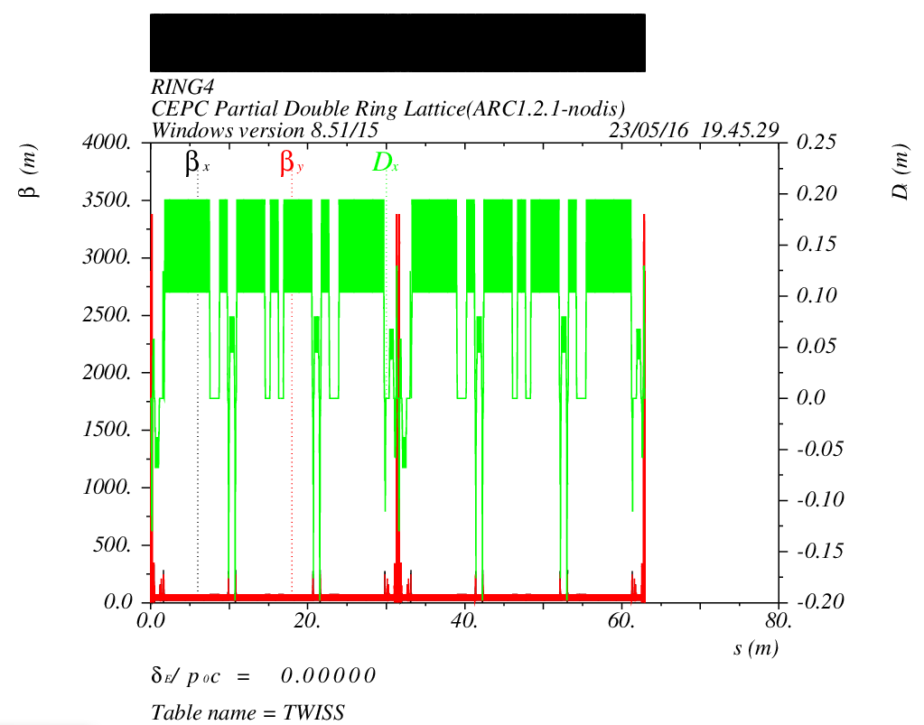
CEPC Advanced Partial Double Ring Optics I
PDR1
PDR3
Bypass2
Bypass4
APDR
APDR
APDR
APDR

Slide 35
CEPC Advanced Partial Double Ring Option II
RF
RF
IP1_ee
ARC
APDR
APDR
RF
3.7Km
RF
APDR
C=65640.2m
APDR
RF
C=67km
RF
APDR
APDR
IP1_ee/IP3_ee, 3703.46m
IP2_pp/IP4_pp, 1132.8m
APDR, 1426m
Short Straights, 94.4m
RF Station, 188.8m
ARC, 3020.8m
IP3_ee
RF
RF
SU Feng
2016.8.15

Slide 36
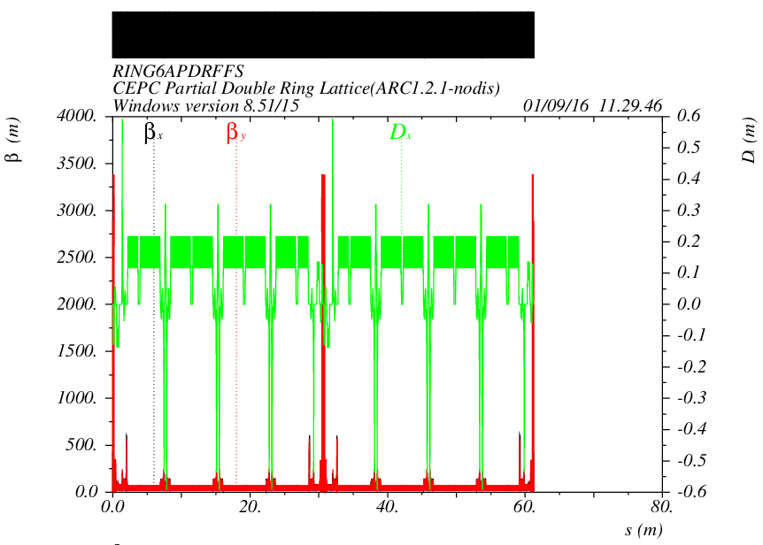
CEPC Advanced Partial Double Ring Optics II
PDR1
PDR3
APDR
APDR
APDR
APDR
APDR
APDR

Slide 37
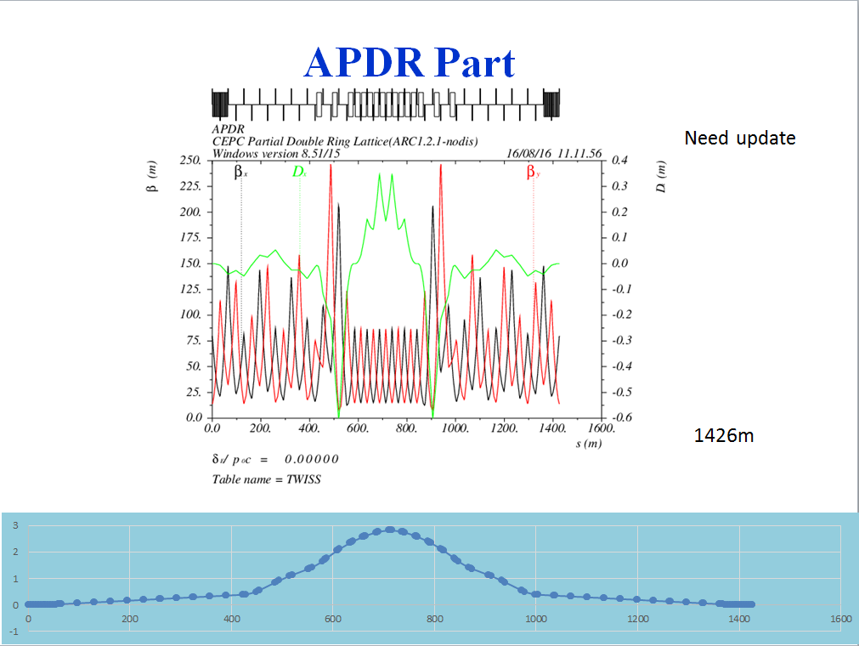
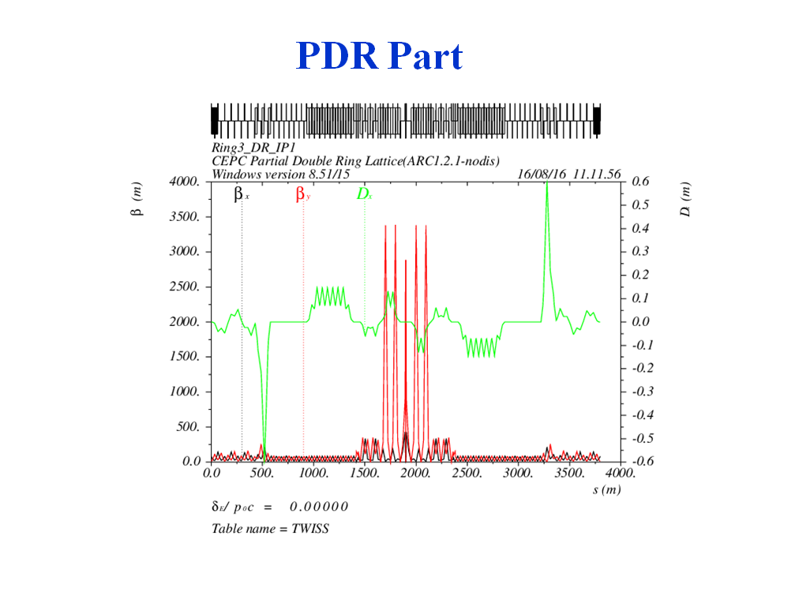

Slide 38
Outline
5. CEPC Double Ring Scheme

Slide 39
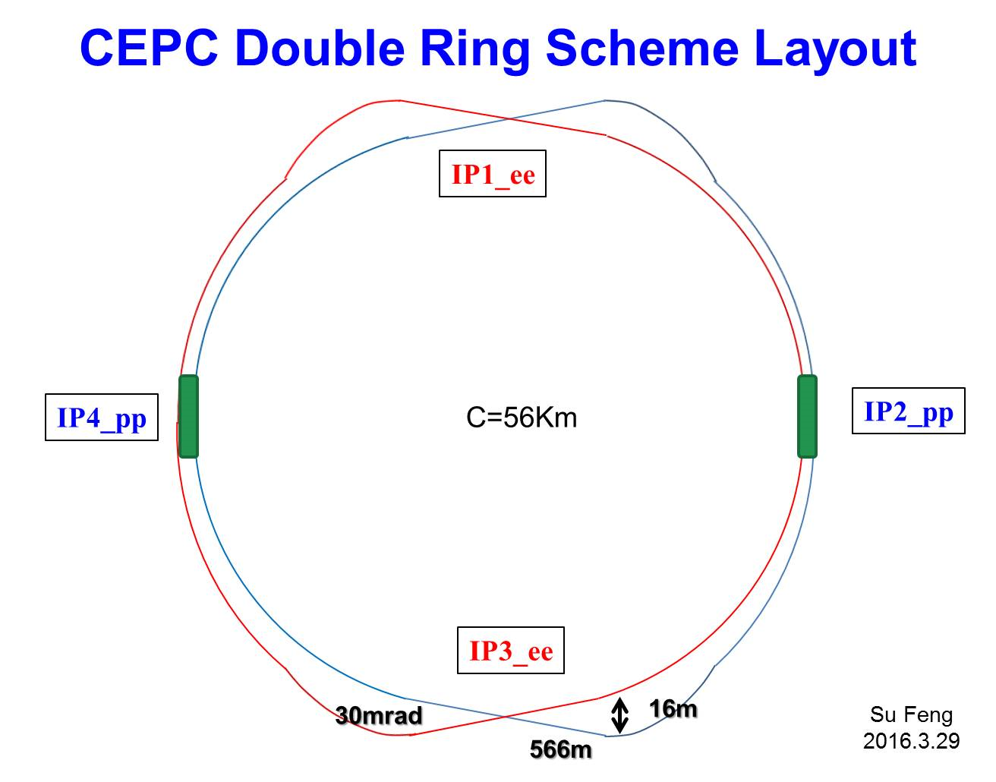
RF station
RF station
?
C=61km

Slide 40
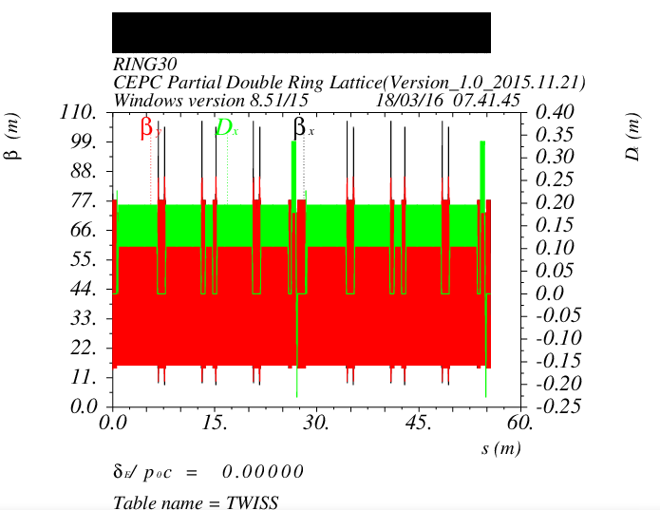
Double Ring Scheme
e-ring
IP1
IP2
Bypass
42m
IP3
IP4
Bypass
42m

Slide 41
Outline
6. Summary
The first version of CEPC Partial Double Ring Lattice was designed (Version 1.0). The whole length of CEPC PDR is 3781.27m, full crossing angle is 30mrad, maximum distance between two ring is 14.913m.
The Dynamic Aperture need to be optimized. Now the DA of CEPC with PDR and Bypass(at IP2/4) and without FFS is better than before, but the DA with FFS is not good enough.
The linear lattice of PDR may also be optimized.

Slide 42
Outline
CDR Report & CDR & Plan & Next to do

Slide 43
CDR Report & CDR & Plan & Next to do
CDR Report (by the end of 2016)
LSS2/4/6/8(inj/extr、RF)：optics的考虑，根据各功能段，重新设计，不再是和弧区相同FODO代替，接入实际optics。
PDR：优化设计，孔径进展，争取达标。
APDR8：线性Lattice搭建好，孔径优化初步结果。
Double Ring：Lattice搭建好，带对撞区，孔径优化初步结果。
CDR (by the end of 2017)
针对于选定的某一方案，各指标达标。

Slide 44
CDR Report & CDR & Plan & Next to do
CDR Report (by the end of 2016) ------SPPC
参数优化且完备，包含纵向动力学参数。
LSS2/4/6/8(inj/extr、RF)：optics的考虑，根据各功能段，重新设计，不再是和弧区相同FODO代替，接入实际optics。
Lattice优化设计好,动力学孔径优化结果好
比较好的version 1 的SPPC Lattice。

Slide 45
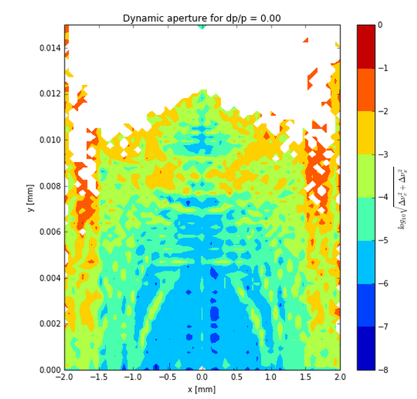
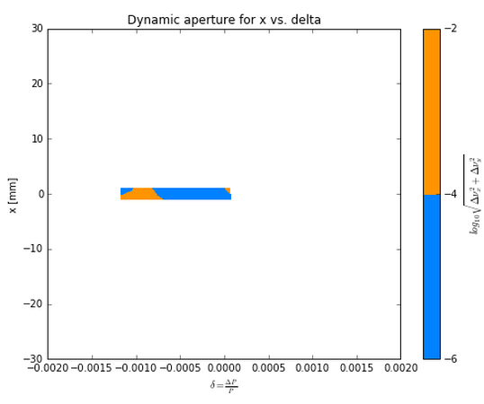
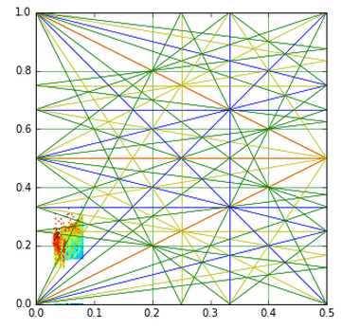
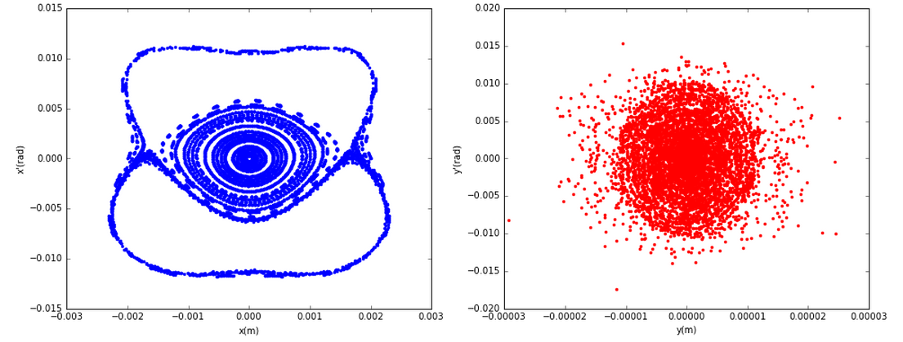
CEPC_ARC_PDR_IR_96fam_damp
0.8mm
5um
21.731um
0.08026um
37 SigmaX
63 SigmaY

Slide 46
DA result
Dynamic aperture result
W/O error of the magnets
Synchrotron motion included, w/ damping
Tracking with 100 turns
Coupling factor κ=0.003 for εy
Working point (0.08, 0.22)
DAx
DAy

Slide 47
Thank You !

Slide 48
Acknowledge
The authors would thank Frank Schmidt very much for the help in SixTrack and Dynamic Aperture Study.
Thanks for Gang Xu, Qing Qin, Yuan Zhang, Yuemei Peng, Qingjin Xu, Xiaohao Cui, Zhe Duan and Yudong Liu’s kind help and beneficial discussion!

Slide 49
Reference
1. F. Zimmermann, “HE-LHC & VHE-LHC accelerator overview (injector chain and main parameter choices)”, Report of the Joint Snowmass-EuCARD/AccNet-HiLumi LHC meeting, Switzerland, 2013.
2. F. Zimmermann et al., “FCC-ee overview”, in Proc. HF2014, Beijing, China, Sep. 2014, p.6-15.
3. Layout and Performance, in LHC Design Report Volume 1, European Organization for Nuclear Research, 2004, p21-22.
4. The Science of the CEPC and the SPPC, in CEPC-SPPC: Pre-CDR, Volume II - accelerator, The CEPC-SPPC Study Group, Mar. 2015, p.28-35.
5. J. Gao, “Review of some important beam physics issues in electron positron collider designs”, Modern Physics Letters A, Vol. 30, No. 11, p. 1530006, 2015.
6. F. Su et al., “Method study of parameter choice for a circular proton-proton collider”, Chinese Physics C, Vol. 40, No. 1, p. 017001, 2016.
7. D. Wang et al., “Optimization Parameter Design of a Circular e+e- Higgs Factory”, Chinese Physics C, Vol. 37, No. 9, p. 97003-0970, 2013.
8. M. Xiao et al., “Study on CEPC performances with different collision energies and geometric layouts”, Chinese Physics C, Vol. 40, No. 8, 2016.
9. F. Su, J. Gao et al, “SPPC Parameter Choice and Lattice Design”, TUPMW001, Proceedings of IPAC2016.
10. F. Su, J. Gao et al, “CEPC Partial Double Ring Lattice Design”, THPOR009, Proceedings of IPAC2016.
11. F. Su, J. Gao, etc., “CEPC partial double ring lattice design and SPPC lattice design”, IAS White Paper, submitted for publication, Apr. 2016.
12. F. Schmidt, “Dynamic Aperture in large Proton Accelerators”, ”A Talk on DA study in IHEP”, May 2016.
13. Oide, FCC-ee_150917.
14. P. Raimondi, Status on SuperB effort, La Thuile, March 11, 2006.
15. Kalbreier, et al, “Layout, design and construction of the electrostatic separation system of the LEP e+e- collider”, CERN, Geneva, Switzerland. 16. R. Martin, et al, “Status of the FCC-ee interaction region design”, HF2014 Workshop, Beijing, China, 9-12 October, 2014.

