Slide 1
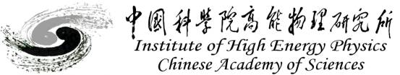
CEPC main ring magnets’ error effect on DA and MDI issues
Sha Bai, Dengjie Xiao, Yiwei Wang, Feng Su, Dou Wang, Tianjian Bian, Yuan Zhang, Huiping Geng, Yingshun Zhu, Qinglei Xiu, Kai Zhu, Hongbo Zhu
09-27-2016
CEPC项目启动会

Slide 2
Outline
CEPC main ring magnets’ error effect on DA
  error effect on DA
  CDR report goal
  Plan in future
MDI issues

Slide 3
BEPCII
CEPC
 | bend | quad | sext | bend | quad | sext
Dx(mm) | 0.2 | 0.15 | 0.15 | 0.3 | 0.1 | 0.15
Dy(mm) | 0.2 | 0.15 | 0.15 | 0.2 | 0.1 | 0.15
Tilt(mrad) | 0.1 | 0.2 | 0.5 | 0.1 | 0.1 | 0.5
B*L | 3e-4 | 3e-4 | 2e-3 | 5e-4 | 5e-4 | 4e-3
quadrupole(s) | 3e-4 |  |  | 8e-4
sextupole(s) | 6e-4 | 5e-5 |  | 2e-4 | 6e-4
Octupole(s) |  | 7e-5 | 6e-4 | 7e-5 | 5e-4 | 1.7e-3
Decapole(s) | 5e-4 | 9e-5 | 2e-4 | 1.3e-4 | 6.9e-4 | 3.4e-3
Dodecapole(s) |  | 6e-4 | 5e-4 | 1.4e-4 | 1e-3 | 6.5e-3
Quadrupole(r) | 1e-4 | 3e-4 |  | 2e-4
Sextupole(r) | 1e-4 | 1e-4 | 3e-3 | 2.9e-4 | 1.2e-3
Multipole(r) | 1e-4 | 1e-4 | 3e-4 | 2e-4 | 1e-3 | 2e-2

Slide 4
Multipole errors Source
Multipole error from two parts:
      Systematic: intrinsic during the manufacture
      Random: Due to the differences between individuals, the field components in the lattice elements may have random errors

Slide 5
Multipole errors effect on DA in CEPC single ring
Bend multipole errors (whole ring including FFS)
Quad multipole errors
(whole ring including FFS)
Sextupole multipole errors(whole ring including FFS)
(B,Q,S)multiple errors
(whole ring including FFS)
Off-momentum DA is not changed obviously, with 2% (2~3σ_{x}, 15~20σ_{y}), on-momentum DA in vertical is reduced to one third of the original.
Tune is kept, no effect on tune
Orbit is kept to be zero, no effect on orbit
Bend is set to be bend, but quadrupole and sextupole are set to be MULT
Tracking in 240 turns, Coupling factor κ=0.003 for emitty
Multipole errors can not be cured during commissioning, but could be accepted due to the not obvious change of off-momentum DA.

Slide 6
Multipole errors effect on DA in CEPC PDRv1
No error
Multipole errors of B,Q,S magnets
Multipole errors of quadurpoles
Multipole errors of sextupoles
Multipole errors reduce DA a little bit , but not much. It seems to have not much effect on DA, especially of off-momentum DA.
Orbit has no change due to multipole errors.

Slide 7
Multipole errors effect on DA in CEPC PDRv4
No error
Multipole erors from B,Q,S magnets
Multipole errors from sextupoles
Multipole errors reduce DA a little bit , but not much. It seems to have not much effect on DA, especially of off-momentum DA.
Orbit has no change due to multipole errors.

Slide 8
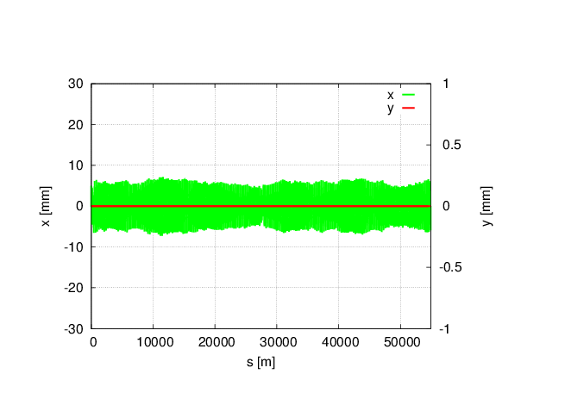
Magnet field error on DA in CEPC single ring
no error
With all (B,Q,S) B*L field errors, whole ring including FFS.
Tune has changed a lot: μ_{x}=0.0510854 μ_{y}= 0.1526778
Orbit correction and tune adjust are needed
Bend set to bend, and Quad and Sext set to be MULT
Tracking in 240 turns, coupling factor κ=0.003 for ε_{y}
Could be cured by adjusting the current during commissioning

Slide 9
Magnet field error on DA in CEPC partial double ring
Main effect coming from the bending magnet
With bend B*L error
(whole ring including FFS)
μ_{x}= 0 μ_{y}= 0
Orbit in X
With bend B*L error
(whole ring including FFS)
Orbit in Y
With bend B*L error
(whole ring including FFS)
no error
With bending magnet field errors, horizontal orbit has changed a lot, but vertical has no change
Tune has changed to be an integer resonance, beam is not stable.
Orbit correction is needed in horizontal
Tracking in 240 turns, coupling factor κ=0.003 for ε_{y}
Could be cured by adjusting the current during commissioning

Slide 10
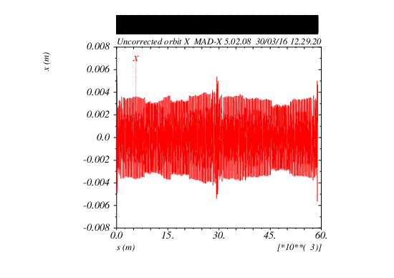
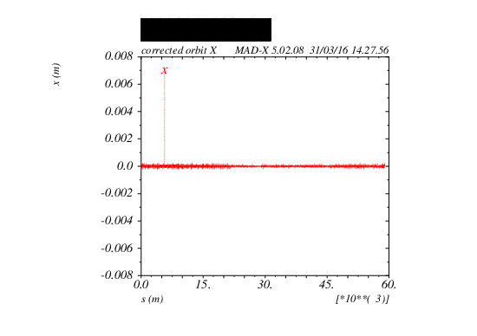
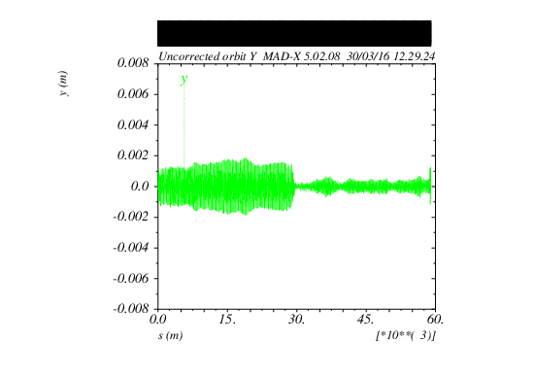
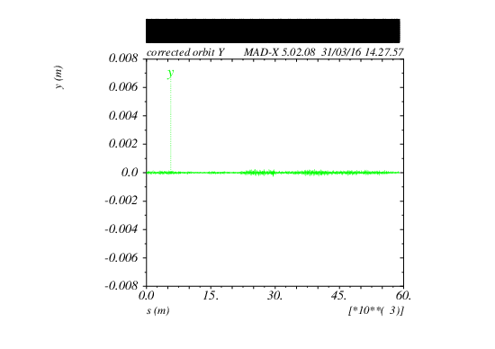
Orbit correction result
Before correction
After correction
Lattice version：
CEPC-ARC1.0-PDR1.0-FFS (WD1.0)

Slide 11
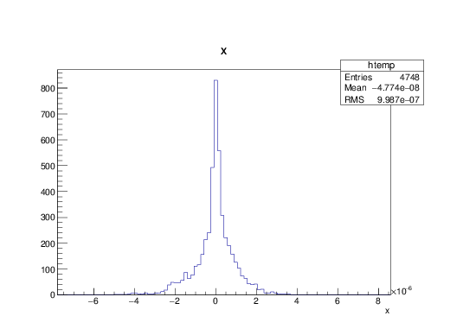
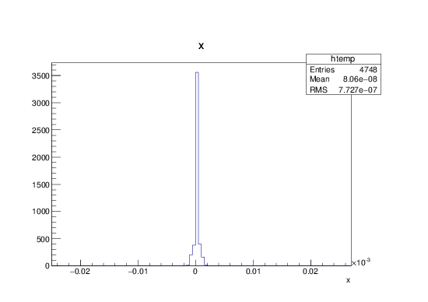
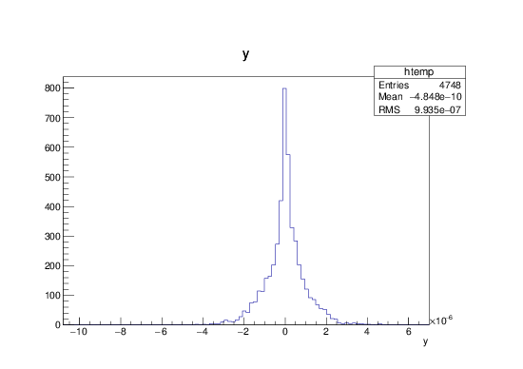
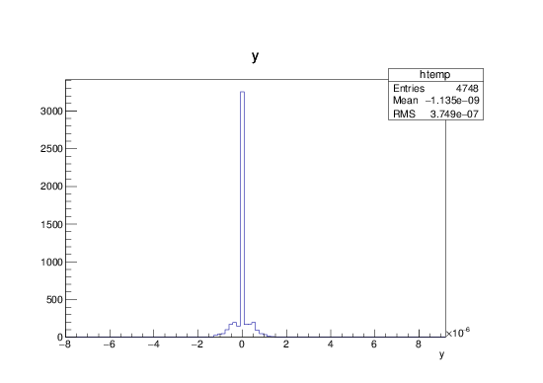
BPM readings and correctors strength statistic
BPM readings statistic
Correctors strength statistic
X CORRECTION:
about 1700 correctors used
Max strength ~ 23urad
RMS ~ 0.77urad
X CORRECTION
SUMMARY:
RMS before correction
2.127 mm
RMS after correction
0.0009987 mm
Y CORRECTION:
about 1700
correctors used
Max strength ~ 6.7urad
RMS ~ 0.37urad
Y CORRECTION
SUMMARY:
RMS before correction
0.6423 mm
RMS after correction
0.0009935 mm

Slide 12
DA(PDR) after orbit correction
Lattice version：CEPC-ARC1.0-PDR1.0-FFS (WD1.0)
No error
DA after orbit correction
(best seed)
DA after orbit correction
(worst seed)
Dynamic aperture can almost be recovered after orbit correction for most seeds.

Slide 13
DA after orbit correction statistics
For both on-momentum and off-momentum DA, most seeds can be recovered.

Slide 14
CDR report goal of error study
lattice without error fixed and DA reach goal.
DA of lattice with multipole errors (impossible to correct & adjust level to requirement) reach goal.
20σx/40 σ y for on-momentum, 5 σ x/10 σ y for off-momentum

Slide 15
Error study plan in future
Orbit correction (misalignment error)
  Orbit correction with correctors & BPM
  Code could be used: SAD, MADX, AT
  Correction procedure:
    From Large error to small error step by step: quadrupole, sextupole .. of 1e-4, 9e-5, 8e-5, 7e-5……, each should be calculated in 100~200 seeds.
    Final focus magnets especially final doublet, quadrupoles and sextupoles in CCS may calculate separately and may need detail analysis.
Optics correction(Dy etc on), coupling correction
  Decide the final magnet misalignment requirement

Slide 16
Machine Detector Interface
Tasks of MDI
  IR lattice and layout design
  Final Focusing magnets
  Solenoid compensation
  Luminosity Measurement
  Beam Induced Background Estimation
  Detector shielding and radiation protection
  Mechanics and integration
Regular group meetings
  Indico: http://indico.ihep.ac.cn/category/323/
  Twiki: cepc.ihep.ac.cn/~cepc/cepc_twiki/index.php/Machine_Detector_Interface
Will compare the difference between single ring and partial double ring.

Slide 17
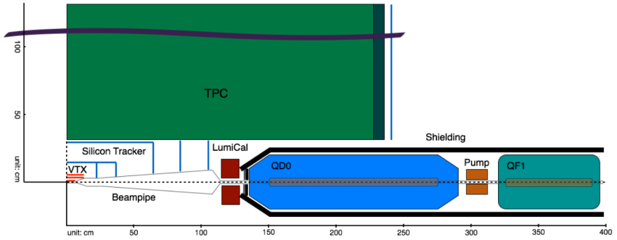
IR Layout -- Single Ring
L* = 1.5m
To meet requirements from both accelerator and detector
Suppress the beam backgrounds as more as possible

Slide 18
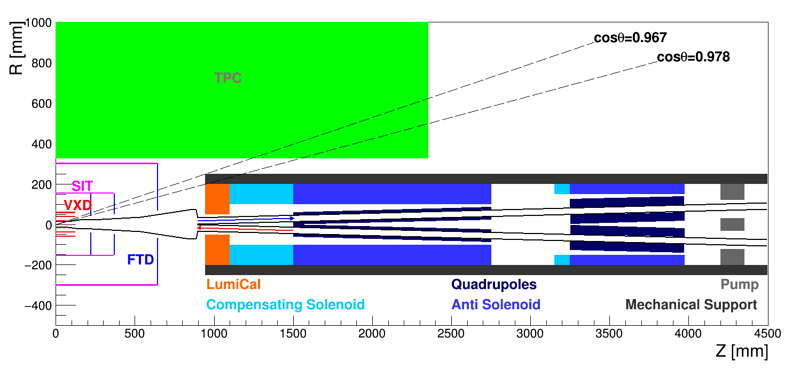
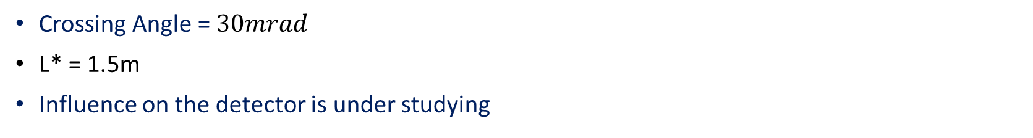
IR Layout -- Partial Double Ring
Crossing Angle = $30mrad$
L* = 1.5m
Influence on the detector is under studying

Slide 19
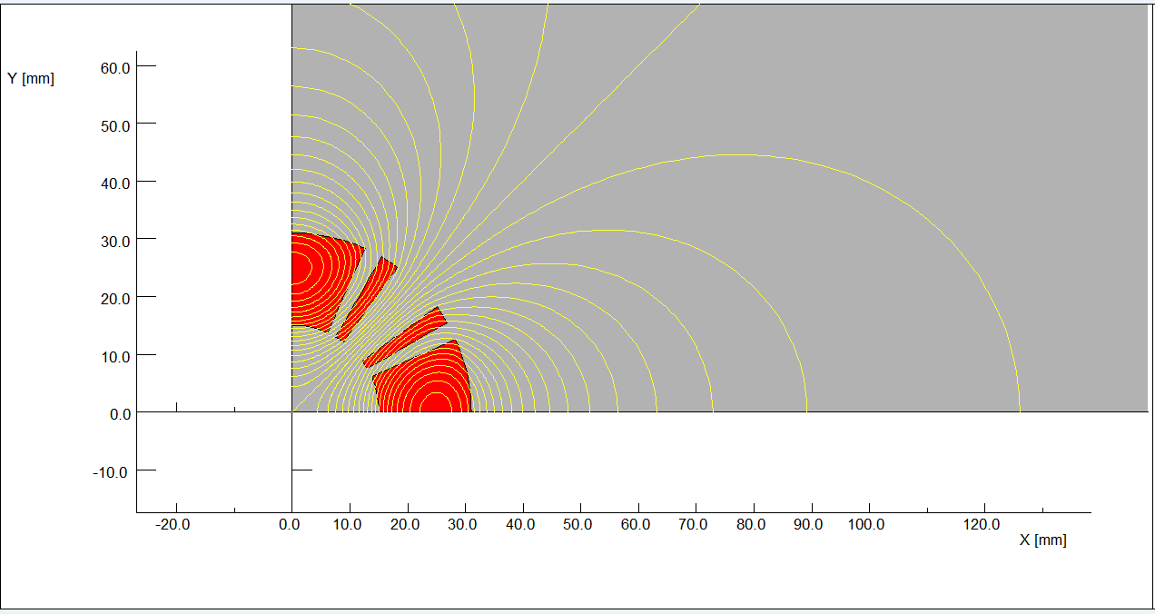
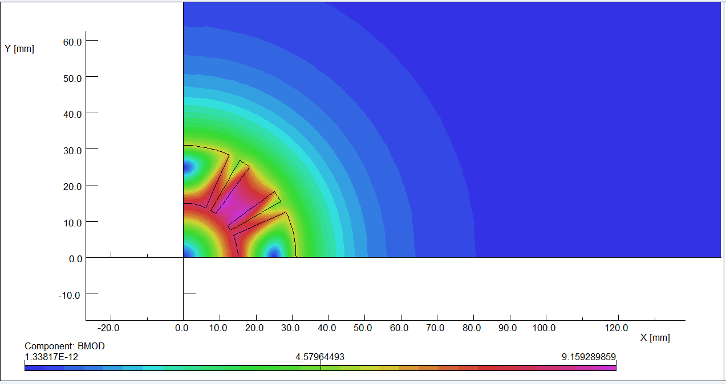
Final Focusing Magnetic -- Single Ring
2D flux lines
Magnetic flux density distribution
Magnet | Length | Field Gradient(T/m) | Coil Inner Radius (mm) | Coil Outer Radius (mm)
QD | 1.25 | 304 → ~200 | 20 | 37
QF | 0.72 | 309 → ~110 | 20 | 37
Coils in Rutherford type Nb₃Sn cables clamped by stainless steel collar
The field gradient will be decreased to match the feasibility in technology

Slide 20
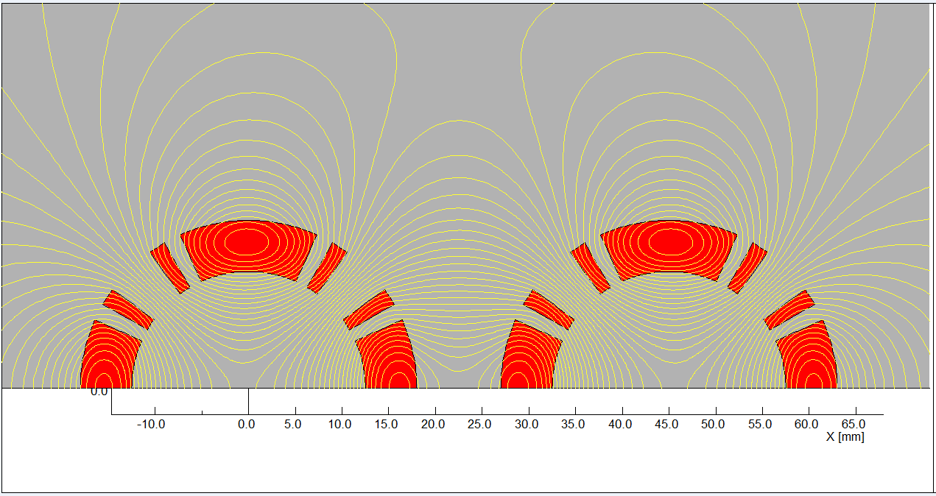
Final Focusing Magnetic – Partial Double Ring
Magnet | Length | Field Gradient(T/m) | Coil Inner Radius (mm) | Coil Outer Radius (mm)
QD | 1.25 | ~200 | 12.5 | 18.5
QF | 0.72 | ~110 | 20 | 37
2 isolated QD are required to make sure e+ e- pass through the center of the quadrupoles separately.
The thickness of the coil is tightly limited by the radius of beam pipe and the distance between two beam pipes.
Cross talk of field between two quadrupoles need be further studied.

Slide 21
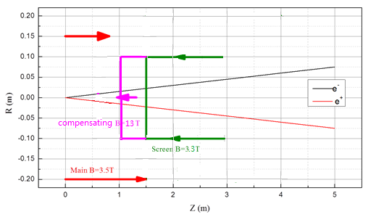
Solenoids layout-sketch
To minimize the effect of the longitudinal detector solenoid field on the accelerator beam, solenoid coils are introduced.
The total integral longitudinal field generated by the detector solenoid and solenoid coils should be zero.
Screening solenoid (at the same location of QD0): The longitudinal field inside the quadrupole bore should be 0.
Center field of screening solenoid :3.3T, magnetic length: the same as QD0.
Compensating solenoid options (before QD0):
1) length 1m, Center field: 5.2T (NbTi technology )
2) length 0.7m, Center field: 7.4T (NbTi technology )
3) length 0.4m, Center field: 13T (Nb₃Sn technology )
Compensation conditions:
B_main*L_main+B_comp*L_comp=0
L* = L_main +L_comp = 1.5m
Compensating solenoid is located between IP and QD0
crossing angle α = 30 mrad
Radius of: Length:
- compensating solenoid R = 0.1 m L=0.4m
- screening solenoid R = 0.1 m L=1.3m

Slide 22
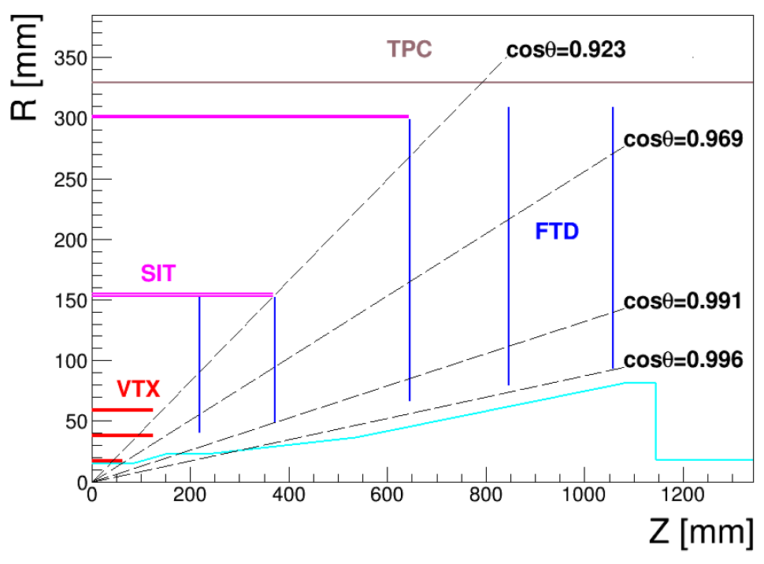
Influences on the Detector
Compensating solenoid
FTD
LumiCal
In the worst case:
  The FTD detector need be more compact
  Dead area to TPC (Reduce Length of TPC ?)
  Very tight space for LumiCal
  More backscattered backgrounds to VTX and FTD

Slide 23
Compensating and screening solenoids
Item | Compensating Solenoid | Screening-Solenoid(QD0)
Central field (T) | 13 | 3.3
Length (m) | 0.4 | 1.3
Conductor Type | Nb₃Sn, 4×2mm | NbTi-Cu, 4×2mm
Coil turns | 2300 | 2600
Coil layers | 23 | 8
Excitation current(kA) | 2.1 | 1.5
Stored energy (KJ) | 1150 | 215
Inductance(H) | 0.53 | 0.21
Peak field in Coil (T) | 13.4 | 3.5
Coil inner diameter (mm) | 200 | 200
Coil out diameter (mm) | 292 | 232

Slide 24
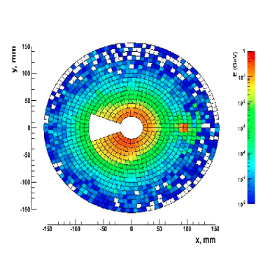
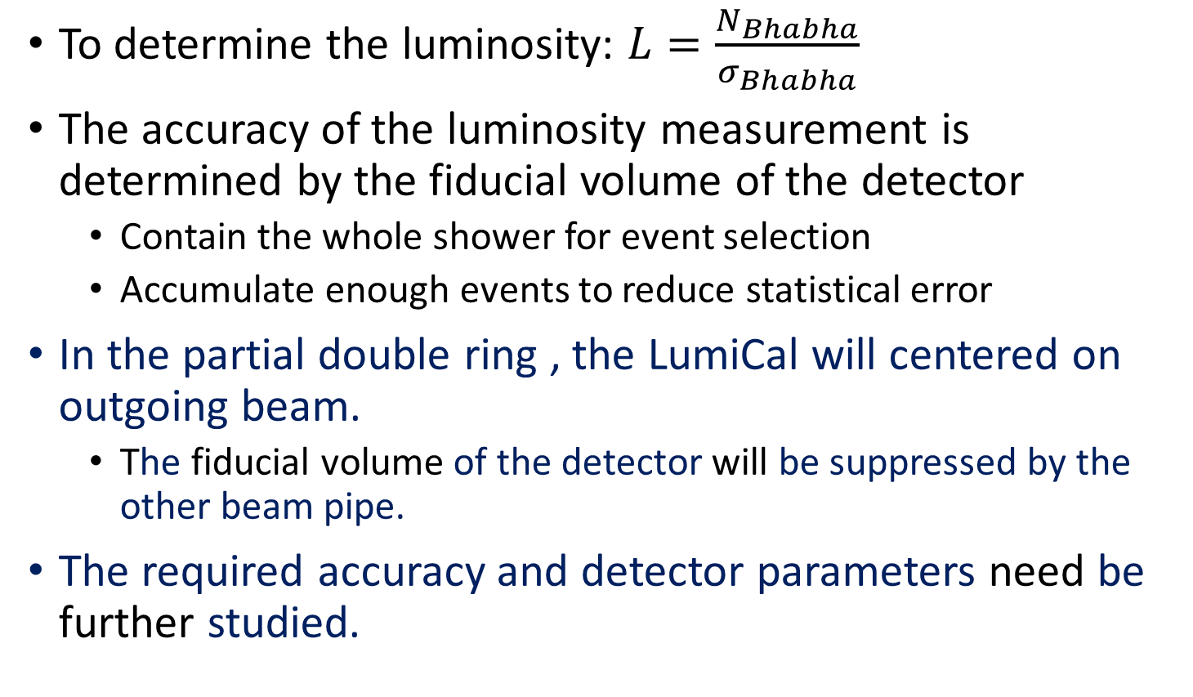
Luminosity Calorimeter
To determine the luminosity: $L=\frac{N_{Bhabha}}{σ_{Bhabha}}$
The accuracy of the luminosity measurement is determined by the fiducial volume of the detector
  Contain the whole shower for event selection
  Accumulate enough events to reduce statistical error
In the partial double ring , the LumiCal will centered on outgoing beam.
  The fiducial volume of the detector will be suppressed by the other beam pipe.
The required accuracy and detector parameters need be further studied.

Slide 25
Source of Beam Backgrounds at CEPC
Synchrotron Radiation
  Bending Magnetic
  Quadrupoles
Lost Particles
  Radiative Bhabha
  Beamstrahlung
  Beam-Gas Scattering
Beamstrahlung
  Pair production
  Hadronic background
Generator
Accelerator
Simulation
Geant4(Mokka)
Analysis

Slide 26
Framework for Background Simulation
Have established a framework for background simulation on the IHEP computing platform.
  Generator:
    Guinea-Pig++: Beamstrahlung
    BBBrem: Radiative Bhabha
    Self developed codes: Beam-gas scattering and other backgrounds
  Accelerator Simulation:
    SAD (Strategic Accelerator Design): Beam particle tracking
    BDSIM: Also used as generator for synchrotron radiation
  Detector Simulation:
    Geant4 (Mokka)
    Fluka
Interfaces between all the software have been implemented.
Developed a toolkit to use these software conveniently

Slide 27
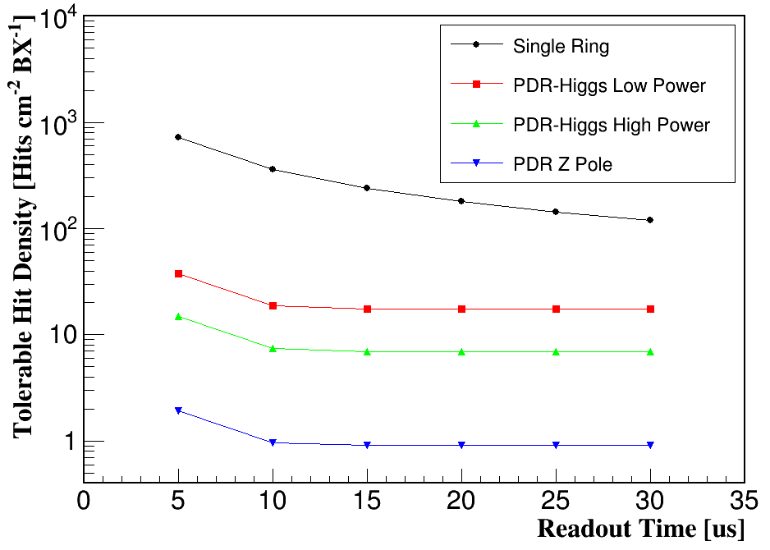
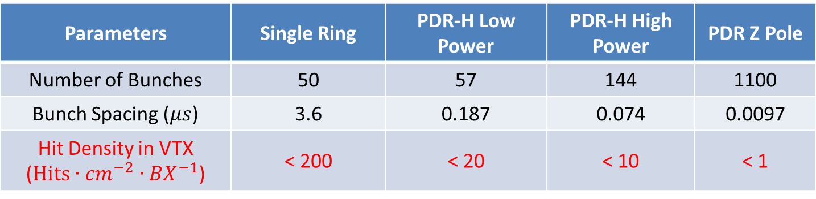
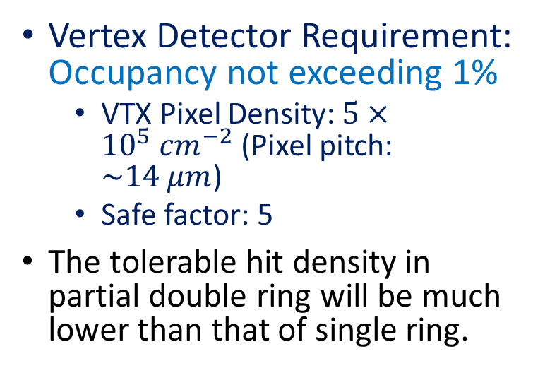
Physical Requirement to Background Level
Vertex Detector Requirement: Occupancy not exceeding 1%
  VTX Pixel Density: $5×{10}^{5} {cm}^{−2}$ (Pixel pitch: $\sim 14 μm$)
  Safe factor: 5
The tolerable hit density in partial double ring will be much lower than that of single ring.
Parameters | Single Ring | PDR-H Low Power | PDR-H High Power | PDR Z Pole
Number of Bunches | 50 | 57 | 144 | 1100
Bunch Spacing ($μs$) | 3.6 | 0.187 | 0.074 | 0.0097
Hit Density in VTX ($Hits∙{cm}^{−2}∙{BX}^{−1}$) | < 200 | < 20 | < 10 | < 1

Slide 28
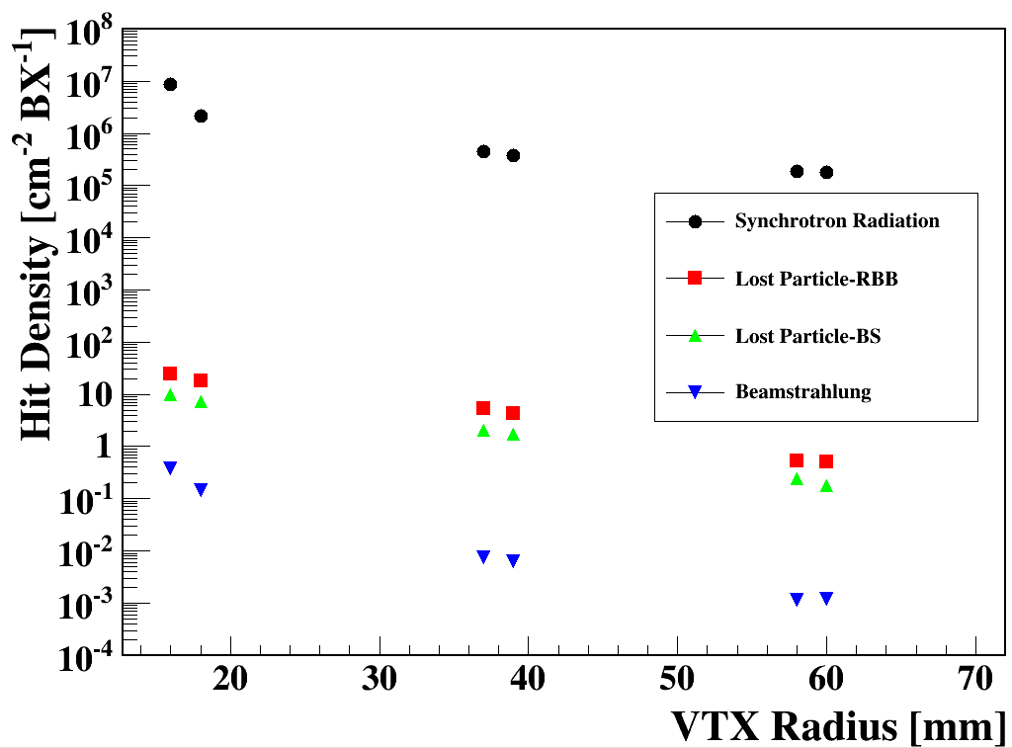
Hit Density Without Shielding
Single Ring
Synchrotron radiation is the most important issue because of the huge photon flux
The beamstrahlung in the partial double ring might be more serious than that in single ring due to the modification of beam pipe.
Shielding and protection are essential to reach the physical requirements

Slide 29
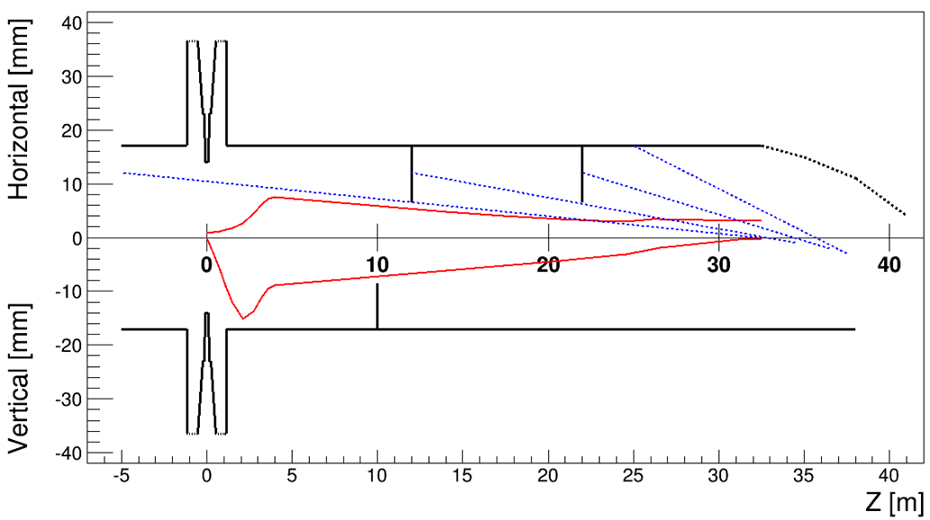
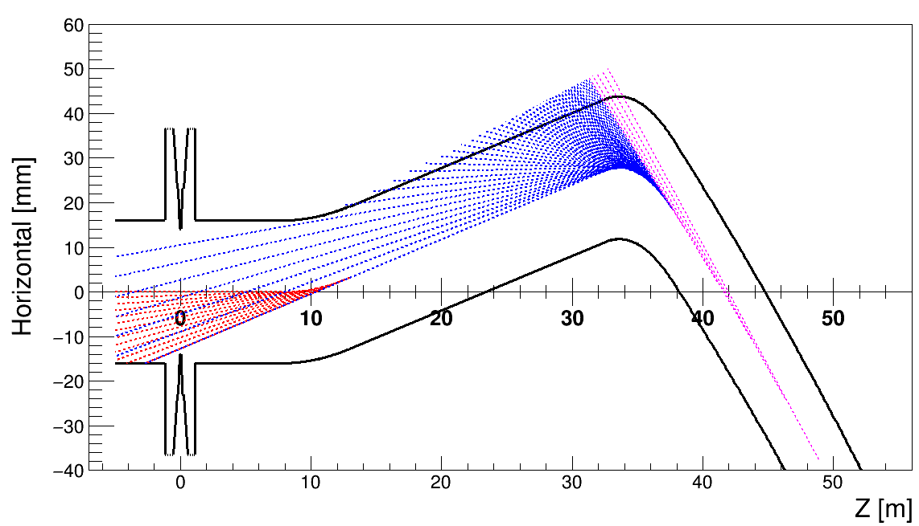
Methods to Suppress Background Level
Synchrotron Radiation
  Shielding the synchrotron photons with collimators
  Let the synchrotron photons pass through the IR by well designed beam orbit.
Lost Beam Particles
  Add collimators along the storage ring.

Slide 30
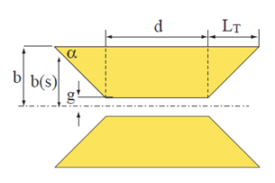
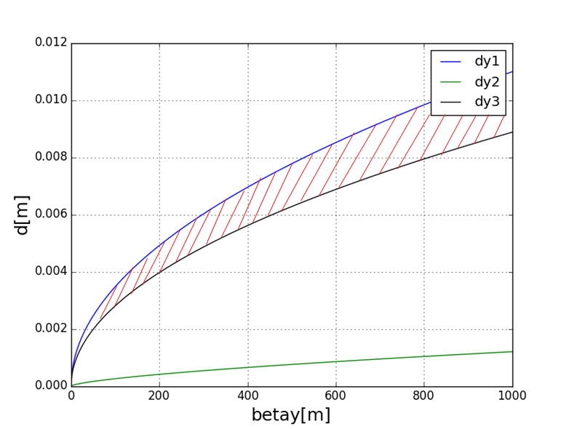

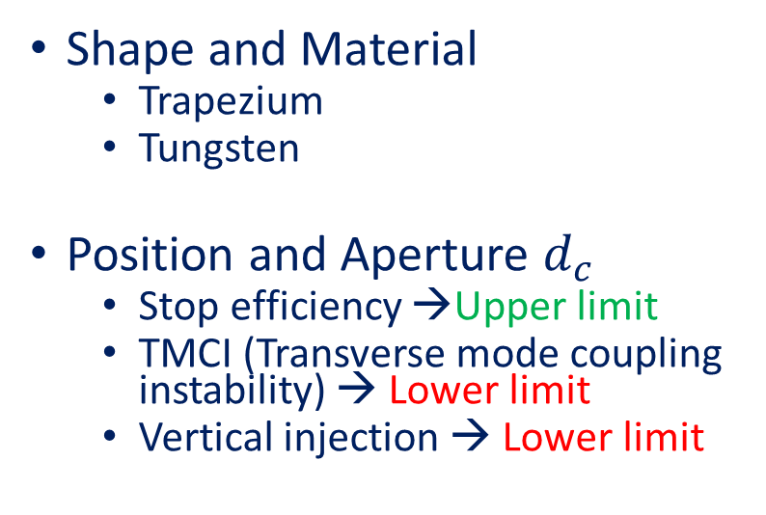
Preliminary Design of Collimators
Shape and Material
  Trapezium
  Tungsten
Position and Aperture $d_{c}$
  Stop efficiency →Upper limit
  TMCI (Transverse mode coupling instability) → Lower limit
  Vertical injection → Lower limit
Vertical
Feasible Region
$$r_{IP}=12mm$$
Upper Limit:
TMCI:
Injection:

Slide 31
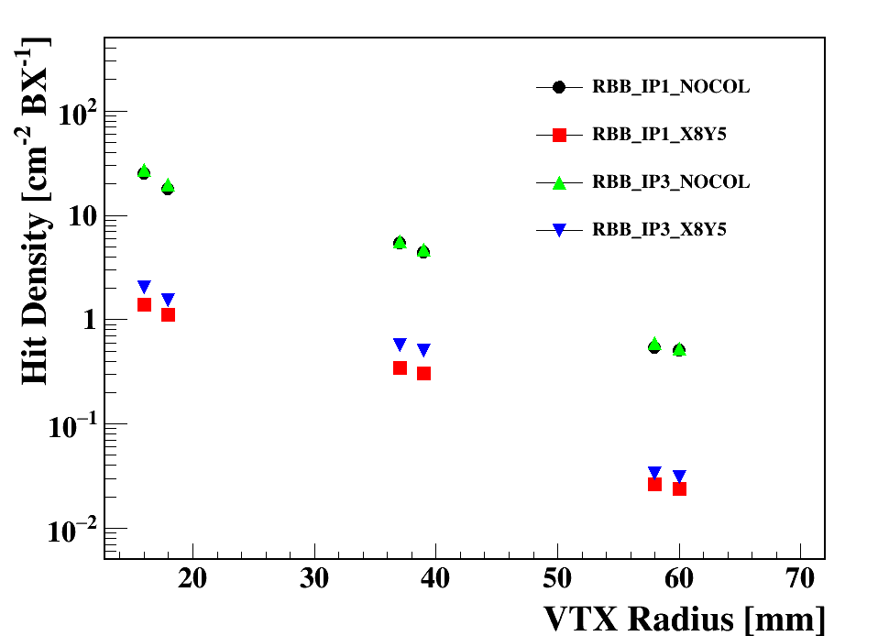
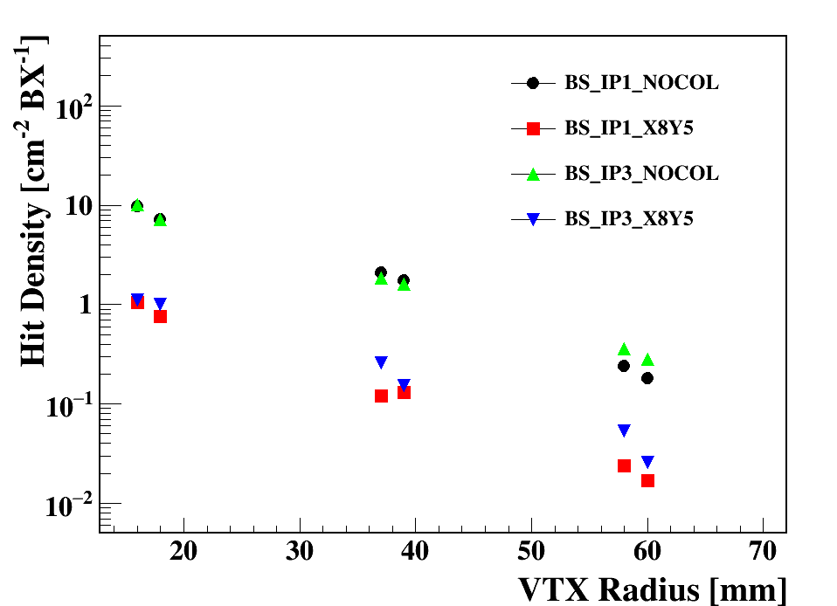
Effects of Collimators to Lost Particles
Radiative Bhabha
Beamstrahlung
The hit density due to lost particles at VTX are significantly suppressed by collimators
Shielding of other backgrounds are under studying

Slide 32
MDI summary
Single Ring
  Lots of progresses have been made in: IR design, final focusing magnets, luminosity calorimeter, background estimation and detector shielding
  The beam pipe design, mechanics and integration have not been covered yet.
Partial Double Ring
  The space for beam pipe and QD0 at L* is tighter than single ring.
  The pressure of suppressing background level in detector is higher than single ring.
  The beam pipe design, mechanics and integration have not been covered yet.

Slide 33
Thank you

Slide 34
Magnet requirement
二四六极铁的准直能做到几十个微米（比如30个微米算很好了）
校正子二极铁一般提磁场均匀度，约在1%量级。
磁铁的场强误差一般不提（因调整电流即可调节场的大小）
高阶场误差达到万分之二已经非常好了, 具体每一高阶场还有差异，越低阶的高阶场越难做好。

