Slide 1
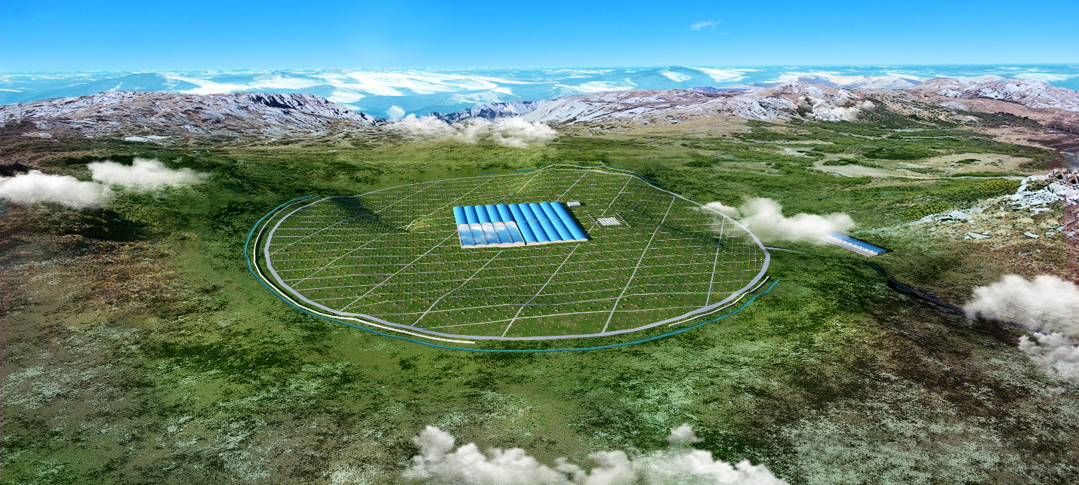
Min Zha
12/10/2016
Discussions on CORSIKA data mass production

Slide 2
Shower mass production
标准的模拟程序、参数。
规范、一致的存储格式；
lasimu/帐号的使用

Slide 3
lasimu/ account
/eos/user/l/lasimu
  a mass production account without the privilege in job production;
    (120 T (80 T used) + no files limitation)
  It is open for corsika data
  Data should be checked or confirmed before the storage;
  simulation data will be used by whole collaboration.
  Everyone can contribute after checking your production;
  There is a format to be followed.

Slide 4
Simulation details
Generator: Corsika 6200
Models
Ecut
Primary
  Proton/Helium/CNO/MgAlSi/Iron
Energy range: 10 GeV – 1 EeV
  8 decades;
Direction
  Uniform solid angle distribution 0 – 15/15-30/30-45 degree
Data Format
  Standard Corsika output format
  Particle + Chereknov
  Thinning
Random seeds

Slide 5
Continued
Each run has 2 files
  Random change with run number seeds simultaneous
  one can completely repeat production
  DAT00000$run.part
  DAT00000$run.tar
    DAT$run.log
    DAT$run.dbase
    DAT$run.long → for CRTNT longitudinal research
Directory: IHEP lxplus argo MC disk
  → /mc2/argomc/zham/corsika/
Database index file
  /mc2/argomc/zham/corsika/LIST-OF-FILE
  /ybjgfs/argo/public/simulation/Corsika/mc_zham/bcorsika

Slide 6
Simple test: iron lateral distribution
Iron
100 GeV – 10 PeV
30 – 40 degree
Gamma/ electron+position/muon

Slide 7
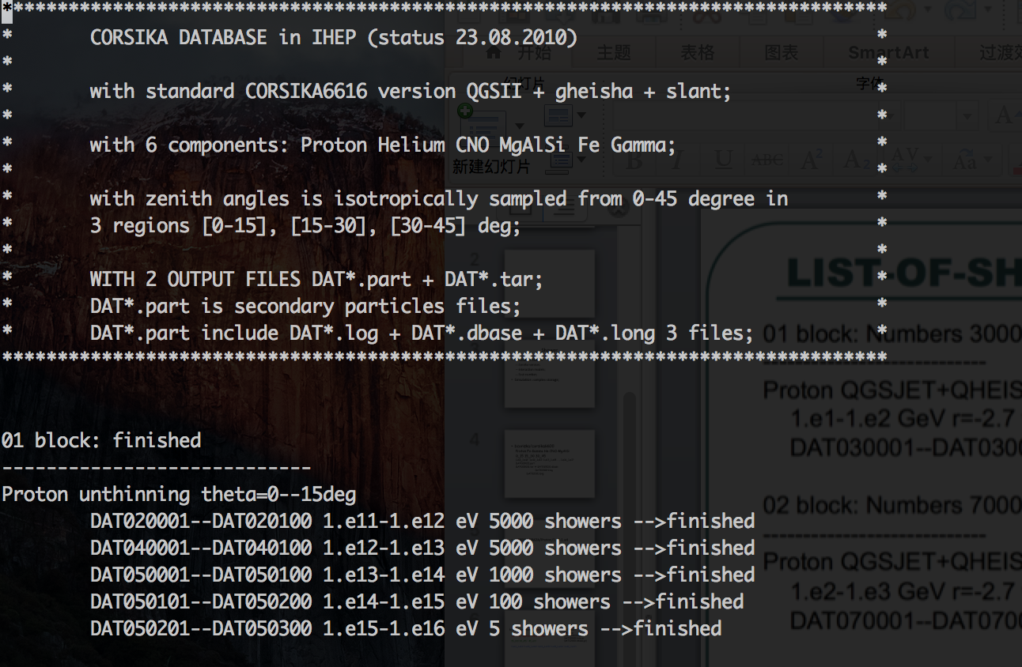
ARGO corsika data
bcorsika/corsika6600/Proton/0_15/1.e11_1.e12/DAT*.part
He/ CNO/ MgAlSi/ Iron/Gamma/
DAT*.tar
(DAT020100.log.gz
DAT020100.long.gz
DAT020100.dbase.gz)
15_30/ 30_45/ 45_60/
1.e12_1.e13/ 1.e13_1.e14/ 1.e14_1.e15/ 1.e15_1.e16/ 1.e16_1.e17/
List of shower

Slide 8
LHAASO corsika data
lasimu/corsika/WFCTA/Proton/0_15/1.e11_1.e12/DAT*
DAT*.tar
(DAT020100.log.gz
DAT020100.long.gz
DAT020100.dbase.gz)
WCDA/ KM2A/ detector
He/ CNO/ MgAlSi/ Iron/Gamma/ primaryid
15_30/ 30_45/ 45_60/ direction
1.e12_1.e13/ …… 1.e16_1.e17/ energy

Slide 9
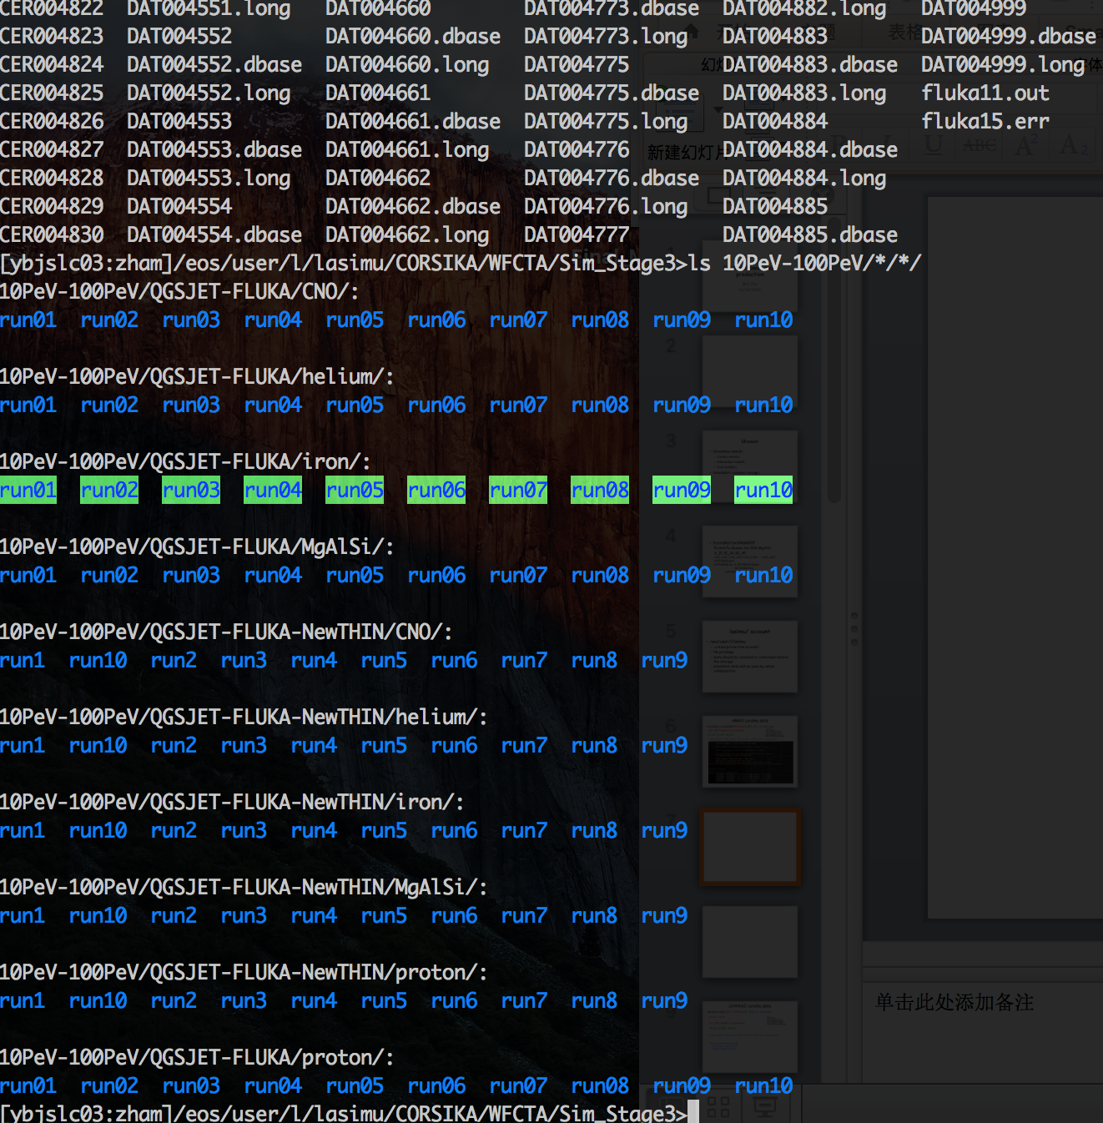
WFCTA

Slide 10
WFCTA
lasimu/CORSIKA/WFCTA/Sim_stage3/10Pev-100PeV/QGSJET-FLUKA/proton/proton01/run01/01/DAT*
Physics target
Energy range
Interaction model
primaryID
Run1 → run01 to keep same digits
Suggest:
/WFCTA/Sim_stage3/10Pev-100PeV/QGSJET-FLUKA/proton/run01/DAT*
Each run 100 files
Every proton has 100 run from run00-run99

Slide 11
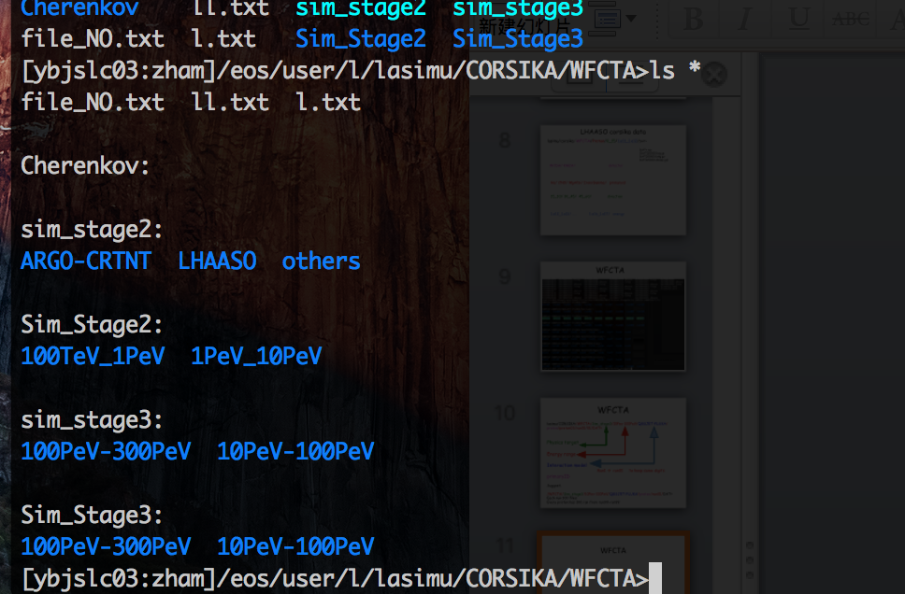
WFCTA
A file is needed to describe your data: README or list-of-showers

Slide 12
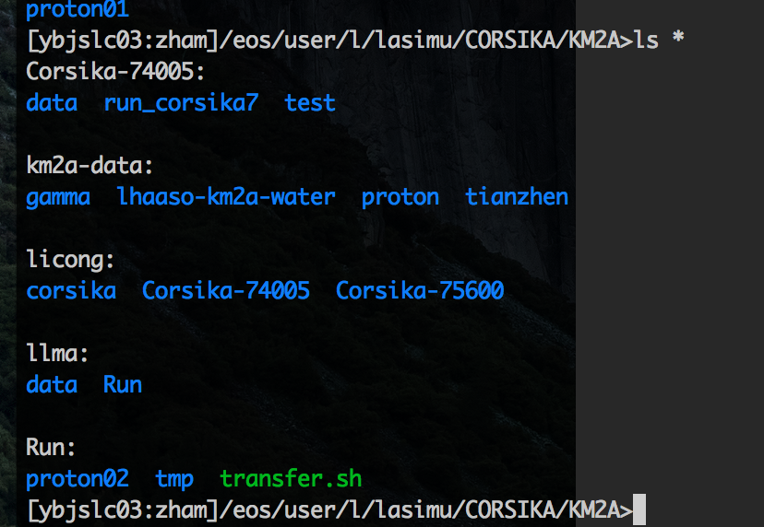
KM2A
User/
Shell/
Source_code/
Lasimu/corsika
Lasimu/src
  Corsika
  Fluka
Job shell script in your own directory

Slide 13
LHAASO requirements on MC samples
Topics | CPU core | Storage (TB) | Time scale (yr.)
Gamma astronomy | 800 | 1600 | 2
Cosmic rays | 300 | 530 | 2
10¹⁶ – 10¹⁷ Cherenkov | 30 | 22 | 1
Sub-EeV fluorescent mode | 26 | 17 | 1
Sum | 1306 | 2265
Common used Software (few)
  CORSIKA(COSMOS,AIRES)/GEANT4/ROOT/CERNLIB/SLALIB/PYTHON；

Slide 14
Comments and discussions
Detector simulation
  KM2A + WFCTA
    Corsika → heavy in disk and cpu;
    Detector simulation → light in disk and cpu
  WCDA
    Coriska → light
    Detector simulation → heavy;
others

