Slide 1
Review of Interacting Felds and Feynman Digrams
Spesker: Lei-wang

Slide 2
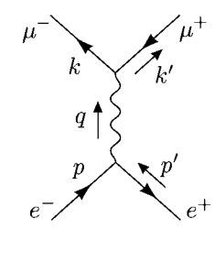
Why do I want to show this to you?

Slide 3
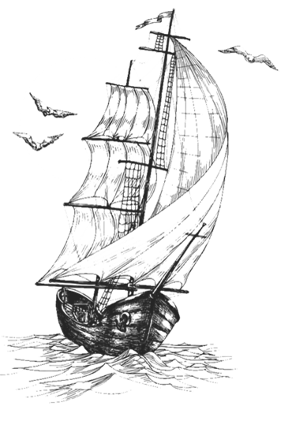
Contents
PART 01
Perturbation Theory
PART 02
Correlation Functions
PART 03
Wick's Theorem
PART 04
Feynman Diagrams

Slide 4
Perturbation Theory
to preserve causality:
interactions:

Slide 5
Perturbation Theory
“phi-fourth”throry
QED
yukawa theory
renormalizable

Slide 6
Correlation Functions
two-point correlation function
Feynman propagator
we would like to know how this expression changes in the interacting interacting theory?

Slide 7
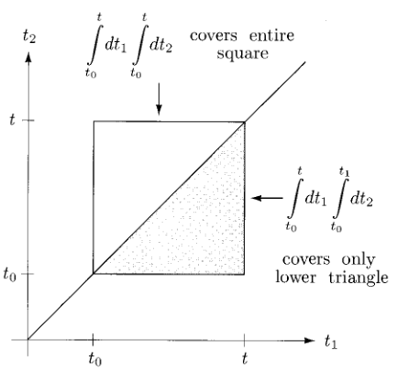
Correlation Functions
where

Slide 8
Correlation Functions
properties

Slide 9
Correlation Functions
where
our final result:

Slide 10
Wick's Theorem
where
normal ordering symbol N
relation between T and N

Slide 11
Wick's Theorem
generalization to arbitrarily many fields
example
prove Wick's theorem

Slide 12
Feynman Diagrams
with the exponential expanded
the second term

Slide 13
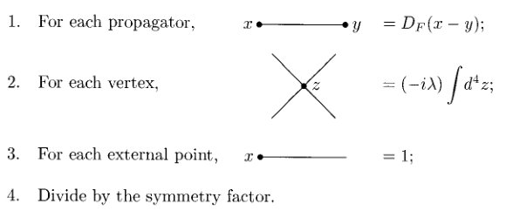
Feynman Diagrams
final result
position-space Feynman rules

Slide 14
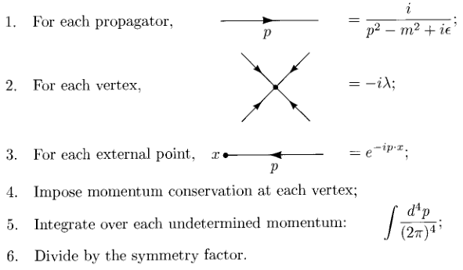
Feynman Diagrams
momentum-space Feynman rules

Slide 15
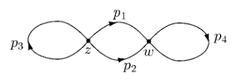
Feynman Diagrams
Consider T
disconnected pieces

Slide 16
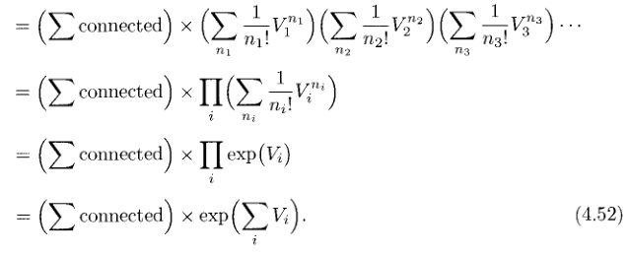
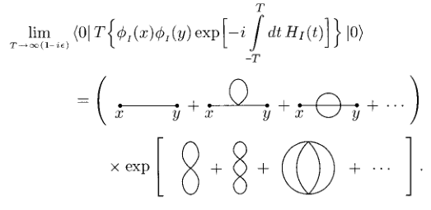
Feynman Diagrams
sum of all diagrams
for connected pieces
then we get

Slide 17
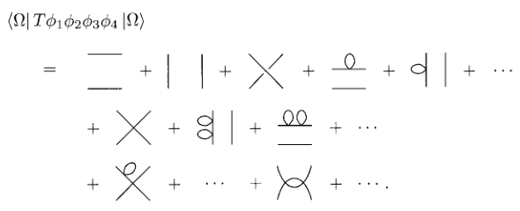
Feynman Diagrams
denominator
finally
generalization
example

Slide 18
THANKS

