Slide 1
Hough Tracking Status

Slide 2
Outline
Physics tracking analysis
Kalman fitting influence for lower pt

Slide 3
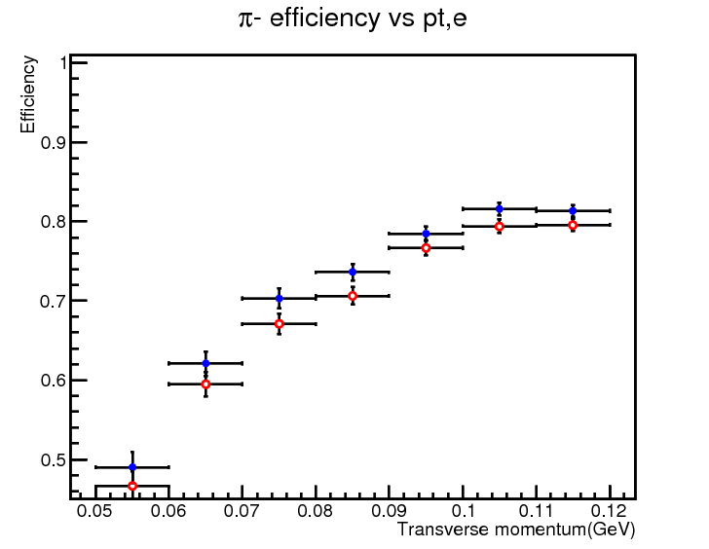
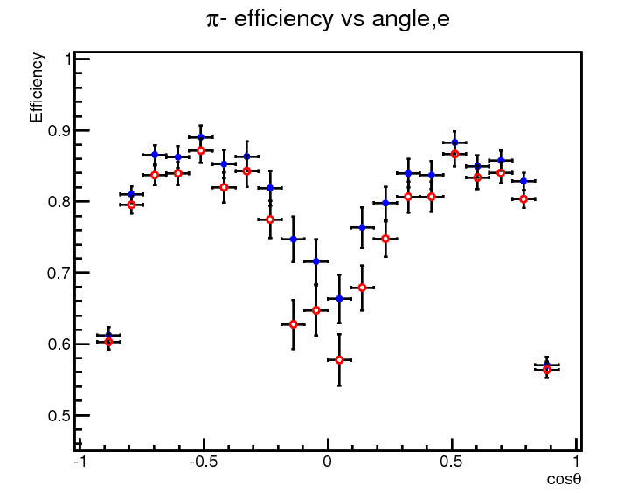
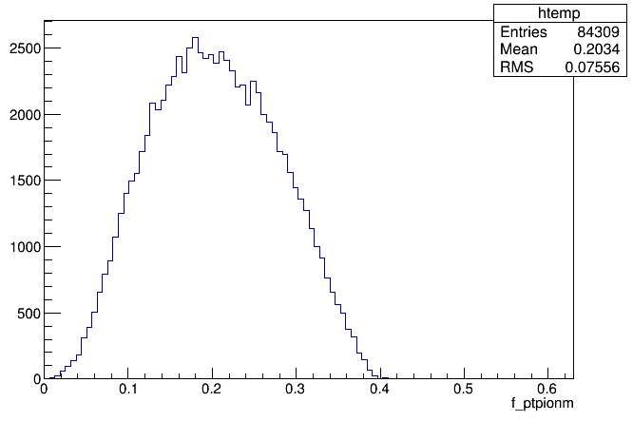
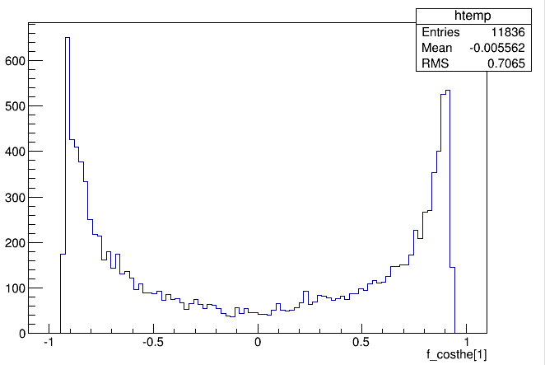
MC Pipijpsi tracking analysis
Distrubution of all tracks vs pt
|cos|>0.837
cos vs pt (uder 0.12GeV)
14% track under 120MeV
More lost track may be found in when |cos|>0.837

Slide 4
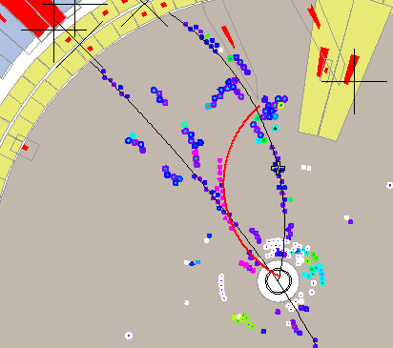
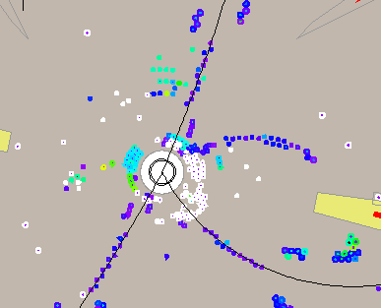
|cos|>0.837
A
For one 75 events data sample
reason | Total:75
Lost or bad par in HOUGH | Total:58
Hits Covered by other track | 8 | Some tracks can be salvaged | A
Inner chamber noise | 7 |  | B
very Leak of hits | 17 | No method | C
Reconstruction problem | 21 | Can be improve | D
Defort by decay | 2 | No method | E
Other problem | 2
Bad par in PATTSF after fitting | Total:17 | Fix in the combining method with HOUGH
Covered by other track or noise | 5 |  | F
Reconstruction problem | 12 |  | G
B

Slide 5
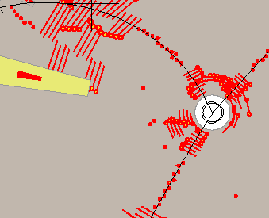
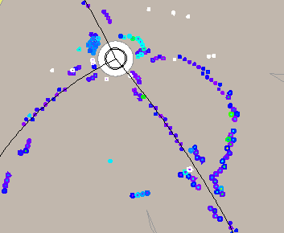
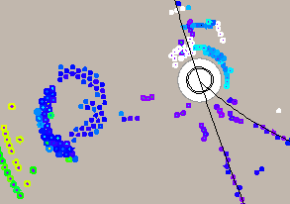
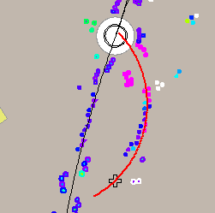
C
D
E
G

Slide 6
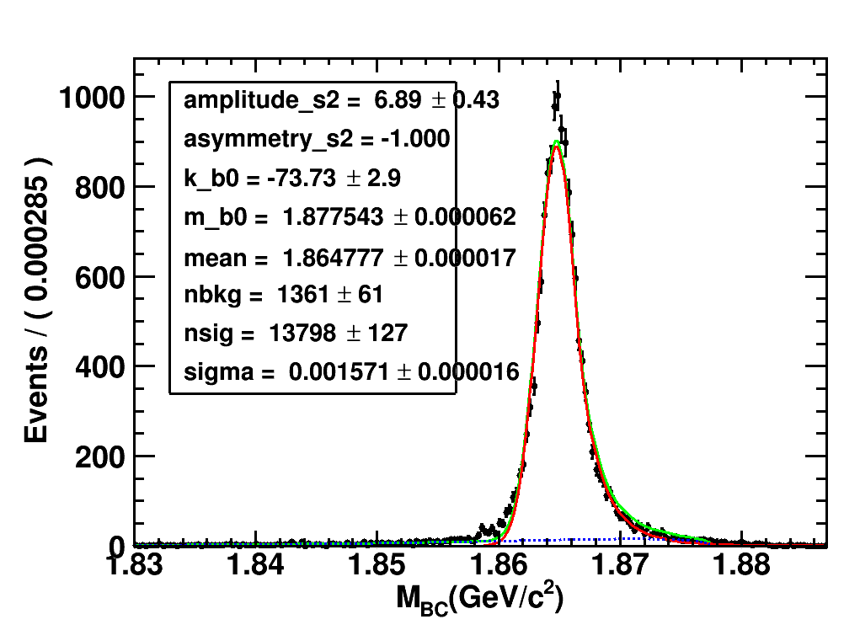
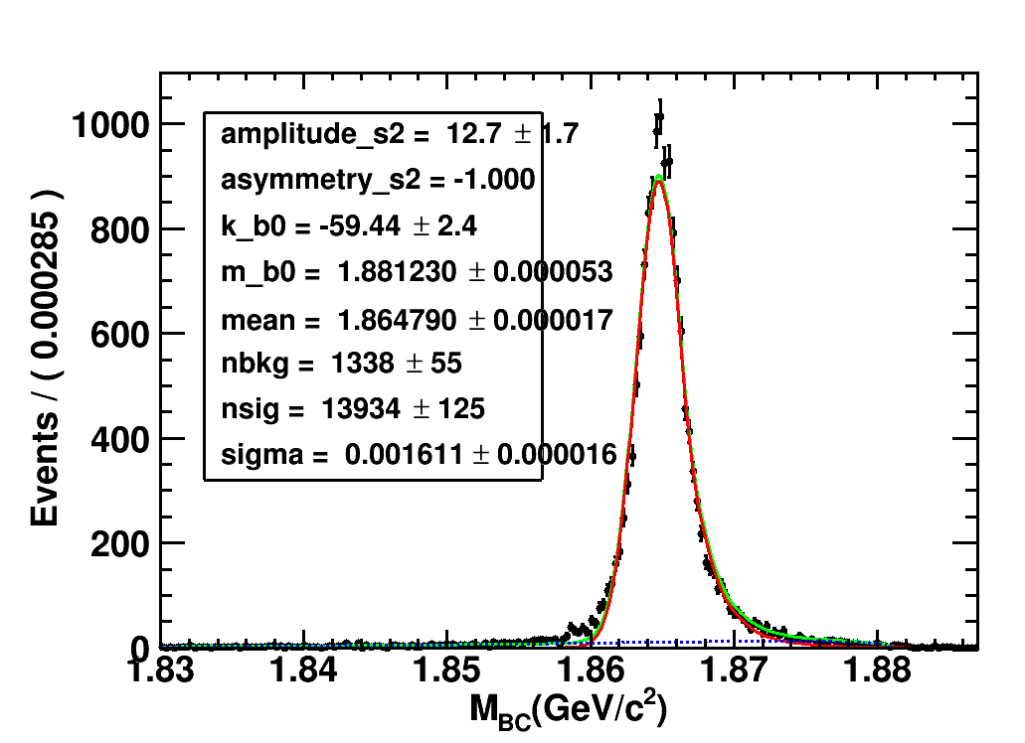
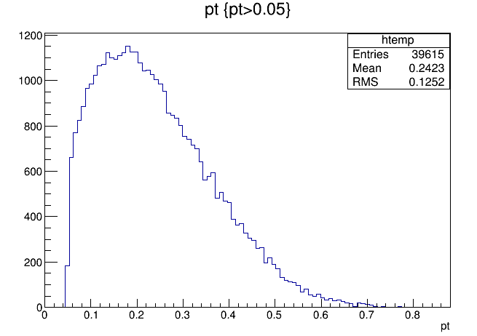
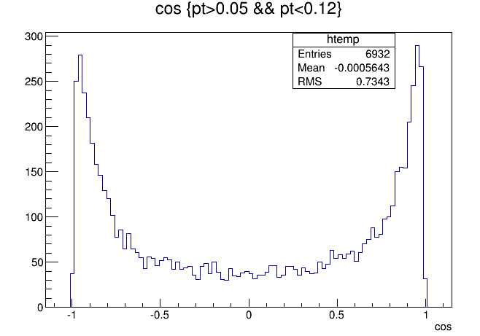
D->k-pi+pi-pi+
PATTSF
HOUGH
13934 signal
13798 signal
For all tracks in MC
For tracks(pt 0.05~0.12MeV) in MC
vs pt
vs cos
16% track under 120MeV

Slide 7
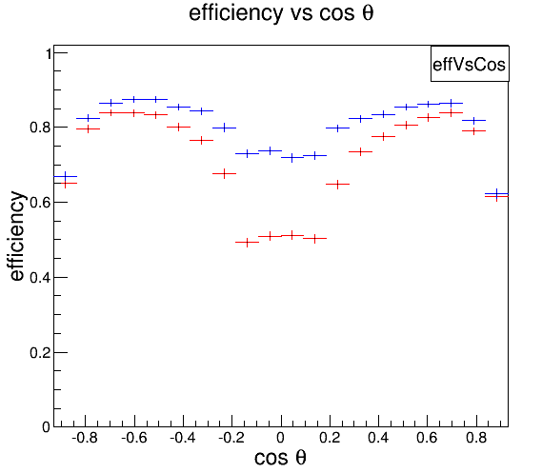
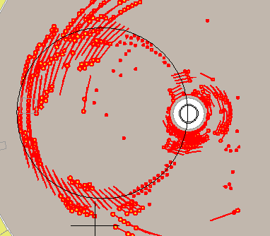
Check in MC Single pi-
From fixpt 60,70,80,90,100,110,120 MeV
Larger |cos| has no clear improvement by HOUGH now – accord with pipijpsi
Multiturn tracks has improvement ,inside|cos|<0.4
For some circumstance , hard to get good track
Not clear useful for physics even though much higher eff
If large |cos| improve more , tracking for physics could be enhanced clearly
Problem in multiturn tracks
In 2D fitting ,can’t tell 2nd turn hits

Slide 8
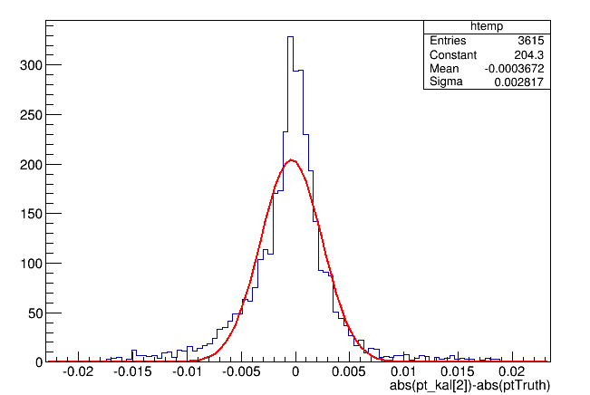
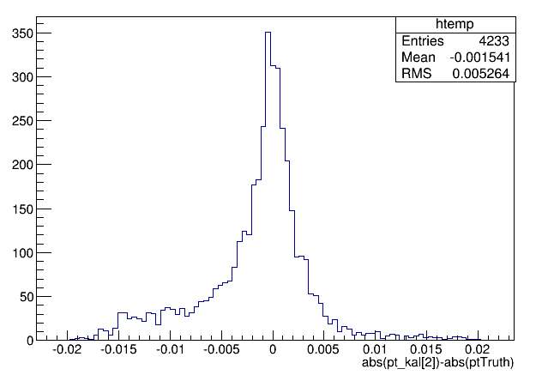
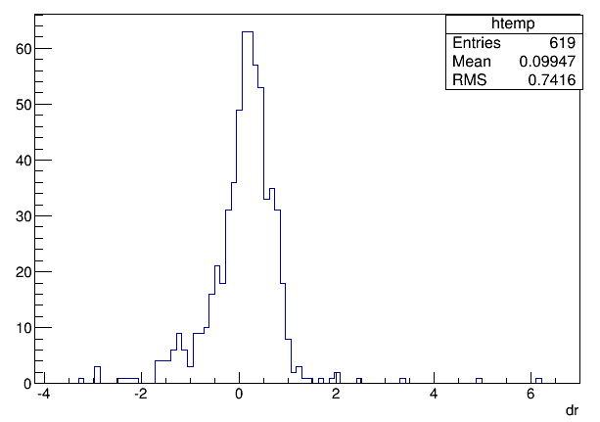
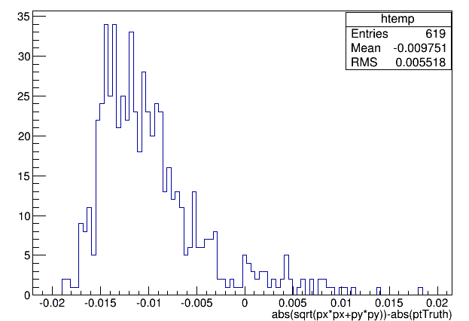
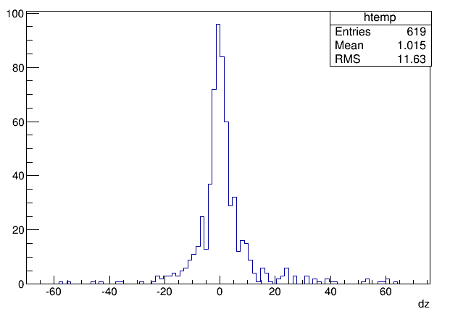
Kalman fitting influence for different pt
Fix pt 60MeV
Pt -ptTruth
Pt -ptTruth
Kalman success
All events
dr
总击中>5
斜丝击中>1
直丝击中>2
Chisquare>0
拟合矩阵对角线>0
参与kalmanfit前后的击中相差<=5
拟合前后的电荷相同
Pt -ptTruth
Kalman fail
dz

Slide 9
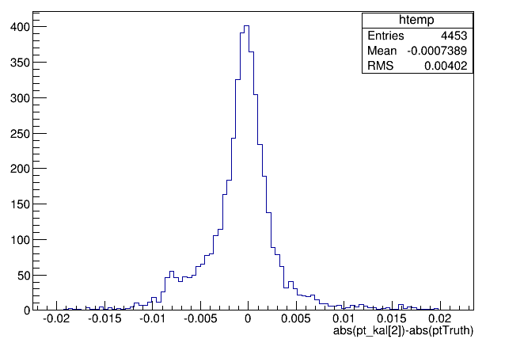
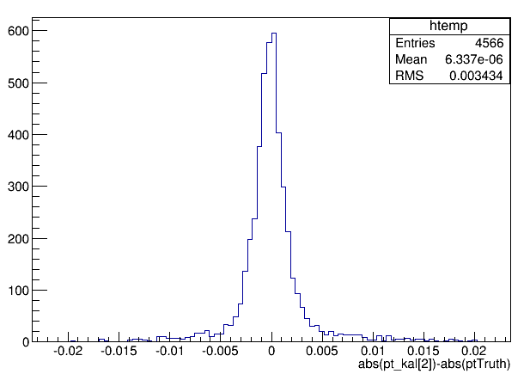
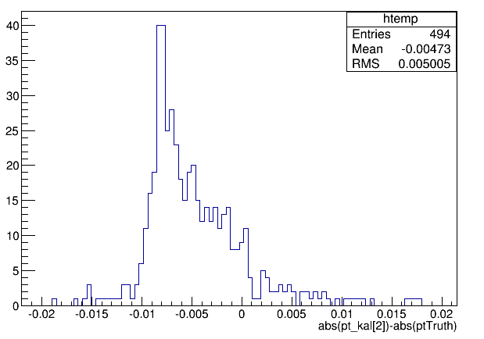
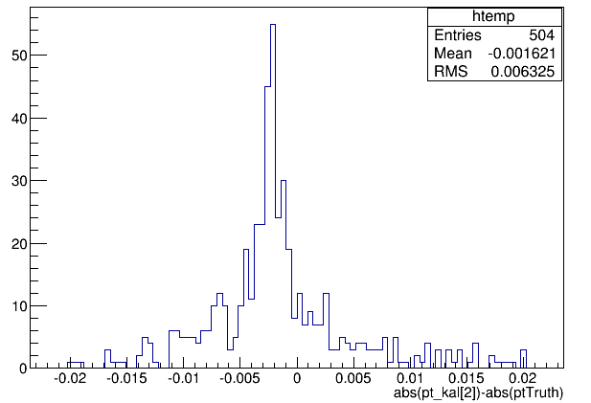
Other pt
70 MeV
110 MeV
For lower pt events , Kalman more important to fix momentum
For lower pt events , fix conditions of drop hits for kalman?

Slide 10
Conclusion
Fix larger |cos| events could be more useful for physics
Some tracks have collected right hits but can’t get good parameters
Suppose better performance if fix kalman for lower pt

