Slide 1
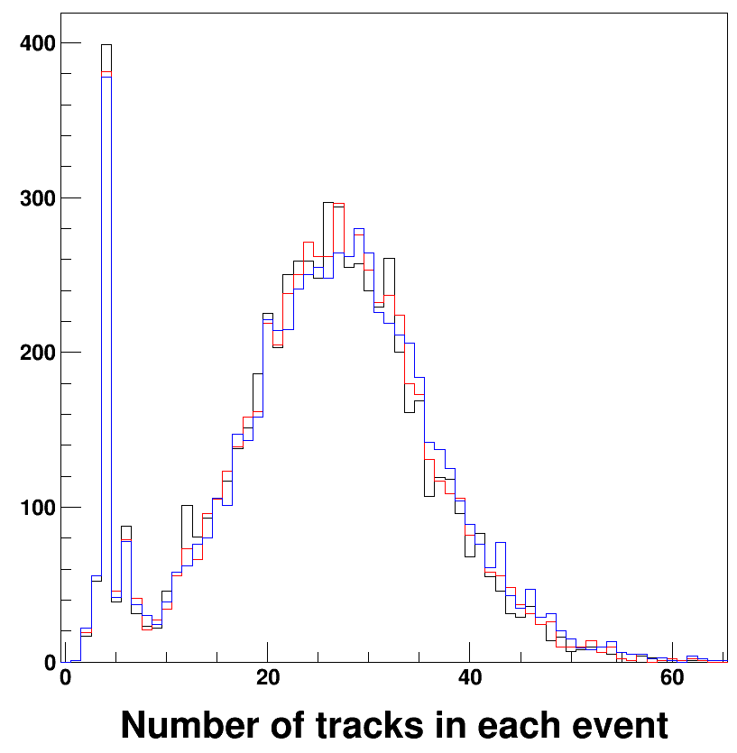
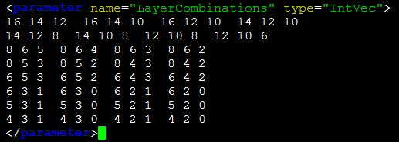
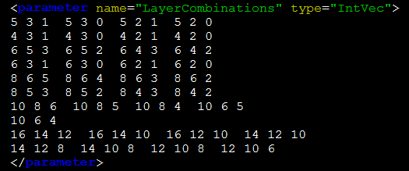
Comparison of reconstruction with full-silicon tracker e2e2h sample different layer combination for triplet; same FTD layer combination.
sit⇒vxd: 166301
vxd⇒sit: 170400
vxd⇒sit: 173317
3 of each 4-neighbor layers

