Slide 1
Study on ATLAS alternative Higgs productions (VBF H->bb & VBF H->WW)
Zhijun Liang （梁志均）
( IHEP, Chinese Academy of Science )

Slide 2
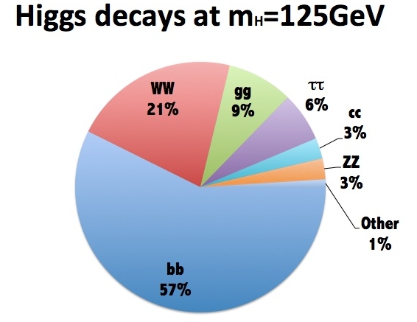
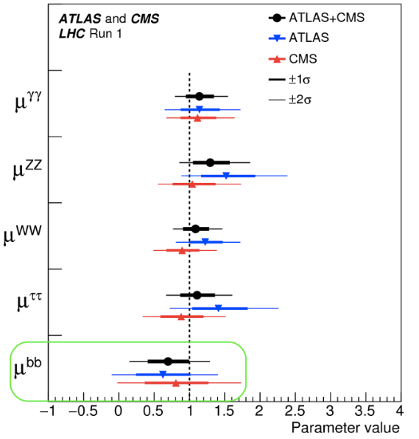
Higgs­-bottom Yukawa couplings
H→bb has the largest branching ratio (~58%)
Evidence of fermionic decays in Run 1:
H → bb: 2.6σ (expected 3.7σ)
channel | Reference | Integrated Lumiosity
VH(bb̄ ) | arXiv:1708.03299 | 36 fb⁻¹ ( 13TeV)
VBF H(bb)𝛾 | ATLAS-CONF-2016-063 | 12.5 fb⁻¹ ( 13TeV)

Slide 3
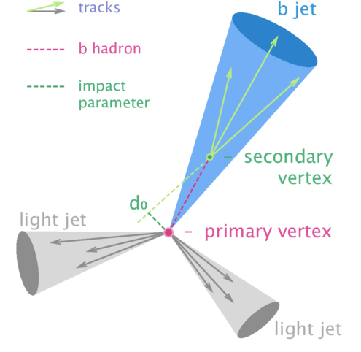
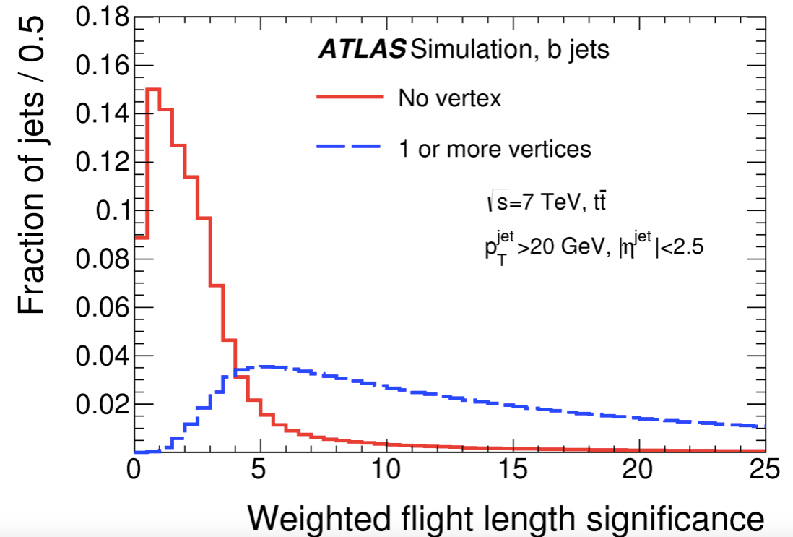
How to Identify b quark jets in ATLAS
Two ways to Identify b jets
impact parameters
secondary vertex from B decay

Slide 4
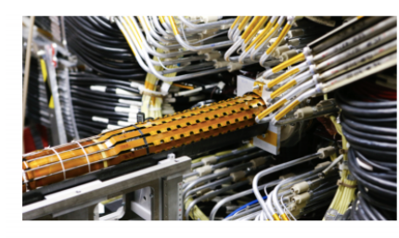
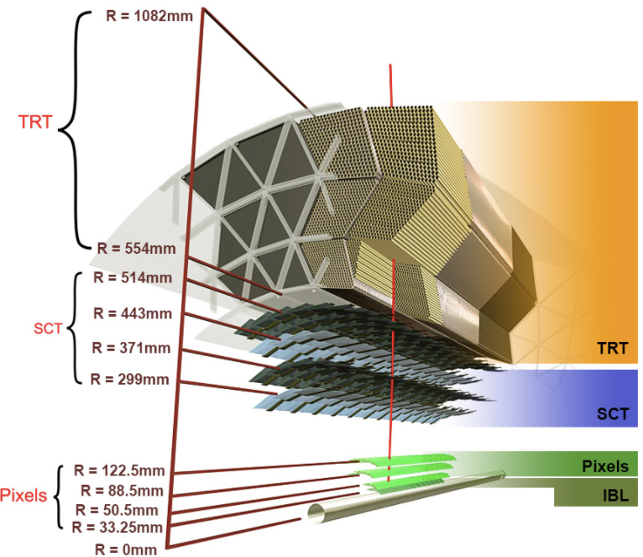
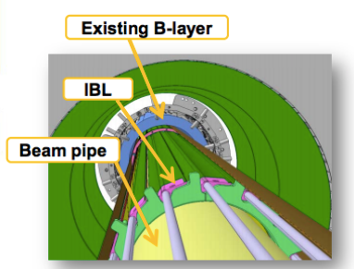
ATLAS Detector upgrade from run 1 to run 2
IBL = New Insertable pixel B-Layer at R=33 mm

Slide 5
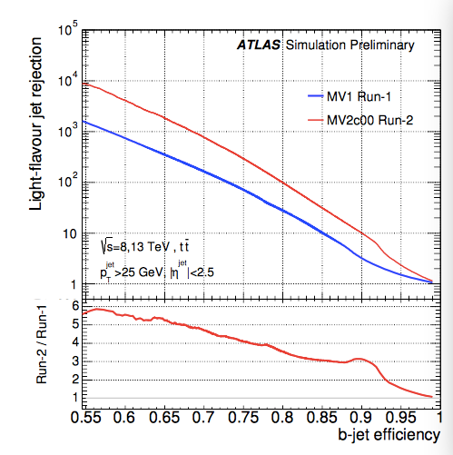
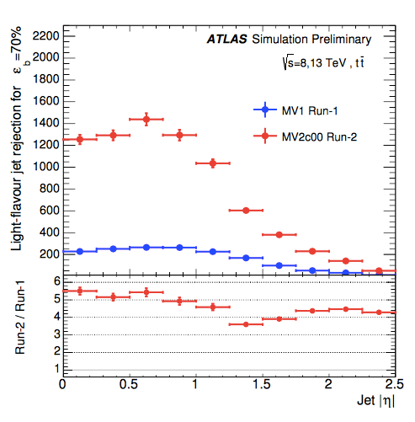
B tagging performance Improvement after upgrade
Light jet rejection power increases by a factor of 10

Slide 6
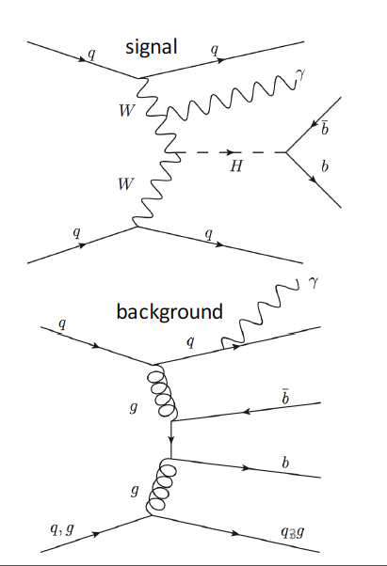
VBF H(bb)𝛾 final state
Search for H->bb in VBF events containing a central photon
Advantages of requiring a photon
extra handle for trigger
suppresses QCD background
Sensitive to WWH VBF production
not sensitive to ZZH VBF
ATLAS-CONF-2016-063

Slide 7
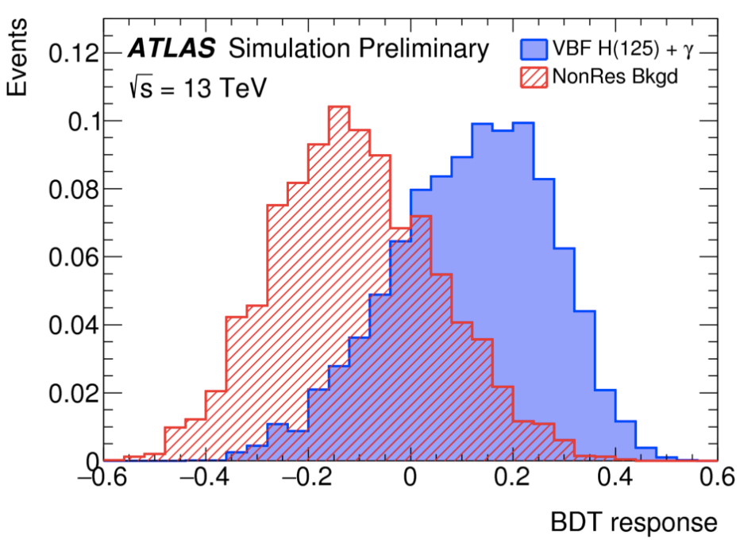
VBF H(bb)𝛾 event selection
ATLAS-CONF-2016-063
Trigger:
L1 trigger: single photon (pT > 25 GeV)
High level trigger: 4 jets pT > 35 GeV, mjj> 700 GeV
Offline Selection:
Tight ID photon, pT > 30 GeV
4 jets with pT> 40 GeV
2 central(|η|<2.5) b-tagged jets
pT(bb)>80GeV
mjj> 800 GeV
BDT discriminant
Define 3 regions with different S/B
Fit m_{bb} in 3 regions

Slide 8
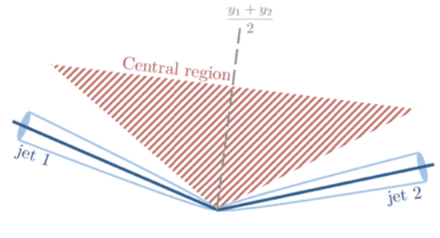
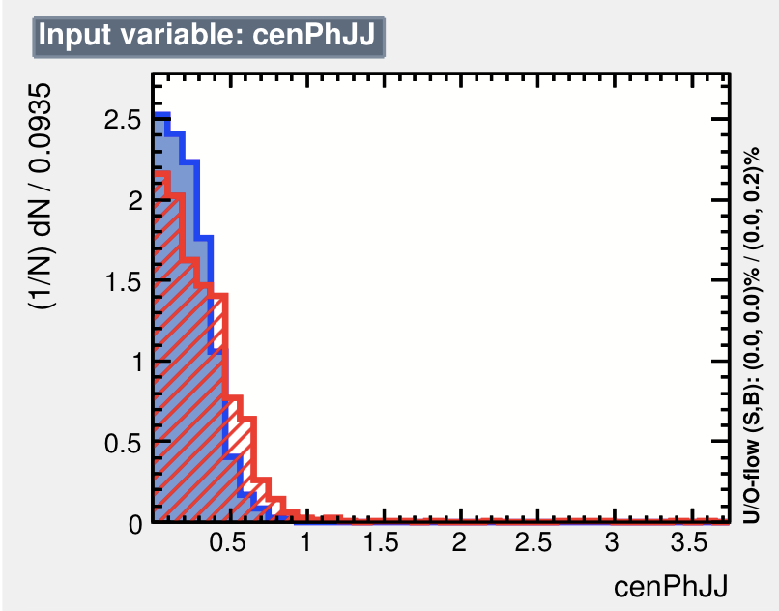
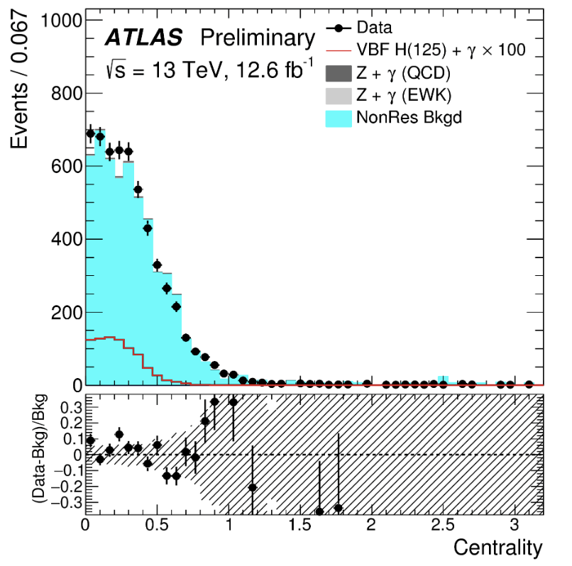
VBF H(bb)𝛾 MVA Input varialbe: photon centrality

Slide 9
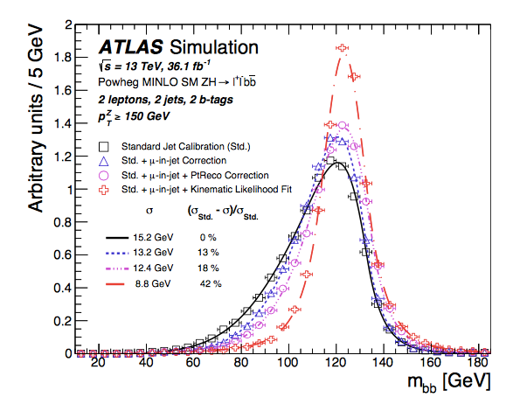
B jet energy corrections
Using ATLAS default jet energy calibrations
Higgs mass resolution is not great
Asymmetry in mass, long tail in low mass region
Dedicated B jet calibration
Muon-in-jets corrections
Kinematic likelihood

Slide 10
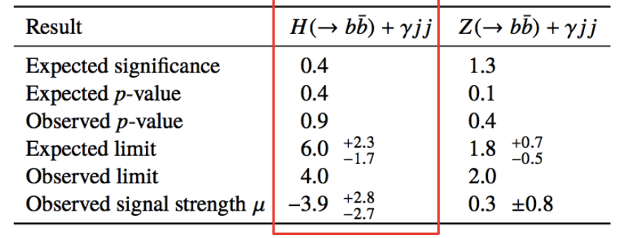
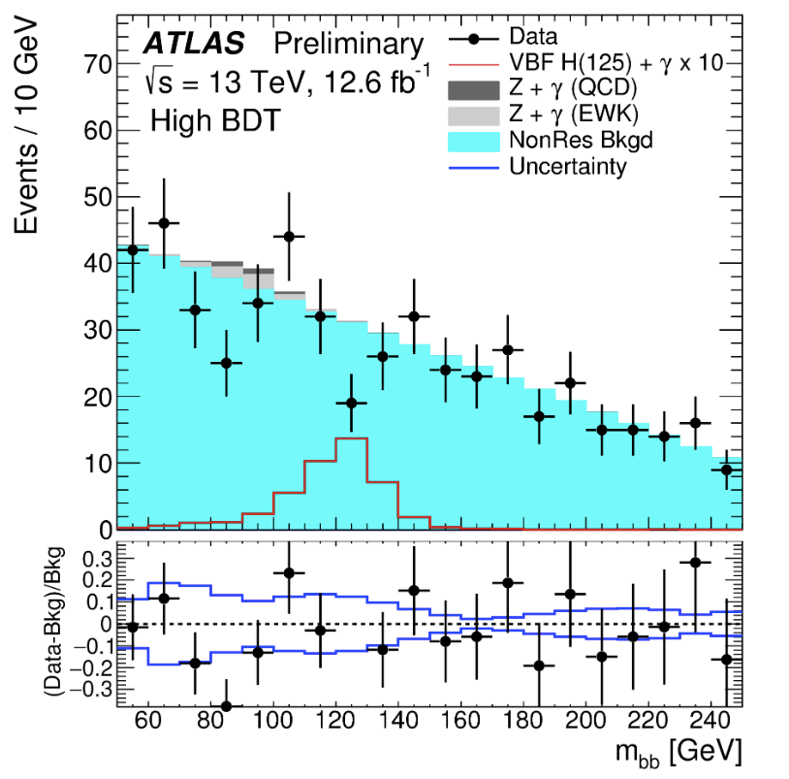
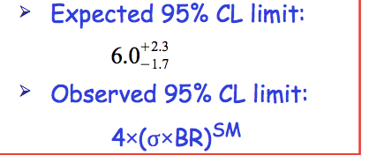
VBF H(bb)𝛾 signal extraction
ATLAS-CONF-2016-063
Non-resonant background (𝛾+jets ) estimated with 2nd order polynomial fit.
Statistics uncertainty in mbb sideband region dominated
High BDT score region
VBF H（bb）𝛾 production cross section limit

Slide 11
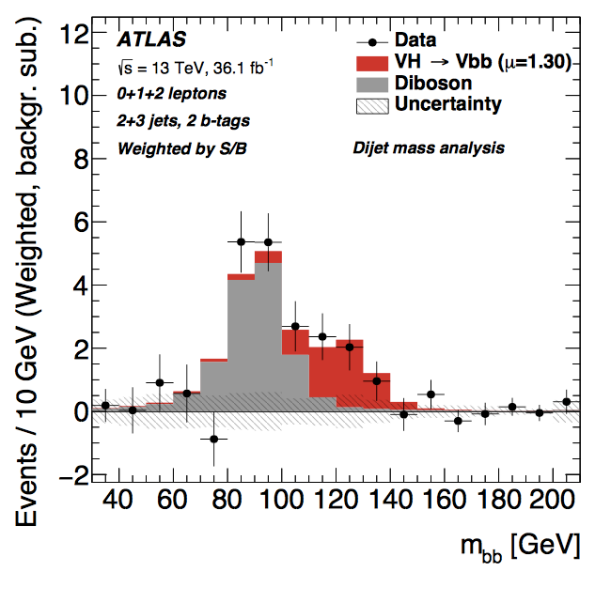
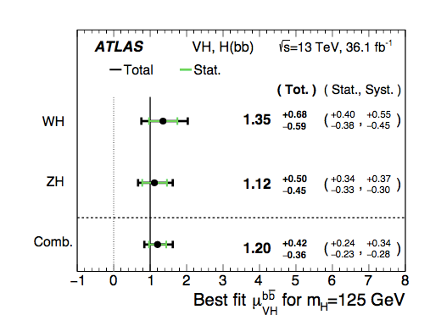
Latest results on H(bb)
Combined signal strength with 36 fb-1 at √s= 13 TeV
VH(bb): 3.5 σ observed significance ( 3.0 σ expected )
Systematics dominated, very hard to reach 5 σ with run 2 data
VBF (bb) & VBF H(bb)𝛾 : 1.8 σ observed significance ( 0.8 σ expected )
Statistics dominated, will catch up with VH
Combination of VBF and VH are more likely to reach 5 σ
VH(bb)
VH(bb)

Slide 12
VBF H->WW
C. Bertella
( IHEP, Chinese Academy of Science )

Slide 13
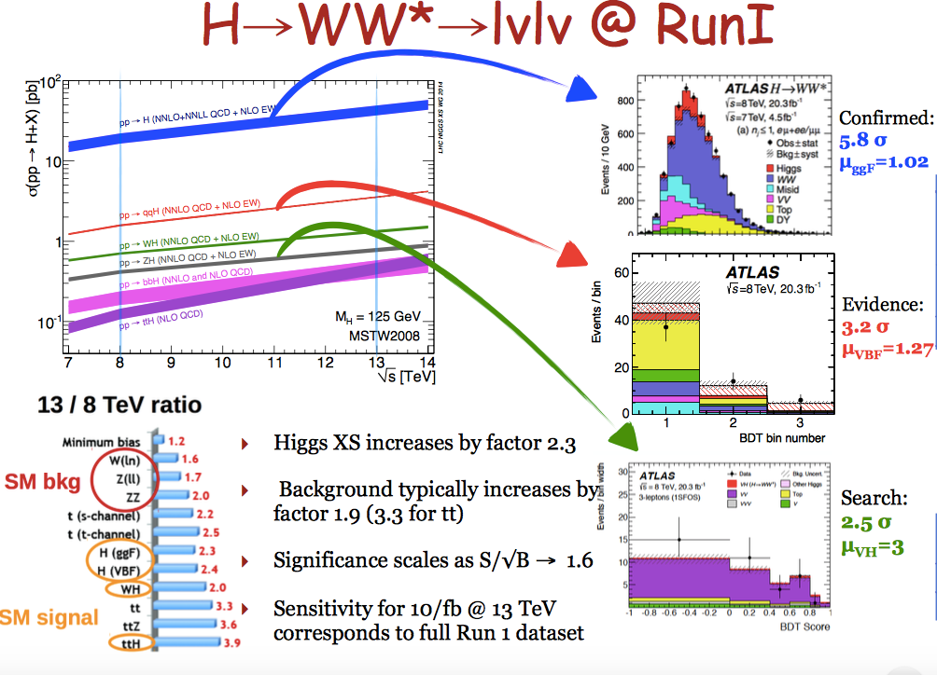
Df

Slide 14
D f

Slide 15
df

Slide 16
df

Slide 17
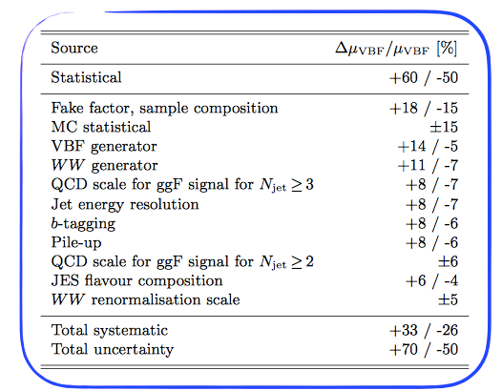
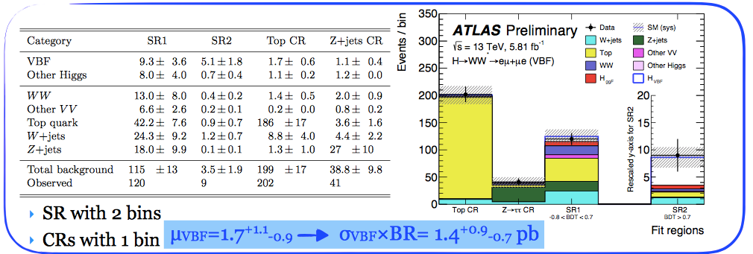
VBF H->WW result
observed (expected) significance
1.9σ (1.2σ) with 5.8 fb⁻¹ data
Statistics dominated
~60% stat.
~30% syst.

Slide 18
Summary
The search for the Higgs decays to b-quarks in ALTAS
VBF H(bb)𝛾: first ATLAS result (ever)
VH(bb) : observed (expected ) significance: 3.5 σ(3.0 σ)
Combination of VBF and VH is likely to reach 5 σ with full run 2 data
VBF H(WW)
observed (expected ) significance 1.9σ (1.2σ) with 5.8 fb⁻¹ data
Likely to reach 3σ ~4σ with full run 2 data

Slide 19
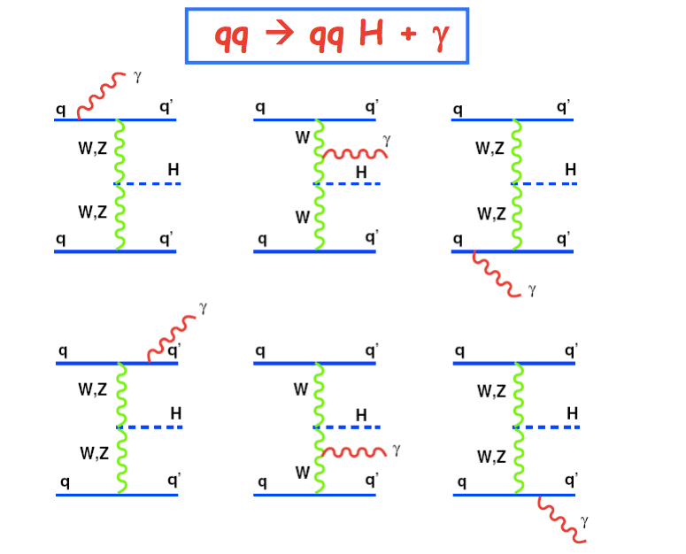
Introduction
Inspired by Barbara Mele’s paper
http://arxiv.org/abs/hep-ph/0702119
Introduce a new channel in VBF H->bb
pp->h(bb) jj +γ
Measurement of bbH and WWH coupling
By requiring a central photon
S/B ratio is much better than VBF H->bb
Help to do trigger the events

Slide 20
MC Samples
Signal samples (VBF H(->bb)+γ):
generated with Madgraph, parton shower by Pythia8
Z(bb)γ+jets (resonance background )
EWK VBF H(->bb)+γ
generated with Madgraph, parton shower by Pythia8
QCD VBF H(->bb)+γ
generated with Madgraph, parton shower by Pythia8
QCD γbb+jets (Non resonance background )
generated with Madgraph, parton shower by Pythia8
For MVA training

Slide 21
Trigger
Threshold for single photon trigger and 4jets triggers are high.
Single photon: trigger EF_g120_loose (ET>120GeV. too high )
General 4jet triggers : ET>100GeV (too high)
Dedicated trigger developed in 2015 for this analysis.
Analysis is mainly based on VBF0b trigger.
L1 item : L1EM22VHI (trigger on EM object with ET>22GeV)
HLT :
Medium ID photon, pT >25GeV
4 HLT jets pT >35GeV, |eta|<4.9
Mjj>700GeV
Nick name | Trigger name | Integrated lumiosity
VBF0b | HLT_g25_medium_L1EM22VHI_4j35_0eta490_invm700 | 2.5 fb-1 (2015) 10.1 fb-1 (2016)

Slide 22
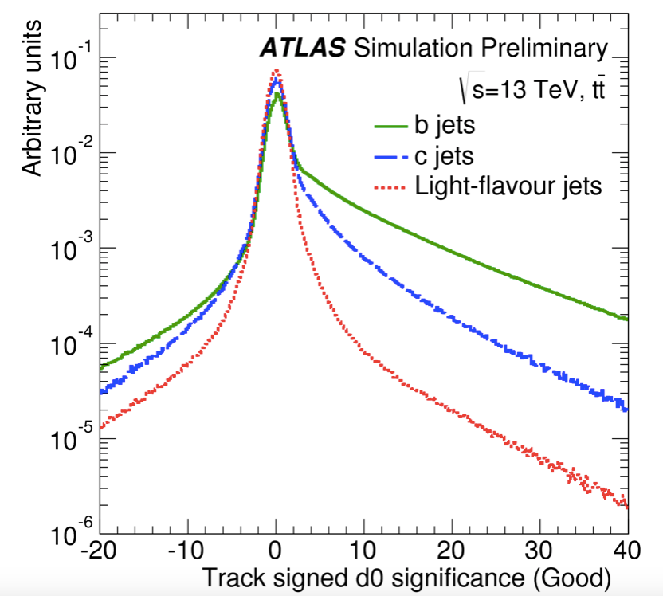
How to Identify b quark jets in ATLAS
Two ways to Identify b jets
impact parameters
secondary vertex from B decay

Slide 23
Impact of each systematics
Non-resonance background systematics is the leading systematics.

Slide 24
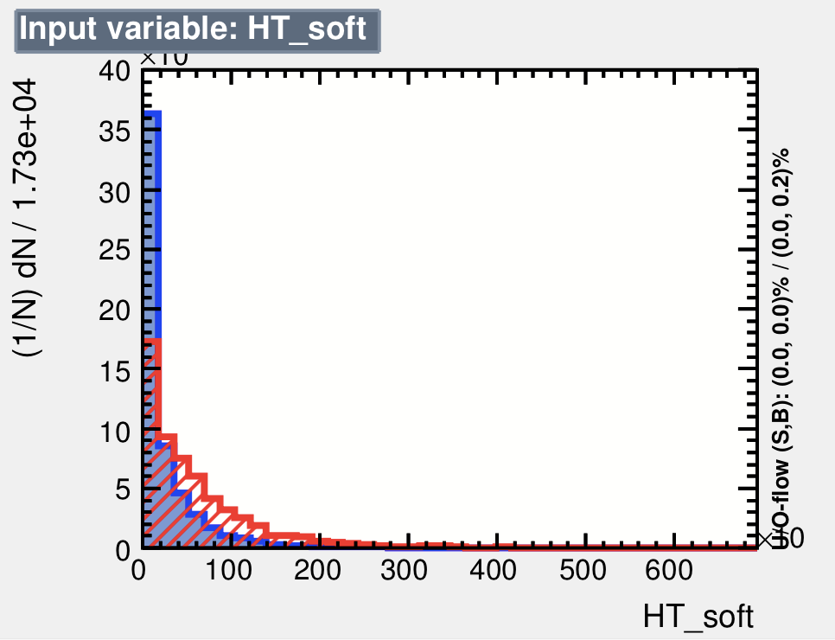
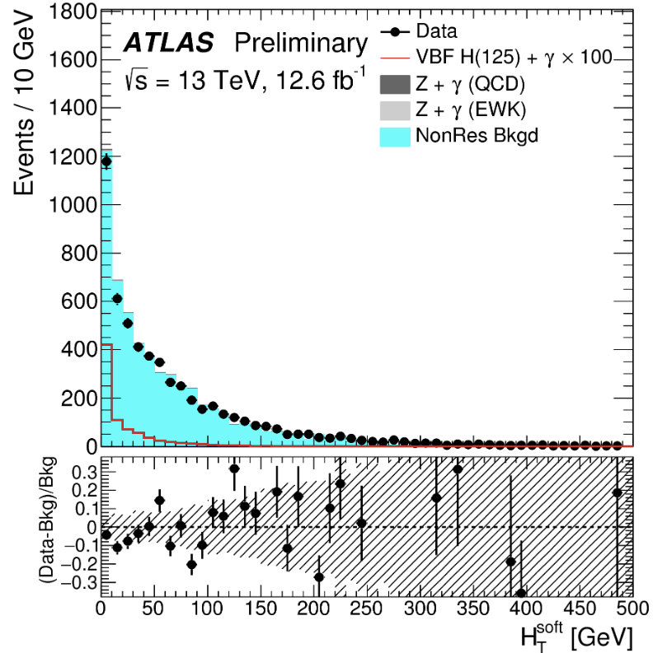
MVA Input varialbe: H_{T}^{soft}
Low QCD activity in rapidity gap of two VBF jets for VBF signature

Slide 25
Major Background process
QCD pbbjj +γ production
Inspired by Barbara Mele’s paper
http://arxiv.org/abs/hep-ph/0702119

Slide 26
Event pre-selection

Slide 27
MVA studies
BDT training samples:
signal: HbbjjaSM125 (direct tag)
background: NonResbbjja (truth tag)
11 BDT input variables:
variable | definition
dRB1Ph, dRB2Ph, dRJ1Ph, dRJ2Ph | angular separation between the selected jets and the photon
mJJ, dEtaJJ | kinematics of the VBF jets
WidthJ1, WidthJ2 | calorimeter jet width of the VBF jets
pTBal | pT balancing variable for selected final state objects
cenPhJJ | centrality of the photon with respect to the VBF jets
HT_soft | scalar sum pT of the soft TrkJets (pT>7GeV)

Slide 28
m_{bb} Fit configurations
H+γ fit configuration
H+γ normalization μ_{H is} the parameter of interest.
H+γ and Z+γ shape from MC simulation
Z+γ normalization from MC predictions
The normalization of are from MC simulation.
Non-resonance background is fitted as 2nd order polynomial
Z+γ fit configuration
EWK Z(bb)γ+jets and QCD Z(bb)γ+jets are considered as signal
H+γ and Z+γ shape from MC simulation
H+γ is normalization from MC simulation
Non-resonance background is fitted as 2nd order polynomial

Slide 29
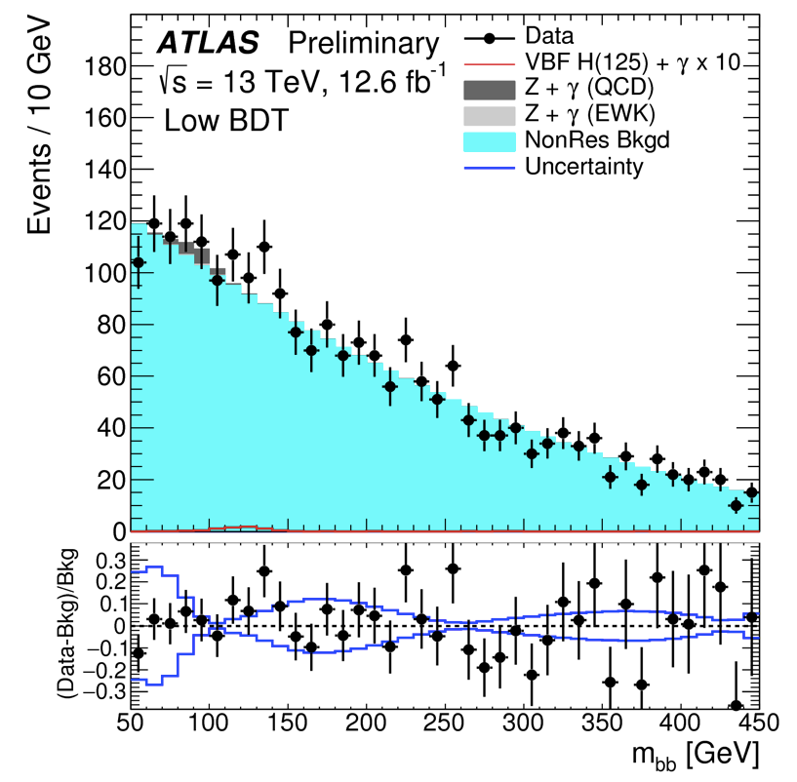
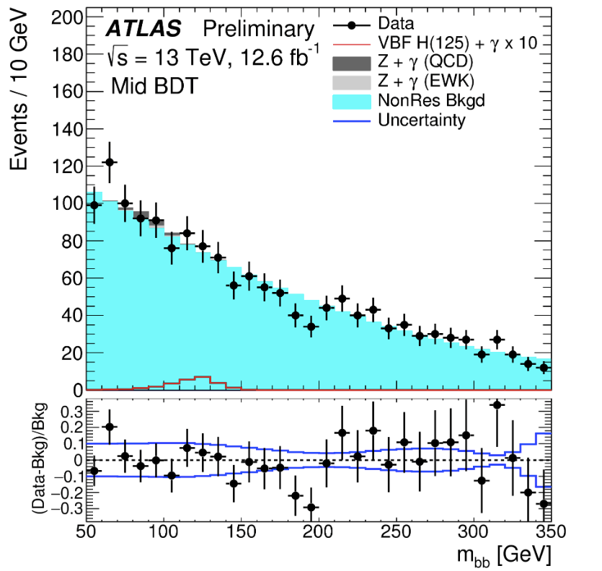
m_{bb} fit
Mbb fit with 3 category : high/medium/low BDT region
Low BDT
Medium BDT
High BDT
BDT categories | BDT score | mBB fit range
low | BDT < -0.1 | [50, 450] GeV
medium | -0.1 < BDT < 0.1 | [50, 350] GeV
high | BDT > 0.1 | [50, 250] GeV

Slide 30
Result
ATLAS-CONF-2016-063
H+γ fit configuration
H+γ normalization μ_{H is} the parameter of interest.
Z+γ normalization and Z+γ shape from MC simulation
Z+γ fit configuration
EWK Z(bb)γ+jets and QCD Z(bb)γ+jets are signal
H+γ normalization and H+γ shape from MC simulation

Slide 31
Systematic uncertainties
Theoretical uncertainties for H+gamma and Z+gamma
QCD scale systematics
Parton shower systematics
Non-resonance background systematics
Statistics in mbb sideband region
Experimental uncertainties
Jet systematics (Jet energy scale)
B-tagging efficiency systematics

Slide 32
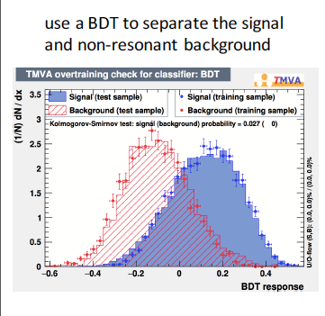
Analysis strategy
Pre-selection cut
MVA analysis (boosted decision tree)
category the events into three category
Extract signal from m_{bb} fit
Perform fit in m_{bb} spectrum

Slide 33
How to Identify b quark jets in ATLAS(1)
Two ways to Identify b jets
impact parameters
secondary vertex from B decay

Slide 34
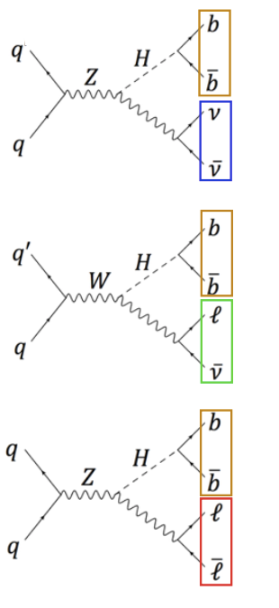
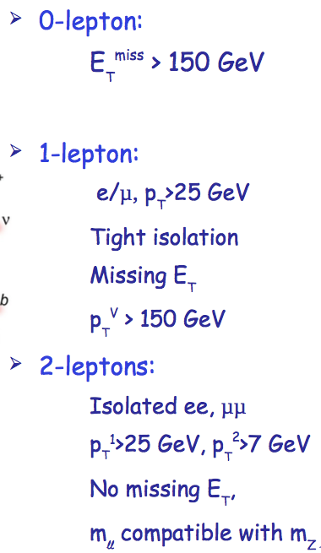
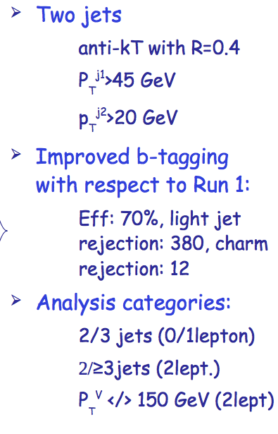
VH(bb): 3 channels

Slide 35
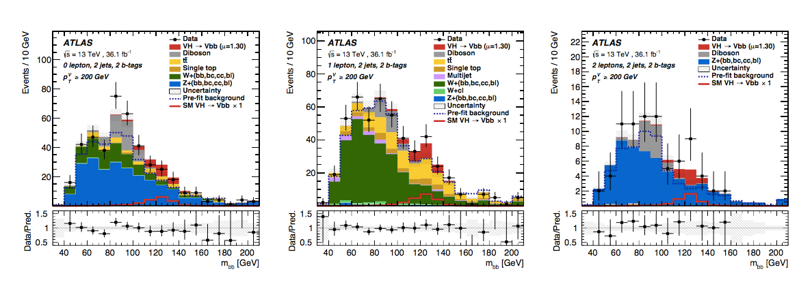
VH(bb) background
Z+bjets dominates in 0, 2 lepton channels
Top quark and W+jets in 1 lepton channel
Multi-jet background
negligible in 0/2 lepton channels after anti-QCD cuts
Data-driven estimate in 1 lepton channel
0 Lepton
1 Lepton
2 Lepton

