Slide 1
CEPC上的2016年理论物理进展
贾宇
(on behalf of 吕才典)
国际创新海外团队，院前沿重点项目暨所创新团队2016年联合年会
Nov. 18, 2016

Slide 2
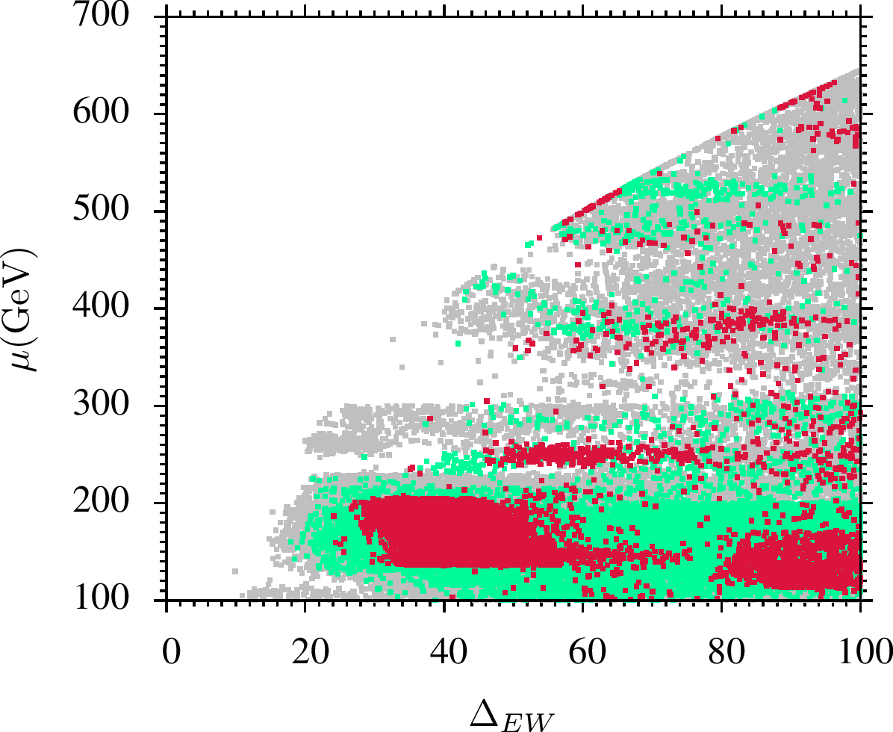
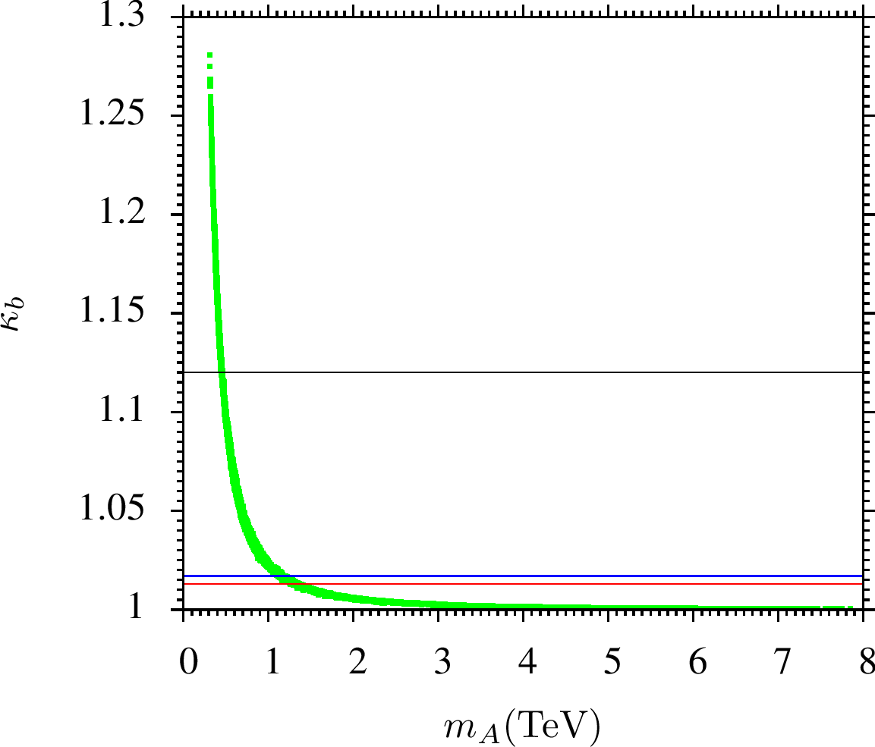
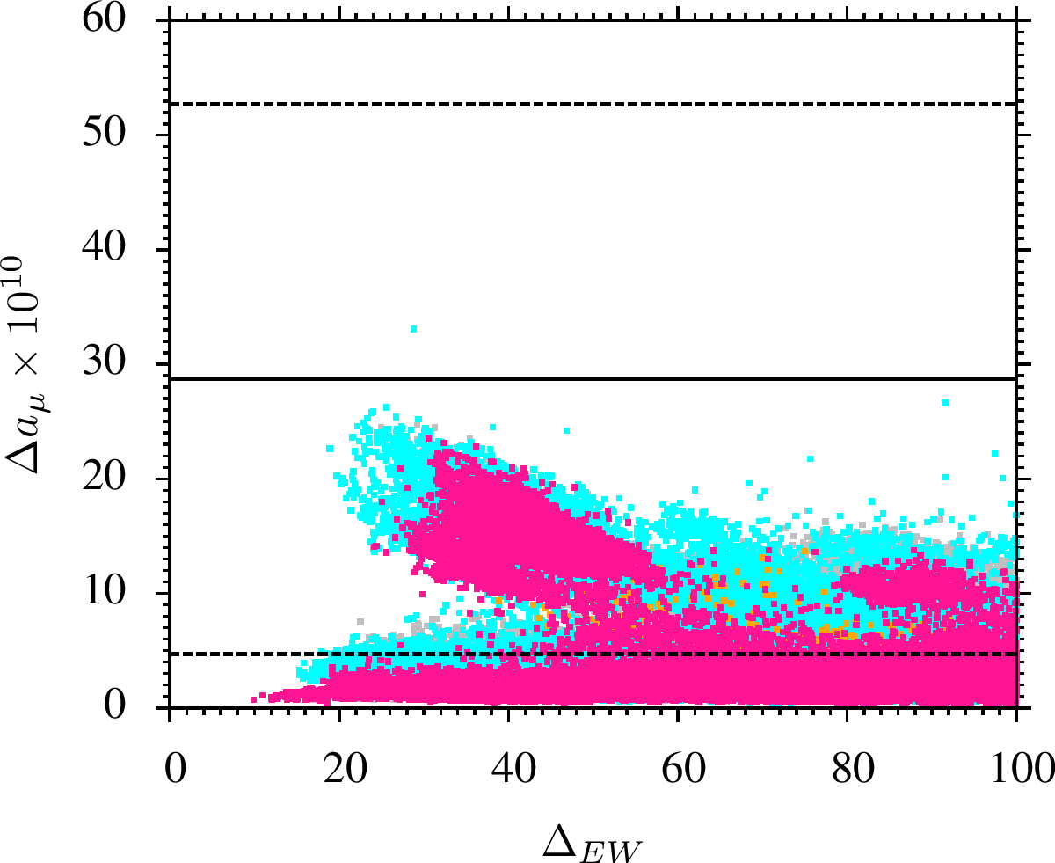
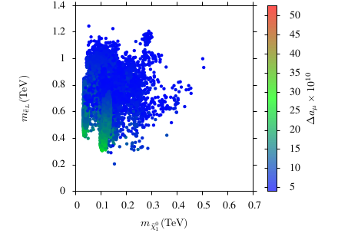
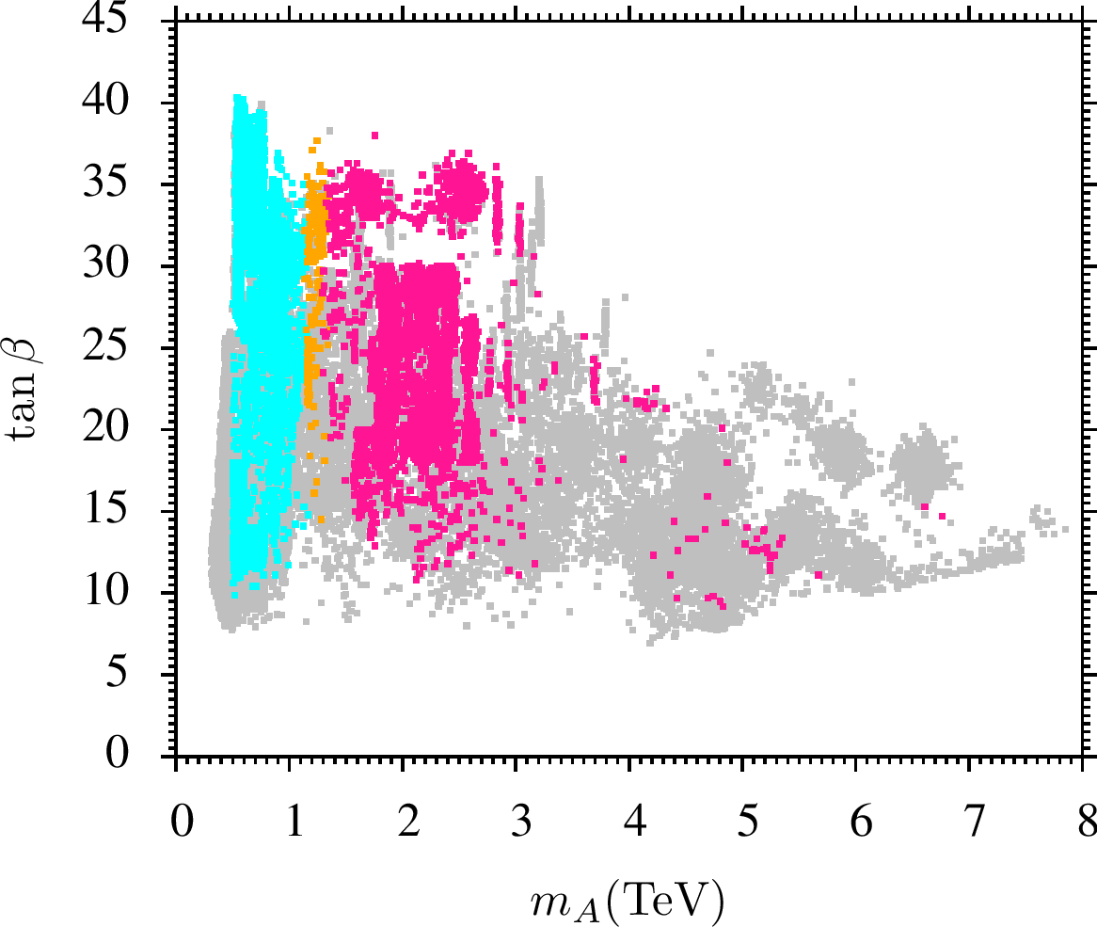
Constraining Natural SUSY @ HL-LHC, ILC & CEPC by 王科臣
Using Muon Magnetic Moment & Higgs Coupling;
“Constraining Natural SUSY using the Higgs Coupling and Muon Magnetic Moment Measurements”
王科臣 PRD93 (2016) 055040
← Basic constraints:
REWSB, neutralino LSP,
sparticle mass, Higgs mass,
B-physics, fine-tuning.
← Muon magnetic moment
← Higgs coupling

Slide 3
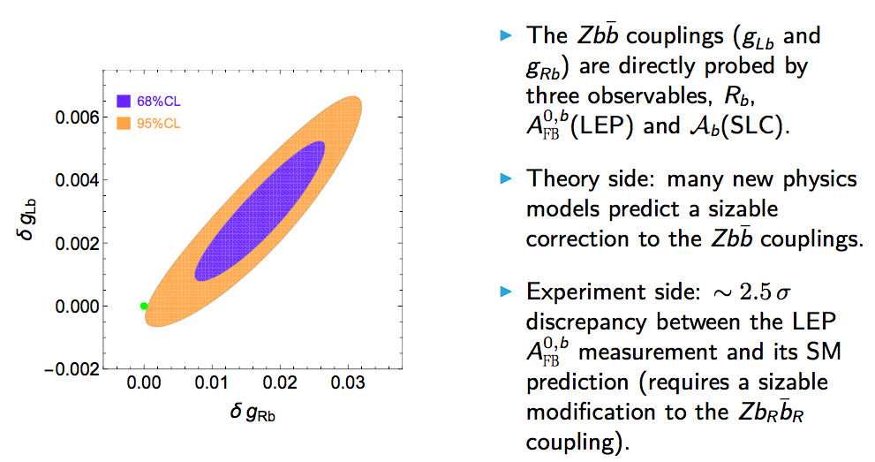
The Zbb couplings at future e^+ e^− colliders.
S. Gori, J. Gu and L.T. Wang, JHEP 1604, 062 (2016)

Slide 4
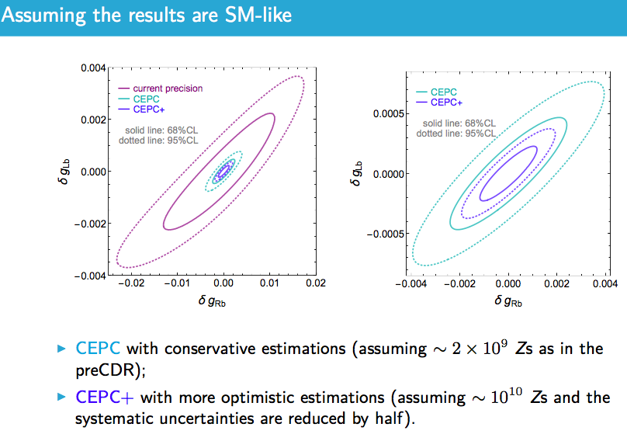

Slide 5
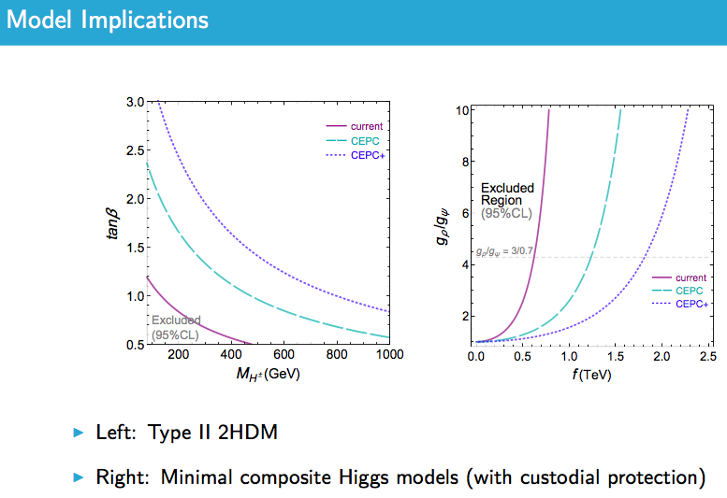

Slide 6
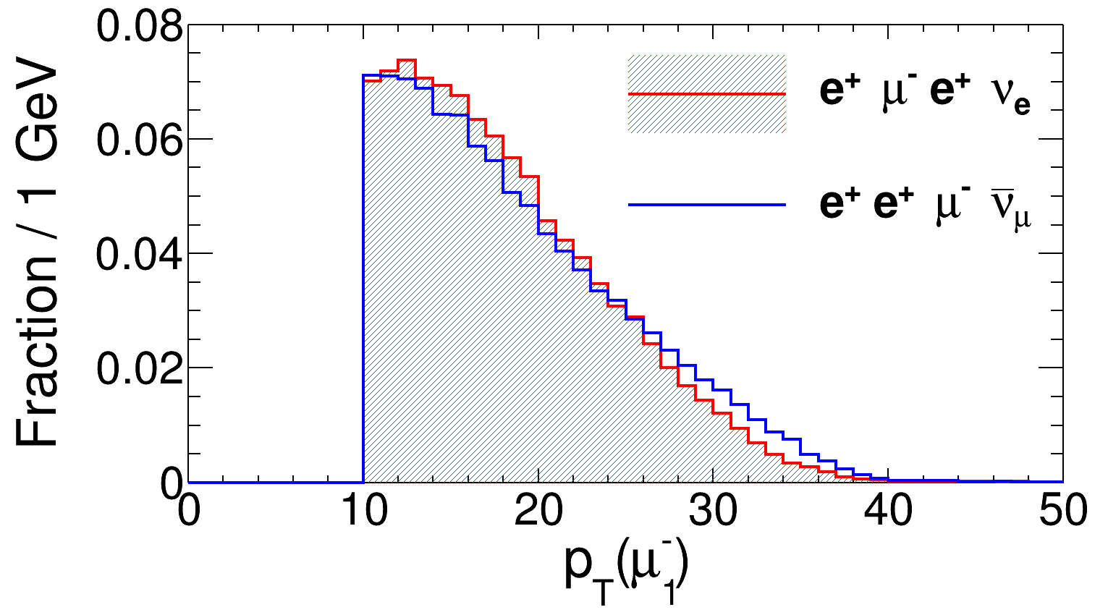
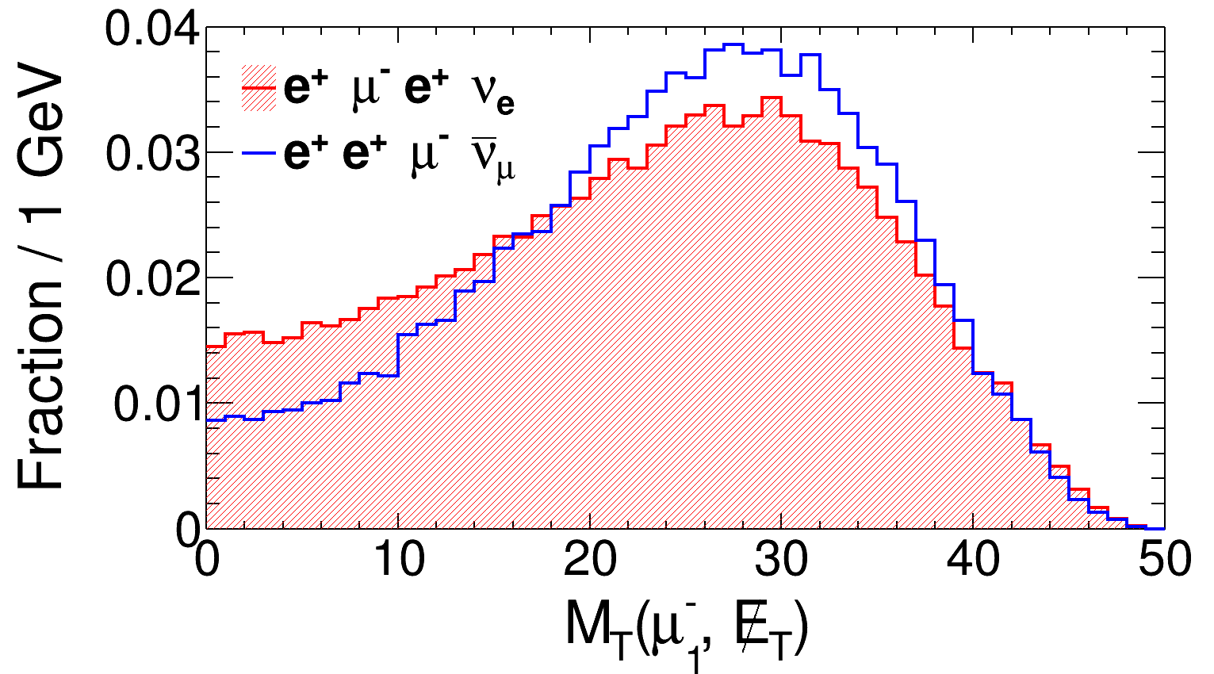
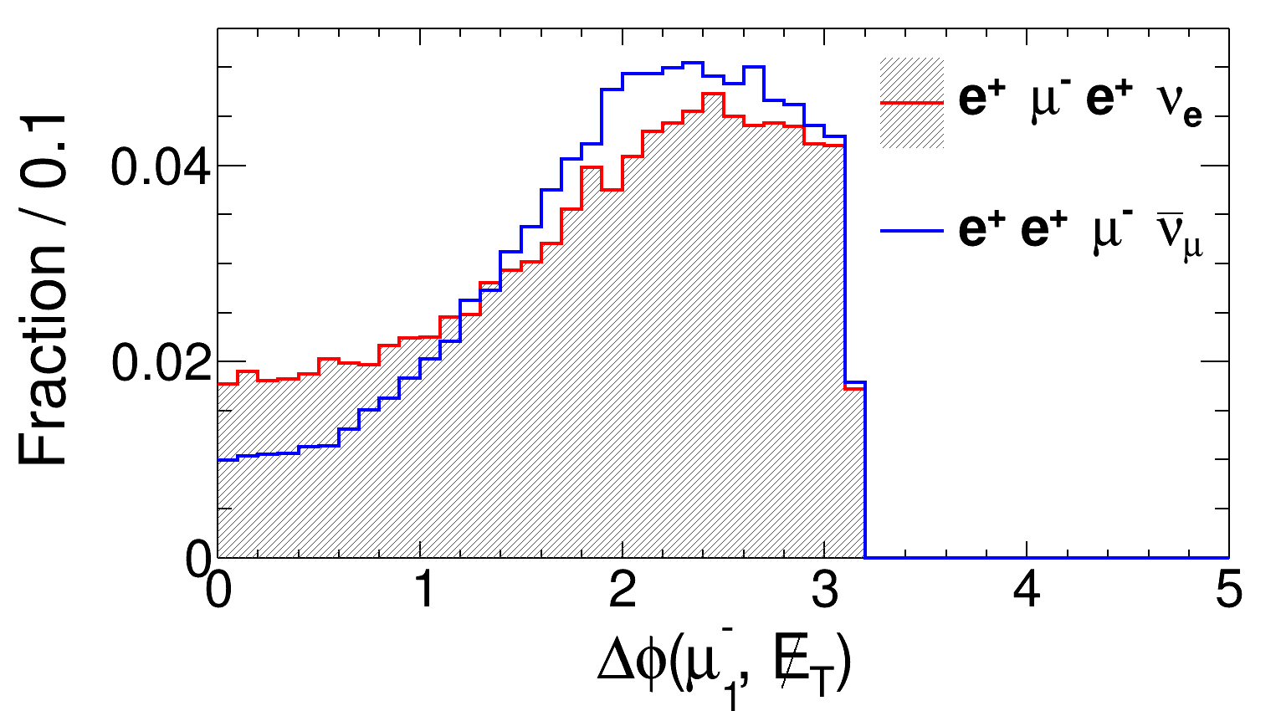
Sterile Neutrino Search @ LHC & CEPC
Distinguishing Majorana and Dirac Using Kinematical Distributions
C.O. Dib, C.S. Kim, Kechen Wang and J. Zhang, PRD94, 013005 (2016)
LNV:
LNC:

Slide 7
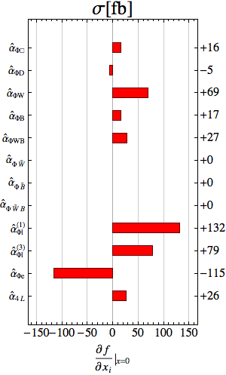
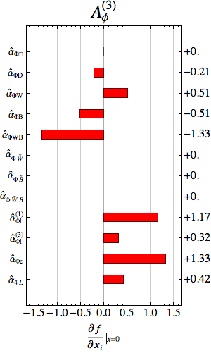
Angular Asymmetry in HZ Production @ CEPC
To Constraining New Physics;
“Beyond Higgs Couplings: Probing the Higgs with Angular Observables at Future e⁺e⁻ Colliders”, Nathaniel Craig, Jiayin Gu, Zhen Liu and Kechen Wang, JHEP 1603 (2016) 050
王科臣 顾嘉荫

Slide 8
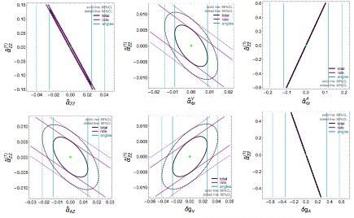
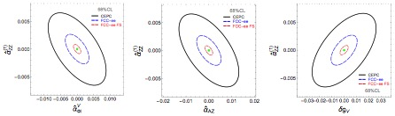
Angular Asymmetry in HZ Production @ CEPC
To Constraining New Physics;
“Beyond Higgs Couplings: Probing the Higgs with Angular Observables at Future e⁺e⁻ Colliders”, Nathaniel Craig, Jiayin Gu, Zhen Liu and Kechen Wang, JHEP 1603 (2016) 050

Slide 9
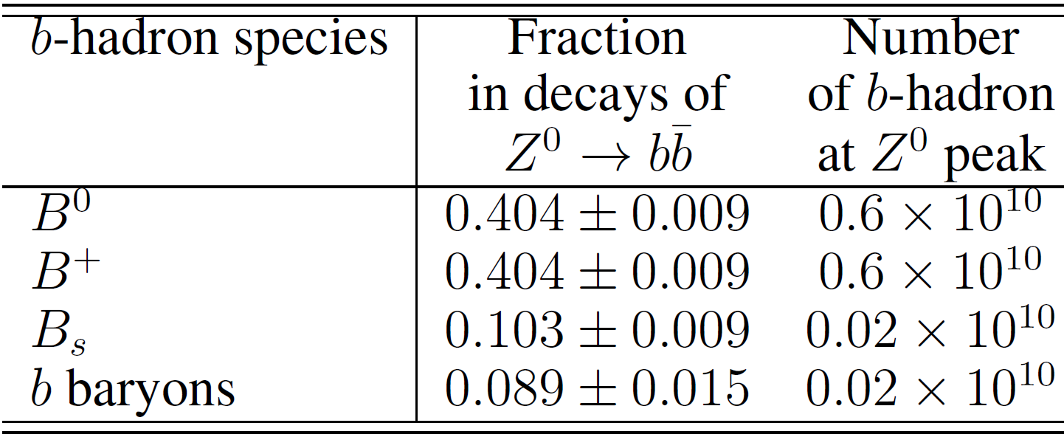
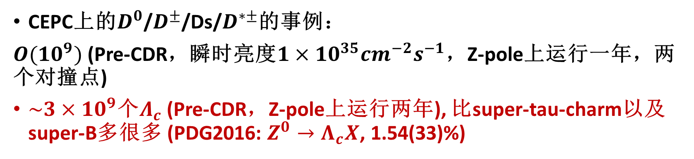
Progress in lattice QCD study（by 刘朝峰）
CEPC is also a flavor factory
CEPC上的$D^{0}$/$D^{±}$/Ds/$D^{∗±}$的事例：
$O({10}^{9})$ (Pre-CDR，瞬时亮度$1×{10}^{35}{cm}^{−2}s^{−1}$，Z-pole上运行一年，两个对撞点)
$\sim 3×{10}^{9}$个$Λ_{c}$ (Pre-CDR，Z-pole上运行两年), 比super-tau-charm以及super-B多很多 (PDG2016: $Z^{0}→Λ_{c}X$, 1.54(33)%)

Slide 10
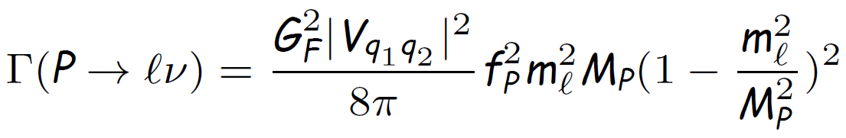
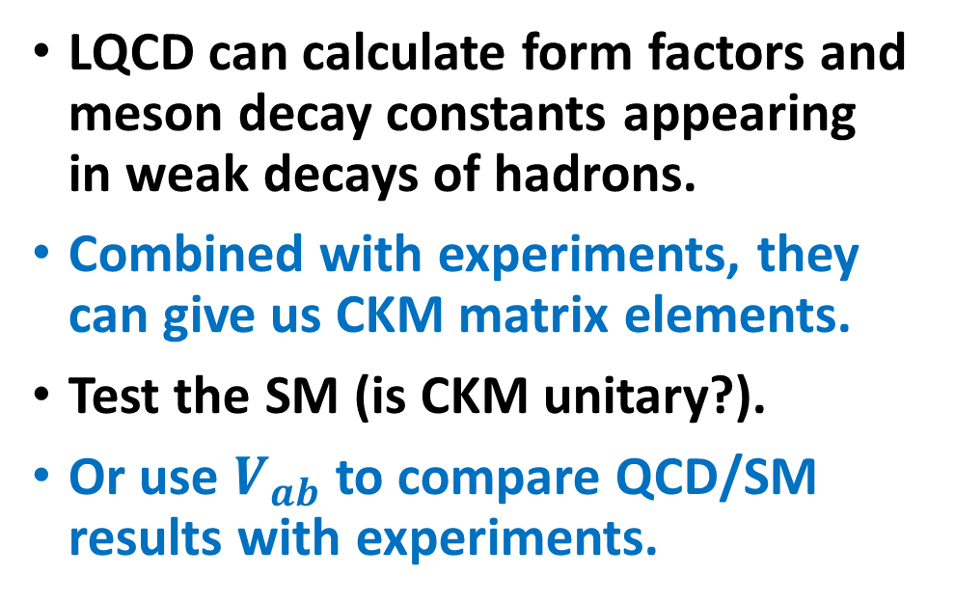
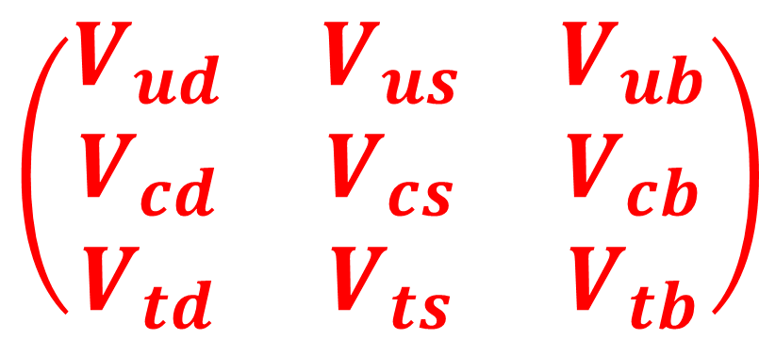
Flavor physics and LQCD
LQCD can calculate form factors and meson decay constants appearing in weak decays of hadrons.
Combined with experiments, they can give us CKM matrix elements.
Test the SM (is CKM unitary?).
Or use $V_{ab}$to compare QCD/SM results with experiments.
$$\left(\begin{matrix}V_{ud} & V_{us} & V_{ub} \\ V_{cd} & V_{cs} & V_{cb} \\ V_{td} & V_{ts} & V_{tb}\end{matrix}\right)$$
Can be calculated by LQCD
例如：

Slide 11
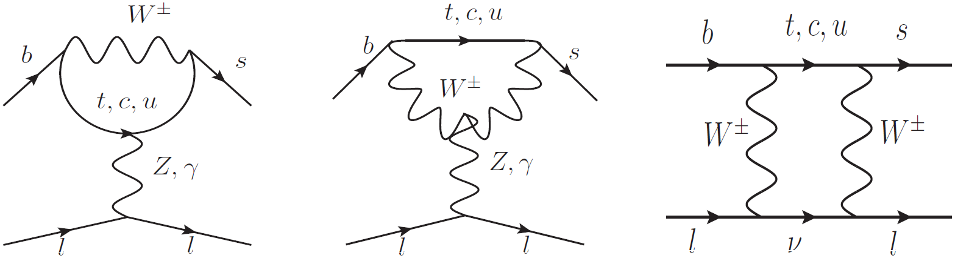
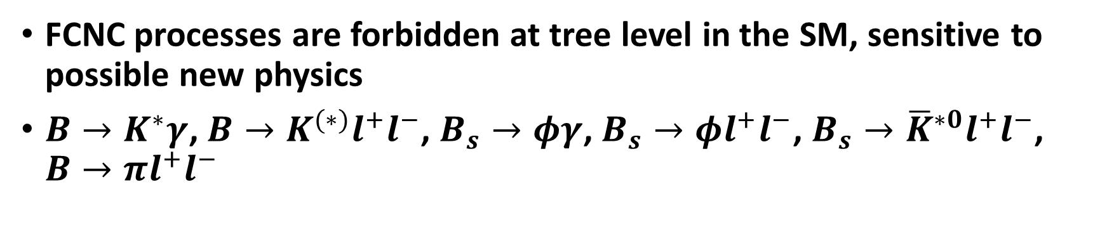

Rare decays $b→d$, $b→s$
FCNC processes are forbidden at tree level in the SM, sensitive to possible new physics
$B→K^{∗}γ$, $B→K^{(∗)}l^{+}l^{−}$, $B_{s}→φγ$, $B_{s}→φl^{+}l^{−}$, $B_{s}→{\overline{K}}^{∗0}l^{+}l^{−}$, $B→πl^{+}l^{−}$

Slide 12
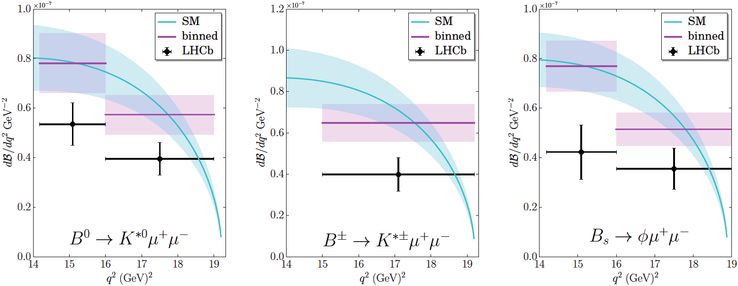
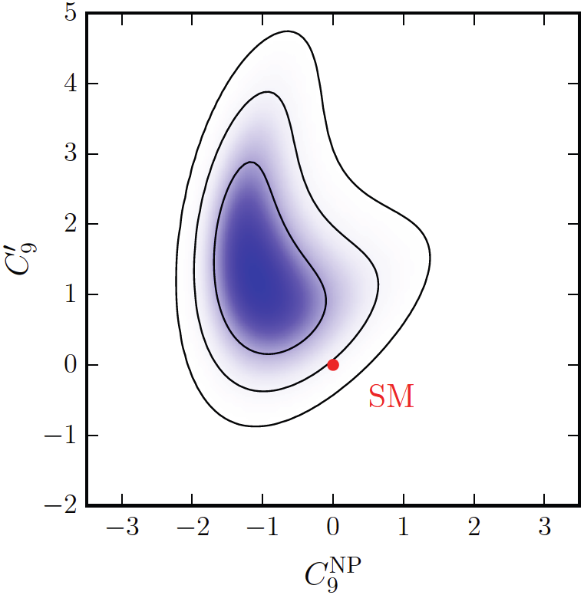

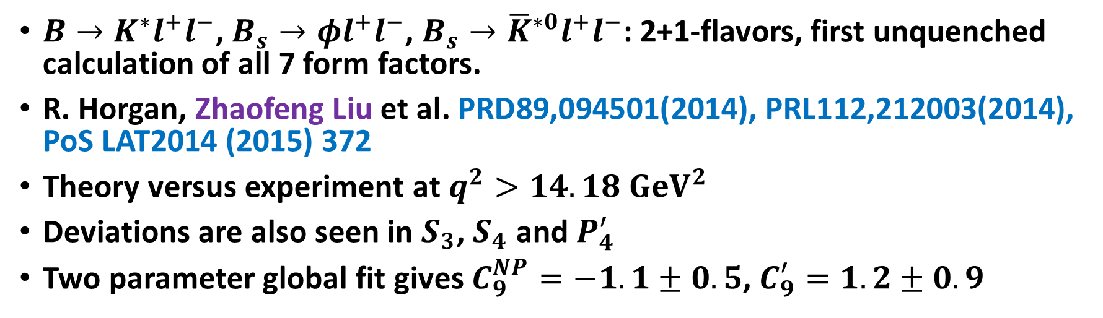
$B→K^{∗}μ^{+}μ^{−}$, $B_{s}→φμ^{+}μ^{−}$observables
$B→K^{∗}l^{+}l^{−}$, $B_{s}→φl^{+}l^{−}$, $B_{s}→{\overline{K}}^{∗0}l^{+}l^{−}$: 2+1-flavors, first unquenched calculation of all 7 form factors.
R. Horgan, Zhaofeng Liu et al. PRD89,094501(2014), PRL112,212003(2014), PoSLAT2014 (2015) 372
Theory versus experiment at $q^{2}>14.18 {GeV}^{2}$
Deviations are also seen in $S_{3}$, $S_{4}$and $P_{4}^{′}$
Two parameter global fit gives $C_{9}^{NP}=−1.1±0.5$, $C_{9}^{′}=1.2±0.9$
Notes:
One uncontrolled approximation is that the vector meson final state is stable in our calculation. The scattering states K\pi are not included in the analysis. The threshold effects are assumed to be small.
Angular observables: S_i: Normalized CP averages of the angular coefficients. P_i: designed to reduce hadronic uncertainties at low q^2.
The analysis of the Fermilab lattice and MILC Collaborations on B to K and B to pi rare decays [PRD93_034005(2016)] also find that the partially integrated branching fractions outside the charmonium resonance region are 1-2sigma higher than the LHCb measurement.

Slide 13
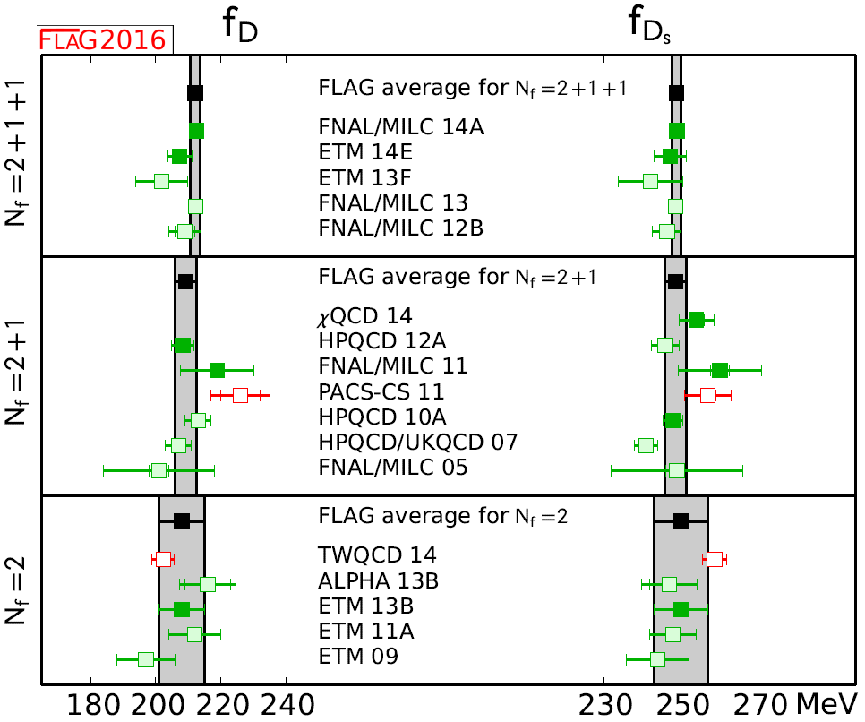

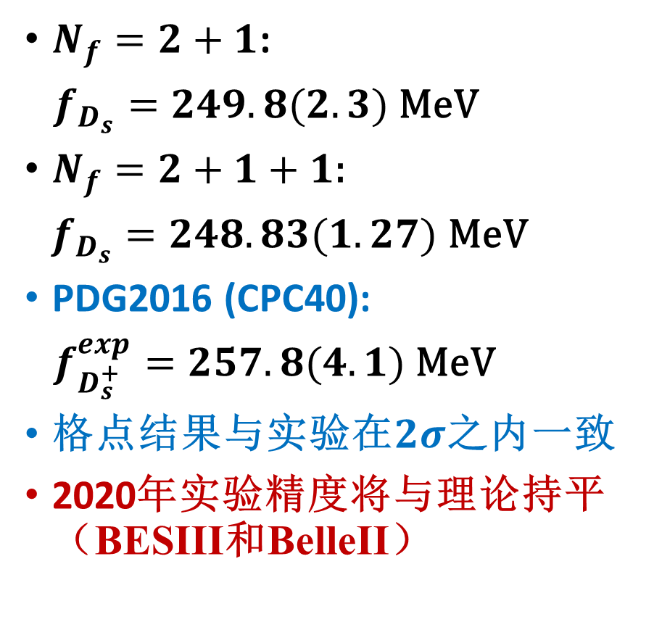
$$f_{D_{s}}$$
Zhaofeng Liu et al., PRD90, 2014
Y.-B. Yang,…, ZL et al., PRD92, 2015
$N_{f}=2+1$:
$f_{D_{s}}=249.8(2.3)$MeV
$N_{f}=2+1+1$:
$f_{D_{s}}=248.83(1.27)$MeV
PDG2016 (CPC40):
$f_{D_{s}^{+}}^{exp}=257.8(4.1)$ MeV
格点结果与实验在$2σ$之内一致
2020年实验精度将与理论持平（BESIII和BelleII）
FLAG2016, arXiv:1607.00299

Slide 14
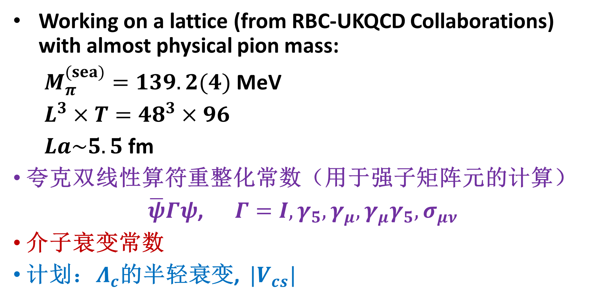
物理夸克质量点上的格点计算(正在进行)
Working on a lattice (from RBC-UKQCD Collaborations) with almost physical pion mass:
$M_{π}^{(sea)}=139.2(4)$ MeV
$L^{3}×T={48}^{3}×96$
$La\sim 5.5$ fm
夸克双线性算符重整化常数（用于强子矩阵元的计算）
$\overline{ψ}Γψ$,$Γ=I, γ_{5}, γ_{μ},γ_{μ}γ_{5}, σ_{μν}$
介子衰变常数
计划：$Λ_{c}$的半轻衰变, $|V_{cs}|$

Slide 15
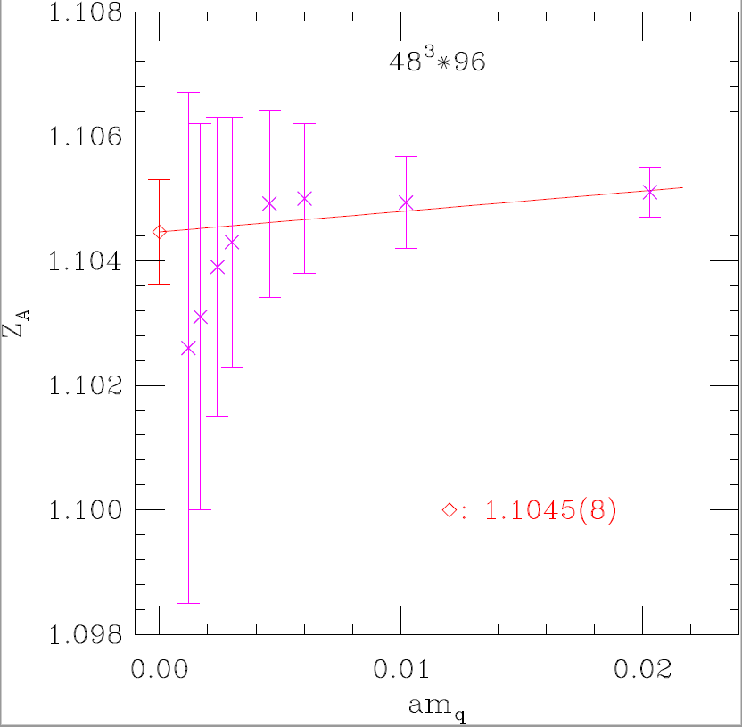
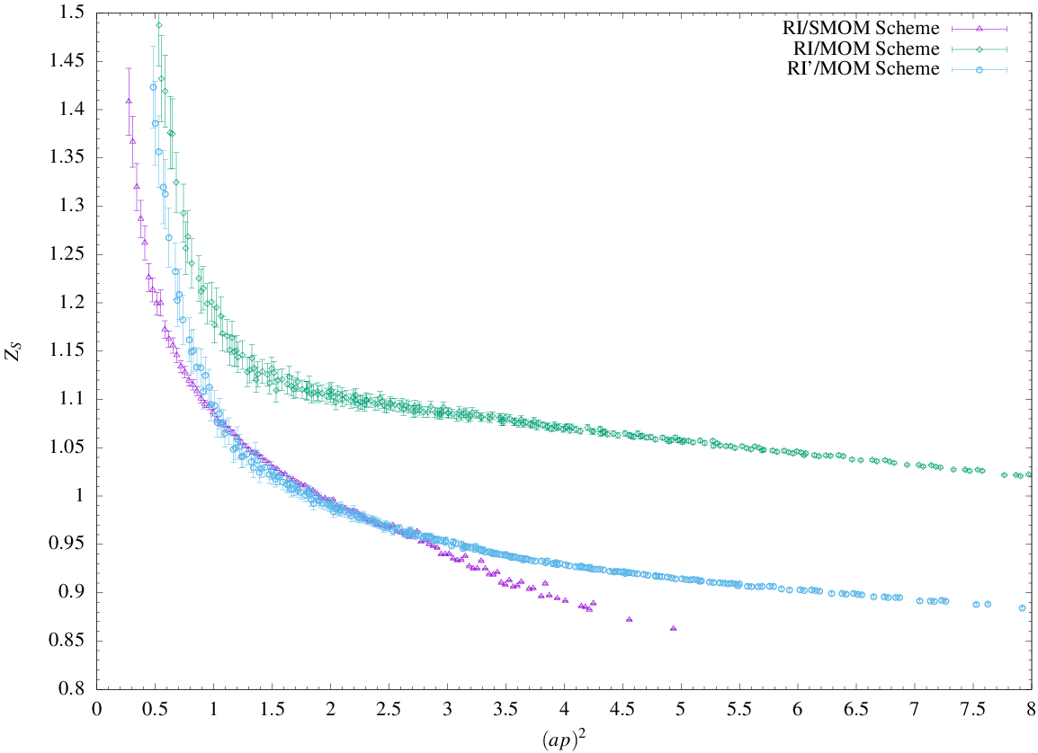

重整化常数($Z_{A}$, $Z_{S}$初步结果)
使用三种动量减除方案(检查系统误差),再转换到常用的$\overline{MS}$方案

Slide 16

孙庆峰，冯峰，贾宇，桑文龙
arXiv:1609.03995[hep-ph]

Slide 17
Motivations
CEPC can measure production cross section for σ(ZH) to an exquisite precision of 0.51%
Knowing the NLO EW correction (a few percent) is not sufficient to meet experimental precision!
O(α²) and O(αα_{s}) correction need be considered.
We will investigate the latter, which should be much dominant

Slide 18
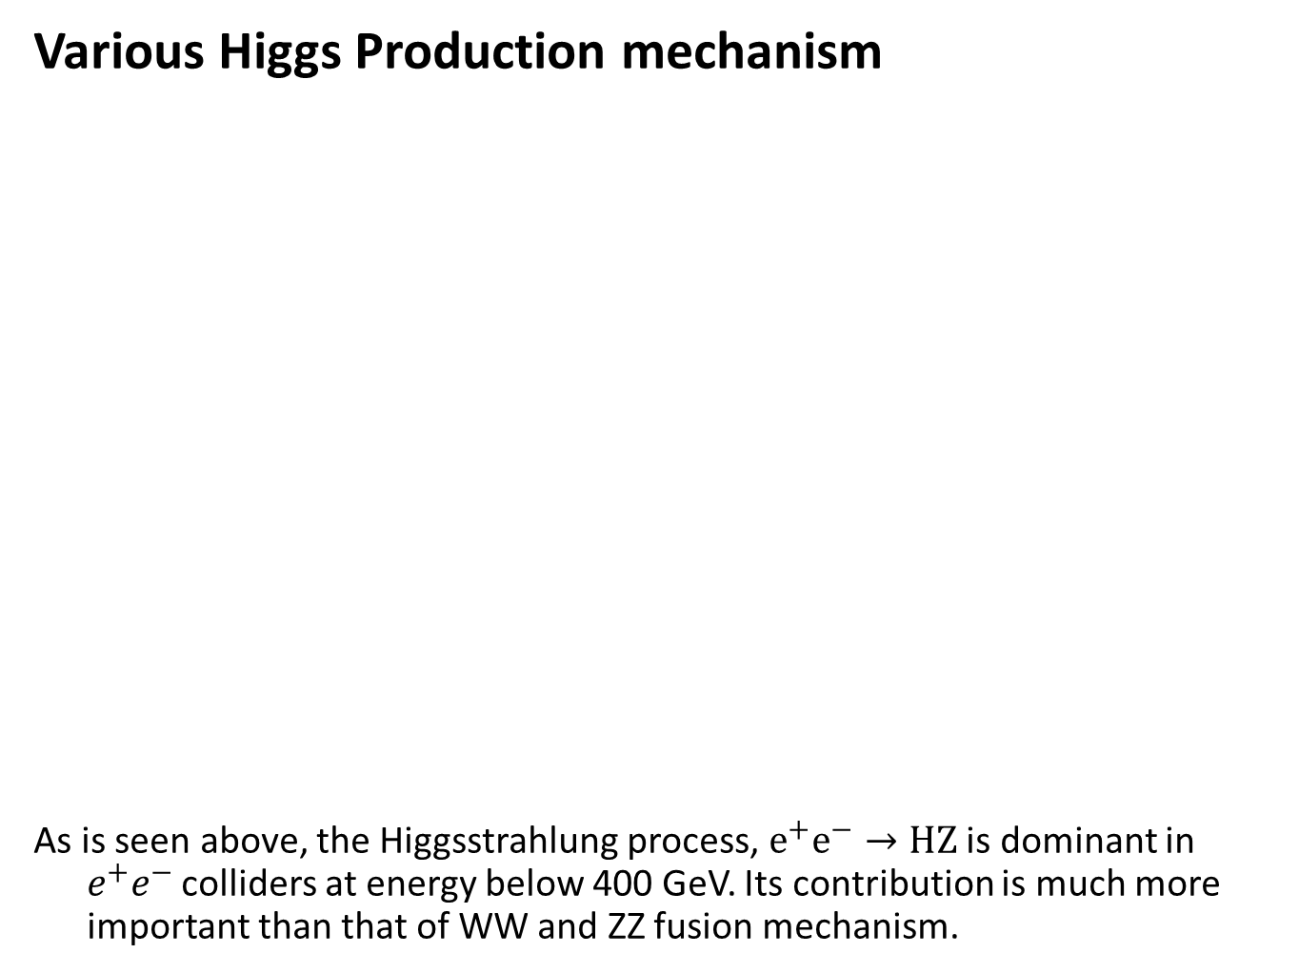
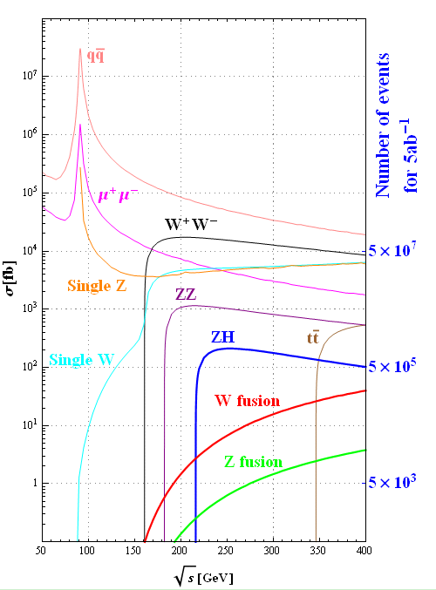
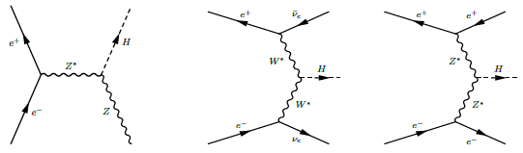
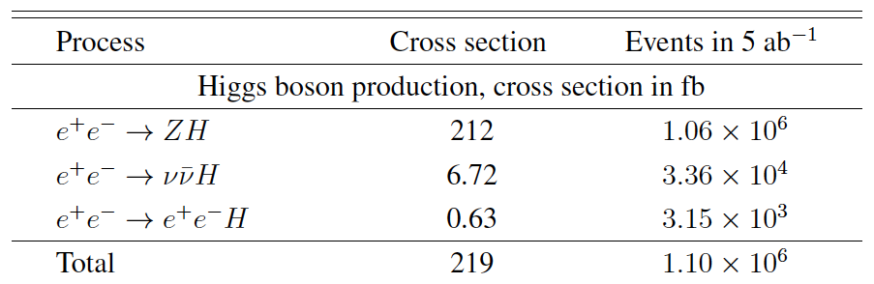

Slide 19

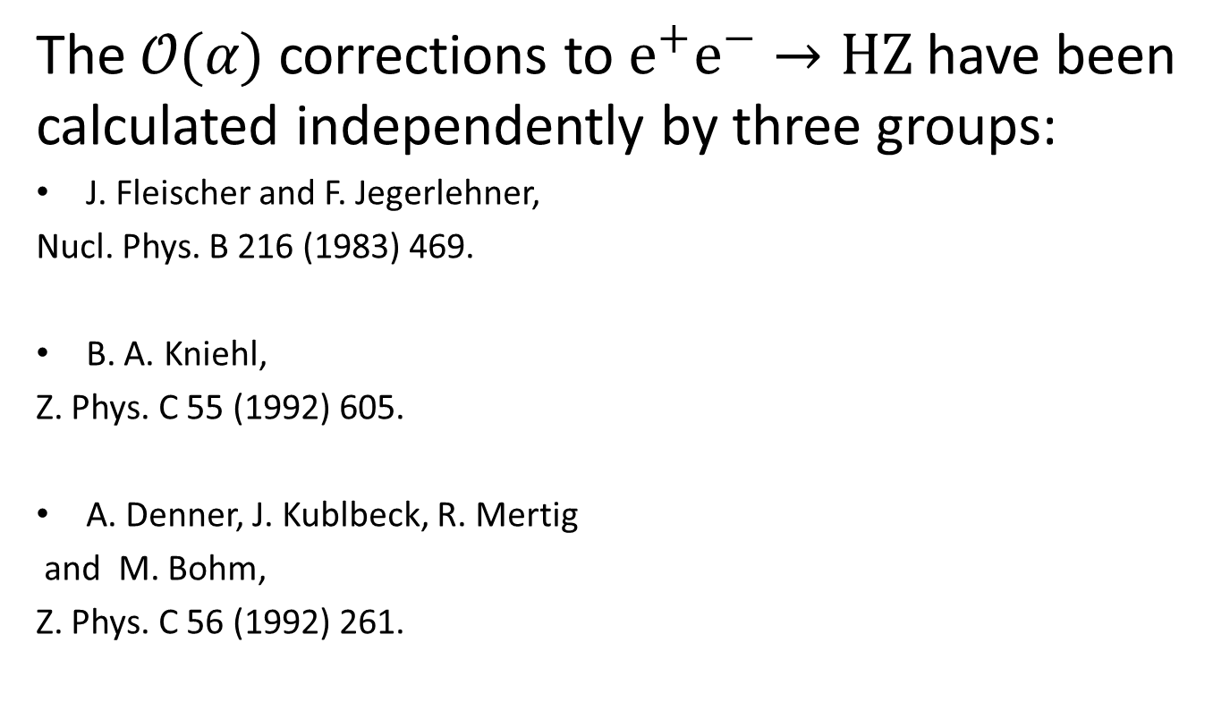
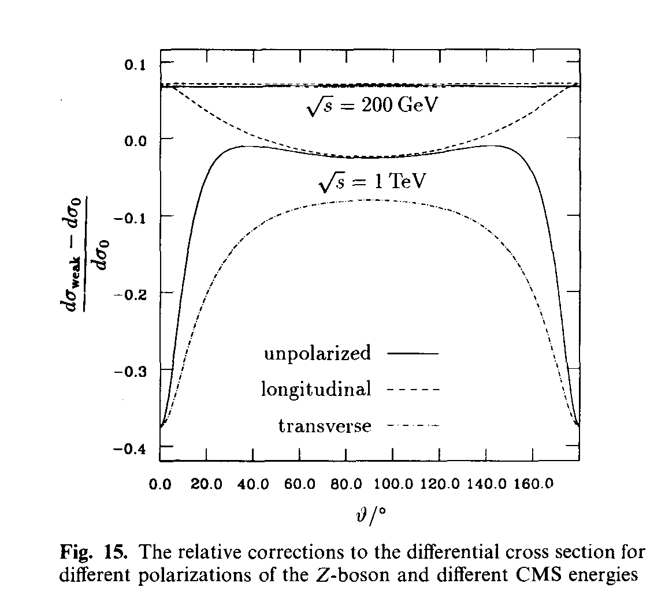

Slide 20
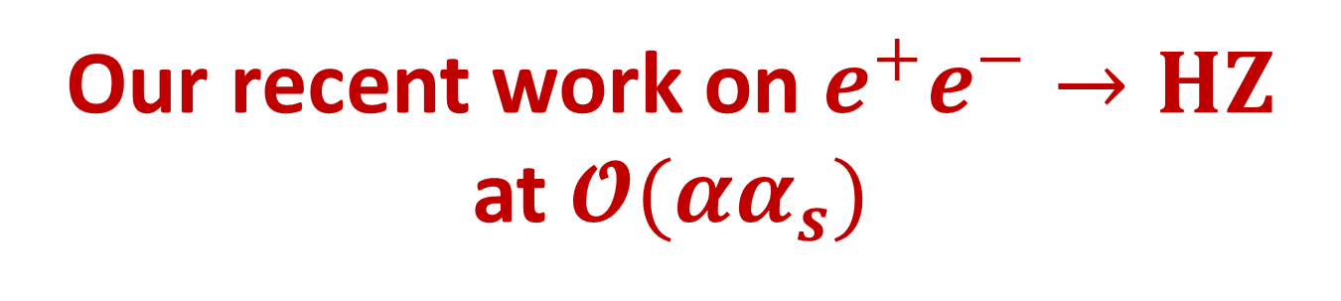
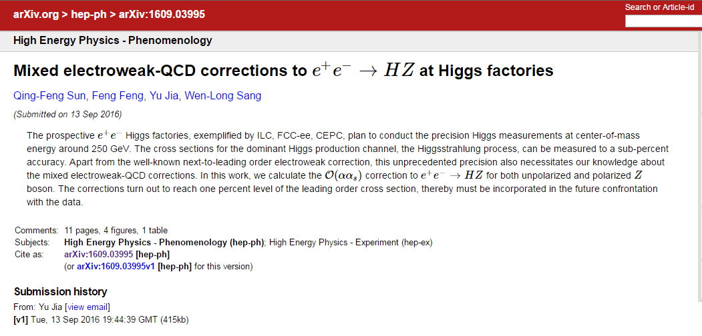
arXiv:1609.03995
Collaborators: 冯锋(中国矿大)，桑文龙(西南大学)，孙庆峰(中科大)。

Slide 21
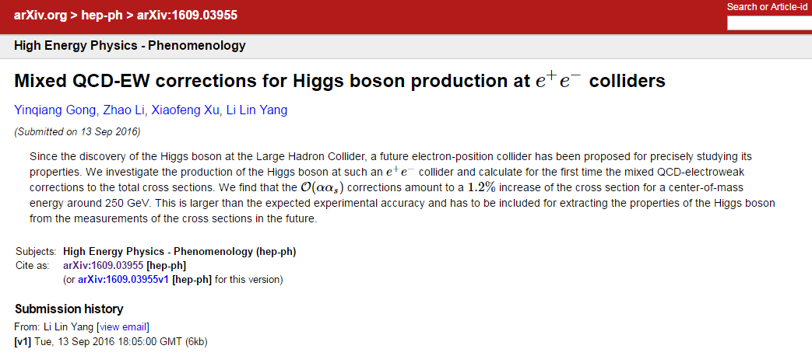
Similar results from different group by 李钊，杨李林 et al.
arXiv:1609.03955
Yinqiang Gong, Zhao Li, Xiaofeng Xu, Li Lin Yang

Slide 22
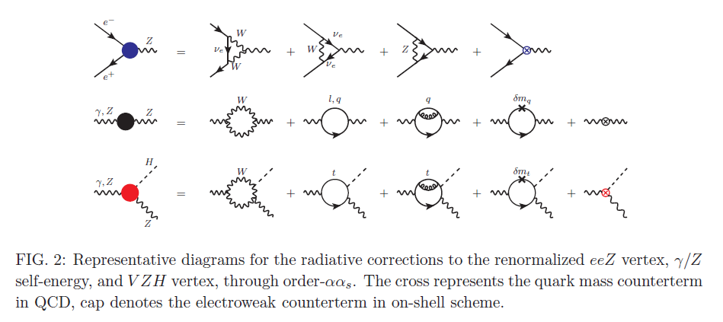
Typical Feynman diagrams for eeZ vertex, self-energy and ZZH vertex.

Slide 23
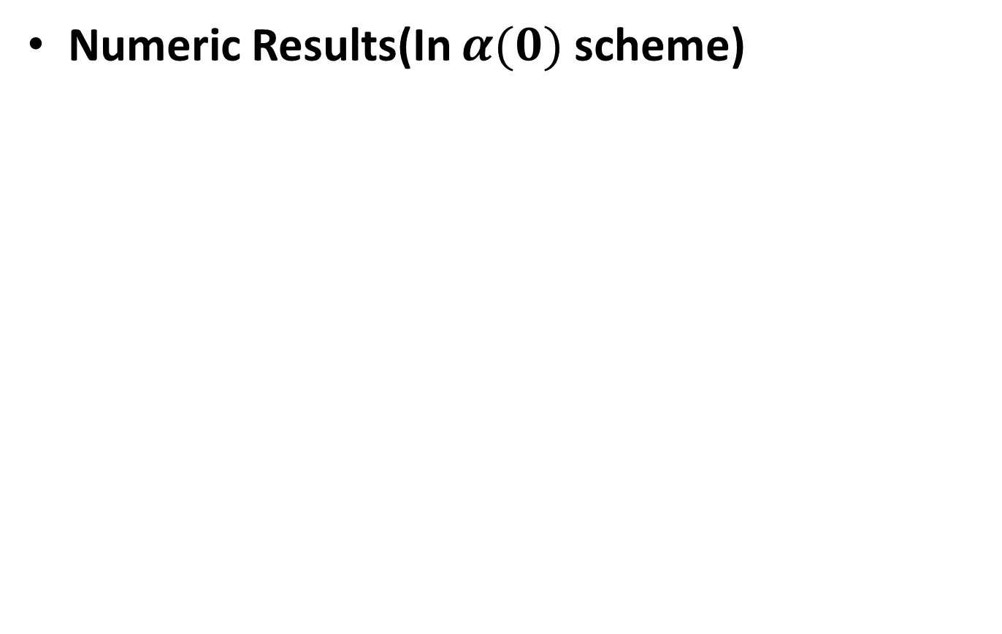
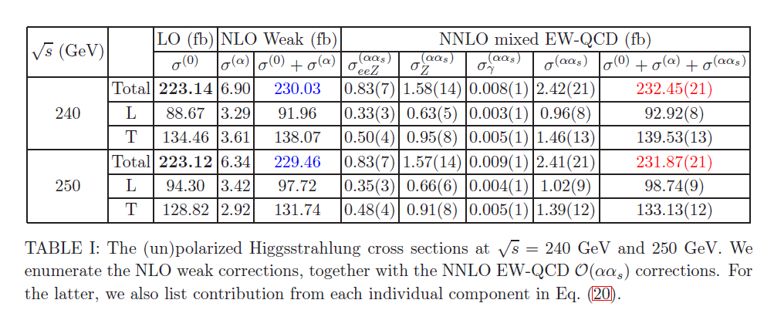

Slide 24
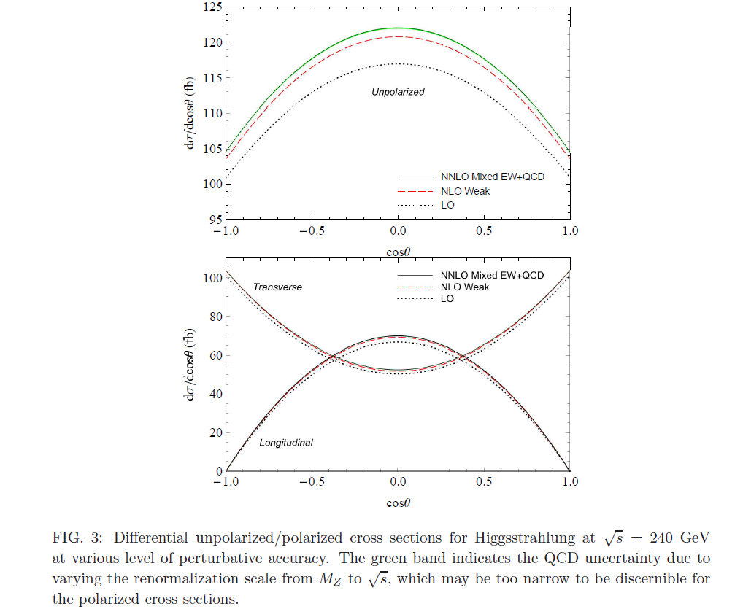
(Un)Polarized differential cross sections:

Slide 25
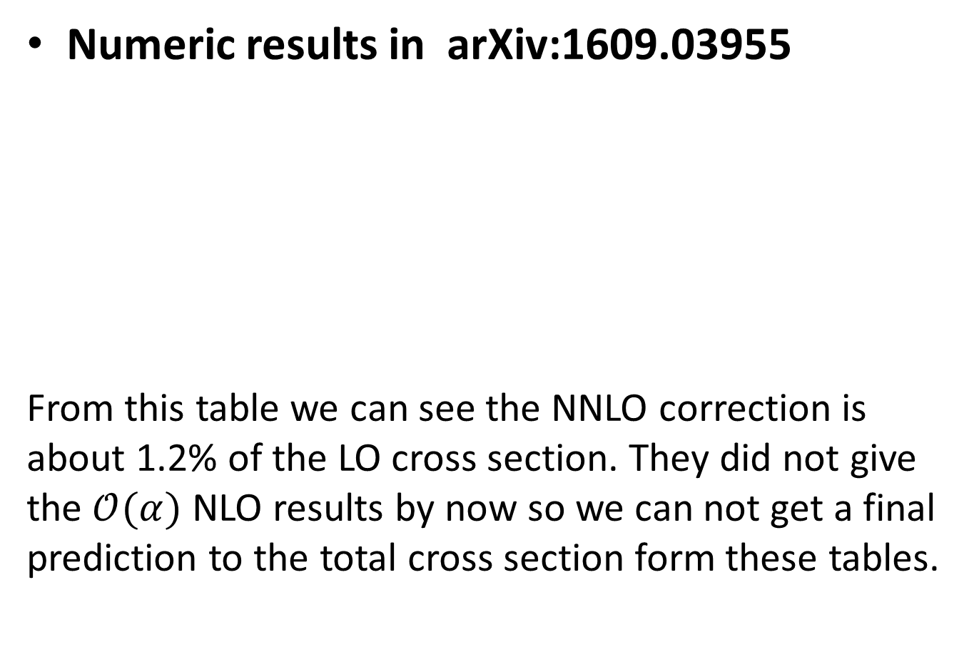
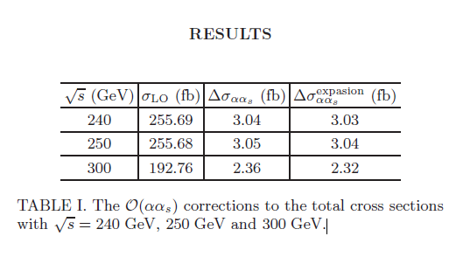
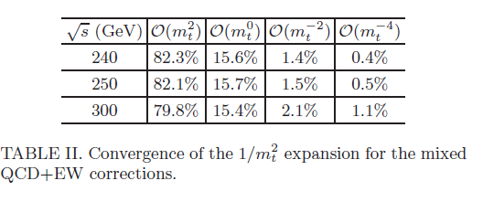

Slide 26
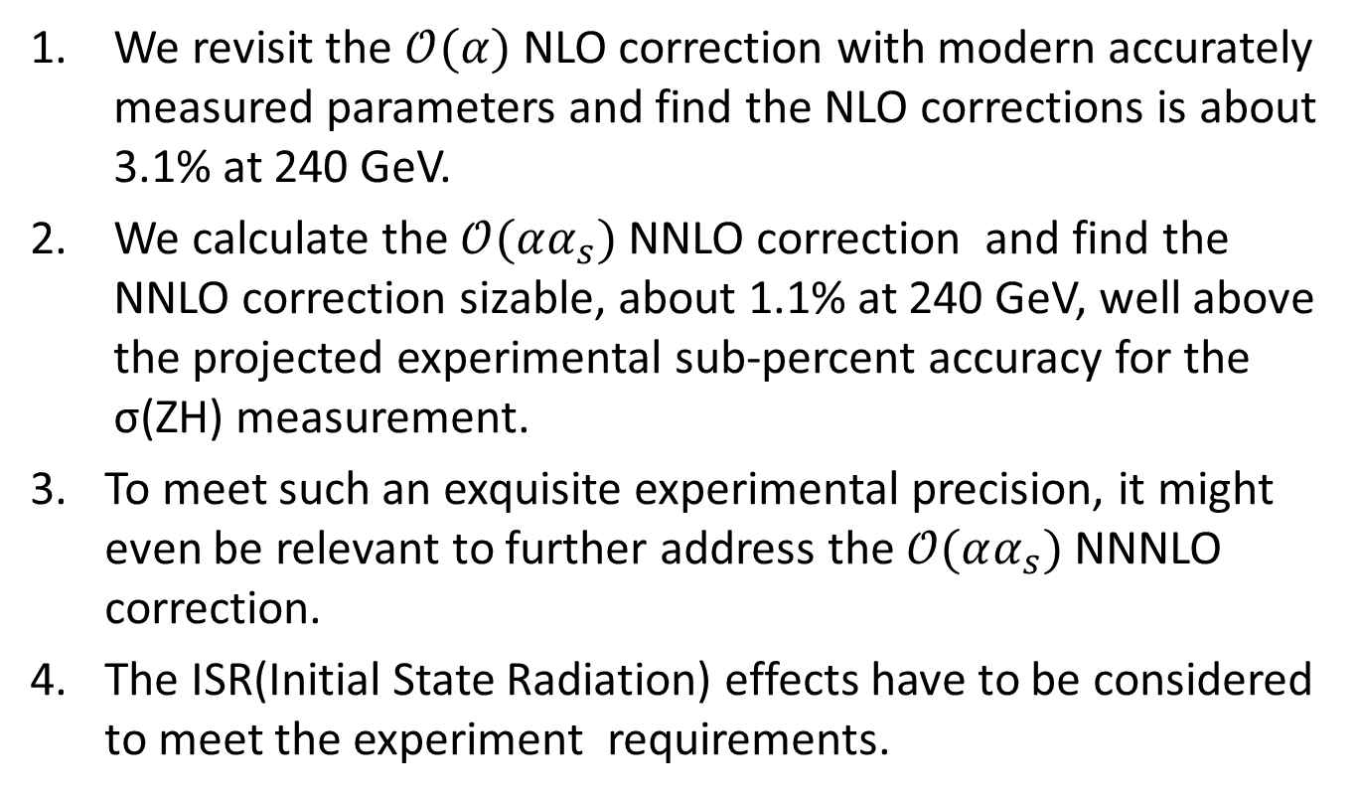
Summary and Outlook

Slide 27
谢谢！

