Slide 1
ICFA Higgs Factory Workshop: eeFACT2016
Weiren Chou
International Creative Team Meeting
November 18, 2016, IHEP, Beijing, China

Slide 2
History of the Higgs Factory Workshop Series
2012-07-04: CERN announced the discovery of Higgs boson.
2012-07-08: Four days later, ICFA approved a special workshop on Higgs Factory (HF2012), with a subtitle “Linear vs Circular,” which included 4 types of Higgs factories: linear (ILC, CLIC, SLC-type), circular (TLEP/FCC, CEPC, SuperTristan, Fermilab site filler), muon collider and γγ collider. It took place in November 2012 at Fermilab. A summary report was published and well received.
2014-10-9/12: HF2014 in Beijing, organized by IHEP, with a focus on CEPC and FCC-ee. Formal proceedings was published via JACoW.
2016-10-24/27: Upon ICFA’s request, the name was changed to “eeFACT2016.” In addition to FCC-ee and CEPC, it also covered SuperKEKB, BEPC II, VEPP-2000, DAFNE, etc. It took place in Daresbury, UK and was jointly organized by CERN, KEK and IHEP.
The next one will be 2018 – hopefully back to North America, but uncertain due to lack of interest in circular e+e- colliders in the US. We will try SLAC first; if unsuccessful, we will consider Hong Kong.

Slide 3
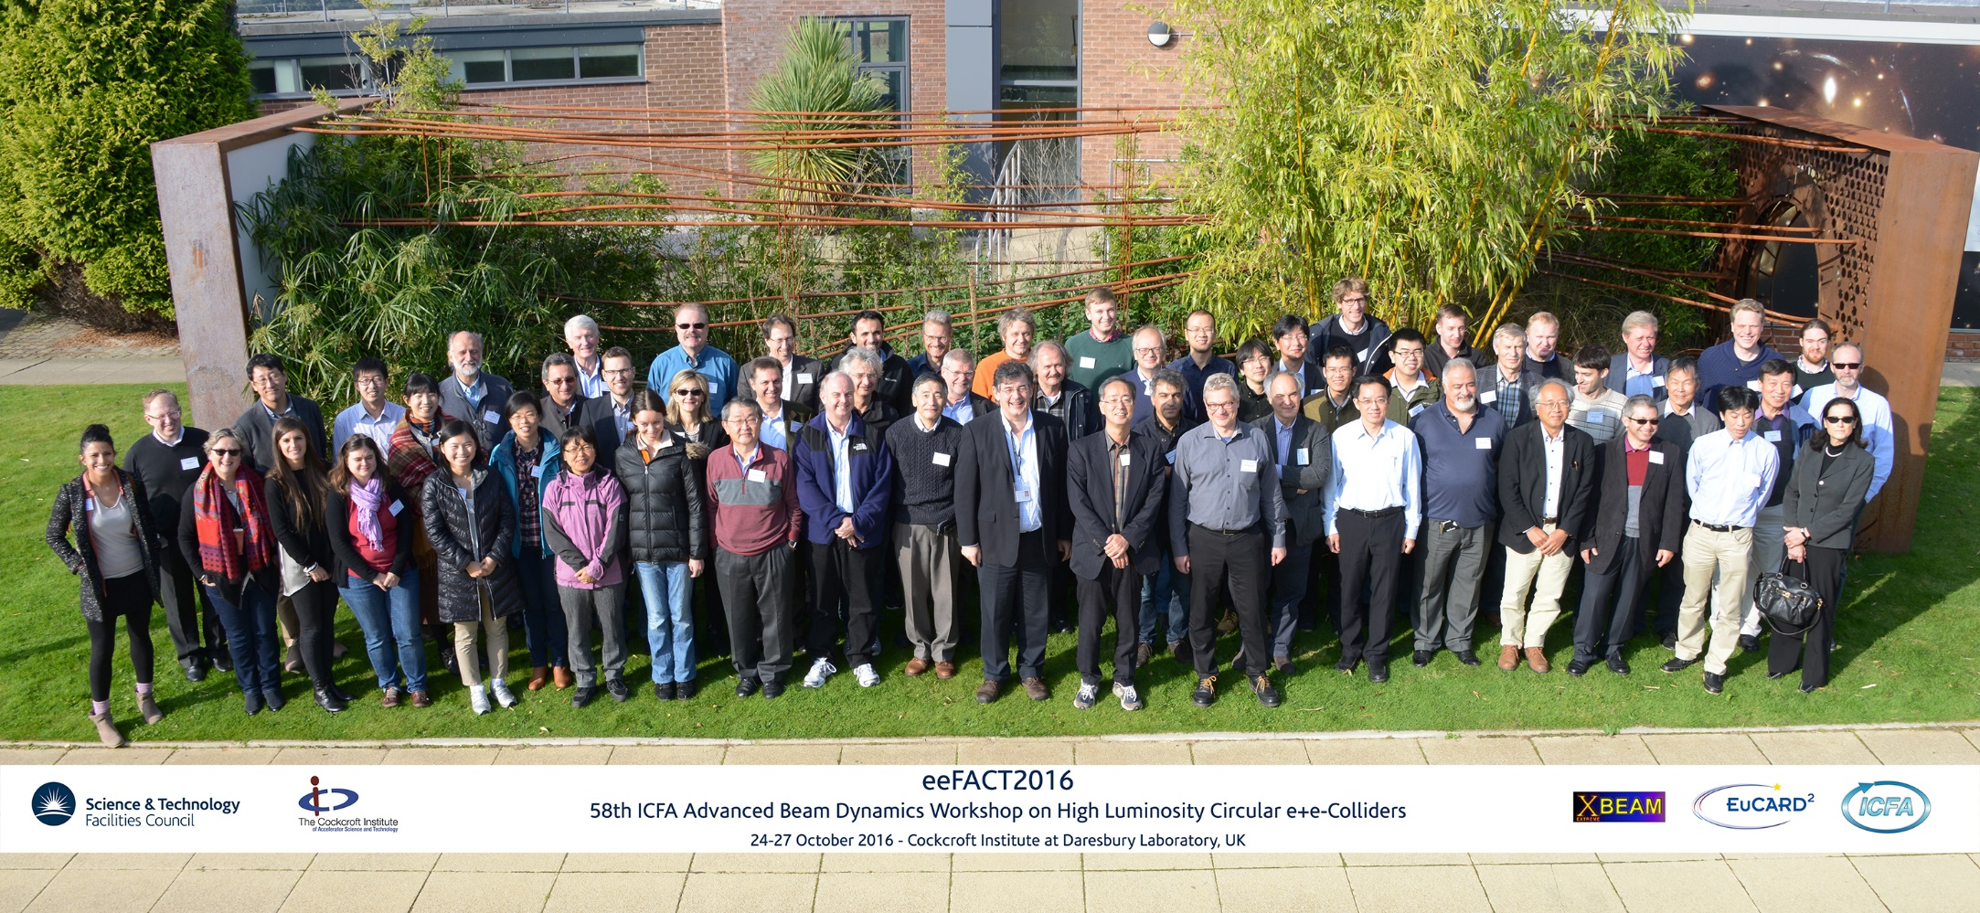
eeFACT2016 Group Photo

Slide 4
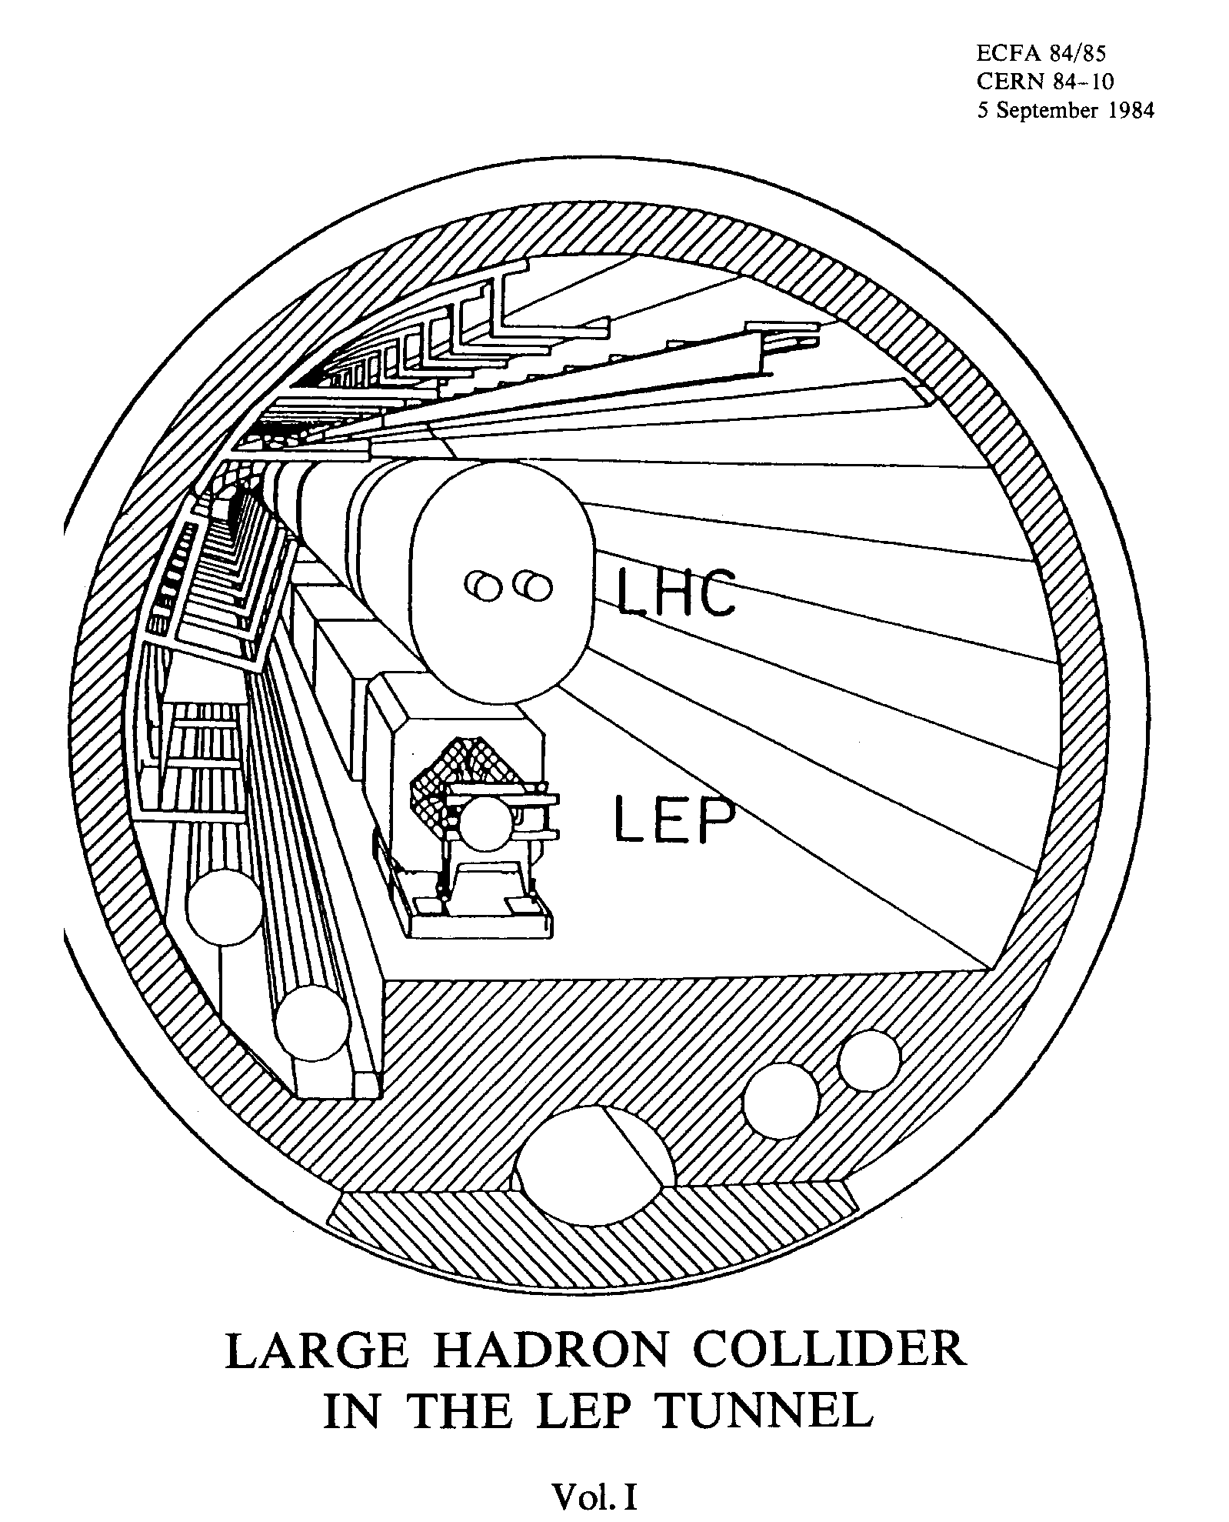
-- LHC was in the plans since 1983…
p p 2009-203x
e+e- 1989-2000

Slide 5
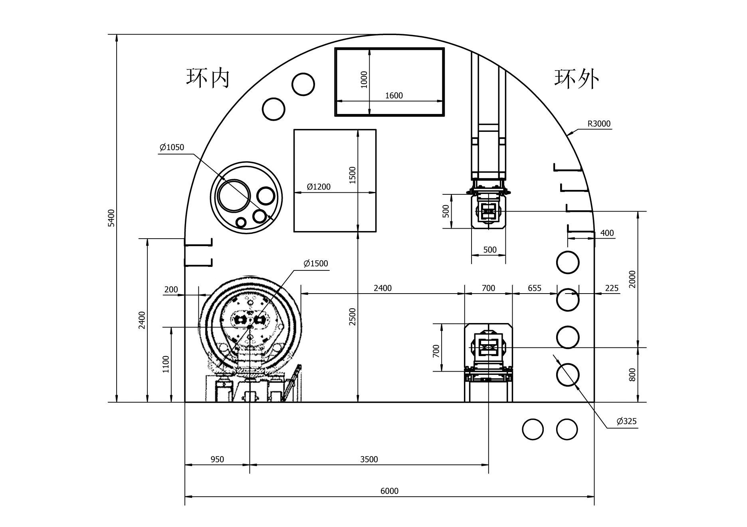
Tunnel Cross Section – SPPC + CEPC Magnets
Drill/Blast Method
Booster
2015
SPPC
CEPC
6 m

Slide 6
LHC Tunnel – Magnet Section
3.6 m

Slide 10
Talk 2 - Higgs Factory Concept, F. Zimmermann (CERN)
Key points:
  FCC-ee & CEPC exploit lessons & recipes from past & present e+e- and pp colliders: combining successful ingredients of recent colliders → extremely high luminosity at high energies – up to and beyond 10³⁶ cm⁻²s⁻¹
  Crab waist successfully implemented in design. Low emittance “easy” for large rings.
  Limitations are being carefully studied: Beamstrahlung, energy sawtooth, luminosity lifetime, SR fans in interaction region, the “Talman barrier”, energy consumption, emittance growth from beamstrahlung, ...
  Mitigations and innovative schemes are being implemented: more RF sections, double ring, partial double ring, magnet tapering, top-up injection, weak bends, asymmetric IR optics, improved klystron efficiency, 2-in-1 arc magnets, ...
Discussion:
  It was asked when FCC-ee could start operation. The answer was not before ~2035-2037 given the present schedule of the HL-LHC.
  The technical readiness for a large e+e- collider like FCC-ee or CEPC was discussed. It was concluded that the required technologies exist, feasibility is guaranteed and performance estimates are realistic. R&D will improve the power efficiency.

Slide 11
FCC-ee injector

Slide 12
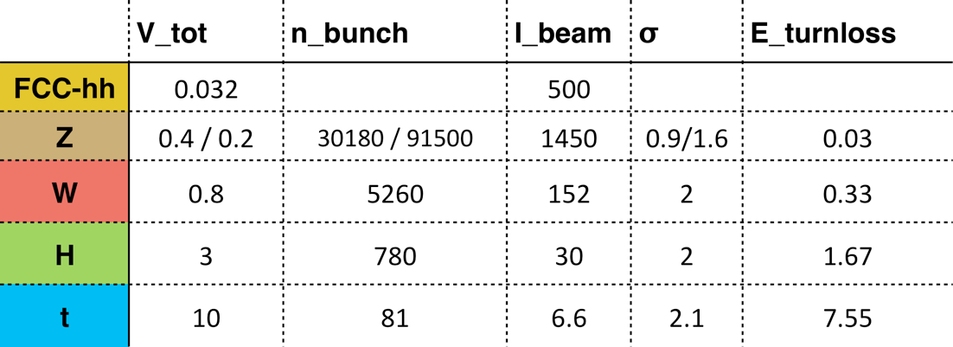
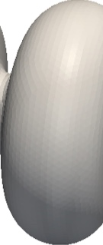
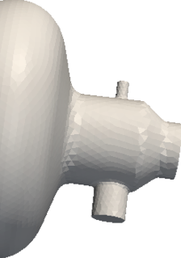
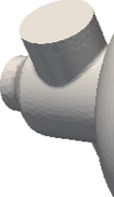
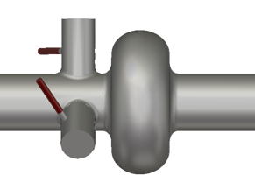
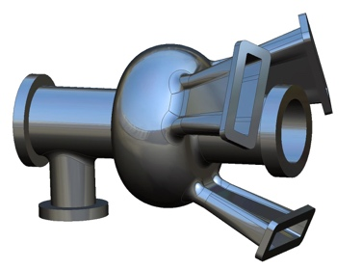
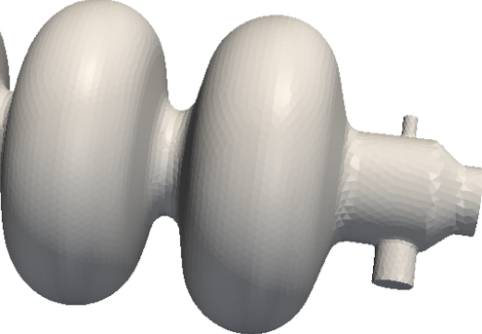

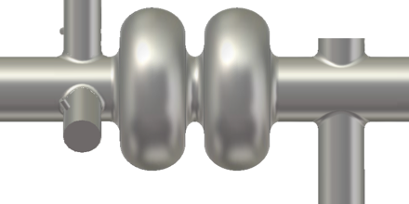
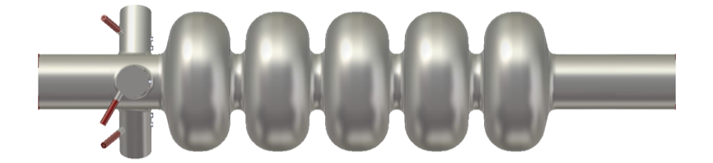
New designs are coming…
O. Brunner, FCC Week 2016, Rome
400MHz,
1 cell, Nb/Cu
952.6 MHz
Jlab cavities with coax and on-cell dampers
CERN 400/800 MHz, multi-cells, Nb/Cu

Slide 13
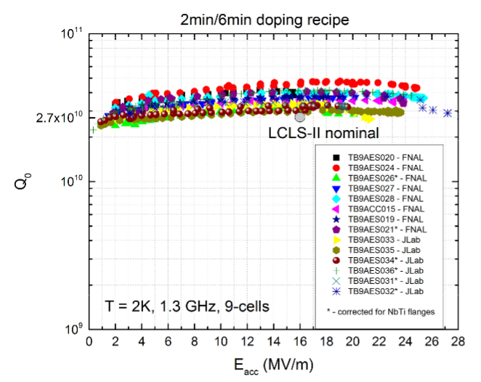
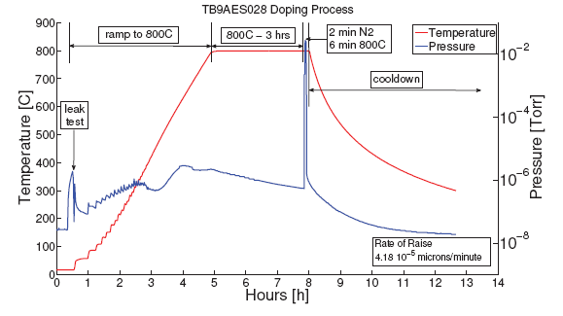
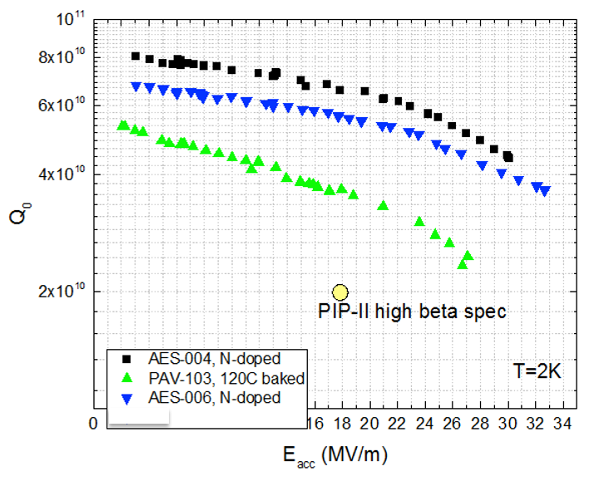
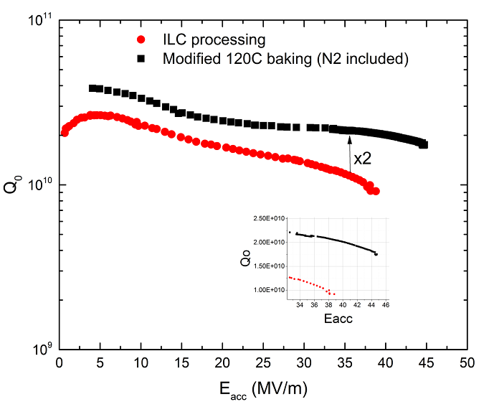
New materials and processes
N₂ doping
Peng Sha
Nitrogen doping for high Qo, adopted by LCLS-II
650 MHz cavities for PIP-II at FNAL
Advanced N2 doping 1.3 GHz at FNAL

Slide 14
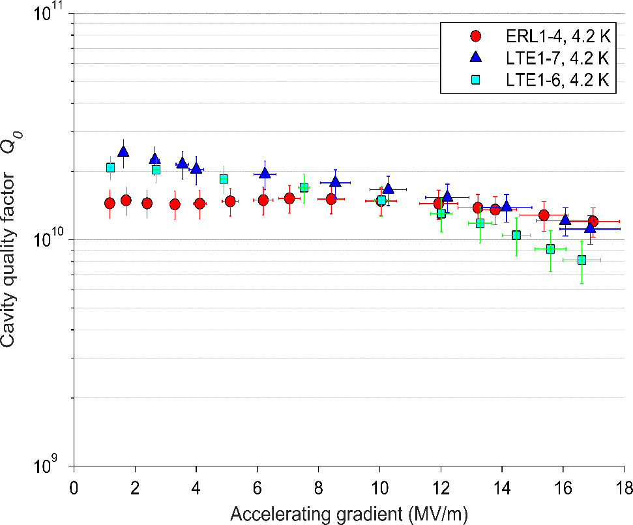
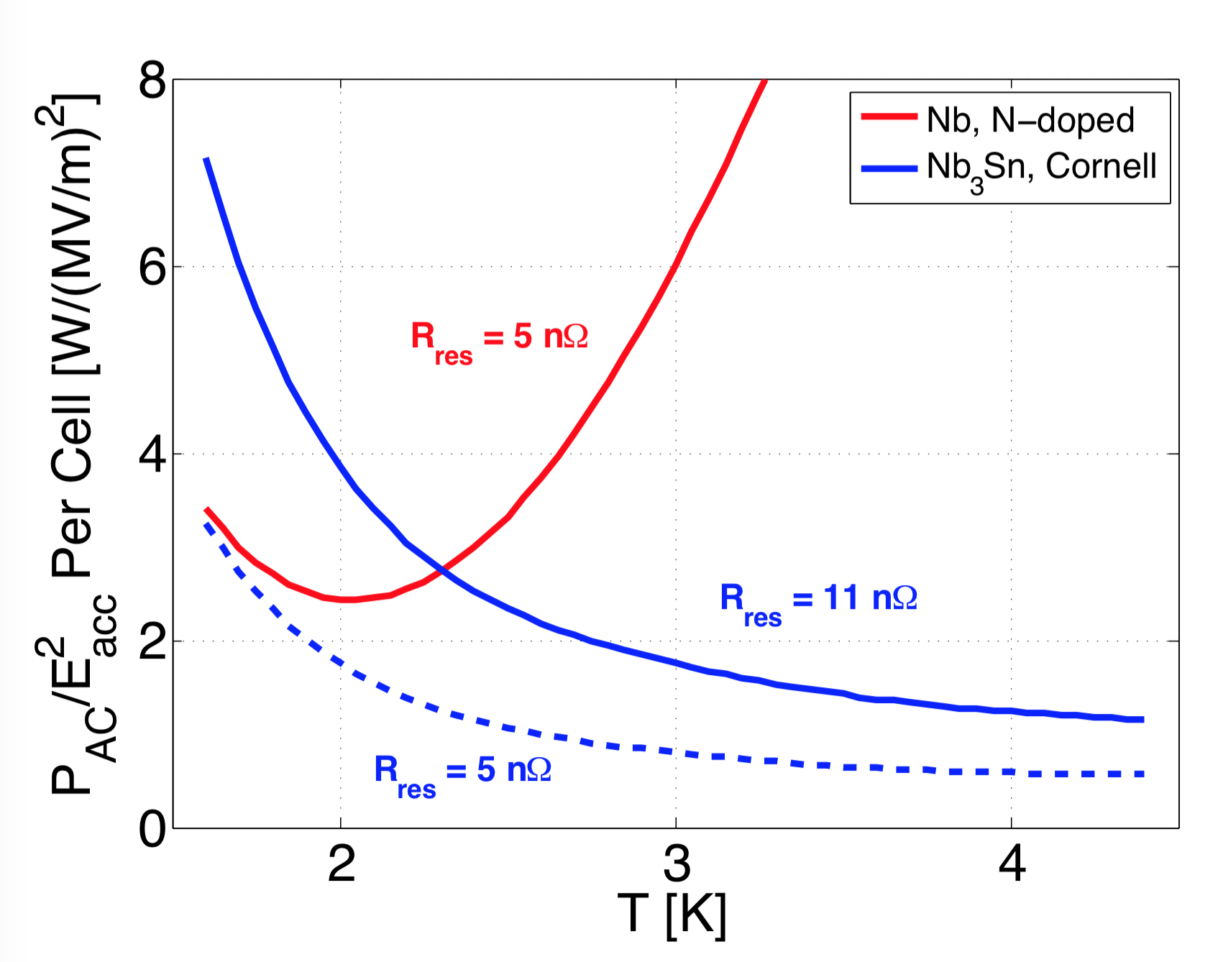
Nb₃Sn:
State of the Art and Repeatability
Nb₃Sn
Matthias Liepe
Single-cell 1.3 GHz cavity at 4.2K
4.2 K performance
Q₀ > 1x10¹⁰ at 4.2K
Current quench field ~17 MV/m
Residual resistance R_{res} = 11nΩ at max field
- 50%
- 75%
SRF operation at ~4K instead of 2K!
Greatly simplified cryo-system
Greatly reduced cryo AC power
M. Liepe eeFACT2016 October 26, 2016 Slide 14

Slide 15
Beyond Niobium: Next Generation Nb₃Sn SRF Cavities
Nb₃Sn
Increase in Q₀ via N-doping
η_{4.2 K} / η_{2.0 K} ≈ 3.6,
simpler cryoplant
 | Niobium | Nb₃Sn
Critical Temperature T_{c} | 9 K | 18 K
Q₀ at 4.2 K | 6 x 10⁸ | 6 x 10¹⁰
Q₀ at 2.0 K | 2.5 x 10¹⁰ | >10¹¹
Max. gradient E_{acc} (theory) | 50 MV/m | 100 MV/m
4 x 10¹⁰
Approximate E_{acc} and Q₀ given for 1.3 GHz TESLA cavities with R_{res} small
Halve # of cavities to reach energy?
M. Liepe eeFACT2016 October 26, 2016 Slide 15

Slide 16
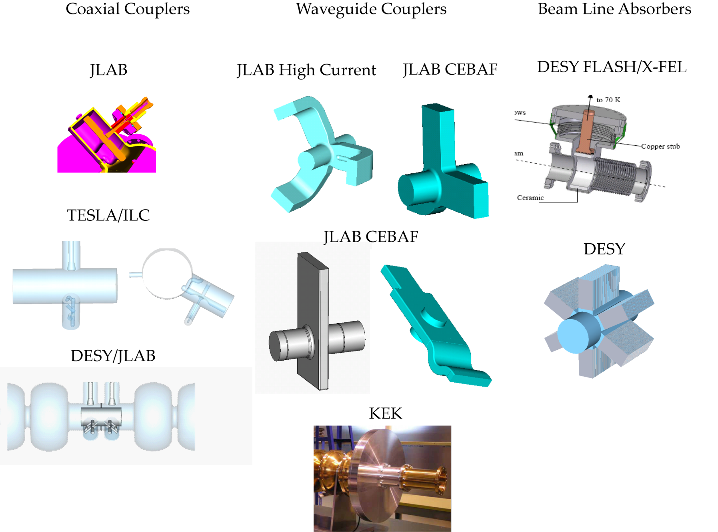
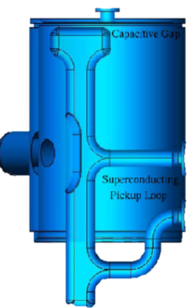
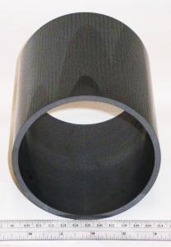
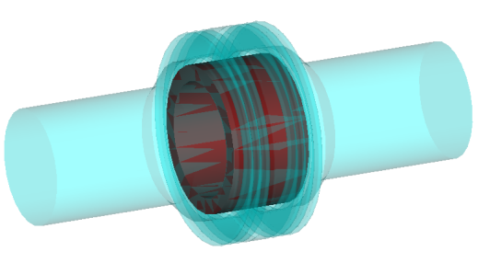
HOM Damping Schemes:
Three Main Types
Matthias Liepe
Antenna / loop HOM couplers
Waveguide HOM dampers
RF absorbing materials
Beamline HOM loads
M. Liepe eeFACT2016 October 26, 2016 Slide 16

Slide 17
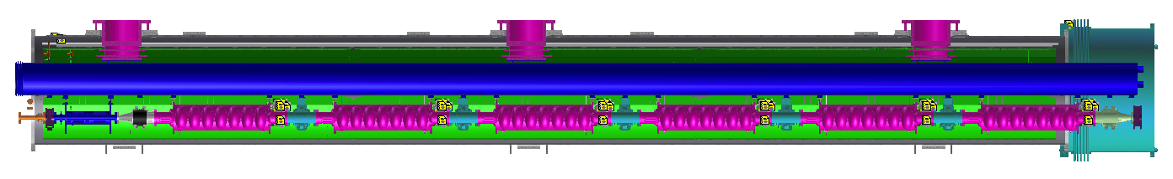
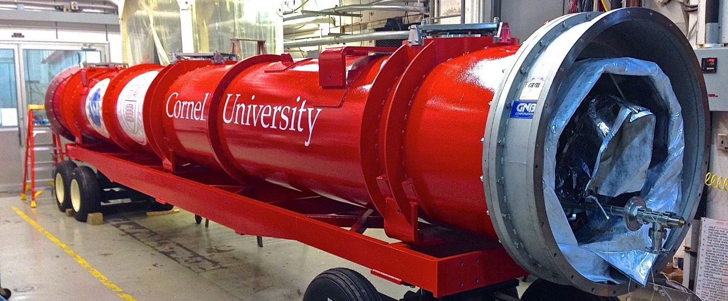
Example: 2x100 mA Cornell ERL Main Linac SRF
~40K thermal shield
HGRP support post
Helium Gas Return Pipe
SC magnet
7-cell cavity
Beamline HOM absorber
~10 m
M. Liepe eeFACT2016 October 26, 2016 Slide 17

Slide 18
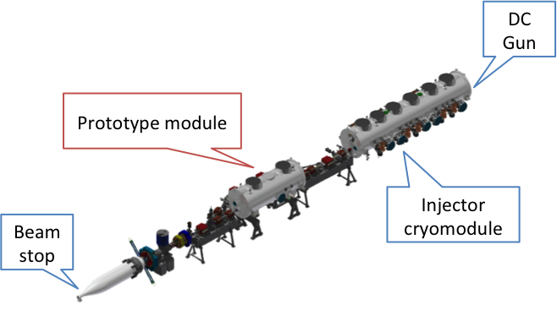
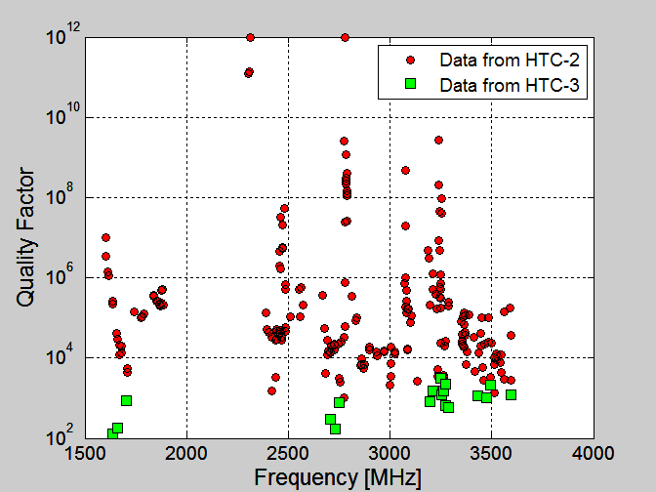
Cornell ERL Test Module Beam Test
HTC-2: No HOM Absorbers
HTC-3: With HOM Absorbers
Beam operation:
  High CW currents >40 mA
  No significant heating from HOMs
  No sign of beam instability or weakly damped modes
M. Liepe eeFACT2016 October 26, 2016 Slide 18

Slide 19
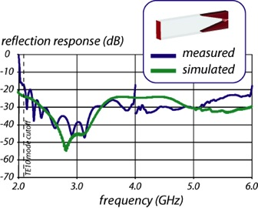
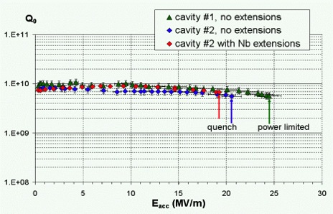
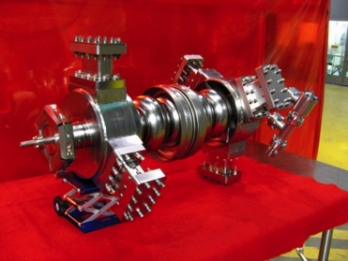
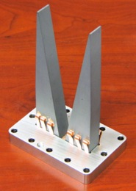
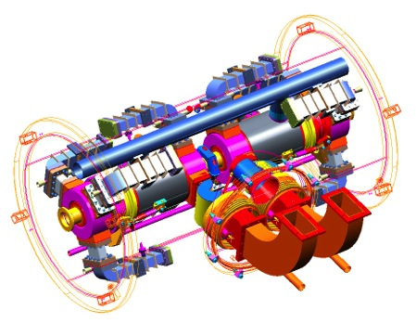
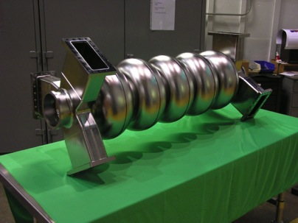
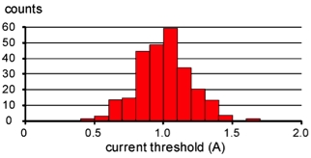
Example: JLAB 1A ERL SRF R&D
Two 1.5 GHz, one 750 MHz prototypes built and tested
Design for >20 kW HOM power per cavity
1.5 GHz ERL cavities
1.5 GHz ERL cavity
HOM load concept
Module concept
750 MHz ERL cavity
BBU simulations for 1.5 GHz ERL
M. Liepe eeFACT2016 October 26, 2016 Slide 19

Slide 20
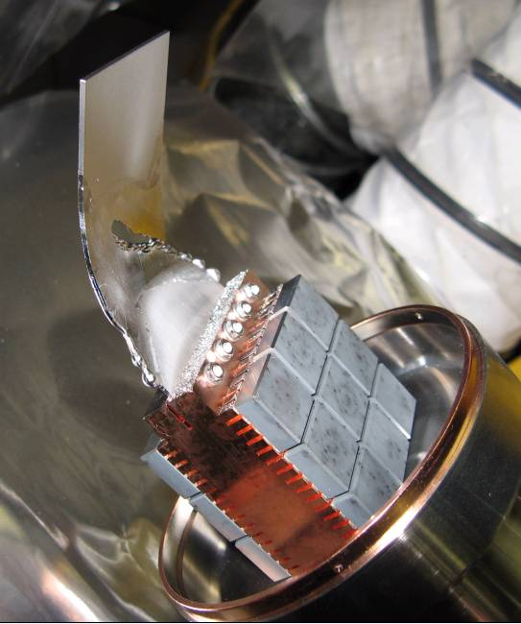
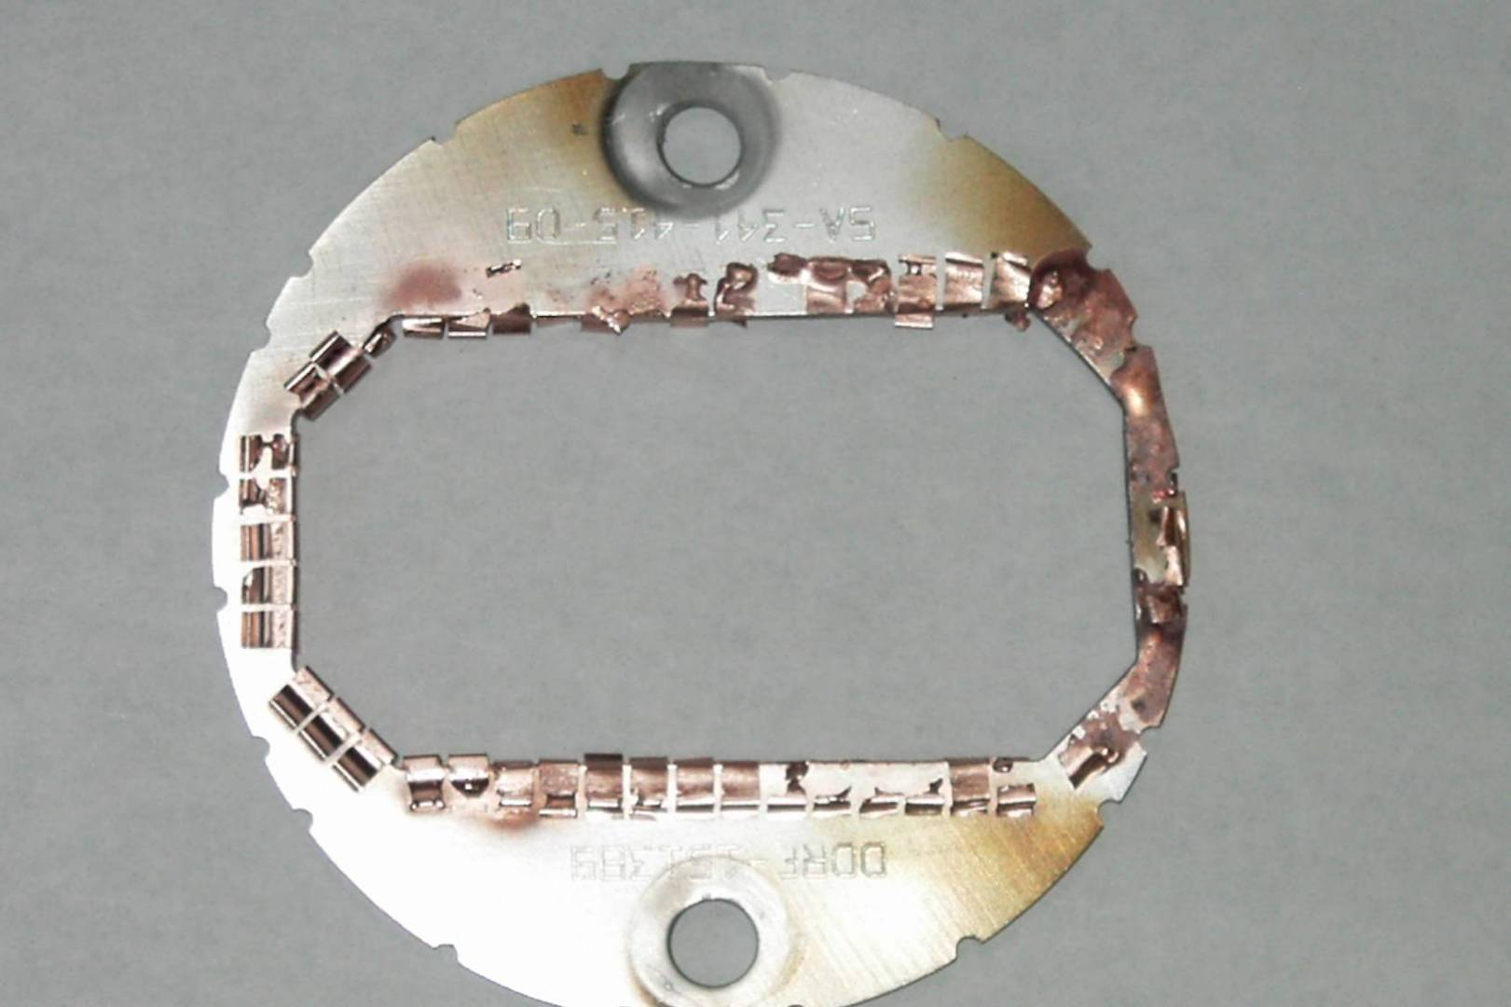
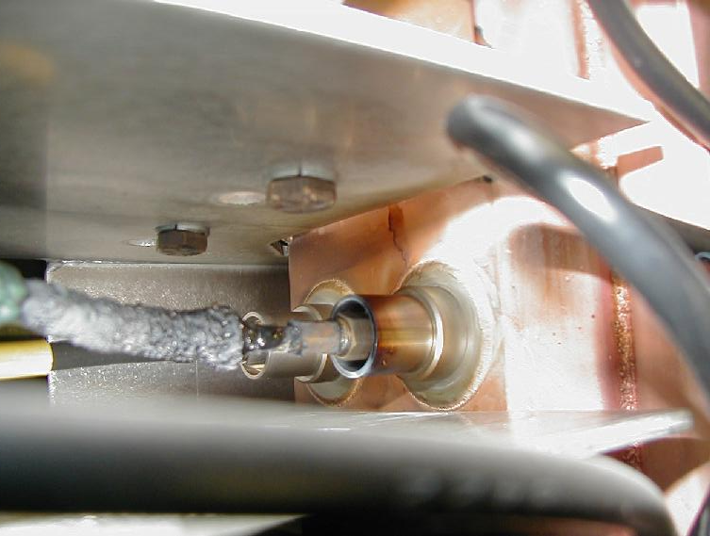
HOM heating due to small gaps at PEP-II
damaged spoiler, RF shield, BPMs,…
A. Novokhatski

Slide 22
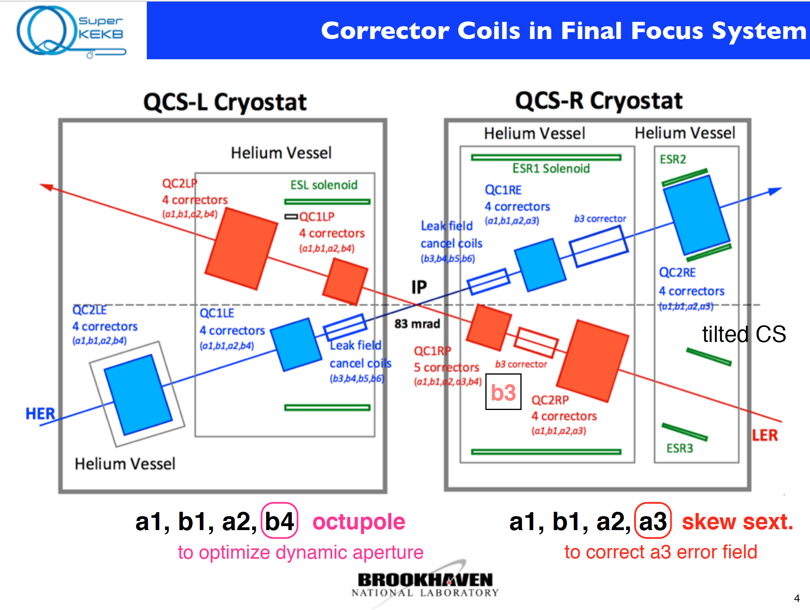
SuperKEKB IR

Slide 23
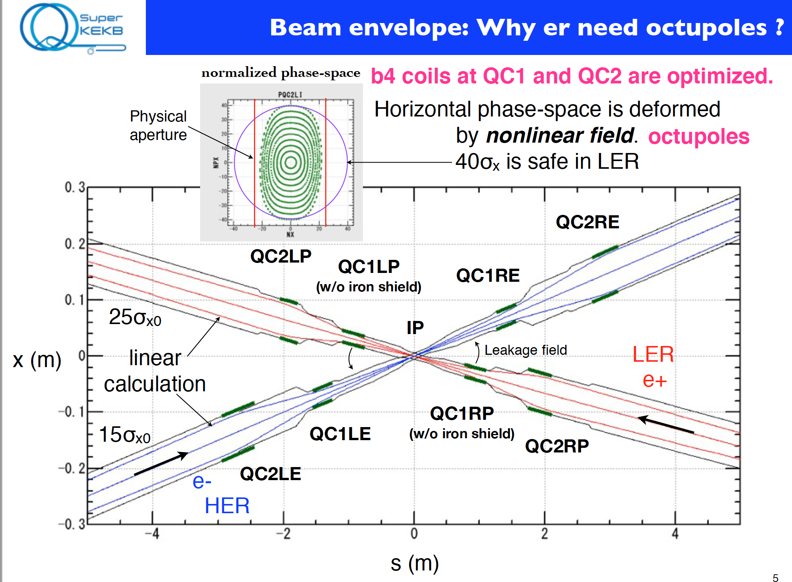
SuperKEKB IR

Slide 24
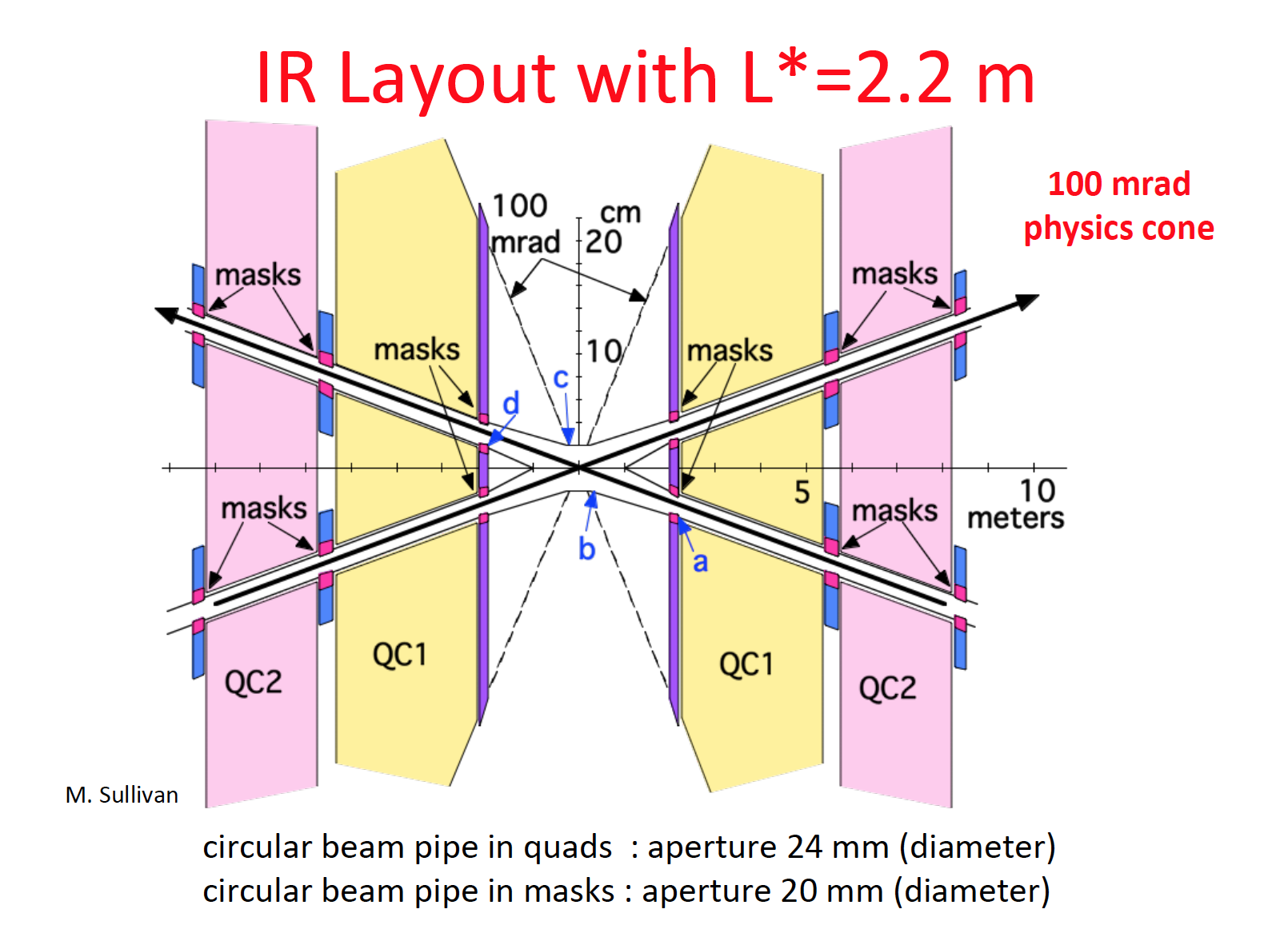
FCC-ee IR

Slide 25
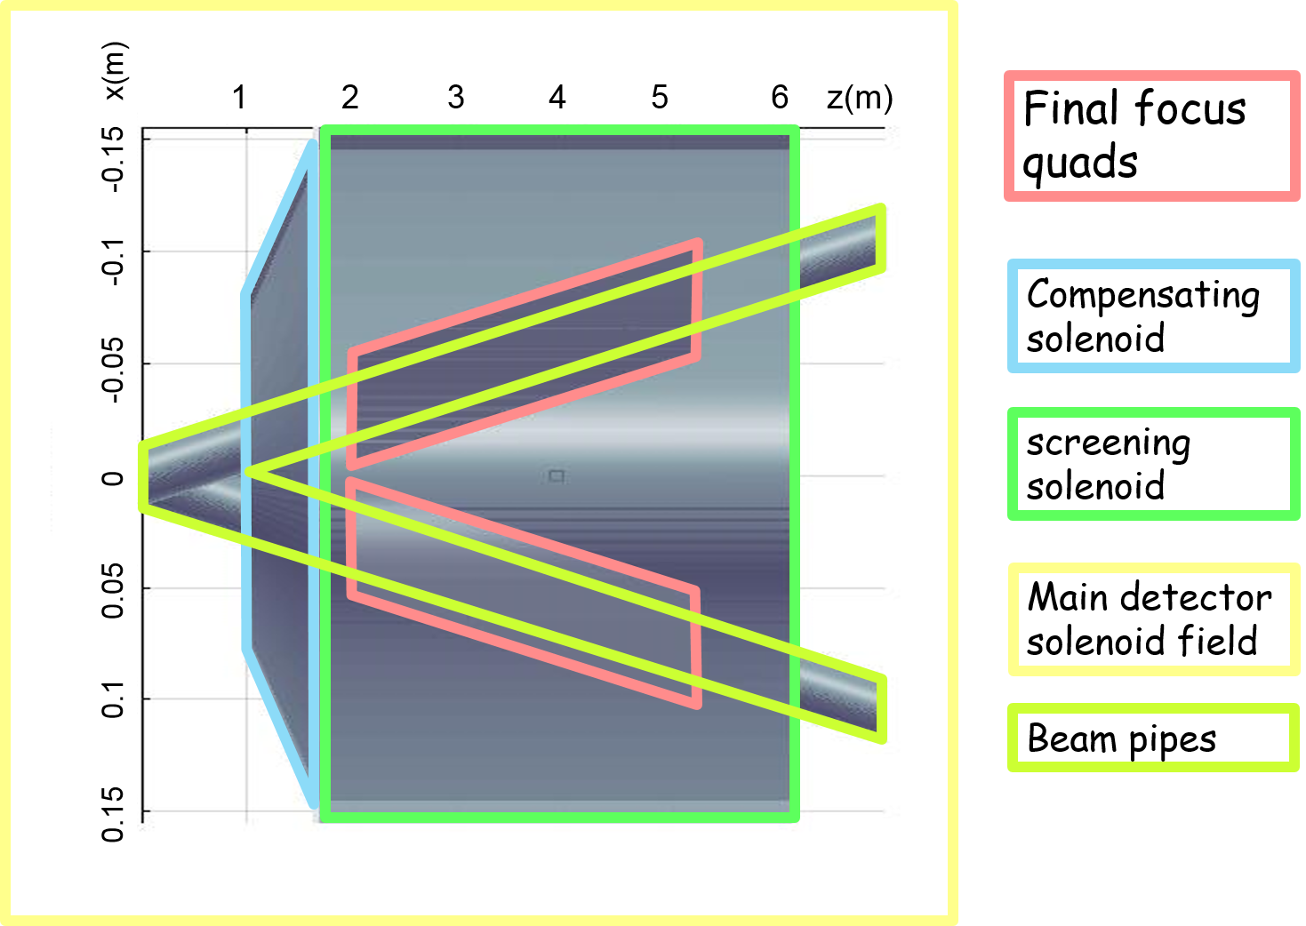
The IR region - baseline
FCC-ee IR

Slide 26
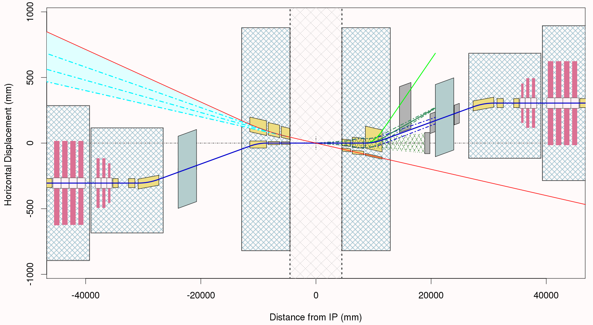
Some eRHIC IR Design Conventions and Terminology
eRHIC IR
Crab Cavities
Detector ±4.5m Clear Space
1m
IP
Hadron Beam
Electron Beam
Crab Crossing Scheme (With No Dipoles Inside Detector*)
Crab Cavities
Hadron Rear Side
Hadron Forward Side
20m
Note Distorted Scale
*Except possibly a shielded dipole on forward side to increase experimental acceptance.

Slide 27
Talk 1 - Crab Waist Concept, P. Raimondi (ESRF)
Key points:
  Crab waist scheme overcomes limitations from hourglass and beam-beam. Allows lower beta*; gains luminosity with large Piwinski angle
  Key feature: crab waist compensation – a new idea from 2006. Positive and useful experience from Dafne
  Price to pay: challenges in final focus system design/construction – but feasible
  Now a key concept for the next generation of high lumi colliders
Discussion:
  It was discussed whether there is a good case for turning Dafne into a test facility for studies on the large Piwinski angle and the crab waist scheme. While this would be useful, it was not entirely clear what would be added beyond the SuperKEKB experience and whether this would not interfere with Dafne physics. Also, the resource needs and their benefits would need to be analyzed.
  It was asked what the limit on beta* is in the crab waist scheme and whether this limit is consistent with the FCC-ee design. The discussion showed that other limits in the final focus design (dynamic aperture) must also be considered.

Slide 28
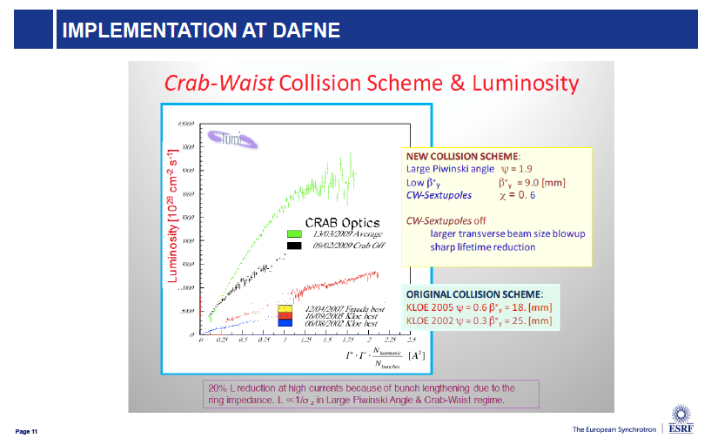

Slide 29
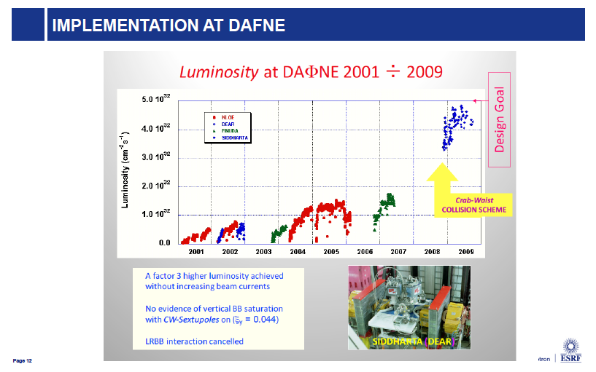

Slide 30
Polarization

Slide 31
New method for beam polarization and energy measurement

Slide 32

Measurements vs Calculations
eeFACT
2016
Daresbury, UK 24-27 Oct 2016

Slide 33
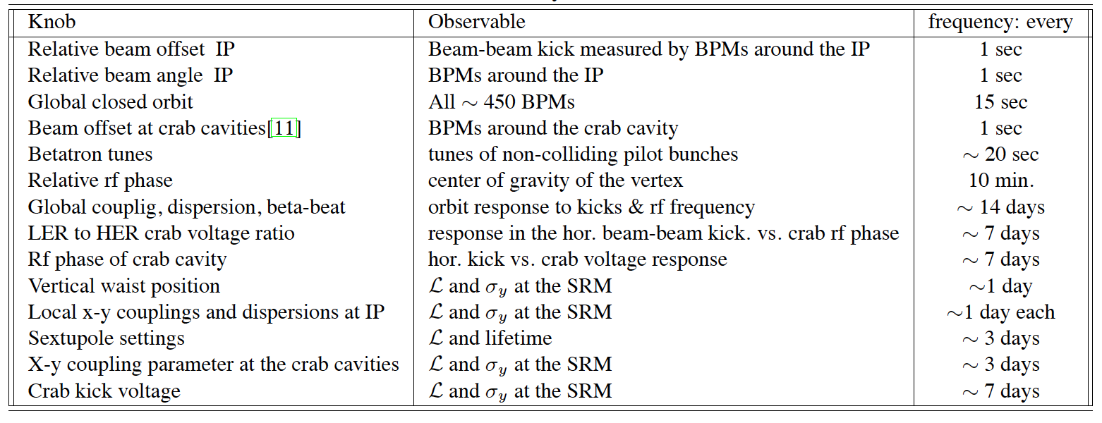
Tuning knobs for luminosity at KEKB
Machine tuning
chromaticity of x-y coupling at IP
L and σy at the SRM
~3days
A method of parameter search based on downhill simplex method was developed in 2007, which can search 12 parameters simultaneously. The speed of the luminosity tuning became faster. However, with this method the achievable luminosity was not improved.

Slide 34
CEPC Power Consumption (ref. Pre-CDR)
For a 500 MW collider in China:
Assuming 1.5 “Snowmass unit” a year for operation:
500 MW x 4000 hours = 2 x 10⁹ kW-hr
Electricity price in China: RMB 0.5 yuan per kW-hr
Yearly cost: RMB 1B (US$ 150M)
(50 Chinese cents per kWh)
Efficiency
(AC to beam) = 20%

Slide 35
CEPC Relative Power Consumption (Pre-CDR)
2%
3%
9%
10%
6%
16%
5%
48%

Slide 36
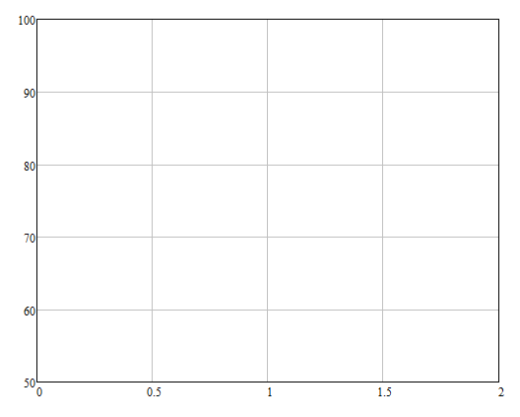

after 80 years a breakthrough in klystron efficiency!
comparing simulated performances of MBIOT and HEKCW MBK
HEKCW
η=90%!
40 kV
I. Syratchev
38 kV
42 kV
36 kV
A 40-beam prototype “BAC” klystron has been built and successfully tested at VDBT, Moscow, this year!
Efficiency, %
34 kV
48 kV
34 kV
Power, MW
Dotted lines – only changing P drive
Solid lines – changing P drive and Voltage

Slide 37
Constable

Slide 38
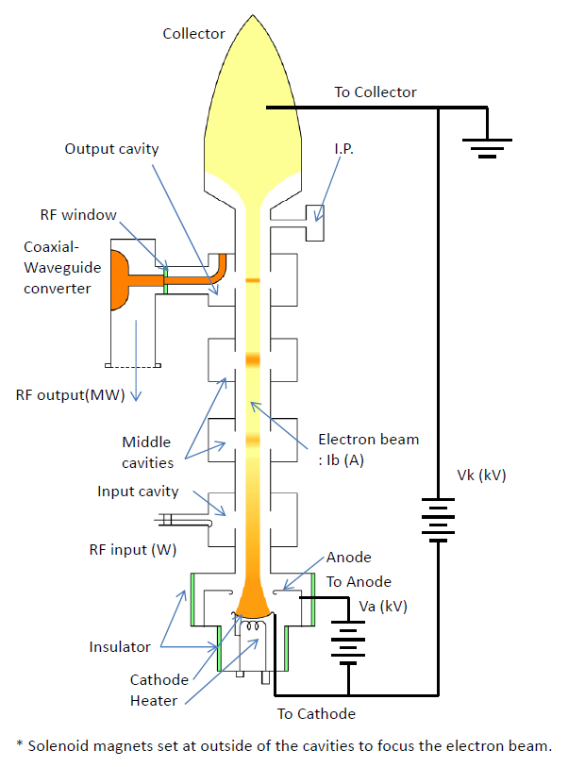
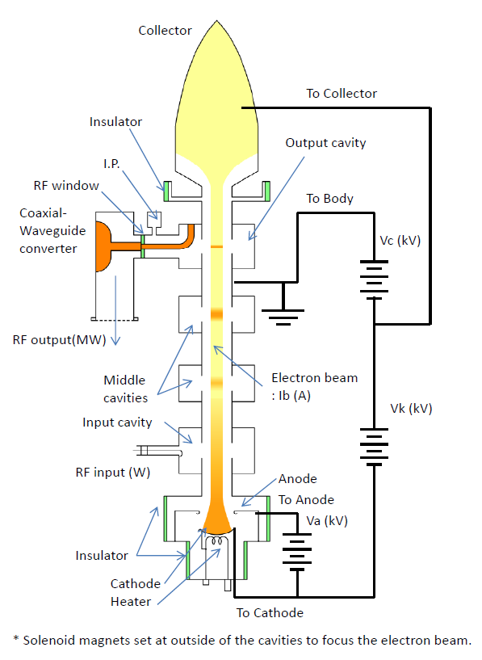
How to apply CPD method to klystron
Watanabe
*An insulator needs to insert between the body and the collector to isolate the collector from body.
Conventional
Schematic diagram of one for CPD
Collector
Isolate a collector from body to apply high-voltage for energy recovery.
High-voltage applies to Collector-body
Without insulator
Ground
Vc
Insulator and gap
RF out
Vk
Vk
Body is a ground.
Notes:
クライストロン電源は既存の構成を出来るだけ保持する方式を考える。下図はVkとVcを直列にする「Power=(Vk+Vc)*Ib」が、
後述する並列「Power=Vk*(Ik+Ic)」または、6.6kV交流へ変換し既存電源の入力とする方式を考えている(詳細検討未だ)。

Slide 39
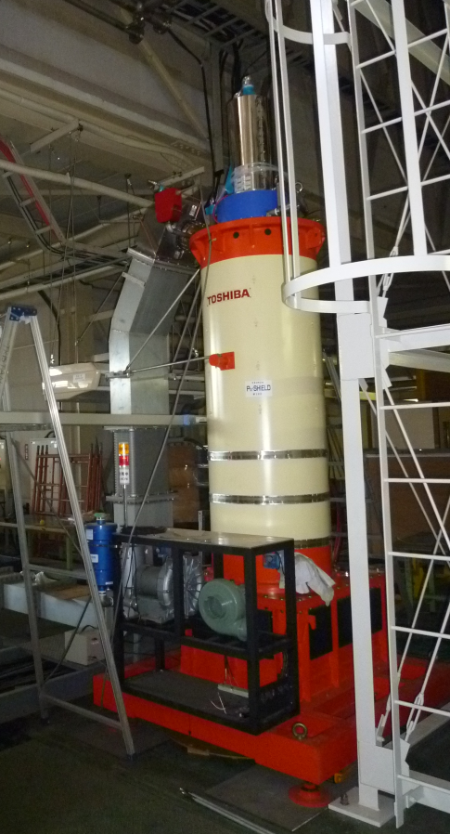
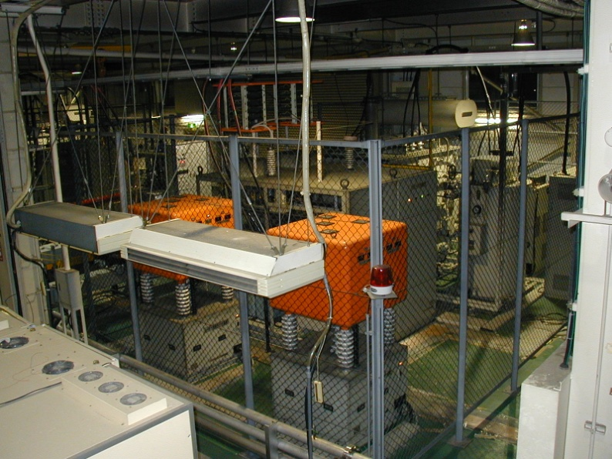
Example of the Power balance of klystron within without CPD
Watanabe
UHF 508.9 MHz
RF out: 300 kW (CW)
RF in: ~ 2W (CW)
Collector loss
Without CPD -> 420 kW
With CPD -> 184 kW
(recovery: 236 kW )
Example of
: Toshiba E37703, CPD
In case of 300 kW RF output (η = 42%) power,
* Without CPD (Vk = 90 kV、Ib = 8 A)
Required DC power is 720 kW
-> RF out 300 kW,
Dissipate power in Collector 420 kW
* With CPD (Vk = 90 kV、Ib = 8A、Vc = 30 kV)
η = 42 -> 62%
-> RF out 300 kW
Dissipate power in Collector 184 kW
Recovery power 236 kW <- Pick-up by cable from collector, then reuse to drive a klystron
After driving CPD, the required DC power is shifted to about 500 kW using by recovery power from the collector.
Power picks by cable
3Φ AC 6.6 kV, ~ 270 A
90 kV, 8 A -> 720kW supply
KPS, DC power supply
(90 kV, Max 20 A)

Slide 40
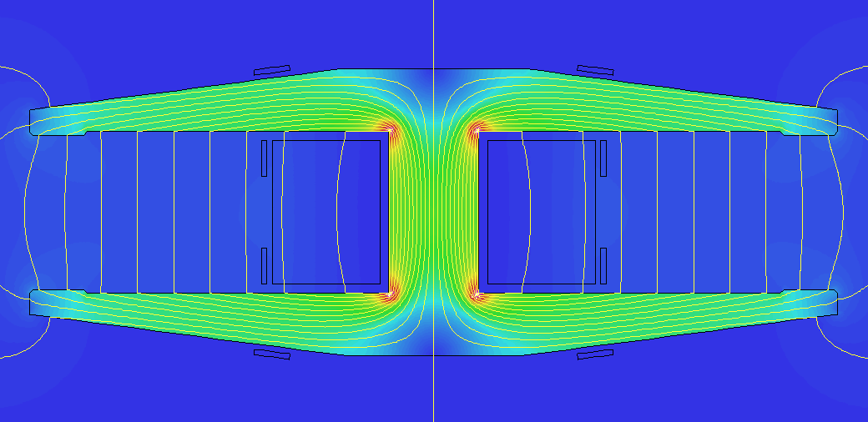

The proposed layout for the main dipoles features a twin aperture yoke and busbars to provide the Ampere-turns
Zimmermann
I = 3570 A, B = 50 mT
320 mm
90 mm
210 mm
120 mm
60×80 mm
450 mm
0
0.5 T
1.0 T

Slide 41

Also for the quadrupoles a twin design with a 50% power saving is possible, with an F/D polarity constraint
Zimmermann
NI = 13500 A
(287 A × 47 turns) B’ = 8.71 T/m
320 mm
88 mm dia
520 mm
640 mm
0
0.75 T
1.5 T

Slide 42
The resistive power for the quadrupoles is about of factor of two lower if the combined function lattice is used
Zimmermann
at 175 GeV | current density [A/mm²] | total power, 2 apertures [MW]
(modified) pure dipole lattice | 2.3 | 21.5
(modified) combined function lattice | 2.0 | 12.4 (7.8 twins + 4.6 single)
Cu conductor
cable losses to be added, for quadrupoles likely only a few %
if twins are not used, then the power goes up to 43 MW for the pure dipole lattice, and 20 MW for the combined function one

Slide 43
Summary
CEPC is becoming a major player in the world e+e- collider community.
But “the grass is always greener on the other side of the fence.” I just feel we are still so much behind our neighbors (CERN, KEK) in almost all the fields.
Our hope is that we have a young army, and soldiers will become commanders when CEPC takes off.
Several fields need special attention:
  SRF
  HOM damper
  IR
  MDI
  Polarization and energy calibration
  “Green CEPC” (power reduction)

