Slide 1
Hough Tracking status

Slide 2
A fix Version
Fix large pattsf & hough combine method
Old version : delete track from pattsf(|dz|>10 or |dr|>1)
New version : for low pt track , both use pattsf & hough tracking , but reserve
the good one ( track with more hit )
A fix version :
For low pt track now
For large pt track
Lost track in pattsf will come into hough

Slide 3
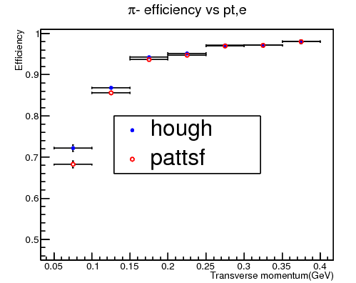
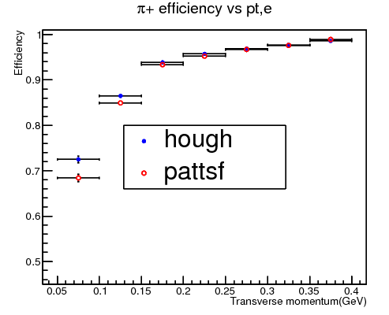
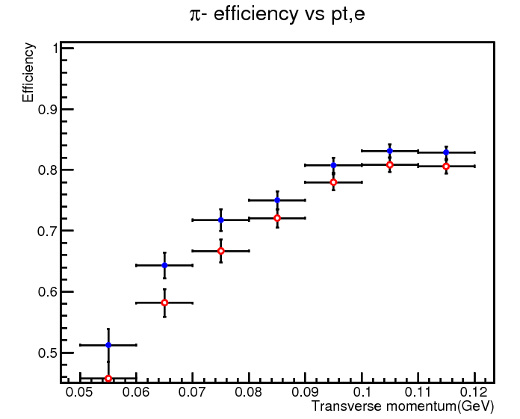
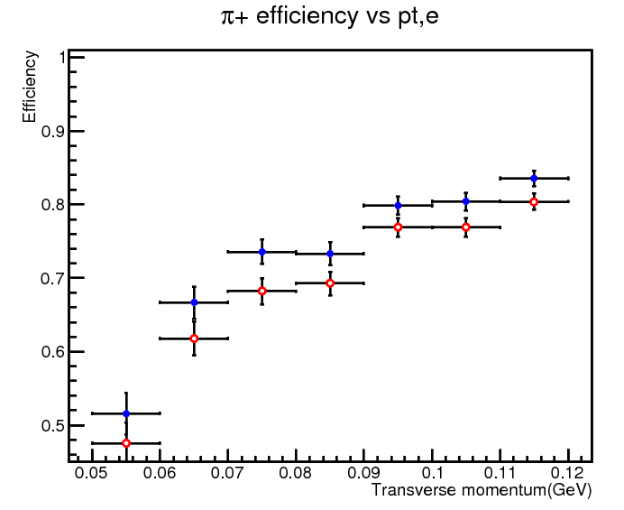
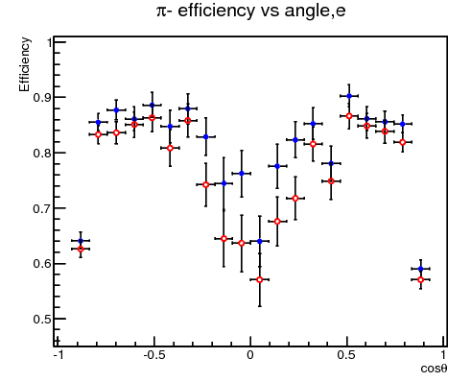
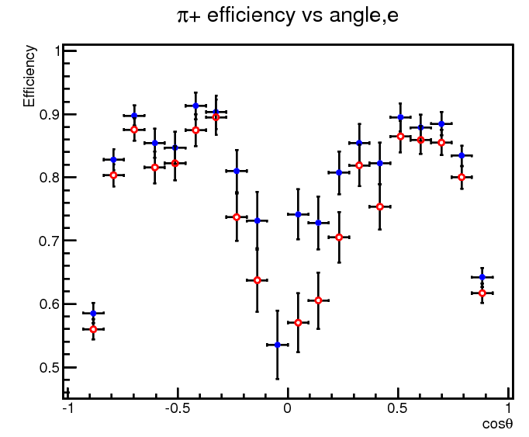
MC pipijpsi Tracking efficiency
4% up

Slide 4
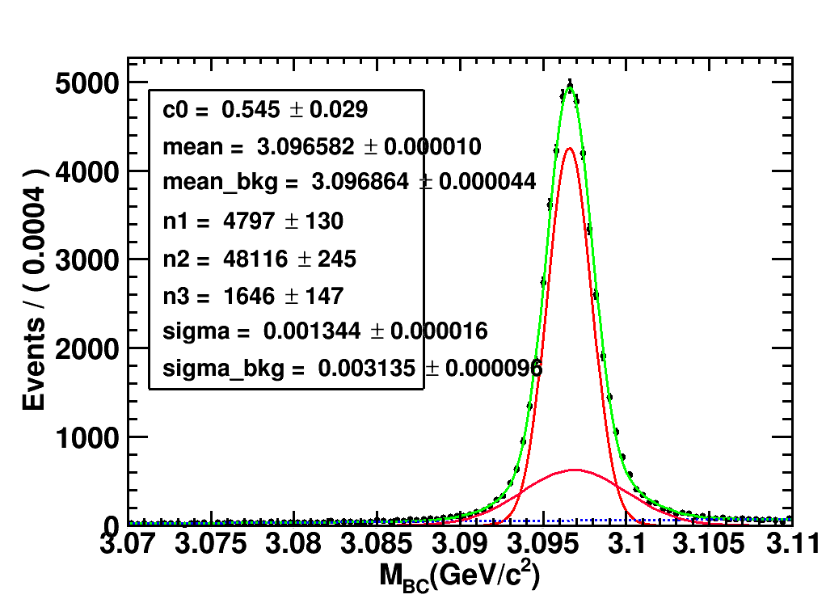
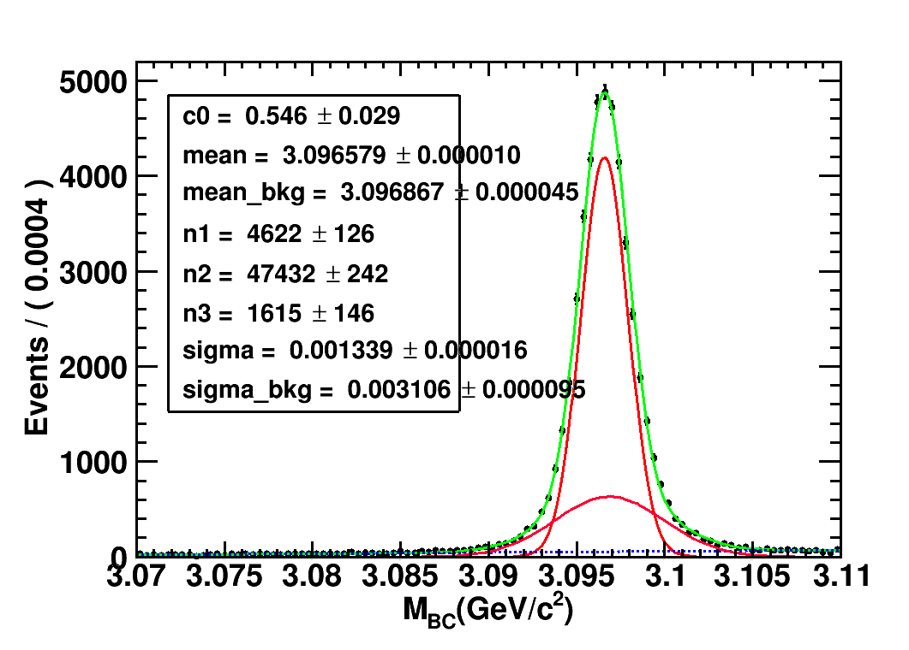
MC PiPi recoil mass fit
HOUGH+PATTSF
PATTSF
Signal :48116+4797= 52913
Bkg :1646
信噪比：99.95%
Signal :47432+4622= 52054
Bkg :1615
信噪比：99.95%
* noise-signal-ratio: signal/sqrt(signal+noise)

Slide 5
On work
Keep running data pipijpsi , check sig/noise ratio
Matching track in MC , check fake tracks ,not finish well

