Slide 1
去掉内室性能分析

Slide 2
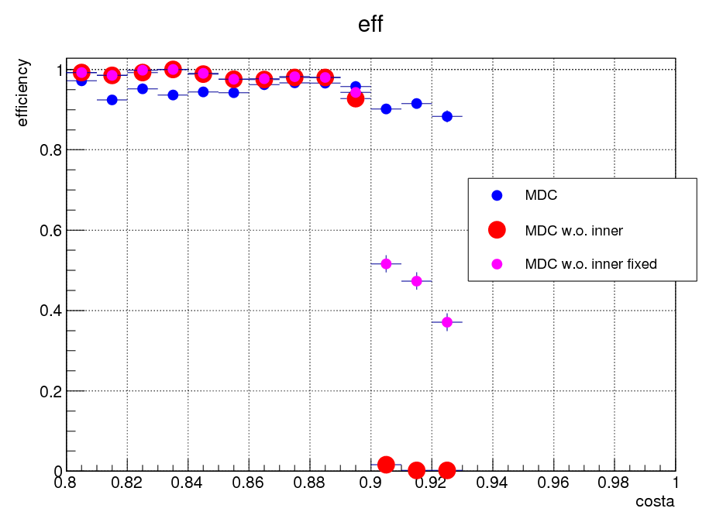
Eff = nTk>0 / Simulation of track number

Slide 3
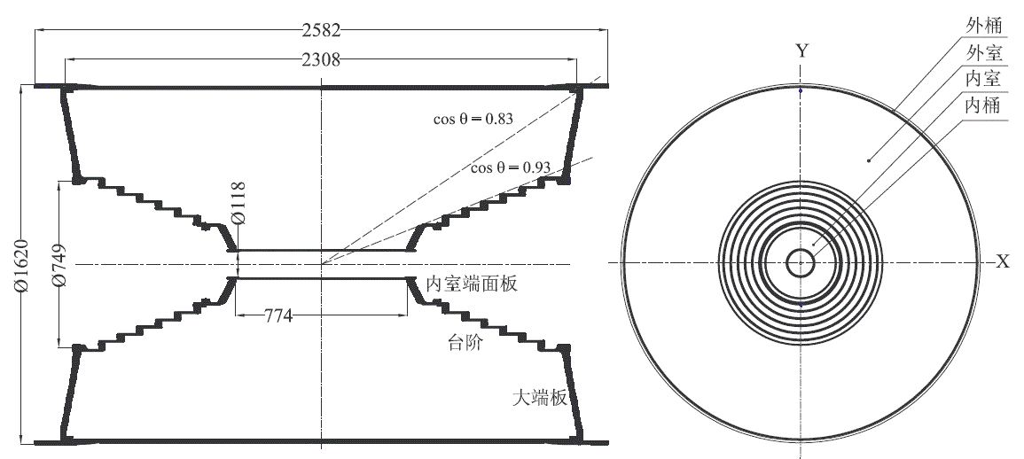
BESIII漂移室总体结构示意图

Slide 4
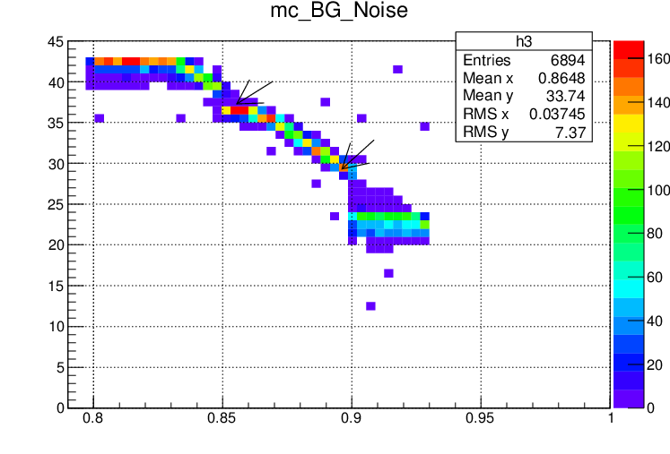
MaxLayer

Slide 5
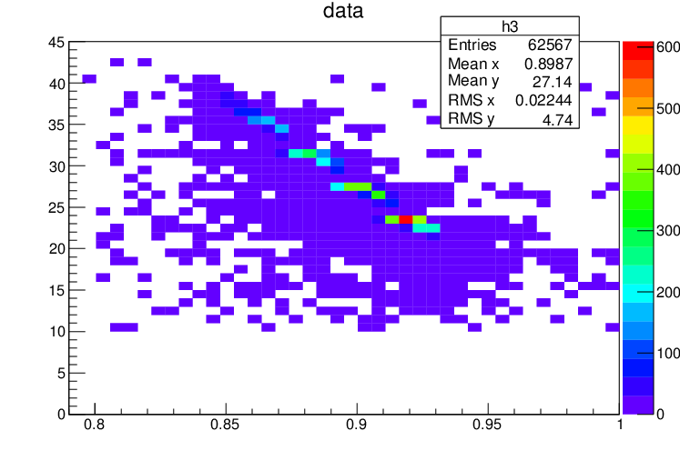
data sample
:/bes3fs/offline/data/cal/round08/150618/run_0043253_GEBhabha_file001_SFO-1.raw

