Slide 1
Status of ECAL Optimization Study
Ji-feng Hu, Jing Li,
Prof. Hai-jun Yang, Liang Li
INPAC, SJTU

Slide 2
Outline
Why ECAL optimization matters?
How to make optimizations
Preliminary results
Basic performance
Physics benchmarks
To do list

Slide 3
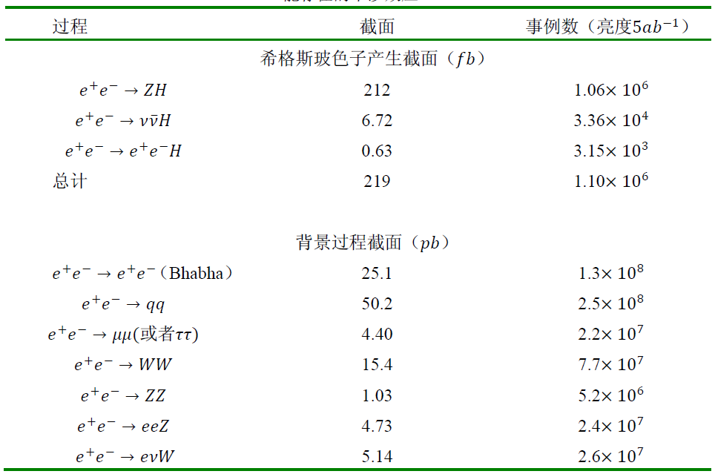
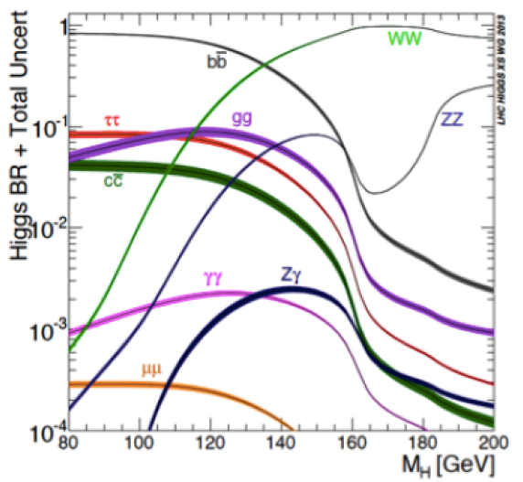
Why ECAL optimization matters?
Both physics goals and budgets require geometry optimization.
ECAL and HCAL are two essential components for gamma/lepton/jets reconstruction and identification.

Slide 4
Software Version and Samples
Software versions,
Simulation: Mokka-08-03 revised
Reconstruction: Arbor_KD_3.3 plus track-related processors
Digitization : G2CDArbor
Samples,
$e^{−}/γ$ single particle, energy@5,10,20,50,100 GeV
$ee→ZH→llγγ$@$\sqrt{s}=250 GeV$, 1000 Events
$ee→ZH→ll lvqq$@$\sqrt{s}=250 GeV$, 1E5 Events
Geometry: cepc_v1 using SiW in ECAL,
Cell size @ 1X1, 5X5, 10X10, 20X20 mm
Number of layers @ 16, 20, 26, 30
fixed total material.
other sub-detectors taken by default.

Slide 5
ECAL and HCAL Simulation Chains
Mokka-08-03
(SimCalorimeterHit)
CEPC_v1
Digitization in G2CDArbor
(CalorimeterHit)
Energy threshold 50 keV, to be checked
Reconstruction in Arbor_KD_v3.3 (LICH)
(lepton Identification)
Some new parameters for Arbor thresholds at different geometry setups.
Linear response only now.
Simple digitization, re-calibration coefficients for non-default geometry.
Emulated digitization models are under development.
New plugin for recording energy deposit in non-sensitive region.
Analysis
Z, best combination of two leptons.
H, two most energetic neutral particles.
Default tracking and clustering

Slide 6
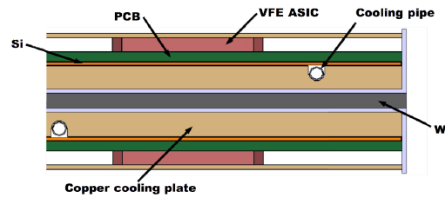
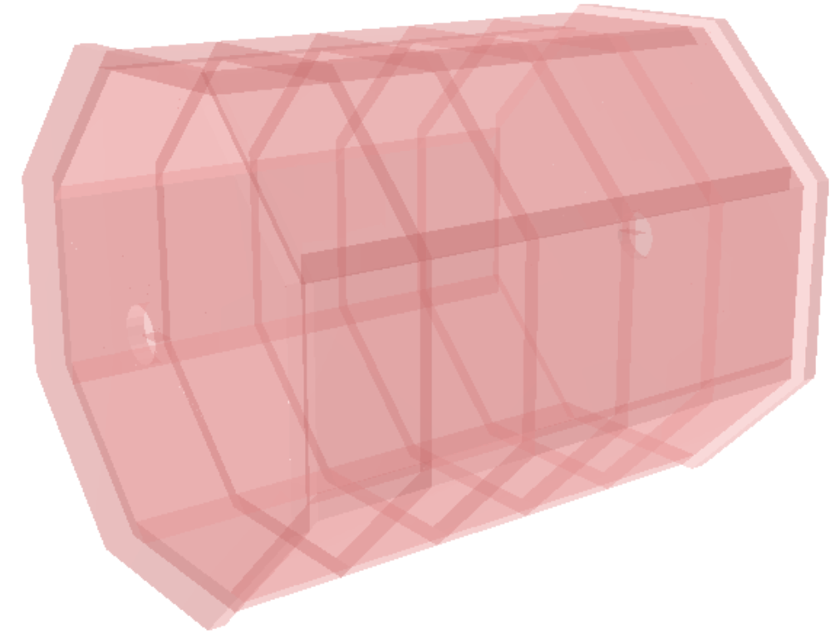
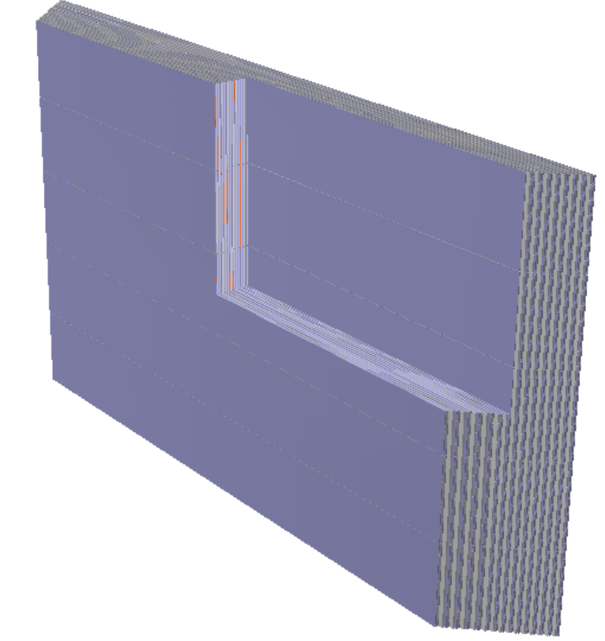
ECAL Setup
Parts | Thickness (mm) | Absorber (mm) | Dimension (mm) | Cell size (mm^2)
Barrel | 5.25 (L0-19) 7.35 (L20-29) | 2.1 4.2 | R, 1843 -2028 Z, 0.00-2350 | 5.08x5.08
Endcap | 5.25 (L0-19) 7.35 (L20-29) | 2.1 4.2 | R, 226.8-2088 Z, 2450-2635 | 5.08x5.08
One Tower
(sectional view)
One tower
(side view)
ECAL

Slide 7
Zoom in Side View (ROOT Geo)
Side shadow(grey and blue)
Illustration:
2 thin layers
4 thick layers.
Si plate(orange）
W plate (4.2 mm)
(white grey, dark grey)
PCB
name | Radiation length (cm)
Si plate | 9.349
PCB board | 2.817
W plate | 0.350
GroundorHVMix | 2.732
W plate (2.1 mm)
10.5mm
14.7mm

Slide 8
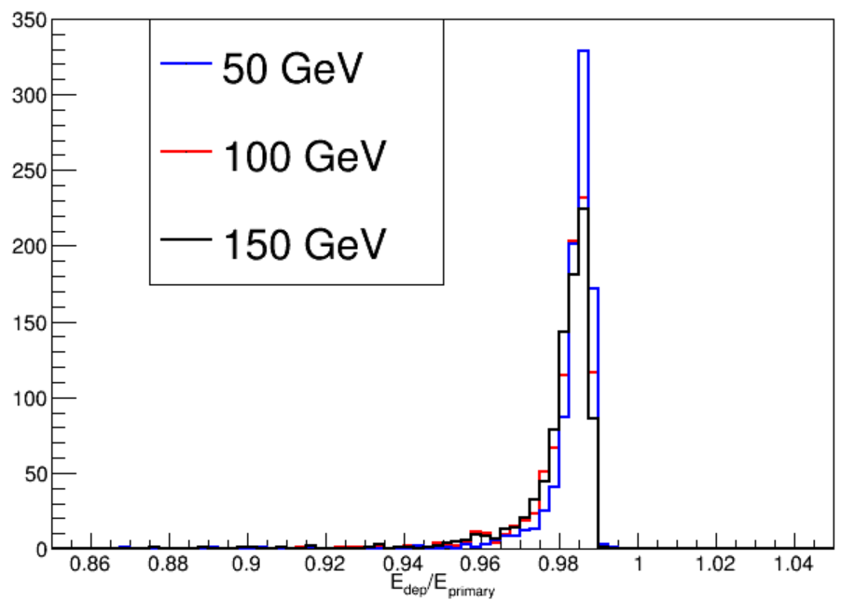
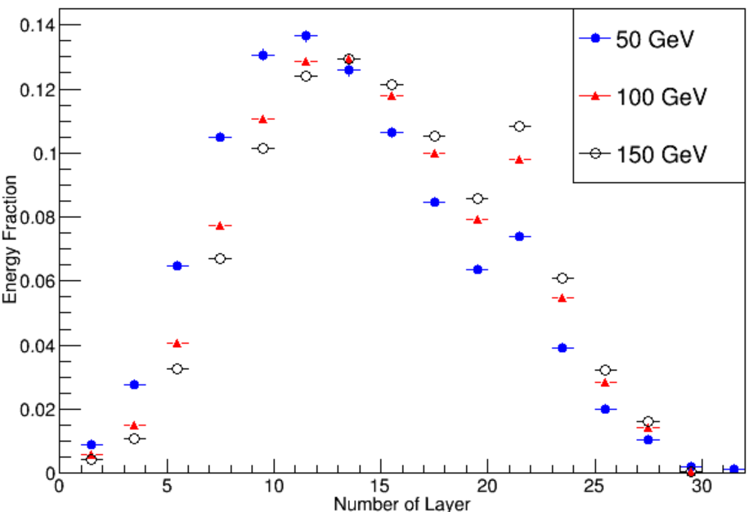
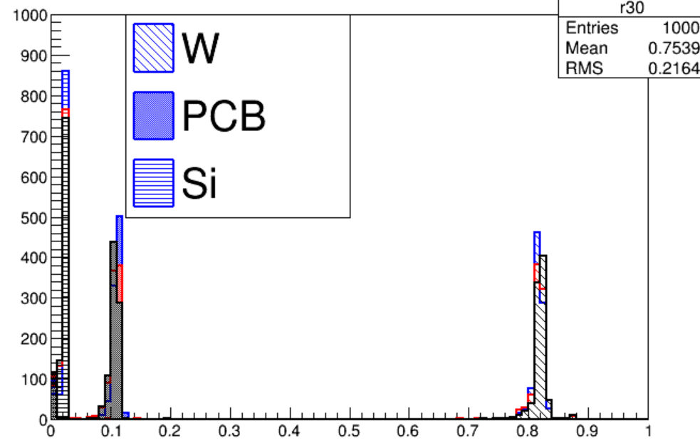
Energy Density Function
(1)
(2)
Energy deposit fraction in ECAL
(1) 99% energy of incident photon will be deposited in ECAL.
(2) the turn point is due to thick layers.
(3) W plates absorb ~82% energy of photons.
(3)
Energy fractions in materials

Slide 9
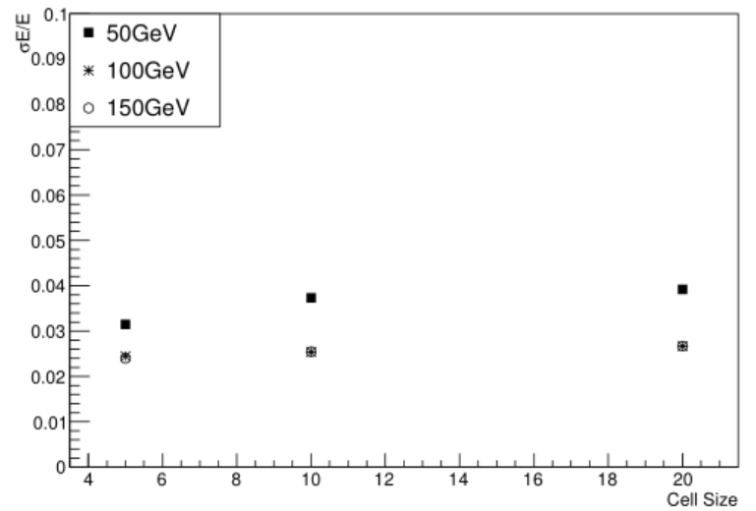
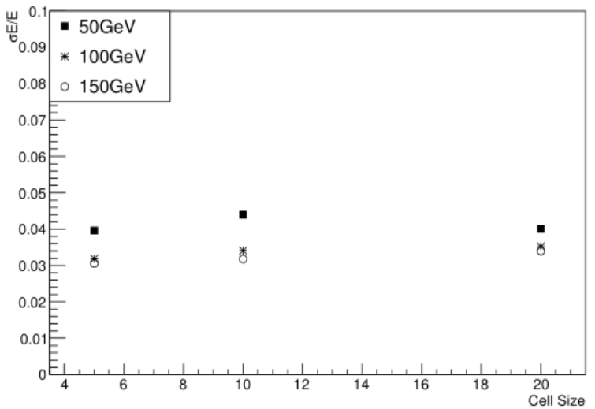
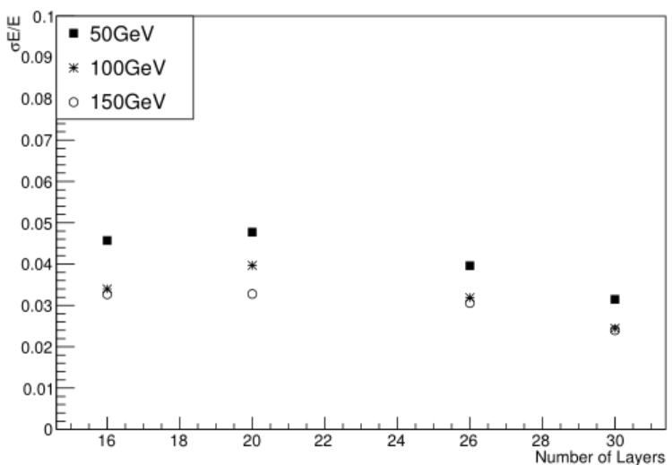
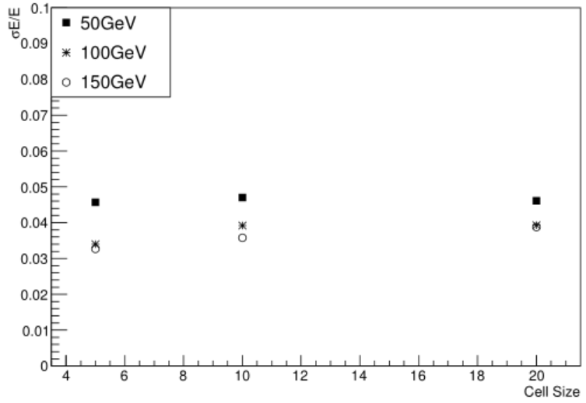
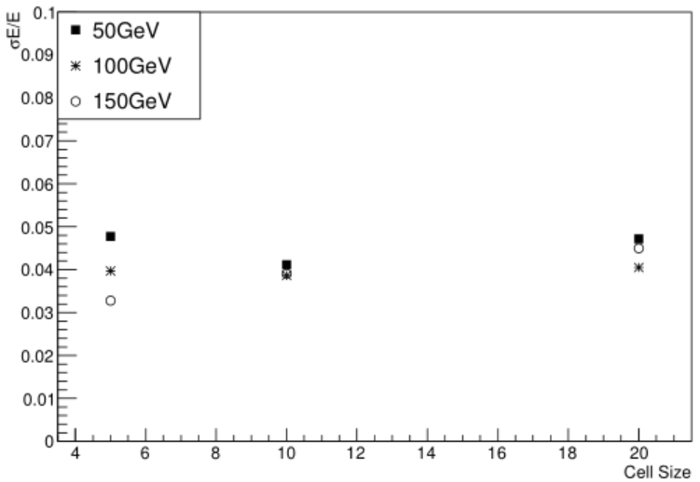
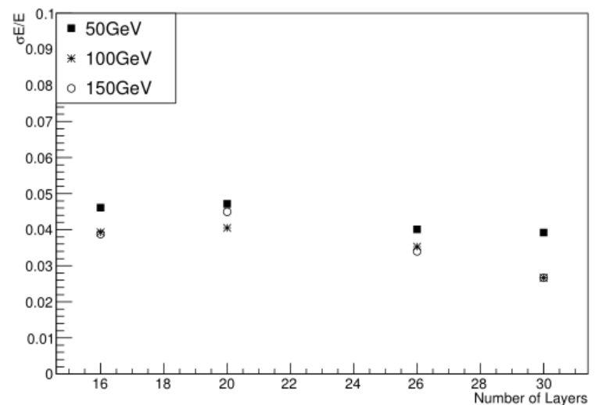
Relative Energy Resolution
26 Layers
Cell 5x5 mm^2
30 Layers
Cell 20x20 mm^2
16 Layers
20 Layers
More layers, better energy resolution
Energy resolution almost is independent of cell size.

Slide 10
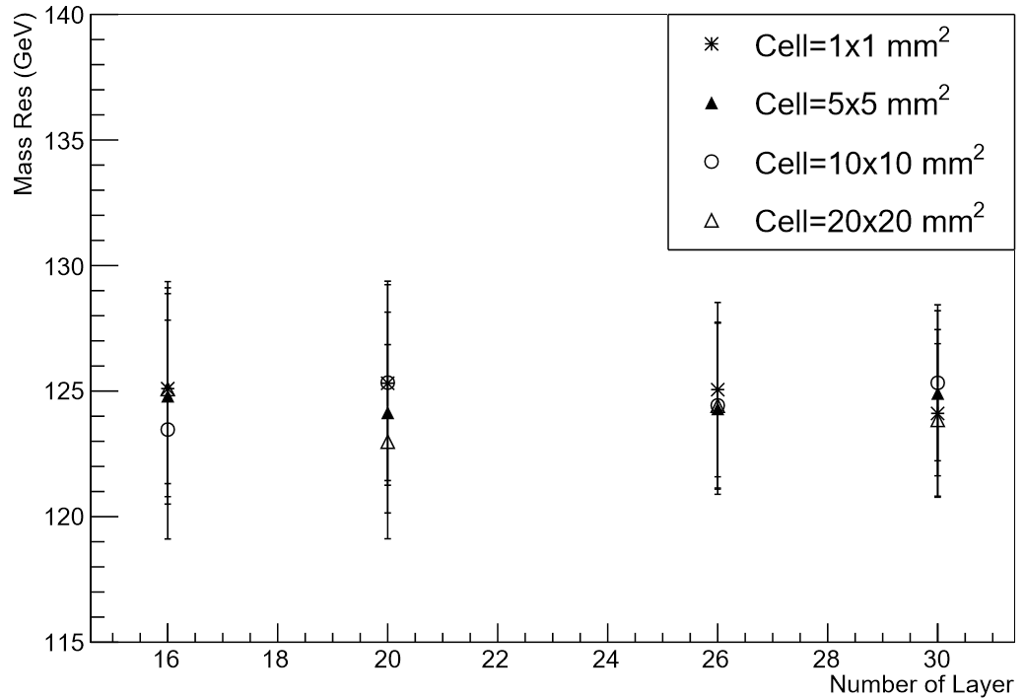
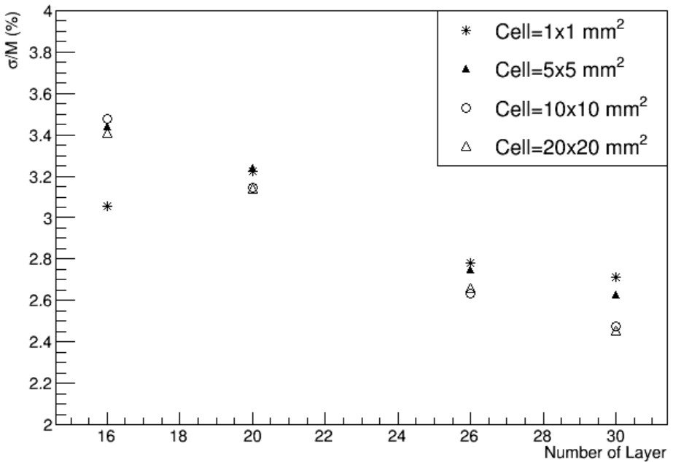
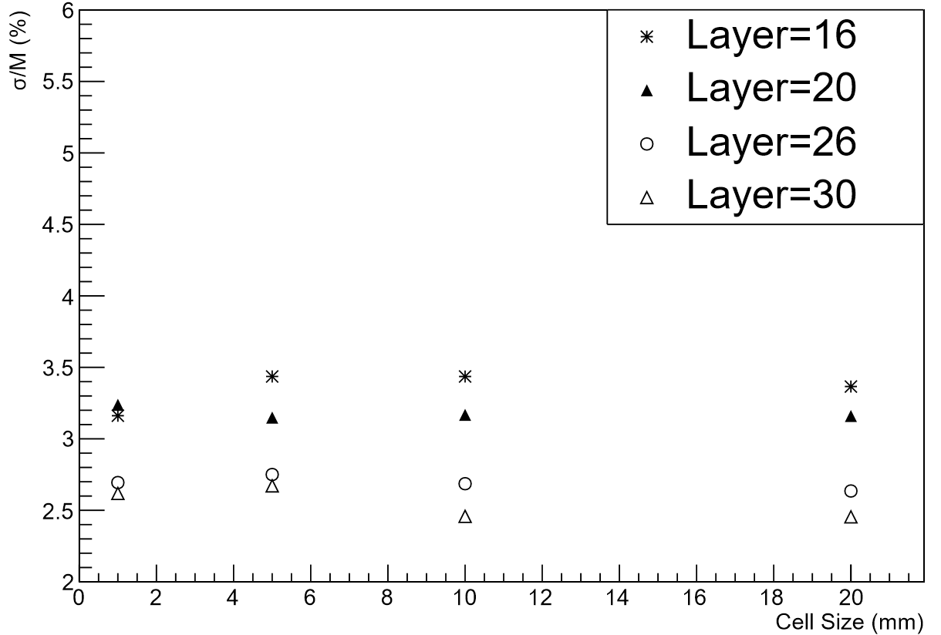
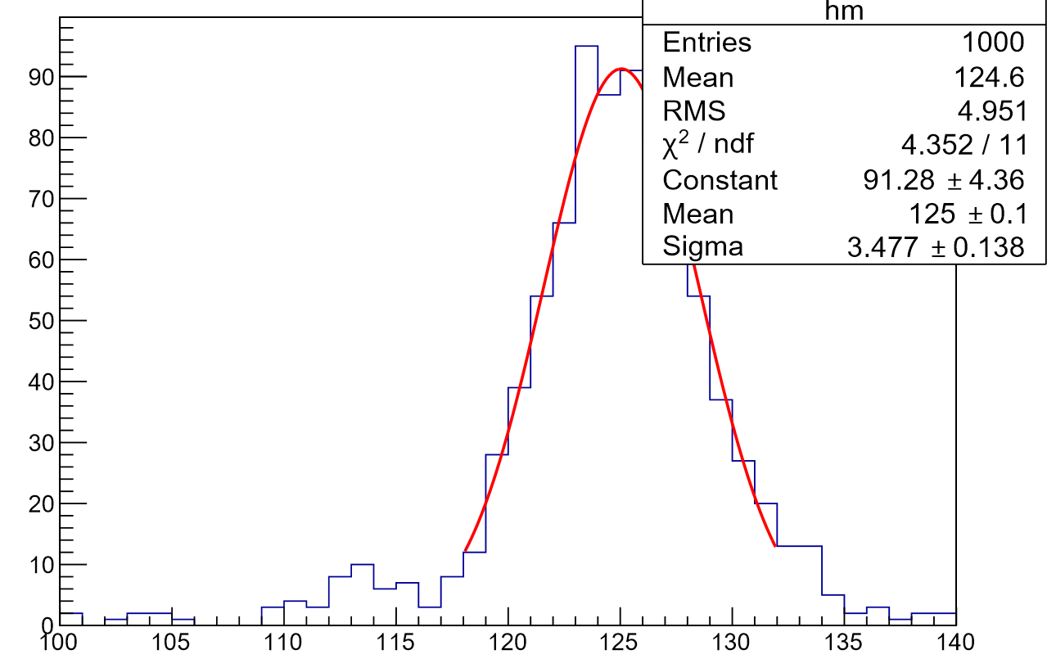
Test of Higgs->γγ
Z reconstructed by two charged leptons
Higgs by the most energetic two neutral particles.
Background not yet investigated.
Higgs invariant mass fitted with a Gaussian
Energy re-calibration at different geometry.
Some new parameters values for Arbor.

Slide 11
Analysis Logic of Higgs→WW
ArborPFOs
[FSR correction]
ArborPFOs
Z Tag
[the least mass difference]
PFOs of Z candidates
Isolated lepton Tag
[no any charged found within a cone angle]
Isolated leptons
Vertex, JetClustering and FlavorTag
The other PFOs
The other PFOs
FsrArborPFOs
Refined Jets
Package provided by Libo liao
Revising some over counting in loops.
Revising some MC truth matching.
Switch to PFOs exported by LICH.
1. LcfiplusProcessor weights
/lcfiweights/d0prob_zpole.root
/lcfiweights/z0prob_zpole.root
2. LICH weights
/new_1pfo/

Slide 12
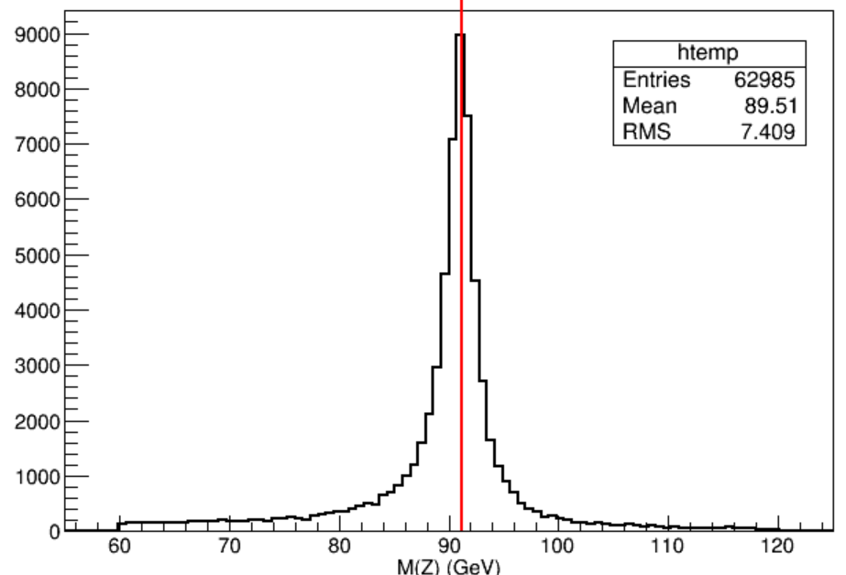
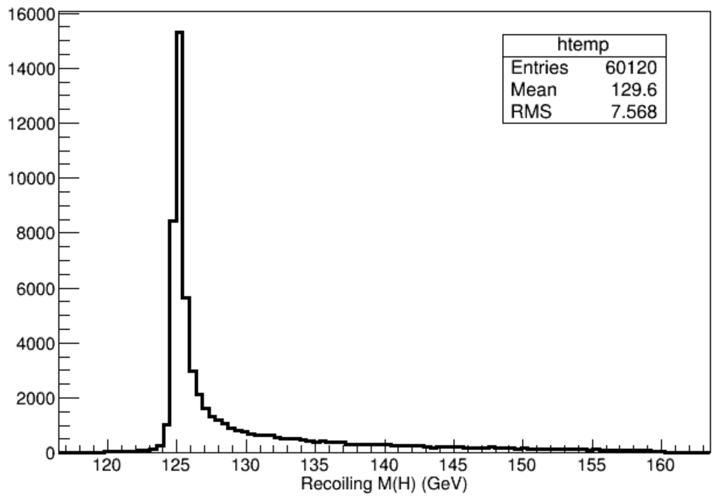
Higgs→WW→lvqq
100000 events
M(Z) in (60, 120),
recoiling M(H) in (120,160) GeV
M(Z) in (60, 120) GeV
(Left), Z mass, (red) line indicates the nominal mass.
(Right), the recoiling mass, $M=\sqrt[2]{E^{2}−{({\vec{p}}_{l1}+{\vec{p}}_{l2})}^{2} }$, lepton 1 and lepton 2 are coming from Z.

Slide 13
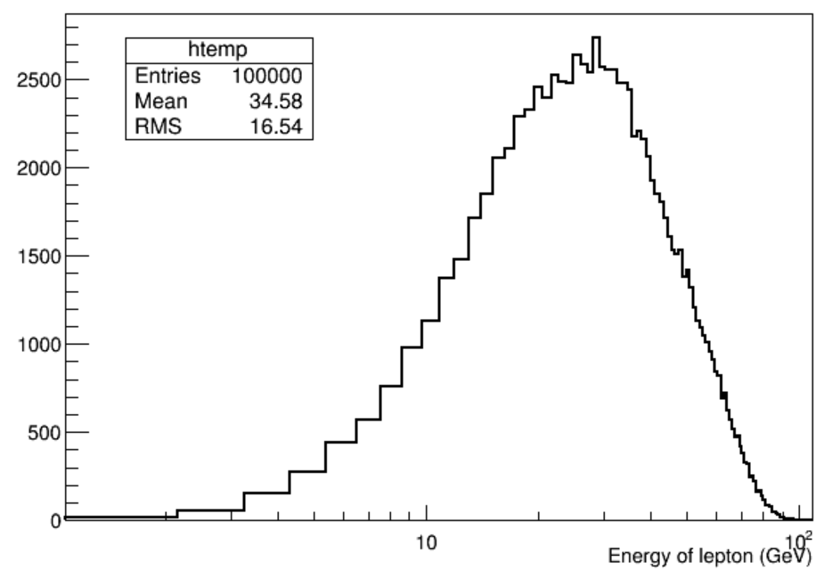
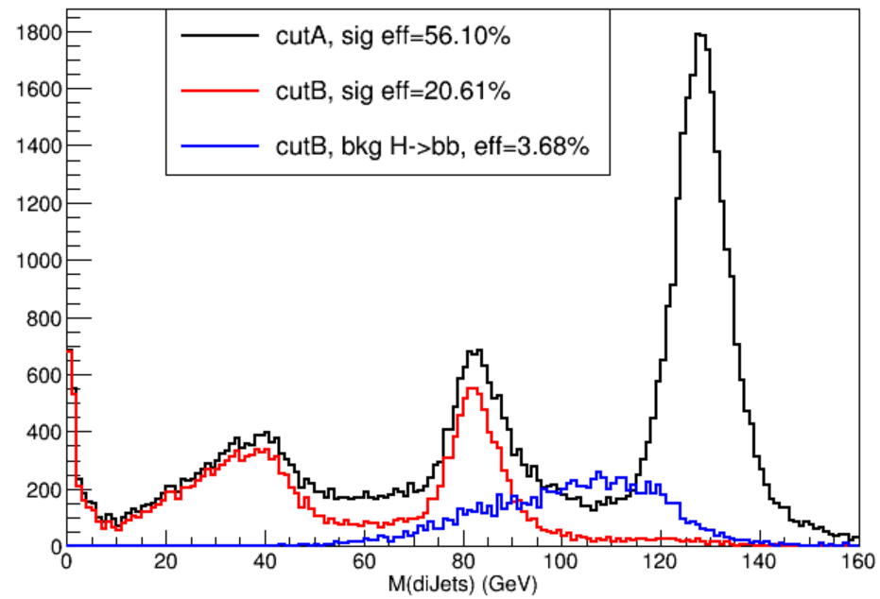
Background Suppression
MC Truth
Cut A, M(Z) in (68.98, 113.38) GeV, approximately within 3 sigma region of Z pole mass. Recoiling M(H) within (120, 160) GeV, Angle of two jets >0;
Cut B, cut A plus number of isolated lepton >=1, its energy >5 GeV (energy threshold needs be discussed).
Other backgrounds are under investigation.

Slide 14
Summary
SiW ECAL optimization was preliminarily studied.
4 X 4 combinations of geometry were tested.
Physics channels of Higgs→γγ, WW are being thoroughly investigated
Conclusions will be made after fine digitization development.
To do list,
Jet Energy Resolution in HCAL
Benchmark of H->WW with background analysis.

Slide 15
Acknowledge
Thanks to Man-qi Ruan, Gang Li, Li-bo Liao, Dan Yu, Shi Chen, Bing Liu, Chen-dong Fu etc. for their helpful discussions and supports.

Slide 16
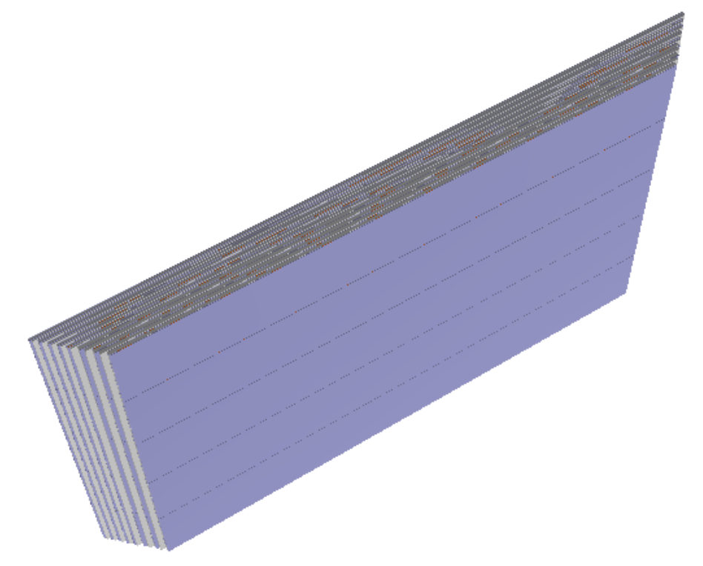
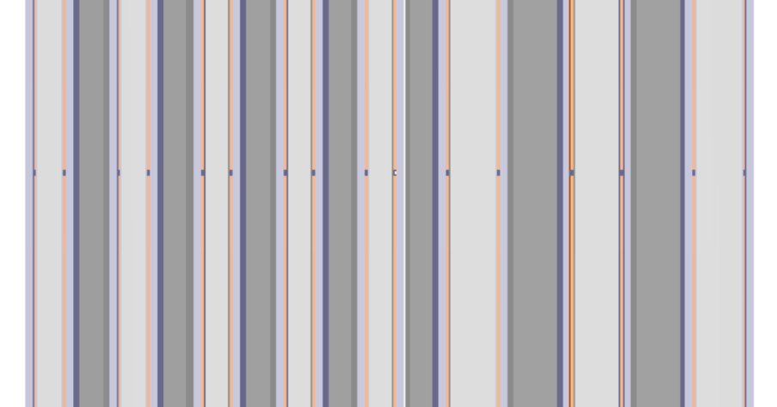
ECAL Geometry (16 Layers)
Si fixed,
Thicker W plate (7.98mm)

Slide 17
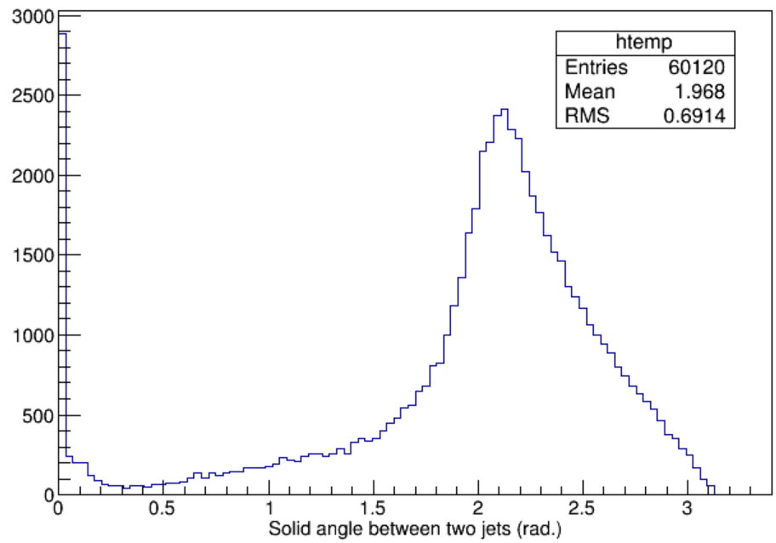
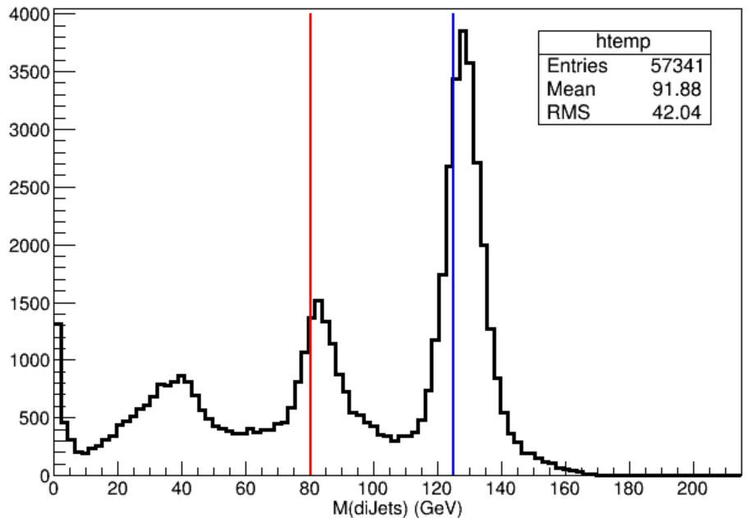
Di-jets Mass
M(Z) in (60, 120) GeV,
recoiling M(H) in (120,160) GeV and
Solid angle > 0
(Left) Solid angle between two jets.
(Right) Invariant mass of di-jets. (red) line indicates W nominal mass, (blue) line the Higgs nominal mass. The Higgs peak is contributed by the leading lepton of virtual W decays mixing in jets reconstruction. Higgs and real W peak mass are a little larger than their nominal mass, which tells not well fined calibration.

Slide 18
Zoom in Side View (ROOT Geo)
PCB
Si plate(orange）
Side shadow(grey and blue)
W plate (4.2 mm)
10.5mm
W plate (2.1 mm, white grey, dark grey)
14.7mm
Air gap(white)

