Slide 1
Photon & Pi0 reconstruction in H->tautau events
Speaker: Yuxuan Zhang
11/29/2016

Slide 2
Physics motivation
CEPC physical objectives
Higgs ->tautau channels
High resolution needed

Slide 3
Tau Physics
Non-strange hadronic branching fractions represent the largest part of tau decays
The main difficulty is Pi0 reconstruction: A neutral Pi0 is often harder to find than a charged Pion

Slide 4
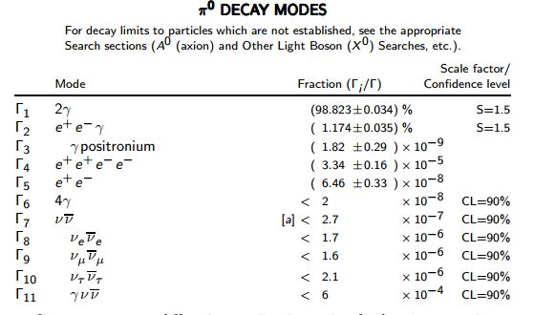
Pi0 Decay modes

Slide 5
Pi0 Reconstruction
Resolved Pi0s can be found from two-photon matching---Coral
Require a high efficiency of photon reconstruction
Photons are closer to each other for higher energy Pi0s due to Lorentz Boost

Slide 6
Coral Introduction
Coral is takes reconstructed particles (by Arbor in this case) as its input
This algorithm runs a loop between each possible photon pair; outputs a Pi0 when the mass of a di-photon is close to 0.135GeV

Slide 7
Event Information
Geometry: CEPC_V1
Radius:1843mm
ECal thickness : 84mm
Half length : 2350
Channel: ZH->e2e2e3e3
Event number: 11,000

Slide 8
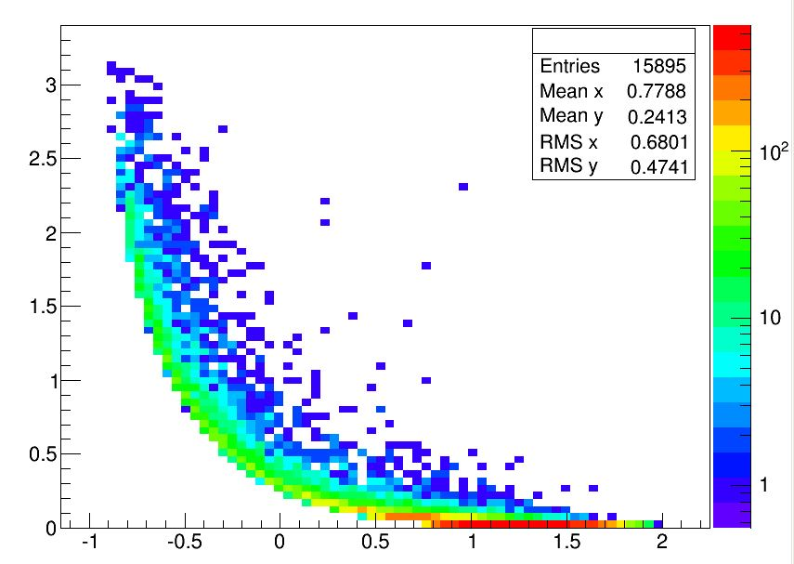
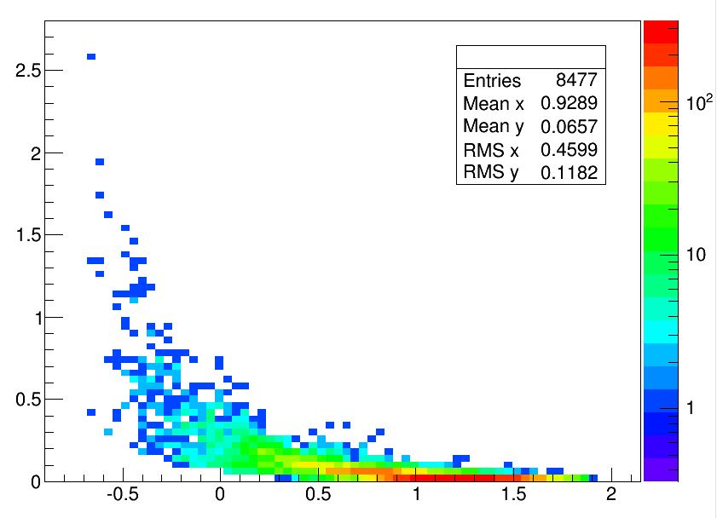
Angle between photons
MC Thuth
Coral

Slide 9
Coral performance
Overall efficiency: 53.3 ±0.51%
Angular distribution behaves as expected
Good performance at high energy; however not able to find many low energy ones

Slide 10
Photon Mapping
To understand how efficient Arbor is doing with photon reconstruction; thus we could conclude what is the pure efficiency of Coral itself.
A mapping between photons at MC level to reconstruction level
Only consider MC photons when they can be recorded by colorimeter (i.e., exclude those who are generated in ECal or decay way before they enter Ecal)

Slide 11
Mapping Criteria
Generated inside ECal and ended outside (at least near Ecal; however, not necessarily a final state photon)
Agular separation between an MC photon and a reconstructed photon
Energy separations: $\frac{σ}{E}=\frac{α}{√E}+β+\frac{γ }{E}$; taking 3$σ$ limit

Slide 12
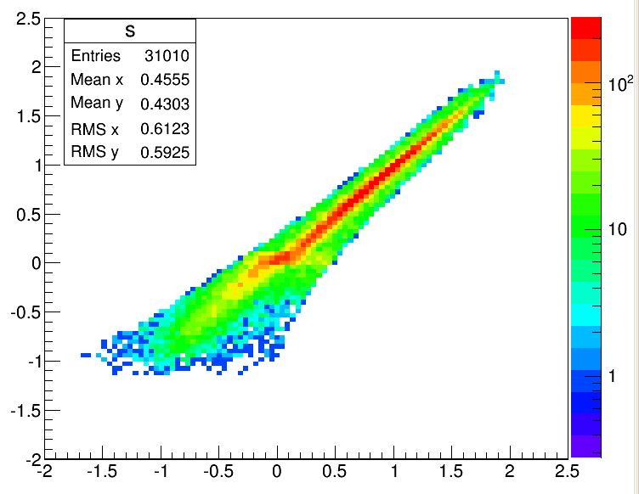
Result:
# Reco Photon = 35552
# Mapped Photon = 31010
# MC Photon = 23.36
Define efficiency = 31010/35552 = 87.22 ± 0.46%

Slide 13
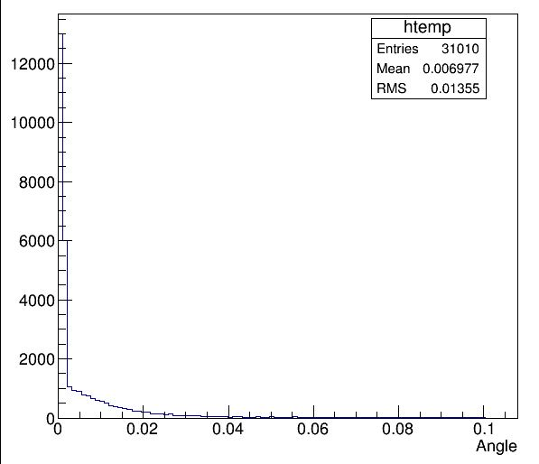
Angle Between Pairs

Slide 14
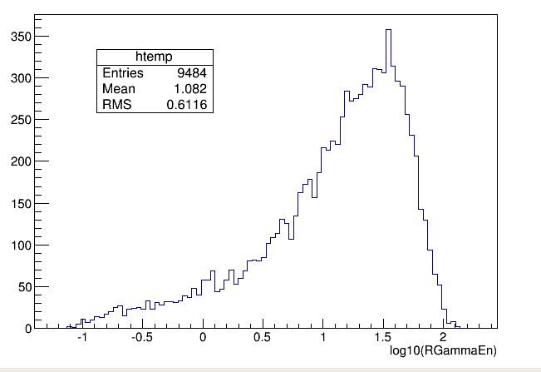
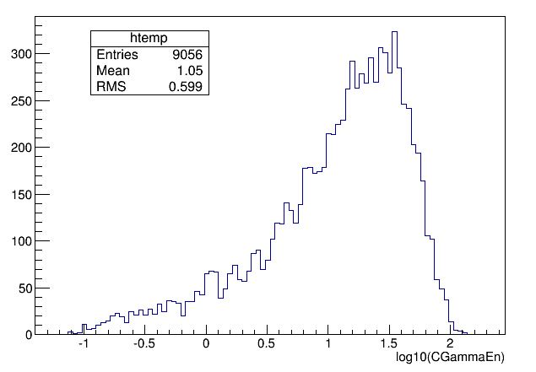
Comparison in Total Energy
Reconstructed level
Matched level

Slide 15
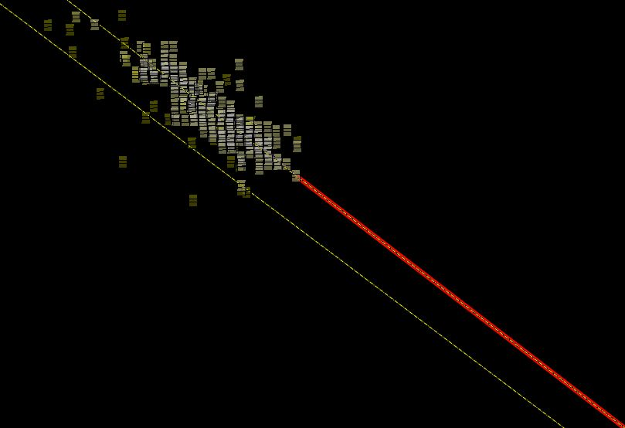

Slide 16
Summary:
Higgs -> Tau -> Pi0->Photon
Coral is working as we expected in high energy region, but not behaving well in low energy regions
Photon mapping successes for most ones, while we have to eliminate fake photons

Slide 17
Next step
Improve the efficiency of Coral itself
Use different samples as comparisons
Think about other effects in the photon reconstruction
Consider using energy intervals

