Slide 1
Status report on H->μ⁻+μ⁺ at CEPC
Zhenwei Cui,Qiang Li,Gang Li,Manqi Ruan,Xin Mo,Lei Wang
2016/11/28
Notes:
I will report current progress about Higgs decay to di-moun’s study at CEPC.

Slide 2
OUTLINE
1. Introduction
2.Inclusive analysis
3.Exclusive analysis
Notes:
The report include 3 parts：
First is introduction。 Then， review the inclusive analysis, and then show the result of the exclusive analysis.

Slide 3
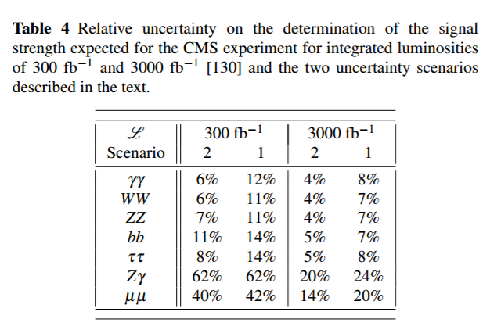
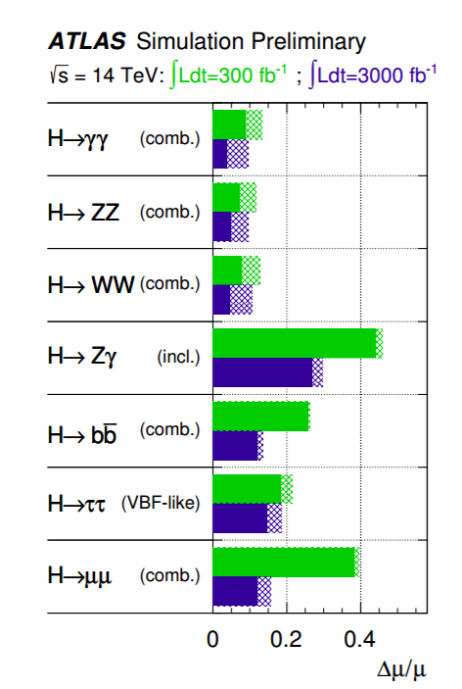
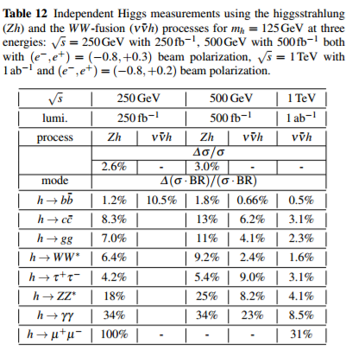
Introduction
(Physics at the e +e − Linear Collider
Aug. 13 2015)
ILC
Notes:
In ILC report at 2015 year, It give us some information about the strength of H decay to di-muon at ATLAS CMS and ILC when the luminosity is big enough.

Slide 4
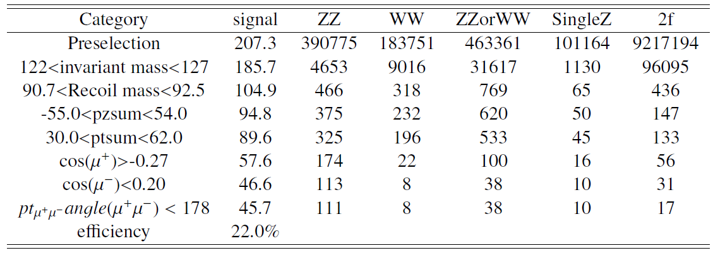
Inclusive analysis
Divide the signal(full) equally with random number. .Part A : Find sections. Part B : Get test result
Signal:full
BKG:
fast
BKG(fast):184
Notes:
In the inclusive analysis , the signal is full simulation data and BKG is fast simulation data. When I used cut-base method to analyze the inclusive data, I divide the signal into two parts randomly for reducing bias. This is the result after one of the cut-chains.

Slide 5
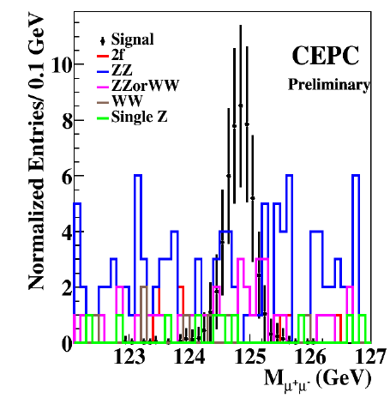
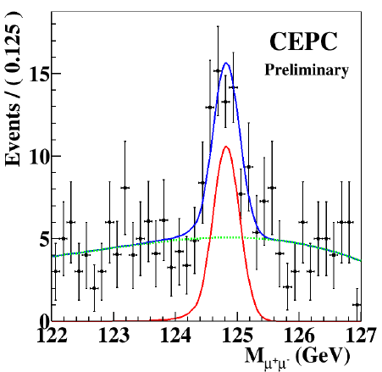
BKG：second order Chebychev function
Signal：CBShape function
Significance： 5.89
Uncertainty：
$${1.0}_{−0.20}^{+0.18}$$
Notes:
Using second order Chebychev function to fit BKG and CBShape function to fit signal. We can get the significance is 5.89 sigma, and the strength is 1 minus 0.20 to plus 0.18 .

Slide 6
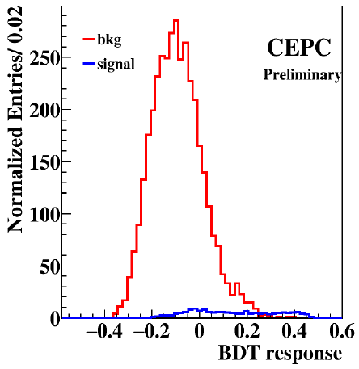
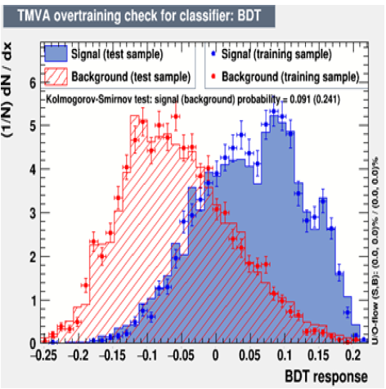
BDT: Ptsum, abs(Pzsum), cosum,cosup,Ptuu
Max Significance: 6.00 at bdt=0.01
Notes:
And I also do the BDT to improve the significance. After invariant mass and recoil mass cut, I use di-moun’s pt ,di-moun’s pz ,the polar angle of u+ and u-, the angle of di-muon’s pt to do BDT. the significance improve to 6.00.

Slide 7
Exclusive:Signal and BKG
Event generator: WHIZARD 1.95
Detector simulation: MOKKA(cepc_v1 model)
Particle reconstruction: arbor_v1(except ww_sl_muq, ww_sl_tauq, zzorww_h_udud, zzorww_h_cscs)
Z decay
Neutrinos (all) | 20.50%
Charged leptons (all) | 10.20%
Electron | 3.40%
Muon | 3.40%
Tau | 3.40%
Hadrons (all) | 69.20%
Event choice:
ZeeHuu | num==1&&nup==1&&nem==1&&nep==1&&nothch==0
ZuuHuu | num==2&&nup==2&&nem==0&&nep==0&&nothch==0
ZnnHuu | num==1&&nup==1&&nem==0&&nep==0&&nothch==0
ZjjHuu | !(num<=2&&nup<=2&&nem<=1&&nep<=1&&nothch==0)&&num>0&&nup>0
num: number of u-
nup: number of u+
nem: number of e-
nep: number of e+
nothch: number of the other charged particles
Notes:
In exclusive analysis , signal and BKG both use the full simulation data, which use wizard 1.95 as event generator , MOKKA(cepc_v1 model) to do the detector simulation and arbor_v1 to do particle reconstruct.
And the channel that higgs decay to di-moun fall into 4 classification according to Z decay type. The event choices are determined on the num of ele moun and other charged particle. We can found the main channel are z decay to neutrinos and hadrons.

Slide 8
ZnnHuu Channel
Variables:
dium | Invariant mass of di-moun
dinm | Invariant mass of missing particles
recoilu | Recoil mass of di-moun
recoiln | Recoil mass of missing particles
ptdiu | Pt of di-muon
pzdiu | Abs(Pz of di-muon)
met | Pt of missing particles
mez | Abs(Pz of missing particles)
cosum | Cos(polar angle of u-)
cosup | Cos(polar angle of u+)
ptuu | the angle between the di-muon' pt
cosumn | Cos(the angle between u- and missing particles)
cosupn | Cos(the angle between u+ and missing particles)
Pre-section:
To choose the events that have missing particles, dinm must over 0. Because the neutrinos are from Z boson, the condition can be: dinm>85.(no fake rate in signal)
Notes:
Now ， let’s see the ZnnHuu Channel. I use 17 variables to analyse this channel, include ()
To choose the events that have missing particles, dinm must over 0. Because the neutrinos are from Z boson, the condition can be: dinm>85.(no fake rate in signal)

Slide 9
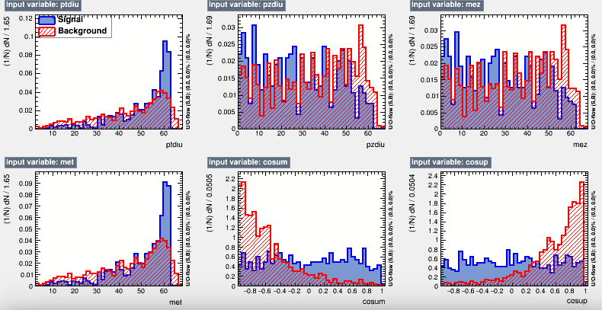
Cut-Chain:
ZnnHuu
 | SZ | ZZ | WW(SW) | ZZorWW | 2f | bkg | sig
pre | 60440.3 | 42614.9 | 244464.0 | 373949.4 | 0.0 | 721468.6 | 44.4
120<dium<130 120<recoiln<130 | 256.7 | 250.3 | 10945.1 | 22875.2 | 0.0 | 34327.3 | 37.8
90<recoilu<93 90<dinm<93 | 85.2 | 90.6 | 823.7 | 1508.9 | 0.0 | 2508.5 | 24.4
Main BKG:
ZZorWW_lmumu:
1505.9
WW_l:
823.7
Notes:
This is the channel’s cut chain. After the cuts, the distribution of different variables are here. The main BKG are zzorww lmumu and ww_l. while, if I use cosum and cosup as the next cut condition, the signal’s efficiency is too low, so I do the BDT directly.

Slide 10
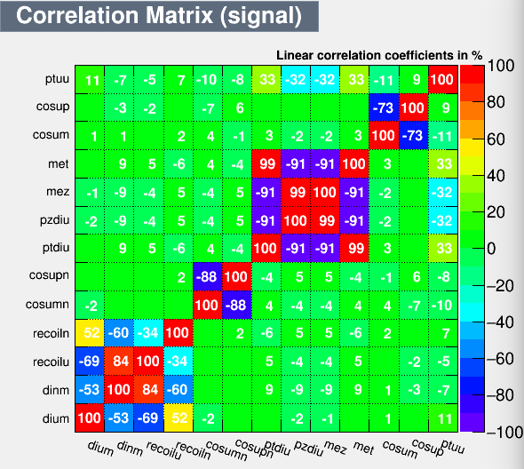
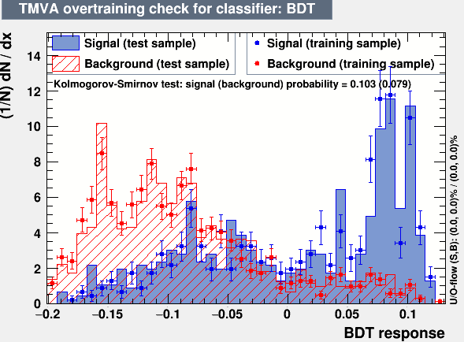
MVA(BDT):
Remove the less important variable. Finally, the variables are used for BDT are:
ptdiu | cosum
pzdiu | cosup
mez | ptuu
Notes:
while I remove all the less important variables. only 6 variables are used for BDT, The overtraining check is all right.

Slide 11
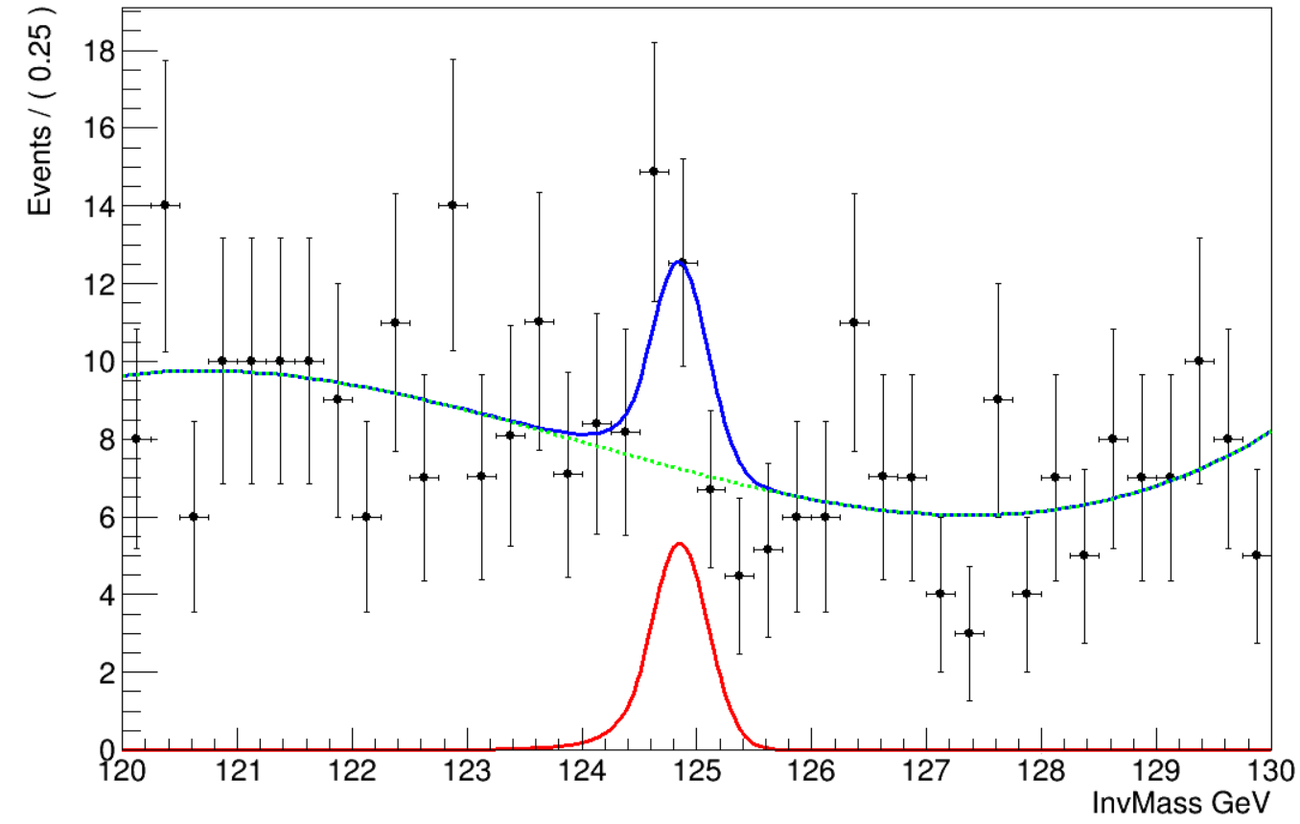
Cut-Chain and fit result:
ZnnHuu
 | SZ | ZZ | WW(SW) | ZZorWW | 2f | bkg | sig
pre | 60440.3 | 42614.9 | 244464.0 | 373949.4 | 0.0 | 721468.6 | 44.4
120<dium<130 120<recoiln<130 | 256.7 | 250.3 | 10945.1 | 22875.2 | 0.0 | 34327.3 | 37.8
90<recoilu<93 90<dinm<93 | 85.2 | 90.6 | 823.7 | 1508.9 | 0.0 | 2508.5 | 24.4
MVA(BDT)>0 |  |  |  |  |  | 308.0 | 18.2
effection |  |  |  |  |  |  | 41.0%
BKG：third order Chebychev function
Signal：CBShape function
Significance： 2.32
Notes:
Finally, after MVA’s cut the signal events remains 18 and bkg remains 308..we can get the significance 2.32 from fit result.

Slide 12
ZjjHuu Channel
Variables:
jet1m | Invariant mass of jet1
jet2m | Invariant mass of jet2
jet1u1a | the angle between jet1 and u+
jet1u2a | the angle between jet1 and u-
jet2u1a | the angle between jet2 and u+
jet2u2a | the angle between jet2 and u-
jet1u1at | the angle between jet1's pt and u+'pt
jet1u2at | the angle between jet1's pt and u-'pt
jet2u1at | the angle between jet2's pt and u+'pt
jet2u2at | the angle between jet2's pt and u-'pt
dijm | Invariant mass of di-jet
dium | Invariant mass of di-moun
recoilu | Recoil mass of di-moun
recoilj | Recoil mass of di-jet
ptu | Pt of di-muon
pzu | Abs(Pz of di-muon)
ptj | Pt of di-jet
pzj | Abs(Pz of di-jet)
cosum | polar angle of u-
cosup | polar angle of u+
cosj1 | polar angle of jet1
cosj2 | polar angle of jet2
yy12 | y12
yy23 | y23
yy34 | y34
yy45 | y45
ptuu | the angle between the di-muon' pt
ptjj | the angle between the di-jet' pt
ptzh | the angle between the Z'pt and H' pt
umed | Energy of u-
uped | Energy of u+
jet1ed | Energy of jet1
jet2ed | Energy of jet2
Notes:
Next, we focus on the zjjhuu channel. The variables I added are the jet’s invant mass which can reduce the signal’s fake rate and ZZ_l BKG and the angle between jet and moun which can reduce the ww_sl BKG.

Slide 13
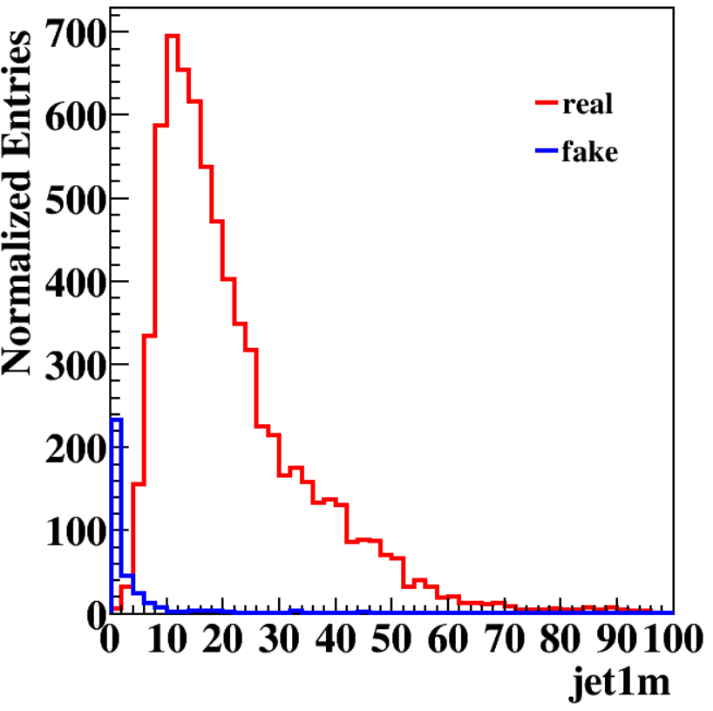
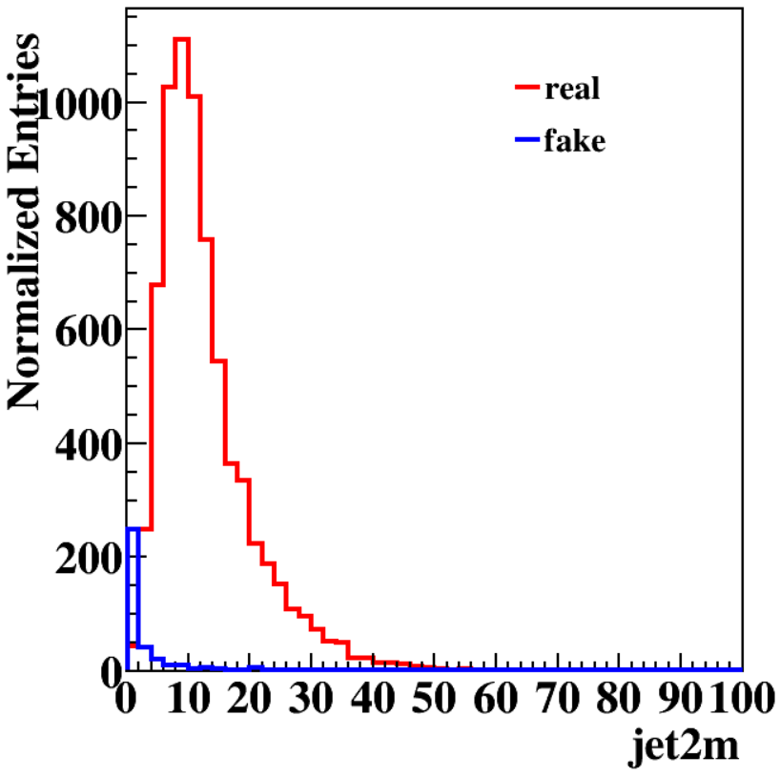
Pre-section:
Signal
Signal
Traverse 2D histogram of jet1m and jet2m and find when jet1m>5 and jet2m>3 the fake rate is smallest, 0.23%
Cut-Chain:
ZjjHuu
 | SZ | ZZ | WW(SW) | ZZorWW | 2f | bkg | sig
pre | 22342.9 | 622906.6 | 3328308.5 | 1798982.3 | 14967017.0 | 20739557.4 | 151.3
120<dium<130 | 8.0 | 3745.4 | 10553.1 | 10.7 | 0.0 | 14317.2 | 132.9
90<recoilu<93 | 1.0 | 1053.0 | 685.5 | 1.3 | 0.0 | 1740.8 | 82.2
abs(pzu)<63 abs(pzj)<75 ptu<64 ptj<80 | 1.0 | 989.6 | 659.2 | 0.0 | 0.0 | 1649.8 | 82.1
zzsl_mudown_or_up:
983.6
Main BKG:
wwsl_muq:
659.2
Notes:
while , because the fake events in signal are belong to channel Z decay to leptons, the invariant mass of jet can reduce the fake rate a lot. I Traverse 2D histogram of jet1m and jet2m and find when jet1m>5 and jet2m>3 the fake rate is smallest.after some cuts, the main BKG are zzsl_mudown ,zzsl_muup and wwsl_muq. In ww_slmuq BKG, one of the moun is a part of jet, and there are two way to reduce it.

Slide 14
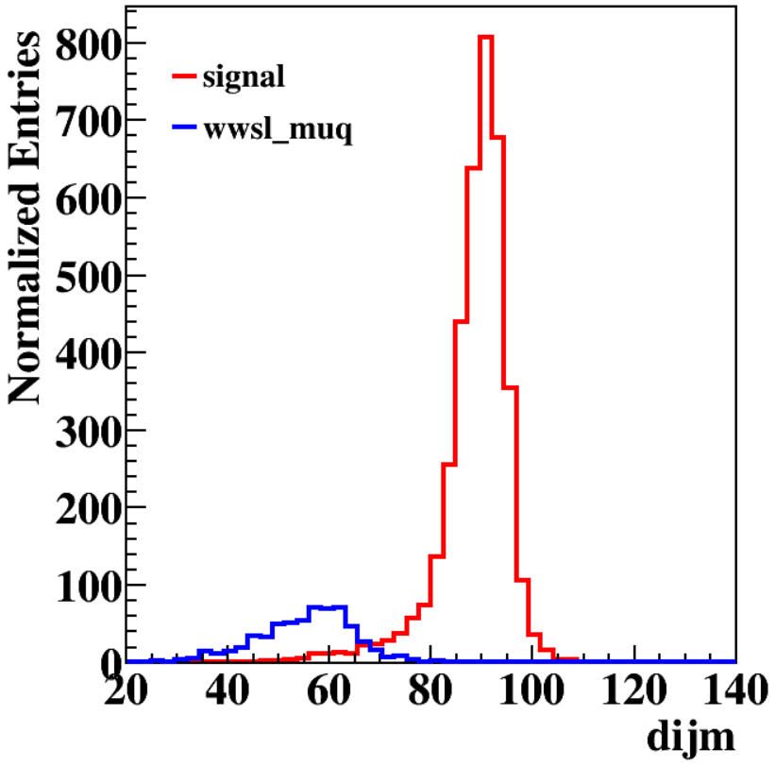
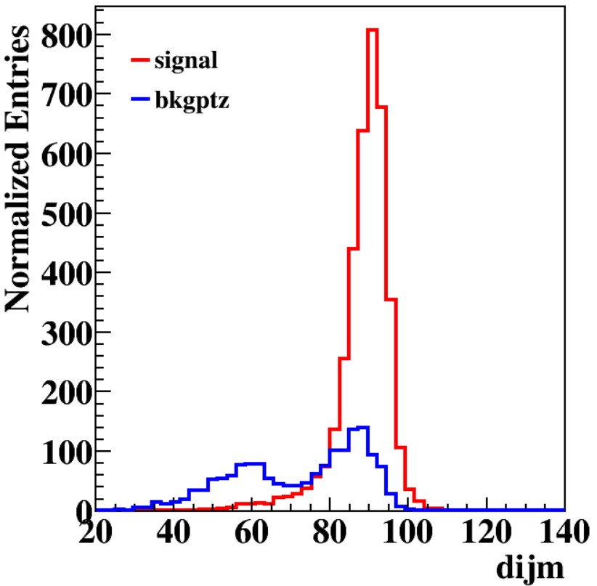
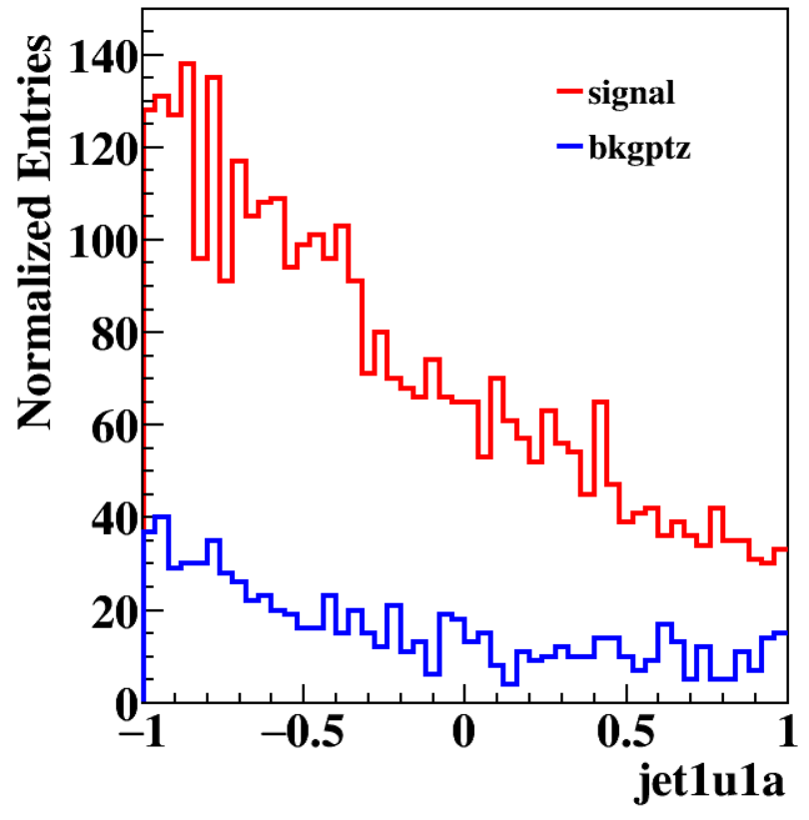
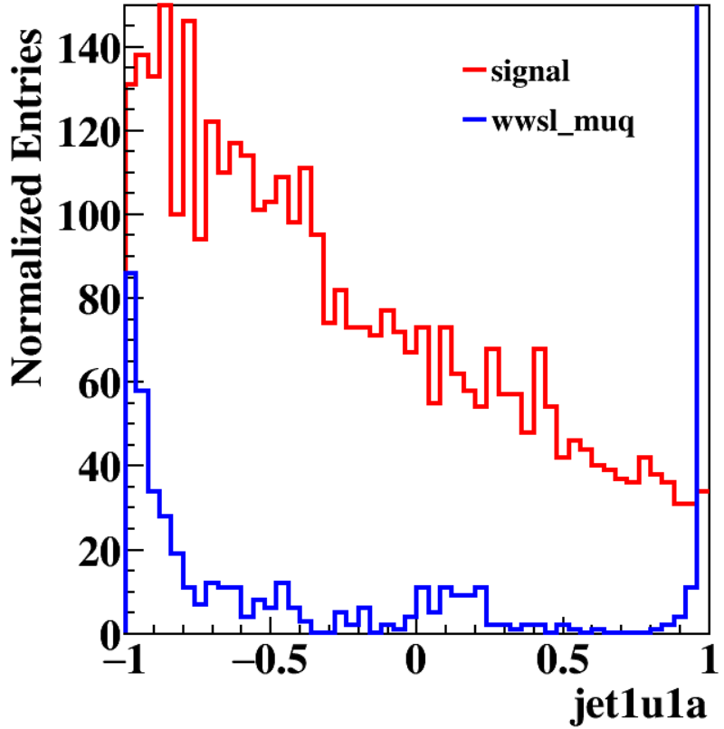
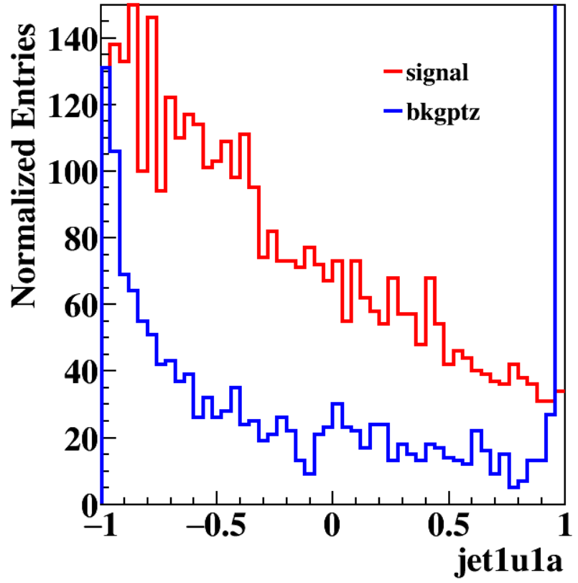
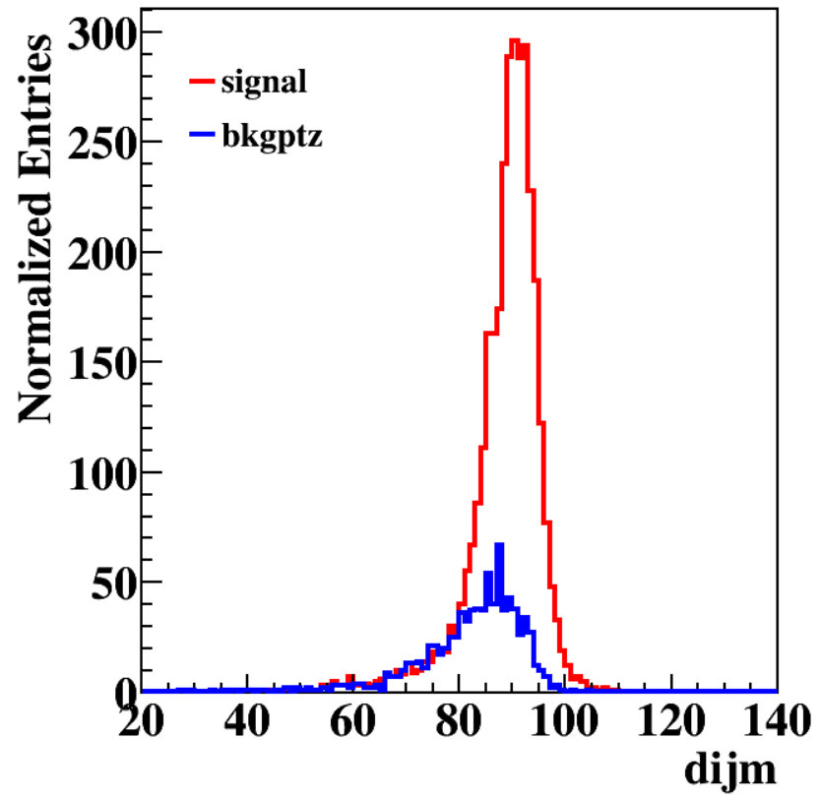
Two way to reduce the wwsl_muq:
dijm>76
No good cut
jetxuxa>0.9
cut: dijm>80
 | SZ | ZZ | WW(SW) | ZZorWW | 2f | bkg | sig
abs(pzu)<63 abs(pzj)<75 ptu<64 ptj<80 | 1.0 | 989.6 | 659.2 | 0.0 | 0.0 | 1649.8 | 82.1
dijm>76 | 1.0 | 803.2 | 8.4 | 0.0 | 0.0 | 812.6 | 77.9
Notes:
This page show how to reduce the wwsl _muq BKG. Signal and wwsl_muq BKG have big difference in dijm and the angle between jet and muon distribution. I finally choose the dijm to reduce this BKG, because if I use jet and u ‘s angle as the next cut, I can find a good cut in dijm distribution, too. But if I use dijm as the next cut ,there is no good cut in angle distribution.
Now, after the dijm cut almost all the wwsl_muq BKG are reduced, we should use BDT to reduce the BKG futher.

Slide 15
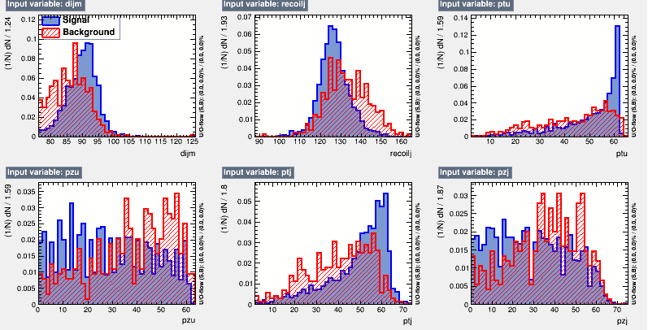
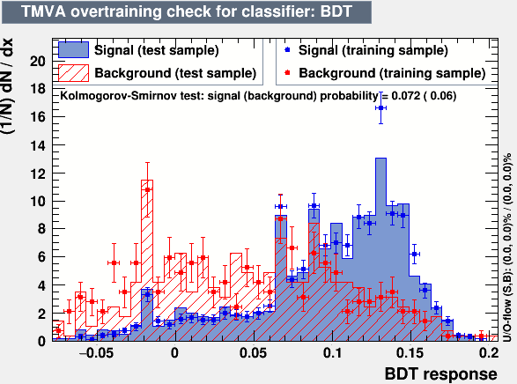
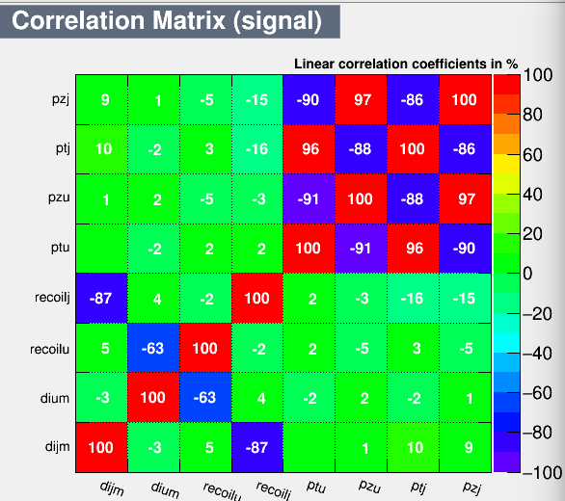
MVA(BDT):
Use different variables' combine and find the best one
dijm | recoilj | ptu | pzu | ptj | pzj
Notes:
In this BDT analysis ,I try to use different variables' combination and find the best one. The following pictures are the related information

Slide 16
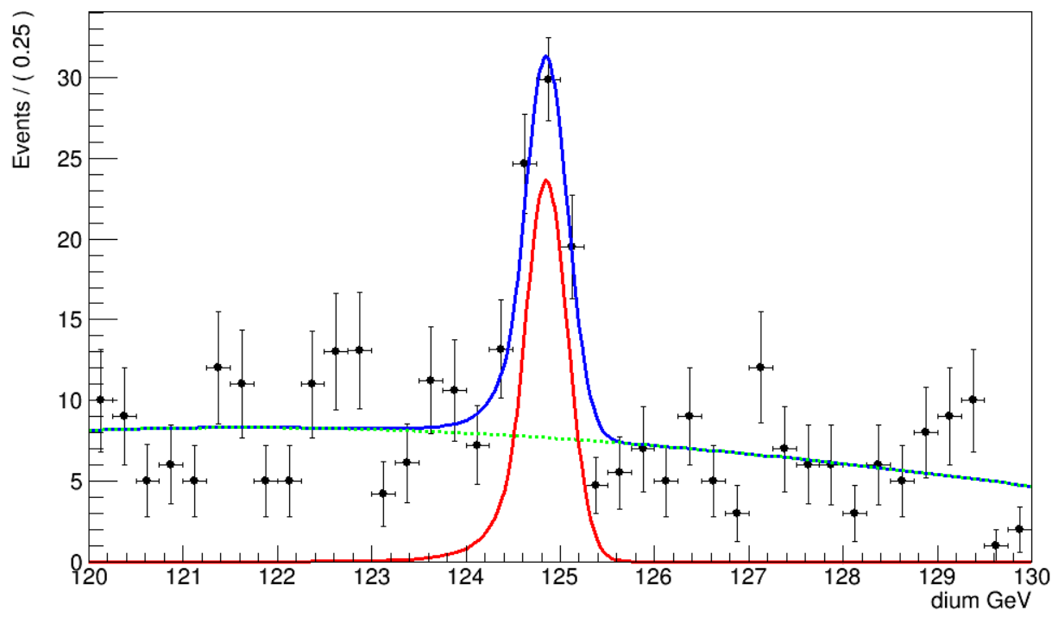
BKG：third order Chebychev function
Signal：CBShape function
Significance： 7.93
ZjjHuu
 | SZ | ZZ | WW(SW) | ZZorWW | 2f | bkg | sig
pre | 22342.9 | 622906.6 | 3328308.5 | 1798982.3 | 14967017.0 | 20739557.4 | 151.3
120<dium<130 | 8.0 | 3745.4 | 10553.1 | 10.7 | 0.0 | 14317.2 | 132.9
90<recoilu<93 | 1.0 | 1053.0 | 685.5 | 1.3 | 0.0 | 1740.8 | 82.2
abs(pzu)<63 abs(pzj)<75 ptu<64 ptj<80 | 1.0 | 989.6 | 659.2 | 0.0 | 0.0 | 1649.8 | 82.1
dijm>76 | 1.0 | 803.2 | 8.4 | 0.0 | 0.0 | 812.6 | 77.9
MVA(BDT)>0.07 |  |  |  |  |  | 288 | 58.1
effection |  |  |  |  |  |  | 51.5%
Notes:
This is the fit result. The significance can be 7.93. a big improvement.

Slide 17
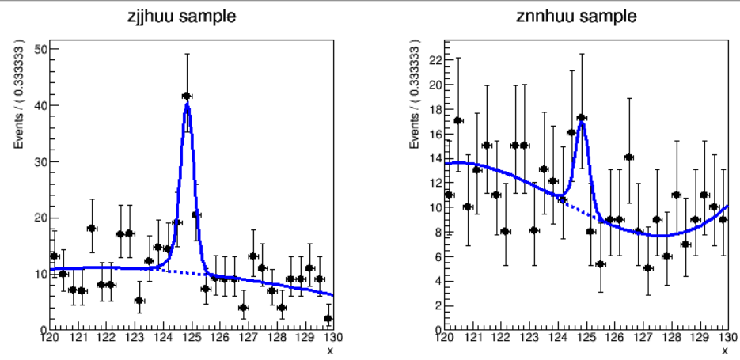
Simultaneous fit
BKG：third order Chebychev function
Signal：CBShape function
Significance： 7.83
Notes:
So far, zjjhuu and znnhuu channel have been finished. This page show the result that combine two channel by simultaneous fit. The significance is 7.83 after the fit. A litter lower than zjjhuu channel.

Slide 18
ZeeHuu and ZuuHuu(bkg:fast)
ZeeHuu（SVM）
 | Signal | sz | zz | ww(sw) | zow | 2f | bkg
presection | 272 | 2045762 | 1890 | 210 | 1 | 1894 | 2049757
120<dium<130 | 241 | 1806 | 5 | 0 | 0 | 0 | 1811
89<recoilu<100 | 214 | 290 | 3 | 0 | 0 | 0 | 293
diem<92 | 214 | 227 | 3 | 0 | 0 | 0 | 230
recoile>124 | 214 | 209 | 3 | 0 | 0 | 0 | 212
90<recoilu<93 | 141 | 83
mva>0.51 | 110 | 27
Normalization | 2.64 | 27
Eff | 40%
ZeeHuu: Significance=0.5
ZuuHuu(BDT)
 | signal | sz | zz | ww(sw) | zow | 2f | bkg
presection | 302 | 0 | 45060 | 0 | 0 | 0 | 45060
120<(di-mu)H.M<130 | 272 | 0 | 2229 | 0 | 0 | 0 | 2229
89<(recoil-mu)H.M<121 | 271 | 0 | 1217 | 0 | 0 | 0 | 1217
84<(di-mu)Z.M<94 | 258 | 0 | 348 | 0 | 0 | 0 | 348
123.5<(recoil-mu)Z.M<150 | 258 | 0 | 267 | 0 | 0 | 0 | 267
mva>-0.05 | 232 | 0 | 57 | 0 | 0 | 0 | 57
diumall<250 | 232 | 0 | 49 | 0 | 0 | 0 | 49
recoilall>0 | 184 | 0 | 29 | 0 | 0 | 0 | 29
normalization | 4.41 | 29
eff | 61%
ZuuHuu: Significance=0.75
Notes:
This page shows the zeehuu and zuuhuu analysis. Because I have some puzzles in the full simulation data, the bkg is fast simlulation and next, I will change it to full simulation. However, for little signal events, the significance is small,too. Zeehuu is 0.5 and zuuhuu is 0.75.

Slide 19
Conclusion
 | N_sig | N_sig_fit | sigma | mean | significance
znnhuu | 18.2 | 13.7±6.7 | 0.247 | 124.85 | 2.32
zjjhuu | 58.1 | 57.0±9.6 | 0.227 | 124.85 | 7.93
combine | 76.3 | 13.9±6.6 / 57.4±9.4 | 0.245 | 124.84 | 7.83
zeehuu | 2.64 | - | - | - | 0.50
zuuhuu | 4.41 | - | - | - | 0.75
inclusive | 45.7 | - | - | - | 5.89
BKG:fast simulation
Next：
1 Update all analysis to full simulation and give the strength
2 H-> tau+moun
3 Write note
Notes:
The table show the details about fit.

Slide 20
THANK YOU

Slide 21
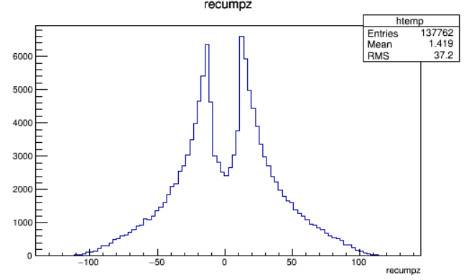
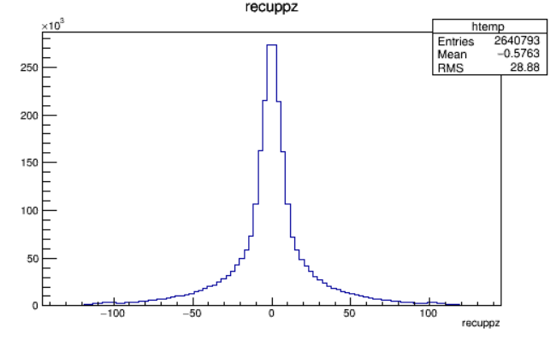
BACKUP
sze_lmu
full
fast
Pt also have some problem

Slide 22
3sigma: 0.63-1.38
1sigma: 0.8-1.18

