Slide 1
EW precision measurement at Z pole
Zhijun Liang
IHEP

Slide 2
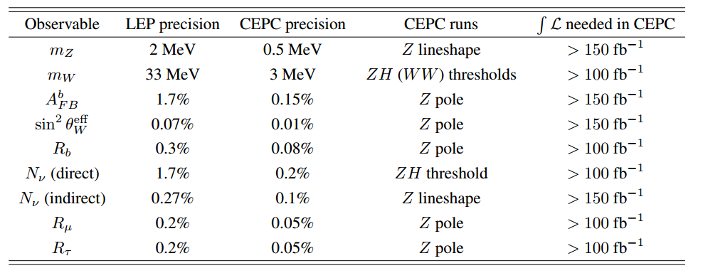
Z pole physics in pre-CDR
Some study on expected precision based on extrapolation from LEP results.
No full simulation study yet

Slide 3
Z pole physics: Plan for CDR
Study Physics Requirement for accelerator
Z mass
Weak mixing angle
W mass
Requirement for detector
Z->bb branching ratio (R_b)
Z->cc branching ratio (R_c)

Slide 4
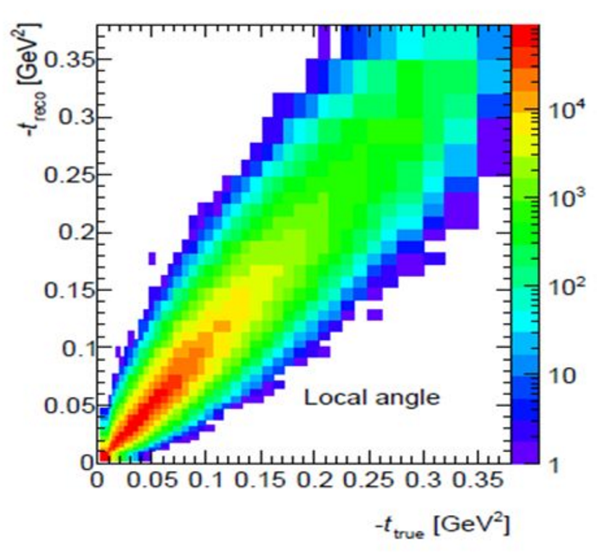
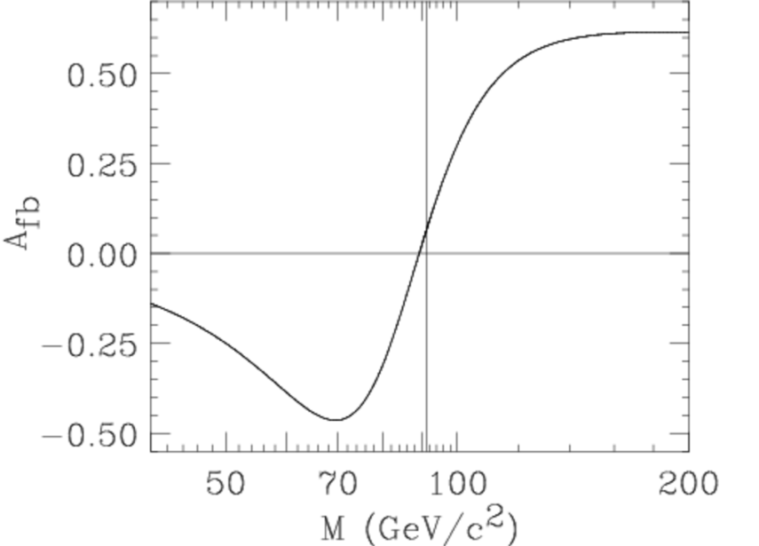
Plan for Weak mixing angle
More details in Mengran’s talk
Truth distribution
From Z fitter
unFolding matrix
Reco level distribution

Slide 5
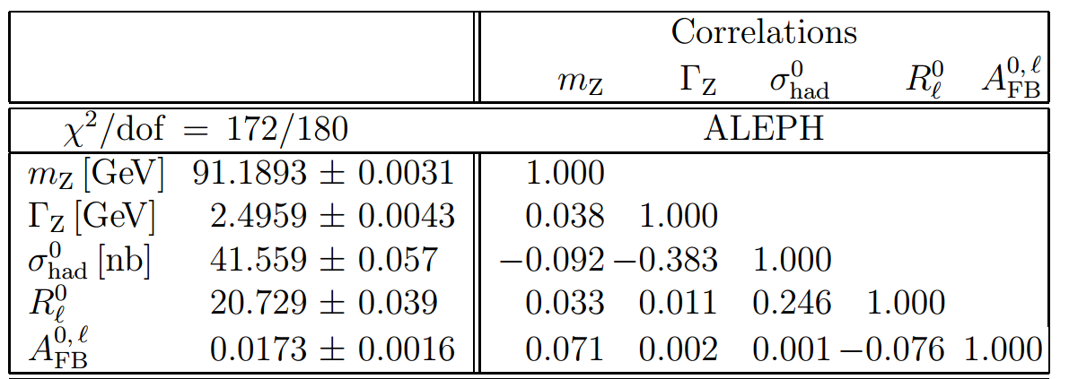
Physics Requirement for accelerator
Expected Beam momentum scale uncertainty
CEPC pre-CDR : 500keV (10¹⁰ Z)
FCC-ee : 100keV (10¹³ Z)
Requested by FCC-ee experts to do more study
Propagate beam momentum scale uncertainty to all EW measurement.
Give a clear physics requirement to accelerator

Slide 6
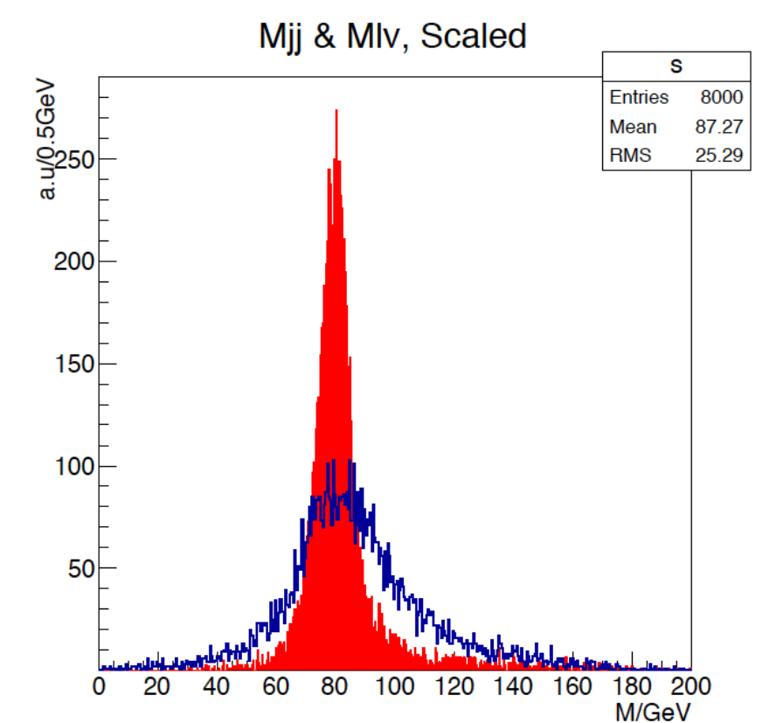
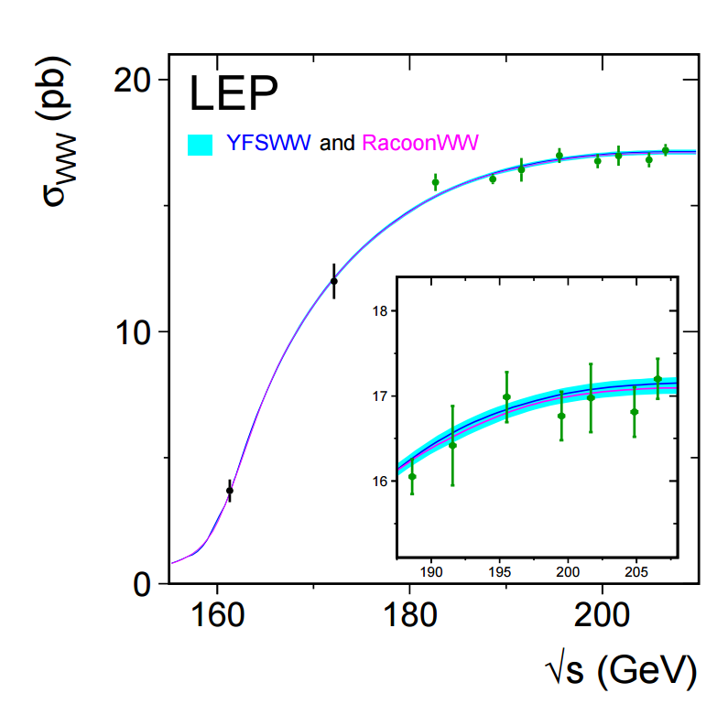
W Mass measurement
Two methods for W mass measurement
WW threshold scan (beam momentum uncertainty)
Requested by FCC/ILC experts at ICHEP2016
Direct measurement in ZH runs in WW->lvjj events
Jet energy scale/resolution uncertainty
beam momentum uncertainty
WW threshold scan by LEP
Fullsim
WW->lvjj in ZH run
By Manqi

Slide 7
Candidate of branch mark channel at Z pole
Requirement on CEPC beam momentum uncertainty
Weak mixing angle and Z mass , semi-fullsim
W Mass (threshold scan), Z fitter level study
Requirement on TPC detector occupancy (track efficiency)
Weak mixing angle
Requirement on pixel detector optimization
(impact parameter)
Z->bb branching ratio (R_b) ,need fullsim
Z->cc branching ratio (R_c)
Requirement on calorimeter (Jet energy scale/resolution )
W mass (direct method) , fullsim
Requirement on calorimeter (granularity, tauID )
Z-> tautau branching ratio

Slide 8
Summary
Lots of work for Z pole physics CDR study.
Aim for publication of CEPC Z pole physics prospect in one year.
Lots of room for contribution
We need your contribution !

