Slide 1
Silicon Tracking with GENFIT
Zhang Yao
29 August 2016
CEPC Physics Software Meeting

Slide 2
Motivation of tracking study
Optimization of SID and future application
Requirements
Robust : can give reliable efficiency and resolution
Flexible : adapt to different detector design
independent : insensitive to the constantly changed geometry and data format
Easy to debug and validation
Status
ILC (Vertex and TCP based) tracking --- quickly verify
Standalone track fitting toolkit (GENFIT) --- crosscheck

Slide 3
Introduction to GENFIT
The trend to use a toolkit for tracking which is independent and can be used in a wide range of experiments
The generic toolkits have been developed to meet this challenges, such as GENFIT* and RecPack**
GENFIT is a novel framework for track fitting
First Developed as part of the PANDA framework and now distributed as a stand-alone package
Used by recent HEP experiment such as BelleII
Written in C++,modular and highly object oriented design
* NIM A, Vol 620, 518-525 (2010), Code http://sourceforge.net/projects/genfit/
** NIM A, Vol 534 180–183 (2004)

Slide 4
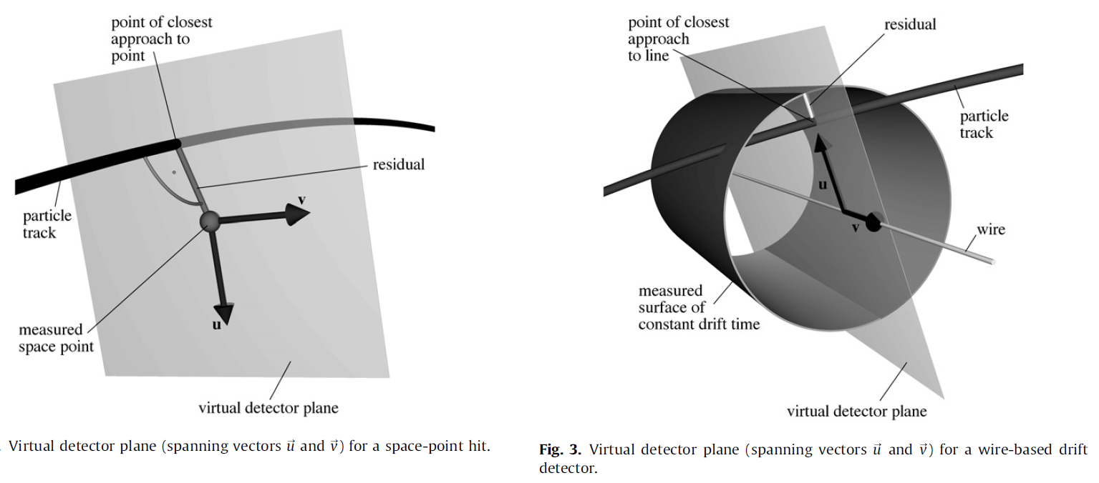
Features of GENFIT(1)
Can treat several types of detectors
silicon strip detectors or multiwire proportional chambers
silicon pixel detectors
drift chambers or straw tubes
TPC
Stations of several planes of category 1 and 2, or electromagnetic calorimeters
Hits are defined in detector planes:
1D for strips/wires, 2D for pixels, virtual detector planes in the case of drift tubes, TPC

Slide 5
Features of GENFIT(2)
Fitting algorithms can be easily implemented
Validated Kalman filter
Deterministic Annealing Filter (DAF)
Gaussian sum filters
Extrapolations method
Runge-Kutta
invoke of external libraries , such as GENAE
Simultaneous fitting of several tracks to the same set of hits
Optimize track parameterizations and extrapolation
different phase space regions with different track models
fit different mass hypotheses

Slide 6
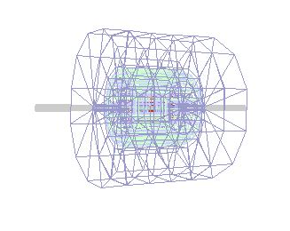
Fitting implementation
Material
Get from GDML file generated by simulation
A TGeo(ROOT) object is encapsulated in the track representations
Detector geometry
Geometry interface not implemented
Magnetic field
Constant field with B=(0, 0 ,3.5)Tesla
Read track(s) from truth
Initial position and initial momentum
Read hits from truth
Cell id or Position
Momentum of each hit (to define virtual detector plane)

Slide 7
Fitting flow
Create track
Create initial with track from MC truth
Smear the start position and momentum
Create the track representation with mass hypothesis
Add measurements on track
Create a space point truth hit position coming from particle
Smear hit (digitization)
Smear pixel measurement with gauss at (r-phi, z)=0.02x0.02 mm for both barrel and endcap
Smear strip measurement with gauss at (r-phi, z)= 0.05x0.1 mm for both barrel and endcap
Create virtual detector plane by the plane perpendicular to momentum direction at this hit
Put detector resolution : 1/sqrt(12) * detector element width
fit track with DAF (Deterministic Annealing Filter )

Slide 8
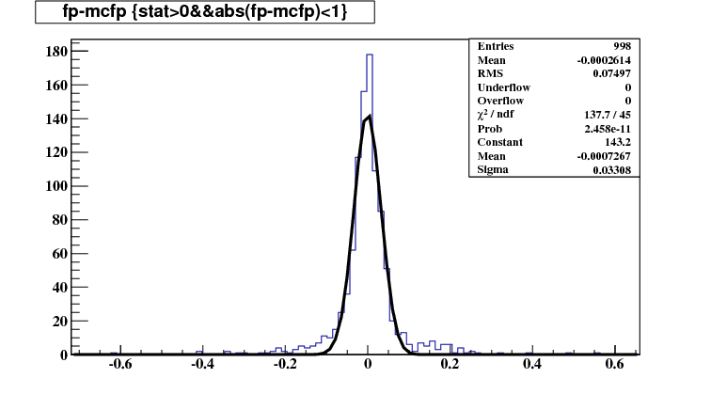
First fit result
10GeV muon
Initial track and hits not smeared
Preliminary
Fit momentum – truth momentum(GeV/c)

Slide 9
Future plane
Geometry requirement
For a given cell knows the direction of boundaries for each detector element
Solution:
geometry toolkit
get detector plane vector saved with ROOT format
Magnetic field
Reading filed map (get field vector of specified position)
Measurement fitting
Form fit space point to fit a measurement in defined detector plane
Migrate to Marlin
Use VirtuleBox and mini Marlin as development environment
Start from TruthTracker(create rec. track from MC truth) in Marlin
Read cluster, hit and track from track finding
Convert track to LCIO representation

Slide 10
Summary and Outlook
A generic track fitting toolkit---GENFIT is preliminary implemented for SID fitting
Resolution and tail events should be checked
More work on integration in Marlin framework
Geometry interface
Measurement on detector plane
Using track finding results
Track IO
Track finding proposal
Hough finding or combinational Kalman filtering
Neural Network or Machine learning

